Slide 1
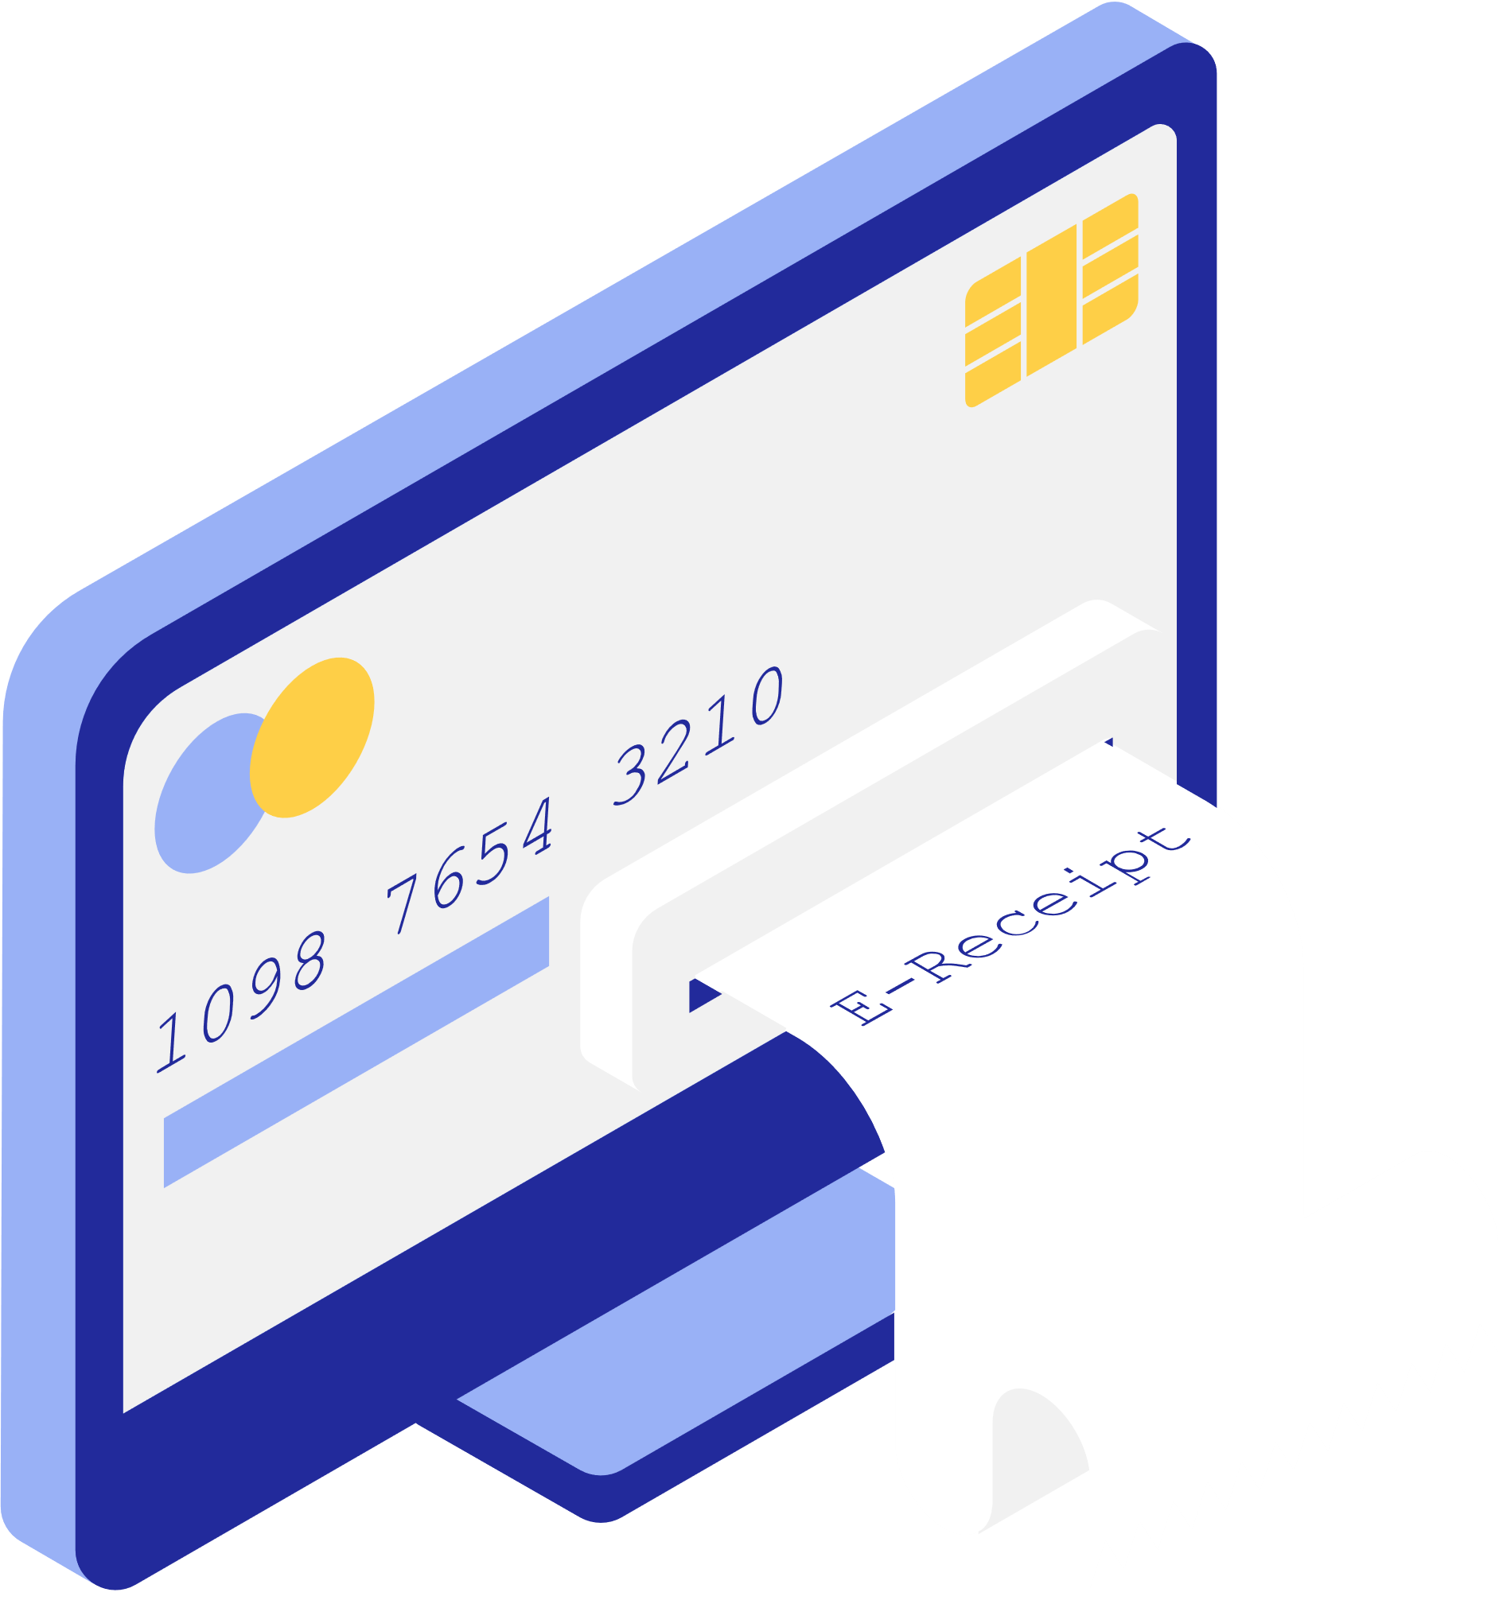

Credit Card Fraud Detection Analysis
By:
Sweekrit Acharya
Charmi Raghavani
Reebika Bhatta
Shirish Thapaliya
Ruchita Soni

Slide 2
Introduction
Target Audience
Problem and Needs
Data Overview
Data Preprocessing
Methodology
Analysis and Results
Conclusion
Reference
Overview
.

Slide 3

Introduction
Credit card fraud detection is the process of identifying and preventing unauthorized or fraudulent transactions made using credit cards, typically employing algorithms and machine learning models to analyze patterns and anomalies in transaction data ¹.
Primary Goal: Creating an intelligent model that can accurately differentiate between genuine and fraudulent transactions in real-time.
Importance: Safeguarding consumers and financial institutions from financial losses, maintaining trust in the banking system, and fostering a secure environment for digital commerce.

Slide 4
Target Audience
Financial Institutions
Consumers
Business
Provide Financial Institutions with advanced tools and techniques to detect and prevent fraudulent activities, thereby minimizing financial losses and preserving the trust of their customers.
Consumers are directly benefited by our project as it enhances the security of their credit card transactions, protecting them from financial losses and potential identity theft.
Businesses that rely on electronic transactions benefit indirectly from our project as it contributes to a safer and more secure environment for conducting online commerce, thereby reducing the risk of financial losses due to fraudulent activities.

Slide 5

Why we need Credit Card Fraud Detection?
Early Detection: Predicts fraudulent activities swiftly, preventing significant financial losses.
Adaptability: Evolve with fraud patterns, detecting new tactics effectively.
Accuracy: Identifies subtle anomalies, enhancing detection precision over rule-based systems.
Enhanced Customer Experience: Minimizes impacts on legitimate transactions, improving customer satisfaction.
Possible Challenges:
Sophisticated Fraud Techniques: Fraudsters continually evolve their tactics to bypass detection systems, requiring detection methods to stay ahead of emerging fraud patterns.
Imbalanced Data: Fraudulent transactions are typically rare compared to legitimate ones, leading to imbalanced datasets that can skew model performance and accuracy¹.
Real-time Processing: The need for timely detection and prevention of fraud requires systems capable of processing large volumes of transactions in real-time. Real-world credit card transaction datasets cannot be publicly available because they contain sensitive information about customers³.
Model Interpretability: Understanding how fraud detection models make decisions is crucial for trust and regulatory compliance, highlighting the need for interpretable machine learning models.

Slide 6

The dataset comprises 284,808 records of historical credit card transactions.
2. The dataset consists of several features providing insights into each transaction, including:
Time: Timestamp indicating the date and time of the transaction
Amount: The monetary value of the transaction.
V1-V28: Principal components resulting from PCA transformation for anonymization purposes.
Class: Binary label indicating the transaction's legitimacy, with 0 representing legitimate transactions and 1 representing fraudulent transactions.
Dataset Overview
Data Source: Kaggle

Slide 7
Data Preparation
Data Cleaning
Addressing missing values and outliers.
The original dataset had 284,807 rows, after removing duplicates 283,726 unique rows in the dataset left.
Data Transformation
This phase involves techniques like normalization, standardization, encoding categorical variables, and feature engineering to improve model predictions.
Transaction Amount Binning
Binning transaction amounts into "Amount_Category" feature can enhance model generalization.
Categorization helps mitigate variability and noise in raw transaction data.
.
Normalization
Normalization using StandardScaler is applied to 'Amount', 'Hour', 'Minute', and 'Second' features in the dataset.
'Amount' normalization ensures its proportional influence on learning relative to other features due to widely varying transaction amounts.

Slide 8
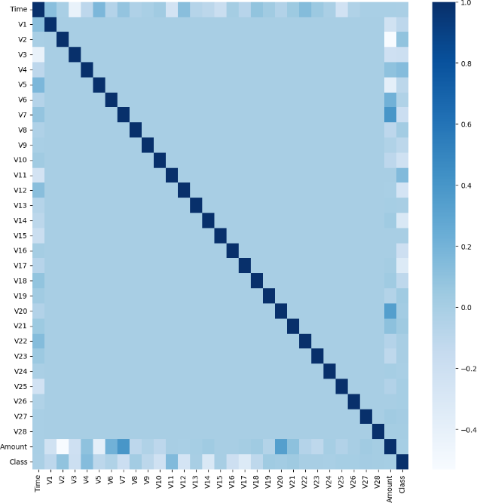
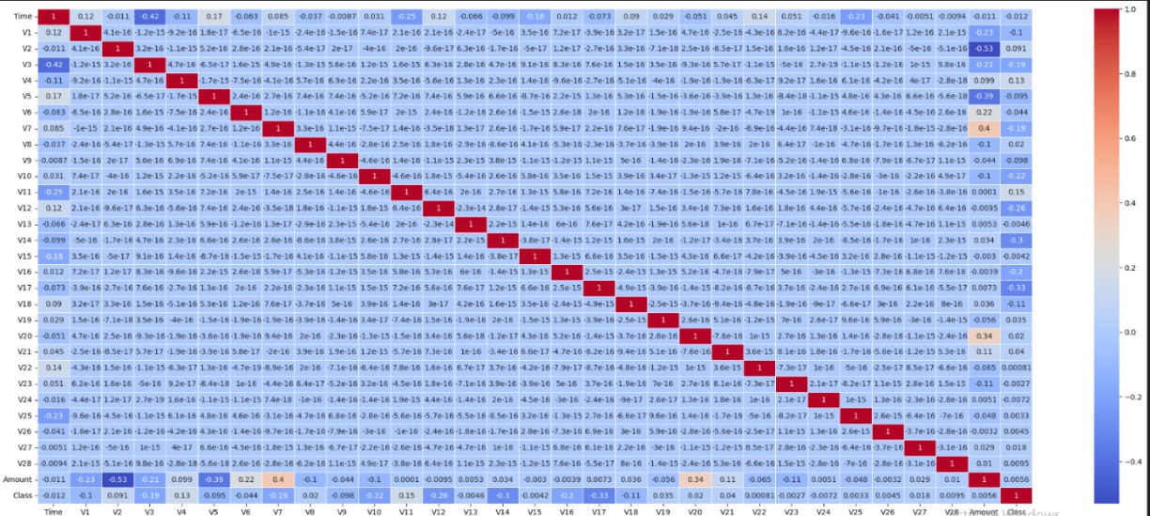
Data Visualization
The correlation coefficient gauges the strength and direction of relationships between variables in a dataset, ranging from -1 to 1.
The heat map indicates no significant high correlation values among predictor columns, and none exhibit a strong correlation with the Class column.

Slide 9
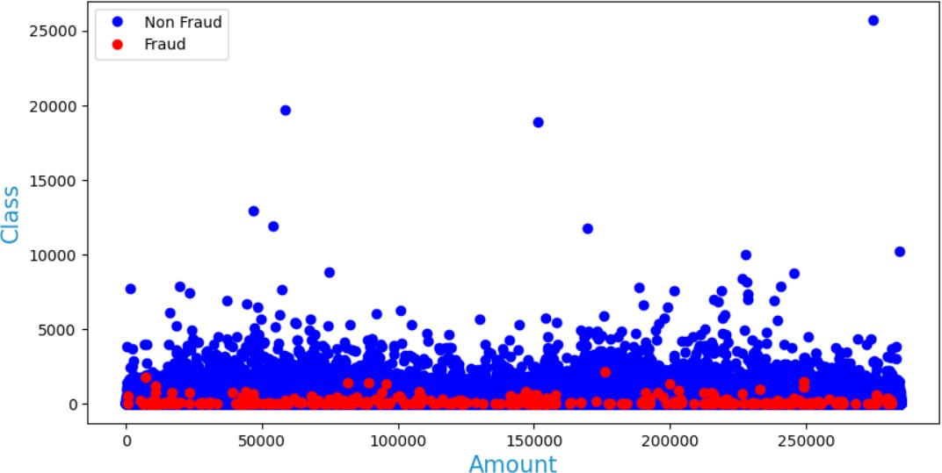
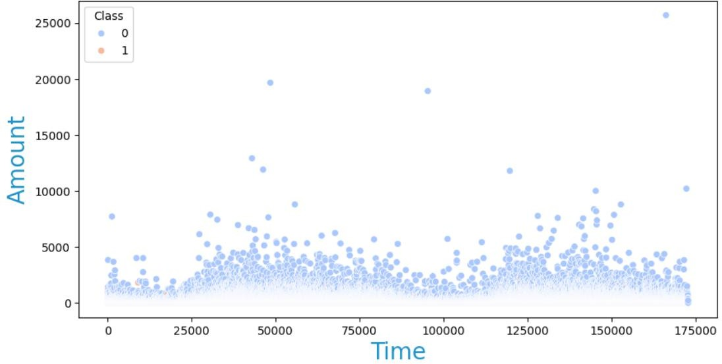
Data Visualization
The scatter plot visualization indicates that there is no clear correlation between the transaction amount ('Amount') and the occurrence of fraud ('Class').
The scatter plot displays transactions with time on the x-axis, amount on the y-axis, and distinguishes fraud (pink) from non-fraud (blue), aiding in identifying patterns and outliers related to fraud.

Slide 10
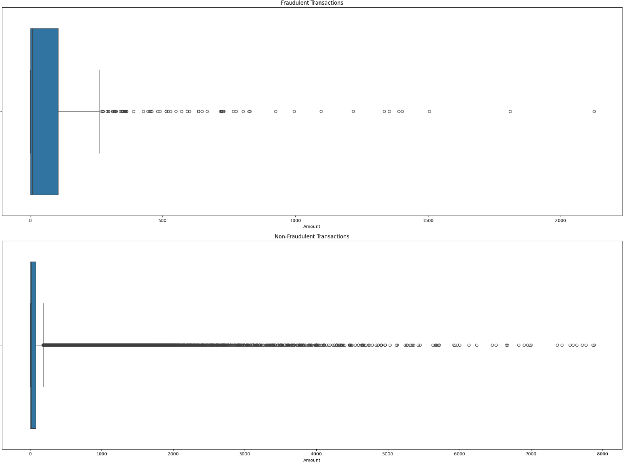
Data Visualization
Fraudulent transactions are frequent at lower amounts, indicated by a prominent blue bar near the 0 mark, while non-fraudulent transactions display a more even distribution across various amounts, with a line extending towards higher values.

Slide 11
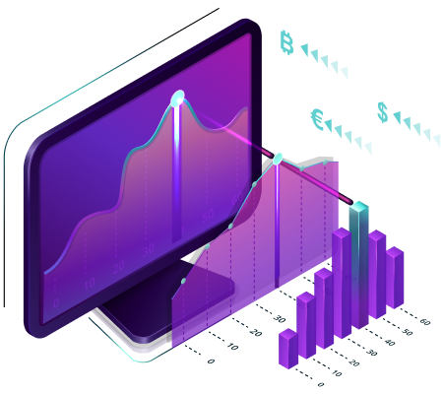
Methodology
Undersampling Technique: It balances class distribution by removing instances from the majority class and utilizes the RandomUnderSampler from the imblearn library.
Oversampling Technique: This method balances class distribution by duplicating instances from the minority class and leverages the RandomOverSampler from the imblearn library.
We have utilized 10 different models :
Logistic Regression
Naive Bayes
AdaBoost
LightGBM
CatBoost
Artificial Neural Network (ANN)
KNN Algorithm
Random Forest Algorithm
XGBoost Algorithm
Decision Tree Algorithm

Slide 12
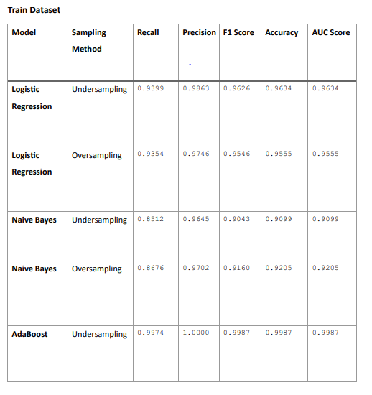
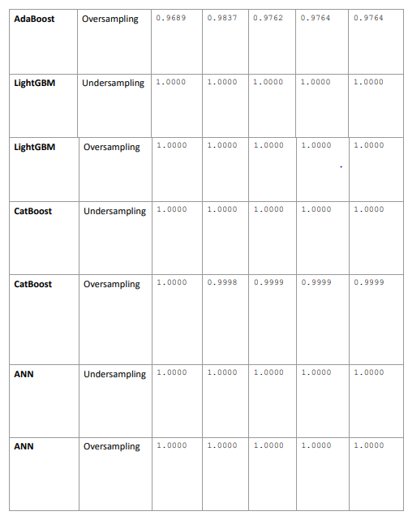
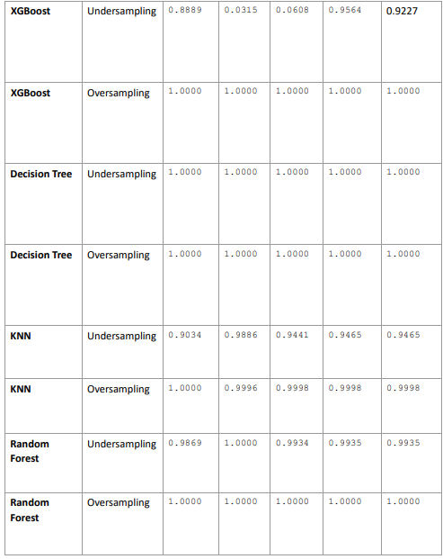
Model Evaluations and Comparison

Slide 13
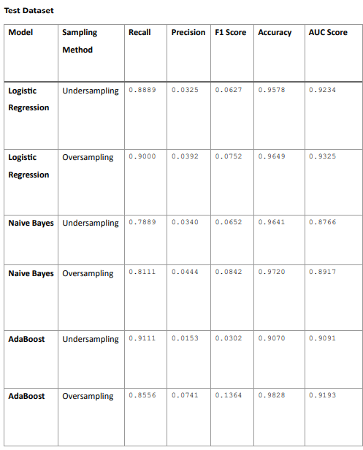
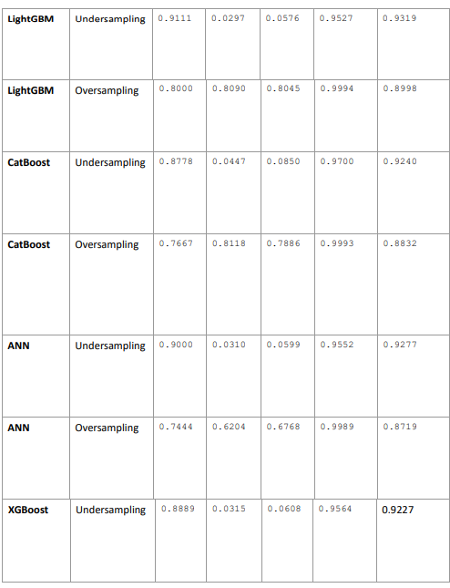
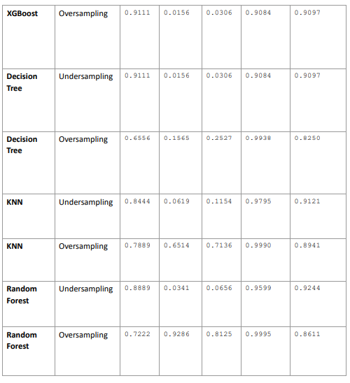
Model Evaluation and Comparison
Whiteboard PagModel e
After comparing between models, Logistic Regression seems to be best model

Slide 14
Future plan of Action
Integrating More Diverse Data Sources
Implementing Advance Techniques
Deploying the Model
Implementing advanced techniques for credit card fraud detection such as : Deep learning Models, Graph-Based Methods and Ensemble Learning Techniques
.
Include behavioral data, geolocation data , social media and public record
Depolying our best model using different technologies such as : AWS Sagemaker, Flask, etc

Slide 15

Conclusion
After comparing between models, the results were found as follows: Best model: Logistic Regression
Training Set Accuracy score = 95.55%.
Test Set Accuracy score = 96.49%.
Our project underscores the significance of interdisciplinary collaboration in understanding fraud patterns and developing effective detection strategies.
We've recognized the importance of continuous monitoring, ethical considerations, and data quality for robust fraud detection systems

Slide 16
References
¹ Anonymous. (n.d.). Credit Card Fraud Detection Predictive Modeling. Retrieved from https://library.ndsu.edu/ir/bitstream/handle/10365/31611/Credit%20Card%20Fraud%20Detection%20Predictive%20Modeling.pdf?sequence=1&isAllowed=y
² National Center for Biotechnology Information. (n.d.). Detecting Fraudulent Transactions. PMC. Retrieved from https://www.ncbi.nlm.nih.gov/pmc/articles/PMC10917329/#:~:text=Detecting%20fraudulent%20transactions%20is%20challenging,generate%20unrealistic%20or%20overgeneralized%20samples.
³ Alturaby, N. (n.d.). Credit Card Fraud Detection: Risks and Challenges. Medium. Retrieved from https://medium.com/@nuhaaltoraby91/credit-card-fraud-detection-risks-and-challenges-f5e94796e1f1
.

Slide 17

Any
Queries??
Thank You!!
.

