Slide 1
SHOP
E-Commerce Management System
In Microsoft SQL Server Management Studio

Slide 2
SHOP
Musharib Rehman Ali Jameel Abdullah Arsalan Mohid Arsalan
Group Member

Slide 3
Introuction
The project showcases the creation of various essential tables such as Customers, Products, Orders, Categories, Sellers, Payments, and Reviews.
Each of these tables is designed to store relevant data, ensuring the integrity and organization of information.
For instance, the Customers table holds personal and contact information, while the Products table includes details about each product available for sale.
The provided SQL queries provide powerful querying capabilities of Managing
E-Commerce.
One of the most significant advantages of an e-commerce management system is the ability to manage all processes into a single platform. This means that inventory, sales, customer service, and payment can all be accessed and managed from one central location.

Slide 4
Benefits
Improved Customer Experience: E-commerce systems often come with user-friendly interfaces, making it easy for customers to find products, compare prices, and complete purchases. Customers can track their orders.
Multiple Payment Options: Customers can choose from various payment methods, including credit cards, debit cards, and even cash on delivery in some cases.
Inventory Management: E-commerce systems provide inventory tracking, helping businesses manage stock levels efficiently and avoid overstocking or stock outs.
Customer Relationship Management: E-commerce platforms often include tools for customer service, such as taking reviews, allowing businesses to respond quickly to customer inquiries and issues.
24/7 Availability: An E-commerce platform allows customers to shop anytime, anywhere. Unlike traditional stores, which are limited by physical opening hours, an online store can operate 24/7, offering products and services at all times.

Slide 5
Area of People
In an e-commerce management system each role has responsibilities aimed at enhancing user satisfaction and ensuring smooth transactions. Let's explore these roles:
Customer: Searches for products or services of interest. Adds items to the shopping cart and proceeds to checkout. Provides accurate billing and shipping information. Makes payments using available payment methods. Leaves reviews and ratings based on their experience.
Seller: Lists products or services for sale on the e-commerce platform. Manages inventory and ensures product availability. Responds to customer inquiries and resolves issues promptly. Processes orders and ensures timely delivery. Maintains a positive reputation through quality products and excellent service.
SQL Developer: Writes and optimizes SQL queries to retrieve and manipulate data. Develops stored procedures, triggers, and views to support application functionality.
Shipping Partner: Manages the shipping and delivery of products ordered through the e-commerce platform. Coordinates with sellers to fulfill orders and schedule pickups. Tracks shipments provides updates to customers.

Slide 6
E-Commerce Tables
Customer
Products
Categories
Reviews
Seller
Manage customer information, including products details, Brand name and Price.
Manage customer information, including contact details, addresses, and registration dates.
Manage information, including name, details, and discription.
Manage customer reviews and ratings for products, providing valuable feedback to the business.
Order
Order_Items
Cart
Payments
Track orders from customers, including order dates, shipping dates, order amounts, and order statuses.
Manage the individual items within each order, including item prices and quantities.
Track the items customers have added to their shopping carts before completing a purchase.
Handle payment transactions, including payment amounts, methods, statuses, and payment dates.

Slide 7
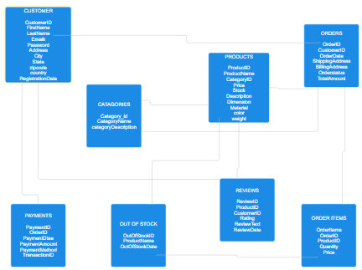
ER Diagram

Slide 8
Queries
Calculate value of each order and total value of all orders
Total value of all orders.
Query to show data for a specific customer by CustomerID
Query to show data for a specific order by OrderID.
Query to show all orders placed by a specific customer by CustomerID.
Query to show detailed information for a specific order including order items.
Query to list the total number of orders and total order amount for each customer.
Find all the products with less than a specified quantity.
List All Pending Orders with Customer and Shipping Details.
Retrieve All Orders Made by a Specific Customer.
Query to show customers that gave the reviews.
Top 3 Product Sold.
PAY

Slide 9
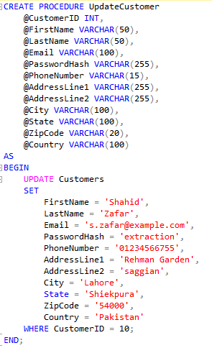
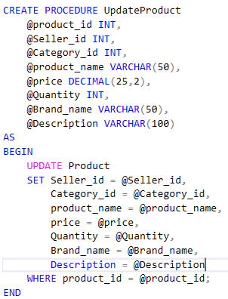
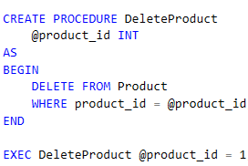
Procedure
Procedure for Updation of Product Table and Costumer Table and Deletion in Product Table

Slide 10
Product having Amount Greater than Average Amount
Query Using Inner Join
FROM Orders o
JOIN Customers c ON o.CustomerID = c.CustomerID
WHERE o.OrderID = 5;

Slide 11
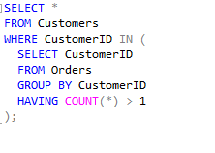
Extract order from Lahore
Query Using Subqueries
SELECT * FROM Customers WHERE CustomerID IN (
SELECT CustomerID FROM Orders GROUP BY CustomerID HAVING COUNT(*) > 1);

Slide 12
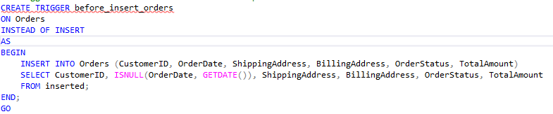
Triggers
Trigger to set OrderDate to the current timestamp

Slide 13

Top Product Sold
SELECT TOP 1
p.ProductID,
p.ProductName,
SUM(oi.Quantity) AS TotalQuantitySold
FROM
OrderItems oi
JOIN
Products p ON oi.ProductID = p.ProductID
GROUP BY
p.ProductID,
p.ProductName
ORDER BY
TotalQuantitySold DESC;

Slide 14
Retrieve Order Details for a Specific Order ID
SELECT
o.OrderID,
o.CustomerID,
CONCAT(c.FirstName, ' ', c.LastName) AS CustomerName,
o.OrderDate,
o.ShippingAddress,
o.BillingAddress,
o.OrderStatus,
o.TotalAmount
FROM
Orders o
JOIN
Customers c ON o.CustomerID = c.CustomerID
WHERE
o.OrderID = 5;

Slide 15
Conclusion
The project showcases the creation of various essential tables such as Customers, Products, Orders, Categories, Sellers, Payments, and Reviews.
Each of these tables is designed to store relevant data, ensuring the integrity and organization of information.
For instance, the Customers table holds personal and contact information, while the Products table includes details about each product available for sale.
These queries enable the extraction of valuable information from the stored data.
The provided SQL queries provide powerful querying capabilities of Managing
E-Commerce.

