Slide 1
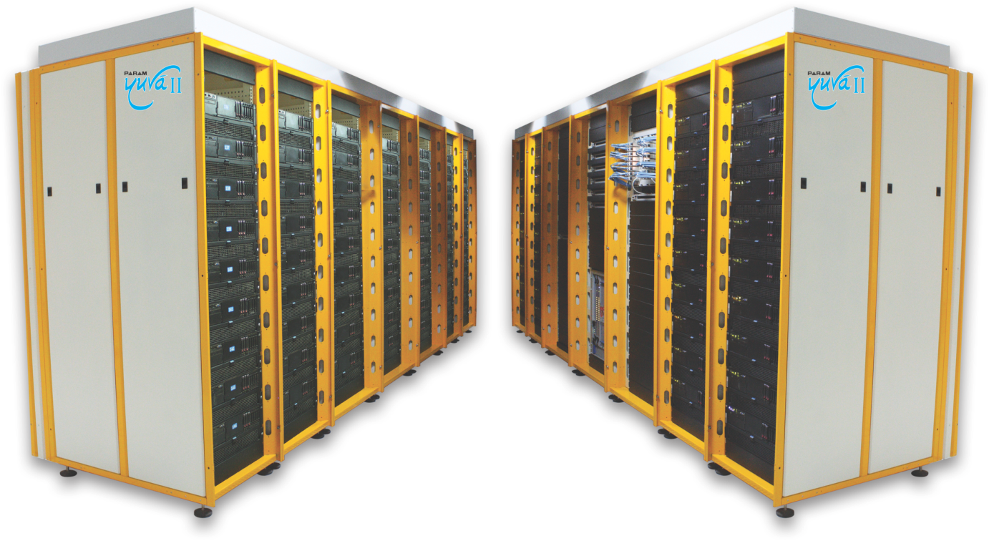
NTRO HPC Training
National PARAM Supercomputing Facility (NPSF).

Slide 2
Outline
What is backup ?
Necessity of backup
Metrics for backup
Type of Backup
Backup Architecture and Process
Backup Optimization
Backup Policy

Slide 3
Backup
Backup : Process of making a secondary copy of data that can be restored to use if the primary copy becomes lost or unusable.
The terms "recover" and "restore" both refer to retrieving files from a backup device.

Slide 4
Necessity of Backup
Use Of Backup in following Scenarios
Logical Corruption (S/w bug, virus infection etc.)
Human Error
Hardware Failure
Hardware Loss

Slide 5
Necessity of Backup
Disaster Recovery
Restores production data to an operational state after disaster
Operational
Restore data in the event of data loss or logical corruptions that may occur during routine processing
Archival
Preserve transaction records, email, and other business work products for regulatory compliance

Slide 6
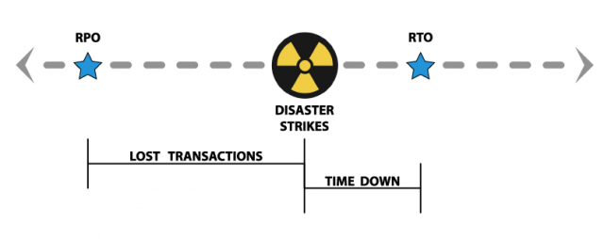
Metrics for backup
Service level of metrics measured by
RPO : Define historical point in time where to backup restored
RTO : the amount of time required to restore backed-up data to the primary system

Slide 7
Types of backups
Three basic types of backups:
Full backups
Differential backups
Incremental backups

Slide 8
Full backups
full and complete backup of entire system
Full Backup
Su
Su
Su
Su
Su

Slide 9
Differential backups
storage of all files that have changed or been added since last full backup
Su
M
T
W
T
F
S
Su
M
T
W
T
F
S
Su
M
T
W
T
F
S
Su
M
T
W
T
F
S
Su

Slide 10
Restoring from Differential Backup
Monday
Tuesday
Wednesday
Thursday
Friday
Files 1, 2, 3
File 4
Files 4, 5
Files 4, 5, 6
Files 1, 2, 3, 4, 5
Full Backup
Cumulative
Cumulative
Cumulative
Production

Slide 11
Key Features of Differential backups
More files to be backed up, therefore it takes more time to backup and uses more storage space
Much faster restore because only the last full and the last cumulative backup must be applied

Slide 12
Incremental backups
Only archives data that have been modified that day
Su
M
T
W
T
F
S
Su
M
T
W
T
F
S
Su
M
T
W
T
F
S
Su
M
T
W
T
F
S
Su

Slide 13
Incremental backup
Monday
Tuesday
Wednesday
Thursday
Friday
Files 1, 2, 3
File 4
Updated File 3
File 5
Files 1, 2, 3, 4, 5
Full Backup
Incremental
Incremental
Incremental
Production

Slide 14
Key Features of Incremental backups
Files that have changed since the last Full backup or incremental backup are backed up
Fewest amount of files to be backed up, therefore faster backup and less storage required

Slide 15
Comparison of backup types
 | Full Backup | Incremental Backup | Differential Backup
What is it | A backup of all files in a specified backup set or job | A backup of all changed and new files since the last backup | A backup of all changed and new files since the last full backup
Backup Speed | Slowest | Fastest | Faster
Restore Speed | Fastest | Slowest | Faster
Storage Needed | Most | Least | More
Advantages | Fastest restore Only needs the last full backup set to restore | Faster backups Less storage space used. No duplicate files | Faster & simpler restores then incremental backup Only needs the first full backup and last differential backup to restore
Disadvantages | Needs the most storage space Inefficient storage with a lots of duplicates stored | Slowest restores Needs all backup sets full + all increments to restores | Slower backups Still stores a lot of duplicate files

Slide 16
Backup Architecture and Process
Backup client
Sends backup data to backup server or storage node
Backup server
Manages backup operations and maintains backup catalog
Storage node
Responsible for writing data to backup device

Slide 17
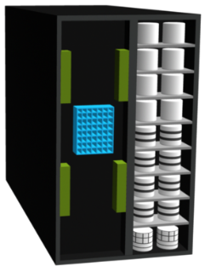
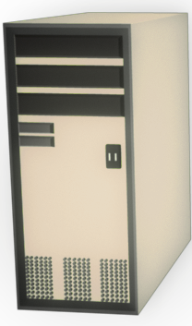
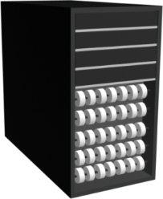
Backup Architecture and Process
Metadata Catalog
Backup Data
Backup Data
Application Server/
Backup Client
Backup Server/
Storage Node
Tape Library

Slide 18
Backup Operation
Start the scheduled backup process
Backup data retrieves backup related information from backup catalog
Backup server instruct backup clients to send its metadata to the backup server.
Backup clients send data to backup server
Backup server sends data to backup device
Backup server update and records the status

Slide 19
Restore Operation
Backup server scans backup catalog to identify the data to be restore and the client that will receive data.
Backup servers load backup media in backup device.
Data is read and send to backup client.
Backup server update restore metadata and catalogs

Slide 20
Backup Terminology
File Level Backup
Block level Backup
Metadata
Snapshot
Archive
Retrieve
Restore

Slide 21
Backup Optimization
Thin Provisioning:
Consume storage on demand by eliminating the preallocation of storage capacity
e.g. Allocation of HDD in ESXi
Data Compression
Reduce file size by eliminating binary level redundant data within a block of data
e.g. JPG, gzip,bzip2
Data Deduplication
Reduce data size by replacing multiple copies of data with references to single

Slide 22
Backup Policy
A backup policy is essentially a set of procedures that you prepare and implement to protect your important digital content from hard drive failures, virus attacks and other events or disasters.
Features of a Good Backup Policy:
Able to recover from data loss in all circumstances like hard drive failure, virus attacks, theft, accidental deletes or data entry errors, sabotage, fire, flood, earth quakes and other natural disasters.
Able to recover to an earlier state if necessary like due to data entry errors or accidental deletes.
Able to recover as quickly as possible with minimum effort, cost and data loss.
Require minimum ongoing human interaction and maintenance after the initial setup. Hence able to run automated or semi-automated.
Planning Your Backup Policy:
What To Backup
Where To Backup To
When To Backup

Slide 23
Tape Library
A tape library is a storage device which contains;
One or more tape drives
Number of slots to hold tape cartridges
Barcode reader to identify tape cartridges
An automated method for loading tapes (a robot)
Software support: There are several large-scale library-management packages available commercially. Open-Source support includes AMANDA, Bacula, and the minimal mtx program.

Slide 24
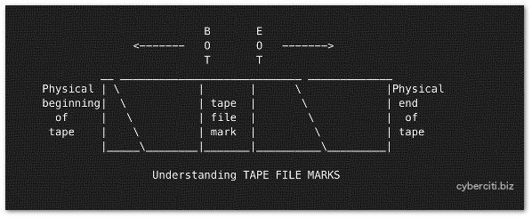
Tape logical structure
Each tape device can store multiple tape backup files. Tape backup files are created using cpio, tar, dd, and so on.
You can store several backups (tapes) on physical tape. Between each tape file is a “tape file mark”. This is used to indicate where one tape file ends and another begins on physical tape.

Slide 25
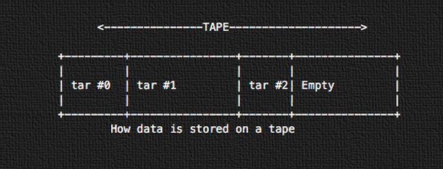
Tape logical structure
All data is stored subsequently in sequential tape archive format using tar. The first tape archive will start on the physical beginning of the tape (tar #0). The next will be tar #1 and so on.

Slide 26
Command
mt command used to control operations of the tape drive, such as finding status or seeking through files on a tape or writing tape control marks to the tape.
Backup Command
#tar cvf /dev/st0 /etc

Slide 27
LTO
LTO stands for Linear Tape-Open
The specific version (form factor) of the tape we are concerned with is called Ultrium. This ‘entire thing’ (tape + cover) is called a cartridge. A drive that reads Ultrium tape is called an Ultrium drive.
A drive typically reads data from a tape in its own generation and at least the two prior generations. This is not necessarily true of all drives.
A drive typically writes data to a tape of its own generation and to a tape from the immediate prior generation (in the prior generation or ‘older’ format). This is not necessarily true of all drives.
LTO also includes an error-verification technology that immediately checks data as it is being written.
The main players are IBM, HP and Quantum.

Slide 28
LTO Generations
Version | Capacity | Durability – Entire tape reads/writes | Approx. years of life | Max Speed (MB/s)
LTO-1 | 100 GB | 200 | 17 | 20
LTO-2 | 200 GB | 250 | 21 | 40
LTO-3 | 400 GB | 364 | 30 | 80
LTO-4 | 800 GB | 200 | 17 | 120
LTO-5 | 1.5 TB | — | — | 140
LTO-6 | 2.5 TB | — | — | 160
LTO-7** | 6.4 TB | — | — | 315

Slide 29
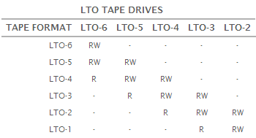
LTO Drive and tape Compatibility

