Slide 1
DAS
Directly attached storage : Own by a single computer
Used when capacity, administration, backup, high-availability, high performance are not key requirements
attached storage disk system is managed by the client operating system
applications access data via file I/O system calls into the Operating System
The file I/O system calls are handled by the File System , which manages the directory data structure and mapping from files to disk blocks in an abstract logical disk space.

Slide 2
DAS
The Volume Manager manages the block resources that are located in one or more physical disks in the Disk System and maps the accesses to the logical disk block space to the physical volume/cylinder/sector address.
The Disk System Device Driver ties the Operating System to the Disk controller or Host Bus Adapter hardware that is responsible for the transfer of commands and data between the client computer and the disk system
The file level I/O initiated by the client application is mapped into block level I/O transfers that occurred over the interface between the client computer and the disk system

Slide 3
DAS Software Architecture
Operating System
Application
Client Computer system
File I/O Access
Block I/O
File System
Volume Manager
Disk Device Driver
Disk Controller or HBA
Disk System

Slide 4
DAS Limitations
Limited storage capacity
Low Efficiency : as the storage capacity is bound to a given
computer/server, resources on one computer can not be used by another computer/server
Availability Limitation : any server failure results in the content on
the attached storage resources becoming inaccessible
Performance Limitation : limited by attached server, content accessible by only attached server

Slide 5
NAS
Sharing the storage over network
storage that is directly attached to a computer network (LAN) through network file system protocols such as NFS and CIFS.
NAS does the file level I/O over the network
the data is transferred across the network to the recipient in a file data stream that was processed from the data blocks
As the file access model is built on a higher abstraction layer, it requires an extra layer of processing both in the host computer, and in the function of translation between file accesses and block accesses in the NAS box.

Slide 6


Client Computer System
NAS Device
NAS File Access Handler
Application
Operating System | I/O redirector
 | Network File Protocol
 | TCP/IP Stack
 | NIC Driver
Operating System | Network File Protocol | File System
 | TCP/IP stack | Volume Manager
 | NIC Driver | Disk system device driver
Network Interface card
Network Interface card | HBA
LAN
Remote File I/O Access Across the
Network
Disk System

Slide 7
Use Cases – NAS
File Storage & Sharing: To Store user data and files.
VMWare: NAS devices are used to run their VMs. ESXi supports using NAS through the NFS protocol.
Hyper-V: Microsoft added NAS support a few years ago, and they appear to have made it a priority.

Slide 8
SAN
SAN provides block-orient I/O between the computer systems and the target disk systems
Fibre Channel or Ethernet (iSCSI) to provide connectivity between hosts and storage
provides high bandwidth, longer reach distance, the ability to share resources, enhanced availability, and other benefits of consolidated storage.
Storage devices and servers are connected through SAN fabrics
SAN fabric provides high bandwidth,longer reach distance, the ability to share resources, enhanced availability, and other benefits of consolidated storage.

Slide 9
SAN Software Architecture
Client Computer System
Application
File Access
Operating System | File System
 | Volume Manager
 | Fiber Channel Stack | iSCSI Protocol
 |  | TCP/IP Stack
 | HBA Driver | NIC Driver
FC HBA | Ethernet NIC
Remote Block I/O carried in SAN protocol Packets
DISK SYSTEM
SAN

Slide 10
Use Cases – SAN
E-Commerce: High-traffic sites with thousands of customers who are processing orders every few seconds will benefit from the speed and efficiency of a SAN. SANs architecture has been optimized for fast I/O which is key to keeping customers happy.
Enterprise Database: The bigger and more critical the DB, the more sense it makes to use a SAN.
Disaster Recovery: When you have many critical servers in your data center running applications that you can’t afford to go down, then a SAN is your best choice. The SAN also allows for a quick recovery if disaster strikes.

Slide 11
Protocols for SAN
SCSI
FC
iSCSI
FCOE
FCoE
Ethernet Ethernet FC
Operating System/Applications
SCSI Layer
iSCSI
FCP
FCP
TCP
IP

Slide 12
SCSI (Small Computer System Interface)
SCSI is parallel bus architecture with 8 or 16 bits
Half duplex- data travel in one direction at a time and one device control bus at one time
Client server model initiator and target
S/W initiator : in OS (kernel disk device driver)
H/W initiator : HBA (Host Bus Adapter)
Target : Single HDD, JBOD, RAID array, Tape Drive
SCSI Speed 320MB/s
Distance 25 meter

Slide 13
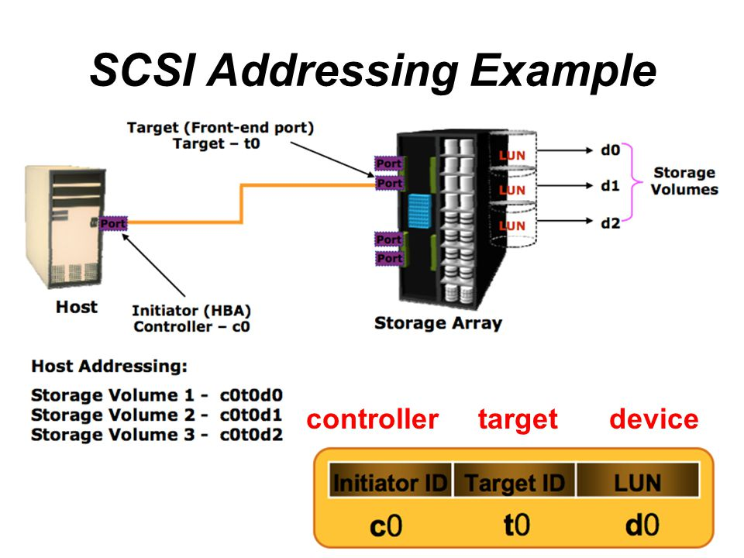
SCSI Addressing
Each SCSI has a unique identifier ID
SCSI uses 3 bit addressing
Initiator ID is always 7 which is highest priority
Target has ID with LUN to indentify specific target disk.

Slide 14
SCSI Architecture
In The SCSI Architecture, there are initiators and targets.
An initiator is like a client.
A target is like a server (Single Harddisk,JBOD,RAID Array).
Initiators send SCSI commands to targets, and receive responses.

Slide 15
SCSI Operations
SCSI specifies three phases of operation:
1. Phase One is the Command Phase. In this phase the required commands and parameters are sent.
2. Phase Two is the Data Phase. The transfer of data in accordance with the command occurs in this phase.
3. Phase Three is the Response Phase. Confirmation of command execution is received in this phase.

Slide 16
SCSI Commands
SCSI commands pass data in one direction only.
Command formatted in CDB (Command Descriptor Block)
SCSI commands: READ, WRITE, Send Diagnostics, Receive Diagnostics, Inquiry, Test Unit Ready.
Each command returns a status code. A special code named 'mode sense' means there is an extra 'sense data' to be received, which contains an explanation for the cause of the problem.
In order to allow a pipeline of commands, it is possible to attach a tag to a command.

Slide 17
SCSI I/O Request
1.The application makes a file I/O request to Volume Manager
2. Volume Manager maps volume to SCSI ID and target LUN
3. File System maps files to blocks, makes block I/O request
4. Command, LBA (Logical Block Address), block count, and LUN sent to SCSI driver
5. SCSI driver creates CDB(Command Descriptor Block)
6. FC (Fibre Channel) driver creates command frame with CDB in payload
7. FC driver sends command frame to target LUN and awaits response

Slide 18
iSCSI –Internet SCSI
enables server host applications to perform traditional “block-level” transactions over a common IP network
The iSCSI protocol encapsulates SCSI commands and assembles the data in packets for the TCP/IP layer.
Packets are sent over the network using a point-to-point connection.
Upon arrival, the protocol translates data back to SCSI. Security is provided through iSCSI authentication and virtual private networks (VPNs), as needed.

Slide 19
Initiator Target
iSCSI Communication
Application
Media
SCSI
SCSI
iSCSI
iSCSI
TCP/IP
TCP/IP
Ethernet

Slide 20
iSCSI Operation
To access iSCSI storage, a server needs an iSCSI initiator connected to a network.
An initiator can be an iSCSI driver with a standard network card, or a card with a TCP offload engine (TOE) to reduce CPU utilization.
HBAs are available that offload both TCP and iSCSI.
TCP ports 860 and 3260

Slide 21
Types of iSCSI initiators
A standard NIC with software iSCSI adapter
A TCP offload engine (TOE) NIC with software iSCSI adapter
iSCSI HBA
Converged Network Adapter

Slide 22
Processed in Server
Processed in Network Interface card
Application
Application
Application
SCSI and iSCSI
SCSI and iSCSI
SCSI and iSCSI
TCP
TCP
TCP
IP
IP
IP
Network Interface
Network Interface
Network Interface
iSCSI driver and NIC
iSCSI driver and NIC with TOE
iSCSI HBA

Slide 23
iSCSI Node Name
There are three formats:
1. iSCSI Qualified Name (IQN) - It is a month and year date followed by a reverse domain name. (2010-4.com.acme:storage.tape.sys1.xyz)
2. IEEE Extended Unique Identifier (EUI) - 64 bits
3. T11 Network Address Authority (NAA) - 64 or 128 bits

Slide 24
iSCSI Discovery
An iSCSI initiator must discover the location of its targets on the network before establishing the session
Discovery happens in two type
SendTargets discovery
internet Storage Name Service (iSNS)
The initiator is manually configured with the target’s network portal (IP address and TCP port number) to establish a discovery session and sends discovery command.
The initiator issues the SendTargets command, and the target network portal responds to the initiator with the location and name of the target.
iSNS is equivalent to Name server and automatic discover target devices.
Initiator sends query to iSNS server for target server.

Slide 25
iSCSI advantages
no distance limitation
lower cost
easy to administer and manage
high availability (multiple connection paths)
better performance than NAS (block level access instead of file level)
maximum utilization of resources (share disk and tape devices across a heterogeneous environment)

Slide 26
Fibre Channel (FC)
Fibre Channel is a set of standards that define a high performance data transport connection technology which transports many kinds of data at speeds up to 1 Gigabit per second (100 Megabytes per second), through copper wire or fiber optic cables, across distances up to 10 km.
It defines only a method for transmitting data from one node to another, regardless of the type of data transmitted.

Slide 27
Fiber Channel
It is the original SAN protocol is still very popular
It uses dedicated adapters, cables and switches and different than ethernet at all layers of OSI stack, including physicsl level
FCP is used to send SCSI command over the fiber channel network
It is stable and reliable protocol
It is lossless unlike TCP and UDP
It supports bandwidths of 2, 4, 6, 8 and 16Gbps

Slide 28
Key Features of Fibre Channel
• Fast: operate at 1 Gbps, or 100 MBps
• Long-distance: up to 10 km between fiber optic connections makes remote mirroring or backup possible, and less expensive copper wire cables for near connections can still span up to 30 meters.
• Scalable: users can start with a basic setup and expand in many ways as a system’s requirements evolve
• Reliable: superior data encoding and error checking, and the improved reliability of serial communications
• Dependable: redundancies ensure that storage or network access is always available
• Flexible in many ways: Carries any kind of data traffic. Mapping protocols have already been defined which enable sending SCSI, IP and other higher-level protocols

Slide 29
Components
Node : Host, Storage, tape library
Requires ports to provide physical interface for communication with other node
Operates in full duplex data transmission mode with a transmit(Tx) and receive (Rx)link
Cabling
Uses optical fiber longer distance and copper cables for shorter distance
Optical cable carry data in light form
Two types cables : Mulitimode Mode cable
Single Mode
Connector
Standard Connector : Used for transmission speed upto 1 Gb/s
Lucent connector : Used for transmission speed upto 4 Gb/s
Straight Tip

Slide 30
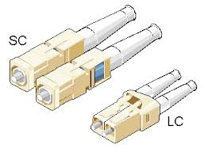
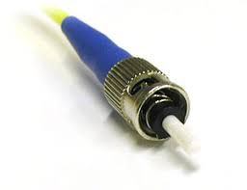
Components

Slide 31
Components
Hub
Switches
Directors

Slide 32
FC Topologies
Point to Point : bidirectional between two devices
Arbitrated loop : unidirectional ring. Only two devices can ever exchange data with one another at any one time.
Fabric : Several devices can exchange data simultaneously at full bandwidth
Devices equipped with one or more FC ports(HBAs). FC port consists of two channels one input and one output channel.
Connection between two ports is called link

Slide 33
FC Topologies
Point to Point and Fabric : links are always bidirectional . Input channel and output channel in the link are connected cross so that every output channel is connected to every input channel.
Arbitrated Loop : Link is always unidirectional. Each output channel is connected to the input channel of the next port until circle is closed. It provides high speed for upto 126 devices.
A hub provides centralized routing for a Fibre Channel arbitrated loop. Instead of connecting devices directly together, each device is connected to a port on a hub.

Slide 34
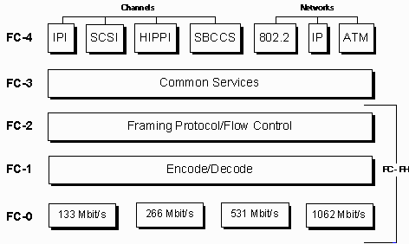
FCP Layers

Slide 35
FC Layers
Fibre Channel is a layered protocol.
It contains 5 layers : FC-0,FC-1,FC-2,FC-3,FC-4
FC-0 Layer : defines the physical link in the system
Include the cabling, connectors, and electrical parameters for the system at a wide range of data rates
Fibre Channel often uses lasers to transmit data

Slide 36
FC-1 Layer
defines the transmission protocol including serial encoding and decoding rules(8bit/10bit, 64bit/66bit), special characters and error control.
integrate the data with the clock information that is required by serial transmission technologies
At Transmitter node : 8 bit char encoded into 10 bit transmission character and transmitted at receiver node
Running Disparity calculated and checked at transmitter and receiver

Slide 37
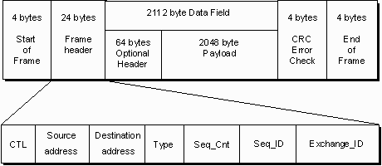
FC-2 Layer
Provides FC addressing
Defines and organization of data in following std.
Order set
Frame
Sequence
Exchange
Order set : 4 bytes transmission words containing data and special character , also establishes word boundary alignment.
Frame :size 2148 byte contains information to be transmitted (Payload), the address of the source and destination ports and link control information

Slide 38
FC-2 Layer
Frame : Each Frame begins and ends with a Frame Delimiter
The Frame Header is used to control link applications, control device protocol transfers, and detect missing or out of order Frames.
CRC is used to detect transmission errors
Sequence : set of one or more related Frames transmitted unidirectional from one N_Port to an other
Each Frame within a sequence is uniquely numbered with a Sequence Count
Exchange :composed of one or more nonconcurrent sequences for a single operation
Exchanges may be unidirectional or bidirectional between two N_Ports
Within a single Exchange, only one sequence may be active at any one time, but Sequences of different Exchanges may be concurrently active

Slide 39
FC Flow Control
process to regulate the data transmission rate between two devices so that a transmitting device does not overflow a receiving device with data.
If all the receive buffers are filled up with received frames and the transmitting port sends another frame, then the receiving port would not have a receive buffer available to hold the new frame and the frame would be dropped.
A fabric uses the buffer-to-buffer credit (BB_Credit) mechanism for flow control.

Slide 40
Buffer-to-Buffer Credit Mechanism
The BB_Credit management occur between any two FC ports.
the transmitting and receiving ports agree on the number of buffers available or BB_Credits during the port login process
The credit value is decremented when a frame is transmitted and incremented upon receiving a response.
A receiver ready (R_RDY) is sent from the receiving port to the transmitting port for every free buffer on the receiving side.
The transmitting port increments the credit value per R_RDY it receives from the receiving port.
The transmitting port maintains a count of available credits and continues to send frames if the count is greater than zero.
If the available credits reaches zero, then further transmission of frames is suspended until the credit count becomes a nonzero value.

Slide 41
FC-3 Layer
Striping is used to multiply bandwidth by using multiple N_ports in parallel to transmit a single information unit across multiple links
Multicast delivers a single transmission to multiple destination ports. This method includes the ability to broadcast to all nodes or a subset of nodes

Slide 42
FC Services
All FC switches provide common set of services as defined in FC std.
These services are available at certain predefined addresses.
Some of these services are Fabric Login Server, Fabric Controller, Name Server, and Management Server.

Slide 43
FC-4 Layer
provides the application-specific protocols
transport both the network and channel information and allows both protocol types to be transported concurrently over the same physical interface.
A channel example is FCP. This protocol is used to transfer SCSI data over Fibre Channel
A networking example is sending IP packets between the nodes.

Slide 44
FC Port Types
N_Port: It is an end point in the fabric. It is a compute system port (FC HBA port) or a storage system port that is connected to a switch in a switched fabric.
E_Port: It is a port that forms the connection between two FC switches. The E_Port on an FC switch connects to the E_Port of another FC switch in the fabric ISLs(Inter switch link).
F_Port: It is a port on a switch that connects an N_Port.
G_Port: It is a generic port on a switch that can operate as an E_Port or an F_Port and determines its functionality automatically during initialization.

Slide 45
FC Zoning
Partitioning of a Fabric to restrict interference, add security and to simplify management.
There are four types of zoning
Port zoning
WWN zoning
Zoning helps to limit the number of RSCNs in a fabric
In the presence of zoning, a fabric sends the RSCN to only those nodes in a zone where the change has occurred.
In Fibre Channel protocol, a registered state change notification (RSCN) is a Fibre Channel fabric's notification sent to all specified nodes in case of any major fabric changes.

Slide 46
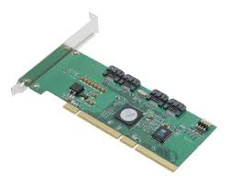
RAID Controller
a way to virtualize multiple, independent hard disk drives into one or more arrays to improve performance, capacity and reliability
A hardware RAID solution has its own processor and memory to run the RAID application.
Hardware RAID can be implemented in following ways:
i. as a discrete RAID Controller Card
ii. as integrated hardware based on RAID-on-Chip technology

Slide 47
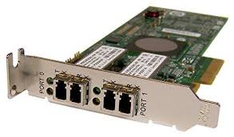
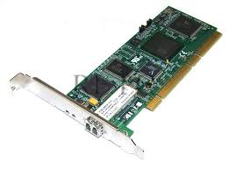
HBA : Host Bus Adapter
It is a circuit board or integrated circuit adapter that provides input/output processing and physical connectivity between computer or host system to network and storage devices
HBA relives host processor from data storage and retrieval task, improves performance
HBAs are most commonly used in Fibre Channel (FC) SAN environments and are also used for connecting SCSI and SATA devices.

Slide 48
WWN (World Wide Name)
It’s a 64 bit unique identifier
WWN may be used as a WWNN (World Wide Node Name) to identify an endpoint, or a WWPN (World Wide Port Name) to identify an individual port on a switch.
assigned to a manufacturer by the Institute of Electrical and Electronic Engineers (IEEE) and hard-coded into a Fibre Channel device.

Slide 49
WWN
FCP uses WWN World Wide Names for its addressing
WWNs are 8 byte addresses made up of 16 hexadecimal characters
Their format is : 15:00:00:f0:8c:08:95:de
WWN is assigned to a node in the storage network

Slide 50
WWPN
It is individual assigned to every induvial port on a node
A multi-port HBA will have different WWPN`s on each port
Equivalent to MAC addresses in Ethernet
The WWPN is burned in by the manufacturer and guaranteed to be globally unique
WWPNs are assigned to HBAs on both the clients and the storage system
WWPNs are consider when configuring fiber channel network

Slide 51
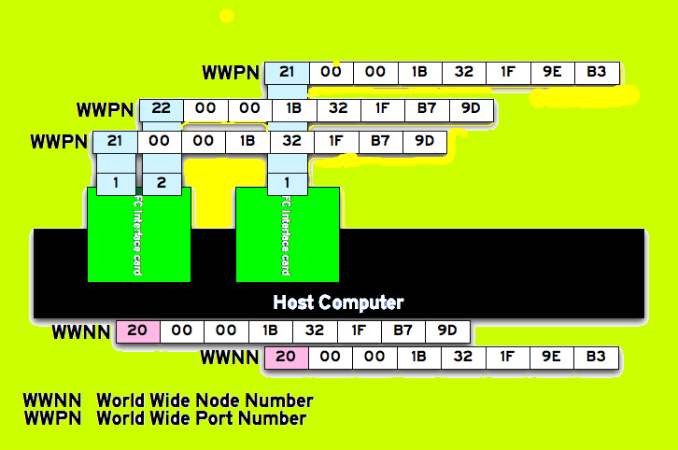
20 - this is a Node (WWNN)
21 - this is the WWPN of Port 1
22 - this is the WWPN of Port 2

Slide 52
Aliases
Aliases can be configured to make configuration and troubleshooting easier
For example we could create an alias named EXCHANGE –SERVER for the Exchnage Server with WWPN 15:00:00:f0:8c:08:95:8e
Aliases can be configured on both th the fibre channel switches and storage system

Slide 53
Cache
a hardware or software component that stores data so future requests for that data can be served faster
A cache hit occurs when the requested data can be found in a cache
A cache miss occurs when the requested data can not be found in a cache
There are three caching techniques
Write Through
Write back

Slide 54
Multipathing
Multiple paths to access data
technique of creating more than one physical path between the server and its storage devices.
Goal is protection and performance
Used as failover for accessing data
multipathing can assist with load balancing spreading I/O across multiple paths to reduce latency

Slide 55
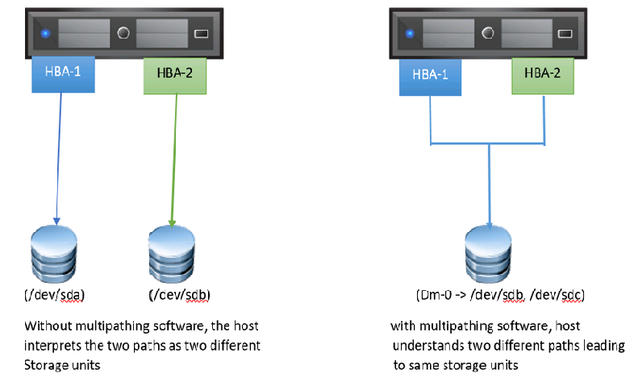
Multipathing
Example of Multipathing Driver built in operating systems:
MPIO for windows OS
DM-Multipath for Linux OS
NMP for VMware ESXi

Slide 56
WWN Zoning
groups a number of WWNs in a storage-area network zone and allows them to communicate with each other.
The switch port that each device is connected to is irrelevant when WWN zoning is configured.
An advantage to this type of zoning is that if a port is suspected of being faulty, another port can be used without the need for fabric reconfiguration.
A disadvantage with WWN zoning is that if there's a host bus adapter (HBA) failure, the fabric will need to be reconfigured for the host to reconnect to its storage.

Slide 57
Zoning
For secucrity zoning will be configured on the switches to control which hostts are allowed to communicate with each other

Slide 58
PORT ZONING
groups particular switch ports together to allow any device connected to those ports to communicate with each other.

Slide 59
LUN masking
It critical that the right LUN is prsented to the right host
If the wrong host is able to connect to a LUN then it is able to corrupt it
Zoning prevents unauthorized hosts from reaching the storage sytem, but it will not prevent a host from accessing the wrong LUN once it get there
LUN maskig is configured on the storage system to lock a LUN down to host or hosts who are authorized to access it
To secure your storage you need to configure zoning on your switches and LUN masking on your storage system

Slide 60
Switch Domain IDs
Each switch in the fiber channel network will be assigned a unique Domain ID
One switch in the network will be automatically assigned as the principle switch. It assigns Domian IDs to the other switches
Each switch learns about the other switches in the network and how to route to them based on their Domain ID

Slide 61
FLOGI Fabric Login
When a server ‘s or storgae system’s HBA powers on it will send a Fabric login request to its locally attached FC switch
The switch will then assign it a 24 bit FCID Fibre Channel ID address
The FCID assigned to hosts is made up of the switch’s Domain ID and switch port the host is plugged into.
The FCID is similar to an IP address. It is used by fc switches to route traffic between server and their storage
Switches maintain a table of FCID to WWPN address mappings and what port host is located on

Slide 62
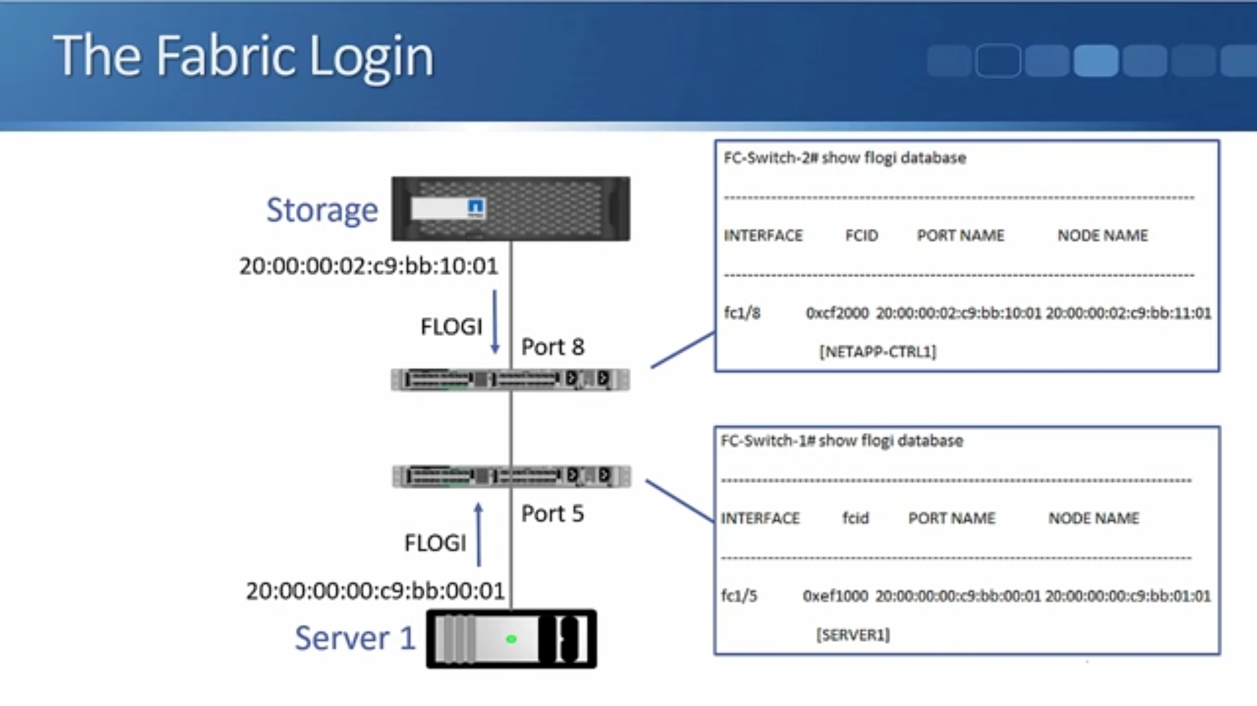

Slide 63
Fibre Channel Name Service (FCNS)
FC switches share the FLOGI database information with each other using the FCNS
Each switch in the network learns where each WWPN is and how to route traffic there

Slide 64
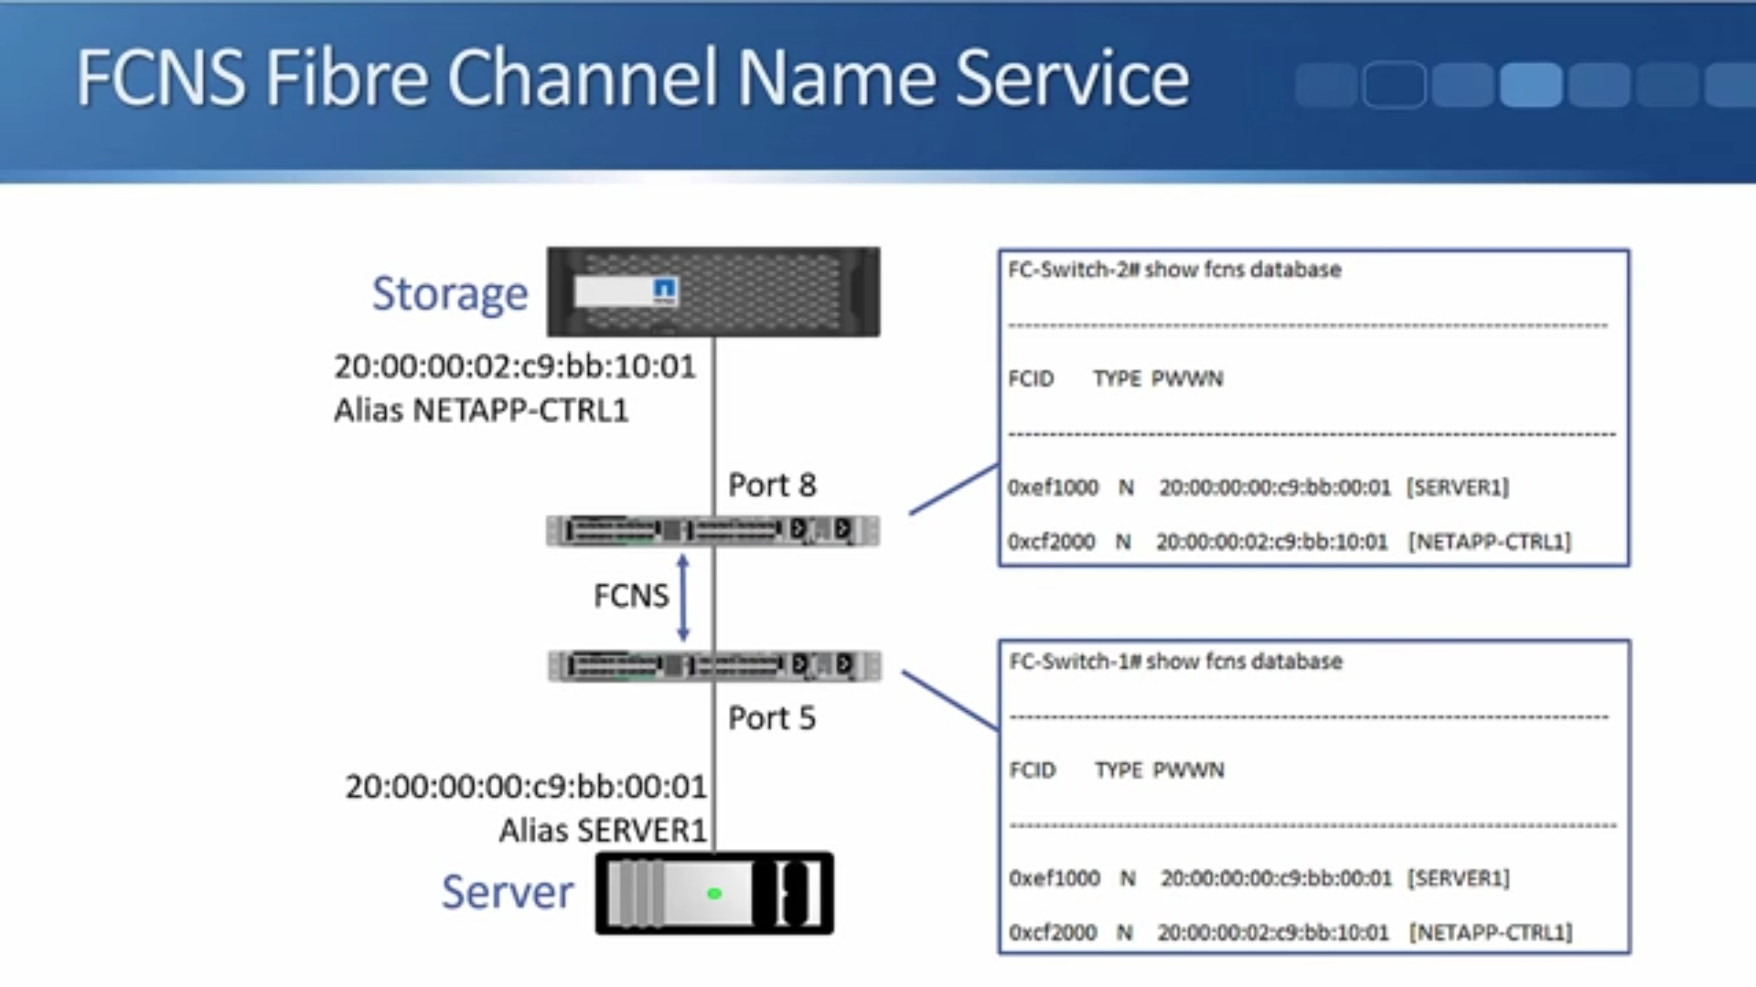

Slide 65
PLOGI Port Login
After the FLOGI Fabric login process is complete, the iitiator will send the PLOGI port login
Based on the zoning configuration on the switch , the host will learn its available target WWPNs

Slide 66
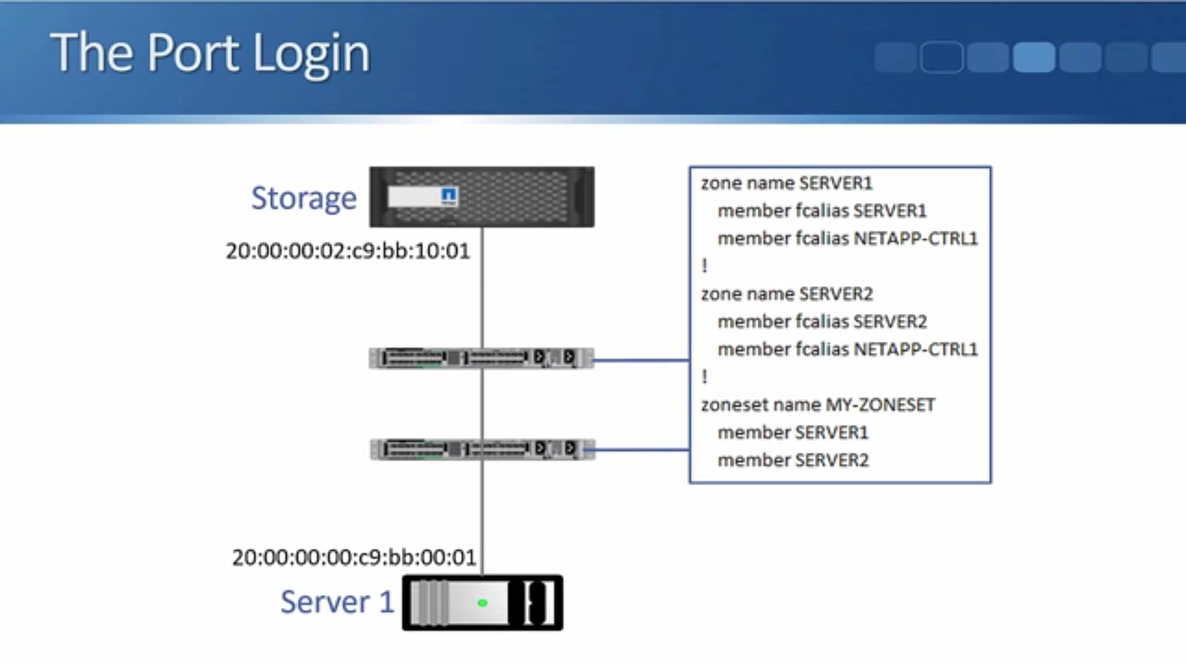

Slide 67
PLRI Process login
Finally the initiator host will send a PLRI Process Login to its target storage
The storage system will grant access to the host based on its configued LUN masking

Slide 68


