Slide 1
Processor Organization
Computer Organization
Dept. of Computer Engineering
Smt. Kahibai Navale College of Engineering
Prof. Aaradhana Deshmukh

Slide 2
About Micro-Processor in Brief
Microprocessor: A silicon chip that contains a CPU. Is used in general purpose machines and is termed as computer on a chip.
A microprocessor (sometimes abbreviated μP) is a digital electronic component with miniaturized transistors on a single semiconductor integrated circuit (IC).

Slide 3
About Micro-Processor in Brief Contd..
Three basic characteristics:
•Instruction set: The set of instructions that the microprocessor can execute.
•Bandwidth: The number of bits processed in a single instruction.
•Clock speed: Given in megahertz (MHz), the clock speed determines how many instructions per second the processor can execute. Higher the value, the more powerful the CPU.
•In addition to bandwidth and clock speed, microprocessors are classified as being either RISC (reduced instruction set computer) or CISC (complex instruction set computer).

Slide 4
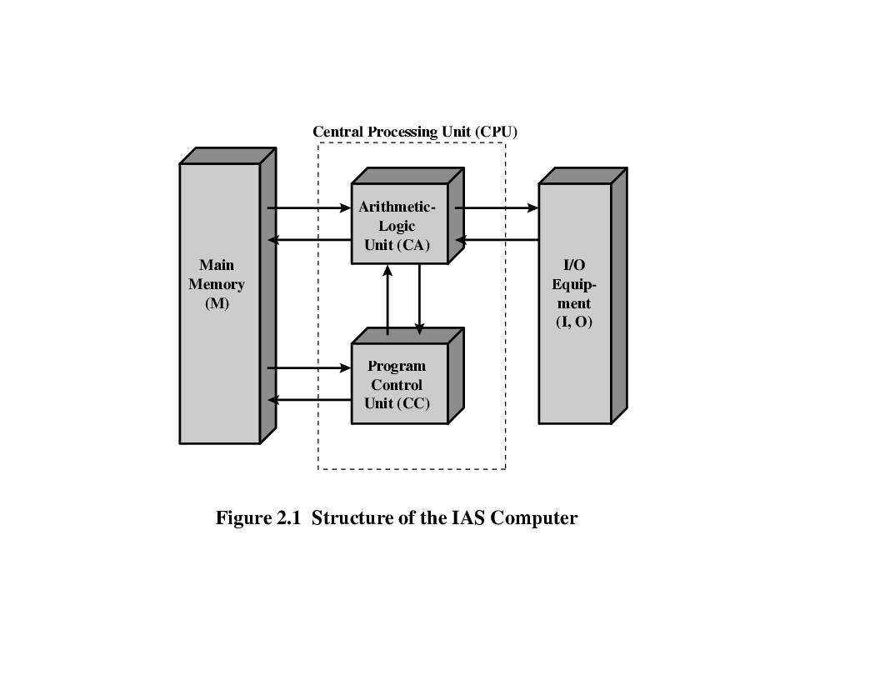
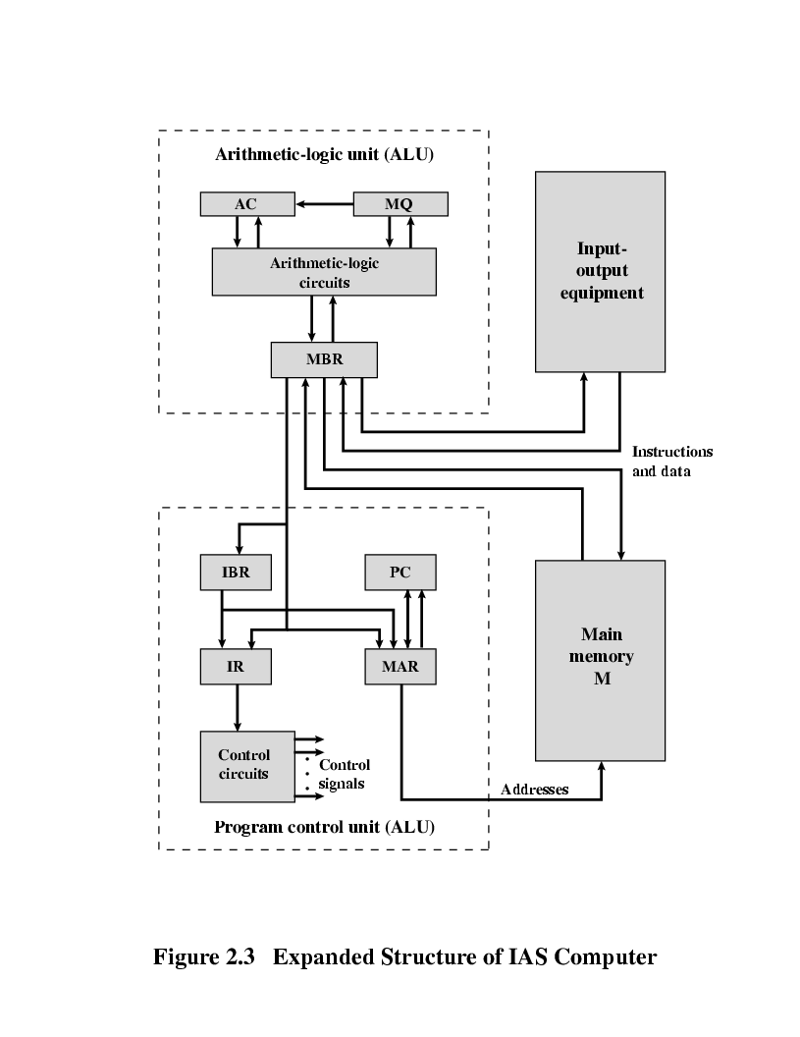
Von-Neumann & IAS Structure
(A) Von-Neumann model
(B) IAS model

Slide 5
ABOUT VON NEUMANN COMPUTER IN BRIEF
Stored Program concept
Main memory storing programs and data
“Turing Machine” (Alan Turing): Given enough memory and sufficient time the general purpose computer can compute all functions that are computable.
ALU operating on binary data
Control unit interpreting instructions from memory and executing
Input and output equipment operated by control unit
Princeton Institute for Advanced Studies
IAS Computer (major components in a computer system)
Foundation for general-purpose computer
Completed 1952

Slide 6
ABOUT IAS COMPUTER IN BRIEF
Comprises of 21 instructions which are grouped as follows:
Data Transfer: Moves data between memory and ALU registers or
between two ALU registers
Unconditional Branch: Changes the sequence of instructions to
execute repetitive operations
Conditional Branch: The branch can be made dependent on a
condition, thus, allowing decision points.
Arithmetic: Operations performed by the ALU
Address /modify: Permits addresses to be computed in the ALU and
then inserted into instructions stored in memory.

Slide 7
What is a BUS? Definition & Operation
A bus is a communication pathway connecting two or more device.
A key characteristic of a bus is that it is a shared transmission medium.
A bus consists of multiple pathways or lines.
Each line is capable of transmitting signal representing binary digit (1 or 0)
A sequence of bits can be transmit across a single line.
Several lines can be used to transmit bits simultaneously.
It connects major components (CPU,Memory,I/O) is called System Bus. The most common computer interconnection structures are based on the use of one or more system buses.

Slide 8
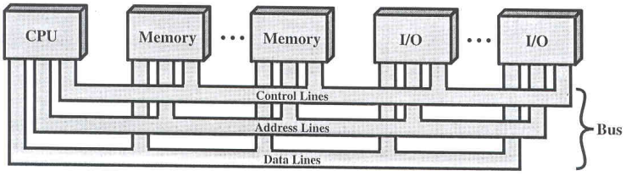
About BUS organization Contd...
On any bus the lines can be classified into 3 groups
Data lines
Address lines
Control lines
(A) System bus

Slide 9
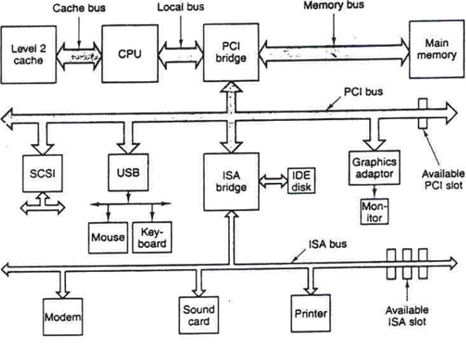
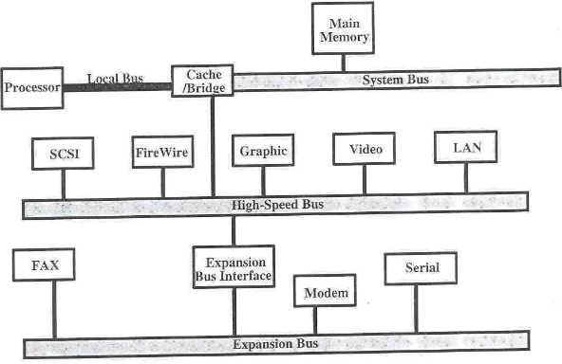
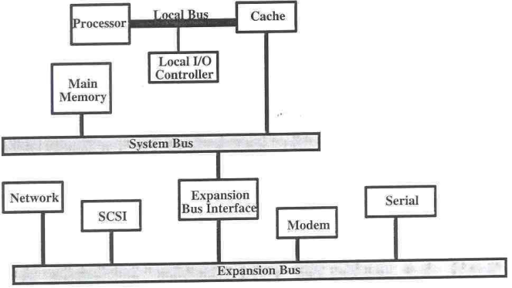
About BUS organization Example Contd...
(A)
(B)
(c)
A- Traditional
B- High performance
C-Multisystem

Slide 10
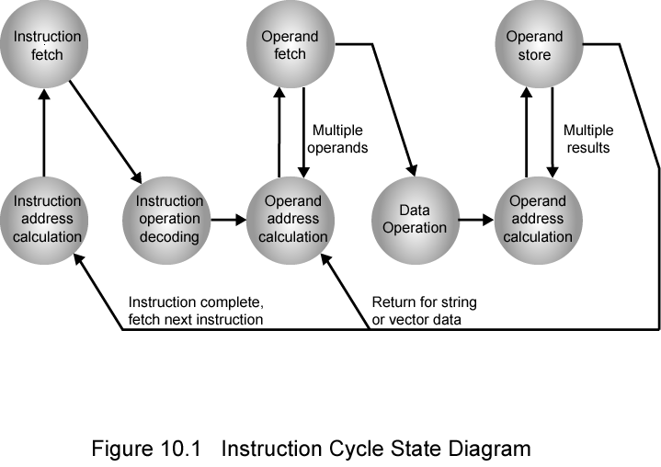
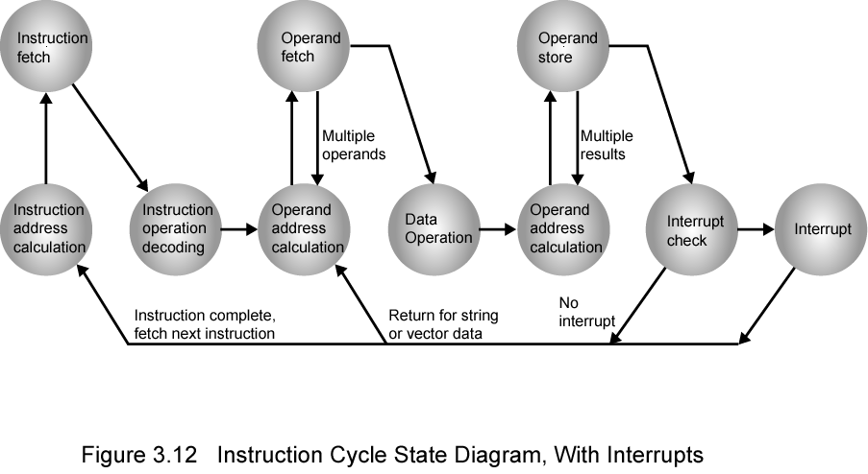
About Instruction Execution cycle
(A) Without Interrupt
(B) With Interrupt

Slide 11
Instruction formats
0 (zero) addresses
All addresses implicit
Uses a stack
e.g. push a
push b
add
1 address
Implicit second address
Usually a register (accumulator)
Common on early machines
e.g. Clear A (A = 0)

Slide 12
Instruction formats Contd…
2 addresses
One address doubles as operand and result ,
a = a + b
Reduces length of instruction
Requires some extra work
Temporary storage to hold some results
E.g. Add A, B (B = A + B)
3 addresses
Operand 1, Operand 2, Result
a = b + c;
Not common
Needs very long words to hold everything
E.g. Add A, B, C (C = A + B)

Slide 13
RISK V/s CISC
RISC | CISC
Simple Instructions consuming fix clock cycle | Complex instructions consuming multiple clock cycles
Very few instructions refer memory | Most of the instructions refer memory
Hardwired instruction execution | Micro-programmed instruction execution
Fixed instruction format | Variable instruction format
Limited instruction set | Large instruction set
Comparatively lesser addressing modes | Many addressing modes

Slide 14
RISK V/s CISC Contd..
RISC | CISC
Multiple Register set | Single register set
Highly pipelined | Moderately or almost non-pipelined
Complexity lies in compiler | Complexity lies in micro-program
Example: Motorola 8800, MIPS R 4000 | Example: IBM 360/168, VAX11/780

Slide 15
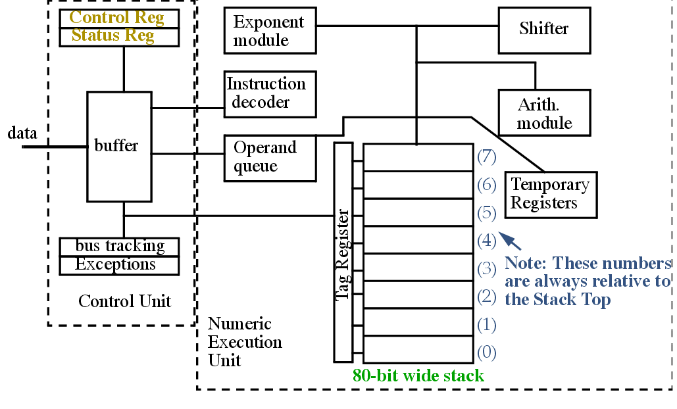
Basic structure of 8087 Co-Processor

Slide 16
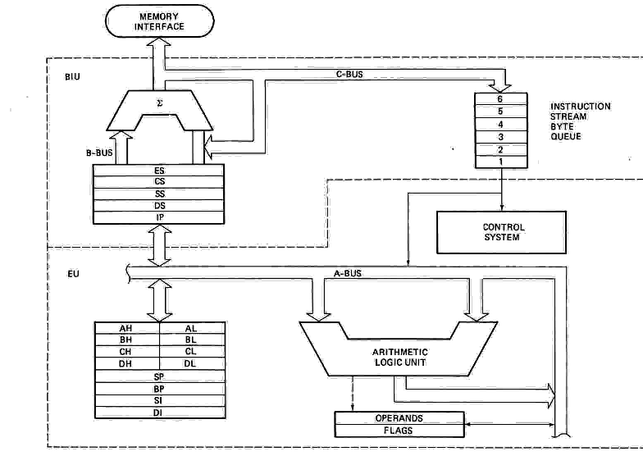
8086 Architecture & programming model.

Slide 17
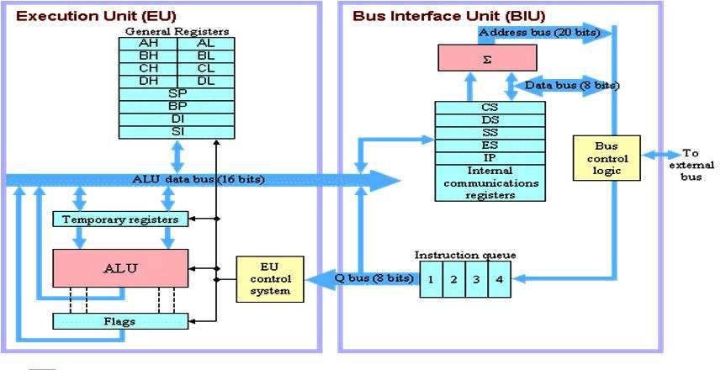
8088 Architecture & programming model.

Slide 18
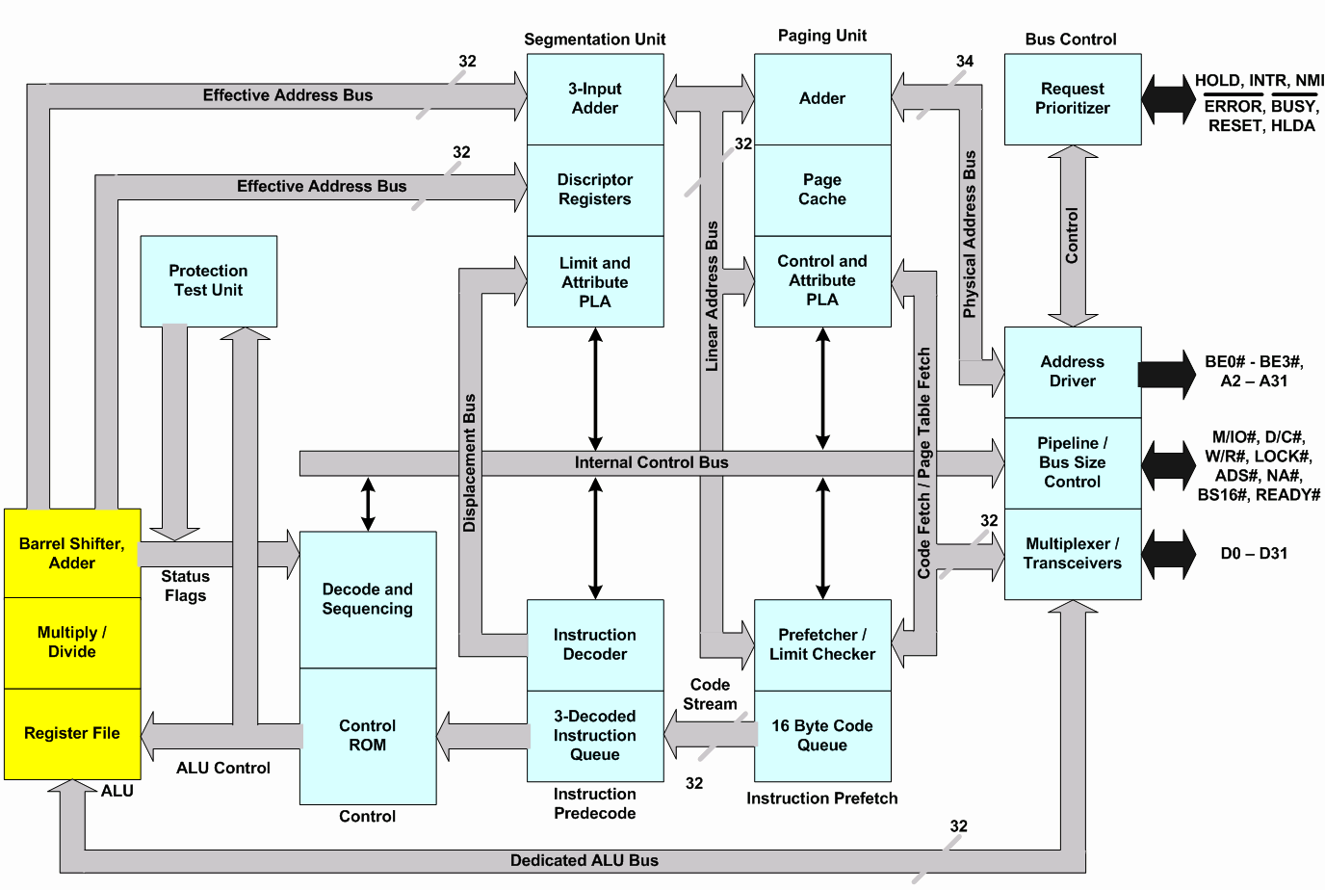
80386 Architecture & programming model.

Slide 19
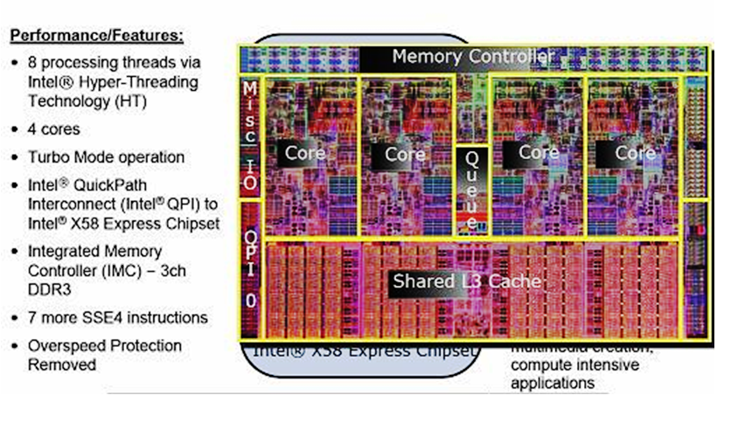
Intel`s i7 Desktop Processor

Slide 20
Compare 8085 and 8086 µp model.
8085 Microprocessor | 8086 Microprocessor
It is a 8 bit microprocessor | It is a 16 bit microprocessor
It has 16 bit address lines | It has 20 bit address lines
It has 8 bit data bus | It has 16 bit data bus
It utilizes 3 MHz clock | It uses 5 or 8 or 10 MHz clock depends on flavor
IT does not support pipelining | It support pipelining
It operates on clock cycle with 50% duty cycle | It operates on clock cycle with 33% duty cycle
It does not support memory segmentation | It supports memory segmentation

Slide 21
Compare 8085 and 8086 µp model Contd..
8085 Microprocessor | 8086 Microprocessor
8085 chip comprises of 6500 transistors | 8086 chip comprises of 29000 transistors
Is a accumulator based processor | Is a General Purpose Register based processor
It has no Minimum mode and Maximum mode of operations | It has both Minimum mode and Maximum mode of operations
8085 is used as a single processor with no cascading of more 8085 possible | In 8086 more than one processor can be used as an additional external processor
Only 64 KB memory can be used together | Up to 1 MB memory can be used together

Slide 22
Compare 8086 and 8088 µp model.
8086 Microprocessor | 8088 Microprocessor
It has 16 bit data bus | It has 8 bit data bus
It uses 5 or 8 or 10 MHz clock depends on flavor | It uses 5 or 8 10 MHz clock depends on flavor
Memory space is organized as 512 KB banks | Memory space is organized as 1 MB * 8 banks
It has 6 bit instruction queue | It has 4 bit instruction queue
It has BHE | It has SS0 status signal
Can read or write 8 or 16 bit data at a time | Can read or write 8 bit data at a time

Slide 23
Compare 8086 and 8088 µp model contd..
8086 Microprocessor | 8088 Microprocessor
I/O voltage levels can be measured at 2.5 mA | I/O voltage levels can be measured at 2 mA
In 8086 more than one processor can be used as an additional external processor | In 8086 more than one processor can be used as an additional external processor
Draws maximum supply current of 360 mA | Draws maximum supply current of 340 mA

Slide 24
Compare 8086 and 80386 µp model
8086 Microprocessor | 80386 Microprocessor
It is a 16 bit microprocessor | It is a 32 bit microprocessor
It has pipelined architecture and high speed bus interface on a single chip | It has highly pipelined architecture and has high speed bus than 8086
It is upward compatible with 80386 | 80386 can support 8086 programming model & can run 8086 programs directly in 8086 virtual mode if VM=1(in protected mode)
It is housed in 40 pin DIP | It has 132 pins
It uses HMOS technology | It is built using high speed CHMOS III technology

Slide 25
Compare 8086 and 80386 µp model contd..
8086 Microprocessor | 80386 Microprocessor
No special hardware required for task switching | It has special hardware for task switching
Operates on 5 Mhz clock | Operates on 33MHz clock Max
Address and data bus is multiplexed | It has separate address and data bus for time saving
Transistor density is 29,000 | It has 2,75,000 transistors
It has 117 instructions | It has 129 total instructions
It has no mechanism protection, paging | It support paging and is having relevant instructions
It contains nine flags totally | It contains nine flags totally along with IOP,NT,RF,VM

Slide 26
Compare 8086 and 80386 µp model contd..
8086 Microprocessor | 80386 Microprocessor
It operates in one mode only. | It operates in 1)Real 2) protected 3) virtual 8086 mode
It has instruction queue only | It has instruction queue as well as pre-fetch queue

Slide 27
This is the beginning .. Thank You

