Slide 1
Intrusion Detection Systems & Intrusion Prevention Systems

Slide 2
Definitions
Intrusions: attempts to compromise the confidentiality, integrity, availability, or to bypass the security mechanisms of a computer system or network
(illegal access).
Intrusions have many causes, such as malware, worms, spyware, etc…, attackers gaining unauthorized access to systems from the Internet, and authorized users of systems who misuse their privileges or attempt to gain additional privileges for which they are not authorized.
Although many intrusions are malicious in nature, many others are not; for example: a person might mistype the address of a computer and accidentally attempt to connect to a different system without authorization.

Slide 3
Definitions
Intrusion detection: is the process of monitoring the events occurring in a computer system or network and analyzing them for signs of possible intrusions (incidents).
Intrusion detection system (IDS): is software that automates the intrusion detection process. The primary responsibility of an IDS is to detect unwanted and malicious activities.
Intrusion prevention system (IPS): is software that has all the capabilities of an intrusion detection system and can also attempt to stop possible incidents.

Slide 4
Need for Intrusion Detection Prevention Systems
It’s a fact that while every enterprise has a firewall, most still suffer from network security problems. IT professionals are acutely aware of the need for additional protective technologies, and network equipment vendors are anxious to fill in the gap.
Intrusion Detection/Prevention Systems have been promoted as cost-effective ways to block malicious traffic, to detect and contain worm and virus threats, to serve as a network monitoring point, to assist in compliance requirements, and to act as a network sanitizing agent.

Slide 5
Need for Intrusion Detection/Prevention Systems
IDPSs are primarily focused on:
Identifying possible incidents, logging information about them, attempting to stop them, and reporting them to security administrators.
Identifying problems with security policies
Documenting existing threats
Deterring individuals from violating security policies.

Slide 6
Recording information related to observed events. Information is usually recorded locally, and might also be sent to separate systems such as centralized logging servers, security information and event management (SIEM) solutions, and enterprise management systems.
Notifying security administrators of important observed events.
This notification, known as an alert, may take the form of audible signals, e-mails, pager notifications, or log entries. A notification message typically includes only basic information regarding an event; administrators need to access the IDPS for additional information.
Producing reports.
Reports summarize the monitored events or provide details on particular events of interest.

Slide 7
An IDPS might also alter the settings for when certain alerts are triggered or what priority should be assigned to subsequent alerts after a particular threat is detected.
IPSs respond to a detected threat by attempting to prevent it from succeeding. They use several response techniques:
The IPS stops the attack itself. Examples:
Terminate the network connection or user session that is being used for the attack. Block access to the target (or possibly other likely targets) from the offending user account, IP address, or other attacker attribute. Block all access to the targeted host, service, application, or other resource.

Slide 8
The IPS changes the security environment. The IPS could change the configuration of other security controls to disrupt an attack. Such as reconfiguring a network device (e.g., firewall, router, switch) to block access from the attacker or to the target, and altering a host-based firewall on a target to block incoming attacks. Some IPSs can even cause patches to be applied to a host if the IPS detects that the host has vulnerabilities.
The IPS changes the attack’s content.
Some IPS technologies can remove or replace malicious portions of an attack to make it benign. An example is an IPS removing an infected file attachment from an e-mail and then permitting the cleaned email to reach its recipient.

Slide 9
Most IDPSs also offer features that compensate for the use of common evasion techniques.
Evasion is modifying the format or timing of malicious activity so that its appearance changes but its effect is the same. Attackers use evasion techniques to try to prevent IDPSs from detecting their attacks.
For example:
an attacker could encode text characters in a particular way, knowing that the target understands the encoding and hoping that any monitoring IDPSs do not. Most IDPSs can overcome common evasion techniques by duplicating special processing performed by the targets. If the IDPS can “see” the activity in the same way that the target would, then evasion techniques will generally be unsuccessful at hiding attacks.

Slide 10

Types of IDS
Signature-based
Anomaly-based
Network-based
Host-based

Slide 11

Classes of detection methodologies:
Signature-based: compares known threat signatures to observed events to identify incidents.
This is very effective at detecting known threats but largely ineffective at detecting unknown threats and many variants on known threats.
Signature-based detection cannot track and understand the state of complex communications, so it cannot detect most attacks that comprise multiple events. Examples:
A telnet attempt with a username of “root”, which is a violation of an organization’s security policy
An e-mail with a subject of “Free pictures!” and an attachment filename of “freepics.exe”, which are characteristics of a known form of malware

Slide 12

Anomaly-based detection:
sample network activity to compare to traffic that is known to be normal.
When measured activity is outside baseline parameters or clipping level, IDPS will trigger an alert.
Anomaly-based detection can detect new types of attacks.
Requires much more overhead and processing capacity than signature-based .
May generate many false positives.

Slide 13
For example:
a profile for a network might show that Web activity comprises an average of 13% of network bandwidth at the Internet border during typical workday hours. The IDPS then uses statistical methods to compare the characteristics of current activity to thresholds related to the profile, such as detecting when Web activity comprises significantly more bandwidth than expected and alerting an administrator of the anomaly. Profiles can be developed for many behavioral attributes, such as the number of e-mails sent by a user, the number of failed login attempts for a host, and the level of processor usage for a host in a given period of time.

Slide 14
Stateful protocol analysis:
A key development in IDPS technologies was the use of protocol analyzers.
Protocol analyzers can natively decode application-layer network protocols, like HTTP or FTP. Once the protocols are fully decoded, the IPS analysis engine can evaluate different parts of the protocol for anomalous behavior or exploits against predetermined profiles of generally accepted definitions of benign protocol activity for each protocol state.
Problems with this type include that it is often very difficult or impossible to develop completely accurate models of protocols, it is very resource-intensive, and it cannot detect attacks that do not violate the characteristics of generally acceptable protocol behavior.

Slide 15
For example:
the existence of a large binary file in the User-Agent field of an HTTP request would be very unusual and likely an intrusion. A protocol analyzer could detect this anomalous behavior and instruct the IPS engine to drop the offending packets.
IDPS technologies cannot provide completely accurate detection. When an IDPS incorrectly identifies benign activity as being malicious, a false positive has occurred. When an IDPS fails to identify malicious activity, a false negative has occurred. It is not possible to eliminate all false positives and negatives; in most cases, reducing the occurrences of one increases the occurrences of the other.

Slide 16
Many organizations choose to decrease false negatives at the cost of increasing false positives, which means that more malicious events are detected but more analysis resources are needed to differentiate false positives from true malicious events.
Altering the configuration of an IDPS to improve its detection accuracy is known as tuning.

Slide 17

Types of IDPSs
Network-based:
perform packet sniffing and analyze network traffic to identify and stop suspicious activity. They are typically deployed inline. Like a network firewall. They receive packets, analyze them, decide whether they should be permitted, and allow acceptable packets to pass through.
Allow some attacks ,such as network service worms, e-mail.borne worms and viruses with easily recognizable characteristics (e.g., subject, attachment filename), to be detected on networks before they reach their intended targets (e.g., e-mail servers, Web servers).
Most products use a combination of attack signatures and analysis of network and application protocols.

Slide 18
Network-based products might be able to detect and stop some unknown threats through application protocol analysis.
Some products allow administrators to create and deploy attack signatures for many major new malware threats in a matter of minutes. Although poorly written signature triggers false positives that block benign activity, a custom signature can block a new malware threat hours before antivirus signatures become available.
However, network-based products are generally not capable of stopping malicious mobile code or Trojan horses.

Slide 19
Placement of Network IDPSs
Deployment options:
Outside firewall
Just inside firewall
-Combination of both will detect attacks getting through
firewall and may help to refine firewall rule set.
Behind remote access server
Between business units
Between corporate network and partner networks
Sensors may need to be placed in all switched
network segments

Slide 21

Types of IDPSs
Host-based:
are similar in principle and purpose to network-based , except that a host-based product monitors the characteristics of a single host and the events occurring within that host, such as monitoring network traffic (only for that host), system logs, running processes, file access and modification, and system and application configuration changes.
They often use a combination of attack signatures and knowledge of expected or typical behavior to identify known and unknown attacks on systems.
If a host-based product monitors the host’s network traffic, it offers detection capabilities similar to a network-based.

Slide 22
Host-based IDPSs are most commonly deployed on critical hosts such as publicly accessible servers and servers containing sensitive information.
For example: attempted changes to files can be effective at detecting viruses attempting to infect files and Trojan horses attempting to replace files, as well as the use of attacker tools, such as rootkits, that often are delivered by malware.

Slide 23
Placement of host IDPSs
Deployment options:
Key servers that contain mission-critical and
sensitive information.
Web servers.
FTP and DNS servers.
E-commerce database servers, etc.
Other high value assets.

Slide 25
Types of IDPSs
Network Behavior Analysis (NBA):
examines network traffic to identify threats that generate unusual traffic flows, such as denial of service (DoS) and distributed denial of service (DDoS) attacks, certain forms of malware (e.g., worms, backdoors), and policy violations (e.g., a client system providing network services to other systems).
NBA systems are most often deployed to monitor flows on an organization’s internal networks, and are also sometimes deployed where they can monitor flows between an organization’s networks and external networks (e.g.,the Internet, business partners’ networks).

Slide 26
organizations should consider using multiple types of IDPS technologies to achieve more comprehensive and accurate detection and prevention of malicious activity.
For most environments, a combination of network-based and host-based IDPSs is needed for an effective IDPS solution.
NBA technologies can also be deployed if organizations desire additional detection capabilities for DoS & DDoS attacks, worms, and other threats that NBAs are particularly good at detecting.
Wireless IDPSs may also be needed if the organization determines that its wireless networks need additional monitoring or if the organization wants to ensure that rogue wireless networks are not in use in the organization’s facilities.

Slide 27
Before evaluating IDPS products
organizations need to understand the characteristics of their system and network environments, so that a compatible IDPS can be selected that can monitor the events of interest on the systems and/or networks.
Organizations should articulate the goals and objectives they wish to attain by using an IDPS, such as stopping common attacks, identifying misconfigured wireless network devices, and detecting misuse of the organization’s system and network resources.
Organizations should also review their existing security policies, which serve as a specification for many of the features that the IDPS products need to provide.

Slide 28
Organizations should determine if they require IDPSs or other specific system security resources.
Organizations also need to define specialized sets of requirements for the following:
Security capabilities: including information gathering, logging, detection, and prevention.
Performance: including maximum capacity and performance features
Management: including design and implementation (e.g., reliability, interoperability, scalability, product security), operation and maintenance (including software updates), and training, documentation, and technical support Life cycle costs, both initial and maintenance costs.

Slide 29
Intrusion Detection

Slide 30
One of the biggest concern of any security conscious network administrator is to keep intruders off the network.
It can be accomplished through good security practices, such as restrictive policies
Updating the software's frequently also keeps intruders away.
However an intruder may manage to slip past though your security.
In such case you need to know about these incidents.
This is where an intrusion detection system (IDS) comes into play.
An IDS alerts you when someone has penetrated your defenses (or in some cases when someone is attempting to penetrate your defenses).
There are a lot of very good IDS systems are available, but they may prove to be costly.
In such cases snort works out to be a very cost effective option.
Snort is an open source IDS which is available for download for free.
Snort is available for various OS platforms including windows.
Snort can be downloaded from the site http://www.snort.org.

Slide 31
Snort is distributed under the GNU GPL license by the author Martin Roesch.
Snort is a lightweight network IDS, capable of performing real-time traffic analysis and packet logging on IP networks.
It can perform protocol analysis, content searching/matching.
It can be used to detect a variety of attacks and probes, such as buffer overflows, stealth port scans, CGI attacks, SMB probes, OS fingerprinting attempts, and more.
Snort uses a flexible rules language to describe traffic that it should collect or pass, and includes a detection engine utilizing a modular plug-in architecture.
Snort has real-time alerting capability as well, incorporating alerting mechanisms for Syslog, user- specified files, a UNIX socket, or WinPopup messages to Windows clients using Samba's smbclient.
Snort has three primary uses. It can be used as a straight packet sniffer or as a packet logger that is useful for network traffic debugging.
It can also be used as a full blown network intrusion detection system.

Slide 32
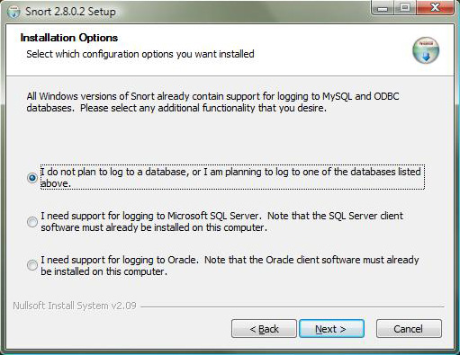
Installing Snort on Windows
Get the Snort installer exe file and start installation.
Accept the snort license agreement.
Snort is capable of storing the logs either in a SQL Database or in a ORACLE database. If you have one and plan to store snort logs in it select one of the last two actions else select the first action.
This will store the logs in files.

Slide 33
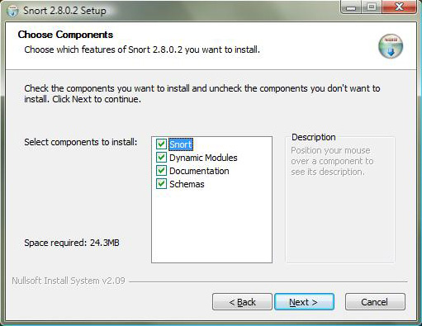
On the following screen select the snort components to be installed.
It is a good idea to select all the components and it requires only around 24 MB.

Slide 34
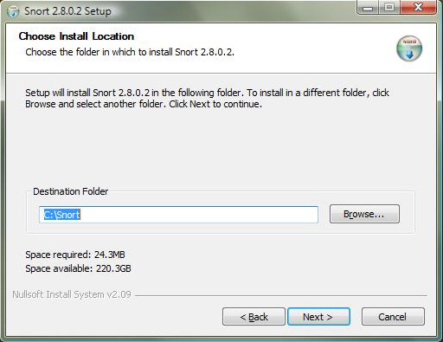
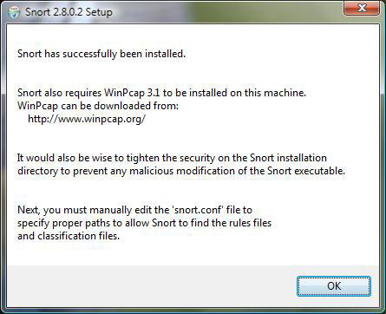
Next installation option allows to select the snort installation location.
Default location is c:\snort which can be changed.
When clicked next in the above
screen a window showing installation
progress bar appears. When the
Installation is over clicking next gives
the window shown on the right hand
side.

Slide 35
As stated in the last window snort requires a program called WinPcap.
WinPcap is Windows Packet Capture Library.
It provides certain types of network access that Snort needs for its IDS and packet sniffing functions.
Visit the WinPcap Web site mentioned on the last screen.
Select the latest stable download
The download includes a Windows installer you can start by double-clicking.
Installing WinPcap is very easy.
Snort is mostly a command based tool.
All the snort commands are stored in the bin directory under the snort installation directory.
Thus it is a good idea to add this directory in the PATH variable.
Now executing the command snort provides help.
Now snort is ready for use.

Slide 36
Snort can be used as a packet sniffer.
To make snort work as a packet sniffer issue the following command.
Snort -v
However administrative privilege is required for the user who executes the above command.
Press Ctrl + C to terminate snort output as snort will display sniffed packet information continuously.
The command snort -l LogDir will make the snort work as a packet sniffer but the command output is not displayed to the screen but logged to a file within the specified directory.
Again Ctrl + C will terminate snort.
Because the types of intrusions change rapidly, Snort has a set of rules that you can download from the Snort site that details these intrusions and allows Snort to look for them.
The rules change frequently, keeping up with (or at least trying to) the various types of attacks that are going on.

Slide 37
Additionally, snort needs to be configured for what to do when it senses an attack.
The command snort -A, which puts Snort in alert mode.
A modification to snort.conf file is required to make snort work as IDS according to the requirements.
A GUI based front end for snort is available which is called IDSCENTER.
It can be downloaded from http://www.engagesecurity.com/downloads/#idscenter
It makes the snort configuration more easy.
It requires a snort version of 2.x or higher and similarly winpcap version 2.3 or higher.

