Slide 1

Performance Monitoring Tool: Collectl

Slide 2
Performance Monitoring Utilities: Need & Issues
Once you have a cluster operating, typically the next thing you want to do is monitor the cluster.
For example, are all the compute nodes operating correctly? Is the network and storage operating correctly, as well as other components?
Linux system admins often need to monitor system resources like cpu, memory, disk, network etc. to make sure that the system is in a good condition. And there are plenty of commands like iotop, top, free, htop, sar etc to do the task.
There are a number of times in which you find yourself needing performance data. These can include benchmarking, monitoring a system's general heath or trying to determine what your system was doing at some time in the past

Slide 3
Performance Monitoring Utilities: Need & Issues
Depending on what you're doing, you often end up using different tools, each designed for that specific situation.
Most of the monitoring tools focus on a small set of statistics, format their output in only one way, run either interactively or as a daemon but not both.

Slide 4
Collectl

Slide 5
Collectl :
Collect for linux
An advanced All-in-One Performance Monitoring Tool for Linux
Is a very nice, feature rich command-line utility that can be used to collect performance data that describes the current system status.
You can choose to monitor any of a broad set of subsystems which currently include cpu, disk, inodes, infiniband, lustre, memory, network, nfs, processes, sockets and tcp
Getting collectl :
yum install collectl
Web : http://sourceforge.net/projects/collectl/

Slide 6
Collectl Features :
It can run interactively, as a daemon or both.
It can display the output in many formats.
It has the ability to monitor almost any subsystem.
It can play the role of many other utilities such as ps, top, iotop, vmstat.
It has the ability to record and playback the captured data.
It can export the data in various file formats. (this is very useful when you want to analyse the data with external tools).
It can run as a service to monitor remote machines or an entire server cluster.
It can display the data in the terminal, write to a file or a socket (Default socket port : 2655)

Slide 7
Using Collectl (Brief Subsystem):
b - buddy info (memory fragmentation)
c - CPU
d - Disk
f - NFS V3 Data
i - Inode and File System
j - Interrupts
l - Lustre
m - Memory
n - Networks
s - Sockets
t - TCP
x - Interconnect
y - Slabs (system object caches)

Slide 8
Using Collectl (Summary Subsystem):
C – CPU
D - Disk
E - Environmental data (fan, power, temp), via ipmitool
F - NFS Data
J - Interrupts
L - Lustre OST detail OR client Filesystem detail
N - Networks
T - 65 TCP counters only available in plot format
X - Interconnect
Y - Slabs (system object caches)
Z - Processes

Slide 9
To change the subsystems being reported on, use -s and to change the interval, use -i
The best way to learn how to use command-line tools is to practice as much as possible

Slide 10
Collectl Modes :
Mainly operates in one of the 3 modes
Mode depends on which combination of switches are selected
1) Display Mode
Display to stdout
The most basic mode, which you get if you don't select one of the other 2
Eg :
collectl –sm
Collectl -sC

Slide 11
Collectl Modes :
2) Record Mode
specified by the -f switch
data is written in real-time
often used when running a test of a limited duration from a couple of minutes to several hours or more
Example : collectl –c 5 –f /tmp/DATA
When run as a deamon via ”service collectl start” data will be written to /var/log/collectl by default.
When collectl is not being run as a daemon, the default sampling rate is 1 second else it is 10 seconds.

Slide 12
3) Playback Mode
You need a data file
selected with -p, data is read from a file that was generated in record mode at an earlier time
You can playback a subset of data by inclusion of the -s switch
You can select a subset of the time period with --from and –thru
Examples :
collectl -sc -p /tmp/DATA/ibrouter-20190604-105019.raw.gz

Slide 13
Playback Between 2 Time Periods
collectl -oTm -p /tmp/DATA/ibrouter-20190604-123135.raw.gz --from 12:31:55-2:31:57
collectl -p /tmp/DATA/ibrouter-20190604-123135.raw.gz --from 11:02 --thru 11:05 -sN'

Slide 14
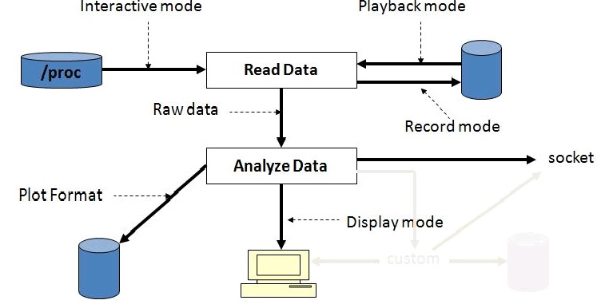
Collectl Modes :

Slide 15
Collectl One Liners :
collectl -scmd -oT
collectl -sZ -i5:5
collectl -P
Network Statistics
~pankajd/lectures/collectl-4.1.0/collectl –sN
NFS Statistics
~pankajd/lectures/collectl-4.1.0/collectl –sfF

Slide 16
Collectl One Liners
Infiniband Statistics
  ~pankajd/lectures/collectl-4.1.0/collectl –sx
Lustre Data :
  Collectl –sL –oTm
Overall :
  Collectl --all –verbose
  collectl --all --verbose --home

Slide 17
On multiple Nodes (Clusterwide) :
If an application was leaking memory when it ran but there was no easy way to observe all the memory on all the nodes at the same time
It has always been easy to observe all of these types of behaviors with collectl one node at a time
But observing cluster-wide activity in real-time ????

Slide 18
Colmux
colmux is a collectl multiplexor, which allows one to collect data from multiple systems and treat it as a single data stream, essentially extending collectl's functionality to a set of hosts rather than a single one.
Colmux runs in 2 distinct modes: Real-Time and Playback.
In real-time mode, colmux actually communicates with instances of collectl running on remote systems which in turn are collecting real-time performance metrics.
In playback mode, colmux also communicates with a remote copy of collectl but in this case collectl is playing back a data file collected some time in the past.

Slide 19
Colmux :
Example :
~pankajd/lectures/collectl-4.1.0/colmux -addr 'ycn[100-105]' -command "-sm"
Note : Colmux requires password less ssh between it and all hosts it is monitoring
“Just a bird's view of this amazing tool collectl”

Slide 20
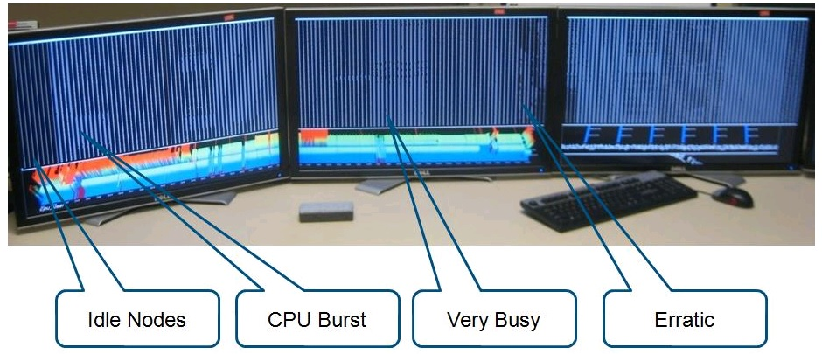
CPU load on a large cluster which is so wide it takes 3 monitors to display it all

Slide 21
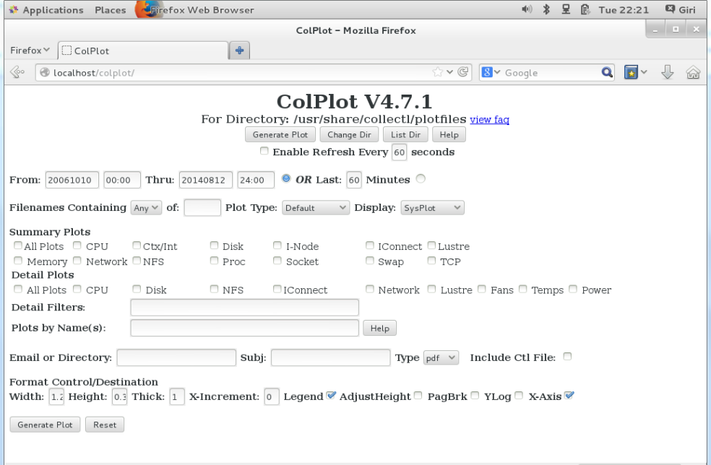
COLPLOT
Collectl supports saving data in plot format - space separated fields - through the use of the -P switch
COLPLOT is nothing more than a script that has intimate knowledge of collectl plot file and directory format

Slide 22
Session 2

Slide 23
Theoretical Peak performance
Peak performance is what the system is theoretically able to deliver
Performance of a supercomputer is measured in floating-point operations per second (FLOPS)
Peak theoretical performance of a node :
Node performance in GFlops = (CPU speed in GHz) x (number of CPU cores) x (CPU instruction per cycle)
Peak theoretical performance of a system :
Peak theoretical performance of a node* No. of nodes

Slide 24
Theoretical Peak performance
Theoretical peak performance is :
Speed that vendor is guaranteed never to exceed
The computational speed of light of the system
The fastest a machine can run without software or data

Slide 25
Top 500
The TOP500 project ranks and details the 500 most powerful non-distributed computer systems in the world.
The project was started in 1993 and publishes an updated list of the supercomputers twice a year.
The project aims to provide a reliable basis for tracking and detecting trends in high-performance computing and bases rankings on HPL
Currently, the China made Sunway TaihuLight in the People's Republic of China (PRC) is the world's most powerful and fastest supercomputer, reaching 93.014 petaflops on the LINPACK*
Reference :https://www.top500.org/

Slide 26
Rmax and Rpeak
In high-performance computing, Rmax and Rpeak are scores are used to rank supercomputers based on their performance using the LINPACK Benchmark.
A system's Rmax score describes its maximal achieved performance
The Rpeak score describes its theoretical peak performance.
The peak performance is the maximal theoretical performance a computer can achieve, calculated as the machine's frequency, in cycles per second, times the number of operations per cycle it can perform
The actual performance (Rmax) will always be lower than the peak performance

Slide 27
HPC Efficiency
HPC efficiency is a measure (percentage) of the actual performance of a HPC system against its theoretical peak performance.
Efficiency = Actual Performance GFLOPS / Theoretical Peak Performance GFLOPS
FLOPS (Floating Point Operations per Second) is specific to the kind of CPU.
To increase the HPC efficiency, increase the actual performance. This can be done by tweaking compilers, math libraries, shared/distributed memory, numactl, kernel parameters, etc.

Slide 28

Top500 Certificate

Slide 29
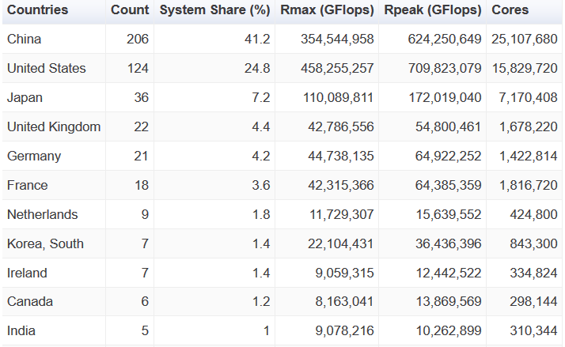
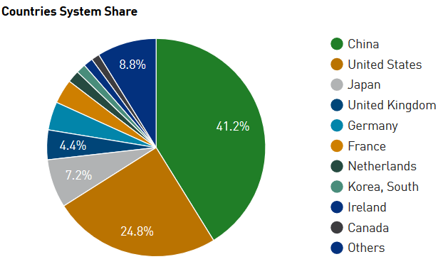
Distribution of supercomputers in the TOP500 list by country
The 51st edition of the TOP500 list saw USA leading, followed by China for supercomputing supremacy. China has 206 systems, US has 124 systems and India has 5 systems in TOP500 List. Compute power grown from 425 MFLOP/S to 122.3 PFLOP/S

Slide 30
Need of Green 500
The focus of performance-at-any-cost computer operations has led to the emergence of supercomputers that consume vast amounts of electrical power and produce so much heat.

Slide 31
Green 500
To address this inequity, the Green500 List was created to provide a complementary view to the TOP500 (since November 2007)
The Green500 list, ranks the top 500 supercomputers in the world by energy efficiency
The Green500 list puts a premium on energy-efficient performance for sustainable supercomputing.
Refernce : https://www.top500.org/green500/

Slide 32
Green 500
The Green500 list ranks computers from the TOP500 list of supercomputers in terms of energy efficiency, typically measured as LINPACK FLOPS per watt
The “performance per watt” metric is defined as
PPW = Performance/Power
GFLOPS Per Watt = Rmax (in GFLOPS)/ P (Rmax) (in Watt)
Actual list shows MFLOPS/ Watt
For PARAM Yuva II : 1850.2 MFLOPS/W

Slide 33

Green500 Certificate :

Slide 34
HPC Efficiency
HPC efficiency is a measure (percentage) of the actual performance of a HPC system against its theoretical peak performance.
Efficiency = Actual Performance GFLOPS / Theoretical Peak Performance GFLOPS
FLOPS (Floating Point Operations per Second) is specific to the kind of CPU.
To increase the HPC efficiency, increase the actual performance. This can be done by tweaking compilers, math libraries, shared/distributed memory, numactl, kernel parameters, etc.

Slide 35
Sustained Performance
Defined as the highest GFLOPS rate that actual program can achieve doing something recognizably useful for certain length of time
It essentially provide an upper bound on what a programmer may be able to achieve
Efficiency rate = The achieved (sustained) performance divided by the peak performance
Benchmarks are used to measure and to predict sustained performance of parallel computer systems.

Slide 36
Benchmarking : Need
Not all people using HPC clusters are familiar with the hardware, operating system and low-level system libraries of which the cluster depends.
Thus there is a need of a tool that allows the measurement process to be practical for cluster administrators or even to non-specialized users (i.e., physicists, chemists, engineers, etc.).

Slide 37
Performance: Benchmarks
Benchmark
A benchmark is a performance testing program that supposedly captures processing and data movement characteristics of a class of applications.
Benchmarking helps us quantify the ability of high-performance computing
Benchmarks are used to reveal their architectural weak and strong points.
Benchmarks are significantly more reliable than peak performance numbers.

Slide 38
Benchmark Suite / Benchmark family
A benchmark suite is a set of benchmark programs together with a set of specific rules governing the test conditions and procedures
This includes the tested platform environment, input data, the output data results, and the performance metrics
A benchmark family is a set of benchmark suites. A benchmark family gives good idea on performance and Scalability of a parallel system.
Benchmarks can be full-fledged applications or just kernels, which are much smaller and simple programs extracted from the applications which maintain characteristics

Slide 39
High Performance LinPack (HPL) :Need
Statistics on high-performance computers are of major interest to manufacturers and potential users.
The aim is to approximate how fast a computer will perform when solving real problems
The performance of a computer is a complex issue that depends on many interconnected variables.
Nevertheless, the LINPACK benchmark performance provides a good correction over the peak performance provided by the manufacturer
The High Performance Linpack (HPL) benchmark is a well-known Linpack implementation and it is designed for the homogeneous clusters

Slide 40
What is HPL
HPL measure how fast a computer solves a dense n by n system of linear equations Ax = b
i.e. solves a (random) dense linear system in double precision (64 bits) arithmetic on distributed-memory computers.
The performance measured by the LINPACK benchmark consists of the number of 64-bit floating-point operations, a computer can perform per second, also known as FLOPS.
The HPL package provides a testing and timing program to quantify the accuracy of the obtained solution as well as the time it took to compute it.

Slide 41
Use of HPL
To provide data for Top500, Green500 list
The LINPACK benchmark performance can provide a good correction over the peak performance provided by the manufacturer
Measure the performance of standalone system and HPC cluster
Checking health of the system

Slide 42
Installation and Configuration of HPL
Install from Source
Configure HPL.dat

Slide 43
Tuning HPL (HPL.dat):
After having built the executable hpl/bin/<arch>/xhpl, modify the input data file HPL.dat.
This file should reside in the same directory as the executable hpl/bin/<arch>/xhpl.
This file contains information about the problem sizes, machine configuration, and algorithm features to be used by the executable.
It is 31 lines long

Slide 44
Tuning HPL (HPL.dat):
Description of the HPL.dat File
Line 1: (unused) Typically one would use this line for its own good. For example, it could be used to summarize the content of the input file. By default this line reads: HPL Linpack benchmark input file
Line 2: (unused) same as line 1. By default this line reads: Innovative Computing Laboratory, University of Tennessee
Line 3: the user can choose where the output should be redirected to. In the case of a file, a name is necessary, and this is the line where one wants to specify it. Only the first name on this line is significant. By default, the line reads:HPL.out output file name (if any). This means that if one chooses to redirect the output to a file, the file will be called "HPL.out". The rest of the line is unused, and this space to put some informative comment on the meaning of this line.

Slide 45
Tuning HPL (HPL.dat):
Line 4: This line specifies where the output should go. The line is formatted, it must begin with a positive integer, the rest is insignificant. 3 choices are possible for the positive integer, 6 means that the output will go the standard output, 7 means that the output will go to the standard error. Any other integer means that the output should be redirected to a file, which name has been specified in the line above.
This line by default reads:
6 device out (6=stdout,7=stderr,file)
which means that the output generated by the executable should be redirected to the standard output.

Slide 46
Tuning HPL (HPL.dat):
Line 4: This line specifies where the output should go. The line is formatted, it must begin with a positive integer, the rest is insignificant. 3 choices are possible for the positive integer, 6 means that the output will go the standard output, 7 means that the output will go to the standard error. Any other integer means that the output should be redirected to a file, which name has been specified in the line above.
This line by default reads:
6 device out (6=stdout,7=stderr,file)
which means that the output generated by the executable should be redirected to the standard output.

Slide 47
Tuning HPL (HPL.dat):
Line 5: This line specifies the number of problem sizes to be executed. This number should be less than or equal to 20. The first integer is significant, the rest is ignored.
If the line reads:3 # of problems sizes (N) this means that the user is willing to run 3 problem sizes that will be specified in the next line.
Line 6: This line specifies the problem sizes one wants to run. Assuming the line above started with 3, the 3 first positive integers are significant, the rest is ignored.
For example:3000 6000 10000 Ns means that one wants xhpl to run 3 (specified in line 5) problem sizes, namely 3000, 6000 and 10000.

Slide 48
Tuning HPL (HPL.dat):
NS (Line 6):
Important parameter “N”, which is the size of your problem, and usually the goal is to find the largest problem size that would fit in your system’s memory.
Choose “N” to be close to your total memory size (double precision 8 bytes), but don’t make it equal to 100% of the memory size since some of the memory is consumed by the system, so choose something like 80% of the size of the total memory size.
If you choose a small value for “N”, this will result in not enough work performed on each CPU and will give you bad results and low efficiency. If you choose a value of “N” exceeding your memory size, swapping will take place and the performance will go down
N=sqrt ((Memory Size in Gbytes * 1024 * 1024 * 1024 * Number of Nodes) /8) * 0.80

Slide 49
Tuning HPL (HPL.dat):
Line 7:
This line specifies the number of block sizes to be run. This number should be less than or equal to 20. The first integer is significant, the rest is ignored. If the line reads:
5 # of NBs this means that the user is willing to use 5 block sizes that will be specified in the next line.
Line 8:
This line specifies the block sizes one wants to run. Assuming the line above started with 5, the 5 first positive integers are significant, the rest is ignored.
For example:80 100 120 140 160 NBs means that one wants xhpl to use 5 (specified in line 7) block sizes, namely 80, 100, 120, 140 and 160.
"good" block sizes are almost always in the [32 .. 256] interval
subset of N to distribute across nodes

Slide 50
HPL.dat
“N”, which is the size of your problem (double precision 8 bytes)
N = sqrt((Memory Size in Gbytes * 1024 * 1024 * 1024 * Number of Nodes) /8) * 0.90
“NB”, which is the block size in the grid
Note : Usually block sizes giving good results are within the [96,104,112,120,128, …, 256] range
N should be NB aligned

Slide 51
Tuning HPL (HPL.dat):
Line 10: This line specifies the number of process grid to be runned. This number should be less than or equal to 20. The first integer is significant, the rest is ignored.
If the line reads:2 # of process grids (P x Q) this means that you are willing to try 2 process grid sizes that will be specified in the next line.
Line 11-12:
2 Ps
8 Qs
(P * Q) is the size of your grid which is equal to the number of processors your cluster has. In the 512 nodes cluster input file, the P and Q product is 4096 which is basically the number of processors we have (512*8).
When picking these two numbers, try to make your grid as “square” as possible in shape. The HPL website mentions that best practice is to have it close to being a “square”, thus P and Q should be approximately equal, with Q slightly larger than P.

Slide 52
Tuning HPL (HPL.dat):
“Picking these values for the input file is the tricky part when running HPL and you will have to try several combinations until you are satisfied with the results, it is basically a skill that you master with practice”

Slide 53
Macro Benchmarks
A macro benchmark measures the performance of computer system as a whole.
It compares different systems with respect to an application class, and is useful for the system BUYER.
However, macro benchmarks do not reveal why a system performs well or badly.
Ex : HPCC

Slide 54
Micro Benchmarks
Micro benchmarks measure a specific aspect of computer system.
CPU speed
Memory speed
I/O speed
Operating system performance
Networking
Ex : HPL

Slide 55
hpcc benchmark : Motivation
The performance of complex applications on HPC systems can depend on a variety of independent performance attributes of the hardware.
No single number can reflect overall performance (HPL)
No single test can accurately compare the performance of HPC systems.
The HPC Challenge Benchmark is an effort to improve visibility into this multidimensional space by combining the measurement of several of the attributes into a single program.

Slide 56
HPCC benchmark Components :
The HPC Challenge benchmark consists of basically 7 tests:
HPL - the Linpack TPP benchmark which measures the floating point rate of execution for solving a linear system of equations.
DGEMM - measures the floating point rate of execution of double precision real matrix-matrix multiplication.
STREAM - a simple synthetic benchmark program that measures sustainable memory bandwidth (in GB/s) and the corresponding computation rate for simple vector kernel.
PTRANS (parallel matrix transpose) - exercises the communications where pairs of processors communicate with each other simultaneously. It is a useful test of the total communications capacity of the network.
RandomAccess - measures the rate of integer random updates of memory (GUPS).
FFT - measures the floating point rate of execution of double precision complex one-dimensional Discrete Fourier Transform (DFT).
Communication bandwidth and latency - a set of tests to measure latency and bandwidth of a number of simultaneous communication patterns; based on b_eff (effective bandwidth benchmark).

Slide 57
HPC Challenge Benchmark (HPCC)
The HPC Challenge benchmark test suite stresses not only the processors, but the memory system and the interconnect.
To examine the performance of HPC architectures using kernels with more challenging memory access patterns than HPL
It is a better indicator of how an HPC system will perform across a spectrum of real-world applications.
The HPCC tests provide users with additional information to justify policy and purchasing decisions
To augment the TOP500 list

Slide 58
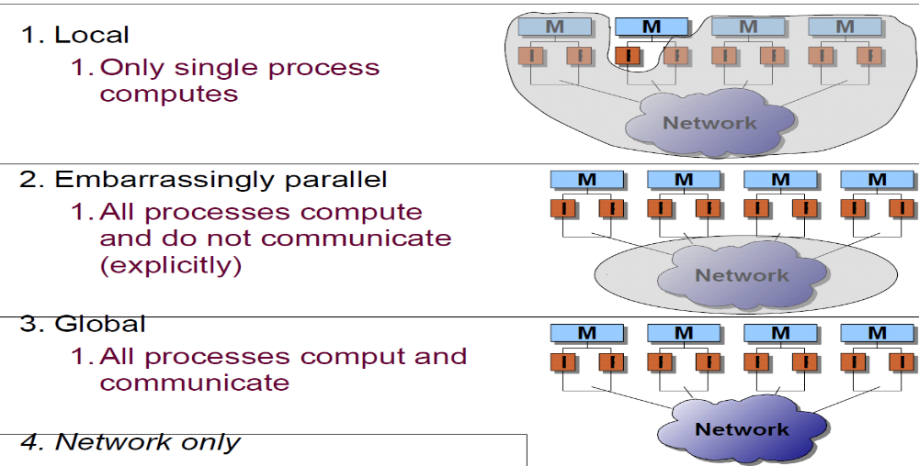
HPCC Testing Scenarios

Slide 59
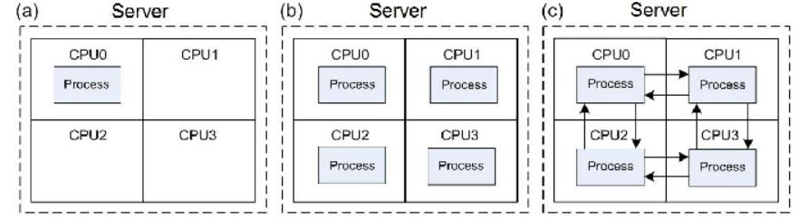
Execution Mode :
a. Single b. Star c. Mpi
HPCC has 3 execution modes: single, star, and mpi.
The single mode executes the HPCC in an only processor; in the star mode, all processors execute separated copies of HPCC without inter-process communication; and in the mpi mode, all processors execute the HPCC in parallel with explicit data communication.
HPCC requires the Message Passing Interface (MPI) and the Basic Linear Algebra System (BLAS)

Slide 60
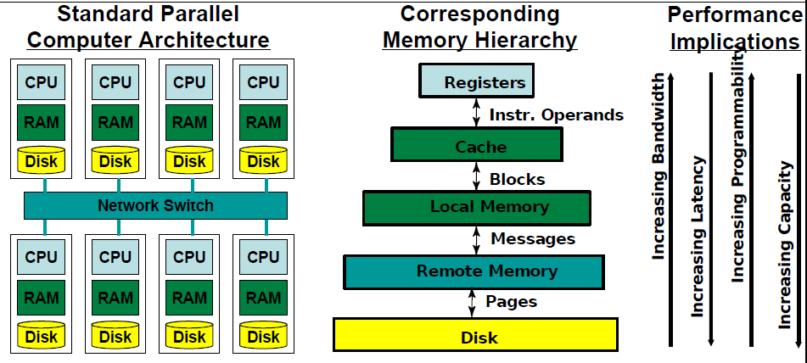
Cluster Architecture and Memory Hierarchy

Slide 61
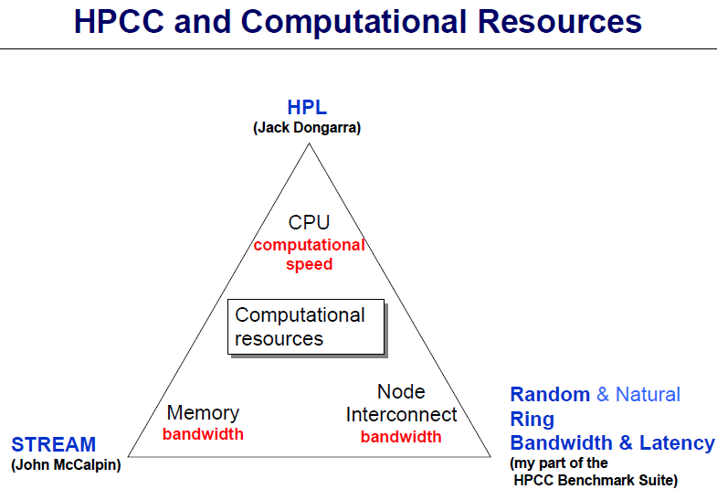

Slide 62
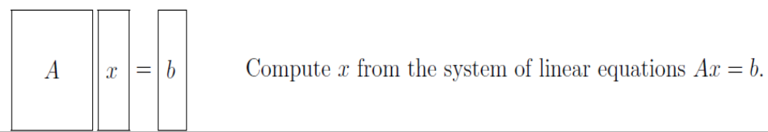
HPL
HPL (High Performance Linpack) is an implementation of the Linpack TPP (Toward Peak Performance) variant of the original Linpack benchmark which measures the floating point rate of execution for solving a linear system of equations. HPL solves a linear system of equations of order n
• Objective: solve system of linear equations
Ax=b, A ∈Rn×n x, b ∈ R
Method: LU factorization with partial row pivoting
•

Slide 63

DGEMM :
DGEMM = Double-precision General Matrix-matrix Multiply
Measures the floating point rate of execution of double precision real matrix-matrix multiplication.
The exact operation performed is
Objective: compute matrix
C <- α AB + βC

Slide 64
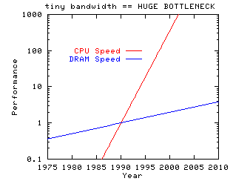
Performance of CPU and Memory
Computer cpus are getting faster much more quickly than computer memory systems.
As this progresses, more and more programs will be limited in performance by the memory bandwidth of the system, rather than by the computational performance of the cpu.

Slide 65
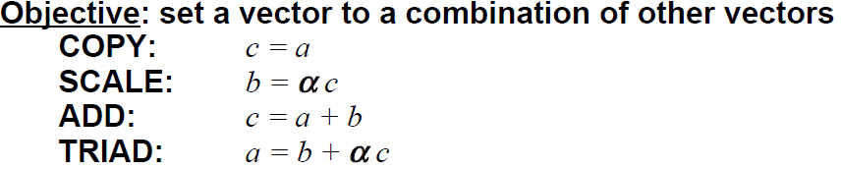
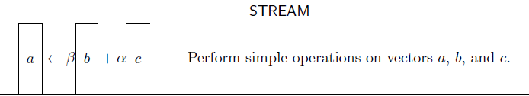
STREAM : Sustainable Memory Bandwidth in High Performance Computers
is a simple benchmark program that measures sustainable memory bandwidth (in Gbyte/s) and the corresponding computation rate for four simple vector kernels:
a,b,c ∈ Rn, α, β ∈ R
β
Method: simple loop that preserves the above order of operations

Slide 66
STREAM
These operations are representative of the ``building blocks'' of long vector operations. The array sizes are defined so that each array is larger than the cache of the machine to be tested, and the code is structured so that data re-use is not possible.
Each of the four tests adds independent information to the results:
``Copy'' measures transfer rates in the absence of arithmetic.
``Scale'' adds a simple arithmetic operation.
``Sum'' adds a third operand to allow multiple load/store ports on vector machines to be tested.
``Triad'' allows chained/overlapped/fused multiply/add operations.

Slide 67
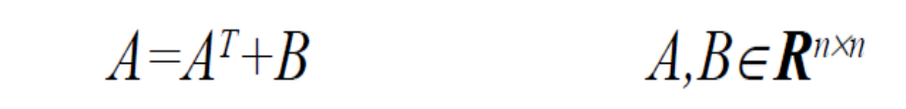
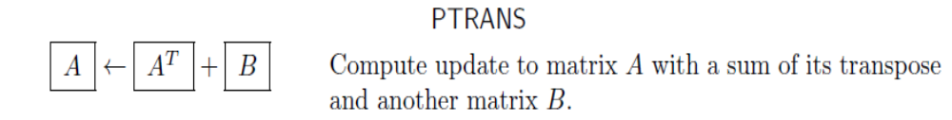
PTRANS (parallel matrix transpose)
Exercises the communications where pairs of processors exchange large messages simultaneously.
a useful test of the total communications capacity of the system interconnect.
The data transfer rate (in Gbyte/s) is calculated by dividing the size of n2 matrix entries by the time it took to perform the transpose.
Allows you to measure the total network transfer capacity of the cluster using large blocks of data, performing a matrix transpose

Slide 68
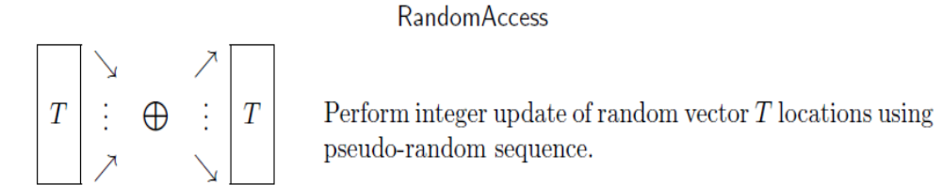
Random Access
Need for a benchmark that discriminates on the basis of random memory access performance.
RandomAccess calculates a series of integer updates to random locations in memory
Randomly updates N element table of unsigned integers, results are reported in Giga Updates Per Second (GUPS)
Randomly updates memory (requires all-to-all communication)
• Stresses interprocessor communication of small messages

Slide 69
Random Access
GUPS (Giga UPdates per Second) is a measurement that profiles the memory architecture of a system and is a measure of performance similar to MFLOPS.
GUPS is calculated by identifying the number of memory locations that can be randomly updated in one second, divided by 1 billion (1e9).
The term "randomly" means that there is little relationship between one address to be updated and the next, except that they occur in the space of 1/2 the total system memory.
An update is a read-modify-write operation on a table of 64-bit words. An address is generated, the value at that address read from memory, modified by an integer operation (add, and, or, xor) with a literal value, and that new value is written back to memory.

Slide 70
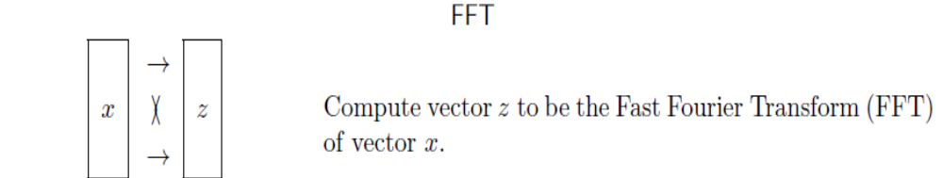
FFT
1D Fast Fourier Transforms an N element complex vector
Results are reported in floating point operations per second (flop/s)
FFT a large complex vector (requires all-to-all communication)
Stresses interprocessor communication of large messages

Slide 71
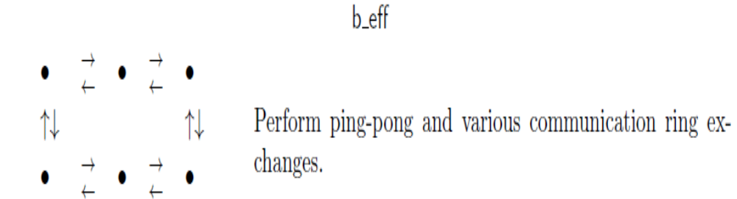
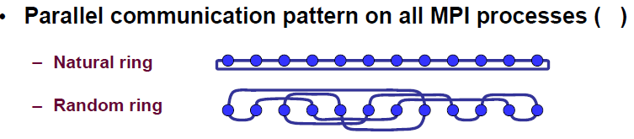
b_eff
b_eff measures effective bandwidth and latency of the interconnect
Objective:
exchange 8 (for latency) and 2000000 (for bandwidth) messages in ping-pong, natural and random ring patterns
• Method: use standard MPI point-to-point routines

Slide 72
b_eff
For measuring latency and bandwidth of parallel communication, all processes are arranged in a ring topology and each process sends and receives a message from its left and its right neighbor in parallel. Two types of rings are reported: a naturally ordered ring (i.e., ordered by the process ranks in MPI_COMM_WORLD), and the geometric mean of ten different randomly chosen process orderings in the ring. The communication is implemented
(a) with MPI standard non-blocking receive and send, and
(b) with two calls to MPI_Sendrecv for both directions in the ring.
Always the fastest of both measurements are used. For benchmarking latency and bandwidth, 8 byte and 2,000,000 byte long messages are used.
With this type of parallel communication, the bandwidth per process is defined as total amount of message data divided by the number of processes and the maximal time needed in all processes

Slide 73
b_eff
The ping pong benchmark is executed on two processes. From the client process a message (ping) is sent to the server process and then bounced back to the client (pong).
MPI standard blocking send and receive is used. The ping-pong patterns are done in a loop. To achieve the communication time of one message, the total communication time is measured on the client process and divided by twice the loop length.
Additional startup latencies are masked out by starting the measurement after one non-measured ping-pong. The benchmark in hpcc uses 8 byte messages for benchmarking the communication latency.
The benchmark is repeated 5 times and the shortest latency is reported. To measure the communication bandwidth, 2,000,000 byte messages with loop length 1 are repeated twice.

Slide 74
Gup/s is short for Giga updates per second.
An update is the basic operation performed by RandomAccess benchmark: read an integer from memory, change it in the processor, and write it back to memory.
The location of read and write is the same by each time is selected at random

Slide 75
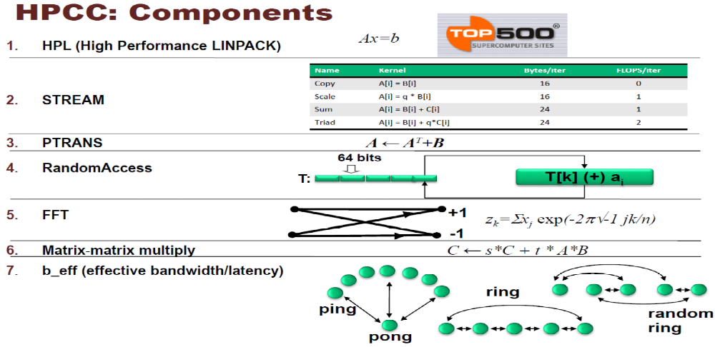
HPCC Benchmark

Slide 76
Application Benchmarking
Motivation
How to run HPC Application

Slide 77
Thank You

Slide 78
Extra

Slide 79
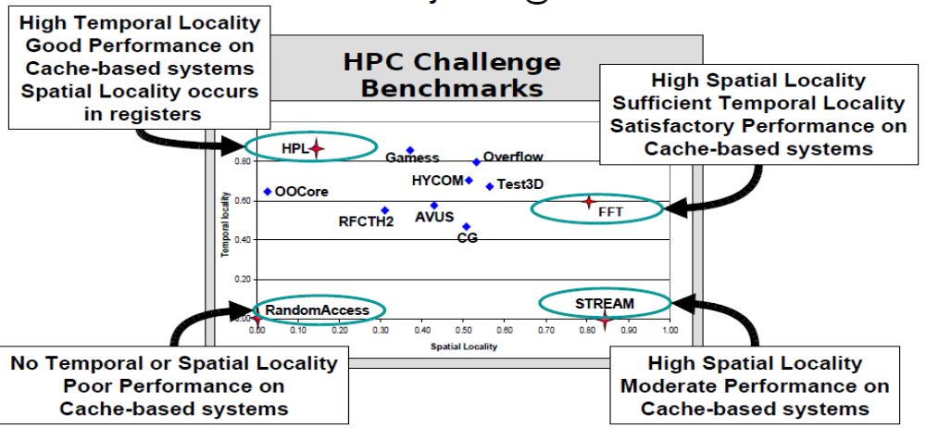
HPCC Benchmark

Slide 80
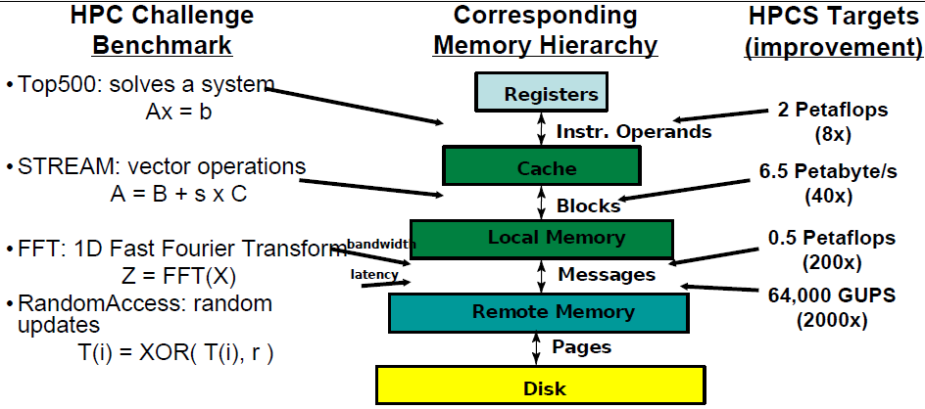
HPCC : performance Targets

