Slide 1
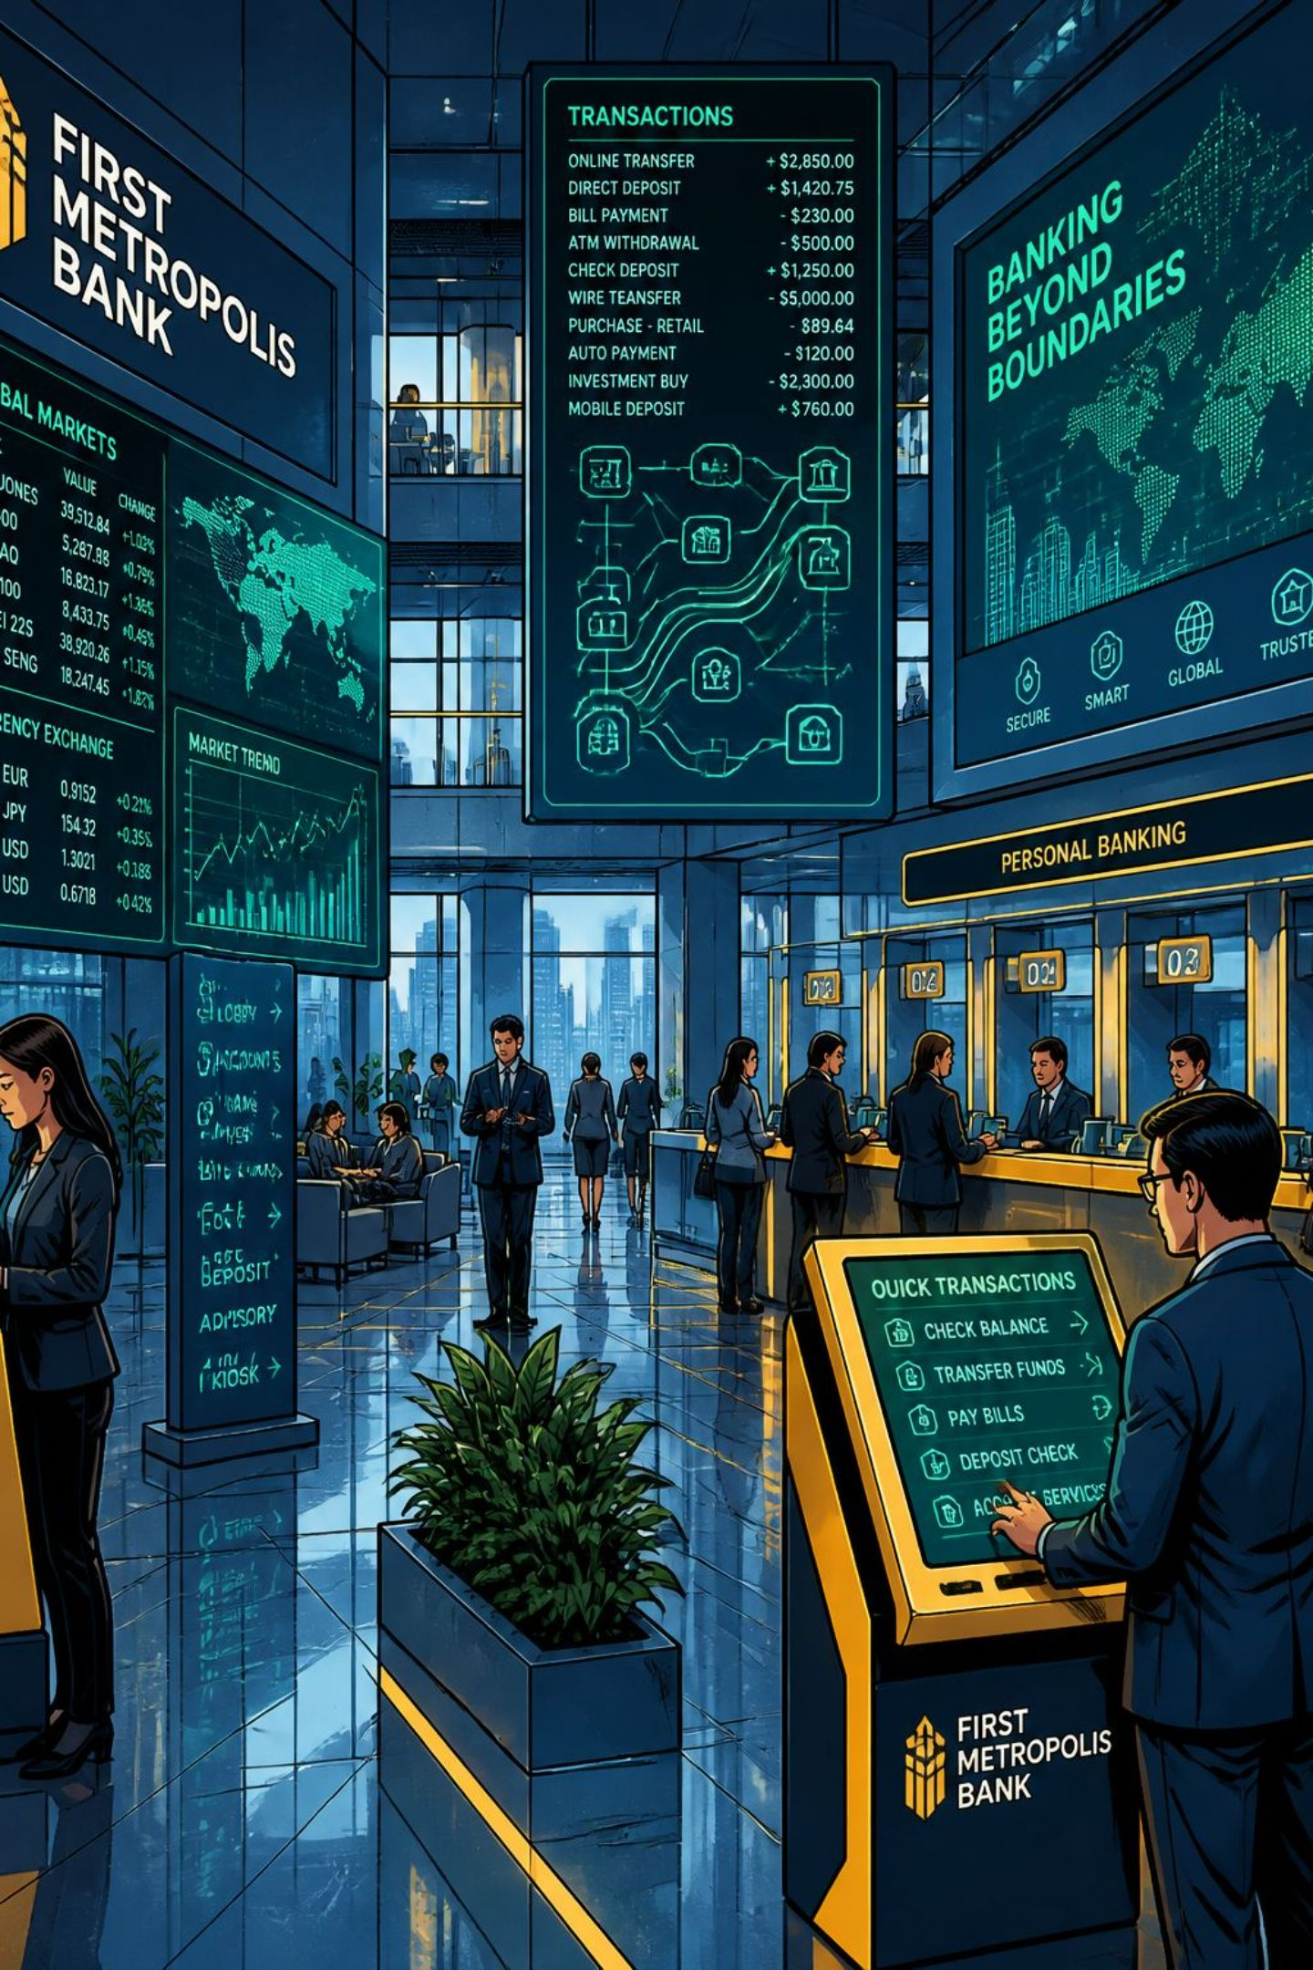
Banking Transaction Analysis using Python
A structured Exploratory Data Analysis (EDA) project uncovering spending patterns, customer demographics, and transaction behavior — built entirely in Python.
DATA SCIENCE
PYTHON
EDA

Slide 2

Project Overview
This project performs Exploratory Data Analysis on a real-world banking transactions dataset. By combining data cleaning, visualization, and statistical analysis, it reveals insights about customer behavior, transaction channels, and account activity.
Clean
Handle missing values, duplicates, and data quality issues
Explore
Uncover transaction trends, distributions, and correlations
Visualize
Generate charts, heatmaps, and boxplots for pattern discovery
Insight
Translate findings into actionable business intelligence

Slide 3
Dataset at a Glance
File: bank_transactions_data_2.csv — 16 columns covering transaction metadata, customer demographics, and account behavior.
Transaction Fields
Customer & Account Fields
TransactionID — Unique identifier
AccountID — Customer account
TransactionAmount — Value per transaction
TransactionDate — Timestamp
TransactionType — Credit or Debit
Channel — ATM, Online, Branch
Location — Geographic point
CustomerAge — Age of customer
CustomerOccupation — Job category
AccountBalance — Current balance
LoginAttempts — Security indicator
TransactionDuration — Processing time
DeviceID & IPAddress — Device & network

Slide 4
Project Objectives
A focused set of analytical goals guiding the full EDA workflow.
01
02
Data Cleaning
Transaction Analysis
Handle missing values, remove duplicates, validate data types
Analyze trends, compare Credit vs. Debit, identify high-value transactions
03
04
Demographic Profiling
Visualization & Insights
Segment by age, occupation, location, and channel
Build charts, heatmaps, and boxplots to communicate findings

Slide 5
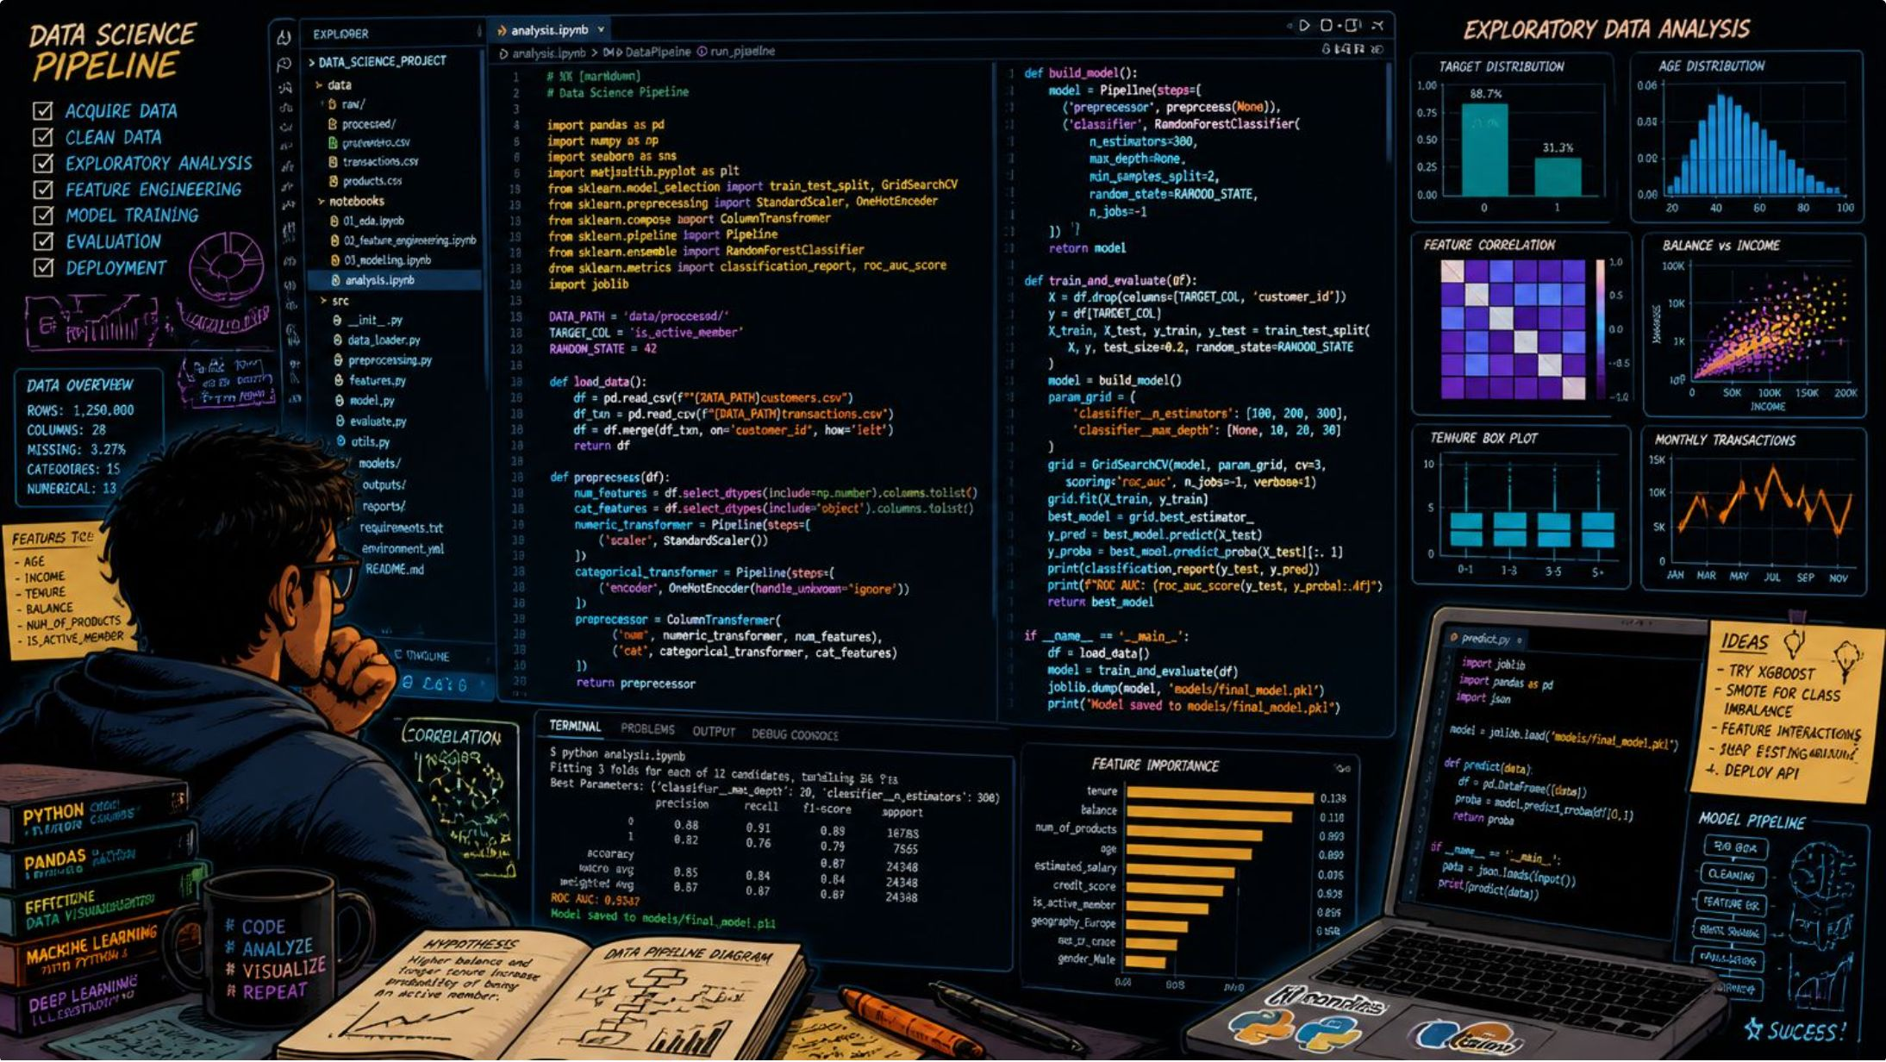

Technologies Used
Python Data Stack
This project leverages the core Python data science ecosystem, all orchestrated within a Jupyter Notebook for interactive, reproducible analysis.
Pandas & NumPy
Matplotlib & Seaborn
Jupyter Notebook
Data manipulation, transformation, and numerical computation
Statistical visualizations, distribution plots, and correlation heatmaps
Interactive environment for iterative exploration and documentation

Slide 6
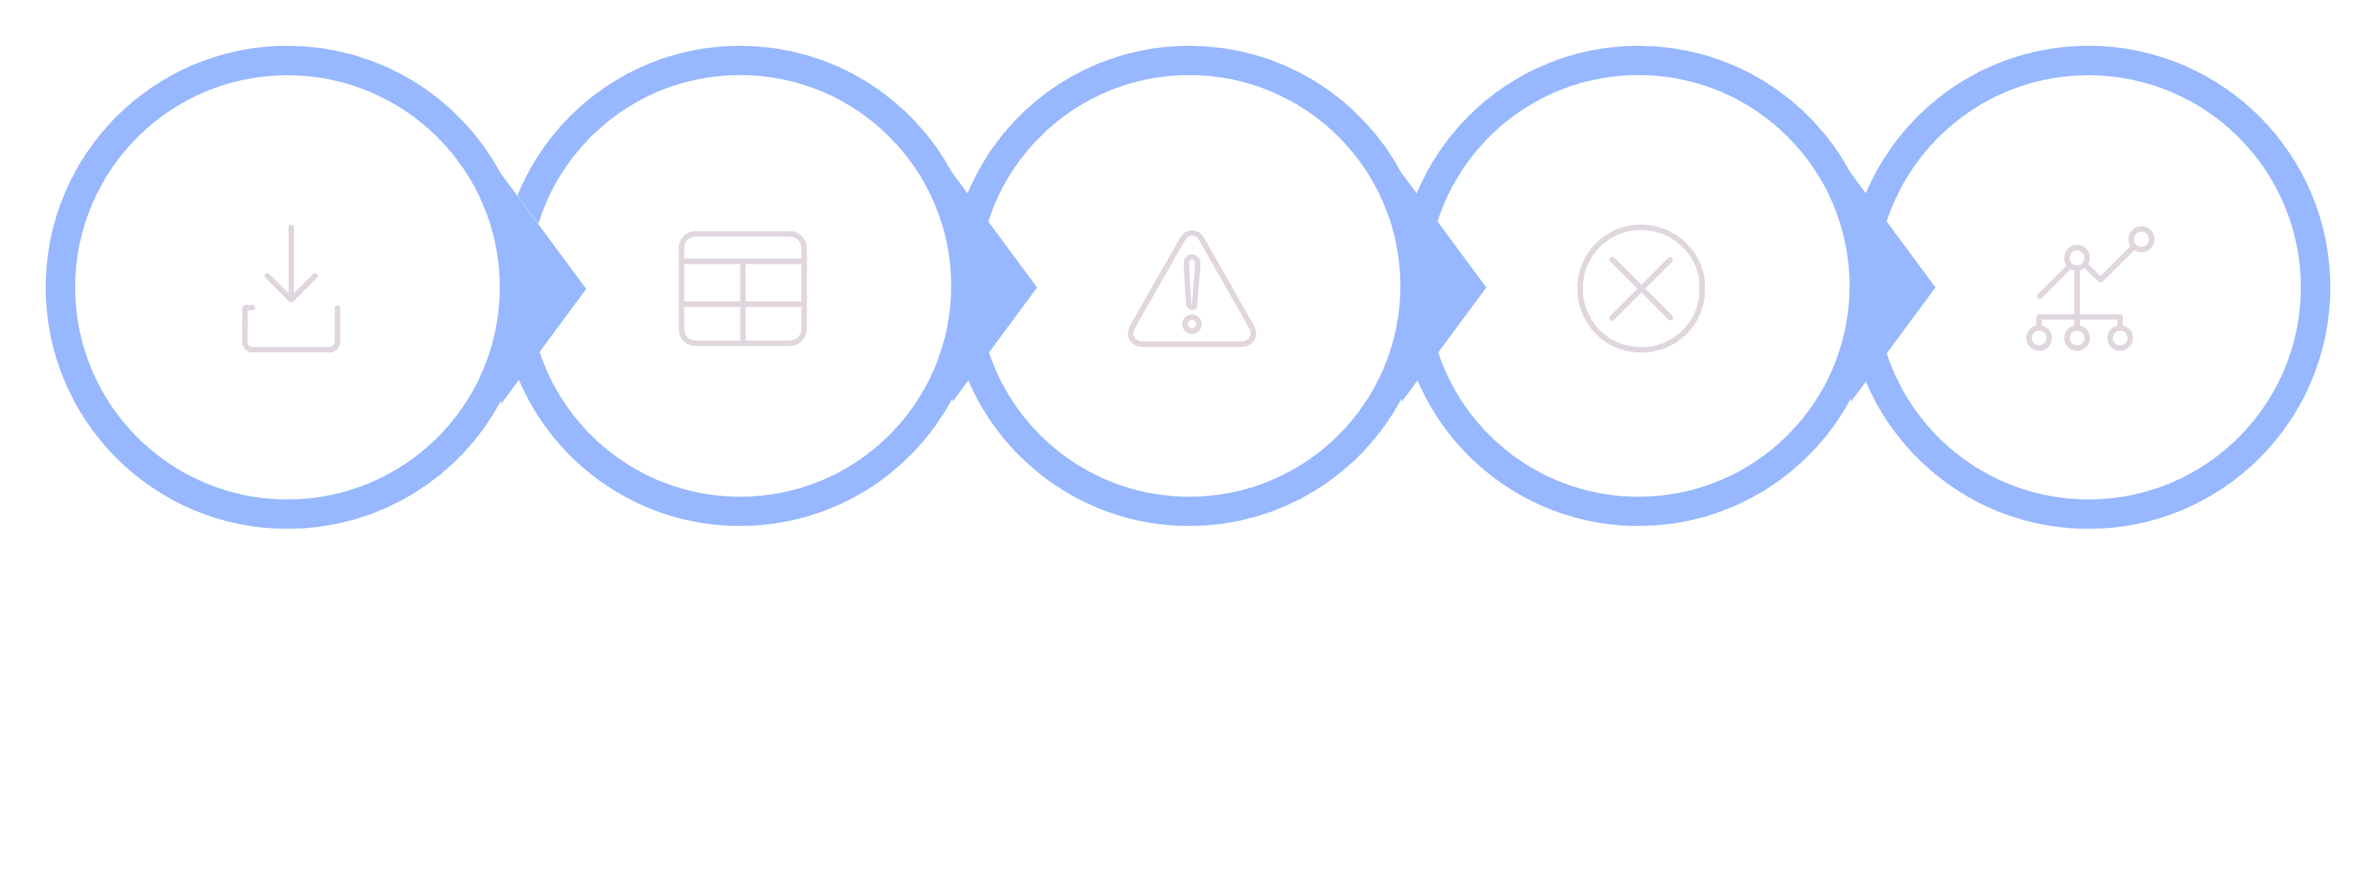
EDA Workflow
A systematic six-step process transforms raw transaction data into validated, insight-ready datasets.
Load Dataset
Inspect Types
Handle Missing
Remove Duplicates
Summary & Correlation
Each step builds on the previous — ensuring data quality before any visualization or modeling begins. Correlation analysis and outlier detection are critical for banking data, where anomalies may signal fraud or system errors.

Slide 7
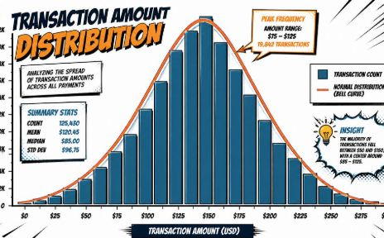
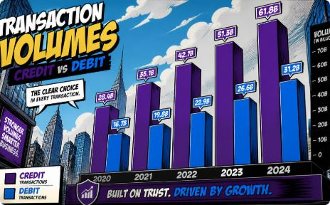
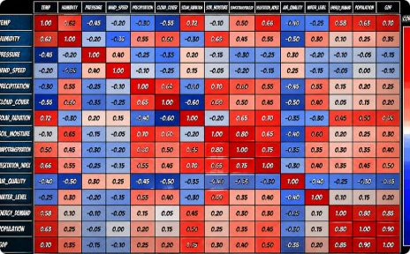
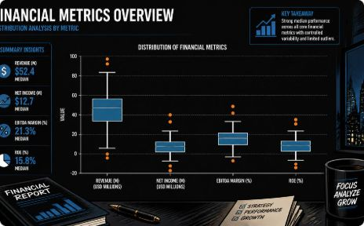
Visualizations Included
Nine visualization types cover every dimension of the dataset — from distributions to correlations.
Amount Distribution
Credit vs. Debit
Correlation Heatmap
Outlier Boxplots
Histograms reveal skewness and transaction value patterns
Side-by-side comparison of transaction type volumes
Detect unusual transaction amounts and login patterns
Variable relationships and multicollinearity at a glance

Slide 8
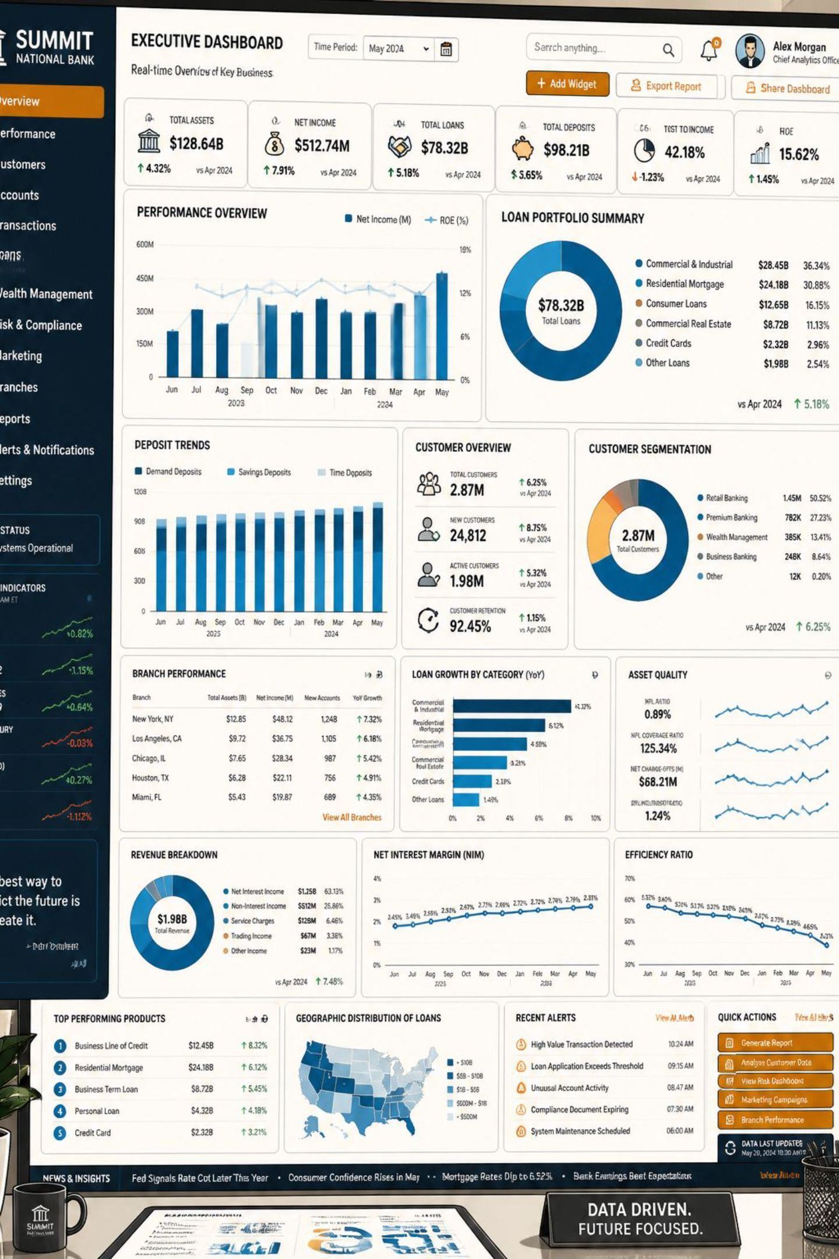
Key Insights Uncovered
Channel Preference
Identify the most-used channel (ATM, Online, Branch) and usage by demographic
High-Value Customers
Surface accounts with elevated balances and unusual transaction volumes
Occupation Patterns
Compare average transaction amounts across customer occupations
Security Signals
Analyze login attempt patterns to flag potentially risky account activity

Slide 9

Getting Started
Installation Steps
Sample Code
Clone the repository
Navigate to the project folder
Install dependencies
Launch Jupyter Notebook
import pandas as pd
df = pd.read_csv("bank_transactions_data_2.csv")
print(df.head())
print(df.info())
print(df.describe())
git clone https://github.com/sweetideveloper/Banking-Transaction-Analysis.git
cd Banking-Transaction-Analysis
pip install -r requirements.txt
jupyter notebook
These three commands load the dataset, inspect structure, and generate statistical summaries — the essential first steps of any EDA.
Libraries: pandas, numpy, matplotlib, seaborn, jupyter

Slide 10


What's Next & Project Info
Future Improvements
About the Author
Fraud Detection
Sweeti Yuonate — Data Analyst & Python Developer
ML models to flag anomalous transactions
GitHub: sweetideveloper
LinkedIn: sweetideveloper
Customer Segmentation
Cluster customers by behavior and demographics
⭐ Found this project helpful? Star the repository on GitHub!
Interactive Dashboard
Contributions welcome — fork, branch, commit, and submit a Pull Request.
Streamlit or Power BI for live exploration
Real-Time Analytics
SQL integration and streaming data pipelines

