Slide 1
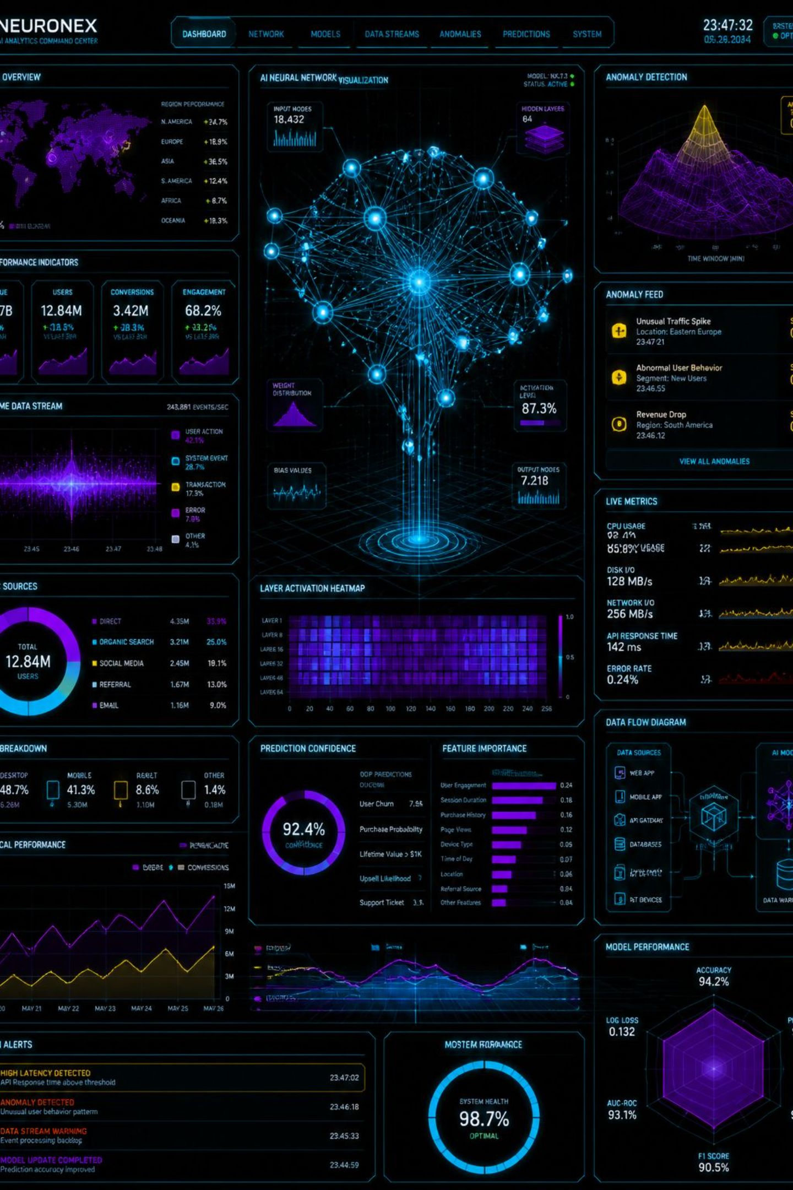
Groq CSV AI Agent
Chat with your CSV data and generate AI-powered visualizations — powered by Groq Llama 3.3 70B and LangChain. Fast, interactive, and built for data professionals.
PYTHON
GROQ
LANGCHAIN
STREAMLIT

Slide 2

What Can It Do?
💬 Natural Language Chat
Ask questions about your CSV data in plain English — no SQL required.
🧠 AI-Powered Analysis
Groq's Llama 3.3 70B interprets your data and generates intelligent insights.
📊 Auto Visualizations
Matplotlib and Seaborn charts are generated automatically based on your query.
⚡ Fast & Interactive
Streamlit UI delivers a responsive, real-time experience for rapid exploration.

Slide 3
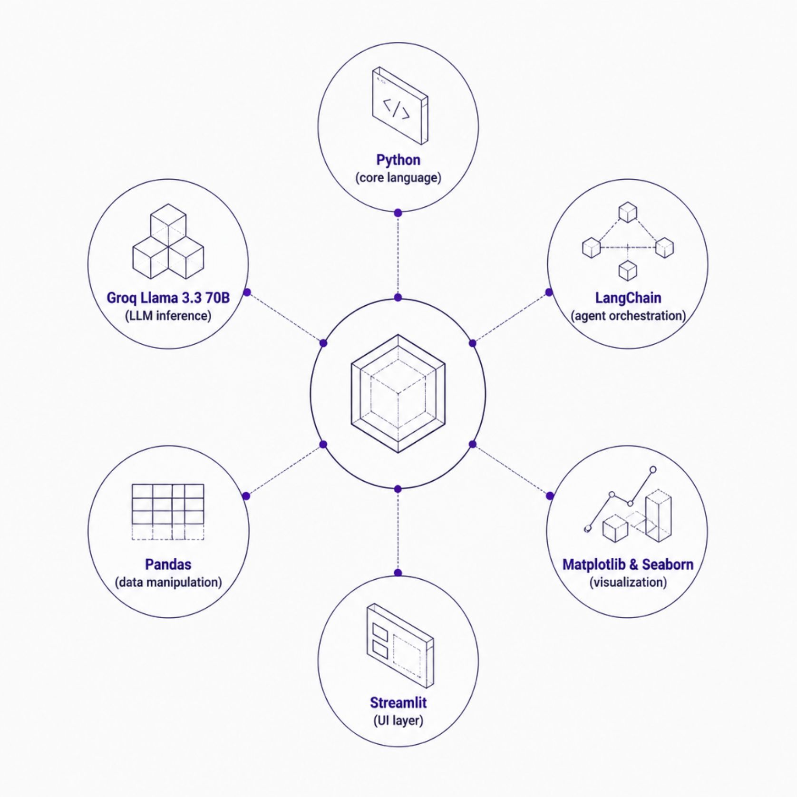
Under the Hood: Tech Stack
Why This Stack?
Each tool plays a critical role in the pipeline:
Groq delivers ultra-fast LLM inference for real-time responses
LangChain orchestrates the agent's reasoning and tool calls
Pandas handles data loading and transformation
Streamlit provides a zero-config interactive UI

Slide 4

How It Works
Enter API Key
Ask Question
Upload CSV
Get Analysis
The agent parses your uploaded CSV, interprets your question through the Groq LLM, executes the appropriate data operation via LangChain, and returns both a textual answer and a generated chart — all in seconds.

Slide 5
Live Demo
See the Groq CSV AI Agent in action — upload a dataset, ask a question, and watch AI-generated insights and visualizations appear instantly.

Slide 6


Getting Started
⚙️ Installation
📂 Project Structure
git clone https://github.com/your-username/groq-csv-ai-agent.git
cd groq-csv-ai-agent
pip install -r requirements.txt
app.py
Main Streamlit application with agent logic and UI
requirements.txt
🔑 Run the App
All Python dependencies: Groq, LangChain, Pandas, Streamlit
streamlit run app.py
Enter your Groq API Key in the UI to get started.
README.md
Setup instructions and usage examples

Slide 7
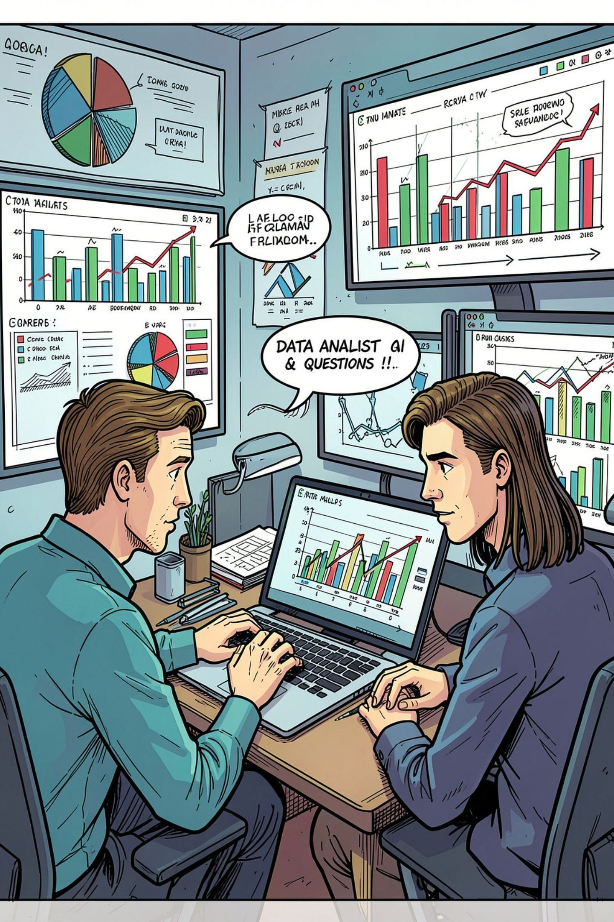



Usage: Ask Anything
Once your CSV is uploaded, the agent understands your data schema and responds to natural language queries instantly.
"What is the average sales?"
"Show top 10 categories by revenue"
"Plot monthly trends over time"

Slide 8
What's Next: Roadmap
Export Options
Multi-File Upload
Download generated charts as PNG and analysis results as CSV
Support joining and analyzing multiple CSV files in a single session
1
2
3
4
Dashboard Mode
Cloud Deploy
Pin multiple visualizations into a persistent, shareable dashboard view
One-click deployment on Streamlit Cloud for team access

Slide 9

Why Groq CSV AI Agent?
70B
3
0
Parameter LLM
Simple Steps
SQL Required
Llama 3.3 delivers deep reasoning for complex data questions
Upload, ask, visualize — insights in seconds
Natural language replaces complex query syntax
Built by Sweeti Yuonate — Data Analyst specializing in Python, SQL, and Power BI. Open to contributions and collaboration.

Slide 10




Get Involved
This is an open-source project — contributions, feedback, and stars are welcome!
Contribute
Star the Repo
Submit pull requests to add features, fix bugs, or improve documentation
Show support on GitHub — it helps the project grow and reach more data professionals
Share Feedback
Open issues for feature requests, bugs, or ideas to shape the roadmap

