Slide 1






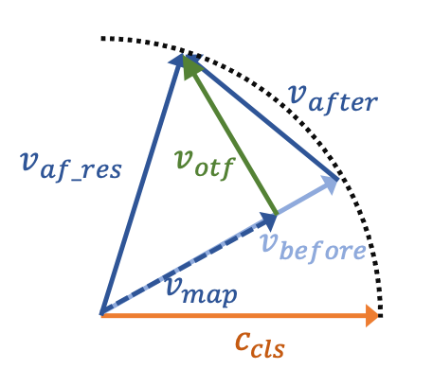
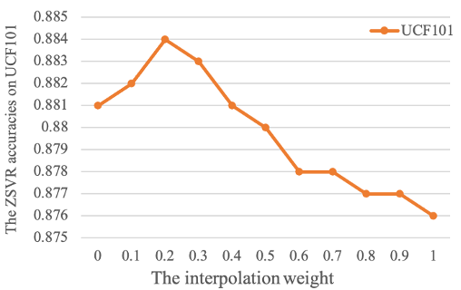
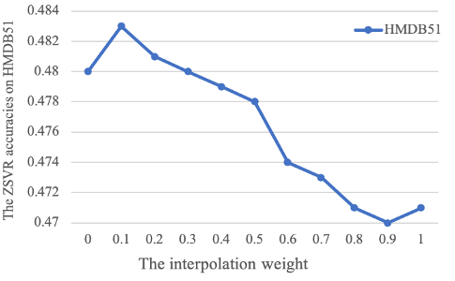

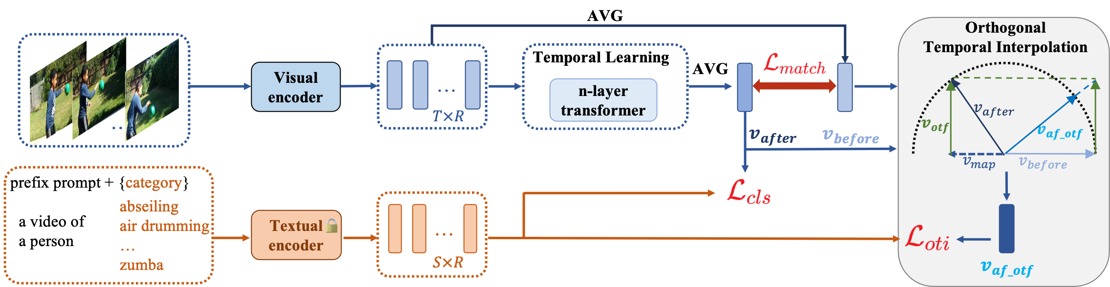
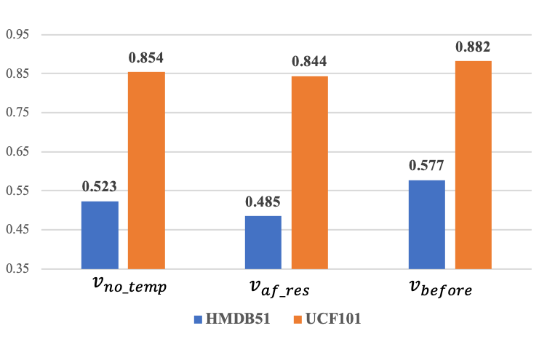
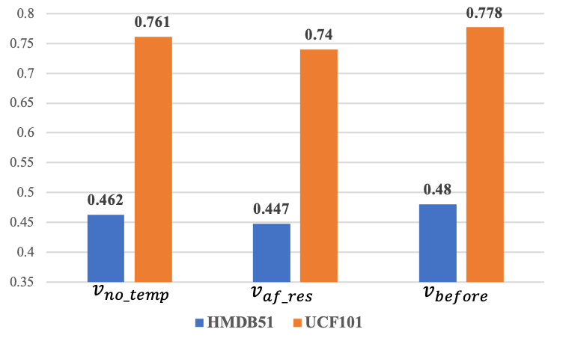
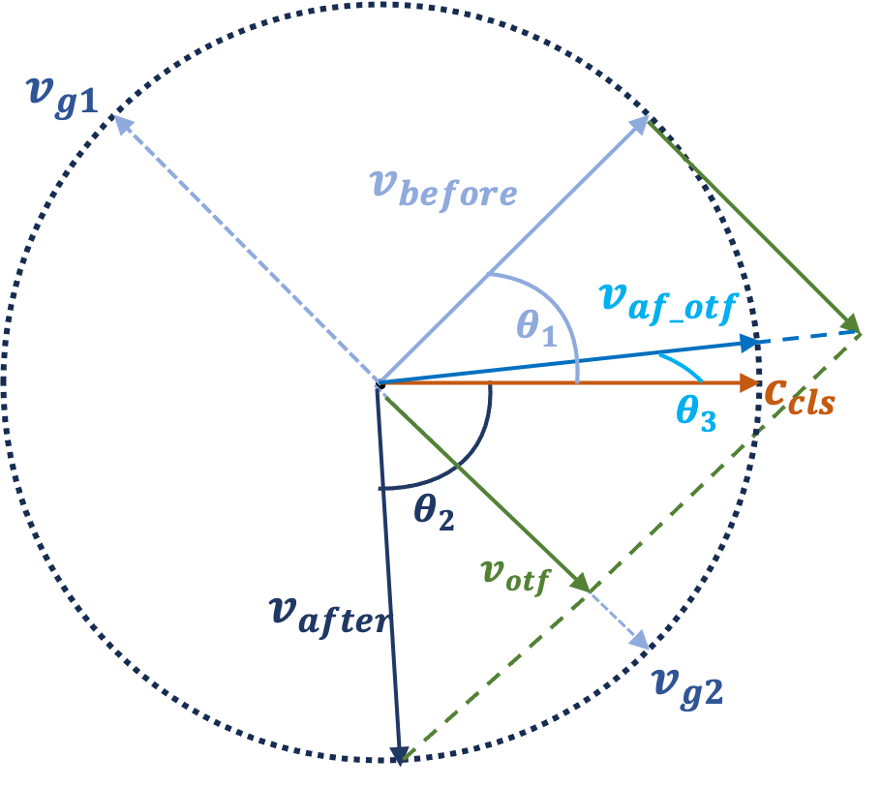
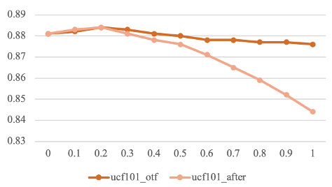
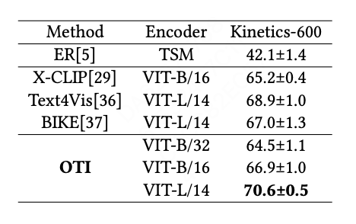
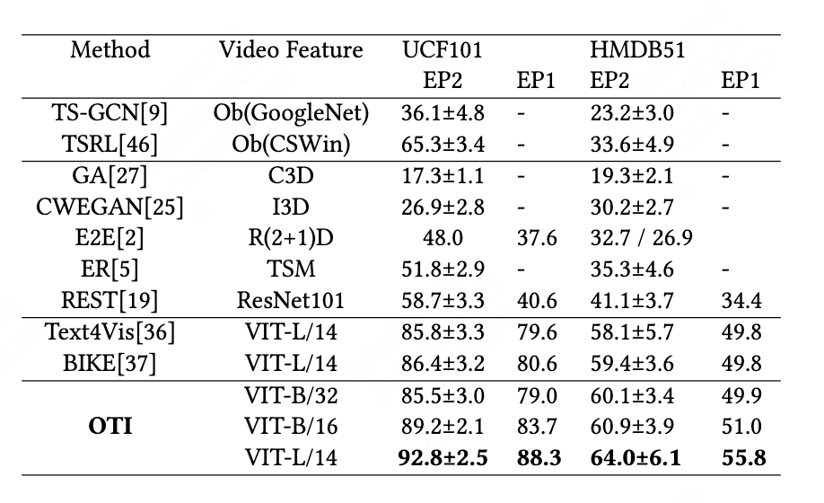
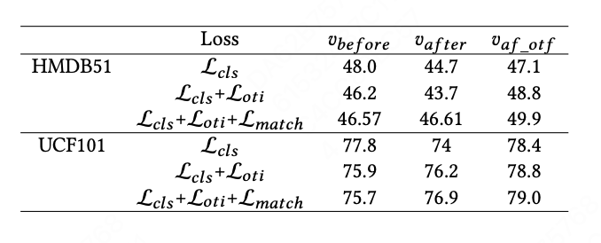
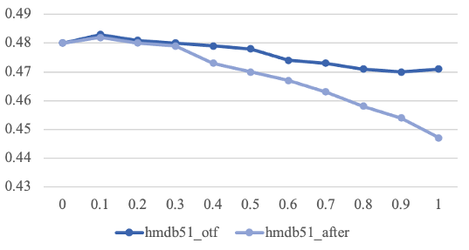
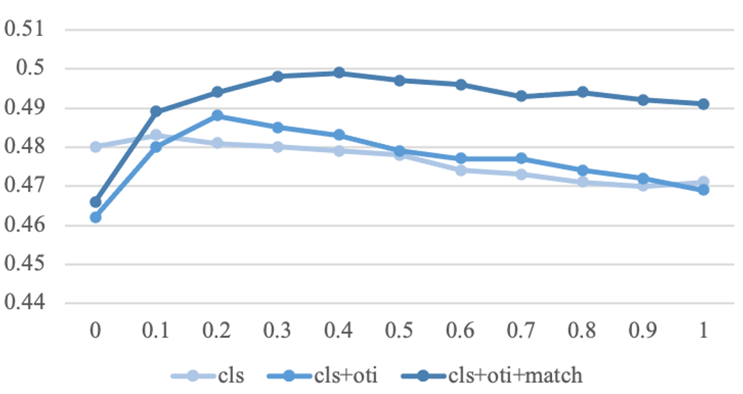
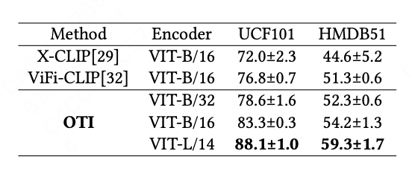

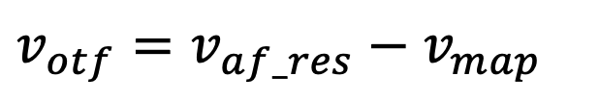
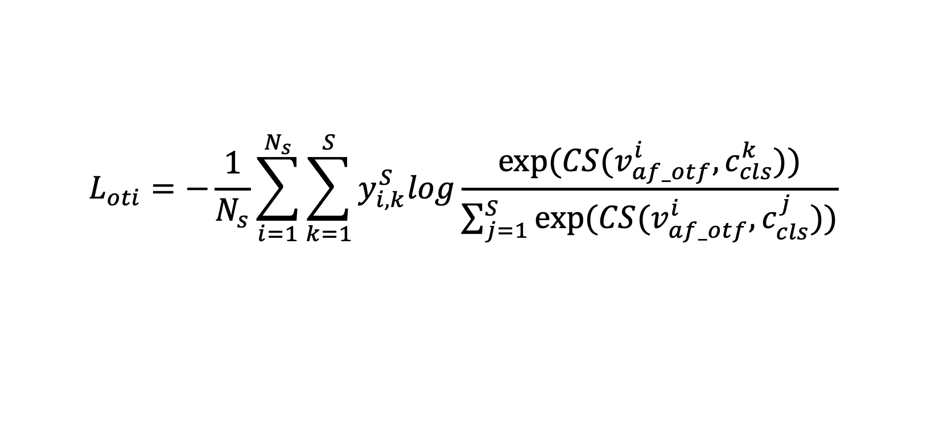
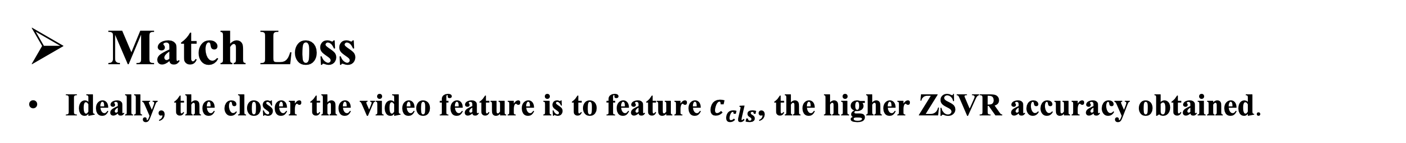

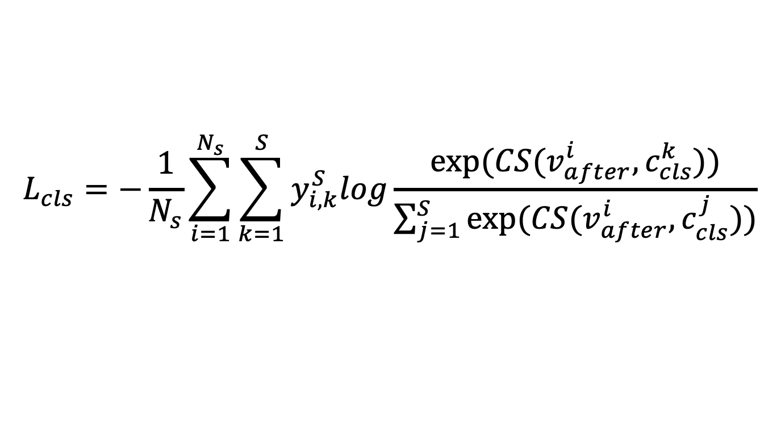
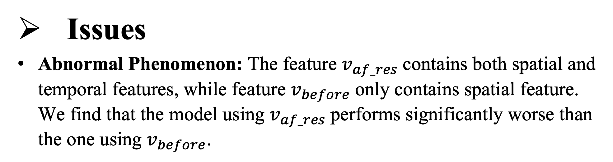

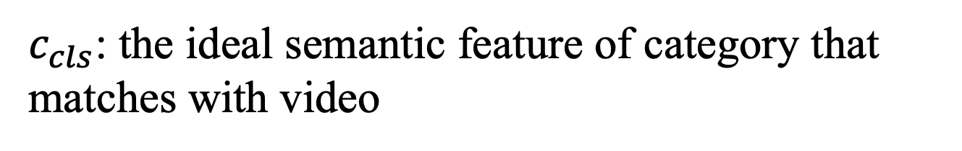
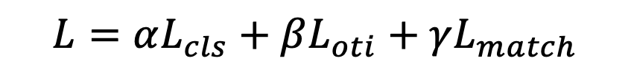
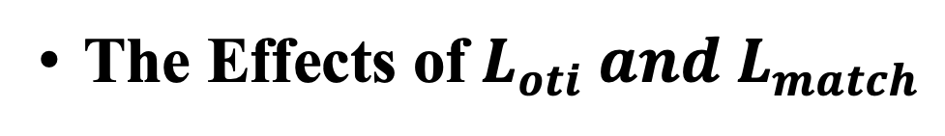
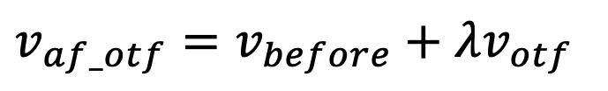
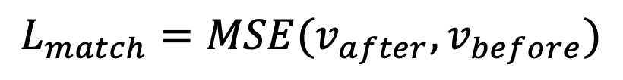


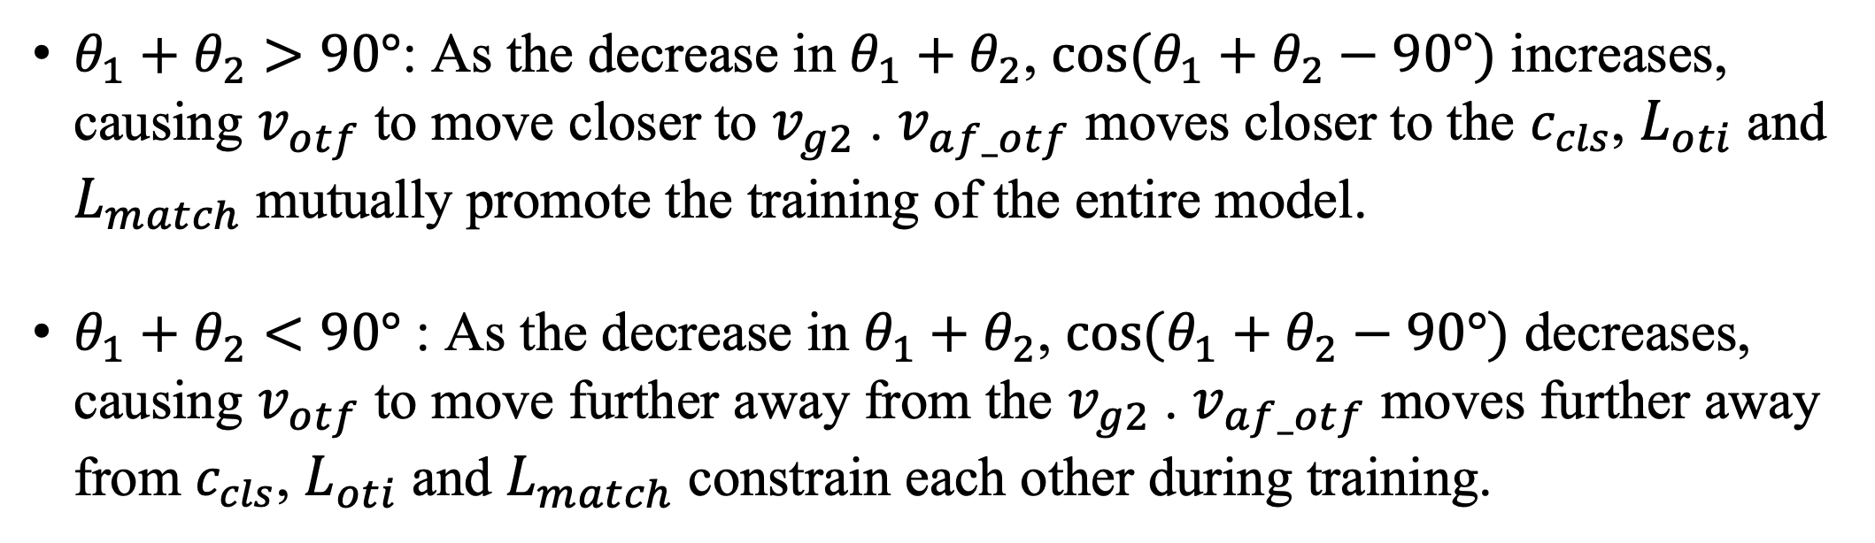
Orthogonal Temporal Interpolation for Zero-Shot Video Recognition
Yan Zhu¹, Junbao Zhuo^{2*}, Bin MA³, Jiajia Geng³,
Xiaoming Wei³ , Xiaolin Wei³ and Shuhui Wang²
¹ University of Chinese Academy of Sciences,
² Key Lab of Intell. Info. Process., Inst. of Comput. Tech., CAS,
³ Meituan Inc.
Motivation
Method
Zero-shot video Recognition
The visual-language models (VLMs) trained on large-scale image-text pairs have achieved a certain alignment between visual and semantic space, enabling high-accuracy zero-shot recognition task (ZSVR).
Feature Factorization
For ZSVR, improper temporal modeling for video disrupts the spatial feature.
The orthogonal temporal feature is valuable.
The appropriate fusion of spatial feature and orthogonal temporal feature is effective.
Seen Categories
$$v_{map}=\frac{<v_{af_res},v_{before}>}{{\left\|v_{before}\right\|}_{2}^{2}}v_{before}$$
Mapping
Skiing
$$f(θ_{v})$$
Transfer
$v_{otf}=v_{af_res}−v_{map}$
Predict
Biking
$$f(θ_{t})$$
$v_{af_otf}=v_{before}+λv_{otf}$
Unseen Categories
$c_{cls}$: the ideal semantic feature of category that matches with video
Issues
Abnormal Phenomenon: The feature $v_{af_res}$contains both spatial and temporal features, while feature $v_{before}$only contains spatial feature. We find that the model using $v_{af_res}$performs significantly worse than the one using $v_{before}$.
VIT-L/14 Text4Vis
VIT-B/32 Baseline
Framework
AVG
AVG
$$v_{before}$$
VIT-L/14 Text4Vis
Frame
embeddings
n-layer transformer
⊕
$$L_{oti}=−\frac{1}{N_{s}}\sum_{i=1}^{N_{s}}{\sum_{k=1}^{S}{y_{i,k}^{S}log\frac{exp⁡(CS(v_{af_otf}^{i},c_{cls}^{k}))}{\sum_{j=1}^{S}{exp⁡(CS(v_{af_otf}^{i},c_{cls}^{j}))}}}}$$
Visual encoder
$$v_{af_res}$$
$$L_{cls}=−\frac{1}{N_{s}}\sum_{i=1}^{N_{s}}{\sum_{k=1}^{S}{y_{i,k}^{S}log\frac{exp⁡(CS(v_{after}^{i},c_{cls}^{k}))}{\sum_{j=1}^{S}{exp⁡(CS(v_{after}^{i},c_{cls}^{j}))}}}}$$
video frames
(a) Text4Vis-backbone CLIP
VIT-B/32 Baseline
$$L_{match}=MSE(v_{after},v_{before})$$
$$L=αL_{cls}+βL_{oti}+γL_{match}$$
Match Loss
Ideally, the closer the video feature is to feature $c_{cls}$, the higher ZSVR accuracy obtained.
Contributions
For ZSVR, the method Feature Factorization validates that improper temporal modeling on video disrupts the spatial feature of the video,
The proposed orthogonal temporal interpolation module can learn better refined spatial-temporal feature for video. The introduced matching loss can improve the quality of the temporal feature.
$θ_{1}+θ_{2}>90°$: As the decrease in $θ_{1}+θ_{2}$, ${cos⁡(θ}_{1}+θ_{2}−90°)$ increases, causing $v_{otf}$to move closer to $v_{g2}$. $v_{af_otf}$ moves closer to the $c_{cls}$, $L_{oti}$and $L_{match}$mutually promote the training of the entire model.
$θ_{1}+θ_{2}<90°$ : As the decrease in $θ_{1}+θ_{2}$, ${cos⁡(θ}_{1}+θ_{2}−90°)$ decreases, causing $v_{otf}$to move further away from the $v_{g2}$. $v_{af_otf}$ moves further away from $c_{cls}$, $L_{oti}$and $L_{match}$constrain each other during training.
Experiments
Comparison
Kinetics-600: 160 categories be selected from the 220 expanded categories, and average the accuracies of the three splits.
HMDB51 and UCF101
EP1: The videos from full categories.
EP2: The half of the categories from all categories, the average accuracy of the 10 evaluations.
EP3: The three official splits and average the accuracies of the three splits.
ZSVC accuracies on UCF101 and Kinetics-600.
The comparison trends of ZSVR accuracies of pretained TextVis with the backbone VIT-L/14.
ZSVC accuracies on UCF101 and HMDB51 with EP1 and EP2.
The Effects of$L_{oti} and L_{match}$
The ZSVR accuracies obtained using three different combinations of training losses.
Ablation Study
Interpolation using different feature
The stage of Feature Factorization
ZSVC accuracies on UCF101 and HMDB51 with EP3.
The comparison trends of ZSVR accuracies of our baseline model with the backbone VIT-B/32.
The comparison trends of ZSVR accuracies of three different combinations of training losses on HMDB51.

