Slide 1
MATLAB
Lab One exercises
Instructor: 黃世強 (Sai-Keung Wong)

Slide 2
Program file name format
Write all your programs in a folder. The folder name is your lab01_student_ID.
Zip the folder and upload it.
Write a program for each problem in one file.
The file name is lab01_X_yourStudentID.m, where X is the problem number.
For example, if your student ID is 12345678 and the problem number is 3, then the file name must be lab01_3_12345678.m.
Do not output all the intermediate results.
Output the results that are required only.

Slide 3
For each problem, display the problem number before showing the results.
clf; clear; clc; % clear the current figure
% clear variables, and clear screen
disp(‘Lab Problem 1.1’) % show Lab Problem 1.1

Slide 4
At the top of the file, write down your name, ID, email address, department, and date.
%%%%%%%%%%%%%%%%%%%%%%%%%%%
% Assignment Number: …
% Problem number: …
% Student Name: …
% Student ID: …
% Email address: …
% Department: Computer Science, NYCU
% Date: ….
%%%%%%%%%%%%%%%%%%%%%%%%%%%%

Slide 5
Example
This program asks a user to input a set of linear functions and plot all of them. The program quits if the coefficient of the x term is zero.
Ask the user to input the coefficients of a linear function y = ax + b.
Plot the curve for y, and x is in [-10, 10]. The step size is 0.05.
If a is zero, quit the program. When it is asked to input something, a message must be shown appropriately.
clf; clear; clc;
x = -10:0.05;10;
while 1
ceof = input(‘Please input the coefficients [a,b]:’);
If coef(1) == 0
fprintf(‘Thanks for playering.\n’);
break
end
y = a .*x + b;
plot(x,y);
hold on;
end

Slide 6
Lab Problem 1.1
Write a program to ask for inputs. Then it plots a function y = f(x).
The function y = a |x| + sin(x). The process is stated as follows.
Clear the screen. Show your student ID and name.
Ask to input a.
If a is zero, show a message “Thanks for playing” and then quit the program. Otherwise go to step 4.
Ask to input the step size, dx, of x. if dx is zero, set it to a default value 0.05. if dx <0, show ‘dx must be a non-negative number’. dx must be a positive number.
Plot y versus x. x is inside [-10, 10]. The step size of x is dx. The line width of the curve is set to 3. Call “hold on” so that more functions can be plotted in the same figure.
Go to step 2.

Slide 7
Lab Problem 1.2
Write a program to ask for inputs. Then it plots a function.
The function is: x² (|sin y|+1) – 2 x y - b y² = 0. The process is stated as follows.
Clear the screen. Show your student ID and name.
Ask to input b
If b is zero, show a message “Thanks for playing” and then quit the program. Otherwise go to step 4.
Clear all curves in the current figure.
Plot the curve . Set the step size properly so that the curve is smooth. The line width of the curve is set to 3.
Go to step 2.

Slide 8
Problem 1.3
Write a program to ask for inputs. Then it plots function y1 = f(x) and a family of function y2 = y2(x,n).
y1 = cos(x)
y2(x,n) = 1 – x²/2! + x⁴/4! +… + ((-1)^{n}/(2n)!) x^{2n}
Clear the screen. Show your student ID and name.
Ask to input m. m is a non-negative integer and inside [0, 10]. MUST check if the input is valid.
If m is zero, show a message “Thanks for playing” and then quit the program. Otherwise go to step 4.
Clear all curves in the current figure.
In the same figure, plot y1’s curve and y2’s curves for all 0 <=n <= m.
x is inside [-10, 10]. The step size of x is 0.01.
The line width is set to 4 for y1’s curve.
The line width is set to 2 for y2’s curves.
Go to step 2.
Hint: use factorial

Slide 9
Problem 1.4
Plot y = (2x²+3e^{-x}-(100a) sin (5x))/(6x²-9x-42)-10
Ask to input a.
Ask to input the step size dx of x. dx must be a non-negative value.
Plot the upper part of the curve as blue color, i.e., y >= 0.
Plot the bottom part of the curve as red color, i.e., y < 0.
The range of x is [-10, 10]. Set the limits of the y axis to -100 and 100.
Hint: you collect the sample points that have the same sign and they are consecutive.

Slide 10
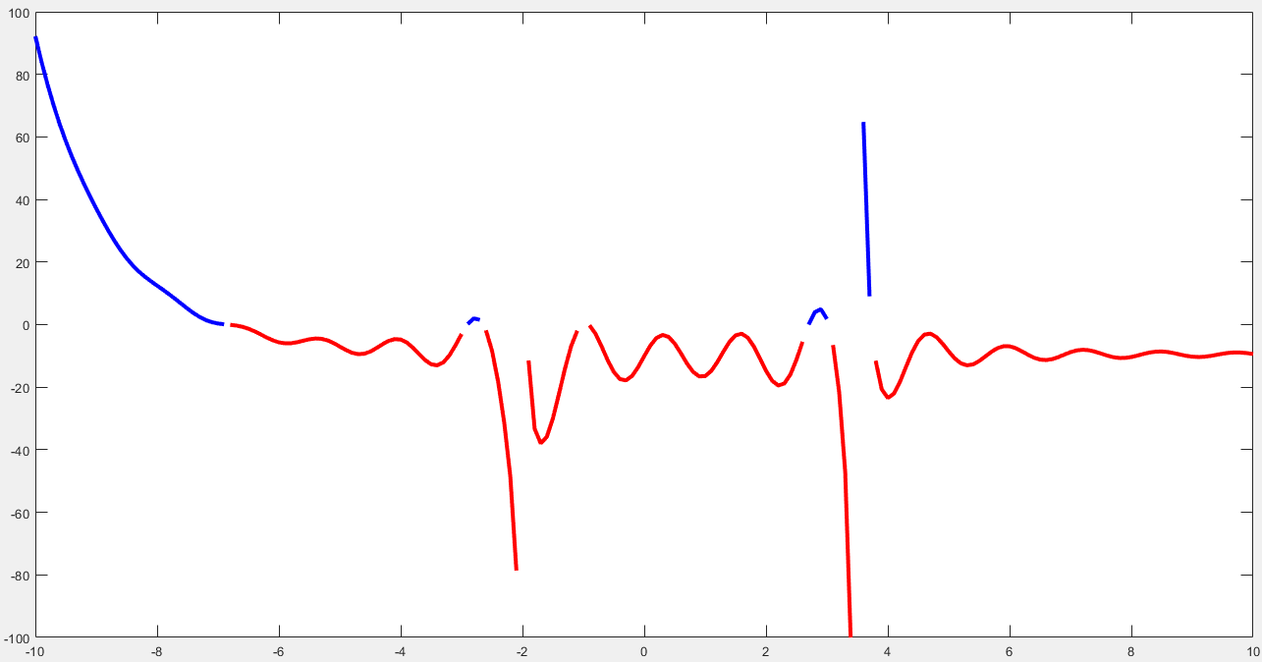
Plot y = (2x²+3e^{-x}-(100a) sin (5x))/(6x²-9x-42)-10 a = 3. dx = 0.1

Slide 11
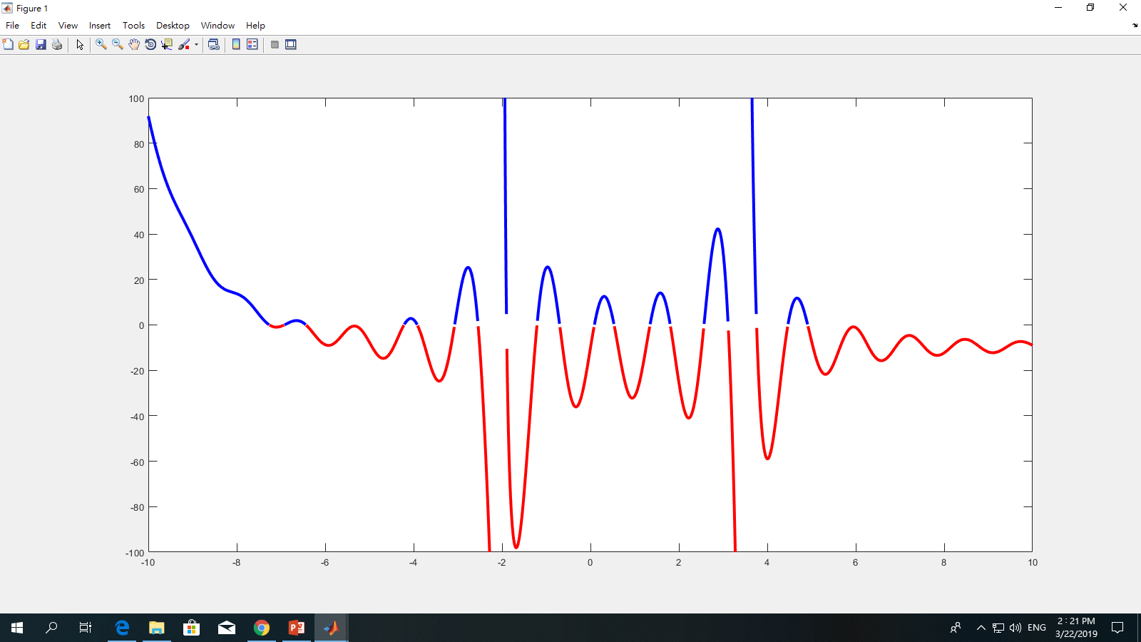
Problem 1.4
Plot y = (2x²+3e^{-x}-(100a) sin (5x))/(6x²-9x-42)-10
a = 10, dx = 0.01

Slide 12
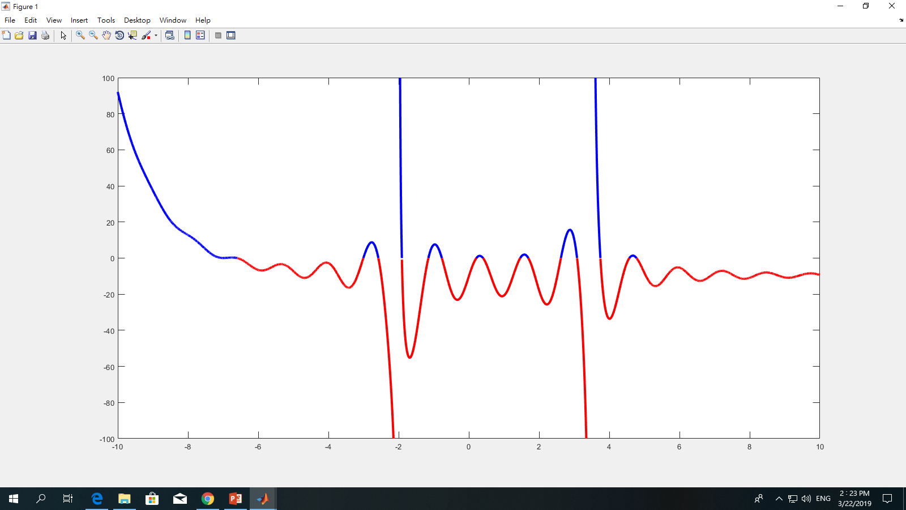
Problem 1.4
Plot y = (2x²+3e^{-x}-(100a) sin (5x))/(6x²-9x-42)-10
a = 5, dx = 0.001

Slide 13
Hint: Problem 1.4
s = size(x);
i = 1;
sig = s(i)>=0; % sign
x1 = [];
y1 = [];
while i <= s(2) % number of samples
sig0 = y(i) >= 0;
if (sig0 == sig) % same sign
x1 = [x1, x(i)]; % collect x-coordinate
y1 = [y1, y(i)]; % collect y-coordinate
i = i + 1;
else %not same sign
……
Use temporary vectors x1 and y1 to store a segment in which the sample points have the same sign.
When a sample point with not the same sign, plot the segment and clear x1, and y1. then start to collect the sample points for the new segment.

Slide 14
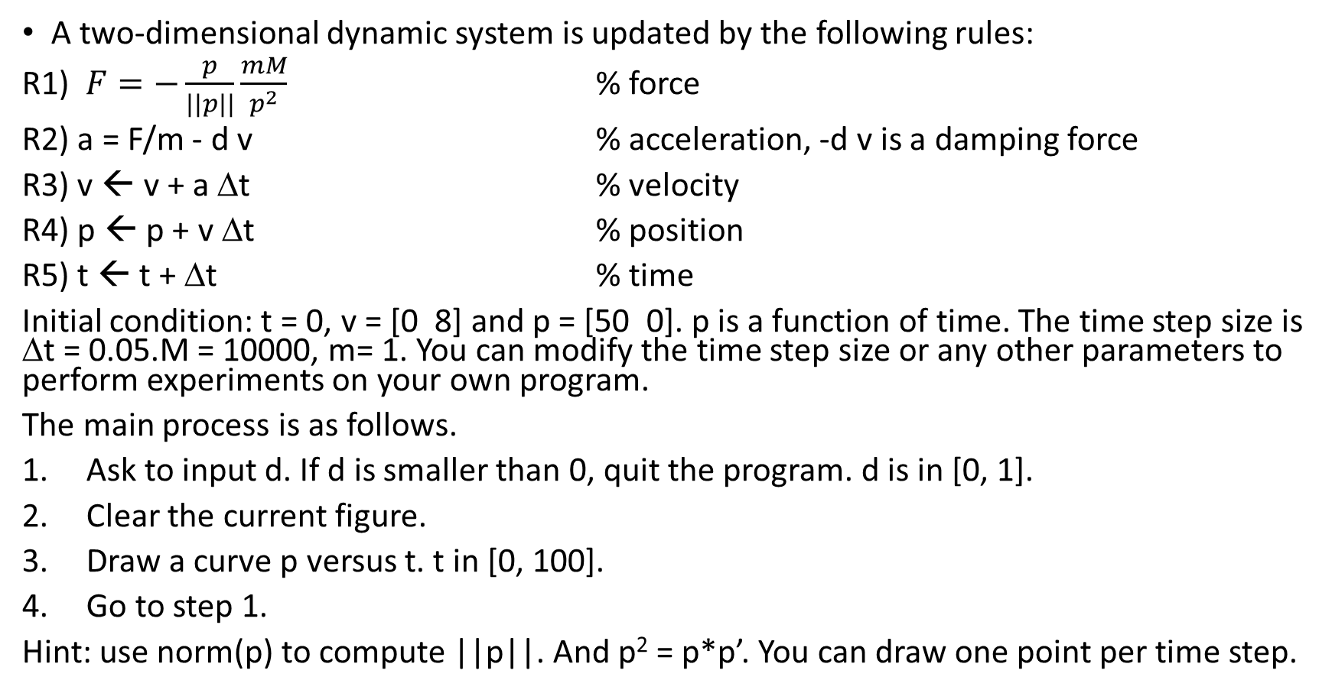
Problem 1.5
A two-dimensional dynamic system is updated by the following rules:
R1) $F=−\frac{p}{|\left|p\right||}\frac{mM}{p^{2}}$ % force
R2) a = F/m - d v % acceleration, -d v is a damping force
R3) v ← v + a Δt % velocity
R4) p ← p + v Δt % position
R5) t ← t + Δt % time
Initial condition: t = 0, v = [0 8] and p = [50 0]. p is a function of time. The time step size is Δt = 0.05.M = 10000, m= 1. You can modify the time step size or any other parameters to perform experiments on your own program.
The main process is as follows.
Ask to input d. If d is smaller than 0, quit the program. d is in [0, 1].
Clear the current figure.
Draw a curve p versus t. t in [0, 100].
Go to step 1.
Hint: use norm(p) to compute ||p||. And p² = p*p’. You can draw one point per time step.

Slide 15
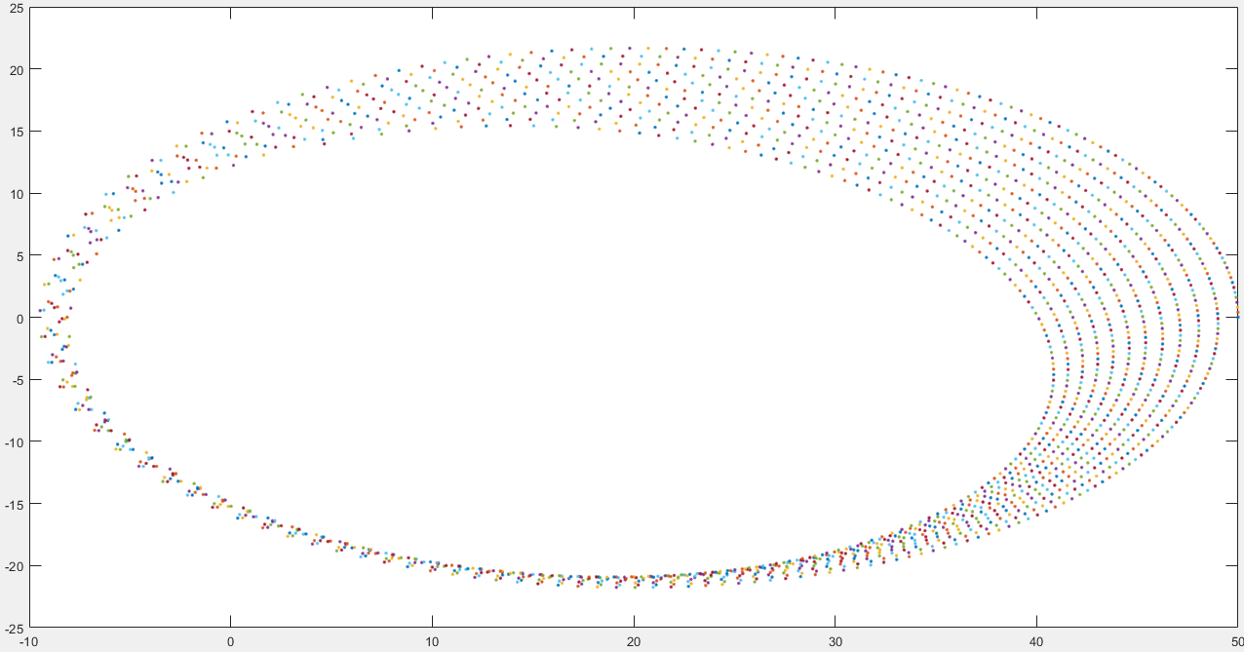
Problem 1.5
d = 0.001;

Slide 16
Lab Problem 1.6
Code debugging
Modify lab01_06_bugs.m

Slide 17
Hints

Slide 18
Hint: Lab Problem 1.1
Write a program to ask for inputs. Then it plots a function y = f(x).
The function y = a |x| + sin(x). The process is stated as follows.
Clear the screen. Show your student ID and name.
Ask to input a.
If a is zero, show a message “Thanks for playing” and then quit the program. Otherwise go to step 4.
Ask to input the step size, dx, of x. dx must be a positive number.
Plot y versus x. x is inside [-10, 10]. The step size of x is dx. The line width of the curve is set to 3. Call “hold on” so that more functions can be plotted in the same figure.
Go to step 2.

Slide 19
Hint: Lab Problem 1.1
The function y = a |x| + sin(x). The process is stated as follows.
Clear the screen. Show your student ID and name.
Ask to input a.
If a is zero, show a message “Thanks for playing” and then quit the program. Otherwise go to step 4.
Ask to input the step size, dx, of x. dx must be a positive number.
Plot y versus x. x is inside [-10, 10]. The step size of x is dx. The line width of the curve is set to 3. Call “hold on” so that more functions can be plotted in the same figure.
Go to step 2.
%%%%%%%%%%%%%%%%%%%%%%%%%%%
% Assignment Number: …
% Problem number: …
% Student Name: …
% Student ID: …
% Email address: …
% Department: Computer Science, NCTU
% Date: ….
%%%%%%%%%%%%%%%%%%%%%%%%%%%%

Slide 20
Hint: Lab Problem 1.1
while true
a = input('a:');
if (a==0)
fprintf('Thanks for playing\n');
break;
end
while true
dx = input('dx:');
if dx == 0
dx = 0.05;
break;
elseif dx >0
break;
else
fprintf('dx must be a non-negative number.\n');
end
end
x = [-10:dx:10]; y = a .*abs(x) + sin(x);
plot(x,y, 'LineWidth', 3);
hold on
end
clf; clear; clc;
disp('Lab Problem 1.1') ;
fprintf('\n');
fprintf('Student Name:... ID:...\n');

Slide 21
End
Enjoy MATLAB Programming.

