Slide 1
MATLAB Programming Language
Programming Assignment One

Slide 2
Problem sets
There are two problem sets. You must finish all of them.
You must use MATLAB with the required version to implement your programs.
You can use any valid functions in MATLAB to implement your programs as long as your programs do not violate the specified requirement of the assignment(s).

Slide 3
File naming convention
Write your programs in a file.
The file name is m_yourStudentID_YourName.m.
For example, if your name is Peter and ID is 12345678, then the file name must be m_12345678_Peter.
Note: YourName should be in letters
Output the results that are required only.
Do not output all the results.
You must not input the elements explicitly one by one.

Slide 4
Program instruction
For each problem, display the problem number before showing the results.
% This instruction is not included in the instruction count of your program
disp(‘Problem 1.1’) % show “Problem 1.1. “

Slide 5
Program instruction
At the top of the file, write down your name, ID, email address, department, and date.
%%%%%%%%%%%%%%%%%%%%%%%%%%%
% Student Name: …
% Student ID: …
% Email address: …
% Department: Computer Science, NYCU
% Date: ….
%%%%%%%%%%%%%%%%%%%%%%%%%%%%

Slide 6
Example
Given n, create the following matrix:
z =
1 2 3 4 5 6 … n % contains n elements
Use at most two instructions. You can change n to get a new row vector.
=================================================================
If you type
n = 10; % instruction 1. You must write this instruction.
z = [1 2 3 4 5 6 7 8 9 10] % instruction 2
Your score is zero.
=================================================================
You may type:
n = 10; % do not output n
z = [1:n ] or z = [1:1:n]

Slide 7
Instruction
An instruction is a standalone entity which can be executed by MATLAB.
You can only use commas and semicolons to define a matrix.
An instruction must not contain a comma or semicolon except at the end of an instruction.
e.g.,
a = 10 %This line is one instruction
a = 10; %This line is one instruction
a = 6, b = 10 %This line has two instructions
a = 6, b = 10; %This line has two instructions
a = 6; b = 10; c = a.*b + 1; %This line has three instructions
[x y] = meshgrid((1:n)’); %This line has one instruction

Slide 8
Problem Set 1

Slide 9
Problem 1.1
Create a row vector P whose elements are from –2n to 2n, with an increment of 2.
For example
n = 4; % Our TAs will change n to another value to check your answer
P =
-8 -6 -4 -2 0 2 4 6 8
Use at most two instructions, , including the line that specifies n.
You can change n to get a new row vector P.

Slide 10
Problem 1.2
You must use meshgrid to create the following matrix.
Q = 1 2^2 3^2 … n^n
1 2^2 3^2 … n^n
…
1 2^2 3^2 … n^n
Q has n identical rows
Use at most 2 instructions, including the line that specifies n.
n = number, e.g., n = 10 (this is one instruction)
Example:
When n = 10,
your program outputs
Q =
1 4 9 16 25 36 49 64 81 100
1 4 9 16 25 36 49 64 81 100
1 4 9 16 25 36 49 64 81 100
1 4 9 16 25 36 49 64 81 100
1 4 9 16 25 36 49 64 81 100
1 4 9 16 25 36 49 64 81 100
1 4 9 16 25 36 49 64 81 100
1 4 9 16 25 36 49 64 81 100
1 4 9 16 25 36 49 64 81 100
1 4 9 16 25 36 49 64 81 100

Slide 11
Problem 1.3
Given n, create the following row vector consisting of n elements:
R = [1 -2 3 -4 5 -6 7 -8 9 -10 11 … ]
Use at most 4 instructions , including the line that specifies n.
You can change n to get a new row vector.
Example:
When n = 10,
your program outputs
R = [1 -2 3 -4 5 -6 7 -8 9 -10]

Slide 12
Problem 1.4
Given n, create the following matrix consisting of n elements:
S = [1 3 3 5 5 7 7 9 9 11 … ]
Use at most 4 instructions, including the line that specifies n.
You can change n to get a new row vector.
You must not use mod.
Example:
When n = 6,
your program outputs
S = [1 3 3 5 5 7]
=====================================
When n = 7,
your program outputs
S = [1 3 3 5 5 7 7]
=====================================
When n = 14,
your program outputs
S = [1 3 3 5 5 7 7 9 9 11 11 13 13 15]

Slide 13
Problem 1.5
You must use mod to create the following row vector which contains n elements:
T = [4+1 3+2 2+3 1+4 4+5 3+6 2+7 ……]
Use at most 2 instructions , including the line that specifies n.
You can change n to get a new row vector.
You need to learn how to use
the mod operator on your own.
Example:
When n = 6,
your program outputs
T = [5 5 5 5 9 9]
=====================================
When n = 7,
your program outputs
T = [5 5 5 5 9 9 9]
=====================================
When n = 8,
your program outputs
T = [5 5 5 5 9 9 9 9]
=====================================
When n = 17,
your program outputs
T = [5 5 5 5 9 9 9 9 13 13 13 13 17 17 17 17 21 ]

Slide 14
Problem Set 2

Slide 15
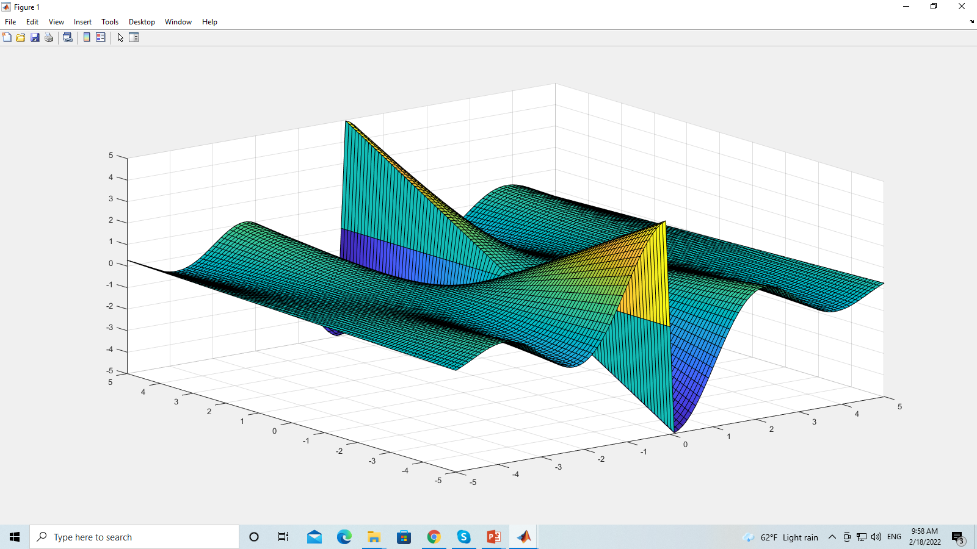
Problem Set 2 Problem 2.1
Use surf to plot a graph
z = y sin(x) cos(x) / (|x| + eps)
x in [-r, r]
y in [-r, r]
z in [-r, r]
Use: shading faceted
You can use a smaller step size to get a smoother surface.
Type: help shading
Try different shading methods: flat, interp, faceted

Slide 16
Problem Set 2 Problem 2.1

Slide 17
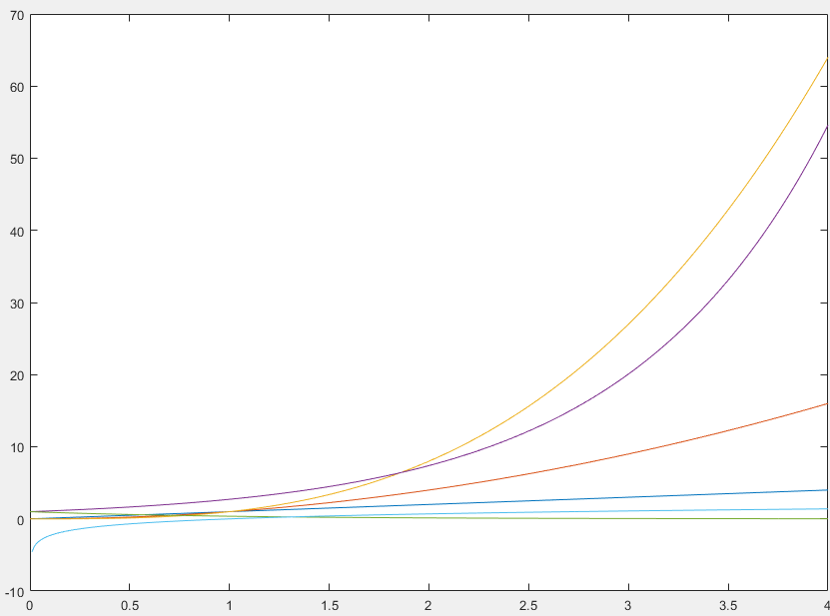
Problem Set 2 Problem 2.2
Plot the following functions in the same figure.
y = x;
y = x²;
y = x³;
y = e^{x}
y = e^{-x}
y = log x
x in [0, 4]. Step size 0.01.
You can use clf to clear all figures.
Do you know how to label the curves?
e is the natural log base.

Slide 18
Problem Set 2 Problem 2.3
Plot the composite function z(x, y(x)) with solid line segments and ‘o’.
y = sin(x) – x;
z = sin(y²) – e^{x}/x;
x is inside [-10, 10].
e is the natural log base.
x’s step size is 0.5 when plot in ‘o’ style. Could we use step size 0.001?
x’s step size is 0.001 when plot in line segments

Slide 19
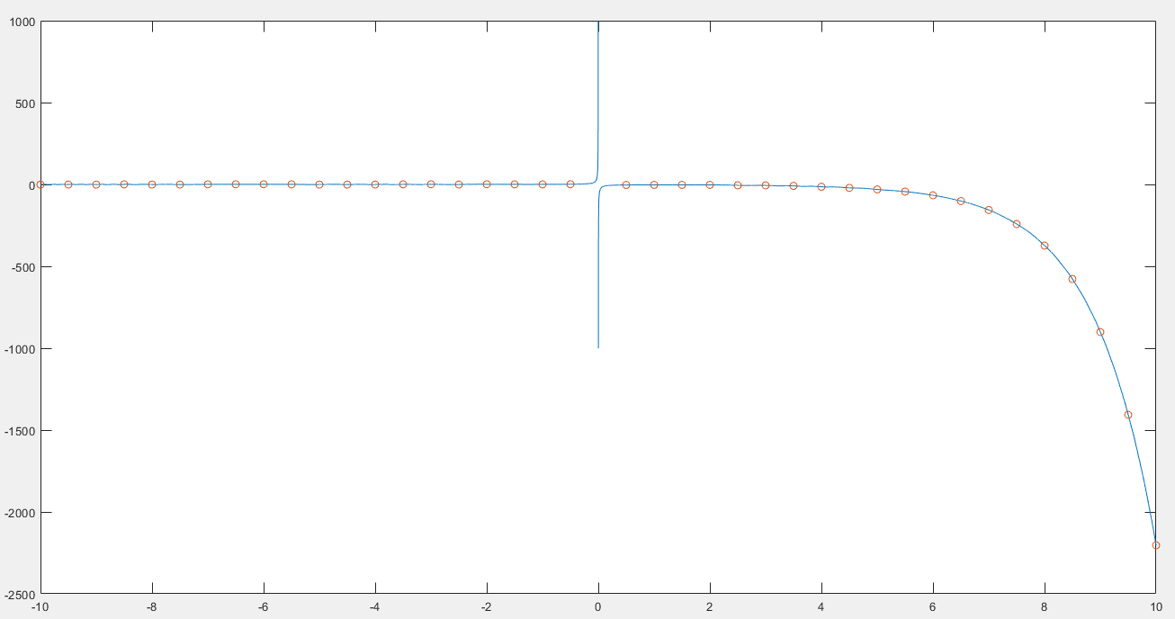
y = sin(x) – x; z = sin(y²) – e^{x}/x;

Slide 20
Problem Set 2 Problem 2.4
Plot the following surface.
z = (x + y) / (x² + y² + 1)
x is inside [-10, 10].
y is inside [-10, 10].
Step size is 0.5.
Use meshc, and shading faceted.
Try to use a step size: 0.01. Check the result again.
Use clf to clear the figure.

Slide 21
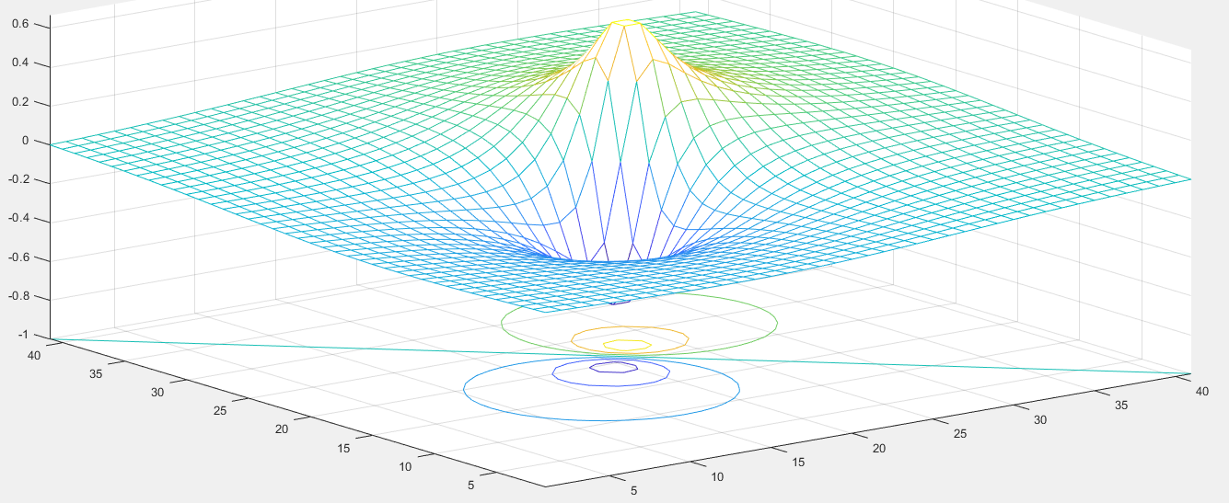
z = (x + y) / (x² + y² + 1)

Slide 22
Problem Set 2 Problem 2.5
Plot the following functions.
y = 0.5 + (x sin x) / ( x² e ^{sin x} + 1);
y = cos²x + sin²x
x is inside [-10, 10].
The step size for x is 0.05;
You can use size(x, 2) to get the number of columns of x.

Slide 23
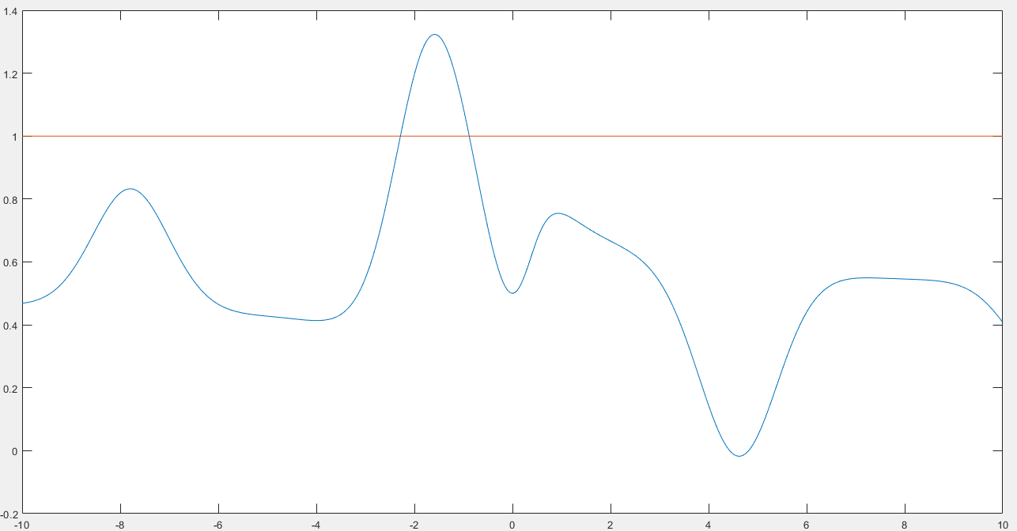
y = 0.5 + (x sin x) / ( x² e ^{sin x} + 1); y = cos²x + sin²x

Slide 24
End
Enjoy MATLAB Programming.

