Slide 1


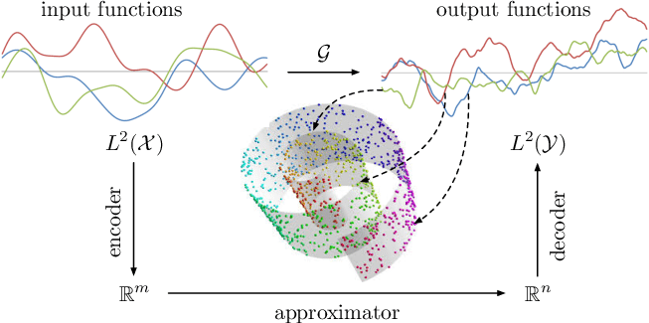
Operator Learning
12432020 Jia Zijun
Department of Mathematics

