Slide 1
Identify good journal and good article
Final Project Report, Springboard
Weina Ke
Notes:
Good afternoon, everyone. Today, I'm here to present the final project report codebook on how to identify good journals and good articles for scientific research. My name is Weina Ke, and I have conducted extensive research in this area. So, let's dive into the details.

Slide 2
Introduction
Literature review: Gathering research papers for basic knowledge base
Choosing the right journal for publication
Impact Factor (IF) as a measure of journal popularity
Challenges in finding credible sources and understanding IF
Notes:
In any research endeavor, one of the first steps is conducting a literature review to gather relevant information. This involves going through numerous research papers to build a solid knowledge base. Additionally, when it comes to publishing our own research, we often face the challenge of finding the right journal. Impact Factor (IF) is often considered a crucial metric in this process. However, understanding IF and identifying credible sources can be quite challenging. In this presentation, I aim to address these issues and provide guidance in selecting journals and articles.

Slide 3
Data Search Tools
Different tools based on available sources (institution subscriptions, Google Scholar)
Introduction to Exaly (https://exaly.com/)
Exaly as a comprehensive and unbiased bibliographic database
Web scraping capabilities for gathering journal information
Notes:
To conduct a thorough literature review, researchers have access to various tools depending on their available sources. These may include institutional subscriptions or widely used platforms like Google Scholar. In addition to these, I would like to introduce you to a valuable resource called Exaly. Exaly (https://exaly.com/) is a comprehensive and unbiased bibliographic database that provides researchers with extensive information. It offers web scraping capabilities, enabling us to gather journal information efficiently.

Slide 4
Method
Researching the field of nanomaterial for cancer research
Data collected:
Journal name
Total article number
Total citation number of the journal
Most cited article title
Published year of the most cited article
Most cited article citation number
Keyword used to search the article
Impact factor
Notes:
For this project, I focused on researching the field of nanomaterial for cancer research. I gathered relevant data, including the journal names, total article numbers, total citation numbers, most cited article titles, published years of the most cited articles, most cited article citation numbers, keywords used to search the articles, and impact factors. These data points provide valuable insights into journal quality and help us make informed decisions.

Slide 5
Data Cleaning
Keyword Formatting and Initial Exploration
Formatting the dataset for analysis
Creation of new keyword columns
Examining keyword presence in article titles and journal names
Dropping non-representative columns
We gathered information for 2072 unique journals searched with keywords: "theranostic", "nanomedicine", "nanodevice", "nanotechnology", "delivery", "diagnosis", "treatment", "cancer", "therapeutic", "antitumor", "nanostructure", "nanoparticle", "therapy", "tumor", "nanocarrier", "imaging", "nanoformulation", "target" paired with "cancer".
Notes:
To ensure the accuracy and reliability of our analysis, we performed data cleaning on the collected dataset. This involved keyword formatting and initial exploration. We formatted the dataset to make it suitable for analysis and created new keyword columns. We examined the presence of keywords in the article titles and journal names. Additionally, we eliminated non-representative columns to focus on relevant information for our study.

Slide 6
Exploratory Data Analysis (EDA)
Analysis of keyword search results
Impact factor distribution
Most cited articles and their publication years
Understanding keyword overlap and relationships
Notes:
In the exploratory data analysis phase, we delved into the collected data to gain valuable insights. We analyzed the results of keyword searches to understand their impact on the research outcomes. We also examined the distribution of impact factors across journals. Additionally, we explored the most cited articles and their publication years, providing us with an understanding of the trends in the field. Furthermore, we investigated the overlap and relationships between different keywords.

Slide 7
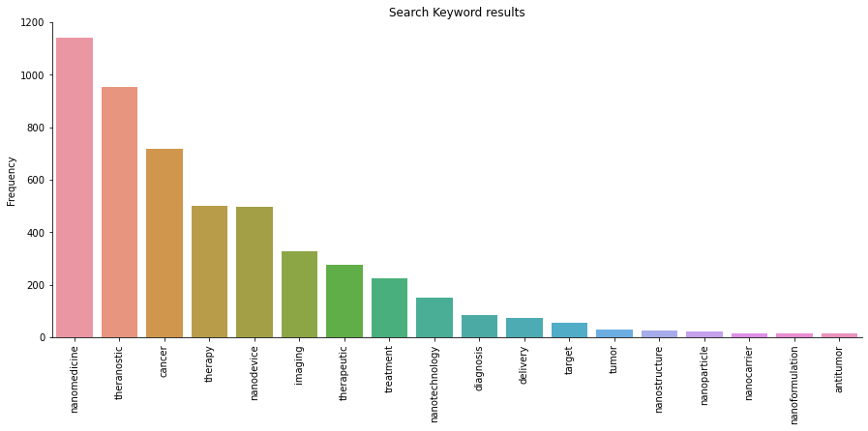
Exploratory Data Analysis (EDA)
Notes:
The most found was nanomedicine, theranostic, and cancer. These keywords and ther results make sense as the top results are more of general descriptions, and other keywords with more targeted fields still needs time and attention to grow.

Slide 8
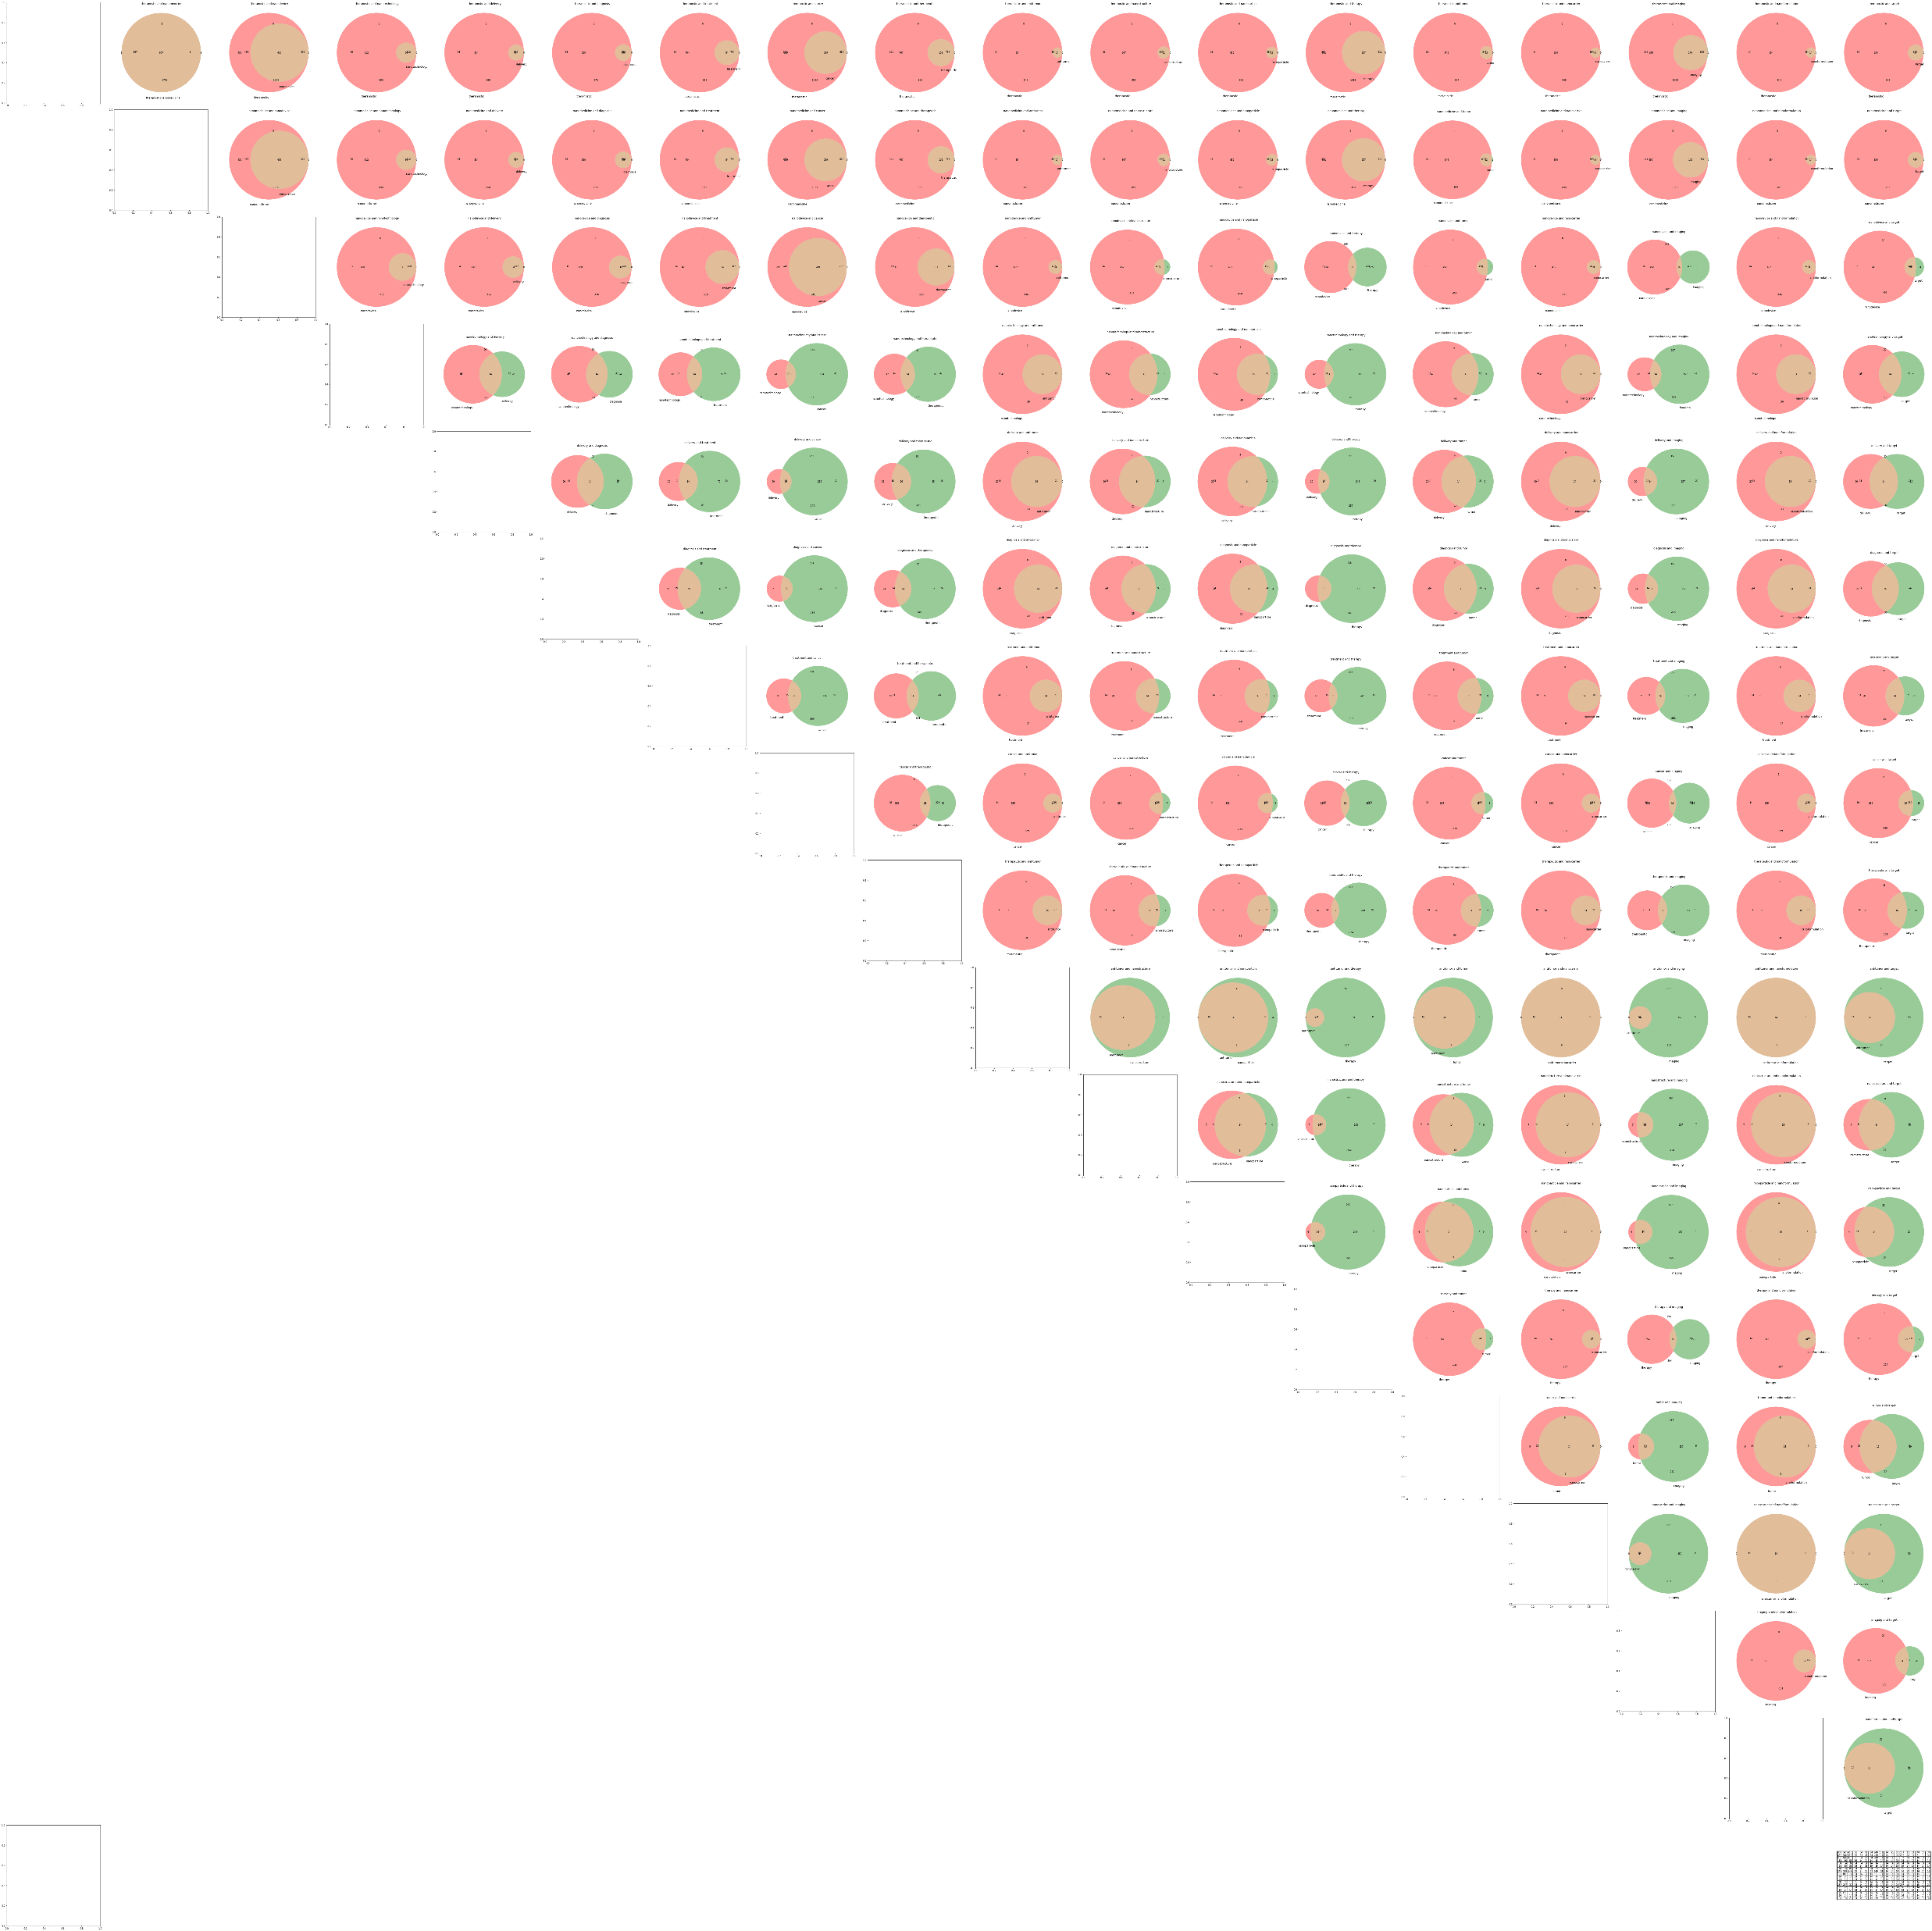
Keyword Pairwise Venn Diagram
Visual representation of keyword overlap
Identifying independent and overlapping keyword pairs
Notes:
To further understand the relationships between keywords, we utilized a pairwise Venn diagram. This visual representation allowed us to identify the overlap and independence among different keyword pairs. By analyzing the diagram, we gained insights into which keywords had higher or lower degrees of overlap, enabling us to refine our search strategies and improve the relevance of our results.

Slide 9
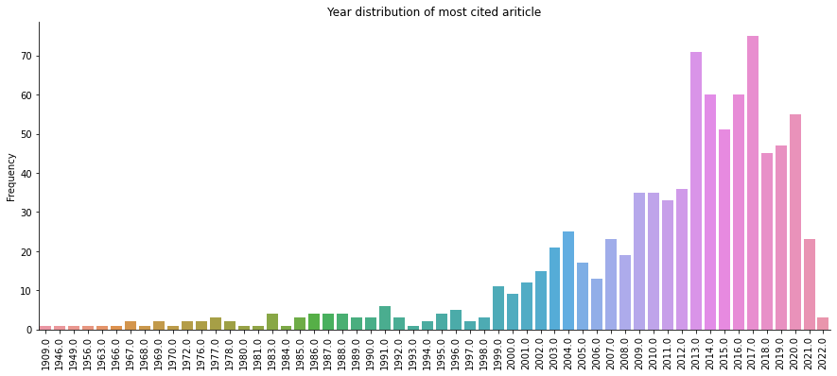
Year Distribution of Most Cited Articles
Analysis of publication years of most cited articles
Indication of field growth and active research
Notes:
Examining the publication years of the most cited articles provided us with valuable information about the growth and activity in the field. By analyzing the distribution of publication years, we observed trends and peaks that indicated periods of breakthroughs or heightened attention. This analysis helps us understand the progression of research in the field and identify key periods of importance.

Slide 10

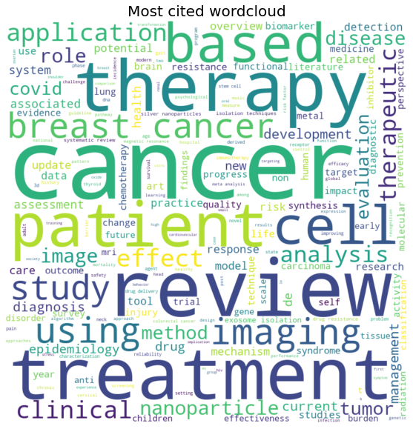
Word Cloud of Journal Names
Visual representation of journal names in the dataset
Frequency of occurrence of different journal names
Notes:
To gain a holistic view of the journal landscape, we created a word cloud of journal names in our dataset. This visual representation displayed the frequency of occurrence for different journal names. By examining the word cloud, we were able to identify prominent journals and understand their prevalence in the field. This information assists researchers in identifying reputable journals for publishing their work.

Slide 11
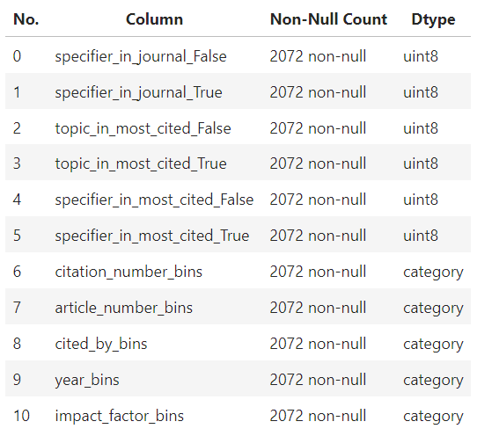
Models
Introduction to Decision Tree Classifier, Random Forest Classifier, and Random Forest Regressor
Dataset structure for modeling and training
Model performance and accuracy evaluation
Notes:
Now let's move on to the modeling aspect of our project. The dataset for modeling and training has the shown structure. We implemented three models: the Decision Tree Classifier, Random Forest Classifier, and Random Forest Regressor. These models were trained on our dataset, which included various features such as citation numbers, article numbers, and keyword presence. We evaluated the performance and accuracy of each model to assess their effectiveness in predicting journal quality and impact factors.

Slide 12
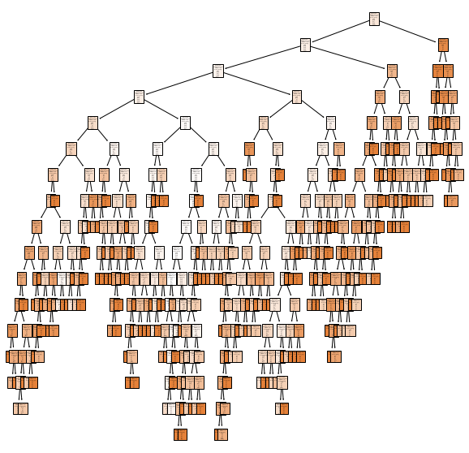
Decision Tree Classifier
Decision tree visualization
Interpretation of complex decision-making process
Accuracy: 0.78
Notes:
The Decision Tree Classifier provided valuable insights into the decision-making process for journal classification. Through a visual representation of the decision tree, we could interpret the complex structure and understand the factors that contribute to the classification of journals as good or not. This interpretation helps researchers gain a deeper understanding of the decision-making process and the underlying features that influence journal quality. The resulting decision tree classifier yielded a 0.78 accuracy.

Slide 13
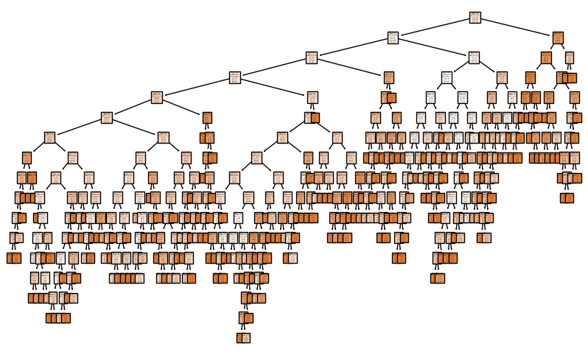
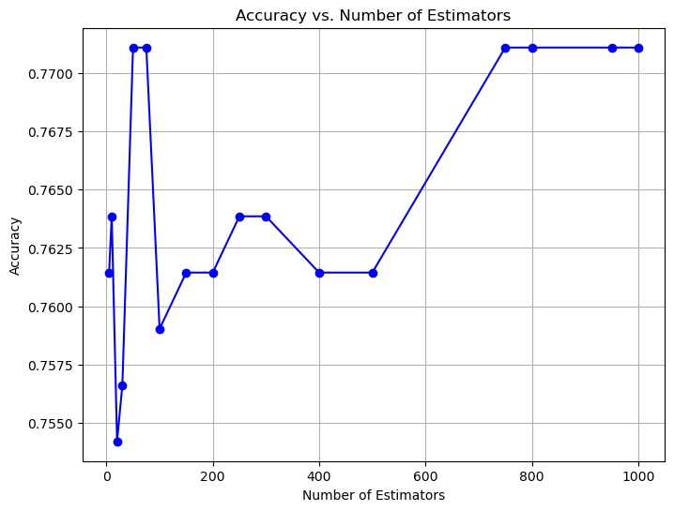
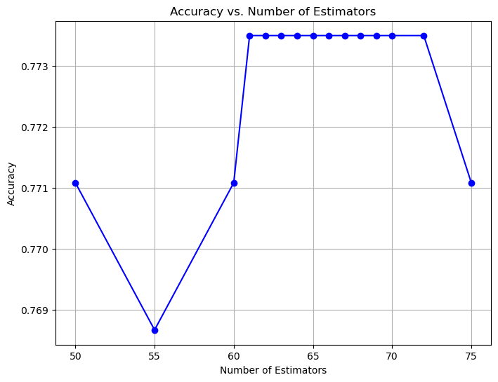
Random Forest Classifier
Optimum number of estimators for random forest
Balancing accuracy and computational resources
Accuracy 0.76.
Notes:
The Random Forest Classifier further enhanced our classification capabilities by leveraging an ensemble of decision trees. We determined the optimum number of estimators for the random forest, striking a balance between accuracy and computational resources. The Random Forest Classifier proved to be a robust and reliable method for predicting journal quality and making informed decisions. The optimum number of estimators for random forest is around 61 to 70. Further increasing the n estimators generally leads to a more accurate and robust, to achieve the same accuracy would require estimator above 700, which is computational expensive and even harder to rationalize. The result of these classifiers is helpful to understand how an high IF factor journal exists, but it is less intuitive as the decision becomes more complex to make.

Slide 14
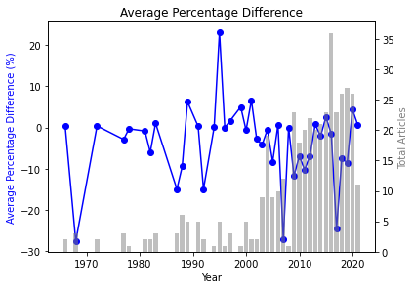
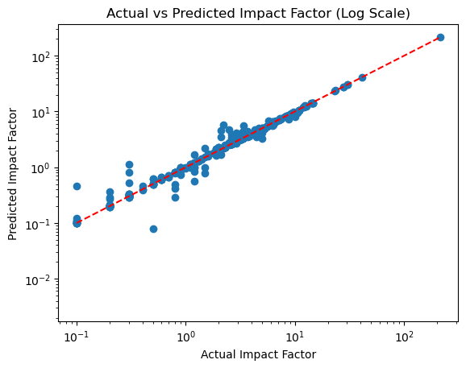
Random Forest Regressor
Predicting impact factor using regression
Evaluation metrics:
Mean Squared Error: 0.153
Mean Absolute Error: 0.156
R-squared: 0.999
Notes:
In addition to classification, we explored the use of the Random Forest Regressor to predict impact factors. By employing regression techniques, we could estimate the impact factor values of journals based on various features. We evaluated the regression model using metrics such as Mean Squared Error, Mean Absolute Error, and R-squared. The results demonstrated the efficacy of the model in predicting impact factors with a high degree of accuracy.

Slide 15
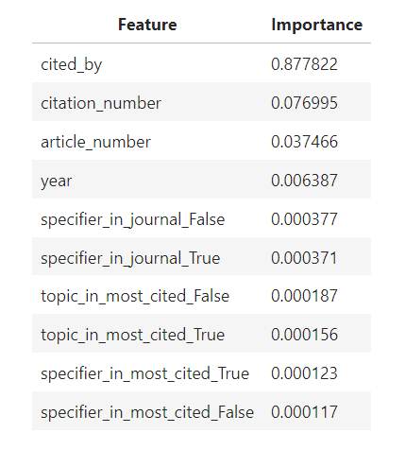
Feature Importance
Determining factors influencing impact factor prediction
Importance of cited_by, citation_number, and article_number
Notes:
To gain insights into the factors influencing impact factor prediction, we analyzed the feature importance. Our findings highlighted the significance of features such as cited_by (number of times the most cited article is referenced), citation_number (total number of citations received by the journal), and article_number (unique identifier of each article). These factors were found to play crucial roles in determining impact factors, providing valuable insights for researchers and publishers.
cited_by: The number of times the journal's most cited article has been referenced is the most important factor in predicting the impact factor.
citation_number: The total number of citations received by the journal also plays a significant role in determining the impact factor.
article_number: The unique identifier of each article has a moderate influence on the impact factor.
year: The year of publication has a minor impact on the impact factor.

Slide 16
Summary of Models
Decision Tree Classifier: Accuracy of 0.78
Random Forest Classifier: Accuracy of 0.76
Random Forest Regressor: MSE of 0.153, MAE of 0.156, R-squared of 0.999
Notes:
In summary, the models we developed showcased strong performance in predicting journal quality and impact factors. The Decision Tree Classifier achieved an accuracy of 0.78, while the Random Forest Classifier achieved an accuracy of 0.76. The Random Forest Regressor demonstrated exceptional accuracy, with metrics such as Mean Squared Error, Mean Absolute Error, and R-squared indicating its high precision in predicting impact factors.

Slide 17
Future Improvements
Include more keywords to improve coverage of the field
Seek feedback from experts for keyword selection
Add a recommendation rating for journals
Explore the evolution of impact factors over time and across fields
Notes:
As with any research project, there is always room for improvement and further exploration. In the future, we aim to include more keywords to improve the coverage of the field and ensure comprehensive results. Additionally, seeking feedback from domain experts will help refine our keyword selection and enhance the relevance of our search queries. We also plan to incorporate a recommendation rating system for journals to gather feedback from researchers regarding their recommendation for publishing and knowledge building. Lastly, we are interested in exploring the evolution of impact factors over time and across different fields to gain deeper insights into the dynamics of academic publishing.

Slide 18
Conclusion
Literature review and journal selection are crucial steps in research
Impact Factor provides insights into journal popularity
Data-driven approach can assist in understanding journal quality
Further improvements and exploration can enhance the research process
Notes:
To conclude, conducting a thorough literature review and selecting the right journal are critical steps in the research process. Understanding Impact Factor provides valuable insights into the popularity and reputation of journals. By adopting a data-driven approach and utilizing the models and techniques discussed in this project, researchers can make informed decisions about journal selection and article assessment. However, there is always room for improvement and further exploration to enhance the research process and ensure the highest quality publications.

Slide 19
Thank You!
Questions and Discussion
Notes:
Thank you all for your attention and time. I hope this presentation has provided you with valuable insights into identifying good journals and articles for scientific research. I'm now open to any questions or further discussion you may have on this topic.

