Slide 1
Make a bid with no price

Slide 2
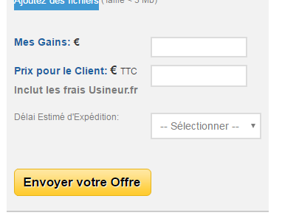

I’d like to enable suppliers to make a bid with no price. It will allow them to communicate with customers without having to define a price immediately
Please add a box with this text that means « Will Submit Amount Later ». When this box is ticked
= > the price and delivery days fields are inactivated.
Remove the price delivey date, « Prix Masqué » fields as show in the next slide.
When box is unticked, then the price an date fields are activated again.
Je préciserai le prix plus tard

Slide 3
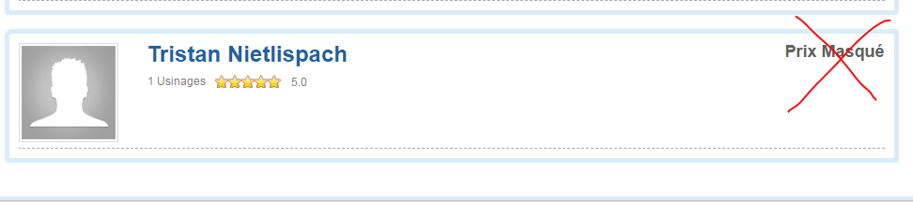
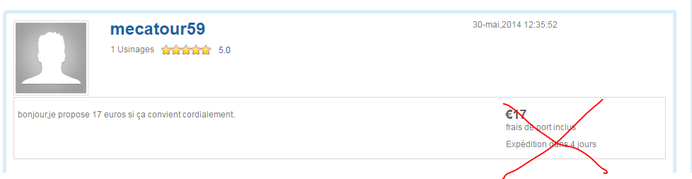
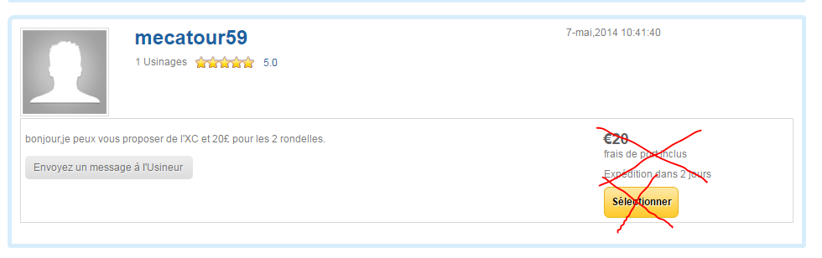
Remove Prix Masqué on unlogged user side, on supplier who did not emit the bid side ,and on customer side who did not emit the job
Remove Price field and delivery days field on supplier side who posted the bid
Replace it with text : « Prix non spécifié »
Prix non spécifié
Remove
- Price field
delivery days field
Select yellow button
on customer side who posted the job
Replace it with text : « Prix non spécifié »
Prix non spécifié

Slide 4
New notif email
When this bid with no price is sent, the bid notif email text is slightly different. Let’s name it « Bid notice with no price » The links are the same.
The notif email text is shown below:
Subject :
Nouveau message de SUPPLIER-name pour PROJECT_Name
Email text :
Bonjour,
Vous avez reçu une nouveau message de SUPPLIER-name. Pour voir le message, suivez le lien :
Link to the project
Cordialement,
Usineur.fr
www.usineur.fr

Slide 5
Please try it test it first on the UK site with a mock uk supplier and uk customer. (text of box is Will Submit Amount Later »)

