Slide 1

Sales & Growth AnalySIS Using Power BI to Visualize Business KPIs
Objective: Designed an insightful and interactive Power BI dashboard to track sales KPIs, customer metrics, and identify trends over time.
Presented By Sweety Gain

Slide 2
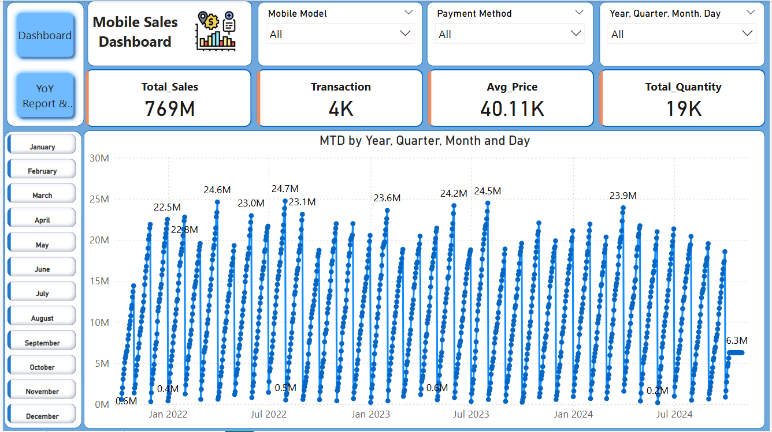
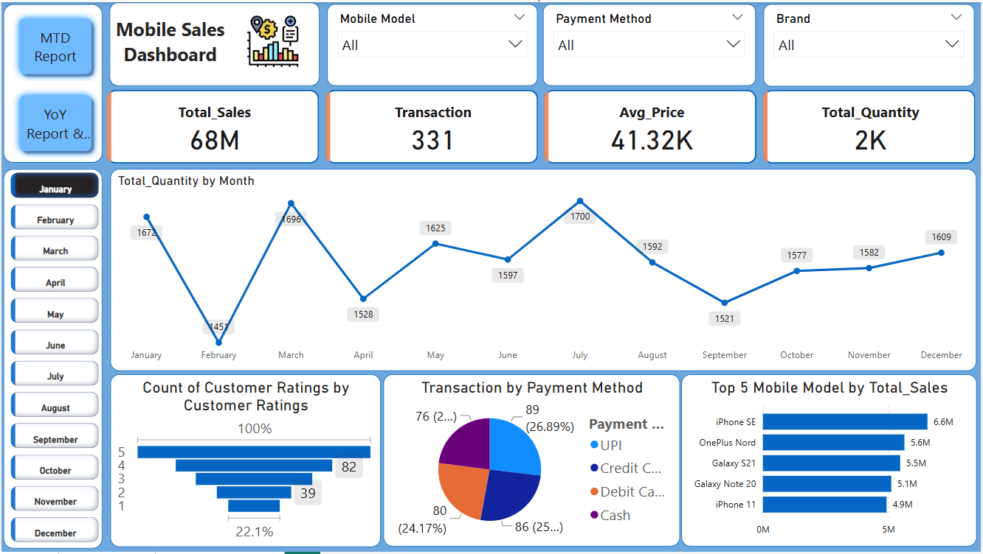

Navigator > Page Navigator
Used Card(new) To show case Total_Sales,Transacion,
Average_Price, Total_Quantity, Slicer To Add Filters according mobile model, Brand ,Payment method which enhance interaction with the dashboard,
To Show Case time-series analysis
Used Line Chart which show Total_Quantity Sold Per Month

Slide 3
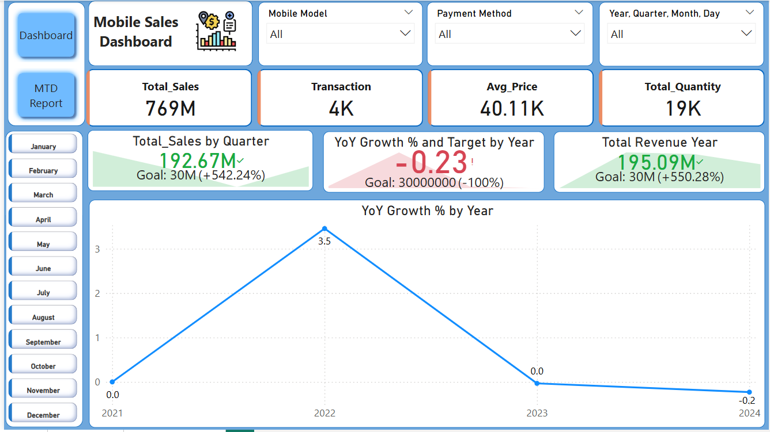
KPIs to show case Sales, Profit, Growth
Year Of Year Growth % : which shows the business growth stop in the year 2023 and decreasing in 2024

Slide 4
Insights & Recommendations: Key Insights : - YoY Growth = -%23% , which is lot less than targeted value and - Apple has highest revenue in Last Year. - Few Cities like Chennai, rajkot, jodhpur have high units sold but low customer ratings . - Average unit price remains consistent across months, Year Of Year(YoY) Revenue Decreasing Year by Year. Recommendation TO IMPROVE BUSINESS : - Boost Marketing & Promotion. - Run targeted promotions and campaigns to drive more revenue growth. - Focus on under performing months identified in the dashboard. - Customer Feedback & Service Improvement. - Investigate low-rated cities via surveys. - Improve after-sales support and delivery experience in those regions.

Slide 5
Thank You!
appreciate the opportunity to work on this dashboard project. It allowed me to explore real-world data challenges, apply DAX for time-intelligence, and design interactive visuals that support business decision-making. This project reflects not just technical execution, but also my commitment to clarity, user experience, and continuous improvement.

