Slide 1
Ch1: Introduction to DBMS

Slide 2
What is DBMS?
"A database management system (DBMS) is a collection of programs that manages the database structure and controls access to the data stored in the database".
The DBMS serves as the intermediary between the user and the database. The database structure itself is stored as a collection of files, So, we can access the data in those files through the DBMS.
The DBMS receives all application requests and translates them into the complex operations required to fulfill those requests. The DBMS hides much of the database’s internal complexity from the application programs and users.

Slide 3
- The purpose of a database is to store and retrieve information in a way that is accurate and effective and to manage the different databases it contains (performance, security, availability, integrity etc.)
- The main objectives of any DBMS are :
provide an efficient and convenient environment that is used to store data in, and retrieve data from a database.
manage information about users who interact with the DBMS and the activities that these users can perform on the data.

Slide 4
ADVANTAGES OF DBMS
1. Reduction of Redundancies
Centralized control of data by the DBA avoids unnecessary duplication of data and effectively reduces the total amount of data storage required. It also eliminates the extra processing necessary to trace the required data in a large mass of data.
2. Elimination of Inconsistencies
The main advantage of avoiding duplication is the elimination of inconsistencies that tend to be present in redundant data files. Any redundancies that exist in the DBMS are controlled and the system ensures that these multiple copies are consistent.
3. Shared Data
A database allows the sharing of data under its control by any number of application programs or users. For example, the applications for the public relations and payroll departments can share the same data.
4. Integrity
Centralized control can also ensure that adequate checks are incorporated in the DBMS to provide data integrity. Data integrity means that the data contained in the database is both accurate and consistent. Therefore, data values being entered for the storage could be checked to ensure that they fall within a specified range and are of the correct format.

Slide 5
5. Security
Data is of vital importance to an organization and may be confidential. Such confidential data must not be accessed by unauthorized persons. The DBA who has the ultimate responsibility for the data in the DBMS can ensure that proper access procedures are followed, including proper authentication schemes for access to the DBMS and additional checks before permitting access to sensitive data. Different levels of security could be implemented for various types of data and operations.
6. Data Independence
The ability to modify a scheme definition in one level without affecting a scheme definition in the next higher level is called data independence. Application programs should be as independent as possible from details of data representation and storage. The DBMS can provide an abstract view of the data to insulate application code from such details.
Data independence is usually considered from two points of view :
a) Physical data independence.
b) Logical data independence.
a) Physical data independence : Physical data independence allows changes in the physical storage devices or organization of the files to be made without requiring changes in the conceptual view or any of the external views and hence in the application programs using the database. Thus, the files may migrate from one type of physical media to another or the file structure may change without any need for changes in the application program.
b) Logical data independence : Logical data independence implies that the application programs need not be changed if fields are added to an existing record, nor do they have to be changed if fields not used by application programs are deleted. Logical data independence indicates that the conceptual schema can be changed without affecting the existing external schemas.

Slide 6
Disadvantages of DBMS
1. Complexity : The provision of the functionality that is expected of a good DBMS makes the DBMS an extremely complex piece of software. Database designers, developers, database administrators and end-users must understand this functionality to take full advantage of it. Failure to understand the system can lead to bad design decisions, which can have serious consequences for an organization.
2. Size : The complexity and breadth of functionality makes the DBMS an extremely large piece of software, occupying many megabytes of disk space and requiring substantial amounts of memory to run efficiently.
3. Performance: Typically, a File Based system is written for a specific application, such as invoicing. As result, performance is generally very good. However, the DBMS is written to be more general, to cater for many applications rather than just one. The effect is that some applications may not run as fast as they used to.
4. Higher impact of a failure: The centralization of resources increases the vulnerability of the system. Since all users and applications rely on the ~vailabi1ity of the DBMS, the failure of any component can bring operations to a halt.
5. Cost of DBMS: The cost of DBMS varies significantly, depending on the environment and functionality provided. There is also the recurrent annual maintenance cost.

Slide 7
Difference between Physical and Logical Data Independence
Sr. No. | Physical Data Independence | Logical Data Independence
1. | It is the ability to modify the physical schema without rewriting application program. | It is the ability to modify the logical schema without rewriting application program.
2. | Modifications are necessary to improve performance | Modifications are necessary whenever logical structure of database is altered.
3. | It is not difficult to be achieved. | It is difficult to be achieved as application programs are dependent on the logical structure of the data that they access.
4. | It provides immunity of conceptual schema | It provides immunity of application programs
5. | The users from changes in physical storage of data. | The users are shielded from changes in the logical structure of the data.

Slide 8
VIEWS OF DATA
The data can be viewed in the following two ways :
Data Abstraction
Instances and Schemas

Slide 9
Data Abstraction
Database systems are made-up of complex data structures. To ease the user interaction with database, the developers hide internal irrelevant details from users. This process of hiding irrelevant details from user is called data abstraction.
The three levels of abstraction are as :
a) Physical level.
b) Logical level.
c) View level.

Slide 10
a) Physical level : The physical level of abstraction is the lowest level of abstraction that describes how the data is actually stored. The physical level or internal schema, which contains the definition of the stored record, the method of representing the data fields, expresses the internal view and the access aids used.
b) Logical level : The logical level of data abstraction defines what data are actually stored in the database and what relationships exist among those data. In relational DBMS, the conceptual schema describes all relations that are stored in the database. For example, in university database, these relations contain information about entities, such as students and faculty, and about relationships, such as students' enrollment in courses.
c) View level : This is the highest level of abstraction as seen by a user. This level of abstraction describes only the part of entire database which exists to simplify the interaction with the system.

Slide 11
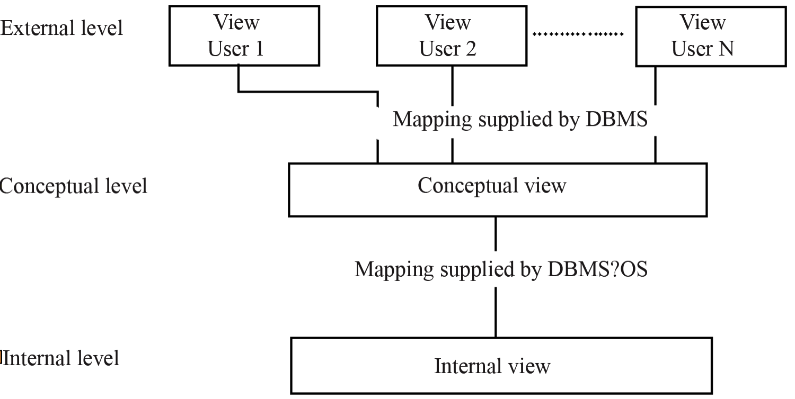
Fig: Shows the relationship among the three levels of abstraction.

Slide 12
Instances and Schemas
INSTANCE
The data stored in database at a particular moment of time is called instance of database. Database schema defines the variable declarations in tables that belong to a particular database; the value of these variables at a moment of time is called the instance of that database.

Slide 13
SCHEMA
Design of a database is called the schema.
Schema is of three types: Physical schema, logical schema and view schema.
The design of a database at physical level is called physical schema, how the data stored in blocks of storage is described at this level.
Design of database at logical level is called logical schema, programmers and database administrators work at this level, at this level data can be described as certain types of data records gets stored in data structures, however the internal details such as implementation of data structure is hidden at this level (available at physical level).
Design of database at view level is called view schema. This generally describes end user interaction with database systems.

Slide 14
Database Languages
A database system provides a data-definition language to specify the database schema and a data-manipulation language to express database queries and dates.
The various database languages are listed and described as below :
1. DDL (Data Definition Language)
2. DML (Data Manipulation Language)
3. DCL (Data Control Language)

Slide 15
Data Definition Language (DDL)
DDL is used for specifying the database schema. It is used for creating tables, schema, indexes, constraints etc. in database.
Commands as CREATE, ALTER, DROP

Slide 16
Data Manipulation Language (DML)
A data-manipulation language (DML) is a language that enables users to access or manipulate data as organized by the appropriate data model.
The types of access are:
- Retrieval of information stored in the database
- Insertion of new information into the database
- Deletion of information from the database
Modification of information stored in the database
Commands listed as SELECT, INSERT, UPDATE, DELETE

Slide 17
Data Control language (DCL)
DCL is used for granting and revoking user access on a database.
Commands are GRANT, REVOKE

Slide 18
File Processing System
A file processing system is a collection of programs that store and manage files in computer hard-disk.

Slide 19
Drawbacks of File system
Data redundancy: Data redundancy refers to the duplication of data, lets say we are managing the data of a college where a student is enrolled for two courses, the same student details in such case will be stored twice, which will take more storage than needed. Data redundancy often leads to higher storage costs and poor access time.
Data inconsistency: Data redundancy leads to data inconsistency, lets take the same example that we have taken above, a student is enrolled for two courses and we have student address stored twice, now lets say student requests to change his address, if the address is changed at one place and not on all the records then this can lead to data inconsistency.
Data Isolation: Because data are scattered in various files, and files may be in different formats, writing new application programs to retrieve the appropriate data is difficult.
Dependency on application programs: Changing files would lead to change in application programs.

Slide 20
Atomicity issues: Atomicity of a transaction refers to “All or nothing”, which means either all the operations in a transaction executes or none.
For example: Lets say Steve transfers 100$ to account X. This transaction consists multiple operations such as debit 100$ from account Y, credit 100$ to account X. Like any other device, a computer system can fail lets say it fails after first operation then in that case account Y would have been debited by 100$ but the amount was not credited to account X, in such case the rollback of operation should occur to maintain the atomicity of transaction. It is difficult to achieve atomicity in file processing systems.
Data Security: Data should be secured from unauthorised access, for example a student in a college should not be able to see the payroll details of the teachers, such kind of security constraints are difficult to apply in file processing systems.

Slide 21
Difference between File Processing System and DBMS
 | File Processing System | DBMS
1. | It coordinates only with physical access. | It coordinates with both physical and logical data.
2. | Data written by one program may not be readable by another | Reduces amount of data duplication
3. | It allows predetermined access to data. | Allow flexible access to data
4. | Data is not secured | Data is secured.
5. | It allows one or more program to access different data files at the same time only if files are readable. | Allows multiple users to concurrently access the data files.

Slide 22
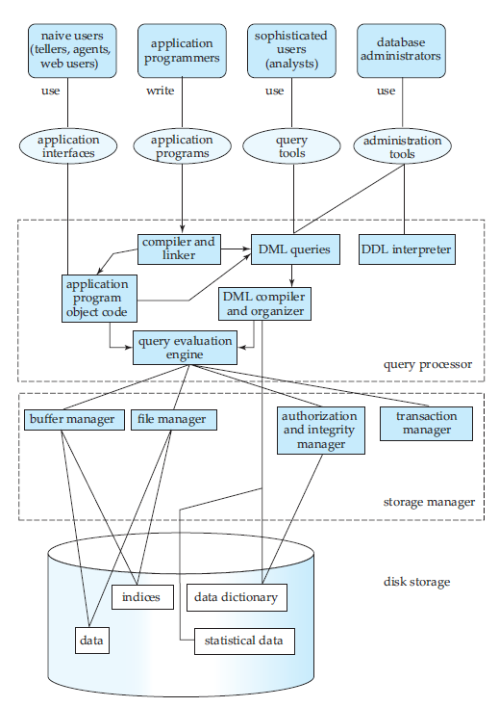
STRUCTURE OF DBMS

Slide 23
DATABASE USERS AND ADMINISTRATORS
The main goal of a database system is to retrieve information from and store new information in the database. People in database can be divided into following different categories :
a) Database Users and User Interfaces
b) Database Administrator

Slide 24
a) Database Users and User Interfaces
There are four different types of database system, differentiated by the way user expects to interact with the system. The four types of data types of database users are :
Naive users
Application programmers
Sophisticated users
Specialized users

Slide 25
Naive users : Naive users are unsophisticated users who interact with the system by invoking one of the application programs that have been written previously. The typical user interface for native users is a forms interface, where the user can fill in appropriate fields of the form. Naive users may simply read reports generated from the database.
Application programmers : Application programmers are computer professionals who write application programs. Application programmers can choose from many tools to develop user interfaces. Rapid Application Development (RAD) tools are tools that enable an application programmer to construct forms and report with minimal programming effort.
Sophisticated users : It interacts with the system without written programs in turn they form their requests either using a database query language. Each query is submitted to a query processor so that it breaks down DML statements into instructions that can be understood by the storage manager.
OLAP(Online Analytical Processing) and data mining are the examples of the analyst who submit the queries to explore in the database.
Specialized users : These are sophisticated users who write specialized database applications that do not fit into the traditional data processing framework.
Computer based system, knowledge based systems and expert systems are the examples which are used to store data with complex data types and environment modeling system.

Slide 26
b) Database Administrator
One of the main reasons of using DBMS is to have a central control of both data and the programs accessing those data. A person who has such control over the system is called a Database Administrator (DBA).
The following are the functions of a Database Administrator :
-Schema Definition.
-Storage structure and access method definition.
-Schema and physical organization modification.
-Granting authorization for data access.
-Routine Maintenance.

Slide 27
Schema Definition : The Database Administrator creates the database schema by executing DDL statements. Schema includes the logical structure of database table (relation) like data type of attributes, length of attributes, integrity constraints etc.
Storage structure and access method definition : Database tables or indexes are stored in flat files, heaps, B+ Tree etc.
Schema and physical organization modification : The DBA carries out changes to the existing schema and physical organization.
Granting authorization for data modification : The DBA provides different access rights to the users according to their level. Ordinary users might have higher restricted access to data, while you go up in the hierarchy to the administrator, you will get more access rights.

Slide 28
Routine Maintenance : Some of the routine maintenance activities of a DBA are given below :
– Taking backup of database periodically
– Ensuring enough disk space is available all the time.
– Monitoring jobs running on the database.
– Performance tuning.
– Ensure that performance is not degraded by some expensive task submitted by some users.

Slide 29
Storage Manager
The storage manager is the component of a database system that provides the interface between the low-level data stored in the database and the application programs and queries submitted to the system.
The storage manager is responsible for the interaction with the file manager.
Thus, the storage manager is responsible for storing, retrieving, and updating data in the database.

Slide 30
The storage manager components include:
Authorization and integrity manager, which tests for the satisfaction of integrity constraints and checks the authority of users to access data.
Transaction manager, which ensures that the database remains in a consistent (correct) state despite system failures, and that concurrent transaction executions proceed without conflicting.
File manager, which manages the allocation of space on disk storage and the data structures used to represent information stored on disk.
Buffer manager, which is responsible for fetching data from disk storage into main memory, and deciding what data to cache in main memory. The buffer manager is a critical part of the database system, since it enables the database to handle data sizes that are much larger than the size of main memory.

Slide 31
The storage manager implements several data structures as part of the physical system implementation:
Data files, which store the database itself.
Data dictionary, which stores metadata about the structure of the database, in particular the schema of the database.
Indices, which can provide fast access to data items.
For example, we could use an index to find the instructor record with a particular ID, or all instructor records with a particular name.

Slide 32
The Query Processor
The query processor components include:
DDL interpreter, which interprets DDL statements and records the definitions in the data dictionary.
DML compiler, which translates DML statements in a query language into an evaluation plan consisting of low-level instructions that the query evaluation engine understands. The DML compiler also performs query optimization; that is, it picks the lowest cost evaluation plan from among the alternatives.
Query evaluation engine, which executes low-level instructions generated by the DML compiler.

