Slide 1
NATURAL LANGUAGE PROCESSING • PROJECT SUBMISSION
Disaster Tweet Classification
Automated Emergency Detection via NLP, Machine Learning & Streamlit
Dataset: 10,000 Hand-Classified Tweets • Models: TF-IDF, Word2Vec, Logistic Regression, Naive Bayes, Random Forest
Submission Date: October 15, 2026 • End-to-End Pipeline: Data Prep ➔ Feature Engineering ➔ Tuning ➔ Cloud Web App

Slide 2
PART 1 • PROJECT FOUNDATIONS
Executive Summary & Core Objectives
Background & The Core NLP Challenge
Twitter is a vital real-time communication channel during disasters (wildfires, earthquakes, floods). However, tweets often use emergency keywords metaphorically (e.g., 'this track is straight fire' vs. 'wildfire raging near highway'). The challenge is building an automated model that discerns genuine disaster reports from colloquial noise.
1. High Classification Accuracy
Distinguish true disaster events with optimal F1-score and low error rate across varied social media texts.
2. High Precision (Low False Alarms)
Minimize false disaster alerts to prevent unnecessary panic and relief resource misallocation.
3. Language Robustness
Handle informal abbreviations, slang, hashtags, user mentions, URLs, and punctuation variations effectively.
4. Scalable Cloud Deployment
Serialize the trained model and build an interactive web interface for real-time inference.

Slide 3
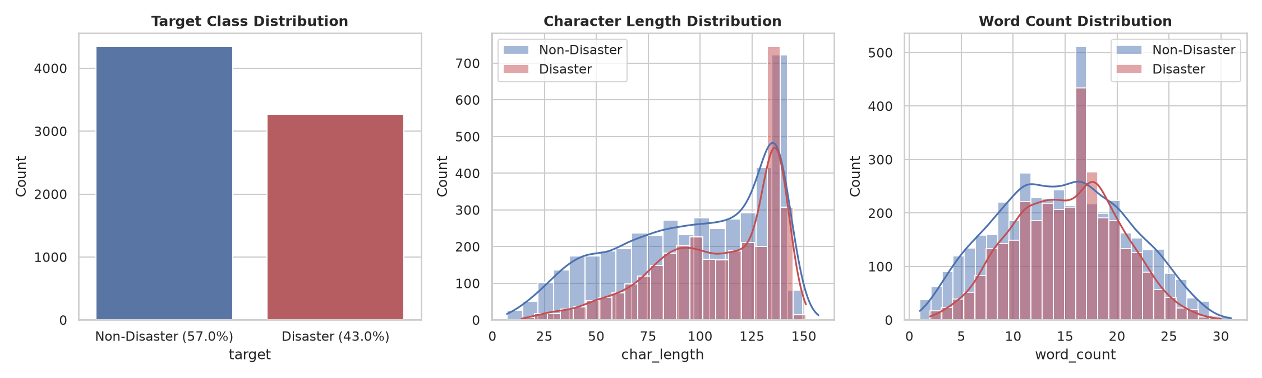
PART 1 • DATA EXPLORATION
Dataset Architecture & Quality Analysis
Dataset Composition & Dimensions
• Total Records: 7,613 hand-classified disaster tweets
• Target Balance: 57.0% Non-Disaster (0) vs. 43.0% Disaster (1)
• Features: id, keyword, location, text, target
Missing Values & Data Integrity Check
• Location Column: 2,534 missing values (33.29% null)
• Keyword Column: 61 missing values (0.80% null)
• Text & Target: 0 missing values (100% complete)
Duplicate Text & Conflicting Labels
• 110 duplicate text entries across 179 rows.
• 18 unique tweets have conflicting ground-truth targets (crowdsourced annotation noise).

Slide 4
PART 1 • TEXT STRUCTURE
Metadata Characteristics & Tweet Length Analysis
Character Length
Disaster: 108.1 chars
Non-Disaster: 95.7 chars
Delta: +12.4 chars
Structural Insight:
Disaster tweets use formal terminology and detail, resulting in longer overall length.
Web URLs / Links
Disaster: 0.77 URLs
Non-Disaster: 0.51 URLs
Delta: +51% More URLs
Structural Insight:
Disaster reports frequently link to live news feeds, weather advisories, and emergency portals.
User Mentions (@)
Disaster: 0.27 Mentions
Non-Disaster: 0.42 Mentions
Delta: -36% Fewer @s
Structural Insight:
Non-disaster tweets feature conversational chatting and social replies with higher mention density.

Slide 5
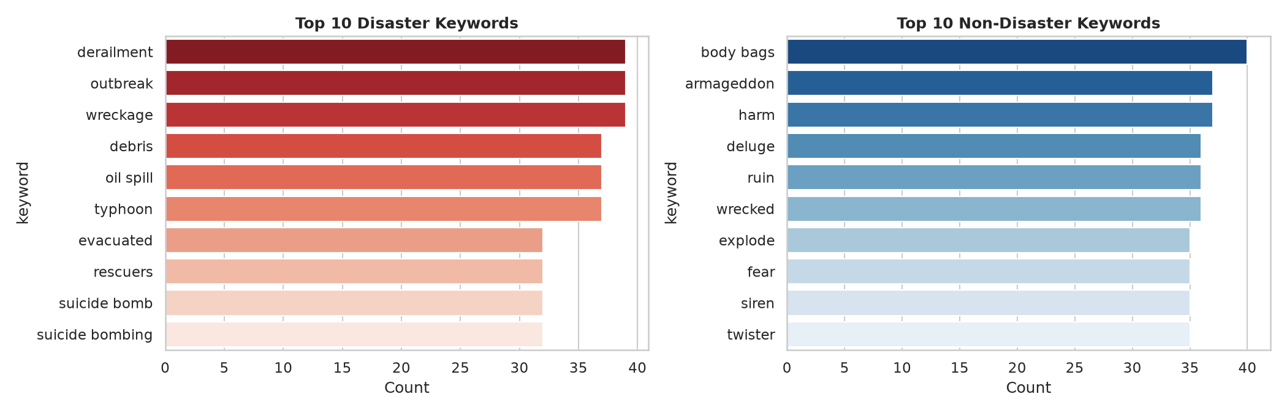
PART 1 • VOCABULARY MINING
Keyword & Phrase Frequency Analysis
Key Finding: Vocabulary Separation vs. Metaphorical Overlap
• True Disaster Keywords: High specificity terms like 'derailment', 'outbreak', 'wreckage', 'oil spill', 'typhoon', 'debris'.
• Colloquial Non-Disaster Keywords: Dramatized emotional words like 'body bags', 'armageddon', 'harm', 'ruin', 'panic', 'screaming'.
• Critical Bigrams: 'suicide bomber', 'northern california', 'burning buildings', 'california wildfire' indicate emergency alerts.

Slide 6
PART 1 • DATA PREPARATION
Text Preprocessing & Pipeline Standardization
1. Lowercasing
Standardizes all character casing to prevent vocabulary duplication.
Rule: TEXT ➔ text
2. URL Removal
Eliminates http/https web links that add dimensionality noise.
Rule: https://t.co/... ➔ ''
3. HTML Stripping
Removes web artifacts like <br>, &amp;, and encoding entities.
Rule: <.*?> ➔ ''
4. Mentions & Hashtags
Removes conversational @handles and strips '#' prefix to keep words.
Rule: @user #fire ➔ fire
5. Punctuation & Digits
Cleans out special symbols and numbers that do not carry semantic intent.
Rule: [!?,.:] & \d+ ➔ ''
6. Stopwords & Pruning
Filters NLTK English stopwords and drops short tokens (< 3 characters).
Rule: tokens > 2 chars

Slide 7
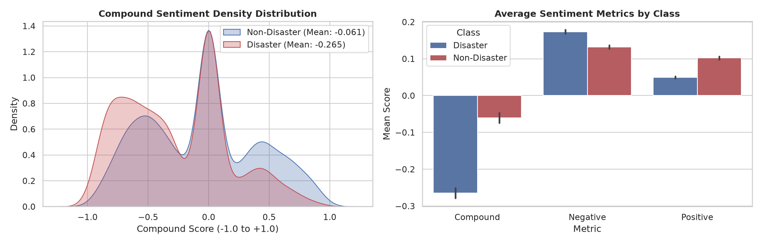
PART 2 • FEATURE EXTRACTION
Feature Engineering: VADER Sentiment Analysis
Why Sentiment for Disaster Detection?
Natural disasters trigger strong feelings of distress, danger, and urgency. VADER (Valence Aware Dictionary and sEntiment Reasoner) was utilized to extract continuous affective scores.
Empirical Sentiment Profile
• Compound Polarity:
Disaster: -0.2646 (Steep negative)
Non-Disaster: -0.0607
• Positive Sentiment:
Disaster tweets contain less than half the positive tone (4.93% vs. 10.21%).
• Categorical Distribution:
56.89% of disaster tweets are strictly Negative vs. only 16.20% Positive.

Slide 8
PART 2 • SEMANTIC REPRESENTATION
Continuous Dense Embeddings (Word2Vec)
1. Dense Vector Architecture
• Trained Word2Vec (Skip-Gram/CBOW)
• 100-dimensional continuous space
• Vocabulary: 6,018 unique disaster words
• Captures synonymy that sparse one-hot encodings completely miss.
2. Learned Semantic Similarities
Cosine distance in learned vector space:
• 'bomb' ➔ bombing (0.96), responder (0.95), vest (0.94)
• 'earthquake' ➔ hawaii (0.97), volcano (0.95)
• 'emergency' ➔ plan (0.82), chemical (0.81)
3. Document Classifier Benchmark
Averaged Word2Vec Document Classifier:
• Accuracy: 76.82%
• F1-Score: 70.66%
• Provides strong continuous baseline; complements sparse TF-IDF n-gram patterns.

Slide 9
PART 2 • MULTI-MODAL FUSION
Feature Experimentation: Text vs. Metadata vs. Hybrid
Pipeline Comparison via Scikit-Learn ColumnTransformer
Configuration Accuracy Precision Recall F1-Score Key Observation
1. Text-Only (TF-IDF N-Grams) 82.73% 85.48% 72.02% 78.17% Highest precision & optimal disaster phrase recognition
2. Metadata-Only (Length, URLs, Sent) 67.63% 65.51% 51.99% 57.97% Achieves ~68% accuracy without reading a single word
3. Hybrid (TF-IDF + Standardized Meta) 80.17% 80.03% 71.71% 75.65% Balanced multi-modal representation across dimensions
Metadata Feature Weights (Coefficients)
• Character Length (+1.31): Strong positive weight (longer formal descriptions).
• Sentiment Compound (-0.44): Strong negative weight (distress indicates disaster).
• User Mentions (-0.28): Negative weight (social chats are non-emergencies).
Key Takeaway for Final Deployment
While metadata carries notable standalone signal (67.6% accuracy), TF-IDF n-grams capture fine-grained vocabulary nuances (e.g., 'derailment' vs. 'delay') necessary for high-precision emergency alerting. TF-IDF was chosen for deployment.

Slide 10
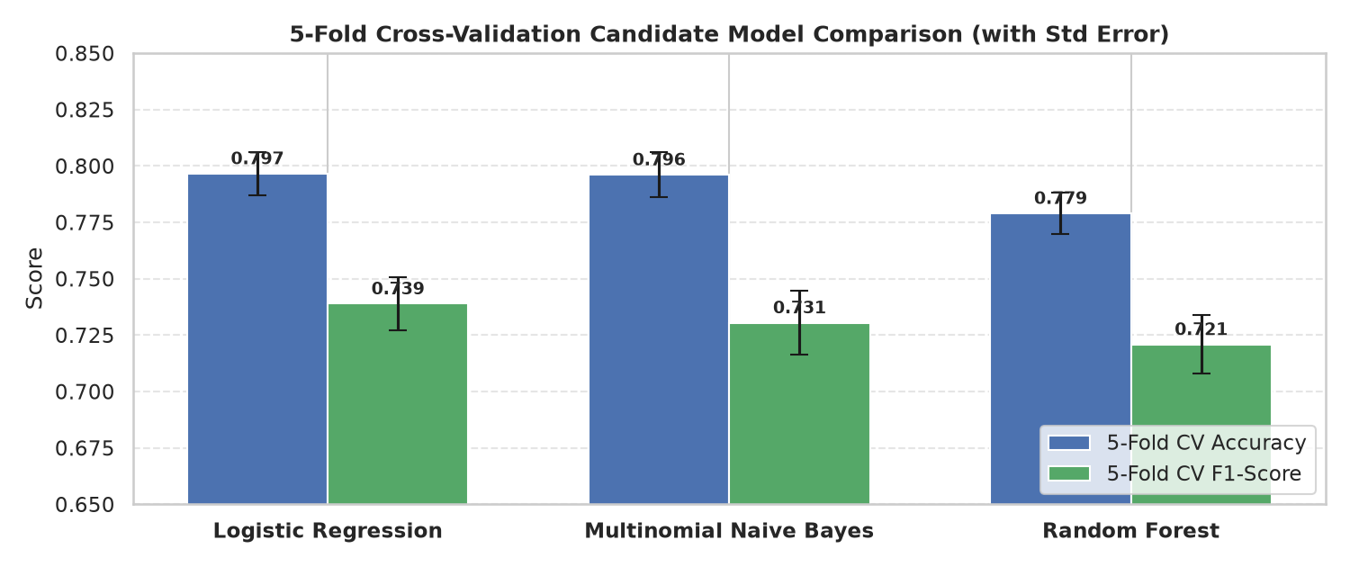
PART 2 • MODEL TRAINING
Model Selection & 5-Fold Cross-Validation
Rigorous Model Benchmarking
To eliminate train-test split bias, 5-Fold Stratified Cross-Validation was conducted across three distinct classifier families:
1. Logistic Regression (Linear + L2)
CV F1: 0.7389 ± 0.0118
CV Accuracy: 79.66% ± 0.97%
2. Multinomial Naive Bayes (Probabilistic)
CV F1: 0.7305 ± 0.0142
CV Accuracy: 79.61% ± 1.01%
3. Random Forest (Ensemble Trees)
CV F1: 0.7209 ± 0.0129
CV Accuracy: 77.90% ± 0.92%
Decision: Logistic Regression selected for highest F1 & stability.

Slide 11
PART 2 • OPTIMIZATION
Hyperparameter Tuning & Grid Search
GridSearchCV Space: 18 Candidates x 5 Folds = 90 Total Fits
• tfidf__ngram_range: [(1, 1), (1, 2)] ➔ Testing unigrams alone vs. unigrams + bigrams
• tfidf__max_features: [3,000, 5,000] ➔ Constraining vocabulary size to control model complexity
• clf__C: [0.1, 1.0, 5.0] ➔ L2 Inverse Regularization Strength (preventing overfitting)
• Scoring Metric: F1-Score (prioritizing harmonic mean of precision and recall)
Optimal C Parameter
C = 1.0
Balanced L2 regularization prevents weight explosion while maintaining sensitivity.
Optimal N-Gram Range
(1, 2) Bi-grams
Captures vital context pairs like 'wildfire evacuation' and 'suicide bomber'.
Max Features
5,000 Vocabulary
Eliminates low-frequency noise while retaining essential emergency tokens.

Slide 12
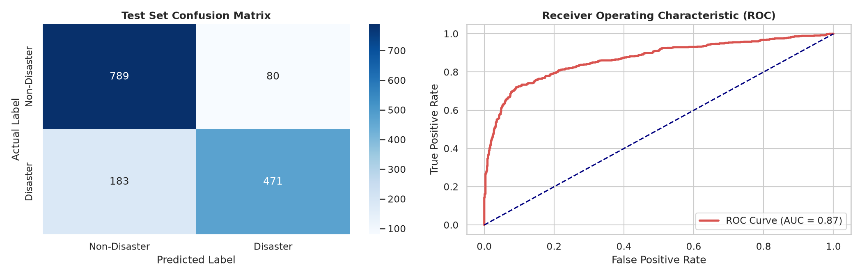
PART 3 • PERFORMANCE ASSESSMENT
Final Model Evaluation on Test Data
ACCURACY
82.73%
Correct predictions overall
PRECISION
85.48%
Low false positive alarms
RECALL
72.02%
True disaster detection rate
F1-SCORE
78.17%
Balanced harmonic mean

Slide 13
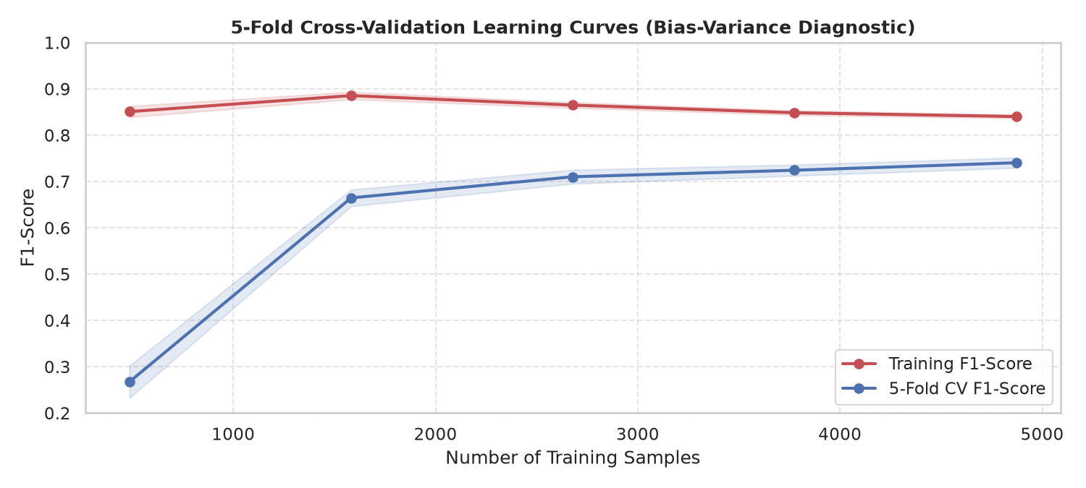
PART 3 • MODEL VALIDATION
Overfitting & Bias-Variance Diagnostics
Generalization Gap Audit
Comparing performance between Train and Test sets:
• Accuracy Gap: +4.18%
(Train: 86.91% vs. Test: 82.73%)
• Precision Gap: +6.81%
(Train: 92.29% vs. Test: 85.48%)
• Recall Gap: +3.87%
(Train: 75.89% vs. Test: 72.02%)
• F1-Score Gap: +5.11%
(Train: 83.29% vs. Test: 78.17%)
Status: Healthy Generalization

Slide 14
PART 4 • CLOUD DEPLOYMENT
Deployment Architecture & Web Interface
Interactive Streamlit UI (app.py)
• Text Area for pasting raw tweet text.
• Real-time classification button.
• Clear prediction badge (Disaster vs. Non-Disaster).
• Confidence probability percentage indicator.
Model Backend Pipeline
• Serialized via joblib: disaster_tweet_classifier.pkl.
• Pipeline integrates TF-IDF Vectorizer + tuned Logistic Regression.
• In-memory model caching via @st.cache_resource.
Production Cloud Readiness
• requirements.txt: Streamlit, scikit-learn, joblib, NLTK.
• Procfile: PaaS execution (Heroku / Render).
• Dockerfile: Standalone container for AWS / GCP.
• .streamlit/config.toml: Headless server configuration.

Slide 15
PROJECT SUMMARY
Conclusions & Future Enhancements
Key Project Achievements
• End-to-End NLP Lifecycle:
Conducted comprehensive EDA, quality audits, cleaning, feature extraction, cross-validation, and deployment.
• High Precision Disaster Alerting:
Achieved 85.5% Precision and 82.7% Accuracy, successfully suppressing false alarms from metaphorical expressions.
• Robust Feature Engineering:
Combined TF-IDF n-grams with VADER sentiment polarity and dense Word2Vec semantic embeddings.
• Production Packaging:
Delivered a containerized web application ready for cloud hosting on Heroku or AWS.
Future Scope & Recommendations
• Transformer Architectures:
Fine-tune BERT, RoBERTa, or DeBERTa models to capture bi-directional context and deep syntactic nuance.
• Real-Time Twitter Streaming:
Integrate Twitter Streaming API with Kafka/RabbitMQ to ingest and classify tweets in real time.
• Geolocation & Interactive Heatmaps:
Extract and geocode user locations to visualize disaster clusters on live GIS mapping dashboards.
• Multilingual Support:
Expand NLP preprocessing and models to monitor global emergencies in Spanish, French, Japanese, and Hindi.

