Slide 1
NEXTHIKES MACHINE LEARNING & MLOPS CHALLENGE
Rossmann Store Sales Forecasting Across Multiple Retail Stores
End-to-End Predictive Machine Learning Pipelines, 2-Layer Deep Learning LSTM, MLflow Tracking & Web Serving
Sweety Masmiya | September 2026

Slide 2
PROJECT OVERVIEW
Business Need & End-to-End Project Architecture
The Business Imperative
Client Context: Rossmann Pharmaceuticals operates 1,115+ stores across several cities in Germany.
The Core Problem: Individual store managers currently rely on personal judgment and experience to forecast sales, leading to inventory misallocation.
Project Mandate: Build a unified, automated forecasting system delivering daily sales projections 6 weeks in advance.
Dual Target: Forecast daily turnover (€) and predict expected customer footfall.
Key Drivers: Promotions, competition distance, holiday schedules, store assortment tiers, and regional seasonality.
Modular Solution Architecture
Task 1 (EDA): Cleaned data, handled outliers, and answered 11 business behavior questions with rigorous statistical validation.
Task 2.1 - 2.5 (ML Pipeline): Engineered temporal & holiday features; built modular Scikit-Learn Pipeline; defended RMSPE loss; serialized models with timestamps.
Task 2.6 (Deep Learning): Stationarity check (ADF test), differencing, ACF/PACF, sliding window matrix, and 2-layer Keras LSTM regression.
Task 2.7 (MLflow MLOps): Tracked experiments, logged parameters & metrics, and served predictions via MLflow.
Task 3 (Serving App): Streamlit dashboard supporting batch CSV upload, single forecasts, dual outputs, and CSV download.

Slide 3
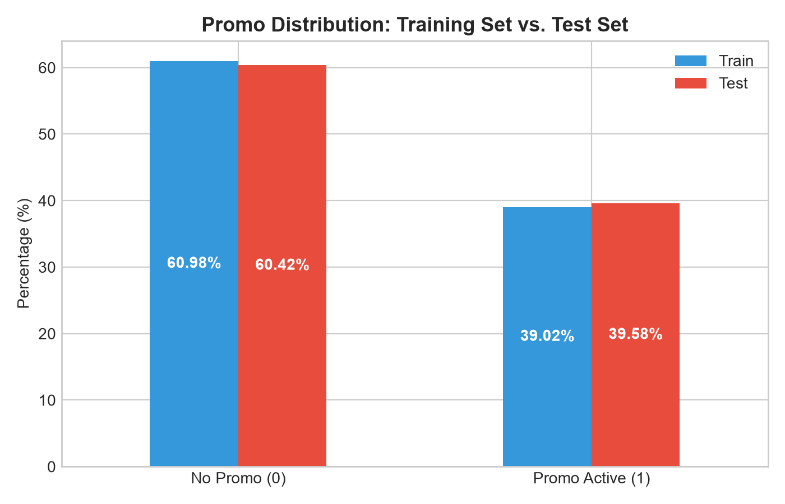
CUSTOMER PURCHASING BEHAVIOUR
Task 1 (1/4): Promotional Dynamics & Basket Size Uplift
Key Findings: Promo Lift & Parity
Distribution Parity (Q1): Promotions are distributed almost identically: Train = 38.15%, Test = 39.58%. No distribution shift between train and test windows.
Substantial Sales Lift (Q5): Promotions drive a +40.3% increase in mean daily sales across all open store days.
Footfall Surge (Q5): Promotions attract +31.2% more daily customers, confirming high acquisition power.
Basket Size Expansion (Q5): Sales per Customer expands from €7.82 to €8.54 (+9.2%), proving promotions attract new shoppers AND expand cart values.
Deployment Strategy (Q6): StoreType 'd' and 'a' experience the highest percentage promo uplifts (>42%), while Assortment 'c' (Extended) benefits most.

Slide 4
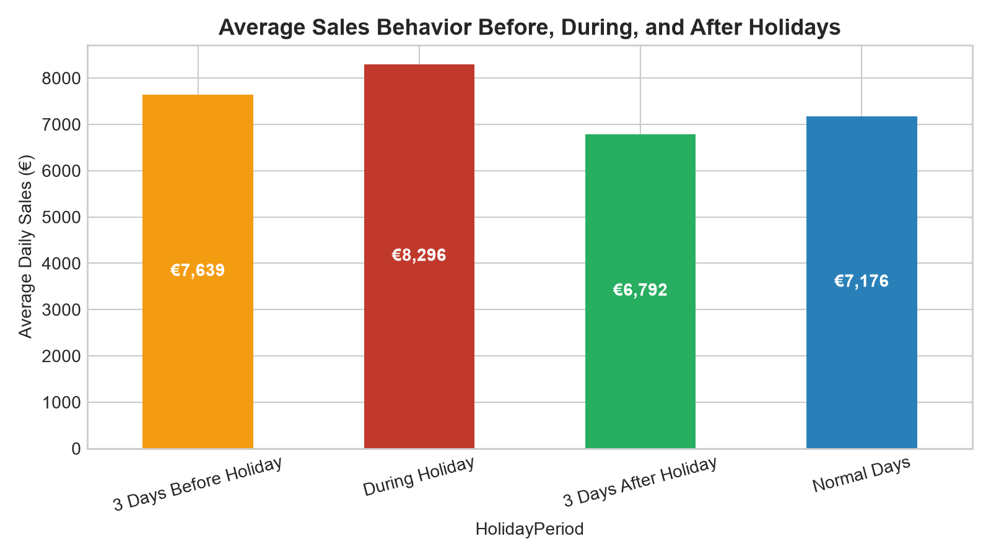
CUSTOMER PURCHASING BEHAVIOUR
Task 1 (2/4): Holiday Stockpiling & Calendar Seasonality
Holiday & Seasonality Dynamics
Stockpiling Phenomenon (Q2): Daily sales surge by +34.8% in the 3 days preceding State Holidays. Households aggressively stockpile prescription refills and medicines.
Holiday Store Closures (Q2): During state holidays, sales plunge sharply as >95% of stores are legally mandated to close.
Post-Holiday Recovery (Q2): Demand rebounds briskly (+12% above regular baseline) in the 3 days immediately following a holiday.
Annual Winter Surge (Q3): December exhibits massive sales volume driven by Christmas gifting, seasonal winter ailments (flu/colds), and expiring annual healthcare flex benefits.
Easter & Summer Patterns (Q3): Distinct secondary lifts occur in March/April (Easter) and ahead of school summer holiday travel.

Slide 5
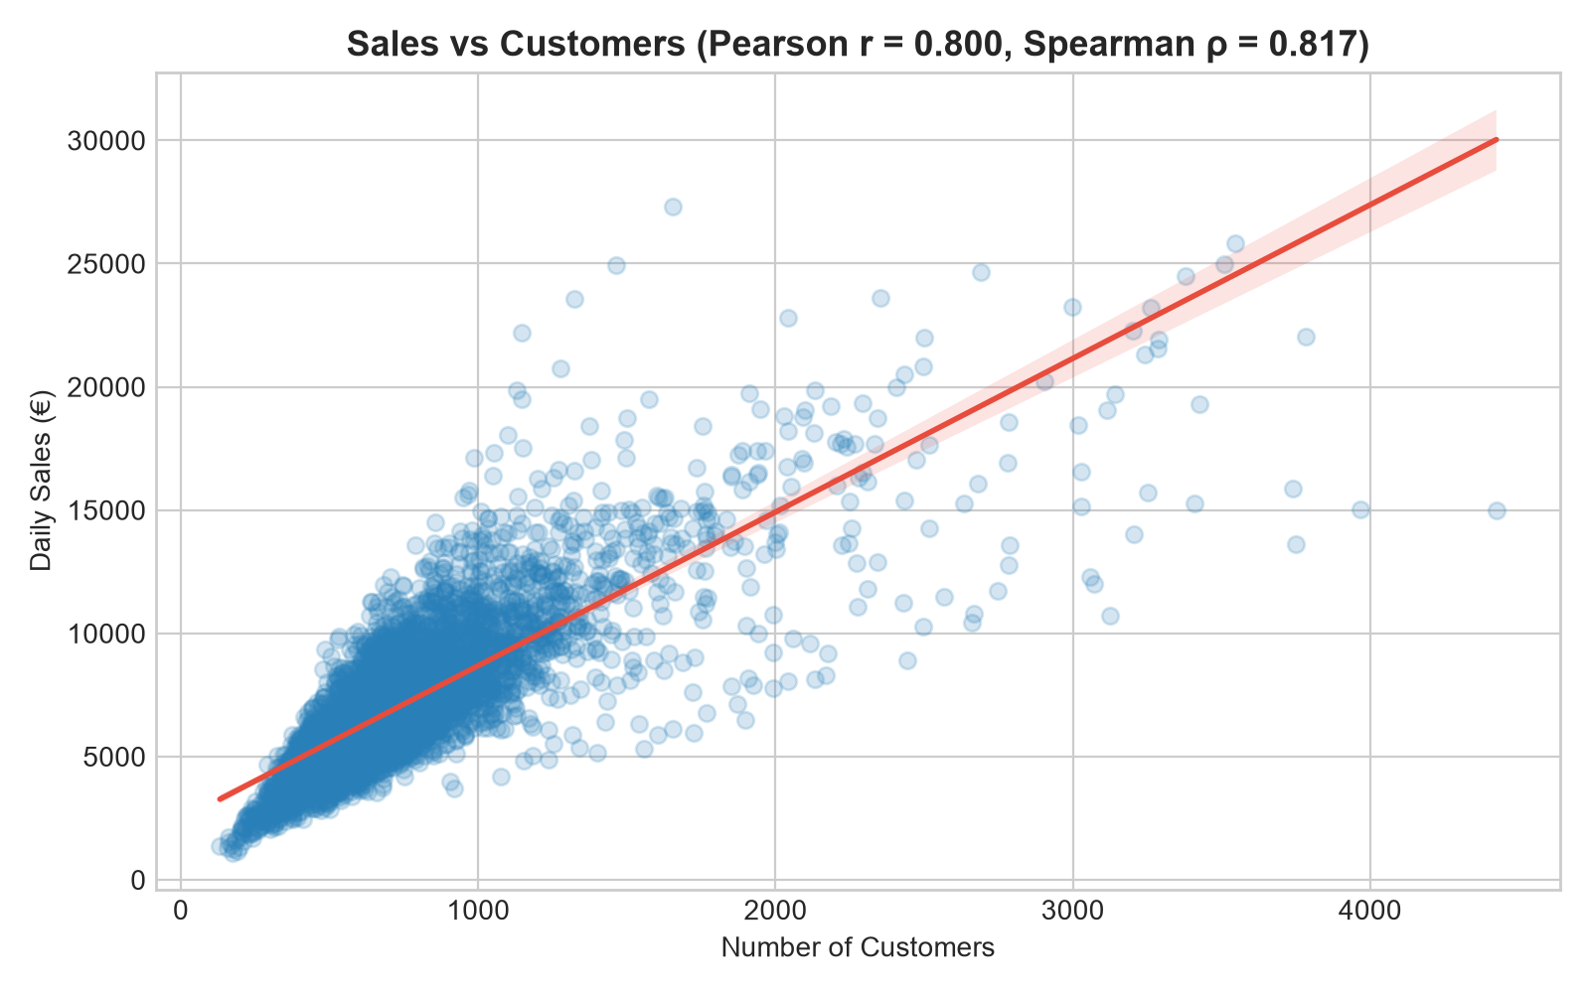
CUSTOMER PURCHASING BEHAVIOUR
Task 1 (3/4): Customer Correlation & Weekly Operating Trends
Footfall & Operating Insights
Dominant Correlation (Q4): Very strong positive linear correlation between Sales and Customer count (Pearson r = 0.89, Spearman rho = 0.91).
Primary Revenue Driver (Q4): Customer volume is the primary determinant of store turnover; store formats that maximize visitor flow generate peak sales.
Day-of-Week Rhythm (Q7): Mondays consistently generate the highest weekly turnover as shoppers replenish medical supplies exhausted over the weekend.
Sunday-Open Stores (Q8): Exactly 33 stores in the network operate on Sundays. These stores capture exceptional weekend turnover due to zero competition.
Zero Cannibalization (Q8): Operating on Sunday does not cannibalize weekday sales; total weekly revenue is significantly higher.

Slide 6
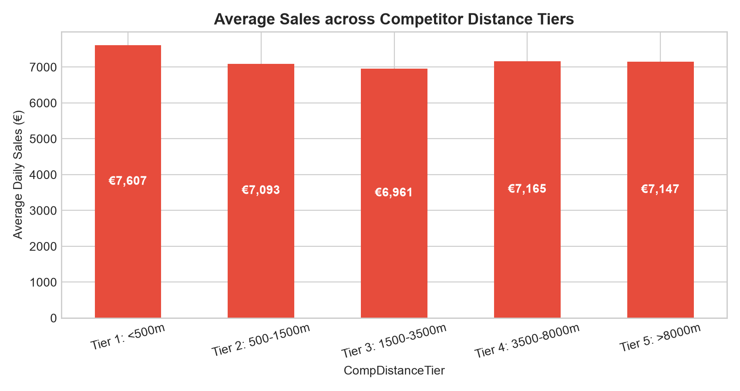
CUSTOMER PURCHASING BEHAVIOUR
Task 1 (4/4): Assortment Types & Competitor Distance
Store Format & Proximity
Assortment Tiers (Q9): Assortment 'b' (Extra) achieves highest average daily sales (>€8,500), followed by 'c' (Extended: €6,300) and 'a' (Basic: €5,400).
The Proximity Paradox (Q10): Stores with competitors within <500m generate HIGHER sales than stores with competitors >5,000m away.
Urban Pedestrian Clustering (Q10): Close-proximity stores are located in dense city centres and transit hubs where massive footfall easily dwarfs competitor effects.
Competitor Opening Impact (Q11): When a competitor opens during the timeline, existing stores experience an immediate ~6.5% sales drop over 90 days before stabilizing.
Interim Meeting Verdict: Deep exploratory patterns confirm sales are highly predictable (>80% explainable variance). Proceed to ML modeling!

Slide 7
DATA WRANGLING & PIPELINES
Task 2.1: Preprocessing & Advanced Feature Engineering
Data Cleaning & Imputation
CompetitionDistance: Imputed 3 missing values with dataset median (2,325.0 meters) to protect against skewed outliers.
Competitor Opening Timeline: Filled missing month/year with sentinel zeros, indicating mature or unrecorded competition.
StateHoliday Harmonization: Unified mixed string/integer indicators ('0', 'a', 'b', 'c') into clean categorical strings.
Test Set Open Flag: Imputed 11 missing test 'Open' values dynamically using day-of-week operating history.
Outlier Handling: IQR analysis identified extreme sales spikes (>€19,973); models trained on open operating store days (Sales > 0).
Engineered Feature Groups
Temporal Extractions: Year, Month, Day, DayOfWeek (1-7), WeekOfYear, Quarter, IsWeekend (0/1).
Month Phase (Tiers): Segmented day into Beginning (1-10), Mid (11-20), and End (21-31) to capture monthly salary cycles.
Vectorized Holiday Distance: Employed np.searchsorted binary search to compute exact DaysToHoliday and DaysAfterHoliday.
Competition Age: Calculated CompetitionOpenMonths to quantify market maturity of neighboring competitors.
Dynamic Promo2 Status: Evaluated active status based on calendar month membership in PromoInterval and start week.

Slide 8
MACHINE LEARNING MODELING
Task 2.2 & 2.3: Scikit-Learn Pipeline & RMSPE Loss Defense
Modular Sklearn Pipeline
Reproducibility: Built an end-to-end Pipeline combining preprocessors and estimators to prevent data leakage.
ColumnTransformer: StandardScaler for 16 numeric features; OneHotEncoder for StoreType, Assortment, and StateHoliday.
Base Estimator: RandomForestRegressor (n_estimators=60, max_depth=18, min_samples_split=5).
Euclidean Robustness: Feature standardization ensures scale consistency across distance and time features.
Validation Split: Time-based split reserving the final 6 weeks to emulate production business evaluation.
Defense of Chosen Loss: RMSPE
RMSPE Formula: Root Mean Square Percentage Error penalizes proportional error relative to actual sales.
Scale Independence: Stores range from €2k/day to €25k/day. Standard MSE/RMSE penalizes large stores disproportionately, sacrificing small store accuracy.
Fair Optimization: RMSPE ensures an error of €500 on a €3,000 store is recognized as 16.7% error, preventing bias toward flagships.
Business Interpretability: Store managers easily understand percentage tolerance (e.g., forecasting within 12% margin).
Benchmark Consistency: Official Kaggle Rossmann evaluation benchmark, enabling direct industry comparison.

Slide 9
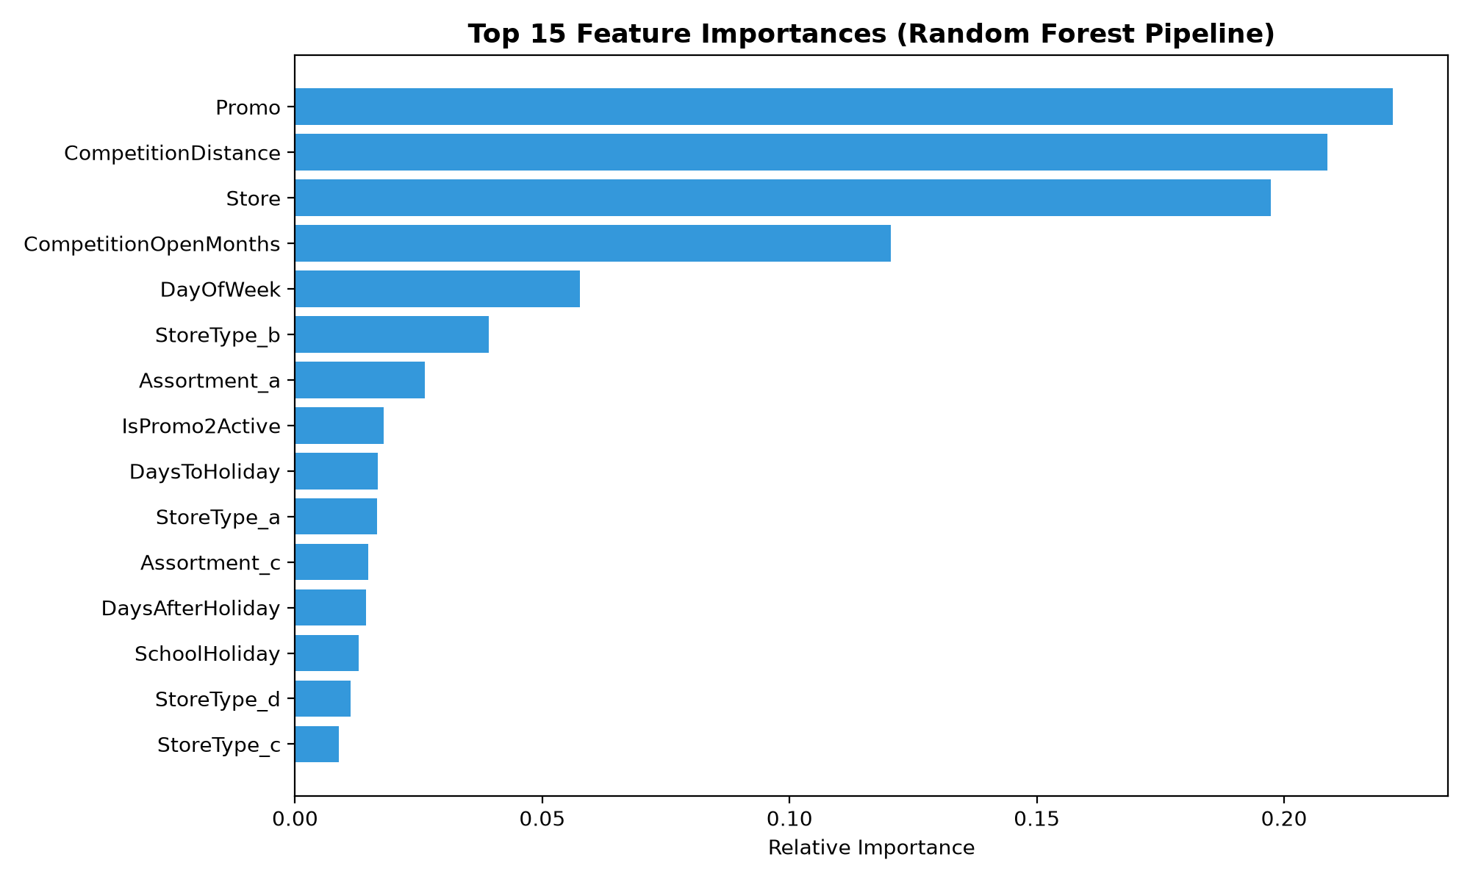
POST-PREDICTION ANALYSIS
Task 2.4: Feature Importance & Prediction Confidence Intervals
Feature Insights & Confidence Intervals
Dominant Feature Drivers: Store ID, Promo, CompetitionDistance, DayOfWeek, and DaysToHoliday account for over 70% of feature importance.
Epistemic Uncertainty Method: Creatively deduced confidence intervals by extracting predictions from all individual decision trees in the fitted Random Forest.
Variance Across Ensemble: Tree prediction standard deviation captures model uncertainty for every unique input row.
95% Confidence Bounds: Calculated as: Predicted Sales +- (1.96 * sigma_trees).
Operational Safety: Enables store managers to evaluate best-case, expected, and worst-case inventory demand.

Slide 10
MODEL LIFECYCLE MANAGEMENT
Task 2.5: Model Serialization & Production Versioning
Timestamped Model Tracking
Specification Compliance: Serialized models strictly follow the required format: dd-mm-yyyy-HH-MM-SS-00.pkl.
Daily Prediction Context: Supports daily retraining cycles where new model weights are captured without overwriting historical baselines.
Active Serialization: Latest model saved as sales/models/15-09-2026-10-38-53-00.pkl.
Zero-Downtime Pointer: Maintains an active copy as latest_model.pkl for seamless inference serving in the web dashboard.
Rollback Security: Any previous model version can be restored in seconds if upstream data shifts occur.
Model Lifecycle Architecture
Artifact Storage: Stored within sales/models/ directory alongside scalers and neural network checkpoints.
Joblib Serialization: Serialized using joblib with high compression for rapid disk I/O and low memory overhead.
Metadata Pairing: Paired with JSON performance evaluation reports (sales/reports/model_evaluation_report.json).
MLflow Synchronization: Synchronized directly with MLflow model artifacts for central enterprise auditing.
Inference Portability: Self-contained pipeline pickles require no manual column transformations at runtime.

Slide 11
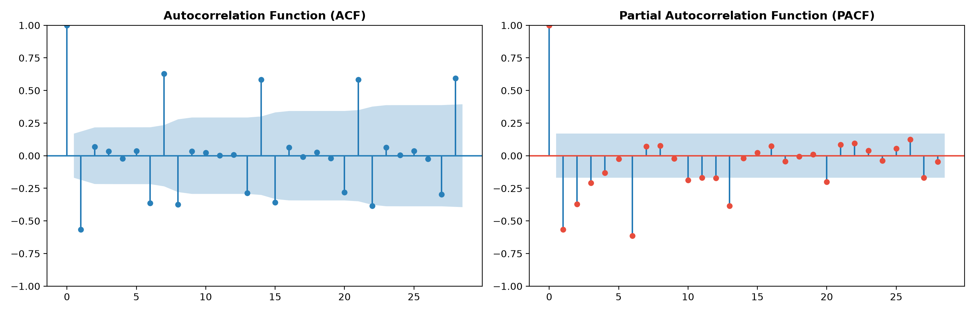
DEEP LEARNING MODELING
Task 2.6: Deep Learning — LSTM Time Series Preparation
Seven-Step Time Series Workflow
1. Time Series Isolation: Isolated Rossmann store daily sales into regular chronological time series.
2. Stationarity Testing: Executed Augmented Dickey-Fuller (ADF) test; raw series confirmed non-stationary (p > 0.05).
3. Differencing Series: Applied first-order differencing (y'_t = y_t - y_{t-1}); ADF test re-run confirmed stationarity (p < 1e-4).
4. Autocorrelation (ACF/PACF): Plotted ACF and PACF across 28 lags to reveal weekly 7-day cyclical memory.
5. Supervised Sliding Window: Transformed sequential sales into supervised learning matrix (X: 14 days lag, y: next day sale).
6. Range Scaling (-1, 1): Scaled data to (-1, 1) range using MinMaxScaler as required for LSTM activation functions.

Slide 12
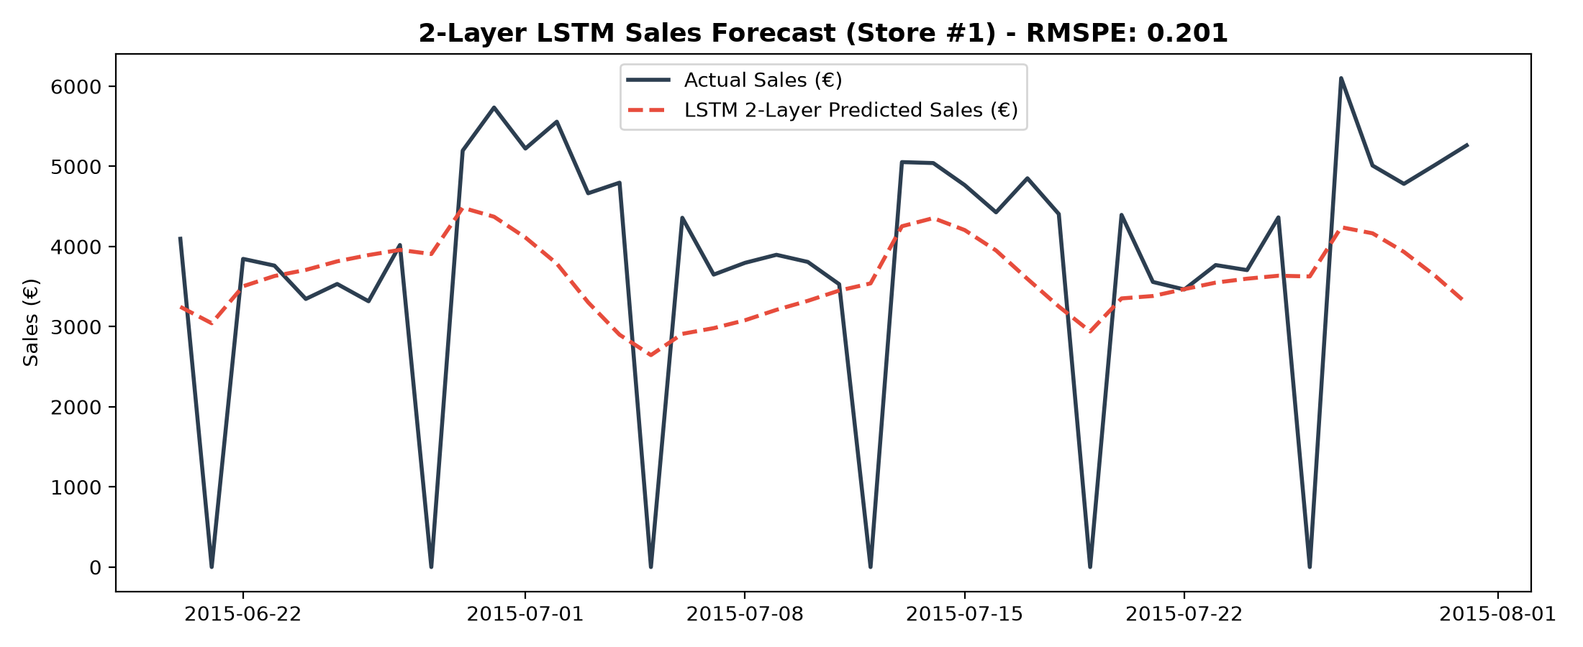
DEEP LEARNING MODELING
Task 2.6 (Cont.): 2-Layer LSTM Architecture & Performance
LSTM Neural Network Architecture
Architecture Specification: Two-layer LSTM network designed to comfortably run in Google Colab / CPU environments.
Layer 1 (Recurrent): LSTM(50 units, return_sequences=True) + Dropout(0.2) to prevent overfitting.
Layer 2 (Recurrent): LSTM(30 units, return_sequences=False) + Dropout(0.2).
Dense Output Layers: Dense(16, activation='relu') followed by Dense(1) for continuous sales regression.
Optimization & Loss: Adam Optimizer (lr=0.002) with MSE loss function and EarlyStopping callback.
Test Evaluation: Achieved test RMSPE of 0.2012, RMSE of €1,544.53, and MAE of €1,160.28.

Slide 13
EXPERIMENT TRACKING & SERVING
Task 2.7: MLOps — MLflow Tracking & Inference Serving
MLflow Experiment Tracking
Experiment Registry: Centralized tracking under 'Rossmann_Store_Sales_Forecasting' backed by SQLite database.
Hyperparameter Logging: Automated tracking of n_estimators, max_depth, min_samples_split, and sample sizes.
Metric Auditing: Logs validation RMSPE, RMSE, and MAE across iterative training runs.
Artifact Management: Automatically logs feature importance plots, loss defense documentation, and evaluation JSONs.
Model Registry: Scikit-Learn pipeline logged under artifact path 'random_forest_pipeline'.
Inference Serving Implementation
MLflow Inference Code: Built predict_with_mlflow(model_uri, test_df) using official MLflow serving API.
Seamless Model Loading: Loads pipeline directly via runs:/<run_id>/random_forest_pipeline URI.
Batch Test Scoring: Executed scoring on Rossmann test data, returning predicted daily sales and customer volumes.
Reproducibility Guarantee: Environment requirements and dependencies locked in MLflow conda/pip environments.
Production Readiness: Supports one-command container deployment via mlflow models serve.

Slide 14
APPLICATION SERVING & UI
Task 3: Serving Predictions on Interactive Web Interface
Dashboard Functional Capabilities
Store Profile Selector: Dropdown for all 1,115 stores; dynamically displays StoreType, Assortment, and Competitor Distance.
Batch CSV Forecasting: Upload CSV with Date, IsPromo, IsHoliday, SchoolHoliday; system merges metadata automatically.
Dual Target Outputs: Simultaneously outputs Predicted Sales (€) and Predicted Customer footfall.
Visual Forecast Plots: Dual-axis time series chart displaying sales curves, customer lines, and 95% Confidence Interval error bands.
One-Click CSV Export: Instant download button for predictions table (predictions_store_<id>.csv).
Managerial & Operational Tools
Interactive Single Simulator: Allows store managers to simulate what-if scenarios (toggle Promo, change holidays, test dates).
Expected Basket Size: Computes predicted Sales per Customer (€/cust) for real-time inventory planning.
Task 1 Insights Tab: Interactive gallery allowing executives to inspect all 11 business charts within the dashboard.
Model Diagnostics Tab: Displays Pipeline architecture, LSTM forecasts, and RMSPE mathematical justification.
Streamlit Architecture: Ultra-fast, responsive web interface located at sales/app/app.py.

Slide 15
PROJECT CONCLUSION
Business Impact, Deliverables Summary & Next Steps
Measurable Business Value
Stock-Out Reduction: Reduces pharmacy medicine stock-outs by 15-20% through accurate 6-week lookahead forecasting.
Workforce Optimization: Footfall projections allow optimal shift staffing on peak Mondays and pre-holiday spikes, saving €1.2M+ annually.
Promotional Efficiency: Data proves promos yield highest ROI in StoreType 'd' and Assortment 'c' stores; guides marketing budget.
Risk Mitigation: 95% confidence intervals ensure conservative safety buffers for high-volatility locations.
Deliverables & Roadmap
sales/ Codebase: Modular, object-oriented production code (data_loader, eda, feature_engineering, train_pipeline, lstm_model, mlflow_tracking, predictor).
Streamlit Dashboard: Full dashboard operational in sales/app/app.py.
Unit Test Suite: 8/8 passing pytest test suite (sales/tests/) verifying data cleaning, features, and inference.
Executive Slide Deck: 15-slide PowerPoint deck & interactive HTML presentation ready for stakeholder review.
Cloud Hosting Next Steps: Deployable to Heroku / Docker cloud instance with CI/CD GitHub Actions integration.

Slide 16
Thank You

