Slide 1
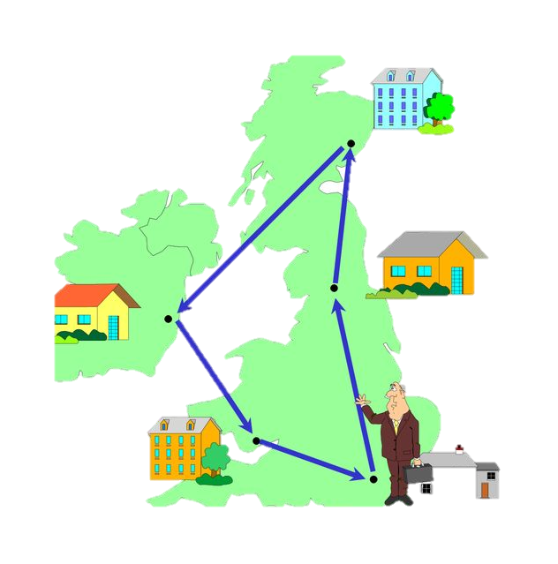
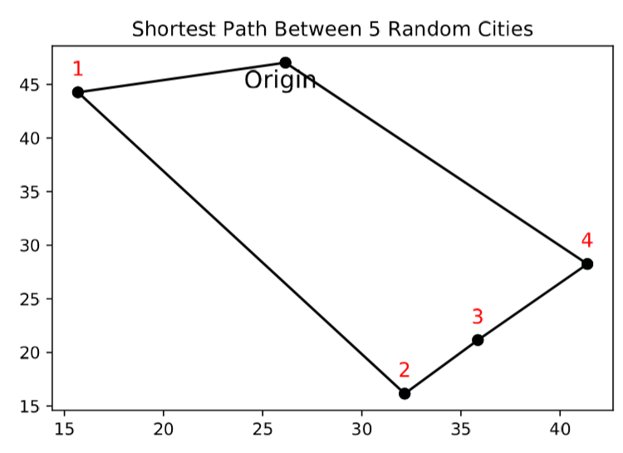
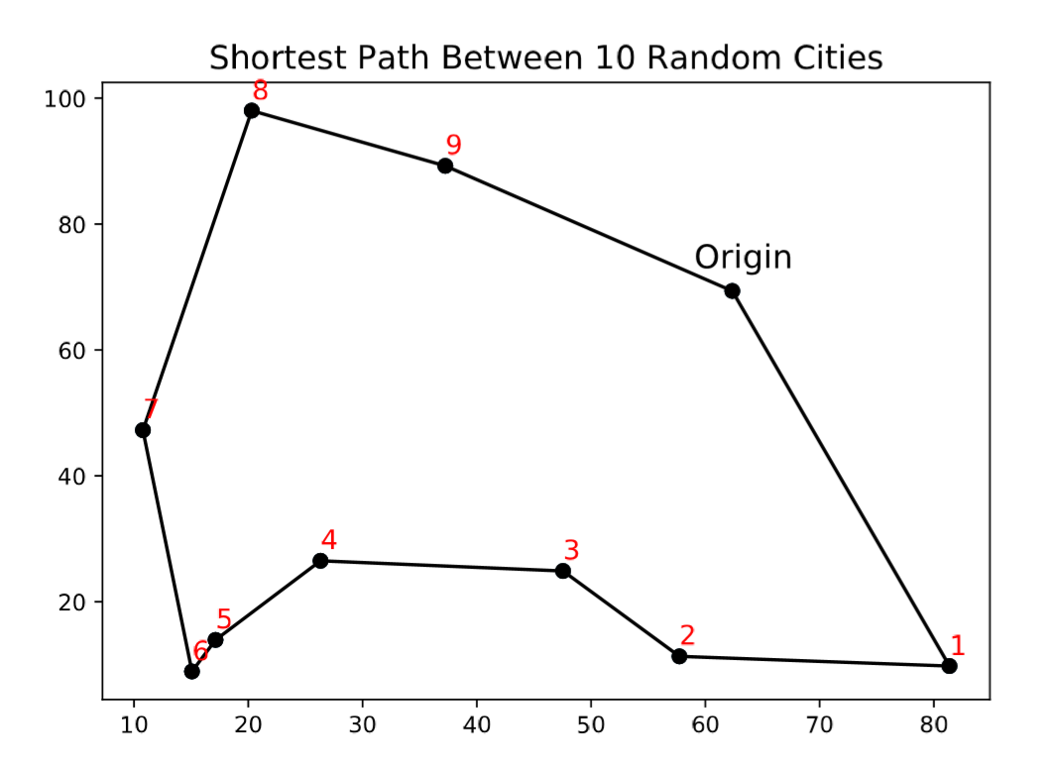
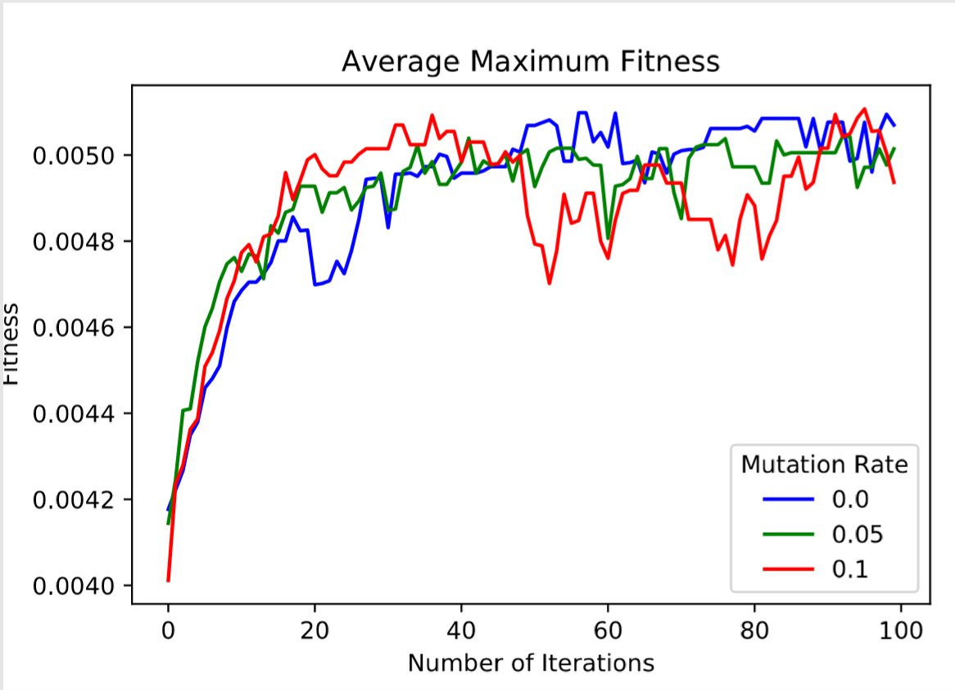
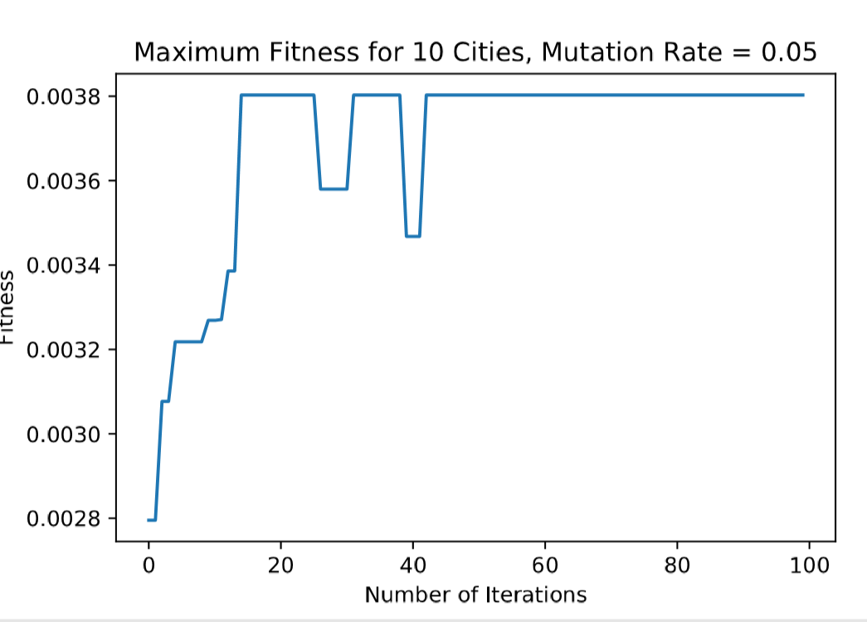
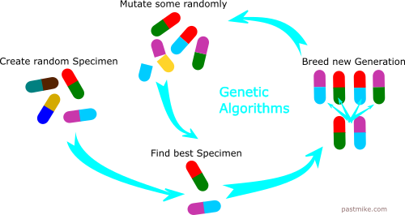
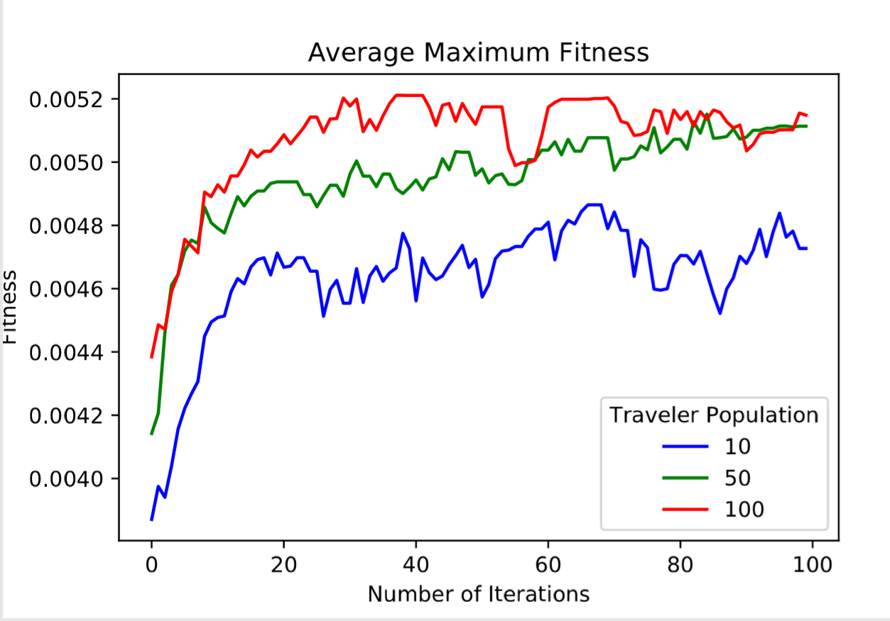
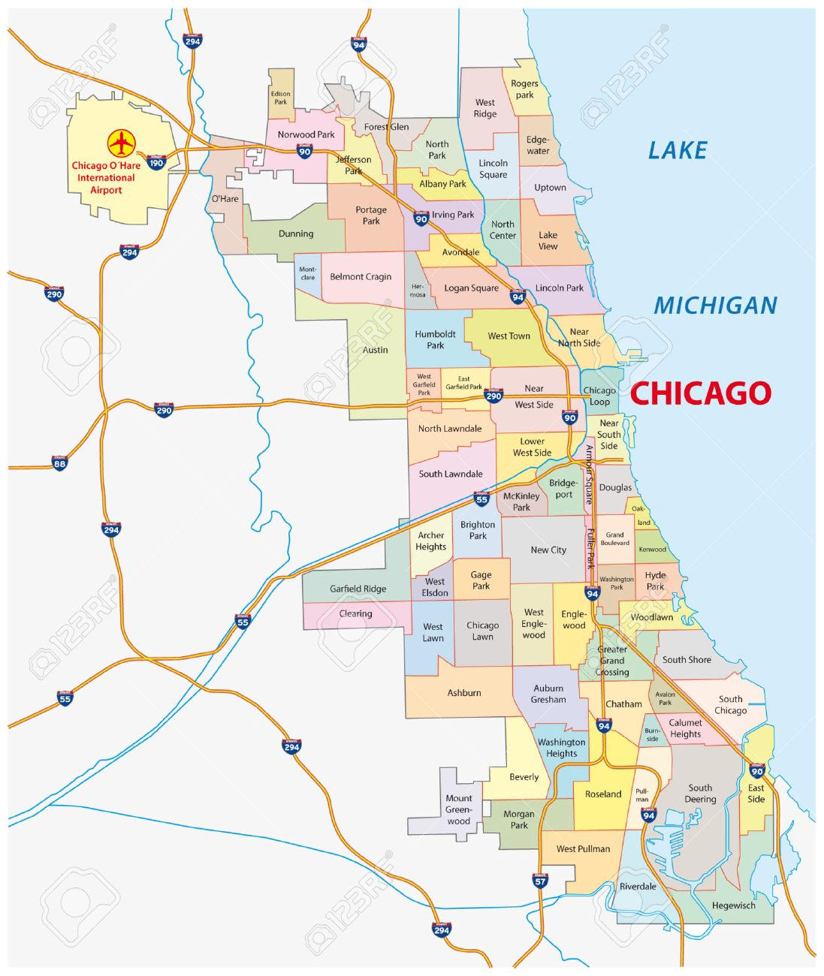
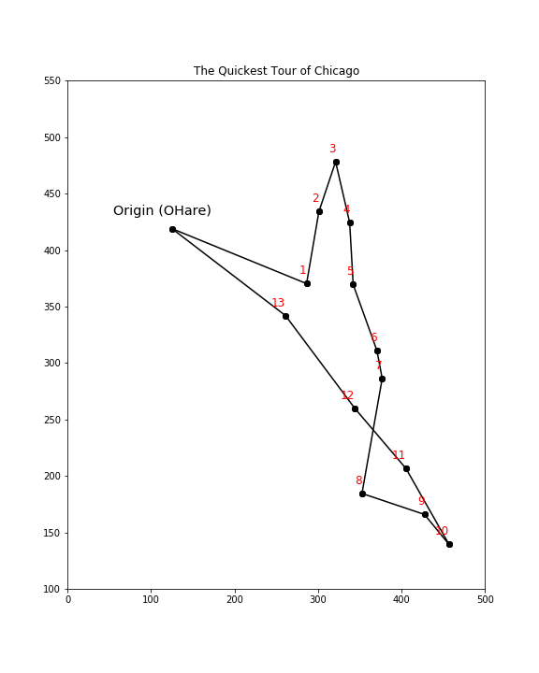
Applying Genetic Algorithms to Find the Quickest Tour of Chicago
University of Chicago Department of Physics
Shalma Wegsman Gueron¹, David Miller¹
Abstract
Results
Analysis
The traveling salesman problem asks, given a set of cities, what is the shortest path which stops at each city exactly once and returns to the origin?
First we apply the algorithm to some randomly placed cities:
The mutation rate and the size of the traveler population may impact the algorithm’s effectiveness.
We test these dependencies by taking the average maximum fitness over 10 trials for different values
This is tested on the case with 10 random cities (held constant for each trial)
To solve this problem, I create a genetic algorithm which starts with a random set of possible paths, and “evolves” the best ones to develop increasingly ideal routes.
I then apply it to a map of Chicago to find the quickest tour around town!
1) Mutation Rate
Plotting the fitness of the best traveler over each iteration shows how the fitness of the paths increases and stabilizes over time:
Genetic Algorithms
Having too high of a mutation rate may reduce the algorithm’s stability
2) Population Size
Applying the algorithm to a map of Chicago, and choosing some essential neighborhoods to visit, we get this final route:
Inspired by evolution, a genetic algorithm solves this problem in the following way:
We generate an initial population of travelers, each with a randomized path
We calculate the “fitness” of each traveler by the inverse of the total distance traveled.
Then we apply “evolution”:
The “parents” are the two travelers with the highest fitness
Randomly combine the parents’ routes to create four “children” routes
With some small probability, “mutate” each child’s route by switching the order of two random stops
Repeat by choosing the next best fit parents until the child population is the same size as the original population
Return to step (2) and repeat
This route is found using:
A population of 50 travelers
Mutation rate of 0.05
200 total iterations
A population of 50 and 100 both achieve similar fitness in the long run, but the population of 50 takes longer to get there
A population of 10 does not achieve the same fitness
Overall, an high population size and small mutation rate appear ideal for this algorithm
1. Logan Square
2. Lincoln Square
3. Rogers Park
4. Uptown
5. Lincoln Park
6. The Loop
7. South Loop
8. Englewood
9. South Shore
10. South Chicago
11. Hyde Park
12. Bridgeport
13. Humboldt Park
14. O’Hare
GitHub Repository:
All code written for this project can be found at https://github.com/swegsman/phys250_finalproject
References:
Mitchell, Melanie. Complexity: A guided tour. Oxford University Press, 2009.
https://pastmike.com/what-is-a-genetic-algorithm/
Acknowledgements: Thank you to Prof. David Miller for leading this class, and to Jan Offermann and Jack Dale for your help throughout.
Notes:
Improving searches for new physics with the LHC
Detailed: to understand the particle composition/kinematics of our background and signal
Big picture: does this signal exist, how can we improve our search for it

