Slide 1
Talk context
This is a practice talk for IFL keynote in early September
Overall talk goals: part new ideas, part tutorial, part invitation for collaboration
Stop me with questions
… I'm assuming you did your homework

Slide 2
How to Implement the Lambda Calculus, Quickly
Stephanie Weirich
University of Pennsylvania
Penn PLCLUB
August 6, 2021
https://github.com/sweirich/lambda-n-ways/

Slide 3
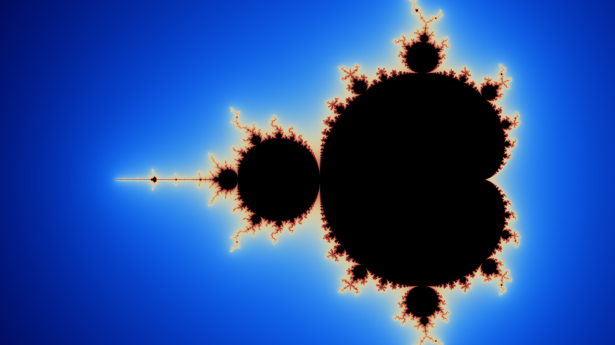
How to implement the lambda calculus, quickly
Stephanie Weirich
Penn PLCLUB, August 6, 2021

Slide 4
How to implement two key operations?
Alpha-equivalence
a ≡_{𝛼} b
Example
λx.x ≡_{𝛼} λy.y
⟾
True
Capture-avoiding substitution
a { b / x }
Example
z (λy.z) { y / z }
⟾
y (λw. y)

Slide 5
Many implementations
Names: simple renaming, BVC
Names: nominal
de Bruijn indices
de Bruijn levels
co-de Bruijn representation
HOAS
Weak HOAS / PHOAS
Locally Nameless
Locally Named
Canonically Named
…
These implementations differ in
Representation of syntax, esp. variables and binders
Implementation of alpha-equivalence, capture-avoiding substitution functions
What you need to do to implement other operations on lambda terms

Slide 6
Why so many?
Different goals: compiler vs. type checker vs. didactic explanation vs. proofs
Subtle bugs are common, some designed to be "easier to implement"
Subtle bugs are common, some designed to be "easier to use"
Proofs are important, some designed to be "easier to reason about"
Performance is important, some designed to be "faster"
But …
Which should you use?
(caveat: of the "pure" implementations)

Slide 7
"Pure" implementation (Haskell)
data Exp = Var Var
| Lam (Bind Exp)
| App Exp Exp
type Var -- some way to represent variables
type Bind t -- some way to represent binding/scope
aeq :: Exp -> Exp -> Bool
subst :: Var -> Exp -> Exp -> Exp

Slide 8
This talk
Overview of common approaches (de Bruijn, Locally Nameless, Named)
Are they easy to define?
Are they easy to use?
Are they fast?
Spoiler alert
Can make them all easy to define (via generic programming)
Trade-offs in ease of use, but I'm not going to talk much about that
Can make them all faster by suspending work at binders
Considerable overlap in performance

Slide 9
This work (in progress)
https://github.com/sweirich/lambda-n-ways/
Inspired by Lennart Augustsson's "Lambda Calculus Cooked Four Ways"
Collection of implementations & variations for comparison
lib/DeBruijn (14 variations)
lib/LocallyNameless (12)
lib/Named (7)
others…
Common test suite
Benchmarks
Used for differing purposes, so no "typical" workload
Language is impoverished, but don't want to over-emphasize Church encodings
Notes:
Warning: Some implementations "in the wild" have bugs!
Project opportunity: use mutation testing to evaluate QC properties and shrink the unit test suite

Slide 10
de Bruijn indices
and variations

Slide 11

de Bruijn indices
and variations

Slide 12
de Bruijn implementations
data Exp = Var Var
| Lam (Bind Exp)
| App Exp Exp
deriving (Eq)
type Var = Int -- variables are indices type Bind t = t -- no info at binders
\x -> x (\y -> x y)
Lam (App (Var 0) (Lam (App (Var 1) (Var 0))))

Slide 13
TAPL definition of substitution (Homework)
subst :: Var -> Exp -> Int -> Exp -> Exp
subst j b = walk
where
walk c (Var x) = if x == j + c then shift c 0 b else Var x
walk c (Lam t2) = Lam (walk (c + 1) t2)
walk c (App t1 t2) = App (walk c t1) (walk c t2)
shift :: Int -> Int -> Exp -> Exp
shift d = walk
where
walk c (Var x) = if x >= c then Var (x + d) else Var x
walk c (Lam t2) = Lam (walk (c + 1) t2)
walk c (App t1 t2) = App (walk c t1) (walk c t2)
Notes:
Find and apply the leftmost beta-redex

Slide 14
TAPL definition of substitution
tmMap :: (Int -> Var -> Exp) -> Int -> Exp -> Exp
tmMap onvar = walk
where
walk c (Var x) = onvar c x
walk c (Lam t2) = Lam (walk (c + 1) t2)
walk c (App t1 t2) = App (walk c t1) (walk c t2)
shift d = tmMap f where
f c x = if x >= c then Var (x + d) else Var x
subst j b = tmMap f where
f c x = if x == j + c then shift c 0 b else Var x
lib/DeBruijn/TAPL.hs
Notes:
Here we can see that there is commonality. And the general idea of "walk over the term and do something special at variables and binders"

Slide 15
TAPL definition of substitution
instantiate :: Exp -> Bind Exp -> Bind Exp
instantiate a b =
shift (-1) (subst 0 (shift 1 b) a)
Instantiation used for beta reduction, i.e. (λx.a)b ⟾ a {b/x}
substitute variable at index 0 in a with "b"
the rest of "a" loses a binder, so decrement the output
but first increment free variables in "b" because they can appear in the output
Running time is O(|a|*|b|) i.e. proportional to size of output term
Notes:
Find and apply the leftmost beta-redex

Slide 16
Variations – Single substitution
Lennart: incorporate shifting into substitution operation
Cornell lecture notes: shift b when going under each binder, instead of at every variable occurrence
Lift (Lennart+Cornell): incorporate post shifting into substitution & shift at binders
subst j b = tmMap f where
f c x
| x == j + c = shift c 0 b -- arg shift
| x > j + c = Var (x - 1) -- post shift
| otherwise = Var x instantiate a b = subst 0 b a
Notes:
Lennart: "Lambda Calculus Cooked Four Ways"

Slide 17
Variations - Parallel Substitution
subst :: [Exp] -> Exp -> Exp
N.G. de Bruijn. Lambda calculus notation with nameless dummies, a tool for automatic formula manipulation, with application to the Church-Rosser theorem. Indagationes Mathematicae (Proceedings), Volume 75, Issue 5, 1972, Pages 381-392.
A substitution is an infinite list, mapping every variable index to an expression.
[Var 0, Var 1, ..] is the identity substitution
[b, Var 0, Var 1, ..] replaces 0 by b, decrements rest
[Var 1, Var 2, ..] shifts all free variables by 1
All free variables in the output come from this input, so no post shifting.

Slide 18
Variations - Parallel Substitutions
subst :: [Exp] -> Exp -> Exp
subst bs = walk where
walk (Var i) = bs !! i
walk (Lam e) = Lam (subst (lift bs) e)
walk (App f a) = App (walk f) (walk a)
lift :: [Exp] -> [Exp]
lift bs = (Var 0 : bs') -- leave 0 alone
bs' = map (subst ([Var 1, Var 2, ..])) bs -- incr vars in bs
Notes:
map subst is
compose bs with incr substitution

Slide 19
Variations - Parallel substitutions
DeBruijn.Par.L.hs – represent substitutions by infinite lists (ala de Bruijn)
DeBruin.Par.Fun.hs – represent substitutions by functions (Nat -> Exp)
DeBruijn.Par.P.hs – defunctionalized version of Fun
data Sub = Inc Int -- "id/shift" [Var i, Var i+1, …]
| Cons Exp Sub -- "cons" e : s
| Sub :<> Sub -- "composition" map (subst s2) s1
DeBruijn.Par.B.hs – delay substitutions at binders to optimize composition
DeBruijn.Par.GB.hs – and then use generic programming to make it easy to define

Slide 20
Are de Bruijn variants easy to define?
Lambda Calculus Implementation
Binding library (for B variant)
data Exp = Var Var
| Lam (Bind Exp)
| App Exp Exp
deriving (Eq, Generic)
instance VarC Exp where
var = Var
instance SubstC Exp where
subst s(Var i) = applySub s i
subst s (Lam b) = Lam (subst s b)
subst s (App f a) =
App (subst s f) (subst s a)
type Var = Int
data Bind a = Bind (Sub a) a
data Sub a = …
class VarC a where
var :: Var -> a
class SubstC a where
subst :: Sub a -> a -> a
applySub :: (SubstC a, VarC a)
=> Sub a -> Var -> a
…
lib/DeBruijn/Par/B.hs
lib/Support/Subst.hs
Notes:
They can be, with the right library support

Slide 21
Are de Bruijn variants easy to define?
Lambda Calculus Implementation
Binding library (w / Generics)
data Exp = Var Var
| Lam (Bind Exp)
| App Exp Exp
deriving (Eq, Generic)
instance VarC Exp where
var = Var
isvar (Var i) = Just i
isvar _ = Nothing
instance SubstC Exp Exp where
type Var = Int
data Bind a = Bind (Sub a) a
data Sub a = …
class VarC a where
var :: Var -> a
isvar :: a -> Maybe Var
class SubstC b a where
subst :: Sub b -> a -> a
default subst :: (VarC a, …)
subst s x = …
lib/DeBruijn/Par/GB.hs
lib/Support/Subst.hs
Notes:
They can be, with the right library support

Slide 22
Stop implementing de Bruijn substitution!
All variations can be automated
Alpha-equivalence already for free (derive Eq)
Users need only implement "tmMap" or something similar
GHC.Generics/TemplateHaskell can automate even that
Example: lib/Support/Subst.hs in repo
Another example: Haskell's "bound" library
parameterize exp by type for variables, uses DeriveFunctor
(limitation: only a single variable sort)
Common in Coq: Dblib, Autosubst, Needle & Knot, Tealeaves

Slide 23
Are de Bruijn indices easy to use?
Not really. Need to remember to shift!
Solution(?): use well-scoped expressions, track scopes in types
Nested – Bird and Patterson
Bound – Kmett's take on Bird and Patterson
CPDT – From Chlipala's Coq textbook
Kit – From Allias, Atkey, Chapman, McBride, McKinna's Agda version (Fun)
Scoped – well-scoped version of "B"
In Haskell, well-scoped expressions can be difficult to work with, but they help eliminate bugs

Slide 24
Summary – de Bruijn indices – 14 variations
 | Simply-typed expressions | Well-scoped expressions
Single substitutions | TAPL, Lennart, Cornell, Lift | Nested, Bound*+, CPDT
Parallel substitutions | L, Fun, P, B*, GB*+ | Kit, Scoped*
Orange – adapted from elsewhere Black – new variants
*optimized, +generic

Slide 25
Benchmarks
for de Bruijn implementations

Slide 26
Benchmarks
for de Bruijn variations
results/sixteen.local/*.html

Slide 27
So, which is fastest?
Benchmark using criterion tool
This laptop (MacBook Pro 2019) MacOS Catalina 2.4 GHz 8-Core Intel Core i9, 64 GB 2667 MHz DDR4
Use normal-order full reduction to generate successive calls to the substitution function
Random terms
Lennart's term ("Lambda calculus cooked four ways")
Constructed term
In Haskell, need to be super careful about evaluation order

Slide 28
Normal-order full-reduction
Reduce everywhere, including under binders
Arguments are substituted into the body of a binder before they are reduced (i.e. leftmost, outermost reduction)
If an expression has a normal form, then normal order evaluation will always find it.
Example: (λx. y) ((λx. x x) (λx. x x))
NOTE: We aren't trying to make reduction fast, just create a lot of calls to substitution. "Optimal reduction" is a separate problem.

Slide 29
Normal order full reduction
nf :: Exp -> Exp
nf a@(Var _) = a
nf (Lam b) = Lam (nfb b)
nf (App a b) =
case whnf a of
Lam a0 ->
nf (instantiate a0 b)
a' -> App (nf a') (nf b)
nfb :: Bind Exp -> Bind Exp
nfb = bind . nf . unbind
whnf :: Exp -> Exp
whnf a@(Var _) = a
whnf a@(Lam _) = a
whnf (App a b) =
case whnf a of
Lam a0 ->
whnf (instantiate a0 b)
a' -> App a' b

Slide 30
Benchmark: Random terms
Generate 100 random terms, keeping those that need at least 15 substitutions during normalization
lams/random15.lam
\x0.\x1.\x2.\x3.\x4.x0 ((\x1.\x2.\x3.x3) x4 x0 x1) ((\x1.\x2.\x3.x1 (\x4.(\x5.\x6.\x7.\x8.(\x9.\x10.\x11.\x12.x12) x1 x2 x3) x4 x2 x1)) (\x1.(\x2.\x3.\x4.(\x5.\x6.x5 x6) x2 x3) x1 x2 x0) (x0 x0) (x1 x2))
Statistics about these terms
Num substitutions required for full normalization: 15 – 158
AST tree depth: 19 – 95
Binding depth: 12-52
Average # of variable occurrences in each substitution: 1.4

Slide 31
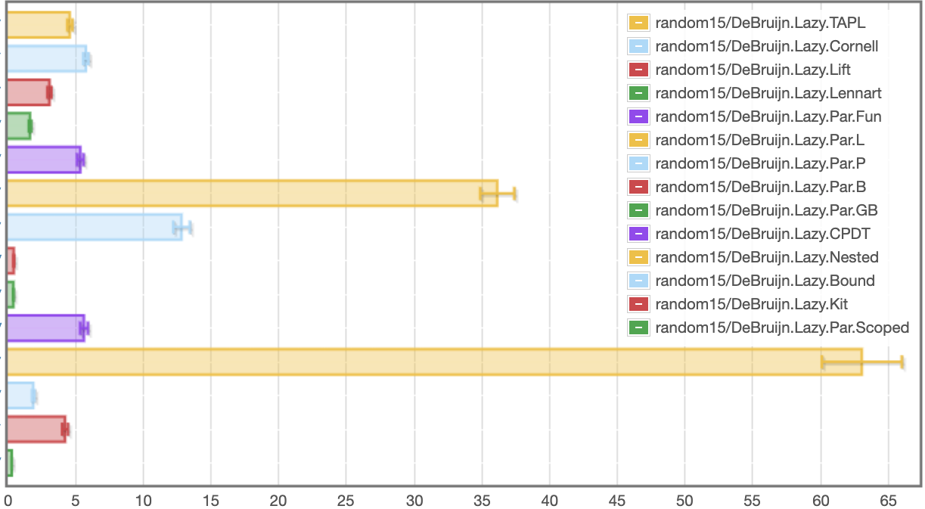
de Bruijn: random, lazy
results/sixteen.local/db_lazy_random15_bench.html
Single substitutions
Parallel substitutions
Scoped single
Scoped parallel
milliseconds
Fastest: Scoped (288 microseconds), Slowest: Nested (63.1s)
Notes:
Note scale change. Slowest is now under a second.

Slide 32
Laziness affects execution
AST definition is "lazy" in Haskell data Exp = Var Var
| Lam (Bind Exp)
| App Exp Exp
What if we make it "strict" ?
data Exp = Var {-# unpack #-} !Var
| Lam !(Bind Exp)
| App !Exp !Exp

Slide 33
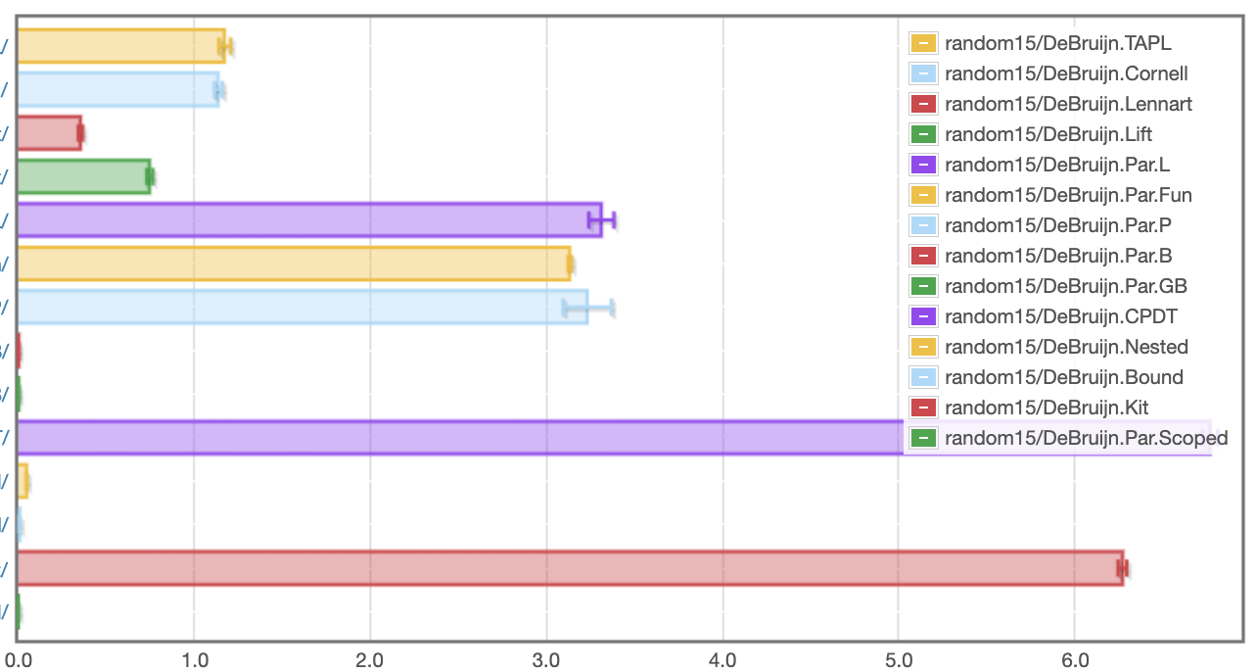
de Bruijn: random, strict
results/sixteen.local/db_random15_bench.html
Single substitutions
Parallel substitutions
Scoped single
Scoped parallel
seconds
Fastest: Scoped (969 microseconds), Slowest: CPDT (6.77s)
Notes:
Most implementations are slower, some significantly so. (cf Kit/CPDT)
BUT: Nested went from 63 to 47 miliseconds

Slide 34
Lennart's term
Benchmark term from "Lambda Calculus Cooked Four Ways"
Church encoding of:
6! == sum [1 .. 37] + 17
i.e. 720 == 719
i.e. False
Statistics
Number of substitutions required for normalization: 119,697
AST depth: 53
Binding depth: 25
Average # of variable occurrences in each substitution: 1.15

Slide 35
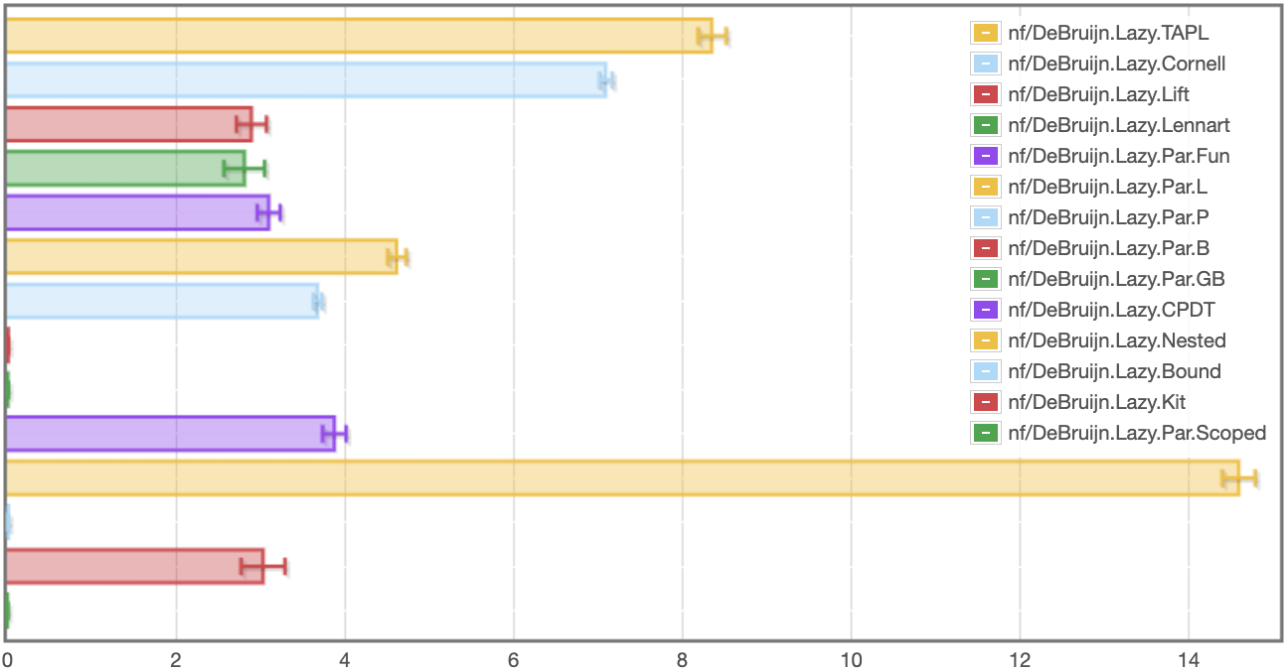
de Bruijn: Lennart, lazy
Single substitutions
Parallel substitutions
Scoped single
Scoped parallel
Fastest: Scoped (5.59ms), Slowest: Nested (14.6s)
seconds

Slide 36
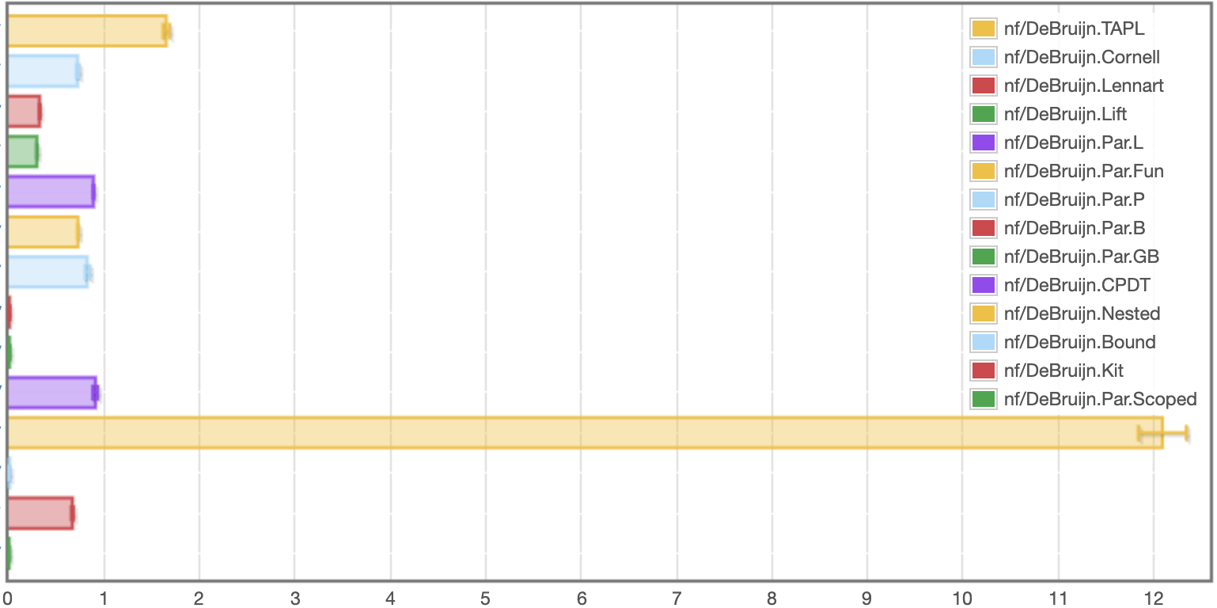
de Bruijn: Lennart, strict
Single substitutions
Parallel substitutions
Scoped single
Scoped parallel
Fastest: Scoped (3.2ms), Slowest: Nested (12.1s)
seconds
Notes:
Different runs lead to differences of .5 seconds.
Strictness helps this time

Slide 37
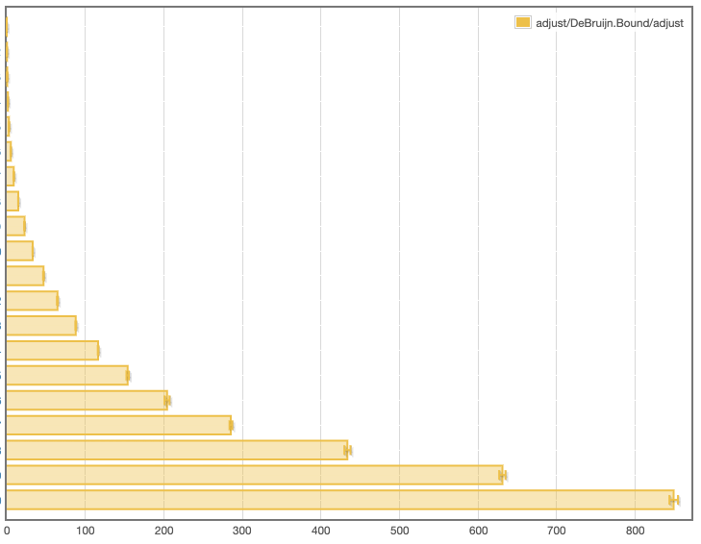
Takeaways from de Bruijn benchmarks
Orders of magnitude difference between fastest and slowest versions
Well-scoped implementations generally do not slow down terms
Sometimes laziness helps significantly, sometimes it doesn't
"bound" library comes out very well
No implementation provides linear performance in worst case
\x0.(\x1.x1) x0
\x0.(\x1.x1 (\x2.x1)) (x0 x0)
\x0.(\x1.x1 (\x2.x1 (\x3.x1))) (x0 x0 x0)
…

Slide 38
Comparison

Slide 39
Comparison

Slide 40
We can do similar things with LocallyNameless & Named representations
General idea of library interface / generic code applies broadly
Scrap Your Nameplate [Cheney, ICFP 2005]
Unbound library [Weirich, Yorgey, Sheard, ICFP 2011]
more versions in repo
General idea of delaying work at binders applies broadly
Locally nameless: aggregate open and close operations
Named: multi-substitutions & cache free variables
Are these easier to use? Opinions vary
Are they faster/slower?

Slide 41
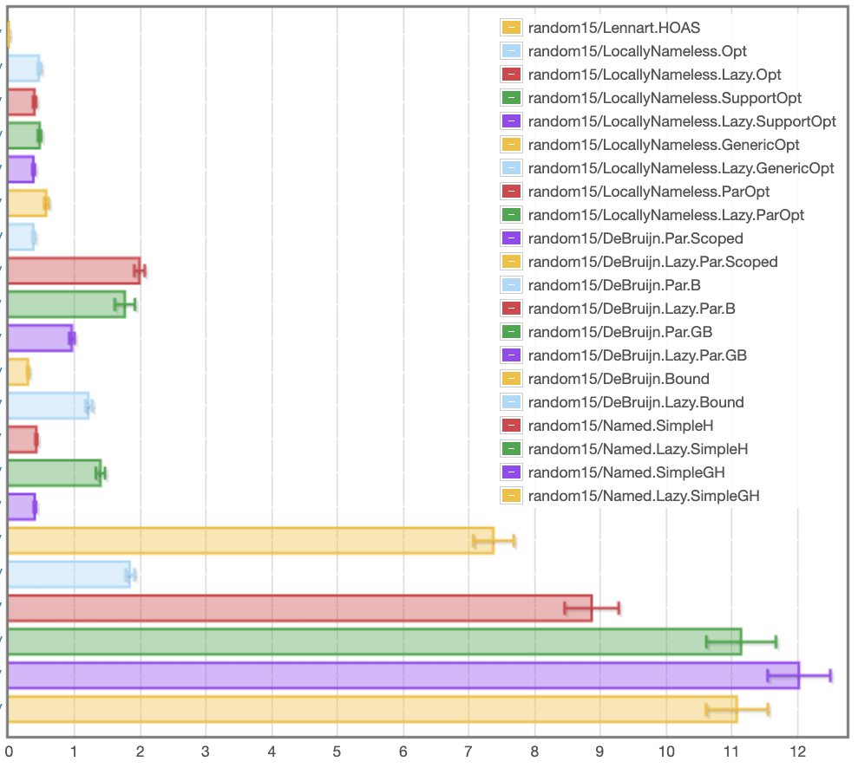
Random15
(fastest variants)
HOAS
Locally Nameless
Fastest: 375 μs
de Bruijn
Fastest: 293 μs
Named
results/sixteen.local/fast_random15_bench.html
milliseconds
Notes:
This is only the fastest versions, both strict and lazy

Slide 42
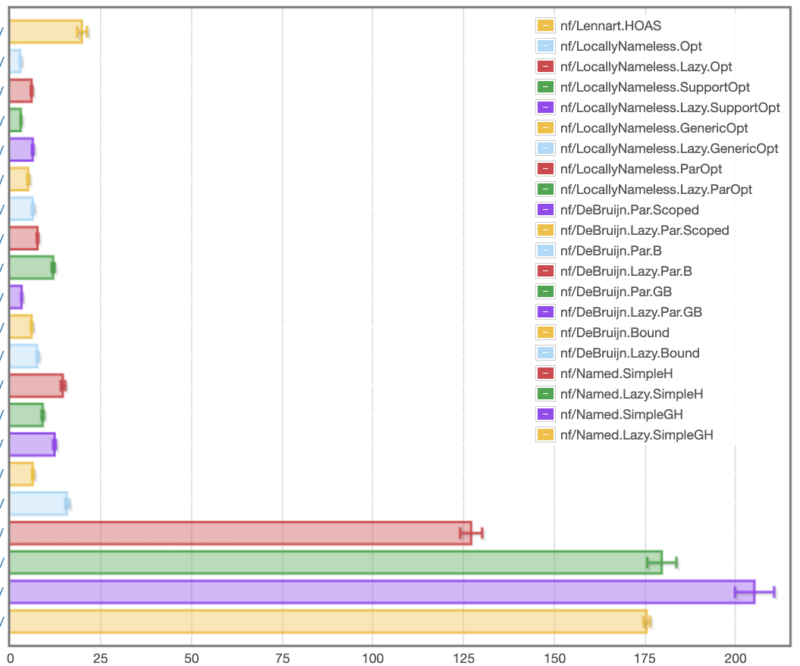
Lennart
(fastest variants)
HOAS
Locally Nameless
Fastest: 2.74 ms
de Bruijn
Fastest: 3.13ms
Named
results/sixteen.local/fast_nf_bench.html
milliseconds
Notes:
This is only the fastest versions, both strict and lazy

Slide 43
Conclusion

Slide 44
Conclusion
There is a lot more to learn here and I can't explore it all on my own
https://github.com/sweirich/lambda-n-ways
More implementations…
More benchmarks…
Opportunities for new Haskell libraries, too

Slide 46
Extra slides, probably wont have time for them

Slide 47
Locally Nameless
and variations

Slide 48
Locally Nameless implementations
data Exp = Var Var
| Lam (Bind Exp)
| App Exp Exp
deriving (Eq)
type Var = B Int | F Id -- distinguish bound/free type Bind t = t -- no info at binders
\x -> x (\y -> x z)
Lam (App (Var (B 0)) (Lam (App (Var (B 1)) (Var (F "z")))))

Slide 49
LN definition of (bound var) substitution
open :: Int -> Exp -> Int -> Exp -> Exp
open j b = walk j
where
walk c (Var (B x))
| x == c = b | x < c = Var (B x) | otherwise = Var (B (x – 1))
walk c (Var (F x)) = Var (F x)
walk c (Lam t2) = Lam (walk (c + 1) t2)
walk c (App t1 t2) = App (walk c t1) (walk c t2)
instantiate :: Bind Exp -> Exp -> Exp
instantiate a b = open 0 b a
No free indices means no need to shift
lib/DeBruijn/TAPL.hs
Notes:
Find and apply the leftmost beta-redex

Slide 50
Locally Nameless Normalization
nf' :: Exp -> N Exp
nf' e@(Var _) = return e
nf' (Abs e) =
scope $ \x -> do
b' <- nf' (instantiate e (Var (F x))
return $ Abs (close x b')
nf' (App a b) = do
a' <- whnf a
case a' of
Abs a0 -> nf' (instantiate a0 b)
_ -> App <$> nf' a' <*> nf' b
Work in Reader or State monad
Need to generate a fresh variable name for the binder.
Replace bound variable with fresh name
Replace fresh name with a bound variable,
inverse of open

Slide 51
Locally Nameless variations
Ott – generated by Ott tool, translated to Haskell
TypedOtt – well-scoped version of Ott
ParOpt – well-scoped version with parallel substitutions (cf. DeBruijn.Scoped)
Opt – optimized Ott version, delays open & close at binders
GenericOpt – optimized Ott version, with Generic Programming=
UnboundRep – generic programming (RepLib) (Yorgey, Sheard, Weirich)
UnboundGenerics – unbound ported to GHC.Generics (Alexey Klieger)
UGEBind – opt ported to UG
UGSubstBind – substbind
UGSubstBind – opt + substbind

Slide 52
Well scoped LN
de Bruijn index usage is "hidden" by the library so clients don't need to think about indices
Clients only work with "locally-closed" expressions
If expression types track bound variables, this is type "Exp 'Z".
As a tradeoff, clients need to make sure that all binders are opened with sufficiently fresh "free" variables.
Monads are good for this, and types can ensure clients don't forget

Slide 53
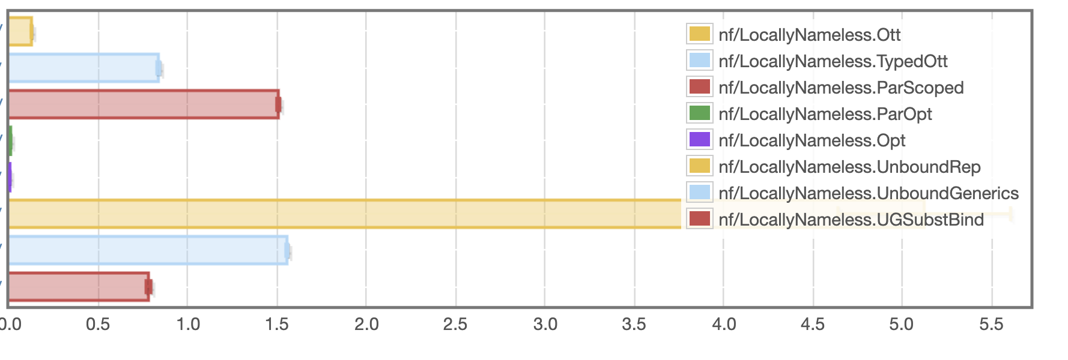
LN: lennart
seconds
Fastest Opt: 2.96 ms, Slowest: Unbound 5.12s

Slide 54
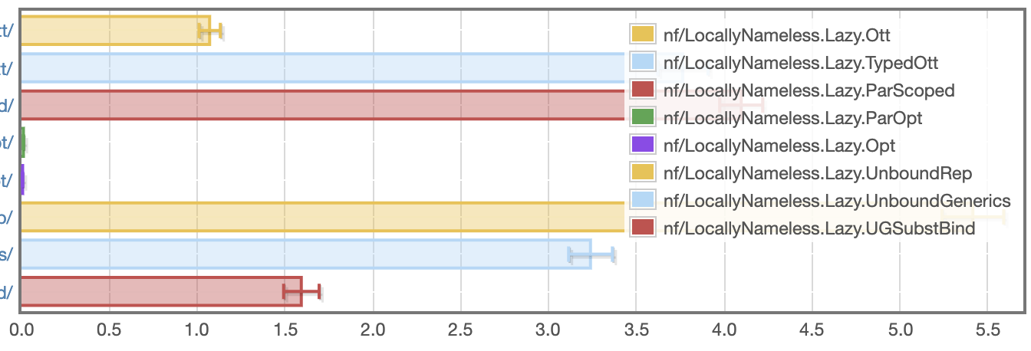
LN: lennart, lazy
seconds
Fastest Opt: 6.02 ms, Slowest: Unbound 5.41s

Slide 55
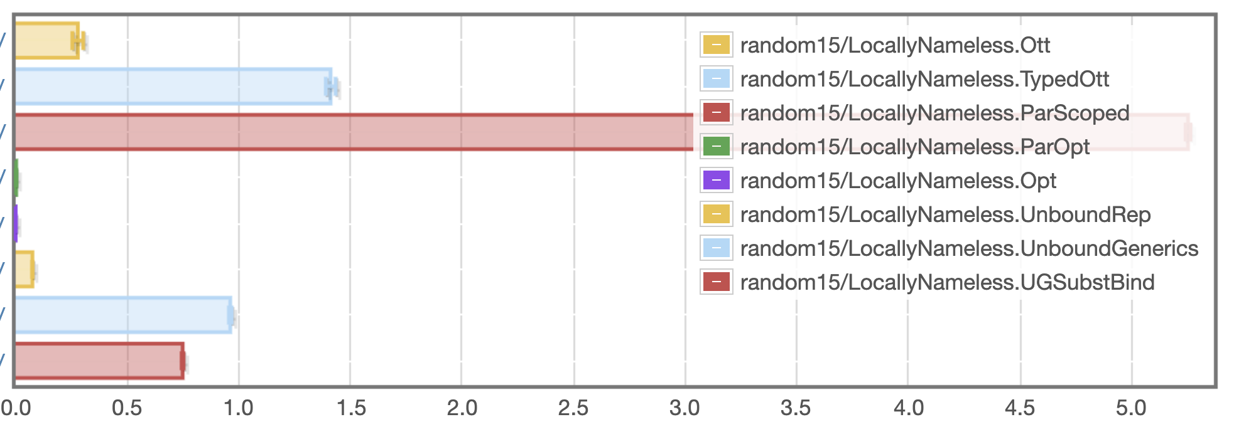
LN: random
seconds
Fastest Opt: 444 microseconds, Slowest: ParScoped 5.25s

Slide 56
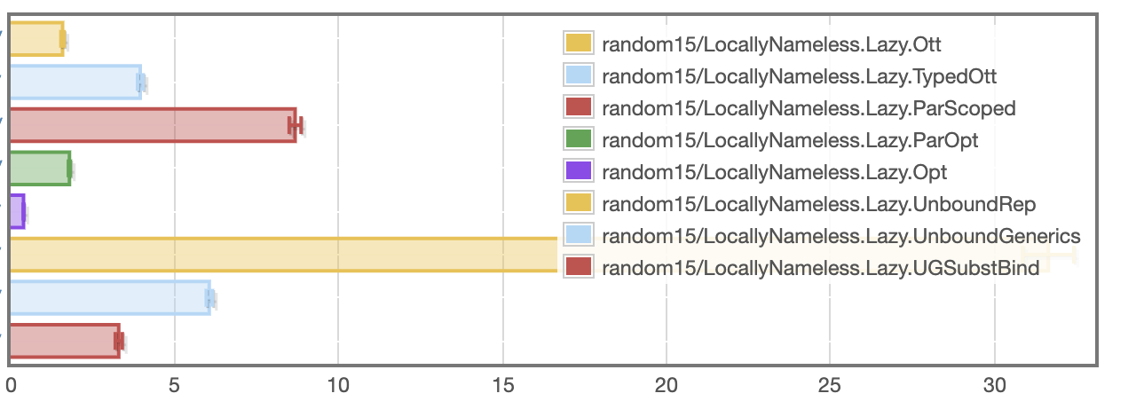
LN: random, lazy
milliseconds
Fastest Opt: 393 microseconds, Slowest: Unbound 31.7 ms

Slide 57
Named / Nominal
and variations

Slide 58
What makes a good implementation?
Quick implementation of key operations, with high confidence
No matter what language, because we are probably not actually implementing the untyped lambda calculus
i.e. could have multiple binders, patterns, etc
Minimal invariants to keep track of
Or at least help with them
example invariants: BVC, shifting indices when changing scopes,
Reasonably fast runtime execution
Very easy to end up with quadratic execution times
Opportunity for early cut-off (\x.a) {b/x}
Constant factors dominate

