Slide 1
Simple Unification-based Type Inference for GADTs
Stephanie Weirich
University of Pennsylvania
joint work with Dimitrios Vytiniotis, Simon Peyton Jones and Geoffrey Washburn

Slide 2
Overview
Goal: Add GADTs to Haskell
Problem: GADT type inference is hard
Requirements:
  Simple, declarative specification
  Easy to implement in GHC
Solution: Type annotations
Non-goal: type as many programs as possible

Slide 3
A typical evaluator
data Term = Lit Int
| Succ Term
| IsZero Term
| If Term Term Term
data Value = VInt Int | VBool Bool
eval :: Term -> Value
eval (Lit i) = VInt i
eval (Succ t) = case eval t of { VInt i -> VInt (i+1) }
eval (IsZero t) = case eval t of { VInt i -> VBool (i==0) }
eval (If b t1 t2) = case eval b of
VBool True -> eval t1
VBool False -> eval t2

Slide 4
Richer data types
data Term a where
Lit :: Int -> Term Int
Succ :: Term Int -> Term Int
IsZero :: Term Int -> Term Bool
If :: Term Bool -> Term a -> Term a -> Term a
here, a=Int.
rhs has type Int
eval :: Term a -> a
eval (Lit i) = i
eval (Succ t) = 1 + eval t
eval (IsZero i) = eval i == 0
eval (If b e1 e2) = if eval b then eval e1 else eval e2
In here, a=Bool
rhs has type Bool
In a case alternative, we learn more about ‘a’;
we call this type refinement
Can’t construct ill-typed terms: (If (Lit 3) …)
Evaluator is simpler and more efficient

Slide 5
Algebraic Data Types
Normal Haskell or ML data types:
data T a = T1 | T2 Bool | T3 a a
gives rise to constructors with types
T1 :: T a
T2 :: Bool -> T a
T3 :: a -> a -> T a
Return type is always (T a)

Slide 6
Generalized Algebraic Data Types
Allow arbitrary arguments to return type
Programmer gives types of constructors explicitly
Subsumes standard algebraic datatypes and datatypes with “existential components” [LO94]
data Term a where
Lit :: Int -> Term Int
Succ :: Term Int -> Term Int
IsZero :: Term Int -> Term Bool
If :: Term Bool -> Term a -> Term a -> Term a

Slide 7
GADTs have MANY applications
Language description and implementation
(Typed evaluators,Pugs)
Domain-specific embedded languages
(Darcs,Yampa)
Generic programming
(Hinze et al.,Weirich)
“Dependent” types
(Xi et al.,Sheard)

Slide 8
Adding GADTs to GHC
Simple extension
  No big changes to language semantics
  No re-engineering compiler
GADTs generalize algebraic datatypes
  Uniform mechanism for ADTs, “existential components” and GADTs
  All existing Haskell programs still work
Complete specification of type inference
  Predictability

Slide 9
Just a modest extension?
Yes....
Construction is simple: constructors are just ordinary polymorphic functions
All the constructors are still declared in one place
Pattern matching is still strictly based on the value of the constructor; the dynamic semantics is type-erasing

Slide 10
Complete type inference is hard
Many examples require polymorphic recursion
Even for those that don’t, problems remain
What is type of f ?
data T a where
C :: Int -> T Int
f (C x) = 3 + x
T Int -> Int
∀ a. T a -> Int
Neither type is
more general
∀ a. T a -> a

Slide 11
Annotations solve the problem
Naïve specification allows multiple types for f
  T Int -> Int
  ∀ a. T a -> Int
  ∀ a. T a -> a
Inference algorithm can assign just one
Annotations remove this ambiguity in the specification

Slide 12
Basic idea
Type system distinguishes between inferred types and those known from user annotations
Typing context and judgment tracks when types are wobbly or rigid
Modifiers m, n ::= w | r
Environments Γ,Δ ::= . | Γ, x:^{m} σ
Judgment Γ ⊢ t :^{m} τ
Γ ⊢ t :^{r} τ means that term t has type τ when we know τ completely in advance.
Γ ⊢ t :^{w} τ checks without that assumption.

Slide 13
GADT refinement
GADT refinement only involves rigid type information
  Rigid scrutinee triggers refinement
  Only rigid context types refined
  Only rigid result types refined
Example:
data T a where C :: Int -> T Int
f :: forall a.T a -> a -> Int
f (C x) y = x + y
-- inferred type: T Int -> Int -> Int
g (C x) y = x + y

Slide 14
Type checking a case expression
x :^{m} τ_{p} ∈ Γ
Γ ⊢ p → t : ^{<m,n>} τ_{p} → τ_{t}
Γ ⊢ (case x of p -> t) :^{n} τ_{t}

Slide 15
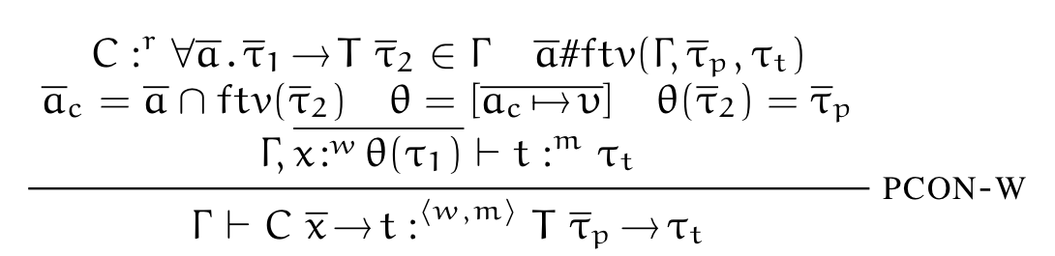
Type checking a wobbly branch
Guess instantiation
of type arguments to C
Type of scrutinee is
wobbly
data T a where C :: a -> T a
f y = case y of C x -> x + 1

Slide 16
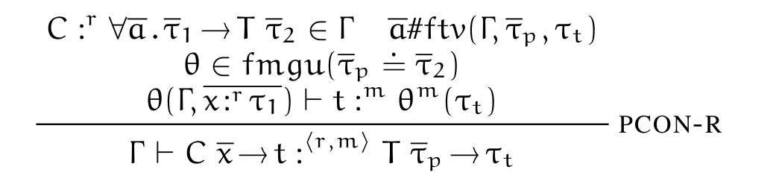
Type checking a rigid branch
Refine rigid
parts of the
context
Refine result
type if it is rigid
Unify scrutinee type
with result type of
constructor
data T a b where C :: b -> T Int b
f :: T a Bool -> a -> a
f y w = case y of C x -> if x then w else 1

Slide 17
Checking + inference is hard
MGU is the standard way to solve constraints and produce a substitution
  Used in Algorithm W
We really thought this would work
But, even with all these annotations
  scrutinee of case
  return type of case
  all refined variables in context
MGU does not produce a complete specification of what programs typecheck.

Slide 18
Pathological example
Should this program type check?
Context: x:^{r} Eq a b, y :^{r} a->Int, z:^{r} b, w:^{w} b
Compute θ = MGU(Eq c c = Eq a b)
  If θ = { a ⇒ b, c ⇒ b } then yes
  If θ = { b ⇒ a, c ⇒ a } then no
  If θ = { b ⇒ c, a ⇒ c } then no
data Eq a b where
Refl :: Eq c c
f :: ∀a b. Eq a b -> (a -> Int) -> b -> Int
f x y z = (\w -> case x of Refl -> y w) z

Slide 19
“Fresh” - mgu
Problem
  Choice of MGU makes refined type match type of wobbly variable
A solution
  Choose the right(?) MGU
Our solution
  Don’t choose any MGU
  In this situation, never let refined type match wobbly type
  Choose a fresh variable d and use unifier
  θ = {a ⇒ d, b ⇒ d, c ⇒ d}
  Rejects pathological example

Slide 20
Other details
Additional rules to locally propagate type annotations
  Like shape inference pass (Pottier/Régis-Gianis)
Lexically-scoped type variables
  Must be able to annotate all sub-expressions
  Bind both “universally” and “existentially” quantified type variables in program text
Nested patterns
  more complicated rules, but straightforward
See paper for details

Slide 21
Non-monotonic annotations
Sometimes adding an annotation can cause a working program to be rejected
Hasn’t been a problem in practice
Pathological example:
  Making y rigid triggers refinement
  Making return type rigid restores typability
data T a where C :: T Int
x:^{r} T a, y :^{w} a ⊢ case x of C -> y :^{w} a
x:^{r} T a, y :^{r} a ⊬ case x of C -> y :^{w} a
x:^{r} T a, y :^{r} a ⊢ case x of C -> y :^{r} a

Slide 22
Formal Properties
Type system is sound
  Type-preserving translation to explicitly-typed language (System F + GADT)
  Soundness proved for explicit language
Type system is expressive
  Any program in explicitly-typed language acceptable (with enough annotations)
Type inference algorithm is sound and complete
Type system is a conservative extension of Hindley-Milner system
All details in companion technical report

Slide 23
Related work
Pottier and Simonet
  Use implication constraints for complete type inference
  Solving such constraints can be intractable
Our previous (unpublished) version
  Implemented in a previous version of GHC
  More complicated than this system: types may be partly wobbly
Pottier and Régis-Gianis
  Constraint-based
  Shape inference pass to propagate local annotations
  Second pass for explicit type system
Sulzmann et al.
  Constraint-based
  Abandons complete type inference
  Concentrates on error messages

Slide 24
Future work
Resolve poor interaction between type classes and GADTs
More general way to combine type inference and type checking
  slightly different mechanism useful for higher-rank/impredicative polymorphism
Towards dependently-typed programming languages

Slide 25
Conclusions
GADTs implemented in GHC
Can extend unification-based type inference with GADTs
Simple specification of type system due to user annotations
Complete specification of where type annotations are necessary is important

