Slide 1
Java Bytecode
What’s inside class files.
MIT AITI
July NNth, 2005

Slide 2
What are these .class files?
You’ve created .java source code files.
You’ve compiled .java source code into .class files.
You’ve run your .class files.
But what’s are those .class files?

Slide 3
Typical Software Production
Source code is ported to different platform-specific sources.
Each port is compiled with a platform-specific compiler.
Each compiler produces platform-specific machine code (or binaries).
Binaries execute on a single platform.

Slide 4
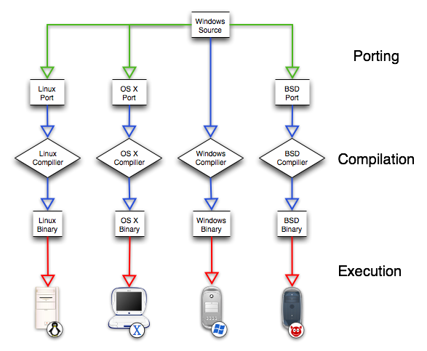

Slide 5
Write Once, Run Anywhere
Java source code is is compiled into machine-independent bytecode class files.
javac command compiles .java source code into .class bytecode.
Bytecode is interpreted by machine-specific Java Virtual Machines (JVMs).
Bytecode consists of simple, step-by-step instructions for the JVM.

Slide 6
Java Virtual Machines
JVM is a computer simulated in a computer.
JVMs are built into most web browsers.
java command gives .class file to JVM.
JVM interprets the bytecode into instructions that a specific platform can understand.
Different JVMs for different platforms: Windows, Mac OS X, Linux, cell phones.

Slide 7
Using javap
javap is a program that can give you information on .class files.
If you get a class file without documentation, javap can tell you what methods you can call.
javap can show you how javac compiles your program into simple instructions.
Good for high-performance optimizations or if you don’t have access to an Application Programming Interface (API).

Slide 8
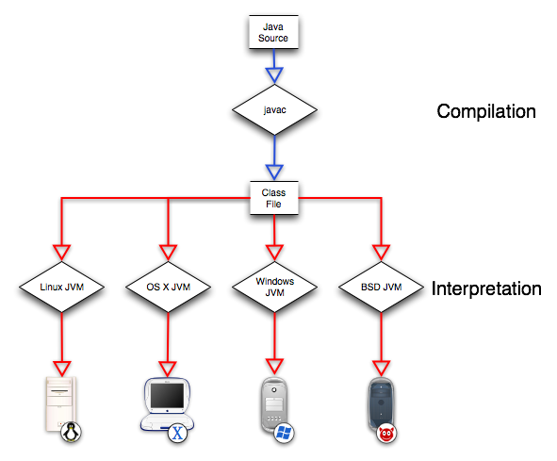

Slide 9
javap Output
Given “Mystery.class”:
> javap Mystery
Compiled from "Mystery.java"
class Mystery extends java.lang.Object{
Mystery();
public static int unknown(int,int);
}
One static method called “unknown” that takes two integers and returns an integer.

Slide 10
javap -c Output
Using the “-c” flag will disassemble the bytecode:
public static int unknown(int,int);
Code:
0: iload_0
1: iload_1
2: iadd
3: ireturn
}
Loads the first integer argument.
Loads the second integer argument.
Adds the two loaded integer values.
Returns the integer sum.
This method just adds two numbers together and returns the sum.

Slide 11
Example: String Appends
Disassemble the following method using javap -c:
public String
append(String a, String b) {
return a+b;
}
The output is surprisingly complicated…

Slide 12
public static java.lang.String stringAdd(java.lang.String,java.lang.String,int);
Code:
0: new #2; //class StringBuffer
3: dup
4: invokespecial #3; //Method java/lang/StringBuffer."<init>":()V
7: aload_0
8: invokevirtual #4; //Method java/lang/StringBuffer.append:(Ljava/lang/String;)Ljava/lang/StringBuffer;
11: aload_1
12: invokevirtual #4; //Method java/lang/StringBuffer.append:(Ljava/lang/String;)Ljava/lang/StringBuffer;
15: invokevirtual #5; //Method java/lang/StringBuffer.toString:()Ljava/lang/String;
18: areturn
}

Slide 13
Example: String Appends
All that bytecode is equivalent to:
StringBuffer temp;
temp = new StringBuffer();
temp.append(a);
temp.append(b);
return temp.toString();
One line of code initializes an object and makes three method calls.

Slide 14
String Append Optimization
What if we had:
String a =“”; String b = “hello”;
  for (int i=0; i<n; i++)
  a += b;
This code performs n initializations and 3n method calls.
Using javap showed us there’s a class called StringBuffer that has an append() function.

Slide 15
String Append Optimization
A more efficient way:
StringBuffer aBuff =
new StringBuffer();
String b = “hello”;
for (int i=0; i<n; i++)
a.append(b);
String a = aBuff.toString();
Only performs two initializations and n+1 method calls -- three times faster.

Slide 16
Questions
What advantages are there in running programs on simulated computers, like JVMs?
What disadvantages might there be?
Could you compile Java directly into native machine code like C or C++, instead of using a JVM?
Is it possible to generate Java source code from class files, i.e. decompile?

