Slide 1
AITI Tutorial:
Internationalization
Coding for the world
MIT AITI
July NNth, 2005

Slide 2
What is Internationalization?
Internationalization:
  Designing applications to easily support different languages and regions.
  Abbreviated as “I18N”.
  (There are 18 letters between ‘I’ and ‘N’).
Localization:
  Adapting software to a specific region.
  Abbreviated as “L10N”.

Slide 3
Why do we care?
Translation: Don’t want to have to search through many files for words to translate.
Date Formats: Is “7/6/5” July 6th, 2005, June 7th, 2005, or June 5th, 2007?
Currency Formats: Is nine thousand dollars
9 000,00, 9.000,00, or $9,000.00?
Non-Latin Characters:
  Spanish: ¡Viva España!
  Chinese: 早晨好
  Arabic: هـ - الموافق

Slide 4
Properties of I18N.
Same executable can be run worldwide with different local data.
Text elements are not hard-coded.
Should not have to recompile to add new languages.
Dates and currencies stored in region independent format.
Localizes easily.

Slide 5
Example Non-I18N Program
public class NotI18N {
static public void main(String[] args){
System.out.println("Hello");
System.out.println(”Thank you");
}
}
What if we want to ship this software to 70 different countries?

Slide 6
Locales
Locales: Objects that identify a particular language and region.
Locale(String country, String lang);
Static Locales: Locale.US, Locale.Japan, Locale.UK, Locale.PRC
Two-letter country and language codes.
Locale swahiliKenya;
swahiliKenya = new Locale(“sw”, “KE”);
Locale arabicIraq;
arabicIraq = new Locale(“ar”, “IQ”);

Slide 7
Check for Supported Locales
Not every Locale will be supported.
Can check which Locales are available:
import java.util.*;
import java.text.DateFormat;
public class Available {
static public void main(String[ args) {
Locale list[];
list = DateFormat.getAvailableLocales();
for (int i = 0; i < list.length; i++)
System.out.println(list[i].toString());
}
}

Slide 8
Resource Bundles
We want to isolate Locale-specifc data, like text strings.
Resource Bundle:
  Look up Locale-specific objects with a key.
  ListResourceBundle: 2D key/value array.
  PropertyResourceBundle: Flat text file.
We’ll deal with plain text properties files: Look up with a string, get back a string.
If you need to look up an object, you’d use a ListResourceBundle.

Slide 9
Properties Files
Example properties files:
# Labels.properties
  hello = Hello
  thanks = Thank You
# Labels_sw.properties
  hello = Jambo
  thanks = Asante
# Labels_es.properties
hello = Hola
thanks = Gracias

Slide 10
Creating Resource Bundles
ResourceBundles are created by giving a base name and optionally a locale.
ResourceBundle labels = ResourceBundle.getBundle
(”Labels", currentLocale);
If currentLocale is “sw_KE” and default is “en_US”, it will search files in this order:
  Labels_sw_KE.properties
  Labels_sw.properties
  Labels_en_US.properties
  Labels_en.properties
  Labels.properties

Slide 11
Using Resource Bundles
static void printMessages(Locale currentLocale) {
ResourceBundle labels =
ResourceBundle.getBundle
("Labels", currentLocale);
System.out.println
("Current Locale is " +
currentLocale.getDisplayName());
System.out.println
(labels.getString("hello"));
System.out.println
(labels.getString("thanks"));
}

Slide 12
What about China?
A few billion people do not use the Latin alphabet.
But your keyboard is likely to use it.
How do we type Chinese, Japanese, Arabic, Thai, Cyrillic, etc., characters in our properties files?

Slide 13
Character Representation
Characters are often represented by fixed-width, 8-bit bytes, esp. C/C++.
This only allows for 256 characters.
Unicode: Character encoding that supports 1,114,112 different symbols.
Can represent any Unicode characters with 3-bytes.
Java has default Unicode support.

Slide 14
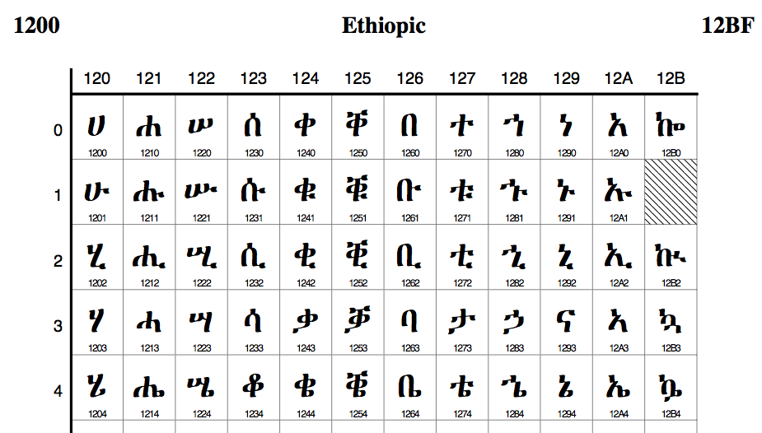
Ethiopic Unicode Characters
Notes:
This is just a portion of the Ethiopic alphabet. It ranges from \u1200-\u12BF. The left-most column are the first five Ethopic characters \u1200, \u1201, etc.

Slide 15
Many Unicode Formats
Most Unicode characters are rarely used.
Programmers don’t want to waste space with 3-byte representations.
There are many different ways to represent Unicode characters.
Official: UTF-8, UTF-16, UTF-32.
Unofficial: UCS-2, UCS-4.
Java uses UCS-2 (very close to UTF-16).
(We can mostly ignore these details.)

Slide 16
Using Unicode in Java
Unicode characters can be represented using regular plaintext.
Characters are represented as ‘\uNNNN’.
4-digit character codes can be found at: http://www.unicode.org/charts/
Encoding the character ‘©’:
  The Unicode value for ‘©’ is 00A9 in hex (169).
  String str = "\u00A9";
  char c = '\u00A9';
Need GUI or terminal that supports Unicode.

Slide 17
Unicode Demo in Swing
import javax.swing.*;
public class UnicodeDemo extends JFrame {
public static void main(String[] Args) {
UnicodeDemo app = new UnicodeDemo();
app.setSize(100,100);
JLabel label =
new JLabel("Copyright \u00A9 2005", JLabel.CENTER);
app.getContentPane().add(label);
app.setTitle("Unicode Demo");
app.setDefaultCloseOperation(JFrame.EXIT_ON_CLOSE);
app.setVisible(true);
}
}

Slide 18
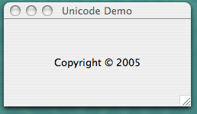
Demo Output

Slide 19
Pop Quiz: Review Terms
Internationalization (I18N)
Localization (L10N)
Locales
ResourceBundles
Properties Files
Unicode
UCS-2

Slide 20
For More Information
Online tutorial with example code:
http://java.sun.com/docs/books/tutorial/i18n/

