Slide 1
Internet Programming
#05- Functions and Control Structures
Wekoslav Stefanovski

Slide 2
Agenda
Conditional Statements
Loops
For loops
While loops
Working with functions
Error Handling

Slide 3

Conditional Statements
if statement
else statement
switch statements
Booleans in JavaScript

Slide 4
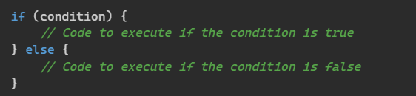
If and Else Statements

Slide 5
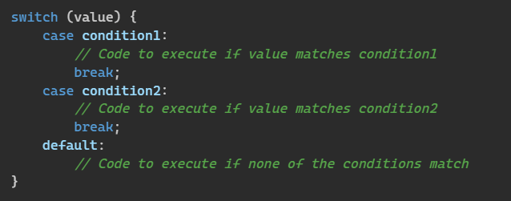
Switch Statement

Slide 6
Booleans in JavaScript
Truthy and Falsy values
Falsy: false, “”, 0, NaN, null, undefined
Truthy: everything else
Conditional operator
Cast-to-boolean “operator”

Slide 7
For Loops
The basic for loop
The for..in loop
The for..of loop
Loop control statements - break and continue

Slide 8
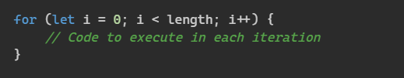
For loop
Most basic, commonly used, most complicated

Slide 9
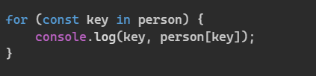
For..in loop
Object iteration, not used very often, better alternatives exist

Slide 10

For..of loop
Specifically designed for collection iteration

Slide 11
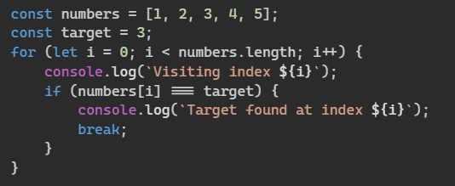
Break statement
Stops the loop execution

Slide 12
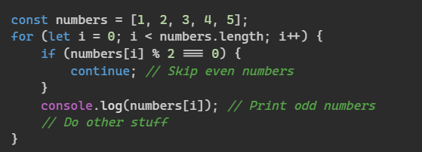
Continue statement
Skips the current iteration

Slide 13


While loops
while
do..while

Slide 14
Functions
Creating functions
Fuction declaration
Function expression
Immediately Invoked Function Expressions (IIFE)
Calling functions
Arrow functions
Function scope
Recursion

Slide 15
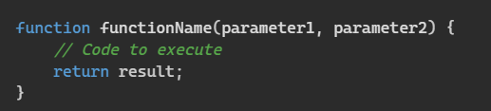
Creating functions with declarations
A piece of code that we can call
Parameters defined in the function
Return value
Function name

Slide 16


Function expressions
Sometimes we don’t need a name

Slide 17

IIFE (iffy)
Sometimes we just need some code executed
Variables and function encapsulation
Does not pollute the global scope

Slide 18


Arrow Functions
Removes the fluff
Shorter and sometimes cleaner syntax
Doesn’t bind this
vs

Slide 19
Error Handling
Why we need error handling
Using the try..catch statement
Using the try..finally statement
Using the throw statement

Slide 20
Error Handling
Why we need error handling
Using the try..catch statement
Using the try..finally statement
Using the throw statement

Slide 21
Why we need error handling
Graceful Failure
Debugging and Troubleshooting
Maintaining Data Integrity
Security
Enhancing User Experience
Predictable Behaviour
Robustness
Reporting and Auditing

Slide 22
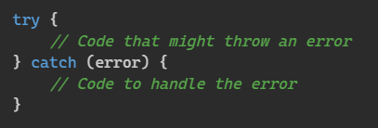
Catching errors
Code that might throw an error can be managed
NEVER catch errors that you don’t know how to handle

Slide 23
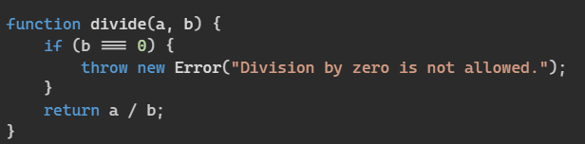
Throwing errors
Situation where some invariant is violated
Error object

Slide 24
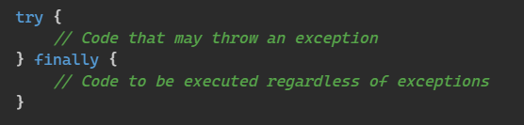
Cleaning up
Using some resource that has to be cleaned up

Slide 25
References
Twitter Handle - @swekster
Discord Server - https://discord.gg/uWZ3RJfBQ5
Email - swekster@gmail.com
Github - https://github.com/sweko/uacs-internet-programming-2023
Youtube - https://www.youtube.com/@swekster

