Slide 1

How to mess up JWT’s
- a practitioner's guide
Wekoslav Stefanovski
@swekster
https://github.com/sweko
https://youtube.com/@swekster

Slide 2
>whoami
Head of Development in Sourcico Macedonia
Coding professionally since last century
I love programming, I love programmers
Long and fruitful love relationship with authorization
Long and fruitful love/hate relationship with authentication

Slide 3
agenda();
What are little JWT’s made of?
How to mess up using them
How to mess up the security
How to mess up performance

Slide 4
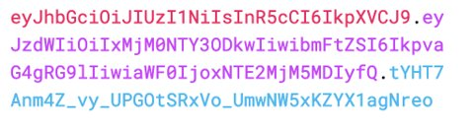
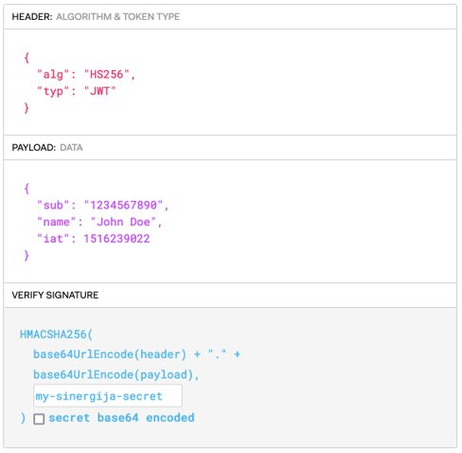
What are JWT's
JWT’s are NOT magic
Encoded text (usually not encrypted)
The text is a piece of JSON data
A Header
A Payload
A Signature (or is there?)

Slide 5
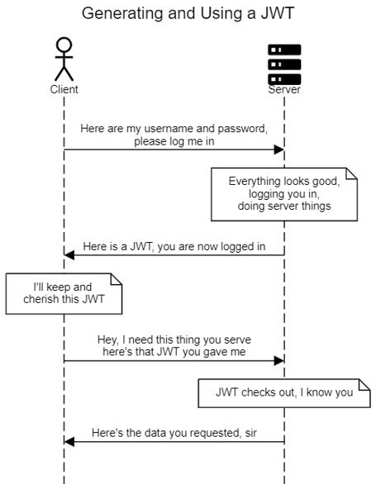
How are they usually used?
Generated on some kind of server
Sent to the client
Communicated from the client
Verified on the server
No magic required

Slide 6
0. Using Sensitive Data inside a JWT
Because JWT’s are not magic, any data that we set in the token is user-accessible
If the token is stolen, any and all PII will be available to the attacker
Even if the token is used by the regular user, there might be system-sensitive data that we don’t want the user to see
The JWT object handling - it can be stolen. Consider storage and attributes

Slide 7
1. Failing to validate JWT’s
JWT’s are not magic
Validation can be cryptographically expensive
It might not be called because of bad code practices
Confusing verify() and decode()
Not a scenario that is often covered by tests

Slide 8
2. Validate JWT’s badly
JWT’s are not magic
Different algorithm from the one we sent out
No algorithm at all
Different key from the one we sent out
Bad key behaviour
Library issues

Slide 9
3. Bloating the JWT’s
JWT’s are not magic
Token are used as headers or cookies
Transmitted on each and every call from the client
Network performance hit
Decoding and verifying performance hit
Possible truncation and weird behaviours

Slide 10
4. Messing up JWT expiration
JWT’s are not magic
Expired token validation
Tokens that are too long lived
Tokens that do not get refreshed
The (missing) magic of revocation

Slide 11
5. Implementing Stateless State
JWT’s are not magic, and neither is the stateless web
No such thing as stateless auth
Using both JWT and stored session state
Using signing keys as state
Scary words: Debug and log

Slide 12
Some more things
Accepting Arbitrary Signatures
JWT Header Parameter Injections
Poor Error Handling
Ignoring the revocation problem
Refresh token rotation abuse
Access / ID token misuse

Slide 13
Questions?
Comments?
Critique?

Slide 14
swekster@gmail.com
@swekster
https://youtube.com/@swekster https://github.com/sweko/wad-jwt
Thank you!

