Slide 1
Case Study: Sales Drivers and Demand Forecasting
Jake McRoberts
July 9th, 2017

Slide 2
Approach
Clean, wrangle, and prepare data for analysis and modeling via machine learning.
Explore the data with descriptive statistics and plotting.
Create new variables based on my intuition and what the data shows.
Perform seasonal decomposition on sales data.
Use machine learning algorithm to predict data based on the original dataset where I split the data into training and testing data. The testing data will serve as the prediction (forecasting) element of the case study.
Evaluate performance (iterate back up to #5 if not satisfactory).
Evaluate which promotion had a larger impact on sales.
Make sure approach is valid.

Slide 3
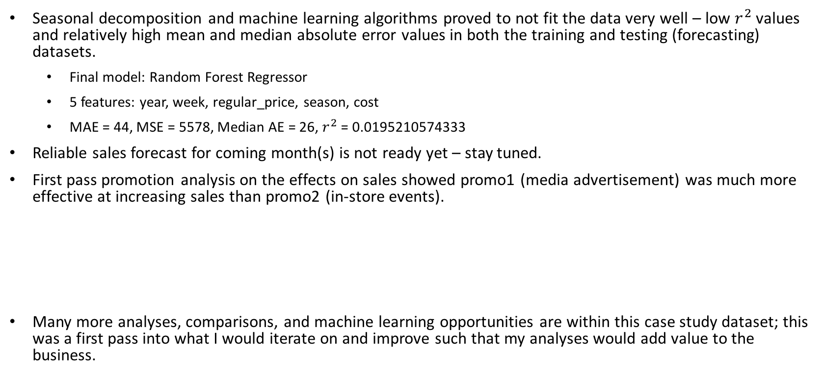
Results & Conclusions
Seasonal decomposition and machine learning algorithms proved to not fit the data very well – low $r^{2}$ values and relatively high mean and median absolute error values in both the training and testing (forecasting) datasets.
Final model: Random Forest Regressor
5 features: year, week, regular_price, season, cost
MAE = 44, MSE = 5578, Median AE = 26, $r^{2}$ = 0.0195210574333
Reliable sales forecast for coming month(s) is not ready yet – stay tuned.
First pass promotion analysis on the effects on sales showed promo1 (media advertisement) was much more effective at increasing sales than promo2 (in-store events).
Many more analyses, comparisons, and machine learning opportunities are within this case study dataset; this was a first pass into what I would iterate on and improve such that my analyses would add value to the business.
 | Promo1 | Promo2
Mean Sales Difference | + 37 | + 3
Median Sales Difference | + 19 | - 6

