Slide 1
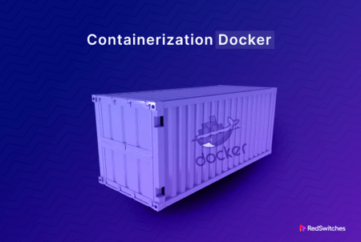

Slide 2
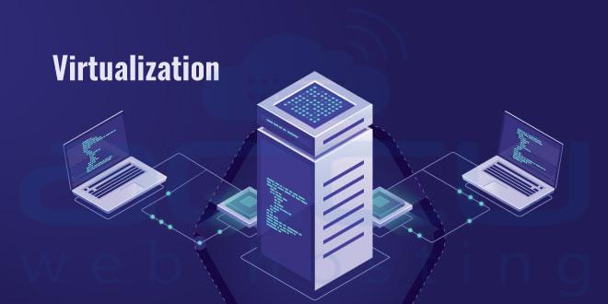

Slide 3
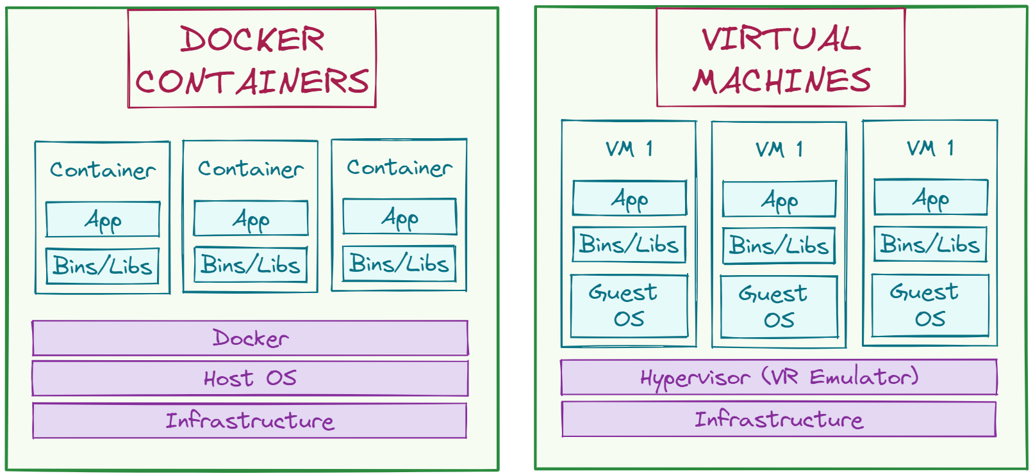

Slide 4
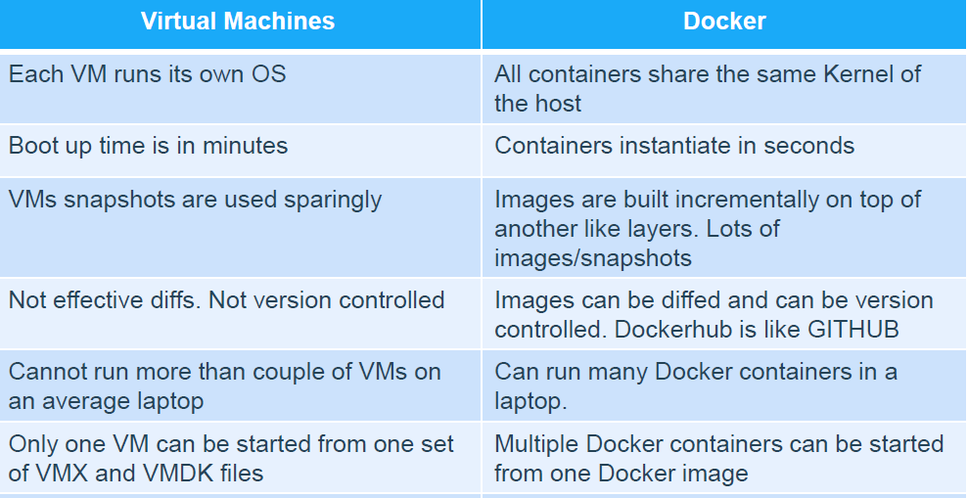

Slide 5
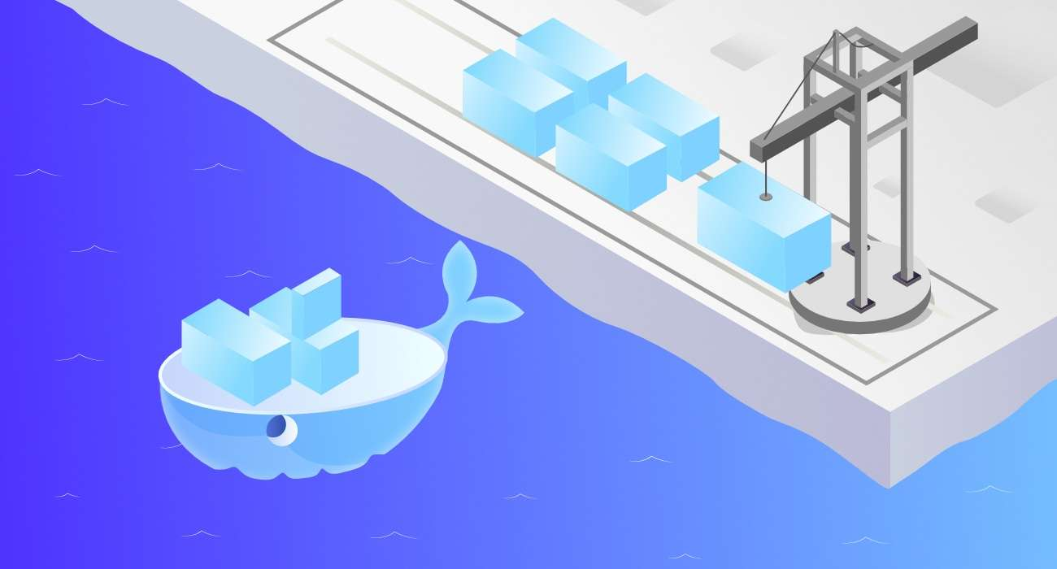

Slide 6
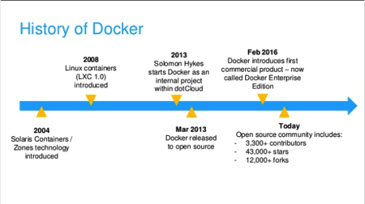

Slide 7
What is docker container ?!
A Docker container is a runtime environment with all the necessary components—like code, dependencies, and libraries—needed to run the application code without using host machine dependencies. This container runtime runs on the engine on a server, machine, or cloud instance. The engine runs multiple containers depending on the underlying resources available.
To deploy and scale a set of containers to communicate effectively across different machines or virtual machines, you need a container orchestration platform like Kubernetes. This helps whether your machines are on premises or in the cloud. Kubernetes manages multiple machines, known as a cluster, within the context of container operations.

Slide 8
What is docker image ?!
A Docker image, or container image, is a standalone, executable file used to create a container. This container image contains all the libraries, dependencies, and files that the container needs to run. A Docker image is shareable and portable, so you can deploy the same image in multiple locations at once—much like a software binary file.
You can store images in registries to keep track of complex software architectures, projects, business segments, and user group access. For instance, the public Docker Hub registry contains images such as operating systems, programming language frameworks, databases, and code editors.

Slide 9
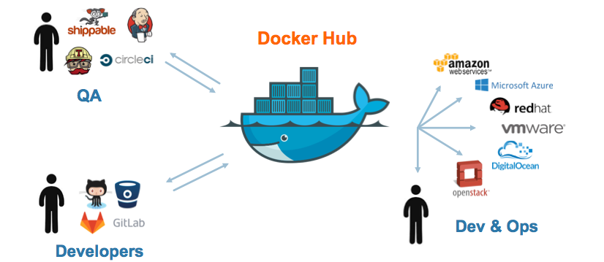

Slide 10
What’s the Difference Between Docker Images and Containers?
-Docker images and containers are application deployment technologies. Traditionally, to run any application, you had to install the version that matched your machine’s operating system. However, now you can create a single software package, or container, that runs on all types of devices and operating systems. Docker is a software platform that packages software into containers. Docker images are read-only templates that contain instructions for creating a container. A Docker image is a snapshot or blueprint of the libraries and dependencies required inside a container for an application to run.

Slide 11
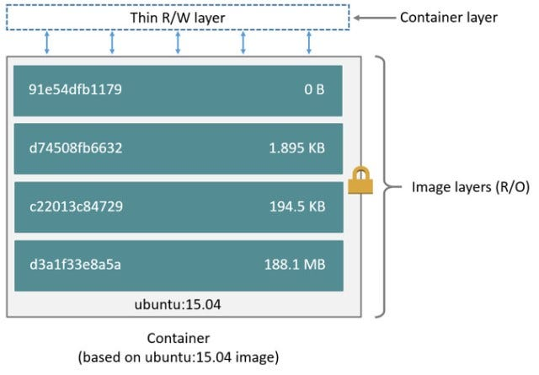

Slide 12
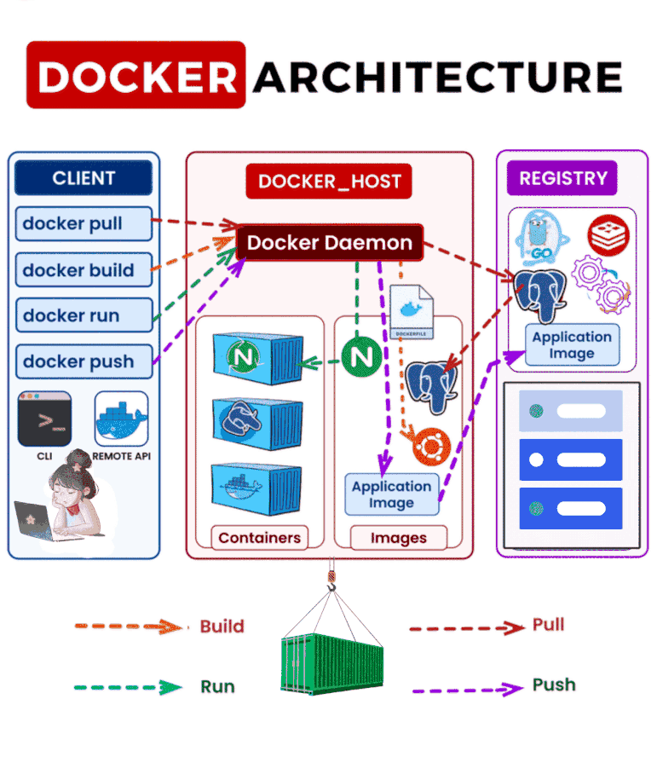

Slide 13
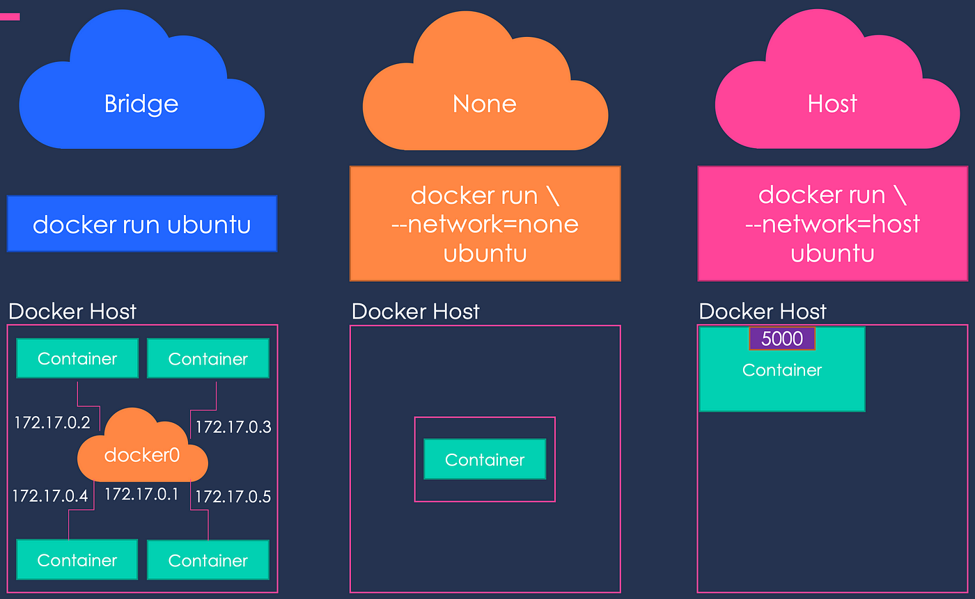

Slide 14
Docker networks key difference
Docker uses a software-based bridge network that allows containers connected to the same bridge network to communicate while isolating them from other containers not running in the same bridge network.
running a container on the host network can optimize performance. When you run a container on the host network, its network will not be isolated from the host, and it will not get its own IP; these are the limits of this type of network.
When you run a container on none this means container is completely isolated

Slide 15
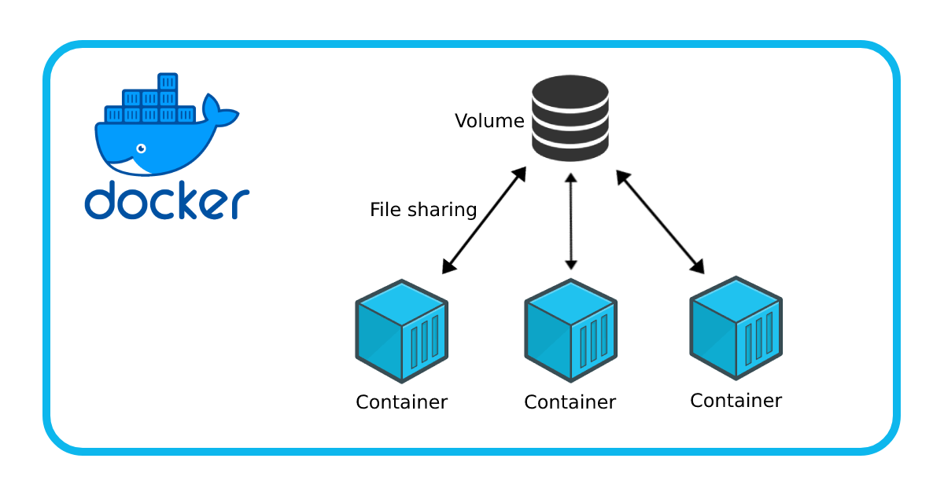

Slide 16
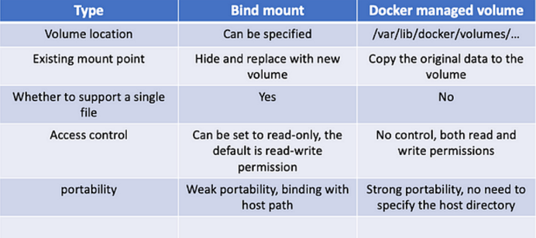

Slide 17
LAB 1
Install docker
Run docker container in de-attached mode
Run ubuntu container and use sleep command as argument
Pull redis image then tag it and push it to your registry repo
Run nginx container with name of nti and map port 8080 on the container to 3828 on the host
Deploy a mysql database using the mysql image and name it mysql-db. set the database password to use db_pass123 then inspect it to check the value.
Create new volume called nti-volume and attache it to mysql database container
Create new mysql container and attach it to previous volume then check if db pw is the same
Create two bridge network and make one container in both of them then check if they can call each others
Create nginx container with network host

