Slide 1
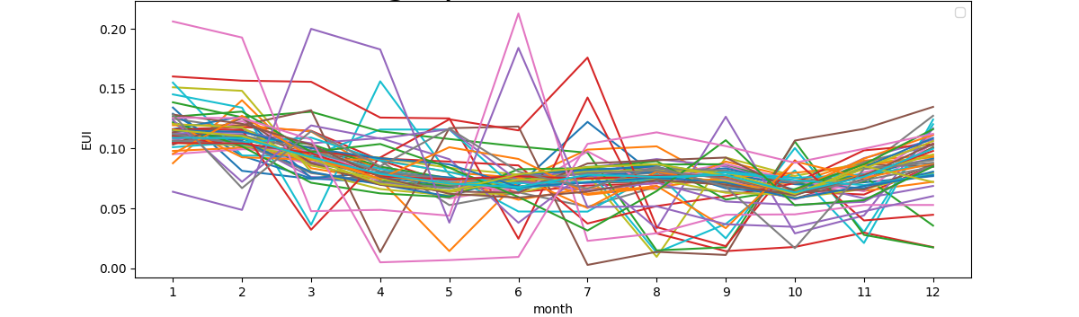
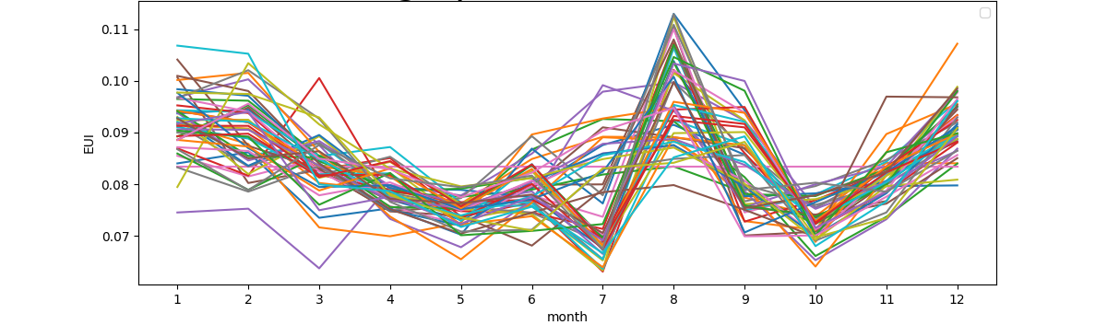
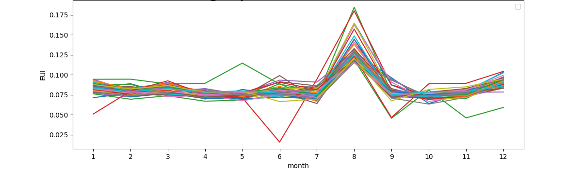
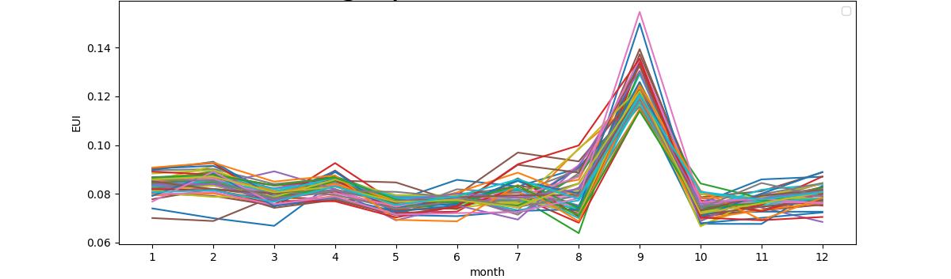
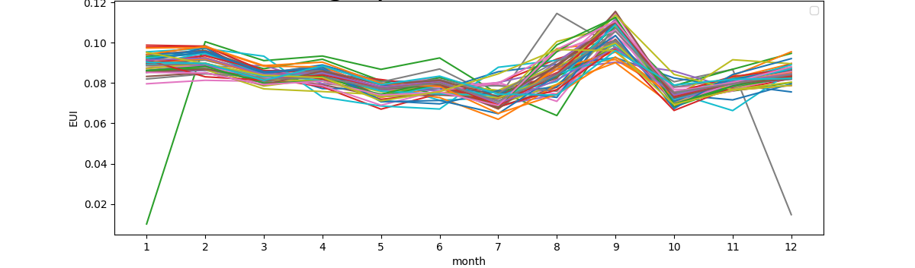
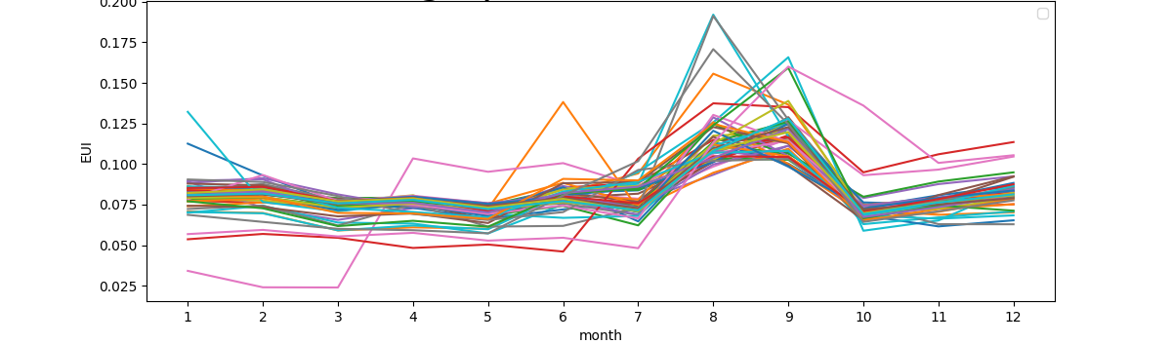
a) Cluster 1
b) Cluster 2
c) Cluster 3
d) Cluster 4
e) Cluster 5
f) Cluster 6

Slide 2
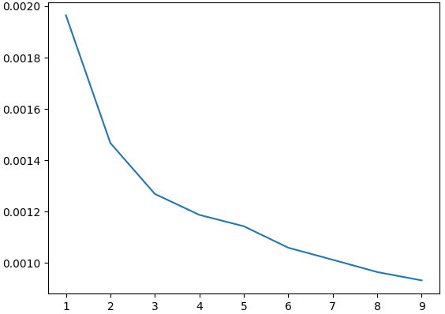
Sum of Square Error
Number of clusters

Slide 3
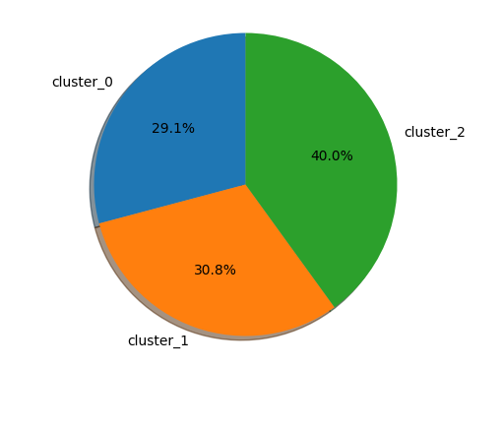
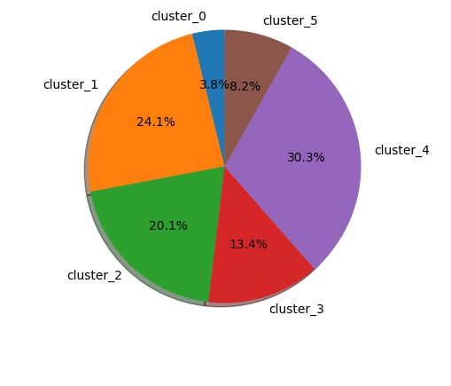
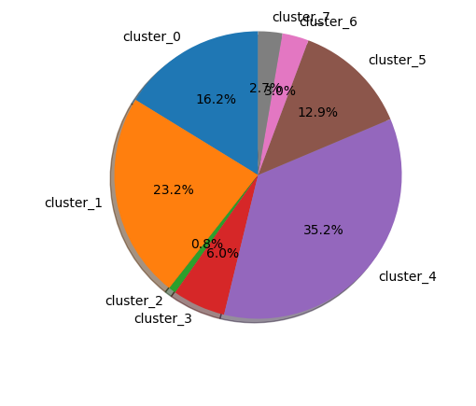
a) Case of 3 clusters
b) Case of 6 clusters
c) Case of 8 clusters

Slide 4
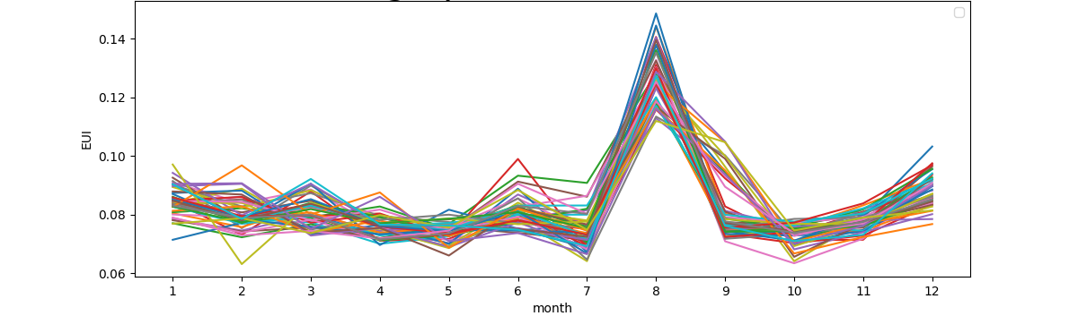
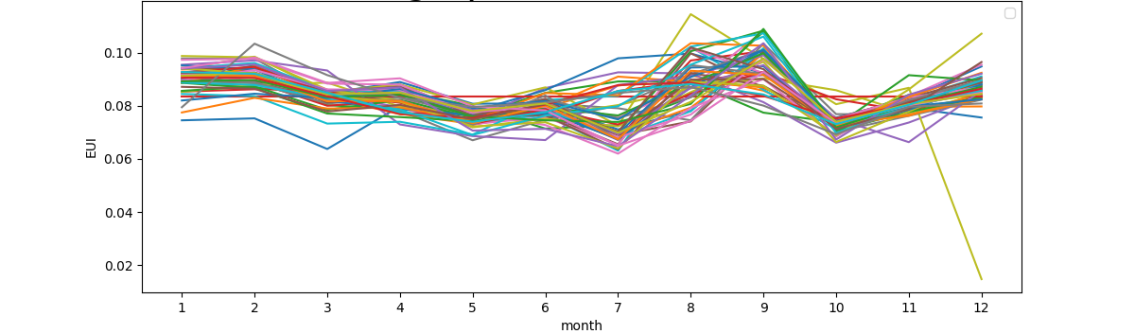
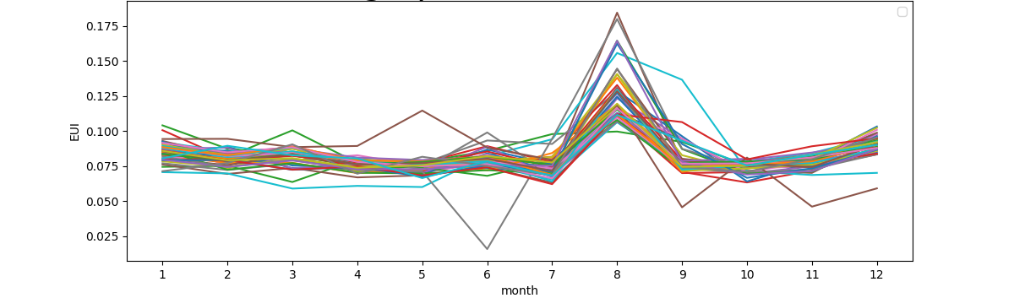
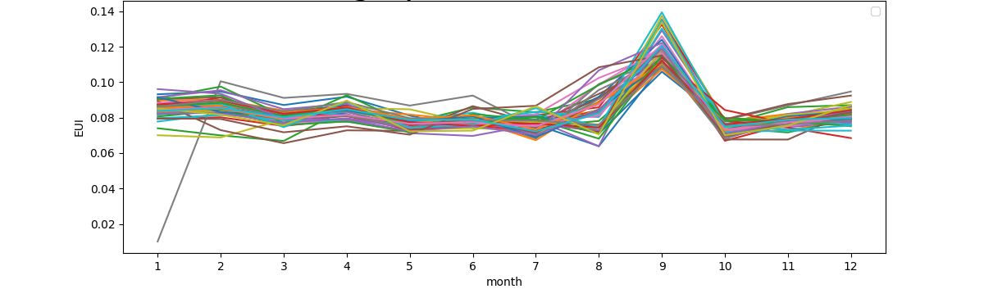
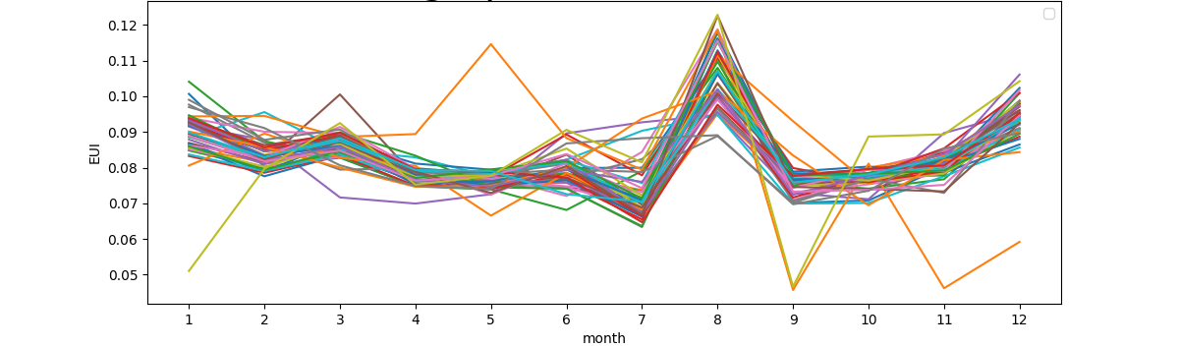
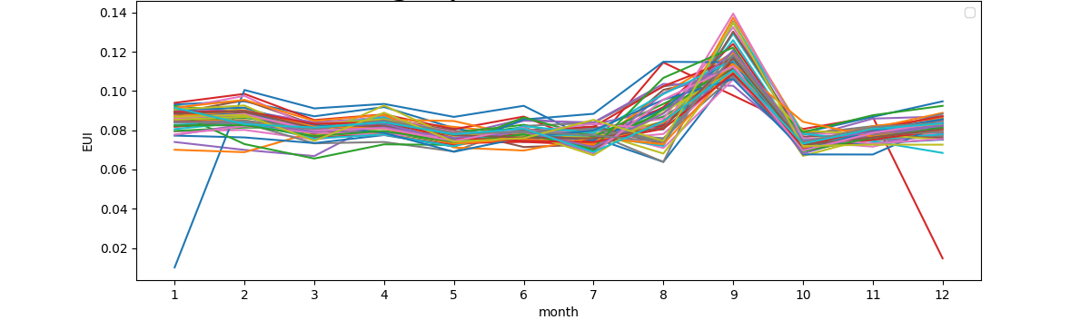
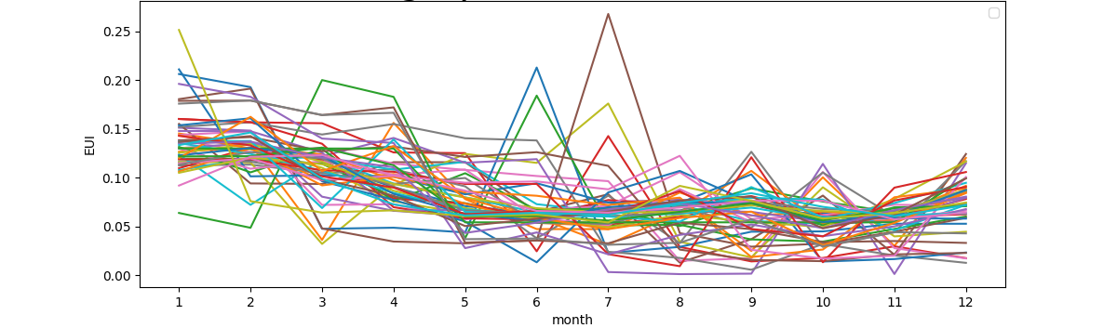
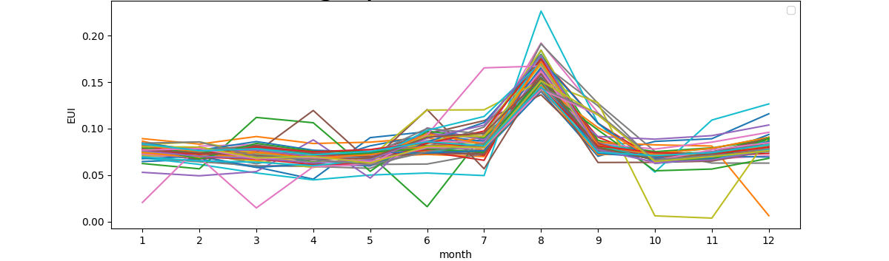
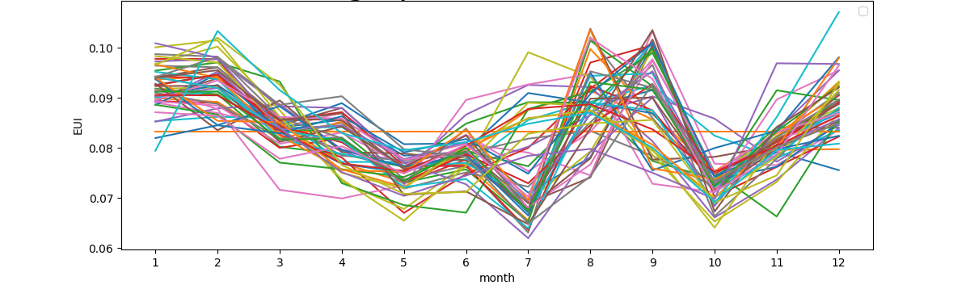
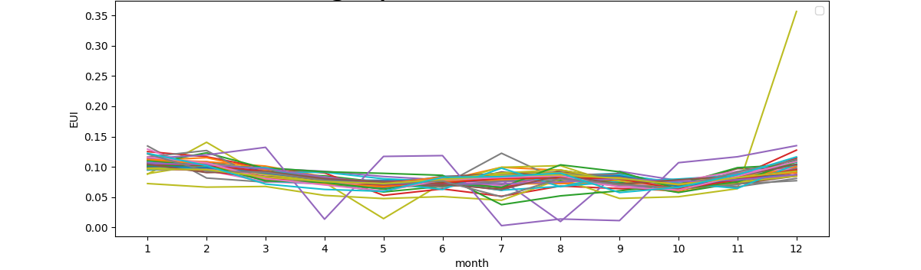
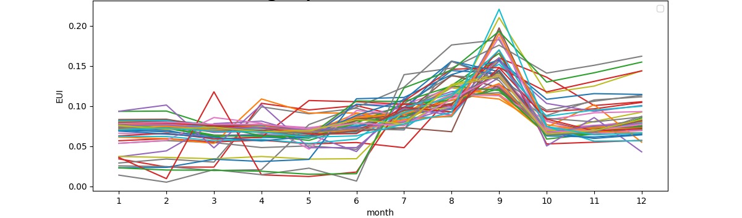
a) Case of 3 clusters
b) Case of 6 clusters
c) Case of 8 clusters

Slide 5
a) Cluster 1
e) Cluster 5
b) Cluster 2
f) Cluster 6
c) Cluster 3
g) Cluster 7
d) Cluster 4
h) Cluster 8

Slide 6
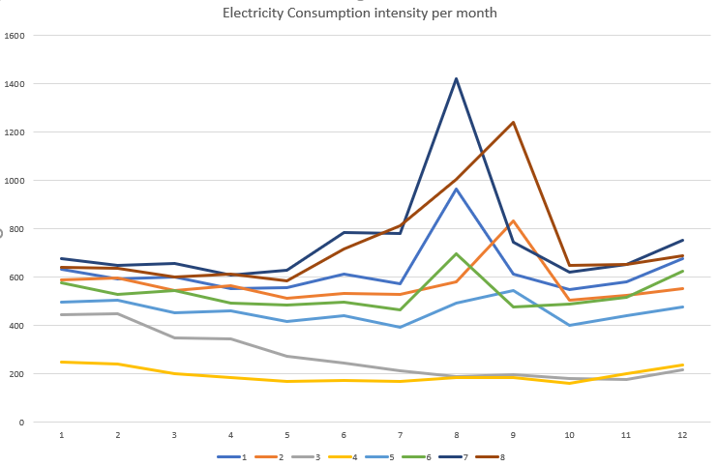
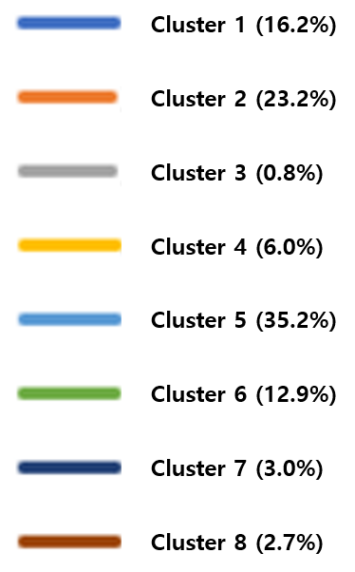

Slide 7
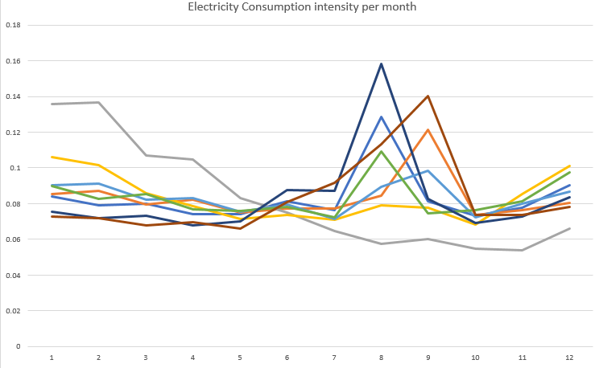

Slide 9
Cluster 1 (16.2%)
Cluster 2 (23.2%)
Cluster 3 (0.8%)
Cluster 4 (6.0%)
Cluster 5 (35.2%)
Cluster 6 (12.9%)
Cluster 7 (3.0%)
Cluster 8 (2.7%)

Slide 10

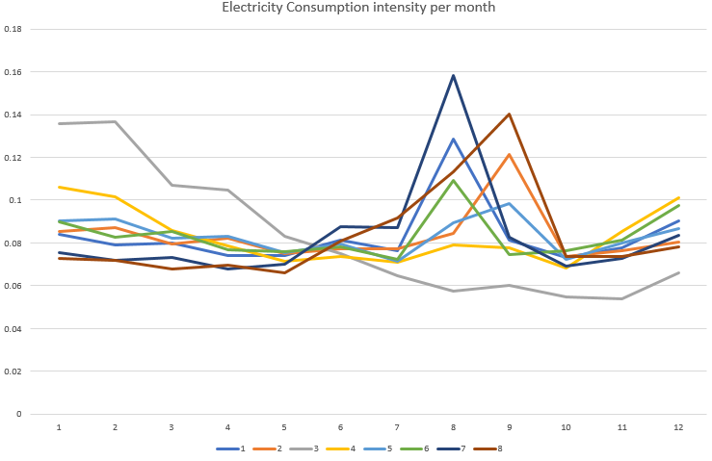
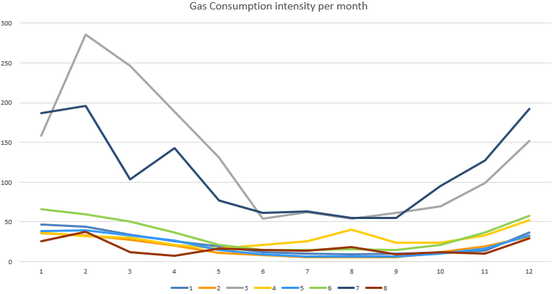
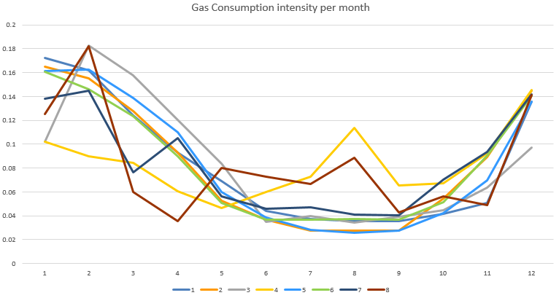

Slide 11
K-APT apartment list API
Building Address
Address Data
Sigungu* code
Apartment code
Complex name
Beopjeongdong* Code
Apartment code
Complex name
Address searching API
Lot No./bldg. No.
Apartment code
Complex name
Mountain code
Apartment code
Complex name
Building name
K-APT general data API
Apartment Code
Road code

