Slide 1
Presentation 3.3 - SOAP
Perry Fulfs | Web 420 | Professor Krasso

Slide 2

What SOAP is
Simple Object Access Protocol
Method that exchanges information on the internet
An independent messaging protocol
Messages are defined at a high level in XML
Used in a Service Oriented Architecture Framework
All of the information is sent by HTTP (standard web protocol)

Slide 3
What SOAP is – More information
SOAP is FREE!
SOAP can pass through firewalls and is often trusted
SOAP messages contain an envelope, header, body & fault
Actor specifies the recipient of the SOAP header
Actors are used when not all parts of the SOAP message are intended for the endpoint
MustUnderstand indicates whether the Header element is optional or mandatory

Slide 4
Envelopes
Is a mandatory part of SOAP message
Must contain exactly one Body element
Are the root elements of the SOAP messages
Defines the document as a SOAP message
Indicates starting and ending of the message
Contains only one Header element

Slide 5
Headers
Encoded as the first immediate child element of the SOAP envelope
Intended to add new features and functionality
It is not required
Offers a flexible framework for specifying additional application-level requirements
Contains management and control information
Are defined in a namespace

Slide 6
Faults and Fault Codes
Fault is an optional part of a SOAP message
Gives specific information about the error and a predefined code
If an error happens, then the fault is returned to the sender of the message
SOAP processor generates the fault
For HTTP binding, a successful response is linked to the 200 to 299 range of status codes
SOAP Fault is linked to the 500 to 599 range of status codes
A SOAP message can carry only one fault block

Slide 7
Faults and Fault Codes
SOAP-ENV:VersionMismatch - Found an invalid namespace for the SOAP Envelope element
SOAP-ENV:MustUnderstand - An immediate child element of the Header element, with the mustUnderstand attribute set to "1", was not understood.
SOAP-ENV:Client - The message was incorrectly formed or contained incorrect information
SOAP-ENV:Server - There was a problem with the server, so the message could not proceed
SOAP message is sent to the sender when a fault element occurs in the body of the message
SOAP fault returns predefined code description and address that created the fault

Slide 8
Faults and Fault Codes Example
<?xml version = '1.0' encoding = 'UTF-8'?>
<SOAP-ENV:Envelope
xmlns:SOAP-ENV = "http://schemas.xmlsoap.org/soap/envelope/"
xmlns:xsi = "http://www.w3.org/1999/XMLSchema-instance"
xmlns:xsd = "http://www.w3.org/1999/XMLSchema">
<SOAP-ENV:Body>
<SOAP-ENV:Fault>
<faultcode xsi:type = "xsd:string">SOAP-ENV:Client</faultcode>
<faultstring xsi:type = "xsd:string">
Failed to locate method (ValidateCreditCard) in class (examplesCreditCard) at
/usr/local/ActivePerl-5.6/lib/site_perl/5.6.0/SOAP/Lite.pm line 1555.
</faultstring>
</SOAP-ENV:Fault>
</SOAP-ENV:Body>
</SOAP-ENV:Envelope>

Slide 9
End-to-end data flow of a SOAP API
Hit An Endpoint - Test an API endpoint and get back header and payload information
Import A Definition - Generate test cases by importing a OAS(Swagger), WSDL, or WADL definition
Can create a project and add a reference to the WSDL file
Record Live Traffic - Record live traffic from an API service, then replay to generate test cases
Provides technical details of the web services for client applications
Requests can be made in data parameters and responses sent back
SOAP can be used by different resources

Slide 10
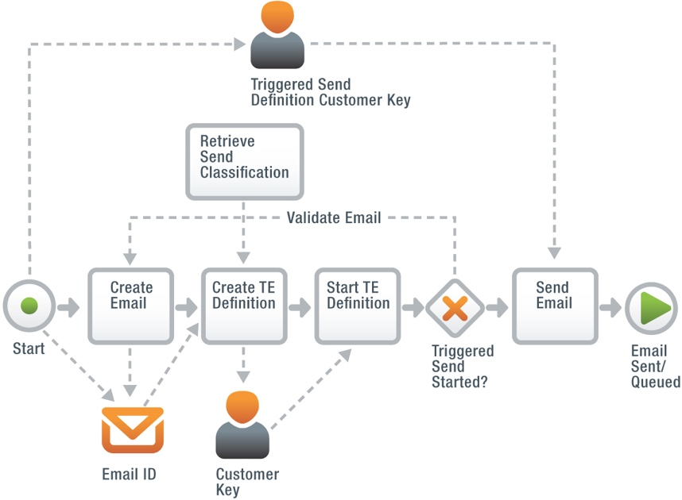
End-to-end data flow of a SOAP API - Flow of the SOAP API

Slide 11
REFERENCES
What is SoapUI? Introduction to SoapUI Testing. (n.d.). Retrieved April 03, 2021, from https://www.guru99.com/introduction-to-soapui.html
Soap - envelope. (n.d.). Retrieved April 03, 2021, from https://www.tutorialspoint.com/soap/soap_envelope.htm
Nolle, T., Sargent, M., & Linthicum, D. (2019, February 13). What is SOAP (simple object access protocol)? - definition from whatis.com. Retrieved April 03, 2021, from https://searchapparchitecture.techtarget.com/definition/SOAP-Simple-Object-Access-Protocol
10 API Testing tips for Beginners (SOAP & REST): Complete Guide. (2021, March 19). Retrieved April 03, 2021, from https://www.katalon.com/resources-center/blog/api-testing-tips/

