Slide 1

Modification-free extensibility for existing apps
Sebastian Wennemers, Joaquin Recio Huertas, Aditya Bhatia June 28, 2019
Notes:
We are from the SAPUI5 Flexibility area

Slide 2
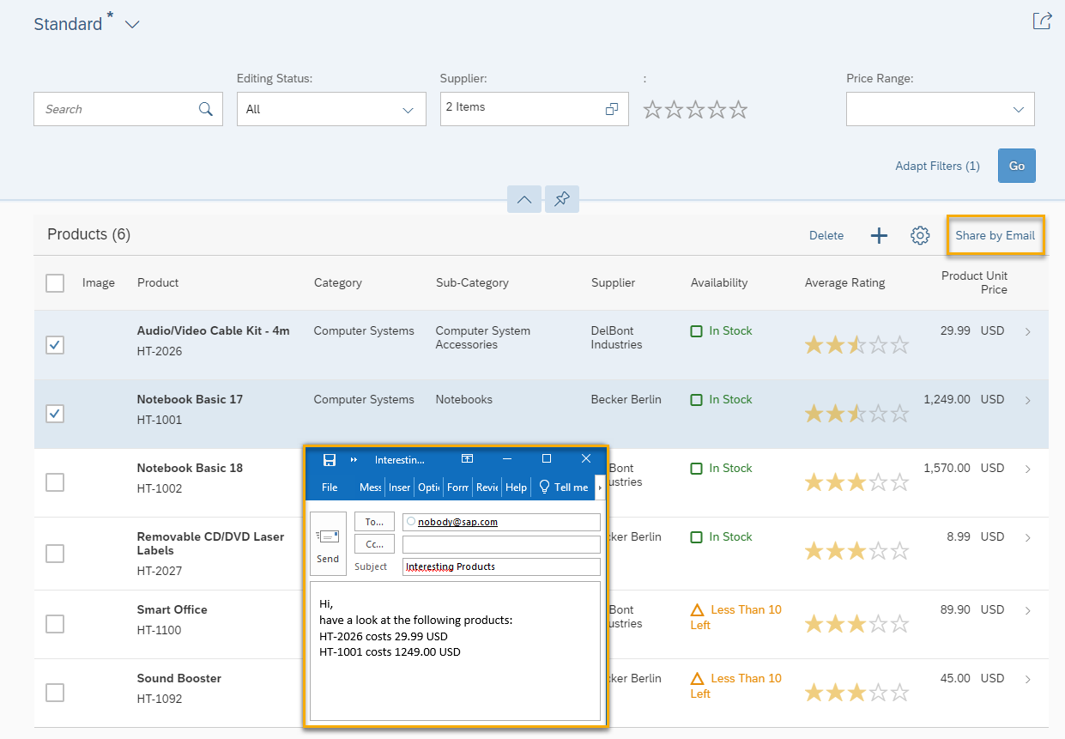
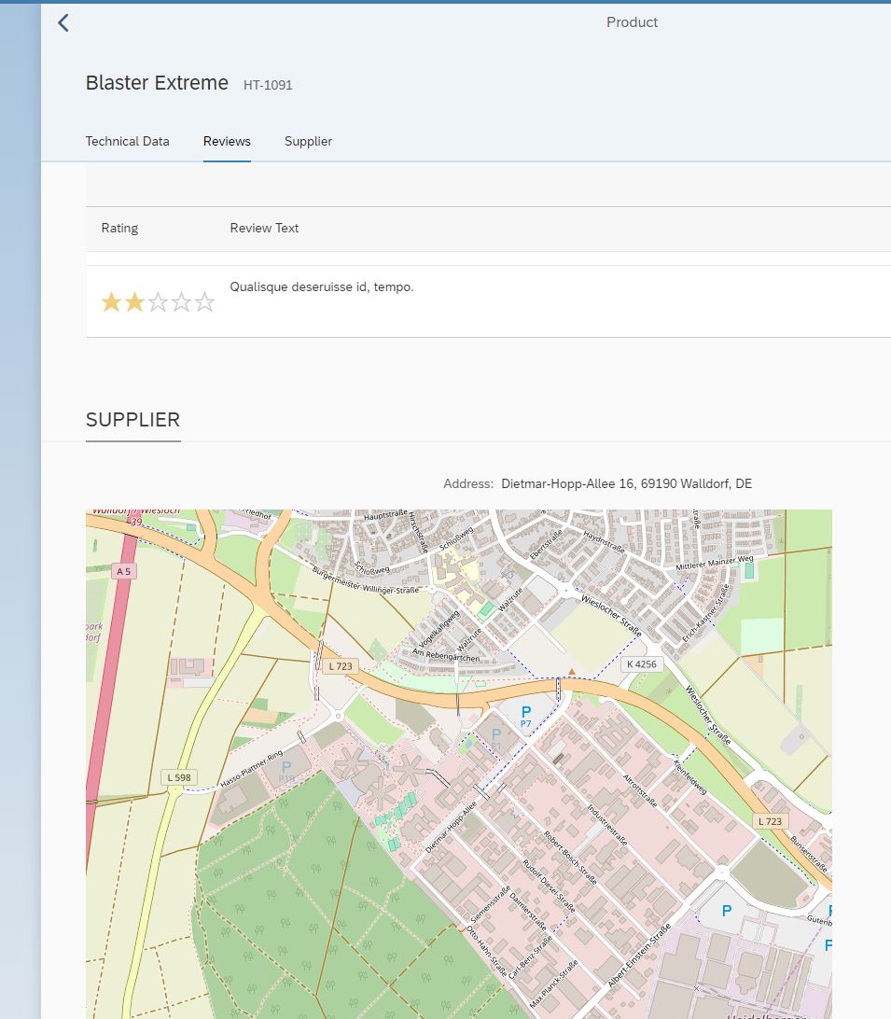
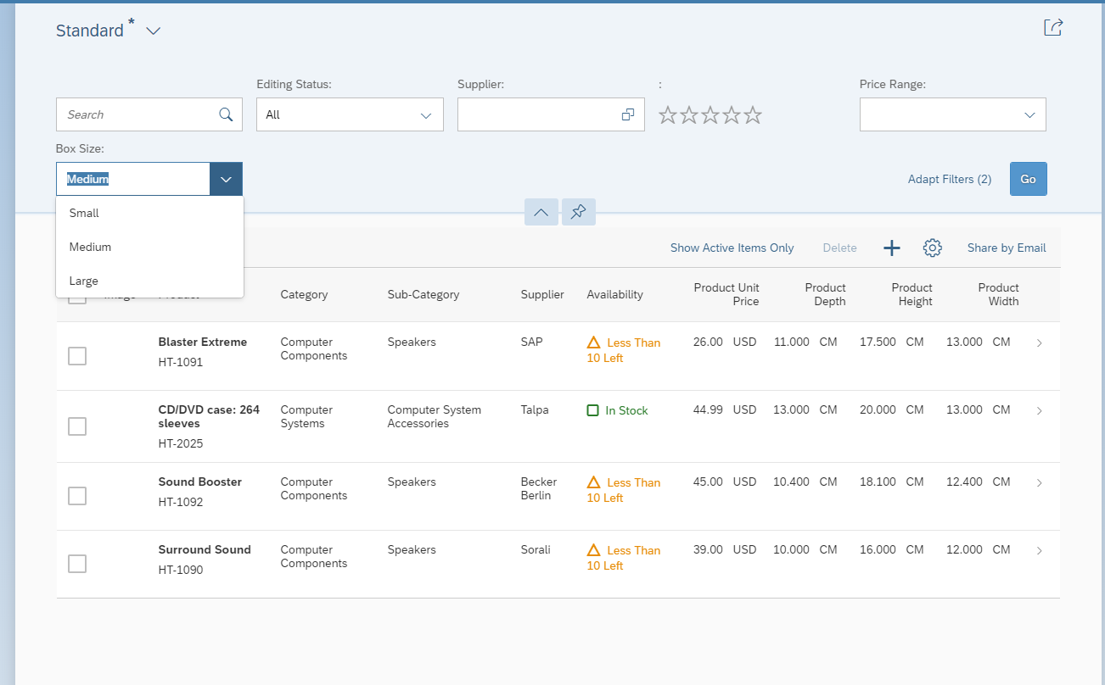
Our Plan
Extend an existing SAPUI5 application with additional functionality: New button, new filter, new section
Prerequisties:
Get the Hands-On document: https://swennemers.github.io/ModificationFreeExtensibilityAdaptationProject.docx
SAP Cloud Platform trial account
SAP Web IDE
User in SAP Gateway Demo Consumption System ES5

Slide 3
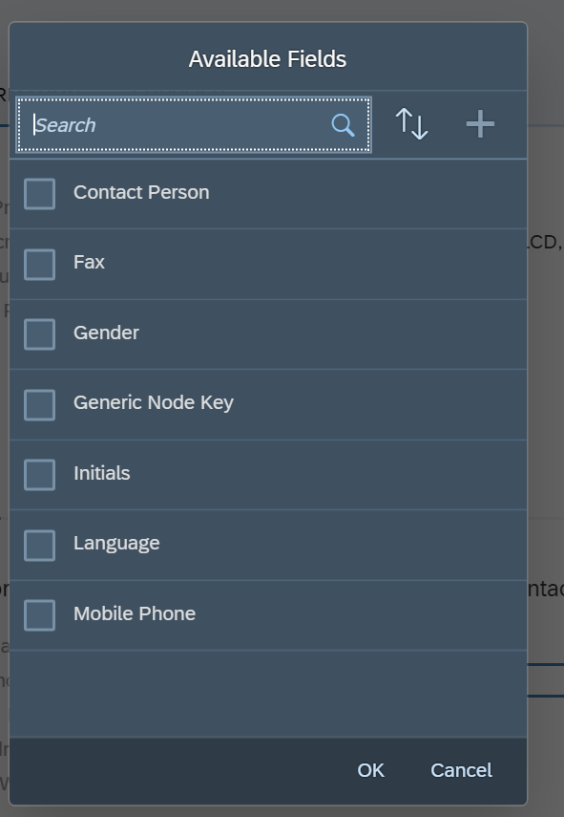
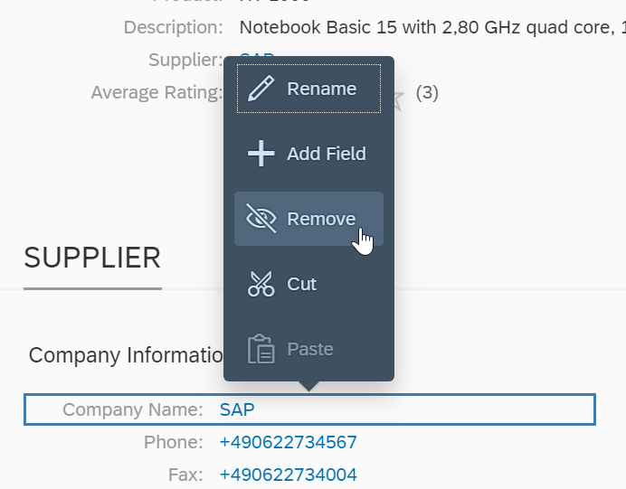
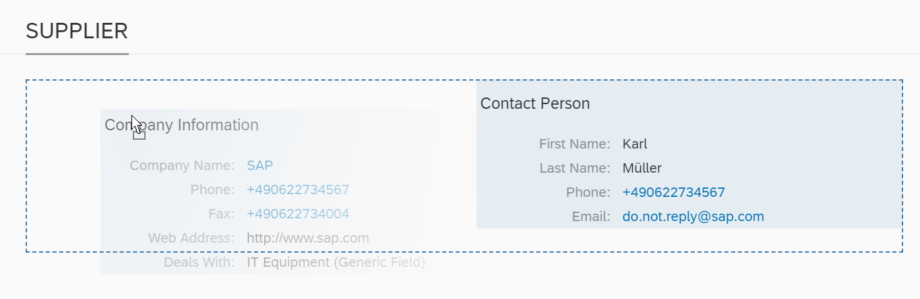
Flexibility - Flexibility is Key
SAPUI5 flexibility enable functions for different user groups to personalize SAP Fiori apps, adapt their user interface at runtime, and develop new apps.
Benefits:
Simplified, cost-effective, and easy to use UI change process
Increased end user acceptance through optimized UI layouts
Adapted UI changes safe for future system updates
Easy and intuitive way to adapt the UI

Slide 4
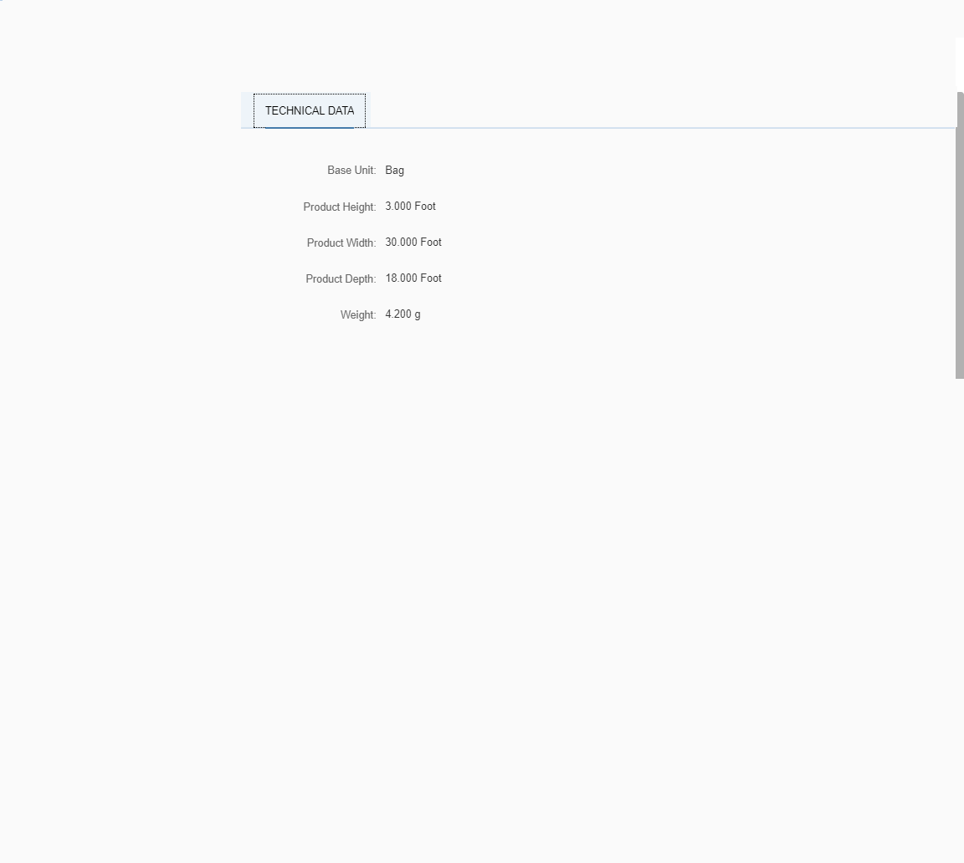
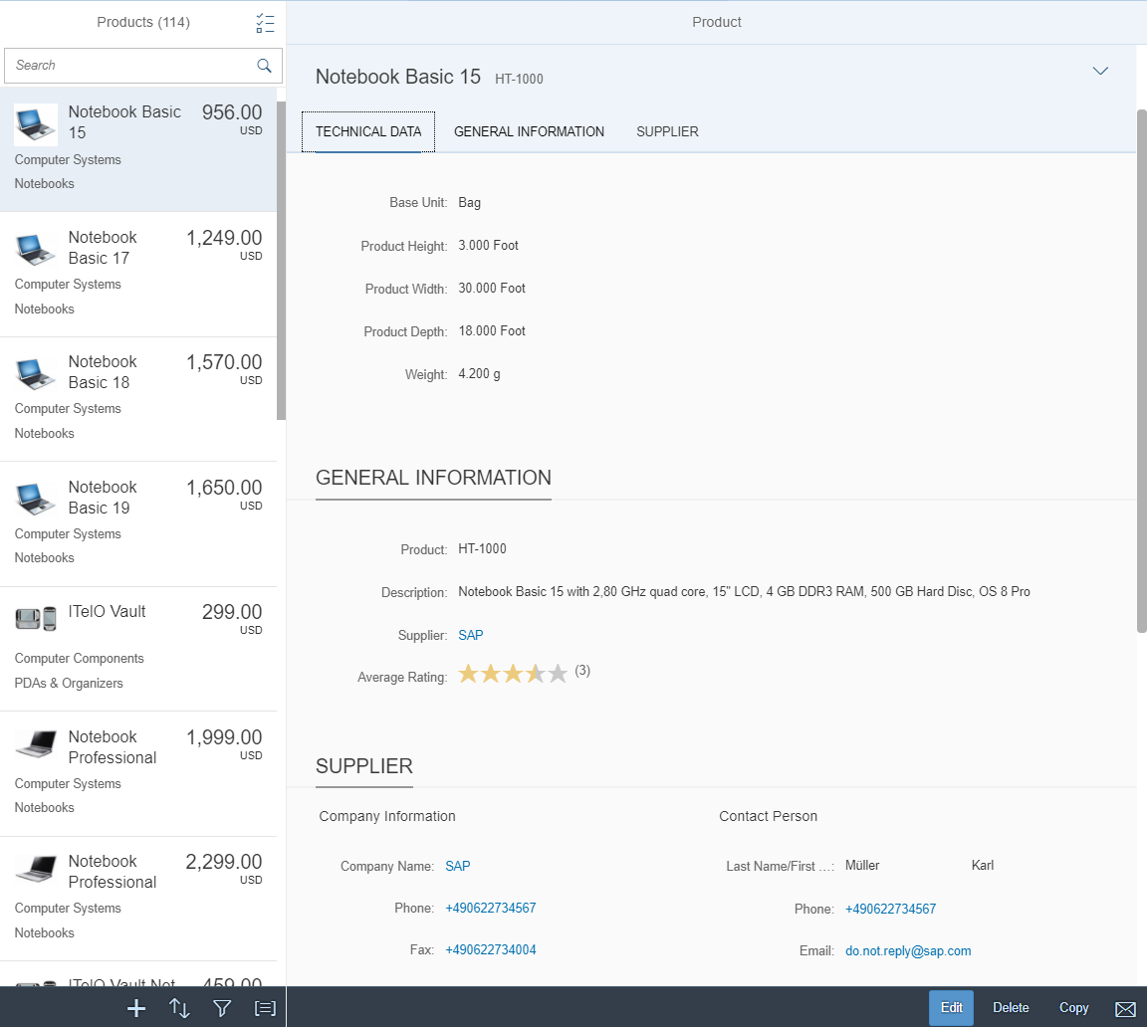
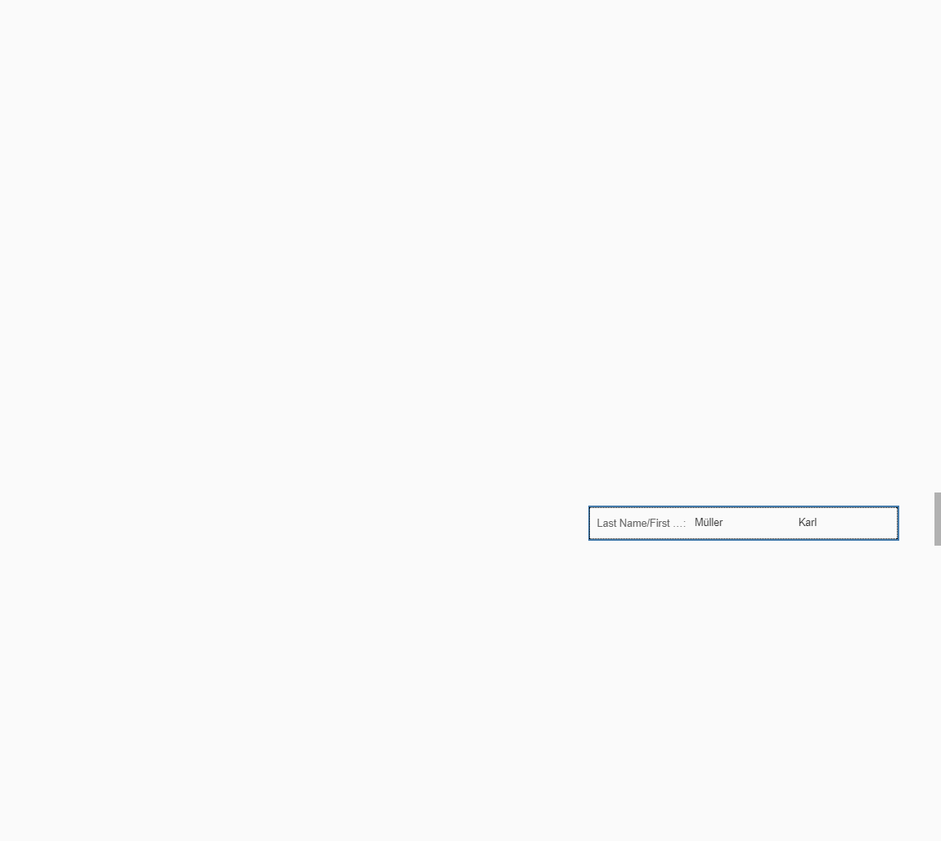
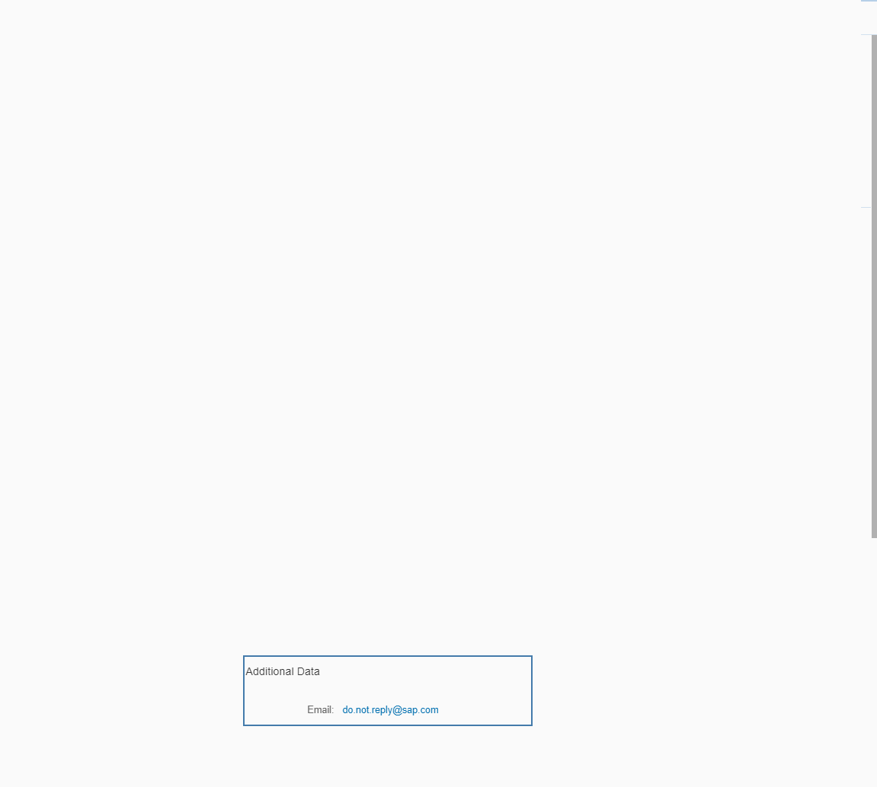
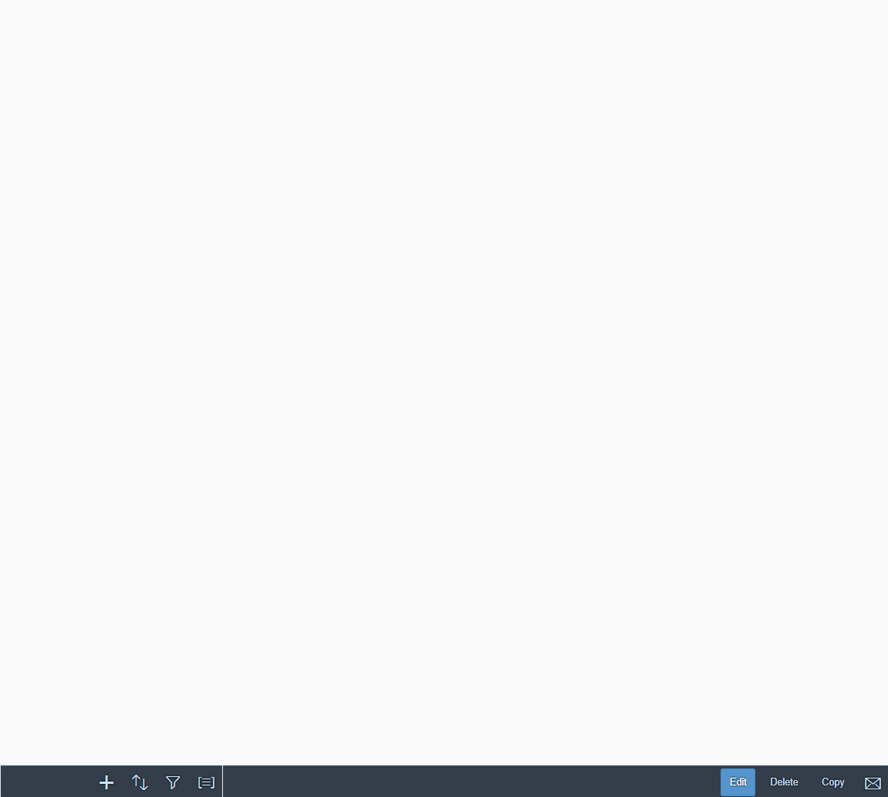

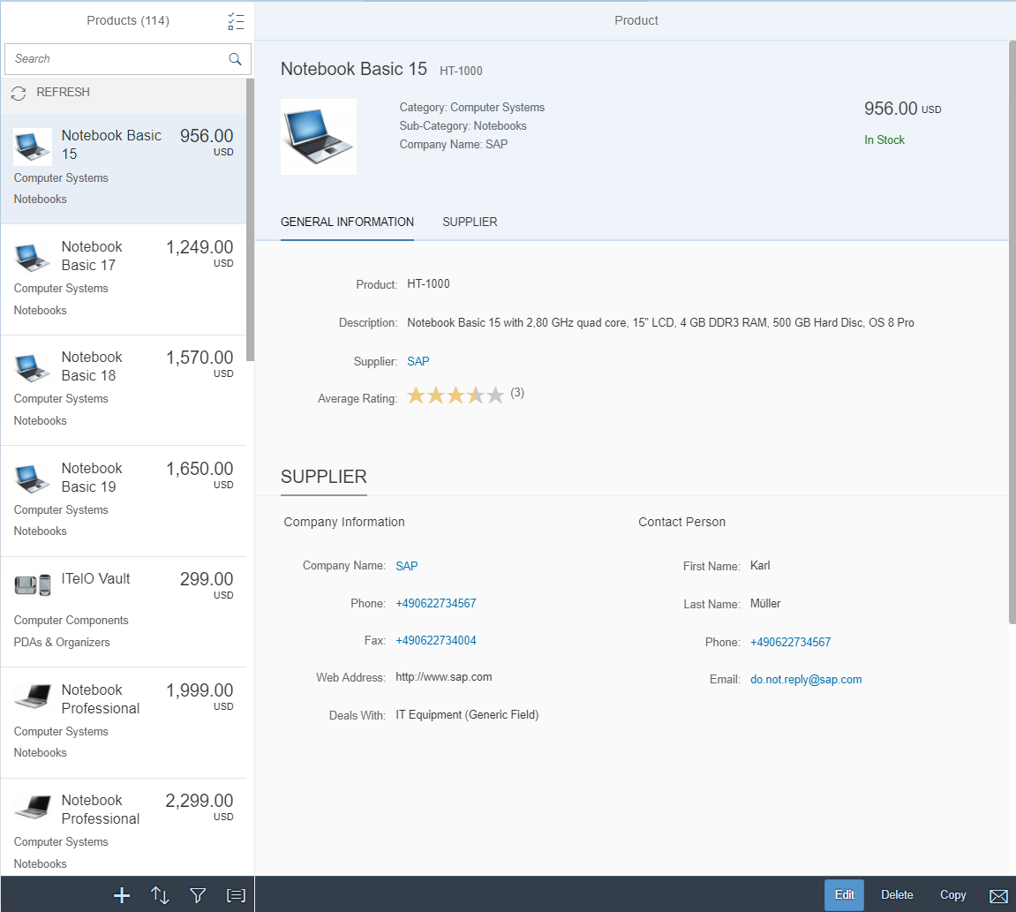


Flexibility – Layering Approach
Flexibility
Personalization
Customer Layer
Key User adaptation
Developer adaptation
SAP Layer

Slide 5
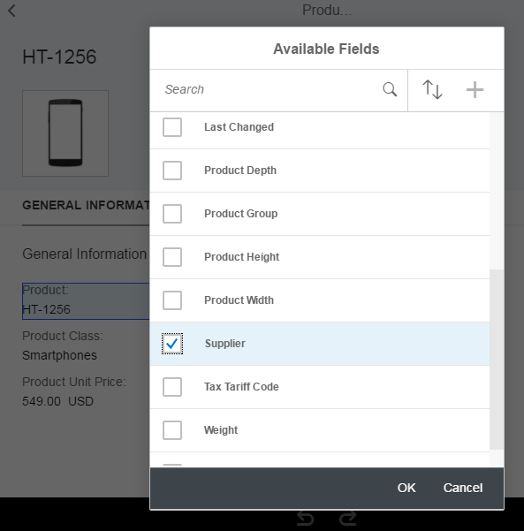
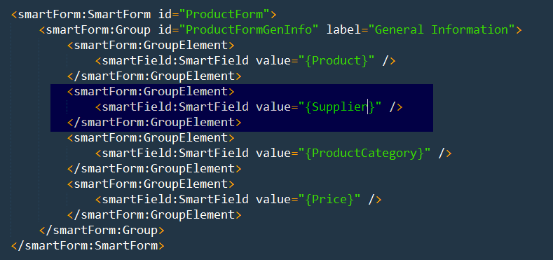
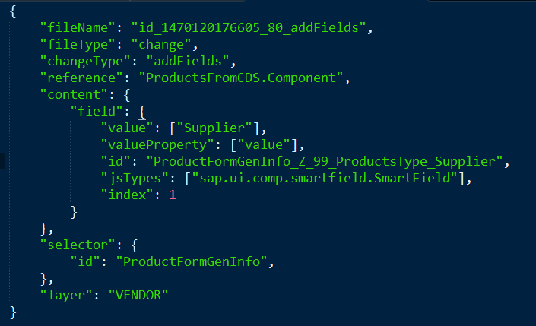
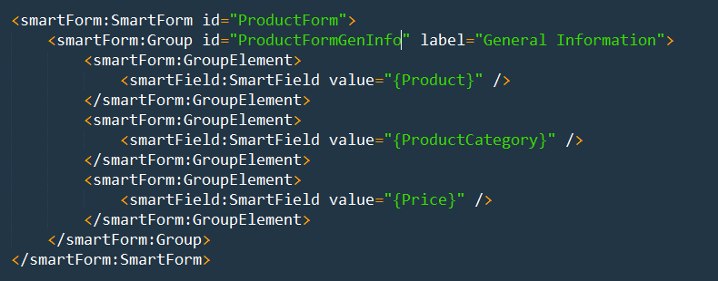
Flexibility – Modification-free Changes
View with a form
A new field is added into the view using UI adaptation at runtime/design-time* …
The change is applied to the view
… and creates a SAPUI5 flexibility change

Slide 6
Flexibility - Personas
* recent innovations
Developer
Business Expert, Key User
End User
I want to
Add/change complex business logic*
Add new business objects / apps*
De-couple software lifecycle of standard and extensions*
I want to
Add custom fields
Change field descriptions
Change order of fields
Create new app variants
Add/manage control variants (views)
I want to
Personalize tables and filters
Save and manage own variants
My changes should not affect other people
My changes should affect people in my company
My changes should affect people in my LOB
Notes:
Explain the different personas
--------
We start the hands-on part now! I will slowly do the stuff and explain what I am doing, and you can follow my steps immediately, if there are questions or issues please raise your hand.
Now assume, we are a developer at an air cargo company. Our company is using an SAP delivered app: Show app: https://sapes5.sapdevcenter.com/sap/bc/ui5_ui5/ui2/ushell/shells/abap/FioriLaunchpad.html?sap-client=002&sap-language=EN#Shell-home

Slide 7
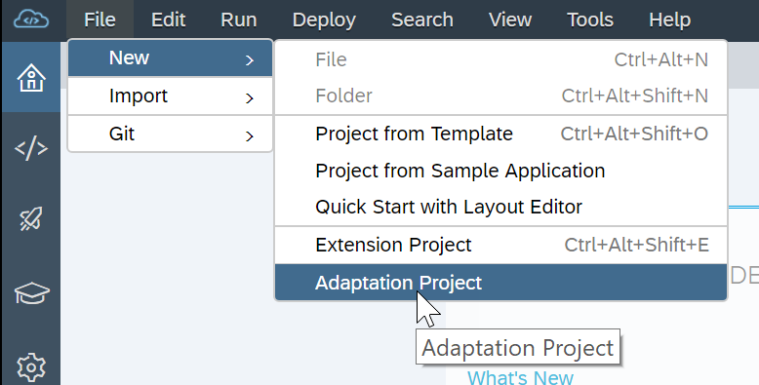
Adaptation Projects in SAP Web IDE
Adaptation project
allows developers to adapt existing SAP Fiori Elements based applications
Key Features
Semantic changes
Property changes
Add XML fragments to extend views
Assign event handlers
Extend i18n
Notes:
Last year it was „Lab Preview“ => now as hands-on

Slide 8
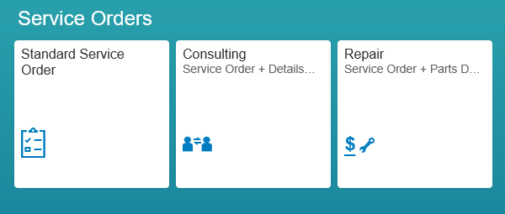


App Variants
original
app variant
Create variant
Original
App variant
Add a tab for parts

Slide 9
Adaptation Projects vs Extension Projects
Adaptation projects allow a developer to create variants of existing SAP Fiori elements based application. What makes adaptation projects different from extension projects?
Adaptation project
Supports SAP Fiori elements based applications
Create semantic app variants with separate app descriptors
Extend in multiple places
Expanded set of changes
i18n extensibility
Supports multiple layers
Extension project
Does NOT support SAP Fiori elements based applications
Extension via manifest configurations
Extend only in extension points
Limited options (e.g. no extend for lifecycle methods)
Only one layer

Slide 10
Flexibility – Platform Support
 | On premise (ABAP) | S/4HANA Cloud | SAP Cloud
 |  |  | Platform (NEO) | Cloud Foundry
personalization Object Pages |  experimental |  experimental |  |  experimental
personalization smart controls & views* |  |  |  | 
pers. and adaptation (sap.ui.fl.variant) |  |  |  | 
Key User Adaptation |  |  | 
App Variants |  | 
SAPUI5 Visual Editor for my own apps |  |  |  |  as part of grunt best practise builds
Adaptation Project & SAPUI5 Visual Editor | 
* views previously known as “control variants”

Slide 11
Additional information

Slide 12
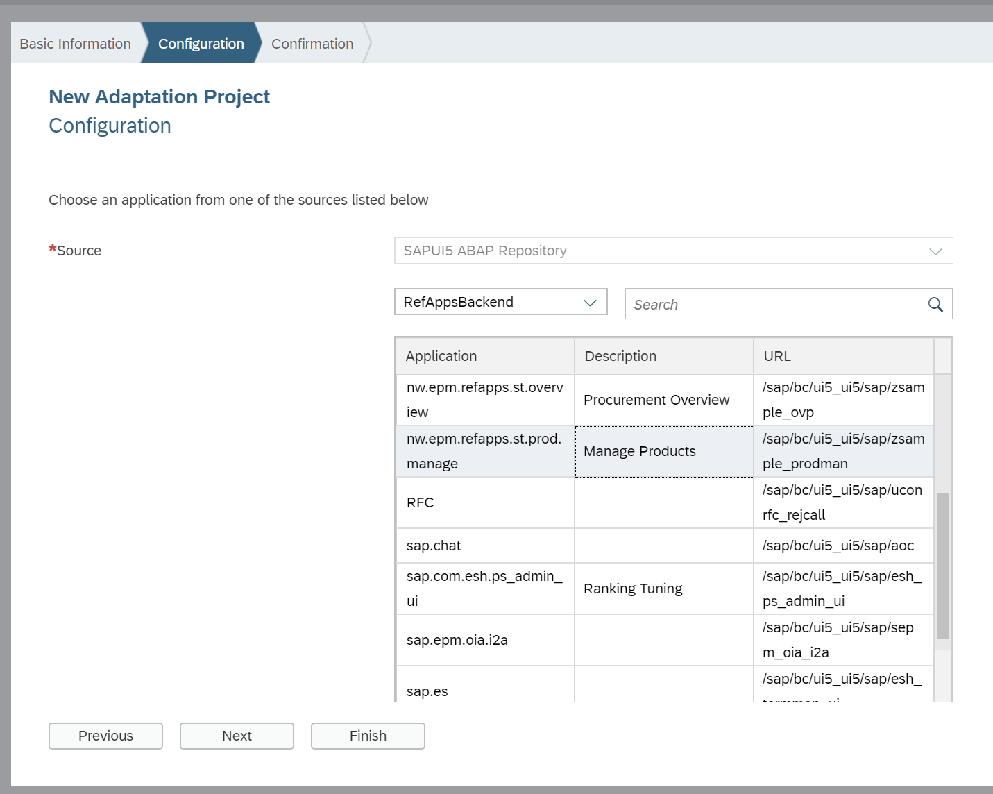
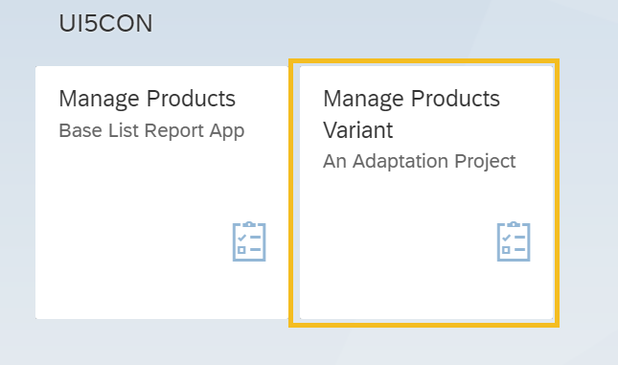
Flexibility – Adaptation Project in SAP Web IDE
New type of project in SAP web IDE
…which allows to create variants of existing apps
…and then configure and deploy them separately.

Slide 13
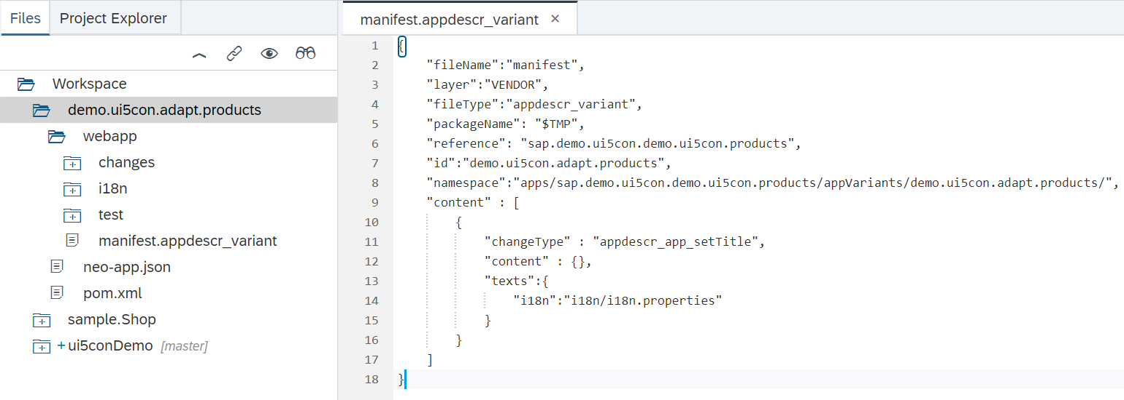
Flexibility – Adaptation Project in SAP Web IDE
Adaptation project reference original application…
…but has an own application id
…and contain separate set of changes.
In this way you can adapt application variant without touching original artefacts!

Slide 14
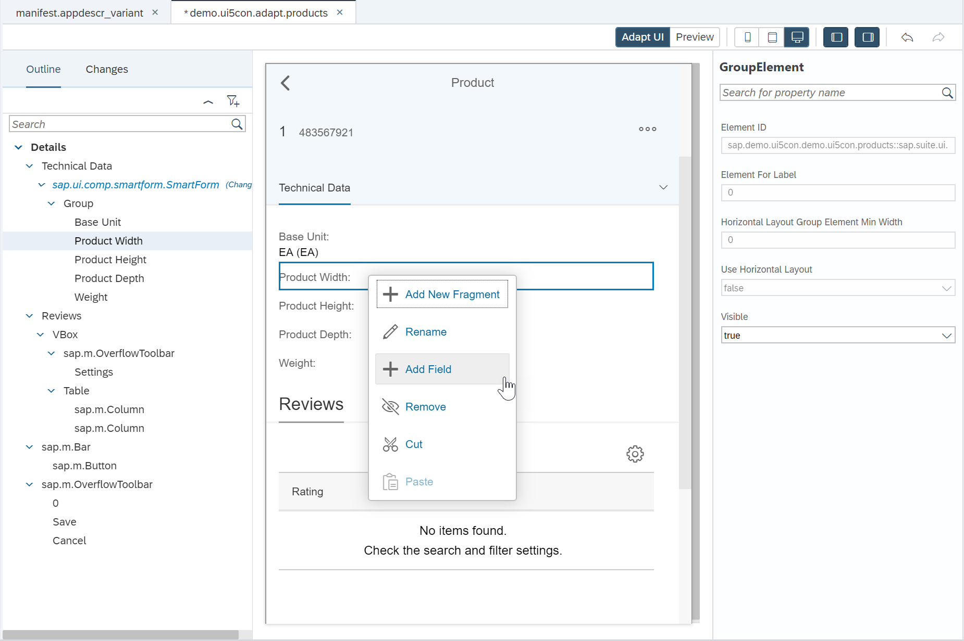
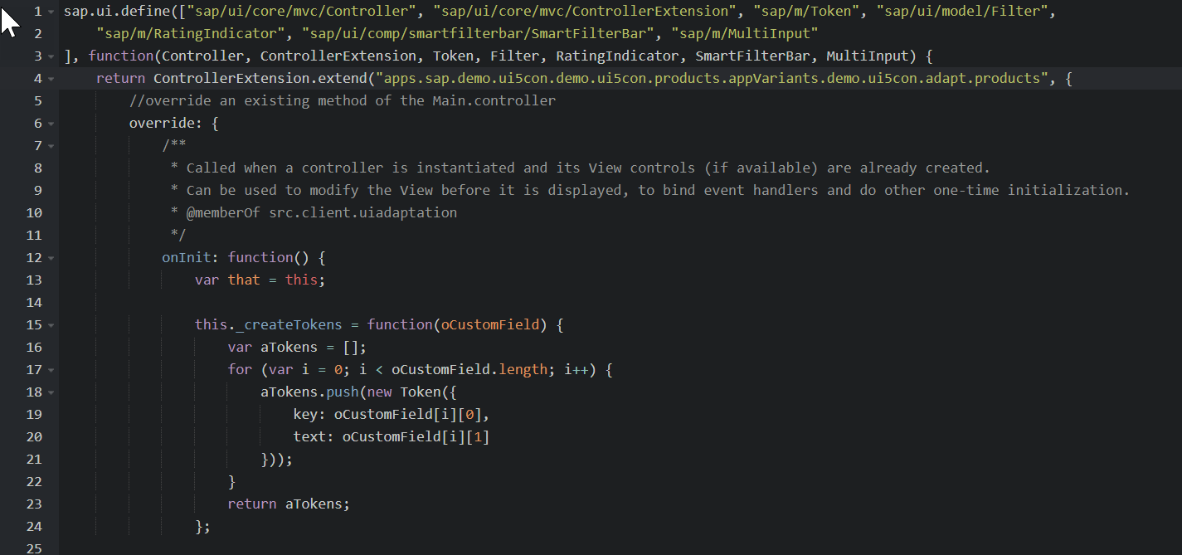
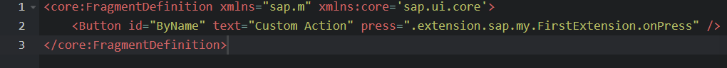
Flexibility – Adaptation Project in SAP Web IDE
Extensibility possibilities of adaptation project include all options available for key users
…but developers are also able to change control properties
…or even extend controller code!
…add XML fragments

Slide 15
Flexibility – Learn More
SAPUI5 Flexibility
https://ui5.sap.com/#/topic/a8e55aa2f8bc4127923b20685a6d1621.html
App Variants for Key Users
https://blogs.sap.com/2018/06/05/easily-create-app-variants-in-sap-s4hana-cloud/
Adaptation Project in SAP Web IDE
Adaptation Projects – it’s time for a new way to extend your Fiori Elements applications
Extending a SAP Fiori Elements application using Adaptation Projects: Video
Adaptation Projects: A Tutorial
Key User Adaptation & Personalization
https://ui5.sap.com/#/topic/f1430c0337534d469da3a56307ff76af.html
Key User Adaptation on CP Neo
https://help.sap.com/viewer/8422cb487c2146999a2a7dab9cc85cf7/Cloud/en-US/f7f671f6c26348d7a662c2c3d120202d.html
Enabled controls and dev guide
https://help.sap.com/viewer/4fc8d03390c342da8a60f8ee387bca1a/1805.500/en-US/e144c749695545eba5d5479a40357fa6.html
openSAP course (Week 5 & 6)
https://open.sap.com/courses/ui52

Slide 16
Thank you.
Contact information:
Sebastian Wennemers
Development Architect
@S7nW7s

