Slide 1
Programming Models in Cloud: MapReduce and Spark

Slide 2
MapReduce: Simplified Data Processing on Large Server Clusters
A programming model and an associated implementation(library) for processing and generating large data sets (on large clusters).
A new abstraction allowing us to express the simple computations we were trying to perform but hides the messy details of parallelization, fault-tolerance, data distribution and load balancing in a library.

Slide 3
Cloud Software System Using MapReduce
User App
MapReduce
Distributed File Systems (GFS)

Slide 4
Google’s MapReduce Paradigm
Platform for reliable, scalable parallel computing
Abstracts issues of distributed and parallel environment from programmer.
Runs over Google File Systems

Slide 5
MapReduce: Insight via Example
Example: “Consider the problem of counting the number of occurrences of each word in a large collection of documents”
How would you do it in parallel ?

Slide 6
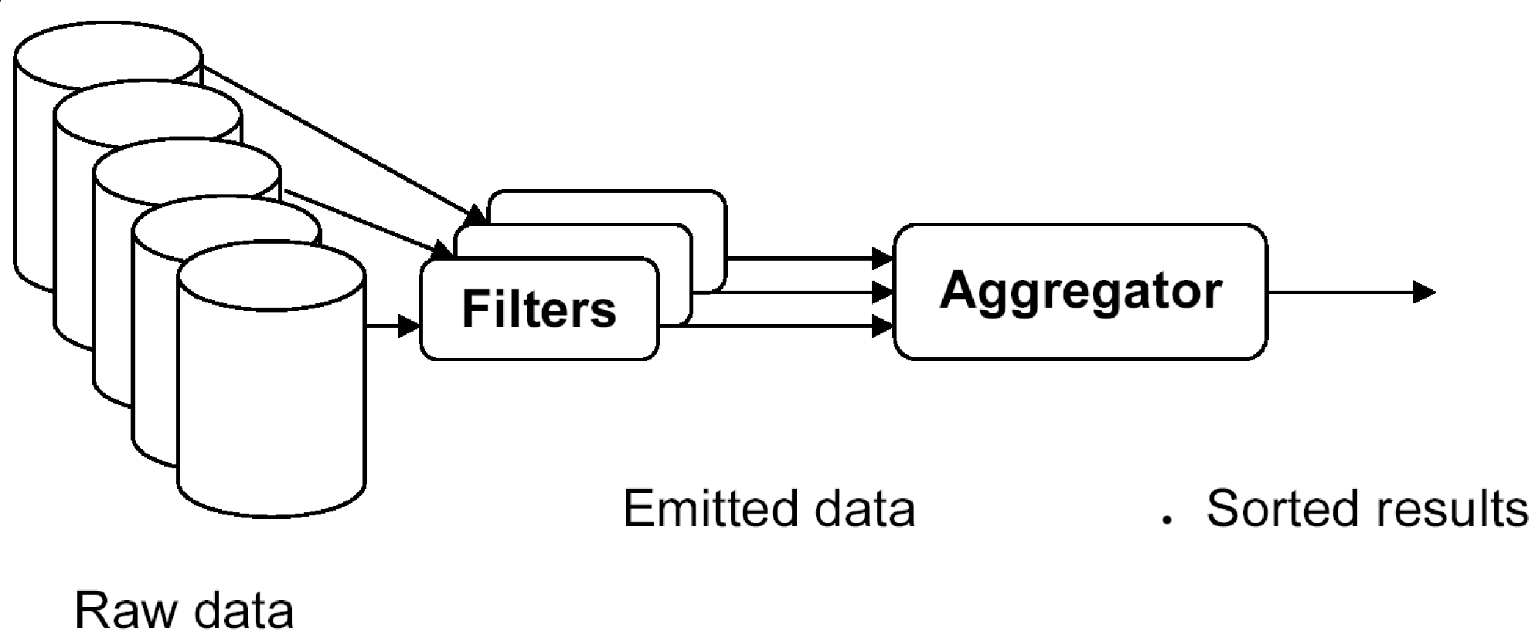
One possible solution
Divide collection of document among the class.
Each person gives count of individual word in a document. Repeats for assigned quota of documents.
(Done w/o communication )
Sum up the counts from all the documents to give final answer.

Slide 7
MapReduce Programming Model
Inspired from map and reduce operations commonly used in functional programming languages like Lisp.
Users implement interface of two primary methods:
1. Map: (key1, val1) → (key2, val2)
2. Reduce: (key2, [val2]) → [val3]
Many real world tasks are expressible in this model.
Assumption: data has no correlation, or it is small.

Slide 8
Map operation
Map, a pure function, written by the user, takes an input key/value pair, and produces a set of intermediate key/value pairs.
e.g. (doc—id, doc-content)
Draw an analogy to SQL, map can be visualized as group-by clause of an aggregate query.

Slide 9
Reduce operation
On completing map phase, all the intermediate values for a given output key are combined together into a list and given to a reducer.
Can be visualized as aggregate function (e.g., average) that is computed over all the rows with the same group-by attribute.

Slide 10
Pseudo-code for the Example
Example: counting the number of occurrences of each word in a large document
map(String input_key, String input_value):
// input_key: document name
// input_value: document contents
for each word w in input_value:
EmitIntermediate(w, "1");
reduce(String output_key, Iterator intermediate_values):
// output_key: a word
// output_values: a list of counts
int result = 0;
for each v in intermediate_values:
result += ParseInt(v);
Emit(AsString(result));

Slide 11
More Examples
Distributed grep:
Map: (key, whole doc/a line) → (the matched line, key)
Reduce: identity function
Count of URL Access Frequency:
Map: logs of web page requests → (URL, 1)
Reduce: →(URL, total count)
Reverse Web-Link Graph:
Map: (source, target) → (target, source)
Reduce: (target, list(source)) → (target, list(source))

Slide 12
MapReduce: Execution overview
Master Server distributes M map task to mappers and monitors their progress.
Map Worker reads the allocated data, saves the map results in local buffer.
Shuffle phase assigns reducers to these buffers, which are remotely read and processed by reducers.
Reducers o/p the result on stable storage.

Slide 13
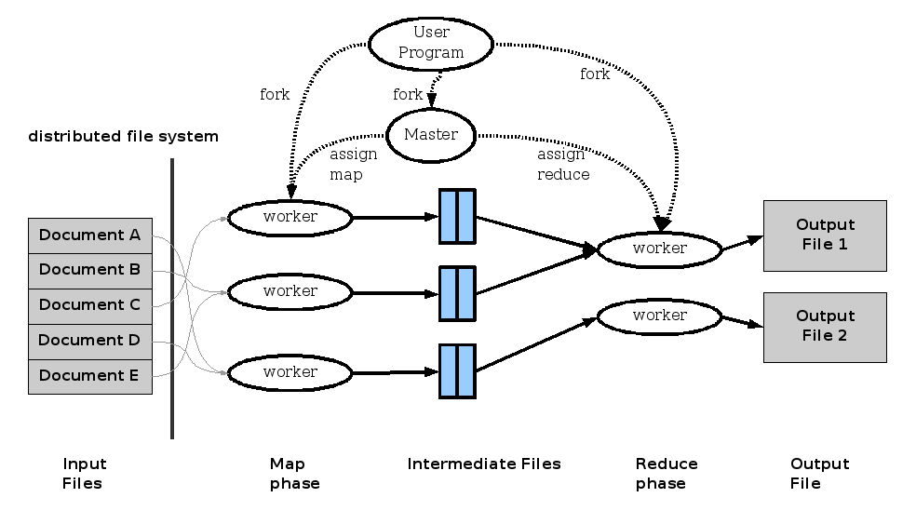
MapReduce: Execution Overview

Slide 14
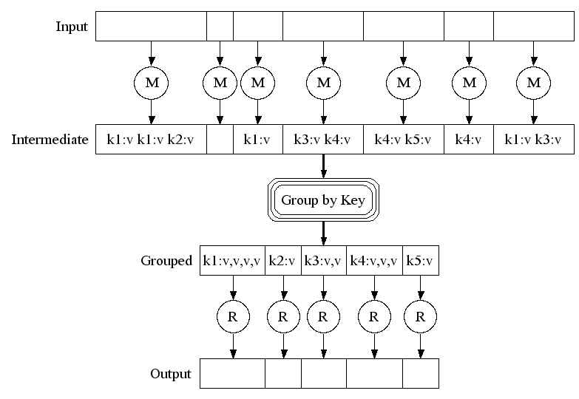
MapReduce: Example

Slide 15
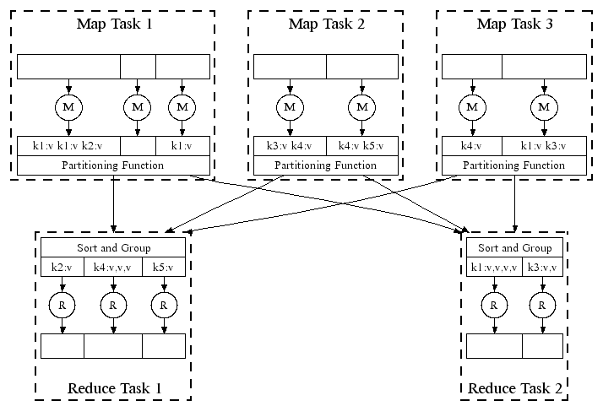
MapReduce in Parallel: Example

Slide 16
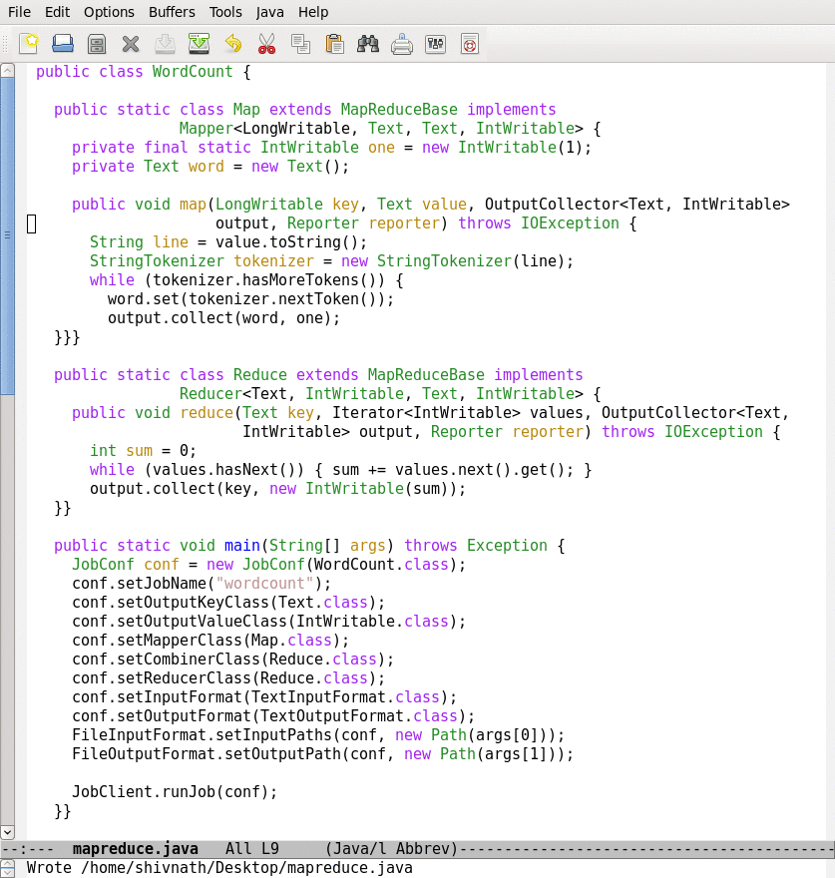
Lifecycle of a MapReduce Job
Map function
Reduce function
Run this program as a
MapReduce job

Slide 17
Lifecycle of a MapReduce Job
Map function
Reduce function
Run this program as a
MapReduce job

Slide 18
Lifecycle of a MapReduce Job
Time
Input
Splits
Map
Wave 1
Map
Wave 2
Reduce
Wave 1
Reduce
Wave 2
Notes:
Industry wide it is recognized that to manage the complexity of today’s systems, we need to make systems self-managing. IBM’s autonomic computing, Microsoft’s DSI, and Intel’s proactive computing are some of the major efforts in this direction.
18

Slide 19
MapReduce: System for Runtime Environment
MapReduce Runtime Environment
Partitioning the input data.
Scheduling program across cluster of machines, Locality Optimization and Load balancing
Dealing with machine failure
Managing Inter-Machine communication

Slide 20
MapReduce: Execution Steps
Split input files (1)
Master and workers (2)
Map task workers (3)
Buffering of results (4)
Copying and sorting (5)
Reduce workers (6)
Return to user code (7)

Slide 21
MapReduce Master
Handling
Task state: idle, in-progress, completed
Identity of worker machine: for in-progress tasks
Location of intermediate file regions of map tasks.
Receive from map tasks
Push to reduce tasks.

Slide 22
Fault Tolerance: Redo
Handled via re-execution of tasks.
Task completion committed through master
What happens if Mapper fails ?
Re-execute completed + in-progress map tasks
What happens if Reducer fails ?
Re-execute in progress reduce tasks
What happens if Master fails ?
Potential trouble !!

Slide 23
Fault Management Details
Master pings workers, re-schedules failed tasks.
Note: Completed map tasks are re-executed on failure because their output is stored on the local disk.
Semantics in the presence of failures:
Deterministic map/reduce function: Produce the same output as would have been produced by a non-faulting sequential execution of the entire program
Rely on atomic commits of map and reduce task outputs to achieve this property.

Slide 24
MapReduce Refinements: Locality Optimization
Leverage GFS to schedule a map task on a machine that contains a replica of the corresponding input data.
Thousands of machines read input at local disk speed
Without this, rack switches limit read rate

Slide 25
Fault Tolerance in MapReduce
Recall that
Nodes fail → re-run tasks
Nodes very slow (stragglers) → launch backup copies of tasks

Slide 26
MapReduce Refinements: Redundant Execution
Slow workers delay completion time.
Near end of phase, create backup tasks, the one finishing first wins.
Speculative execution
Effectively utilizes computing power, reducing job completion time by a factor.

Slide 27
Details on Speculative Execution
Speculative tasks executed only if no failed or waiting avail.
Notion of progress score for a task
A value in [0, 1]
For a MAP task, fraction of input data read
For a REDUCE task, 3 phases of execution
Copy phase
Sort phase
Reduce phase
Each phase weighted by % data processed
Determines whether a job failed, or is a straggler and available for speculation
Notes:
Straggler = score less than average for category-.2
- ties broken by data locality
- older jobs have priority before newer ones

Slide 28
How to Backup Task Scheduling?
Scheduler starts all primary tasks, then looks for tasks to back up
Tasks report “progress score” from 0 to 1
Backup launched if progress < avgProgress - 20%

Slide 29
Hidden Assumptions
Nodes can perform work at exactly the same rate
Tasks progress at a constant rate throughout time
There is no cost to launching a speculative task on an idle node
The three phases of execution in the Reduce phase take approximately same time
Tasks with a low progress score are stragglers
Maps and Reduces require roughly the same amount of work
Observation: does not work well in heterogenous computing environments where servers differ
Notes:
1,2 break down under heterogeneity
3,4,5 break down in homogenous data center, cause poor performance (ex: yahoo/facebook)
6 inherent to mapreduce paradigm - lingering question

Slide 30
MapReduce Refinements: Skipping Bad Records
Map/Reduce functions sometimes fail for particular inputs.
Fixing the Bug might not be possible : Third Party Libraries.
On Error
Worker sends signal to Master
If multiple error on same record, skip record

Slide 31
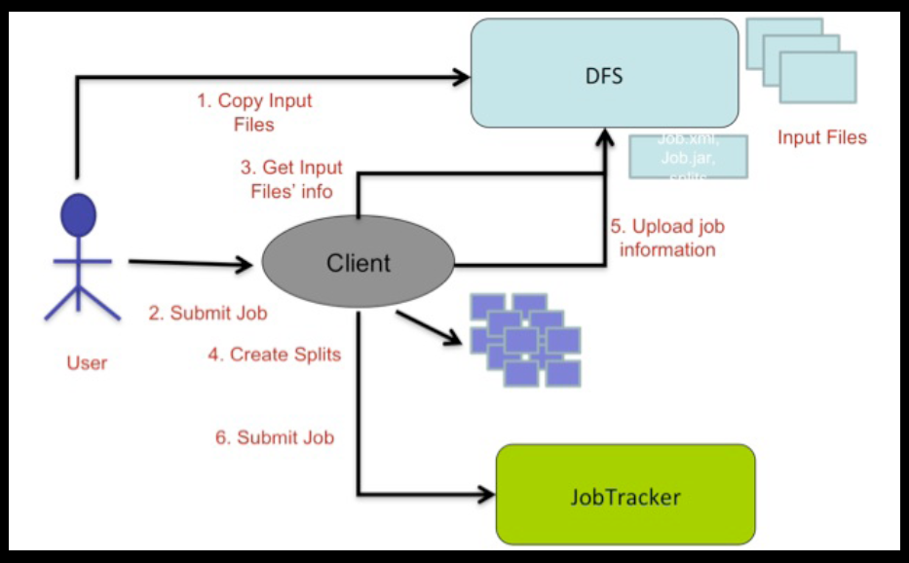
Job Submission

Slide 32
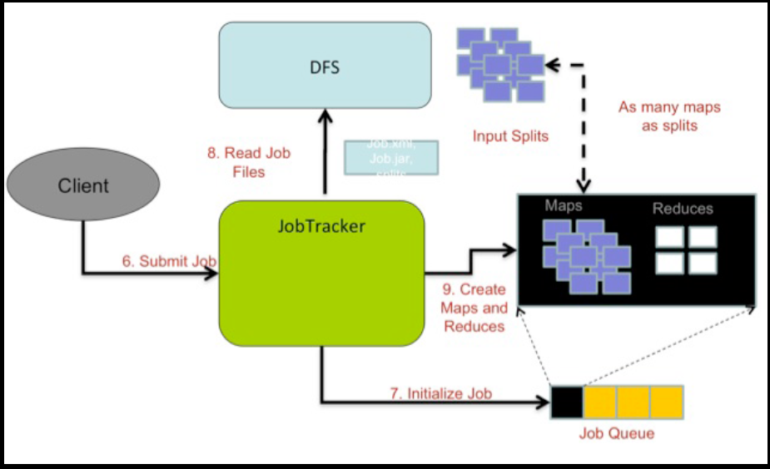
Initialization

Slide 33
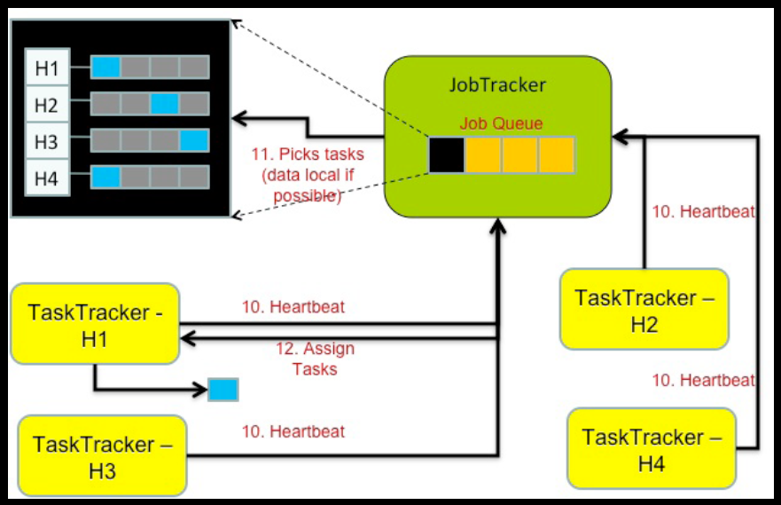
Scheduling

Slide 34
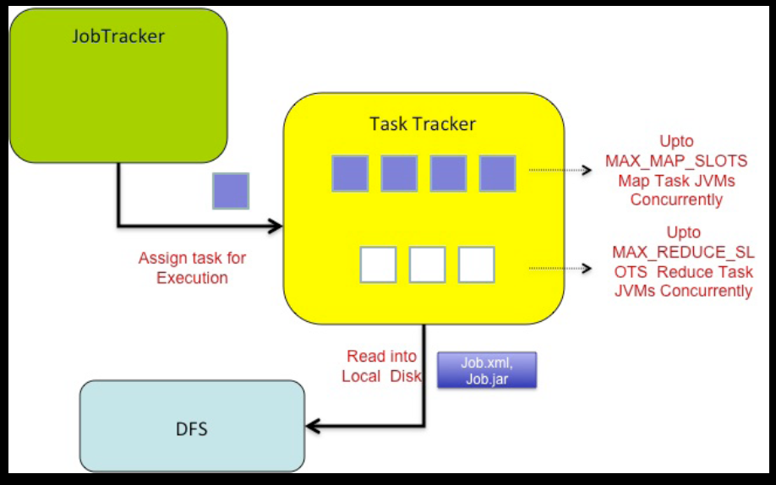
Execution

Slide 35
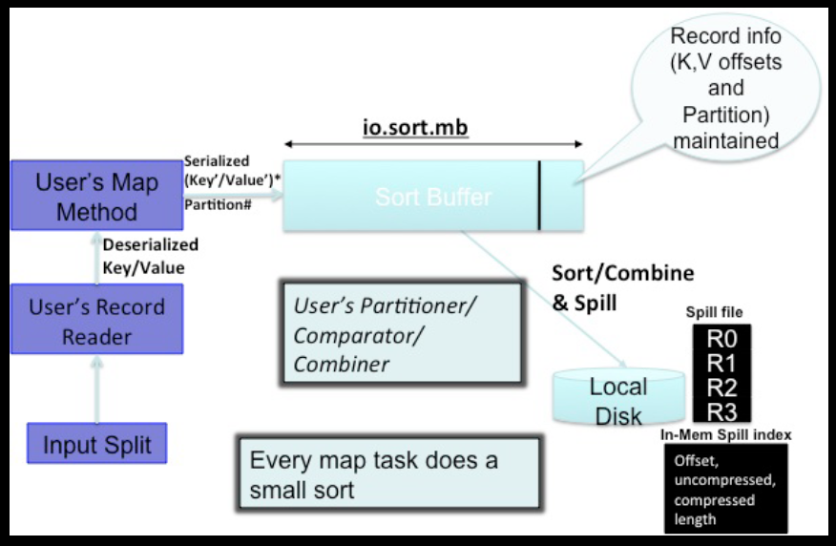
Map Task

Slide 36
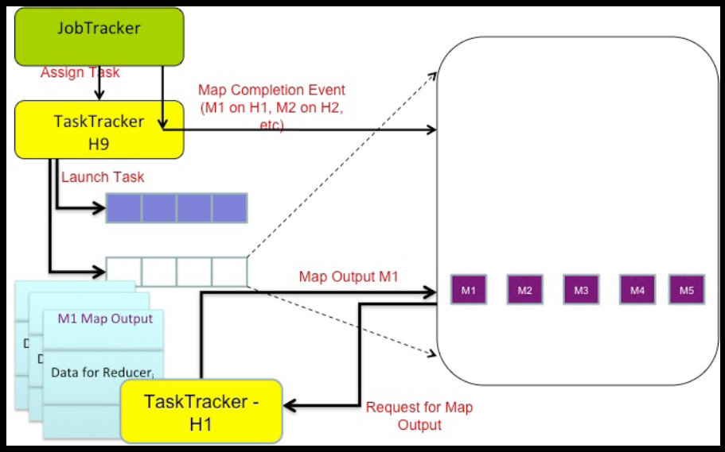
Reduce Tasks

Slide 37
MapReduce: Extensions and Similar
Hadoop (Apache)
PIG (Yahoo)
DryadLinq (Microsoft)

Slide 38

Hadoop Distributed File System (HDFS)

Slide 39
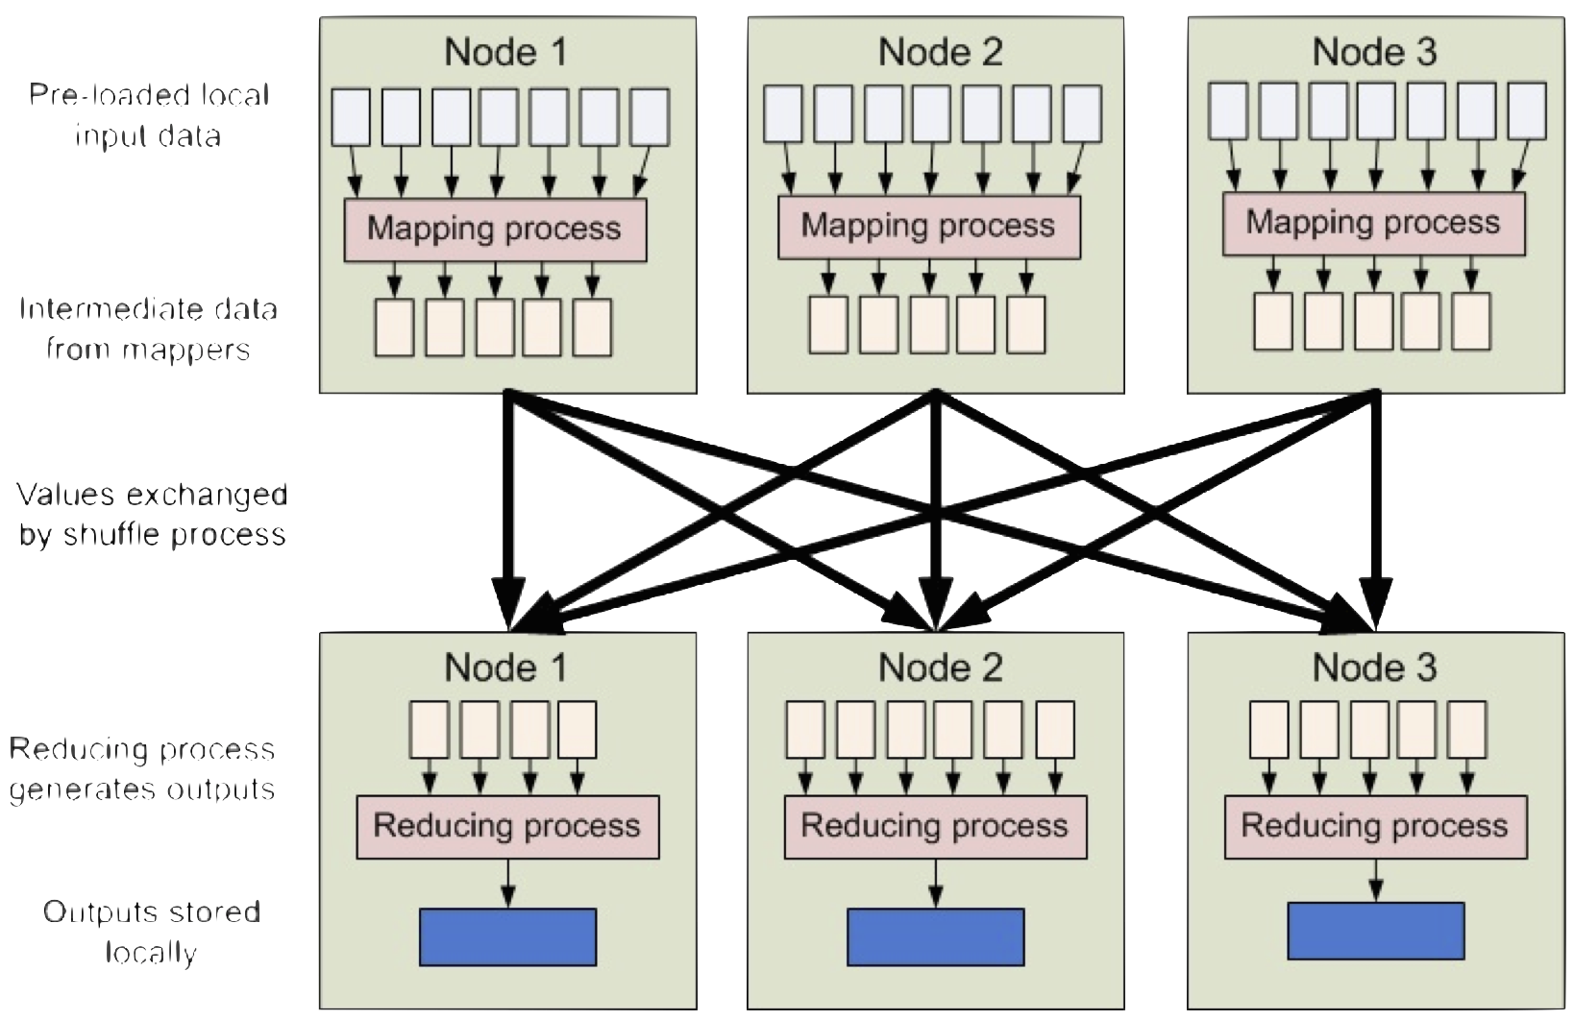
Map Reduce in Hadoop

Slide 40
Summary on MapReduce
Although restrictive, provides good fit for many problems encountered in the practice of processing large data sets.
For “large data, simple operations” where data are mostly independent
Functional Programming Paradigm can be applied to large scale computation.
Easy to use, hides messy details of parallelization, fault-tolerance, data distribution and load balancing from the programmers.
And finally, if it works for Google, it should be handy !!

Slide 41
MapReduce Limitations
MapReduce raised level of abstraction in cloud programming by hiding scaling & faults
However, these systems provide a limited programming model: acyclic data flow
Notes:
Point out that Scala is a modern PL etc
Mention DryadLINQ (but we go beyond it with RDDs)
Point out that interactive use and iterative use go hand in hand because both require small tasks and dataset reuse

Slide 42
MapReduce Limitations
Complex apps and interactive queries both need one thing that MapReduce lacks:
Efficient primitives for data sharing
In MapReduce, the only way to share data across jobs is stable storage ➔ slow!

Slide 43
Motivations
More complex, multi-stage applications
e.g. iterative machine learning & graph processing
More interactive ad-hoc queries
Response: specialized frameworks for some of these apps (e.g. Pregel for graph processing)
Notes:
We all know that MapReduce and related models had huge adoption for data mining
But as soon as people started putting data into them, they wanted to do more

Slide 44
Examples
HDFS read
HDFS write
HDFS read
HDFS write
iter. 1
iter. 2
. . .
Input
HDFS read
query 1
result 1
query 2
result 2
query 3
result 3
Input
. . .
Slow due to replication and disk I/O, but necessary for fault tolerance
Notes:
Emphasize that the overhead of replication and disk IO from HDFS comes from FT

Slide 45
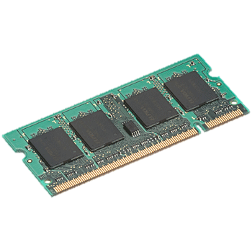
Goal: In-Memory Data Sharing
iter. 1
iter. 2
. . .
Input
query 1
one-time processing
query 2
query 3
Input
. . .
10-100× faster than network/disk, but how to get FT?

Slide 46
Challenge
How to design a distributed memory abstraction that is both fault-tolerant and efficient?

Slide 47
Challenges
Existing storage abstractions have interfaces based on fine-grained updates to mutable states
RAMCloud, databases, distributed memory, Piccolo
Requires replication data or logs across nodes for fault tolerance
Costly for data-intensive apps
10-100x slower than memory write

Slide 48
Spark Goals
Support applications with working sets (datasets reused across parallel operations)
Iterative jobs (common in machine learning)
Interactive data mining
Retain MapReduce’s fault tolerance & scalability
Experiment with programmability
Integrate into Scala programming language
Support interactive use from Scala interpreter
Notes:
Point out that Scala is a modern PL etc
Mention DryadLINQ (but we go beyond it with RDDs)
Point out that interactive use and iterative use go hand in hand because both require small tasks and dataset reuse

Slide 49
Programming Model
Resilient distributed datasets (RDDs)
Created from HDFS files or “parallelized” arrays
Can be transformed with map and filter
Can be cached across parallel operations
Parallel operations on RDDs
Reduce, collect, foreach
Shared variables
Accumulators (add-only), broadcast variables
Notes:
You write a single program → similar to DryadLINQ
Distributed data sets with parallel operations on them are pretty standard; the new thing is that they can be reused across ops
Variables in the driver program can be used in parallel ops; accumulators useful for sending information back, cached vars are an optimization
Mention cached vars useful for some workloads that won’t be shown here
Mention it’s all designed to be easy to distribute in a fault-tolerant fashion

Slide 50
RDD: Resilient Distributed Datasets
Restricted form of distributed shared memory
Immutable, partitioned collections of records
Can only be built through coarse-grained deterministic transformations (map, filter, join, …)
Efficient fault recovery using lineage
Log one operation to apply to many elements
Recompute lost partitions on failure
No cost if nothing fails
Notes:
Define RDDs more precisely here!

Slide 51
RDD Recovery
iter. 1
iter. 2
. . .
Input
query 1
one-time processing
query 2
query 3
Input
. . .

Slide 52
Generality of RDDs
Despite their restrictions, RDDs can express surprisingly many parallel algorithms
These naturally apply the same operation to many items
Unify many current programming models
Data flow models: MapReduce, Dryad, SQL, …
Specialized models for iterative apps: BSP (Pregel), iterative MapReduce (Haloop), bulk incremental, …
Support new apps that these models don’t
Notes:
Similarity to GFS/HDFS: large blocks, append only.

Slide 53
Tradeoff Space
Network
bandwidth
Memory
bandwidth
Fine
K-V stores,
databases,
RAMCloud
Best for
transactional
workloads
Granularity
of Updates
Best for batch
workloads
HDFS
RDDs
Coarse
Low
High
Write Throughput

Slide 54
Spark Programming Interface
Provides:
Resilient distributed datasets (RDDs)
Operations on RDDs: transformations (build new RDDs), actions (compute and output results)
Control of each RDD’s partitioning (layout across nodes) and persistence (storage in RAM, on disk, etc)
Notes:
Mention that Scala is a JVM language

Slide 55
Spark Operations
Transformations (define a new RDD) | map filter sample groupByKey reduceByKey sortByKey | flatMap union join cogroup cross mapValues
Actions (return a result to driver program) | collect reduce count save lookupKey

Slide 56
Task Scheduler
DAGs
Pipelines functions within a stage
Locality & data reuse aware
Partitioning-aware to avoid shuffles
A:
B:
G:
Stage 1
groupBy
C:
D:
F:
map
E:
join
Stage 2
union
Stage 3
= cached data partition
Notes:
NOT a modified version of Hadoop

Slide 57
Programming Models Implemented on Spark
RDDs can express many existing parallel models
MapReduce, DryadLINQ
Pregel graph processing [200 LOC]
Iterative MapReduce [200 LOC]
SQL: Hive on Spark (Shark) [in progress]
Enables apps to efficiently intermix these models
All are based on coarse-grained operations
Notes:
Emphasize Shark

Slide 58

Example: Log Mining
Load error messages from a log into memory, then interactively search for various patterns
Base RDD
Msgs. 1
lines = spark.textFile(“hdfs://...”)
errors = lines.filter(_.startsWith(“ERROR”))
messages = errors.map(_.split(‘\t’)(2))
messages.persist()
Transformed RDD
Worker
results
tasks
Block 1
Master
Action
messages.filter(_.contains(“foo”)).count
messages.filter(_.contains(“bar”)).count
Msgs. 2
Worker
Msgs. 3
Result: scaled to 1 TB data in 5-7 sec (vs 170 sec for on-disk data)
Worker
Block 2
Result: full-text search of Wikipedia
in <1 sec (vs 20 sec for on-disk data)
Block 3
Notes:
Key idea: add “variables” to the “functions” in functional programming

Slide 59
Fault Recovery
RDDs track the graph of transformations that built them (their lineage) to rebuild lost data
E.g.:
messages = textFile(...).filter(_.contains(“error”))
.map(_.split(‘\t’)(2))
HadoopRDD
FilteredRDD
MappedRDD
HadoopRDD
path = hdfs://…
FilteredRDD
func = _.contains(...)
MappedRDD
func = _.split(…)

Slide 60
Fault Recovery Results
Failure happens
Notes:
These are for K-means

Slide 61
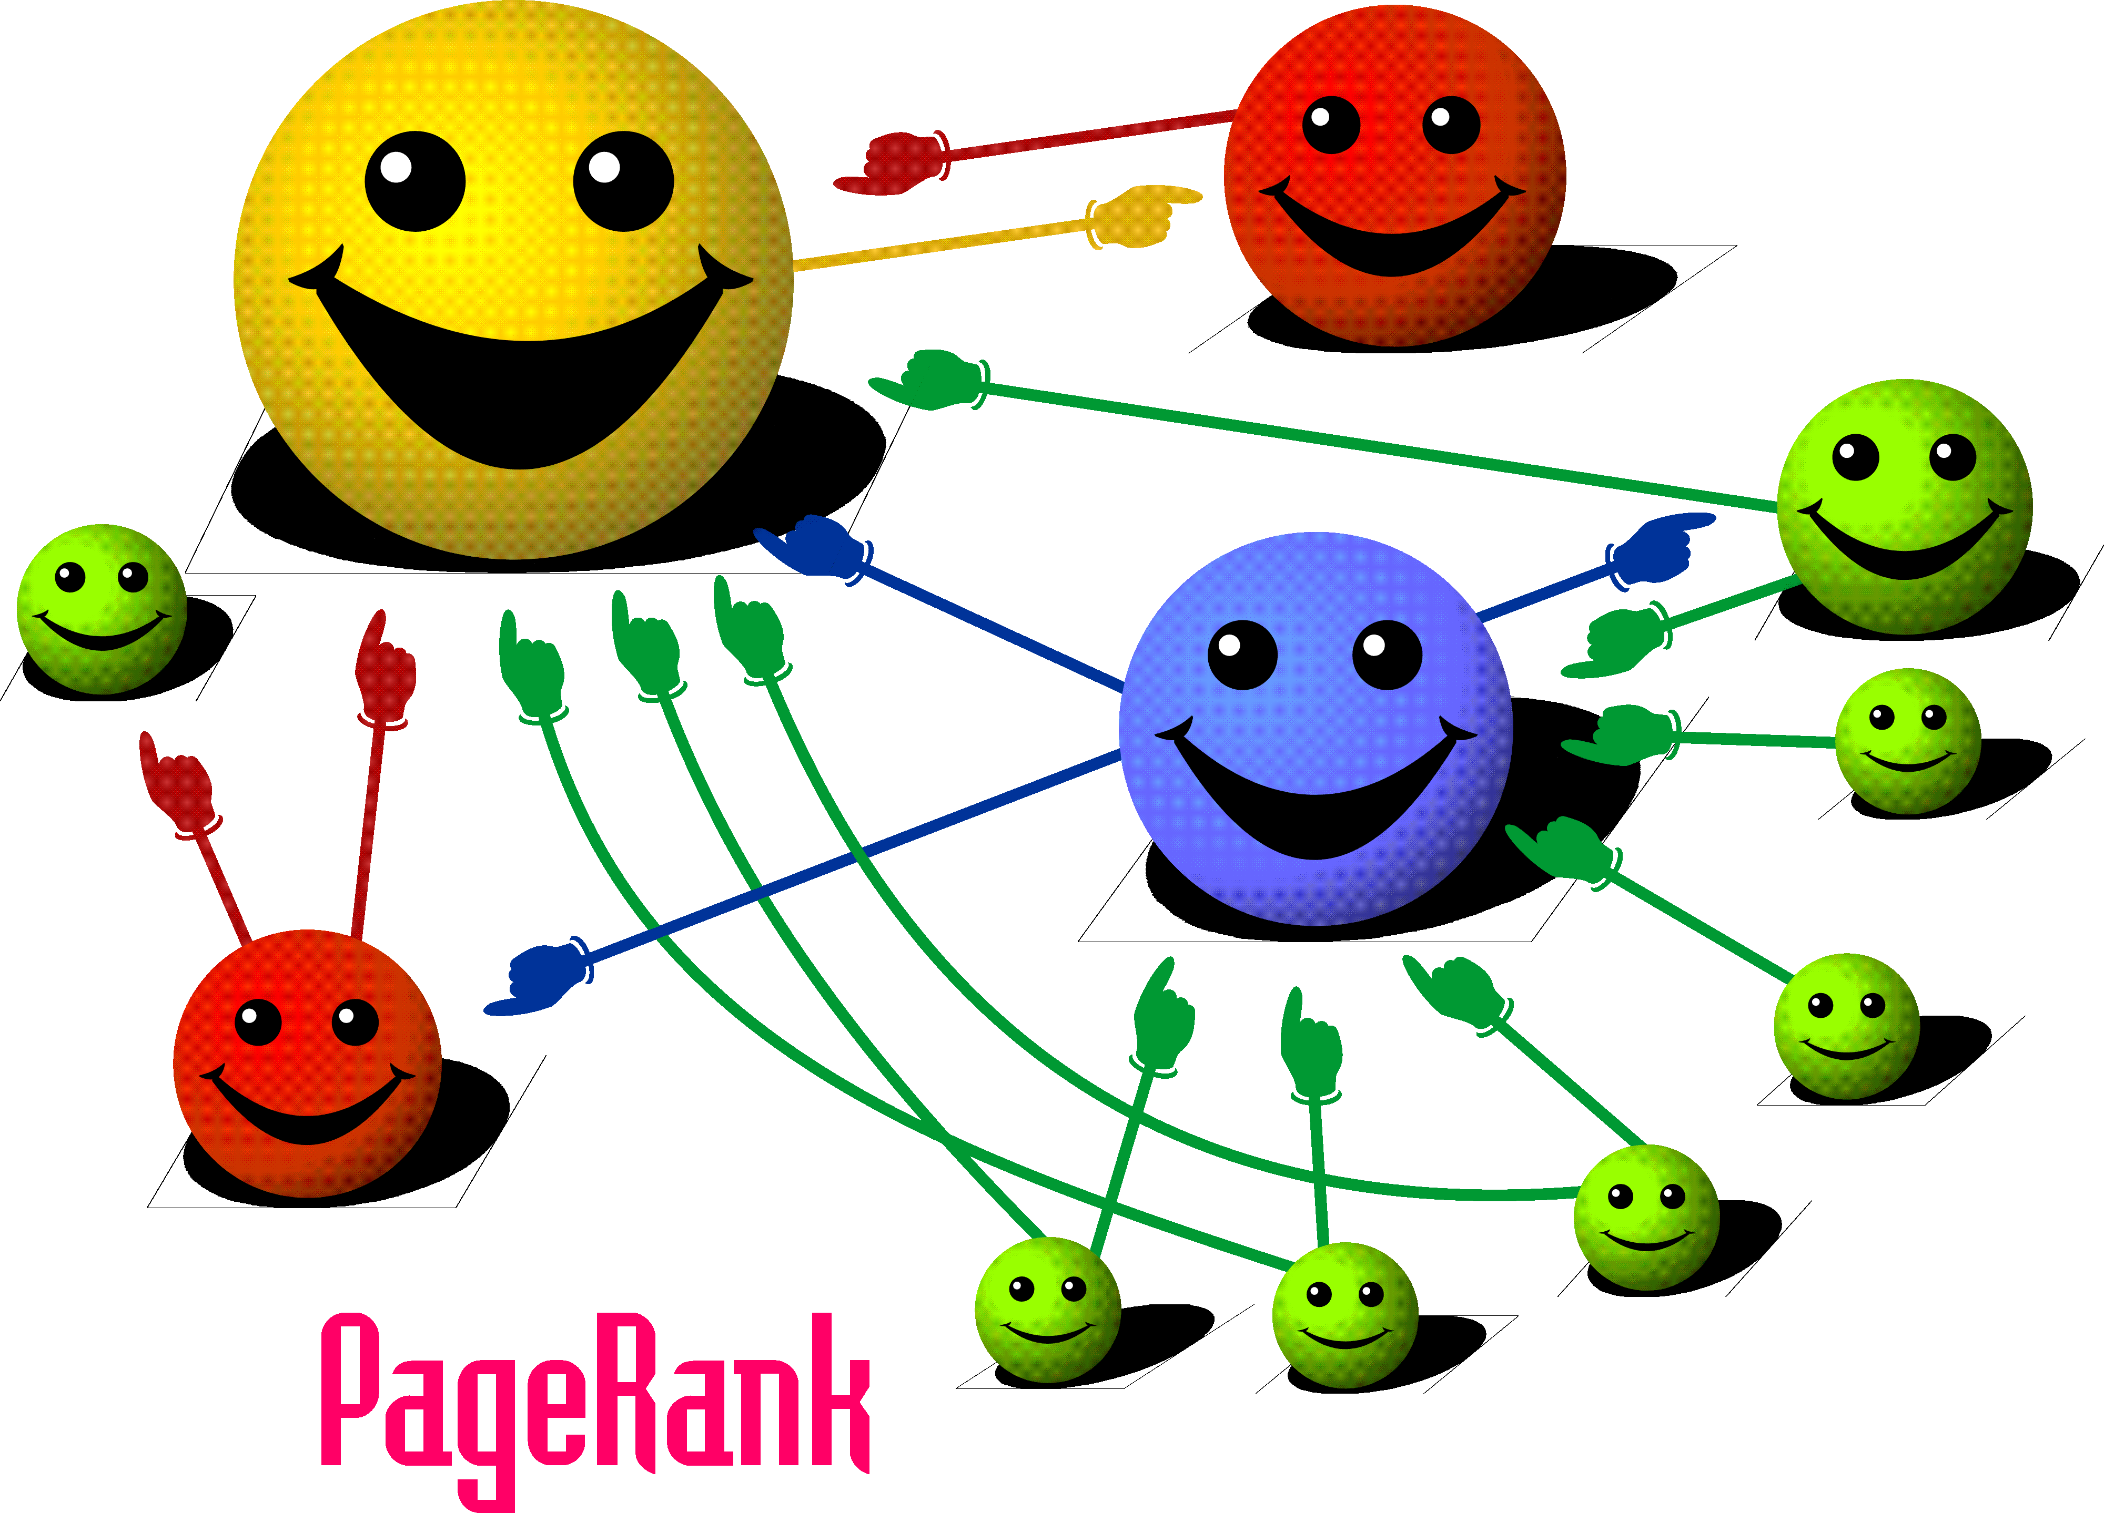
Comparisons of MapReduce and Spark in Illustrative Example

Slide 62
MapReduce : PageRank
PageRank models the behavior of a “random surfer”.
C(t) is the out-degree of t, and (1-d) is a damping factor (random jump)
The “random surfer” keeps clicking on successive links at random not taking content into consideration.
Distributes its pages rank equally among all pages it links to.
The dampening factor takes the surfer “getting bored” and typing arbitrary URL.

Slide 63
Computing PageRank
Start with seed PageRank values
Each page distributes PageRank “credit” to all pages it points to.
Each target page adds up “credit” from multiple in-bound links to compute PR_{i+1}

Slide 64
PageRank : Key Insights
Effect at each iteration is local. i+1th iteration depends only on i^{th} iteration
At iteration i, PageRank for individual nodes can be computed independently

Slide 65
PageRank using MapReduce
Use Sparse matrix representation (M)
Map each row of M to a list of PageRank “credit” to assign to out link neighbours.
These prestige scores are reduced to a single PageRank value for a page by aggregating over them.

Slide 66
PageRank using MapReduce
Map: distribute PageRank “credit” to link targets
Reduce: gather up PageRank “credit” from multiple sources to compute new PageRank value
Iterate until
convergence

Slide 67
Phase 1: Process HTML
Map task takes (URL, page-content) pairs and maps them to (URL, (PR_{init}, list-of-urls))
PR_{init} is the “seed” PageRank for URL
list-of-urls contains all pages pointed to by URL
Reduce task is just the identity function

Slide 68
Phase 2: PageRank Distribution
Reduce task gets (URL, url_list) and many (URL, val) values
Sum vals and fix up with d to get new PR
Emit (URL, (new_rank, url_list))
Check for convergence using non parallel component

Slide 69
PageRank in Spark
1. Start each page with a rank of 1
2. On each iteration, update each page’s rank to
Σ_{i∈neighbors} rank_{i} / |neighbors_{i}|
links = // RDD of (url, neighbors) pairs
ranks = // RDD of (url, rank) pairs
for (i <- 1 to ITERATIONS) {
ranks = links.join(ranks).flatMap {
(url, (links, rank)) =>
links.map(dest => (dest, rank/links.size))
}.reduceByKey(_ + _)
}

Slide 70
Optimizing Placement
Links
(url, neighbors)
Ranks₀
(url, rank)
links & ranks repeatedly joined
Can co-partition them (e.g. hash both on URL) to avoid shuffles
Can also use app knowledge, e.g., hash on DNS name
links = links.partitionBy( new URLPartitioner())
join
Contribs₀
reduce
Ranks₁
join
Contribs₂
reduce
Ranks₂
. . .

Slide 71
PageRank Performance

Slide 72
Spark: Summary
RDDs offer a simple and efficient programming model for a broad range of applications
Leverage the coarse-grained nature of many parallel algorithms for low-overhead recovery

