Slide 1
Google Bigtable
CS219, Winter 2021

Slide 2
Google Scale
Lots of data
  Copies of the web, satellite data, user data, email and USENET, Subversion backing store
Many incoming requests
No commercial system big enough
  Couldn’t afford it if there was one
  Might not have made appropriate design choices
Firm believers in the End-to-End argument
450,000 machines (NYTimes estimate, June 14th 2006)

Slide 3
Motivation
Lots of (semi-)structured data at Google
  URLs:
    Contents, crawl metadata, links, anchors, pagerank,…
  Per-user data:
    User preference settings, recent queries/search results, …
  Geographic locations:
    Physical entities (shops, restaurants, etc.), roads, satellite image data, user annotations, …
Scale is large
  Billions of URLs, many versions/page (~20K/version)
  Hundreds of millions of users, thousands of q/sec
  100TB+ of satellite image data

Slide 4
Why not just use commercial DB ?
Scale is too large for most commercial databases
Even if it weren't, cost would be very high
  Building internally means system can be applied across many projects for low incremental cost
Low-level storage optimizations help performance significantly
  Much harder to do when running on top of a database layer
  Also fun and challenging to build large-scale systems :)
Notes:
Following Google’s philosophy, BigTable was an in-house development designed to run on commodity hardware. BigTable allows Google to have a very small incremental cost for new services and expanded computing power (they don’t have to buy a license for every machine, for example).

Slide 5
Goals
Want asynchronous processes to be continuously updating different pieces of data
  Want access to most current data at any time
Need to support:
  Very high read/write rates (millions of ops per second)
  Efficient scans over all or interesting subsets of data
  Efficient joins of large one-to-one and one-to-many datasets
Often want to examine data changes over time
  E.g. Contents of a web page over multiple crawls

Slide 6
BigTable
Distributed multi-level map
  With an interesting data model
Fault-tolerant, persistent
Scalable
  Thousands of servers
  Terabytes of in-memory data
  Petabyte of disk-based data
  Millions of reads/writes per second, efficient scans
Self-managing
  Servers can be added/removed dynamically
  Servers adjust to load imbalance

Slide 7
API
Metadata operations
  Create/delete tables, column families, change metadata
Writes (atomic)
  Set(): write cells in a row
  DeleteCells(): delete cells in a row
  DeleteRow(): delete all cells in a row
Reads
  Scanner: read arbitrary cells in a bigtable
    Each row read is atomic
    Can restrict returned rows to a particular range
    Can ask for just data from 1 row, all rows, etc.
    Can ask for all columns, just certain column families, or specific columns

Slide 8
Building Blocks
Scheduler (Google WorkQueue)
Google Filesystem
Chubby Lock service
Two other pieces helpful but not required
  Sawzall: domain-specific programming language to process large # of log records
    Open source: szl runtime @201
  MapReduce (despite what the Internet says)
BigTable: build a more application-friendly storage service using these parts

Slide 9
Recall GFS
Large-scale distributed “file system”
Master: responsible for metadata
Chunk servers: responsible for reading and writing large chunks of data
Chunks replicated on 3 machines, master responsible for ensuring replicas exist
OSDI ’04 Paper

Slide 10
GFS Review
Replicas
GFS Master
Master
Client
GFS Master
Client
C0
C1
C1
C0
C3
C3
C4
C3
C5
C4
Master manages metadata
Data transfers happen directly between clients/chunkservers
Files broken into chunks (typically 64 MB)
Chunkks triplicated across three machines for safety
See SOSP^03 paper at http://labs.google.com/papers/gfs.html

Slide 11
MapReduce and BigTable
Many Google problems: “Process lots of data to produce other data”
Many kinds of inputs:
Want to use easily hundreds or thousands of CPUs
MapReduce: framework that provides (for certain classes of problems):
  Automatic & efficient parallelization/distribution
  Fault-tolerance, I/O scheduling, status/monitoring
  User writes Map and Reduce functions
Heavily used: ~3000 jobs, 1000s of machine days each day
See: “MapReduce: Simplified Data Processing on Large Clusters”. OSDI^04
BigTable can be input and/or output for MapReduce computations

Slide 12
Typical Cluster
Cluster Scheduling Master
Lock Service
GFS Master
Machine 1
Machine 2
Machine 3
User
Task
BigTable
Server
BigTable
Server
BigTable Master
User
Task
Single Task
Scheduler
Slave
GFS
Chunkserver
Scheduler
Slave
GFS
Chunkserver
Scheduler
Slave
GFS
Chunkserver
Linux
Linux
Linux

Slide 13
Chubby
{lock/file/name} service
Coarse-grained locks, can store small amount of data in a lock
5 replicas, need a majority vote to be active
An OSDI ’06 Paper to be discussed later

Slide 14
Basic Data Model
Distributed multi-dimensional sparse map
(row, column, timestamp) → cell contents
Good match for most of our applications
“contents”
COLUMNS
ROWS
…
t1
www.cnn.com
…
t2
“<html>…”
t3
TIMESTAMPS

Slide 15
Rows
Name is an arbitrary string
  Access to data in a row is atomic
  Row creation is implicit upon storing data
Rows ordered lexicographically
  Rows close together lexicographically usually on one or a small number of machines

Slide 16
Columns
“contents:”
“anchor:cnnsi.com”
“anchor:stanford.edu”
cnn.com
“…”
“CNN homepage”
“CNN”
Columns have two-level name structure:
    Family:optional_qualifier
Column family
  - Typically a small number (in the hundreds at most)
  Unit of access control
  Has associated type information
Qualifier gives unbounded columns
  Additional level of indexing, if desired

Slide 17
Timestamps
Used to store different versions of data in a cell
  64-bit integers
  New writes default to current time, but timestamps for writes can also be set explicitly by clients
Lookup options:
  “Return most recent K values”
  “Return all values in timestamp range (or all values)”
Column families can be marked w/ attributes:
  “Only retain most recent K values in a cell”
  “Keep values until they are older than K seconds”

Slide 18
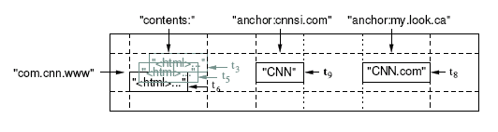
Summarizing Data Model:
A Big Map
<Row, Column, Timestamp> triple for key - lookup, insert, and delete API
Arbitrary “columns” on a row-by-row basis
  Column family:qualifier. Family is heavyweight, qualifier lightweight
  Column-oriented physical store- rows are sparse!
Does not support a relational model
  No table-wide integrity constraints
  No multi-row transactions
<number> of 19

Slide 19
SSTable
Immutable, sorted file of key-value pairs
Chunks of data plus an index
  Index is of block ranges, not values
    Index is loaded into memory when the SSTable is opened
Lookup with a single disk seek
  Find the block via a binary search in the in-memory index, and then reading it from disk
64K block
64K block
64K block
SSTable
Index

Slide 20
Tablet
Contains some range of rows of the table
Built out of multiple SSTables
Tablet
Start:aardvark
End:apple
64K block
64K block
64K block
SSTable
64K block
64K block
64K block
SSTable
Index
Index

Slide 21
Tablets
Large tables broken into tablets at row boundaries
  Tablet holds contiguous range of rows
    Clients can often choose row keys to achieve locality
  Aim for ~100MB to 200MB of data per tablet
Serving machine responsible for ~100 tablets
  Fast recovery:
    100 machines each pick up 1 tablet from failed machine
  Fine-grained load balancing
    Migrate tablets away from overloaded machine
    Master makes load-balancing decisions

Slide 22
Table
Multiple tablets make up the table
SSTables can be shared
Tablets do not overlap, SSTables can overlap
Tablet
Tablet
aardvark
apple
apple_two_E
boat
SSTable
SSTable
SSTable
SSTable

Slide 23
System Structure
Bigtable client
Bigtable cell
Bigtable client
library
Bigtable master
performs metadata ops,
load balancing
Open()
Bigtable tablet server
Bigtable tablet server
Bigtable tablet server
serves data
serves data
serves data
Cluster Scheduling Master
GFS
Lock service
handles failover, monitoring
holds tablet data, logs
holds metadata,
handles master-election

Slide 24
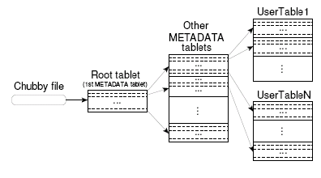
Locating a tablet: Hierarchy

Slide 25
Approach to Locating Tablets
Since tablets move around from server to server, given a row, how do clients find the right machine ?
  Need to find tablet whose row range covers the target row
One approach: could use the BigTable master
  Central server almost certainly would be bottleneck in large system
Instead: store special tables containing tablet location info in BigTable cell itself

Slide 26
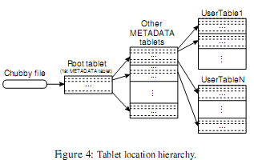
How to Locate Tablets
3-level hierarchical lookup scheme for tablets
  Location is ip:port of relevant server
  1st level: bootstrapped from lock server, points to owner of META0
  2nd level: Uses META0 data to find owner of appropriate META1 tablet
  3rd level: META1 table holds locations of tablets of all other tables
    META1 table itself can be split into multiple tablets

Slide 27
Tablet Servers
Tablet servers manage tablets, multiple tablets per server. Each tablet is 100-200 MBs
  Each tablet lives at only one server
  Tablet server splits tablets that get too big
Master responsible for load balancing and fault tolerance
  Use Chubby to monitor health of tablet servers, restart failed servers
  GFS replicates data. Prefer to start tablet server on same machine that the data is already at

Slide 28
Editing a Table
Mutations are logged, then applied to an in-memory version
Logfile stored in GFS
Tablet
Insert
Memtable
Insert
Delete
apple_two_E
boat
Insert
Delete
Insert
SSTable
SSTable

Slide 29
Tablet Representation
Read
Write buffer in memory
(random-access)
Append-only log on GFS
Write
SSTable on
GFS
SSTable on
GFS
SSTable on
GFS
(mmap)
Tablet
SSTable: Immutable on-disk ordered map from string→string
String keys: <row, column, timestamp> triples

Slide 30
Compactions
Minor compaction – convert the memtable into an SSTable
  Reduce memory usage
  Reduce log traffic on restart
Merging compaction
  Reduce number of SSTables
  Good place to apply policy “keep only N versions”
Major compaction
  Merging compaction that results in only one SSTable
  No deletion records, only live data

Slide 31
Locality Groups
Column families can be assigned to a locality group
  Used to organize underlying storage representation for performance
    Scans over one locality group are O(bytes_in_locality_group), not O(bytes_in_table)
  Data in a locality group can be explicitly memory-mapped

Slide 32
Locality Groups
Group column families together into an SSTable
  Avoid mingling data, ie page contents and page metadata
  Can keep some groups all in memory
Can compress locality groups
Bloom Filters on locality groups – avoid searching SSTable

Slide 33
Shared Logs Per Tablet Server
Designed for 1M tablets, 1000s of tablet servers
  1M logs being simultaneously written performs badly
Solution: shared logs
  Write log file per tablet server instead of per tablet
    Updates for many tablets co-mingled in same file
  Start new log chunks every so often (64MB)
Problem: during recovery, server needs to read log data to apply mutations for a tablet
  Lots of wasted I/O if lots of machines need to read data for many tablets from same log chunk

Slide 34
Shared Log Recovery
Recovery:
Servers inform master of log chunks they need to read
Master aggregates and orchestrates sorting of needed chunks
  Assigns log chunks to be sorted to different tablet servers
  Servers sort chunks by tablet, writes sorted data to local disk
Other tablet servers ask master which servers have sorted chunks they need
Tablet servers issue direct RPCs to peer tablet servers to read sorted data for its tablets

Slide 35
Compression
Many opportunities for compression
  Similar values in the same row/column at different timestamps
  Similar values in different columns
  Similar values across adjacent rows
Within each SSTable for a locality group, encode compressed blocks
  Keep blocks small for random access (~64KB compressed data)
  Exploit fact that many values very similar
  Needs to be low CPU cost for encoding/decoding
Two building blocks: BMDiff, Zippy

Slide 36
BMDiff
Bentley, Mcllroy DCC’99: “Data Compression Using Long Common Strings”
Input: dictionary * source
Output: sequence of
  COPY: <x> bytes from offset <y>
  LITERAL: <literal text>
Store hash at every 32-byte aligned boundary in
  Dictionary
  Source processed so far
For every new source byte
  Compute incremental hash of last 32 bytes
  Lookup in hash table
  On hit, expand match forwards & backwards and emit COPY
Encode: ~100MB/s, Decode: ~1000MB/s

Slide 37
Zippy
LZW-like: Store hash of last four bytes in 16K entry table
For every input byte:
  Compute hash of last four bytes
  Lookup in table
  Emit COPY or LITERAL
Differences from BMDiff:
  Much smaller compression window (local repetitions)
  Hash table is not associative
  Careful encoding of COPY/LITERAL tags and lengths
Sloppy but fast:
  Algorithm % remaining Encoding Decoding
  Gzip 13.4% 21MB/s 118MB/s
  LZO 20.5% 135MB/s 410MB/s
  Zippy 22.2% 172MB/s 409MB/s

Slide 38
BigTable Compression
Keys:
  Sorted strings of (Row, Column, Timestamp): prefix compression
Values:
  Group together values by “type” (e.g. column family name)
  BMDiff across all values in one family
    BMDiff output for values 1..N is dictionary for value N+1
Zippy as final pass over whole block
  Catches more localized repetitions
  Also catches cross-column-family repetition, compresses keys

Slide 39
Compression Effectiveness
Experiment: store contents for 2.1B page crawl in BigTable instance
  Key: URL of pages, with host-name portion reversed
    com.cnn.www/index.html:http
  Groups pages from same site together
    Good for compression (neighboring rows tend to have similar contents)
    Good for clients: efficient to scan over all pages on a web site
One compression strategy: gzip each page: ~28% bytes remaining
BigTable: BMDiff + Zippy
  Type Count(B) Space(TB) Compressed %remaining
  Web page contents 2.1 45.1 4.2 9.2
  Links 1.8 11.2 1.6 13.9
  Anchors 126.3 22.8 2.9 12.7

Slide 40
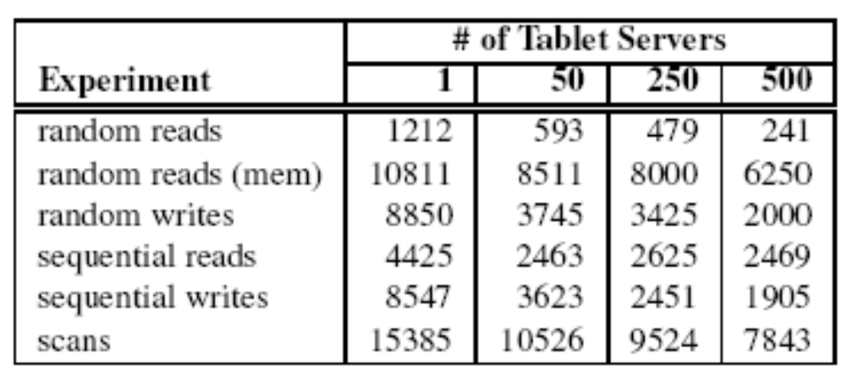
Microbenchmarks

Slide 41
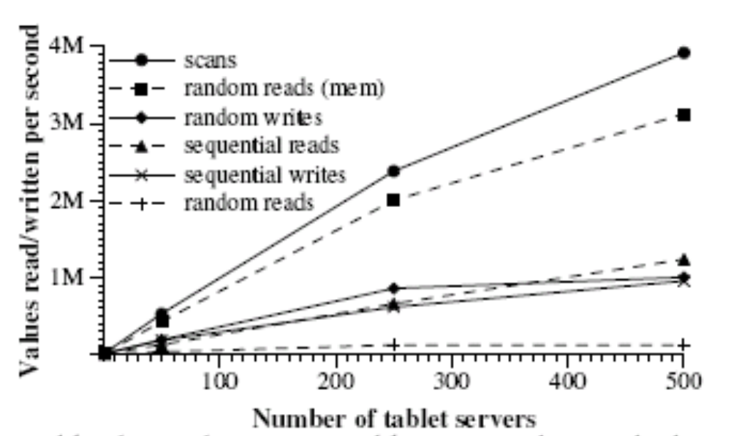

Slide 42
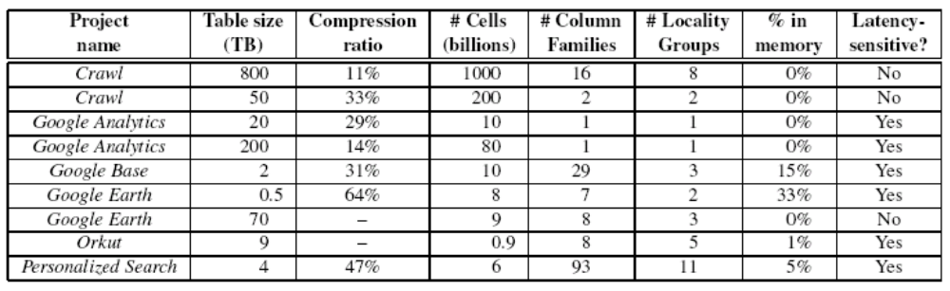
Application at Google

Slide 43
Lessons from BigTable
Interesting point: only implement some of the requirements, since the last is probably not needed
Many types of failure possible
Big systems need proper systems-level monitoring
Value simple designs

