Slide 1
Server-Centric Design for
Data Center Networks

Slide 2
Outline
Server-centric design approach
Two examples:
  Bcube
  MDCube

Slide 3
Server-Centric Approach
An alternative solution approach to switch- centric design
Keep switches unchanged
  Use low-cost commodity switches only
Modify the server for routing and forwarding
  Each end server contributes its processing and memory for data center networking (forwarding and routing)
  Use aggregated power from large # of servers
    Scaling becomes a blessing for networking

Slide 4
Showcase Example:
BCube: A modular data server for high performance using commodity switches

Slide 5
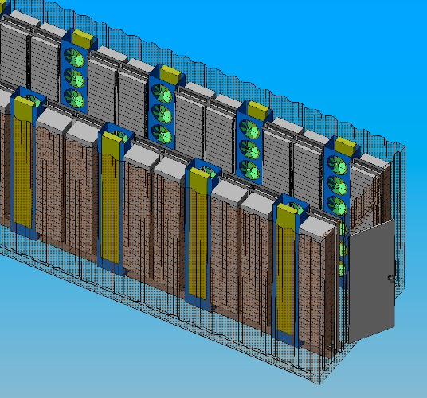
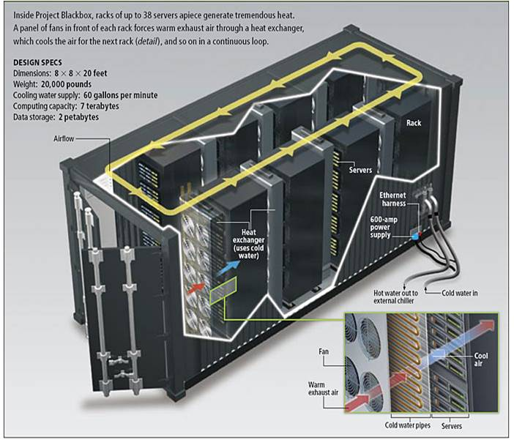
BCube for shipping container DCs
1000-2000 servers in a single container
Benefits of Shipping Container DCs:
  Easy deployment
    Plug-in power, network, & chilled water
  Increased cooling efficiency
  Manufacturing & H/W Admin. Savings
  Single FCC compliance certification
Rackable Systems Container
2800 servers in 40’
Sun Project Black Box
242 systems in 20’

Slide 6
Problem and design goals
Problem
  Interconnect servers using only COTS switches, low-end COTS switches preferred
Goals
  High inter-server capacity
    High aggregate throughput for MapReduce
    Speedup data replication for distributed file systems like GFS
    High inter-server bandwidth between two servers
  Graceful performance degradation
    Fault tolerant
    When some of the server/switches fail, the performance does not decrease sharply
Philosophy
  Place intelligence at servers

Slide 7
BCube Overview
Using low-cost commodity switches only
  Each switch has n ports (n is small, say, 8)
Each server has multiple Ethernet interfaces (NiCs)
  A server has multiple network ports: (k+1)
Recursive structure
  A bcube_{k} is constructed by n bcube_{k-1}s

Slide 8
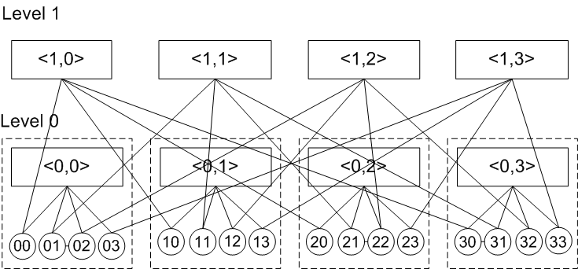
BCube Example

Slide 9
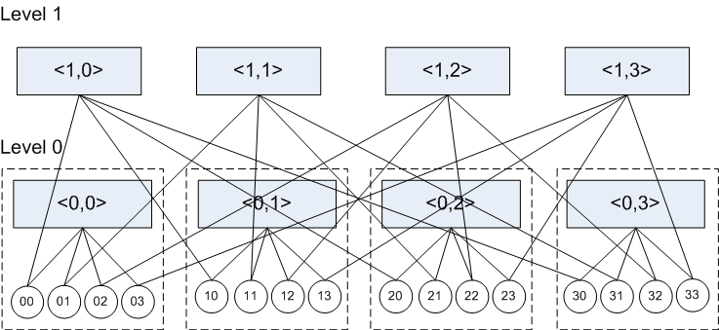
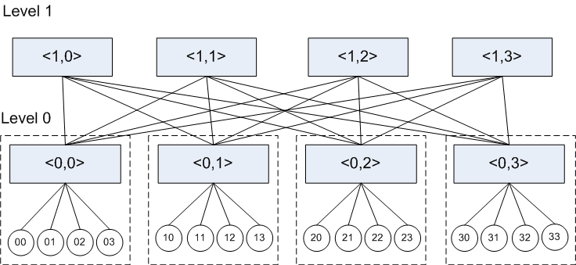
Comparison with Switch-Centric Butterfly
Intelligence at server side
Butterfly

Slide 10
BCube: How to Meet Design Goals
Switches do not connect to switches
  Switches are just cross-bars
  Scales n^{k+1}, n=8 and k=3 -> 4096 servers, hence only mini-switches are needed
Multiple parallel paths between any two servers
  Fault-tolerance, load-balancing
  Graceful performance degradation
  High bandwidth between any two servers
Complete graphs with node-disjointed edges
  Acceleration for data replication in GFS

Slide 11
Bcube: Construction
Each server is connected to a switch at every level
  Servers are connected to switches only
  Servers do not directly connect to each other
Each server has multiple NiCs (1~4)
  Each NiC connects to a switch port at level (0, ..k)
    A server has at k+1 NiCs

Slide 12
Recursive Construction
A leveled structure, can be recursively described
  A server has multiple network ports: (k+1)
  A Bcube₀ is n servers connect to a switch
    Each switch has n ports
  Bcube_{k} is using n Bcube_{k-1}
    Connected by n^{k} switches (each has n-ports) at level-k
    Servers in BCube_{k-1} connect to the n^{k} level-k switches sequentially

Slide 13
Construction Details
Addressing: We use an address array a_ka_{k-1}…a_0 to denote a server; we use the form <l, s_{k-1}s_{k-1}…s_0} to denote a switch
  We arrange the ports of a switch from 0 to n-1
Interconnection rule: Port i of a switch <l, s_{k-1}s_{k-2}…s_0> is connected to the level-l port of server s_{k-1}s_{k-2}…s_lis_{l-1}…s_0.

Slide 14
Bcube: Properties
Bcube is a modular structure, when building a Bcube_k from Bcube_{k-1}s, we do not need to re-wire the Bcube_{k-1}s
h(A,B) is the Hamming distance of two servers A and B.
  k+1 is the maximum hamming distance
Two neighboring servers differ in only one bit in their addresses
From the addresses of two neighboring servers A and B, the address of the switch that connects them can be uniquely determined
  When expressing a path, we do not need to explicitly give the intermediate switches

Slide 15
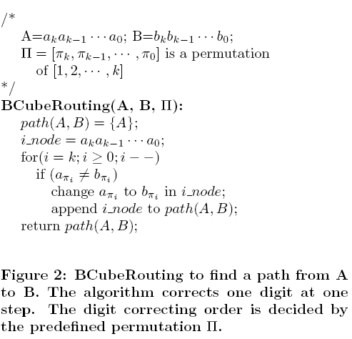
Greedy Routing

Slide 16
Features of Greedy Routing
The path length is h(A,B). The maximum path length is k+1
  The diameter of Bcube is k+1
The number of total paths of length h(A, B) is h(A,B)!
The average path length is about (k+1)(n-1)/n

Slide 17
Choice of n and k
Larger k -> more parallel paths
Larger k does not necessarily increase capacity for all-to-all communication pattern
  Larger k means larger path length
Larger k -> higher cost (more wiring, more switch ports)
n=8 and k=3 is a good choice
  N=2048, a partial BCube

Slide 18

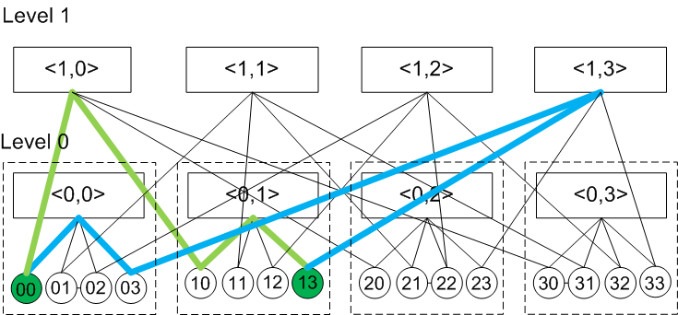
Multiple Paths

Slide 19
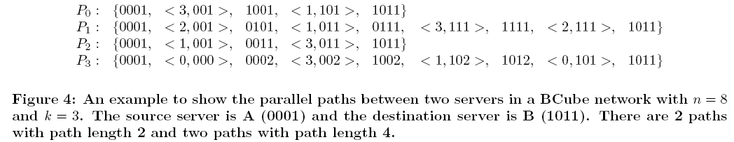
Multipath Example: n=8, k=3

Slide 20
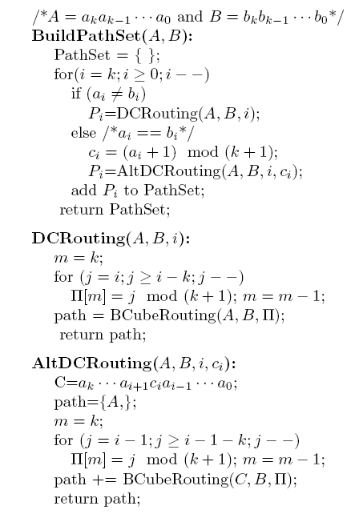
Algorithm for Multipaths

Slide 21
FLSR: Fault-tolerant and load-balanced Source Routing
Assumption: Packets from the same flow traverse the same path (avoid out-of-order arrivals)
Choose reactive source routing
  Source routing: intelligence is at the server, intermediate servers do not need to maintain and compute routing table
    Accelerate hardware implementation
  Reactive routing: no need to distribute routing info and calc paths that are not in active use

Slide 22
Idea of FLSR
We probe k+1 parallel paths simultaneously for available bandwidth, then select the path with the maximum available bandwidth
  Intermediate servers need to update the available bandwidth when they receive probing packets
Try to maintain k+1 parallel paths set during probing
  When one path breaks, add one more parallel path. This path is gotten via Breadth First Search
  This is to make sure we are choosing from a large number of available parallel paths

Slide 23
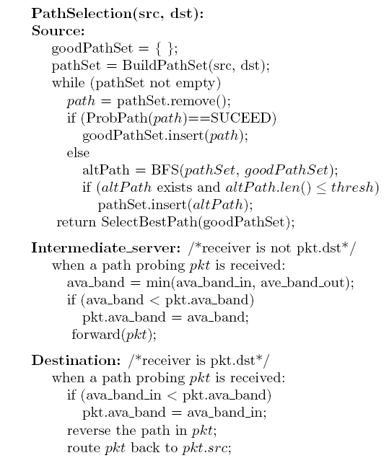
FLSR: the procedure

Slide 24
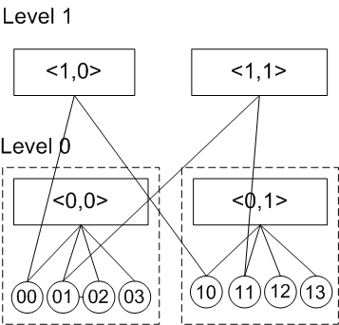

Other Issues: Incremental Expansiion
When build a partial Bcube_k
  Build the complete Bcube_{k-1}s
  Then use a full layer-k switches to interconnect these Bcube_{k-1}s

Slide 25
Cost and Packing
We compare Bcube and Tree with 2048 servers
  Bcube with n=8 and k=3 needs 1280 8-port switches
  Tree with 48-port switches needs 44 48-port switches
  Bcube costs $38,400 and 3840W
  Tree costs $48,400 and 4532W
  Bcube needs 2048+160 rack units, tree needs 2048+44 rack units
Wiring is not a issue: a 40’ container is 12m*2.35m*2.39m. Gigabit Ethernet link can be 100m

Slide 26
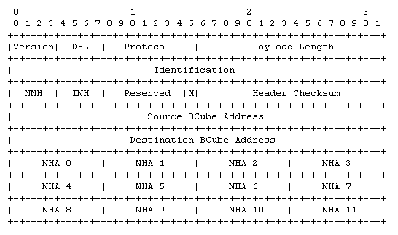
Implementation: BCube protocol stack
Addressing
Bcube protocol header

Slide 27
BCube
configuration
app
software
TCP/IP protocol driver
kernel
BCube driver
Packet
send/recv
LFSR path probing
& selection
Neighbor
maintenance
packet fwd
Ava_band
calculation
Flow-path cache
Ethernet miniport driver
IF 0
IF 1
IF k
hardware
Neighbor
maintenance
packet fwd
server
ports
Ava_band
calculation

Slide 28

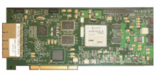
Hardware
Intel® PRO/1000 PT Quad Port Server Adapter
NetFPGA

Slide 29
Packet Forwarding Engine
Forwarding table for server 21:
NHA | Output port | Neighbor MAC | Valid Flag
01 000011 | 01 | Mac of 31 | Valid
00 000010 | 00 | Mac of 22 | Valid
23-21-31
01-21-22

Slide 30
Data Center Network Topologies
Switch centric
  Tree, MIN, Clos, FatTree, Butterfly
  Servers have only one line to switches
Server centric
  2d/3d mesh, torus, ring, hypercube, de bruijn
  BCube, DCell, …
  Either low performance or high node degree

Slide 31
Summary
A Bcube architecture built from low-end commodity switches
High performance
  Low diameter and load-balancing for MapReduce
  High-throughput (k+1) between any two servers
  Complete graph to speedup chunk replication
FLSR and fast forwarding engine

Slide 32
MDCube: Interconnecting BCubes
Scenario, motivation and design goals
Construction of MDCube
MDCube examples and properties
Load balanced and fault tolerant routing
Simulation and experimental results
Related work and summary

Slide 33
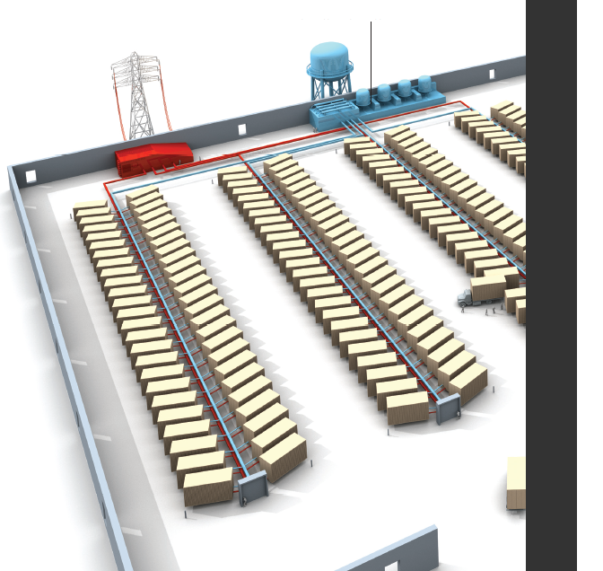
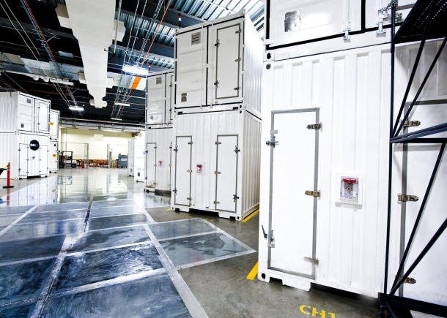
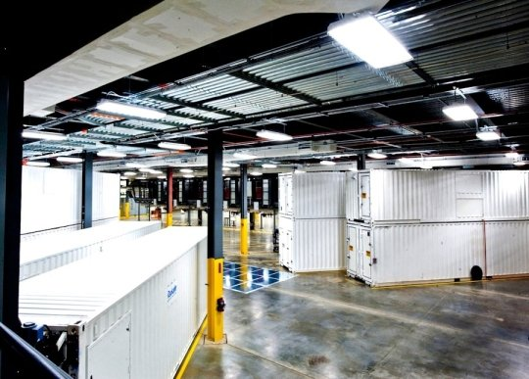

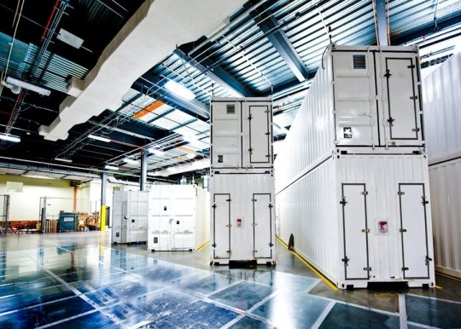
Modular, Mega-Data Center
Graph from Randy H. Katz. Tech Titans Building Boom, IEEE Spectrum Feb., 2009
Notes:
Mega-data centers that use shipping containers as building blocks are being built around the world. One of the key components is the data center networking infrastructure that connects the servers.

Slide 34

Modular, mega-data center networking
Design Goals
  High bandwidth for data intensive computing
  Cost effectiveness for inter-connection structure
  Addressable cabling complexity
MDCube
Notes:
We use shipping containers as building blocks. We study 2 problems: how to connect servers inside a container, and how to interconnect the containers. We have the following design goals. First we want to provide high bandwidth capacity for current and future data intensive applications. Second, we want to provide the best performance-price ratio by only using commodity switches. Third, since we are dealing with mega-data center, the wiring and cabling complexity should be well under control.
The solution we come up is Bcube as the intra container network structure and mdcube as the inter-container network structure.

Slide 35
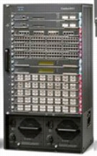

Existing approaches
Scale up
Premium router
Tree
  Oversubscribed
  Bottlenecked root
Fat tree
  1:1 subscription
  Costly as large number of switches
TOR
switches
Container0
Container1 ...
With the number of containers growing
Scale out
TOR
switches
With the number of containers growing

Slide 36
Existing approaches
Scale up
Premium router
Tree
  Oversubscribed
  Bottlenecked root
Fat tree
  1:1 subscription
  Costly as large number of switches
TOR
switches
Container0
Container1 ...
With the number of containers growing
Scale out
TOR
switches
With the number of containers growing

Slide 37
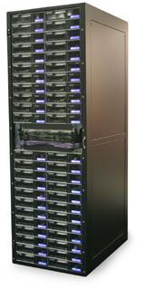
MDCube Design
Leverage the link-rate hierarchy of Ethernet switches
  1Gb/s for server-switch port (48 ports)
  10Gb/s to 40Gb/s for switch uplink (4 uplinks)
Use switch uplinks for inter-container interconnection
10x4=40G
Container0
Container1
Layer-2 switches
1G
Notes:
We leverage the link rate hierarchy for inter-container interconnection. This example shows that we directly connect the switches at different containers with their uplink ports. By doing so, we eliminate the expensive high-end switches.

Slide 38
Construction of MDCube
Treat each container as a “virtual node”
Treat switches’ high speed uplink interfaces as “virtual interfaces”
Connecting switches to peer switches directly
Virtual nodes form a Modular Data center Cube - MDCube

Slide 39
Inner container structure
Why BCube?
  Designed from shipping container data center
  Server centric structure with high capacity
BCube properties
  The longest shortest path length between two switches in a BCube_{k} is 2(k + 1).
  The longest shortest path length between a server and a switch in a BCube_{k} is 2k + 1.
  There are n edge-disjoint parallel paths between any two switches in a BCube_{k}.
  There are k + 1 edge-disjoint parallel paths between a switch and a server in a BCube_{k} network (suppose k + 1 < n).
n is the number of servers under one switch
(k+1) is the level of BCube_{k} inside a MDCube

Slide 40
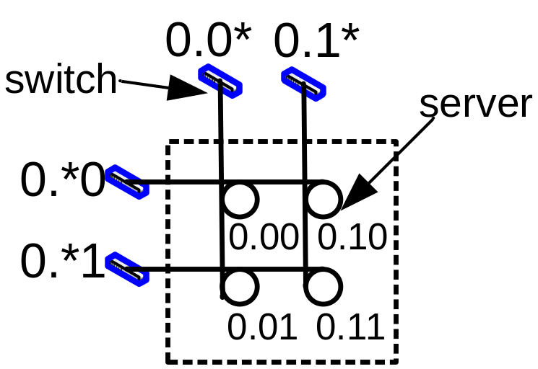
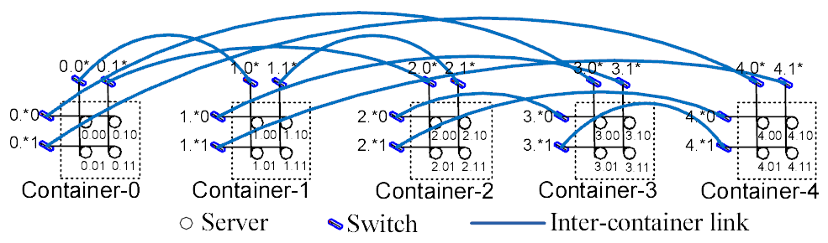
Example for a 1-D MDCube Structure
BCube₁, n=2, k=1, 2¹⁺¹=4 nodes
n=48,k=1,48¹⁺¹=2304
Notes:
This example shows a one-dimensional mdcbue structure. When viewing each container as a virtual nodes, we get a fully connected complete graph.

Slide 41
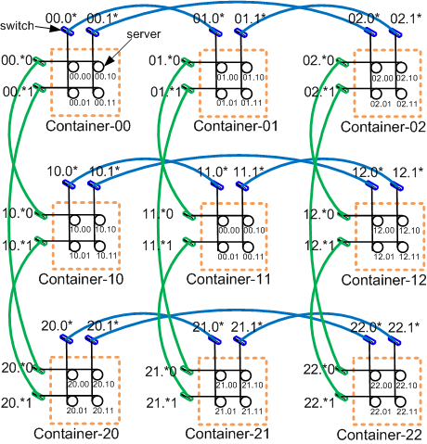
MDCube structure
2-D MDCube
Server-centric MDCube
  Only low-end switches act as L2 crossbars
  Servers control routing, load balancing, fault-tolerance
  Network capacity scales linearly with the number of containers
  With 48X1G+4X10G switch, we can support +5M servers
Notes:
This figure shows a two-dimensional MDCbue structure.
If we consider each container as a virtual node, then the whole MDCube structure becomes a generalized hypercube. Since we are using 10G optical fibers for inter-container wiring, cabling becomes an addressable problem.
Similar to Bcube, MDCbue is also a server-centric structure and it provides very high network capacity which scales linearly with the number of containers.
With 48-port switches, we can scale mdcube to support more than 5 million servers.

Slide 42
Scaling of MDCube
Use level-1 BDube and 48-port switches (k=1, n=48) to construct MDCube:
1-dimensional MDCube
    n(k+1) +1 = 97 containers; 0.22M servers
      each container = 48²=2304 servers
      # of switches: n(k+1)=96
2-dimensional DMCube
    2401 containers; 5.5M servers

Slide 43
Properties of MDCube
Small network diameter: h=4k+3+D(2k+3)
High capacity between servers: (k+1) Parallel paths between servers
Large Aggregate Bottleneck Throughput
Graceful incremental deployment
n is the number of servers under one switch
(k+1) is the level of BCube_{k} inside a MDCube
(D+1) is the dimension of a MDCube

Slide 44
MDCube routing
Hierarchical routing
  Divide and conquer: inter- and inner- container
  Topology is known, but not failure and traffic burst
  Loosely controlled source routing
To achieve container level
  Load balance
  Fault tolerance

Slide 45
Load-balanced routing
Why detour routing instead of “direct path”?
  To achieve high bw between containers, since directly connected high capacity link is still limited
  Balance the traffic between containers by multiple intermediate container disjointed paths
0
1
4
2
3

Slide 46
Detour routing in MDCube
Similar to Valiant Load Balance (VLB)
  In VLB, a random node is selected
  But we choose to detour only at container level
  A random jump to neighbor container only at one dimension and it will be corrected at final step
Property
  Number of parallel (intermediate container disjointed) paths between two containers is the number of high speed interfaces in a container

Slide 47
Fault tolerant routing
A hierarchical routing approach
  Source node only choose which container to route
  The path inside container is maintained by BCube
Properties
  Local failure handling inside container
  Non-local failure triggers error message to source
  Same path for the same flow (source/dest+flowid)

Slide 48
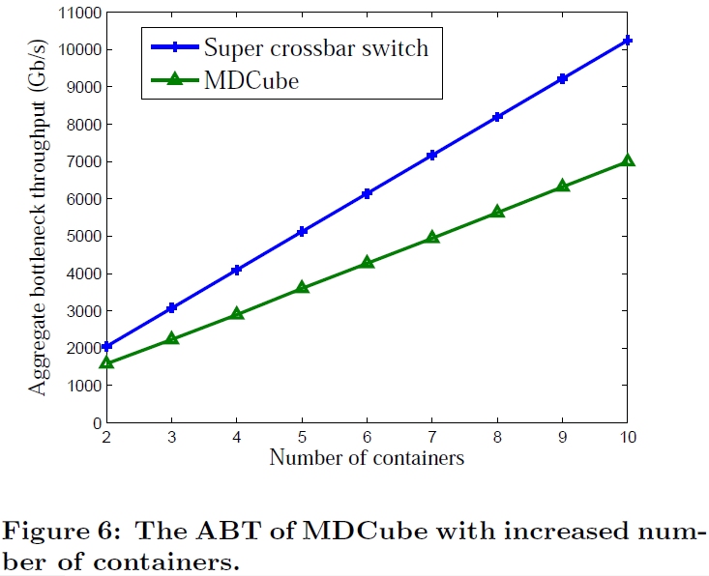
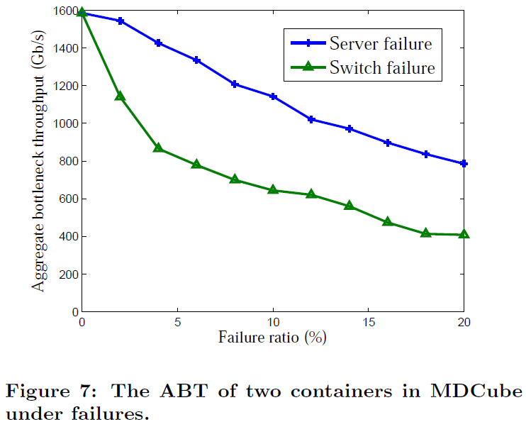
Simulation Results
ABT (aggregate bottleneck throughput)

Slide 49
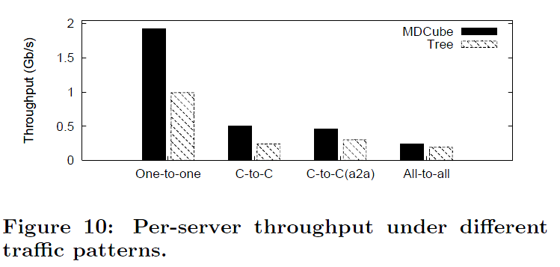
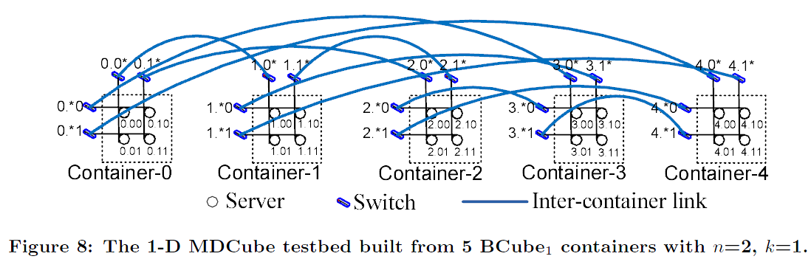
Experimental results
Topology
  20 Dell OptiPlex 755
  Cisco 3560 switches
  5 BCube₁ containers

Slide 50
MDCube Summary
MDCube interconnects hundreds of containers
  Large capacity with a scalable structure
  Greatly reduced inter-container structure cost
  Number of inter-container cables reduced by two orders of magnitudes compared BCube directly
MDCube routing
  Load balanced
  Fault tolerant

Slide 51
Summary
Server-centric design offers a solution alternative to switch-centric design
  Leverage server population to scale out
  Use cheap commodity switches as much as possible
Physical topology forms the foundation for high performance
  Multiple parallel paths for load balancing, fault tolerance
Addressing encodes topological information
  Routing and forwarding made easier

