Slide 1
Upgrading Data Center Network Further

Slide 2
Outline
Upgrading data center network with higher speed
Optical network links: OSA
Serving Internet users
Cloud-scale load balancing: Ananta

Slide 3
OSA: An Optical Switching Architecture for Data Center Networks with Unprecedented Flexibility

Slide 4

Review on Issues on DCN
Core
switch
Serious communication bottleneck!
1:240
Considerations:
Bandwidth
Wiring complexity
Power consumption
Network cost
…
Aggregation
switch
1:5 ~ 1:20
(ToR switch)
Top-of-Rack
1:1
A DCN structure adapted from Cisco
Efficient DCN architecture is desirable, but challenging

Slide 5
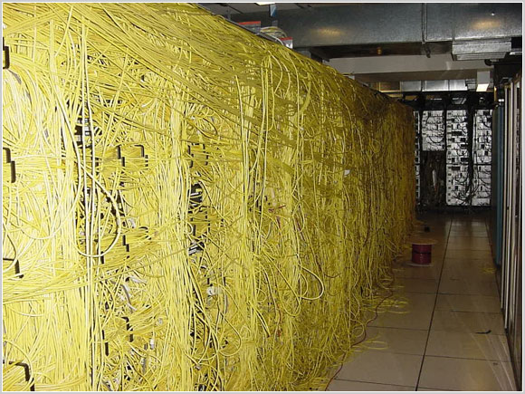


Discussed Efforts and Their Limitations
All-electrical
(static)
Fattree, BCube,
VL2, PortLand
[SIGCOMM’08 ’09]
CLUE
Fattree
Static over-provisioning
High bandwidth, but
high wiring complexity,
high power, high cost
BCube

Slide 6
Recent Efforts and Their Limitations
All-electrical
(static)
Hybrid
electrical/optical
(semi-flexible)
Conventional electrical network
Fattree, BCube,
VL2, PortLand
[SIGCOMM’08 ’09]
c-Through, Helios
[SIGCOMM’10]
Optical links
High bandwidth, but
high wiring complexity,
high power, high cost
Reduced complexity,
power and cost, but
insufficient bandwidth
c-Through
Limited flexibility

Slide 7
Data Center Traffic
[IMC’09][HotNets’09]: only a few ToRs are hot and most of their traffic go to a few other ToRs
[IMC’10]: traffic at ToRs exhibits an ON/OFF pattern
[SIGCOMM’09]: over 90% bytes in elephant flows
[WREN’10]: 60% ToRs see less than 20% change in traffic volume for between 1.6-2.2 seconds
[ICDCS’12]: a production DCN traffic shows stability even on a hourly time scale
Static over-provisioning (i.e., full bandwidth btw all servers at all times) is a waste of resource!
7

Slide 8
OSA
All-electrical
(static)
Hybrid
electrical/optical
(semi-flexible)
All-optical
(high-flexible)
Insight behind OSA:
Data center traffic exhibits regionality and some stability [IMC’09] [WREN’09] [HotNets’09][IMC’10] [SIGCOMM’11][ICDCS’12]
→ flexibly arranging bandwidth to where it is needed, instead of static over-provisioning!
Fattree, BCube,
VL2, PortLand
[SIGCOMM’08 ’09]
c-Through, Helios
[SIGCOMM’10]
OSA
High bandwidth, but
high wiring complexity,
high power, high cost
Reduced complexity,
power and cost, but
insufficient bandwidth
High bandwidth, and
low wiring complexity,
low power, low cost

Slide 9
OSA’s Flexibility: An Example
High capacity link for increased demand
H
G
Traffic demand
10
0
H
A | G | 10
B | H | 10
C | E | 10
D | F | 10
B | D | 10
C | F | 10
E
F
F
D
20
G
A
D
C
C
E
B
OSA can dynamically change its ToR topology and link capacity to adapt to the real demand, thus delivering high bandwidth without static over-provisioning!
A
B
Change
link capacity
Change topology
Demand change
H
A | G | 10
B | H | 10
C | E | 10
F | G | 20
B | D | 10
C | F | 10
D
F
G
A
C
Direct link for real demand
E
B

Slide 10
Outline
Background and high-level idea
How OSA achieves high flexibility?
OSA architecture and optimization
Implementation and Evaluation
Summary

Slide 11
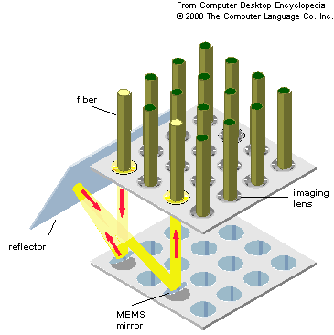
How OSA Achieves Such Flexibility?
Micro-Electro-Mechanical Switch
MEMS
N × N
N
fiber
N
Flexible topology
imaging lens
reflector
MEMS
mirror
MEMS
A
B
C
D
Fixed degree
A
A
D
B
D
C
C
B

Slide 12
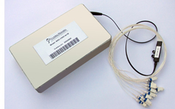
How OSA Achieves Such Flexibility?
Micro-Electro-Mechanical Switch
Wavelength Selective Switch
MEMS
N × N
WSS
1 × k
N
fiber
N
Flexible topology
imaging lens
reflector
MEMS
mirror
MEMS
Output 1
Wavelengths
A
B
C
D
Output 2
Fixed degree
WSS
A
A
Input
D
B
D
C
Output k
C
B

Slide 13
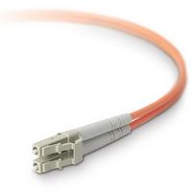
How OSA Achieves Such Flexibility?
Micro-Electro-Mechanical Switch
Wavelength Selective Switch
MEMS
N × N
WSS
1 × k
N
fiber
N
Other optical devices:
Flexible topology
Flexible link capacity
imaging lens
Optical fiber
WDM (DE)MUX
Coupler
Circulator
reflector
MEMS
mirror
bidirectional
MUX
DEMUX
Coupler
Fixed node capacity
100 Terabits X 1
C
MEMS
A
A
Wavelength uniqueness
A
32 port
32 port
4 port
Send
Receive
A
B
C
D
WSS
B
D
Fixed degree
Common features:
Support high bit-rate, high capacity
Power-efficient
Small and compact (except MEMS)
A
A
C
C
B
D
D
B
D
C
C
B

Slide 14
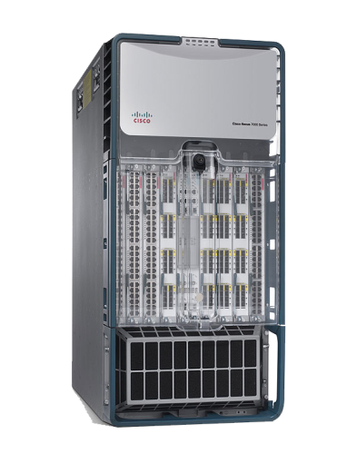
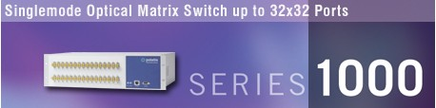
Circuit Switch vs Packet Switch
Optical Circuit Switch
circuit switching
500$/port
rate free
0.24mW/port
~10ms circuit switching latency
Electrical Packet Switch(10G)
store and forward
500$/port
10Gb/s fixed rate
12.5W/port
per-packet switching
14

Slide 15
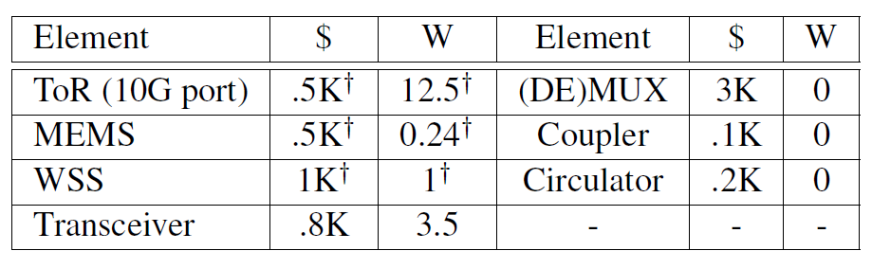
Cost and Power
15

Slide 16
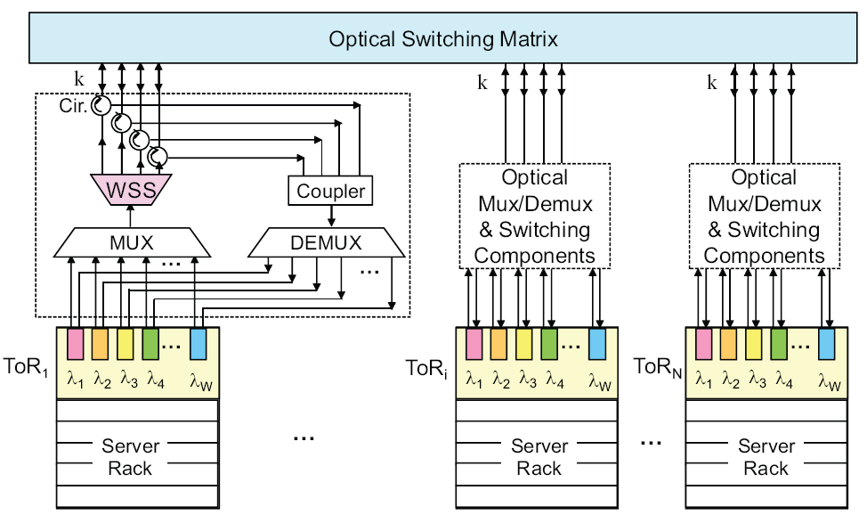
OSA Architecture Overview
Send part
Receive part
(MEMS 320 ports)
Top-of-Rack switch

Slide 17
Data Sending
(MEMS 320 ports)
17

Slide 18
Data Receiving
(MEMS 320 ports)
18

Slide 19
OSA Architecture Overview
At its core
(MEMS 320 ports)
H
MEMS (320 ports)
G
H
H
E
F
F
D
F
D
Each ToR can connect to any k other ToRs
G
A
k
G
A
D
C
C
C
WSS
WSS
Each link can have flexible capacity
WSS
A
B
E
B
E
B
ToR
ToR
…
ToR
OSA can arrange any k-regular topology with flexible link capacity among the ToRs!

Slide 20
OSA Architecture Overview
At its core
Two notes about OSA:
1. Multi-hop routing for indirect ToRs
2. OSA is container-sized DCN for now
(MEMS 320 ports)
MEMS (320 ports)
k
WSS
WSS
WSS
ToR
ToR
…
ToR

Slide 21


Control Plane: Logically Centralized
OSA Manager
Optimize the network to better serve the traffic
Topology
(MEMS 320 ports)
Link capacity
Routing

Slide 22
Optimization Procedure in OSA Manager
Hedera [NSDI’10]
Maximum k-matching
1. Estimate traffic demand between ToRs
2. Assign direct link to heavy communication ToR pairs
OSA Manager

Slide 23
Maximum K-matching for Direct Links Setup
ToR demand graph
A
A
B
B
3
ToR traffic demand
1
3
4
H
2
5
H
1
C
C
 | A | B | C | D | E | F | G | H
A | -- | 3 | 0 | 5 | 2 | 0 | 0 | 1
B | 3 | -- | 4 | 0 | 0 | 3 | 0 | 1
C | 0 | 4 | -- | 2 | 1 | 1 | 4 | 1
D | 5 | 0 | 2 | -- | 1 | 0 | 1 | 3
E | 2 | 0 | 1 | 1 | -- | 4 | 0 | 4
F | 0 | 3 | 1 | 0 | 4 | -- | 3 | 0
G | 0 | 0 | 4 | 1 | 0 | 3 | -- | 3
H | 1 | 1 | 1 | 3 | 4 | 0 | 3 | --
 | A | B | C | D | E | F | G | H
A | -- | 3 | 0 | 5 | 2 | 0 | 0 | 1
B | 3 | -- | 4 | 0 | 0 | 3 | 0 | 1
C | 0 | 4 | -- | 2 | 1 | 1 | 4 | 1
D | 5 | 0 | 2 | -- | 1 | 0 | 1 | 3
E | 2 | 0 | 1 | 1 | -- | 4 | 0 | 4
F | 0 | 3 | 1 | 0 | 4 | -- | 3 | 0
G | 0 | 0 | 4 | 1 | 0 | 3 | -- | 3
H | 1 | 1 | 1 | 3 | 4 | 0 | 3 | --
3
3
1
1
2
G
4
G
1
D
D
3
4
1
F
F
4
E
E
Maximum
weighted 3-matching
Edmonds’ algorithm^{[1]}
ToR connection graph
H
G
E
F
D
C
A
B
[1] J. Edmonds, “Paths, trees and flowers”, Canad. J. of Math., 1965

Slide 24
Optimization Procedure in OSA Manager
Hedera [NSDI’10]
Maximum k-matching
Shortest path routing
1. Estimate traffic demand between ToRs
2. Assign direct link to heavy communication ToR pairs
3. Compute the routing paths
4. Compute the traffic demand on each link
5. Assign wavelengths to provision the link bandwidth
Edge-coloring theory
OSA Manager

Slide 25
Edge-coloring for Wavelength Assignment
H
G
H
G
3
4
F
3
E.g., from F’s perspective
E
E
F
4
3
4
3
2
D
C
D
C
2
5
4
A
3
B
A
B
Expected wavelength graph
Multigraph based on # of wavelengths
Wavelength assignment:
A wavelength cannot be associated with a ToR twice
Edge-coloring:
A color cannot be associated with a node twice
Vizing’s theorem^{[2]}
[2] J. Misra, et. al., “A constructive proof of Vizing’s Theorem,” Inf. Process. Lett., 1992.

Slide 26
Optimization Procedure in OSA Manager
Topology, MEMS
Routing, ToR
1. Estimate traffic demand between ToRs
2. Assign direct link to heavy communication ToR pairs
3. Compute the routing paths
4. Compute the traffic demand on each link
5. Assign wavelengths to provision the link bandwidth
Link capacity, WSS
OSA Manager

Slide 27
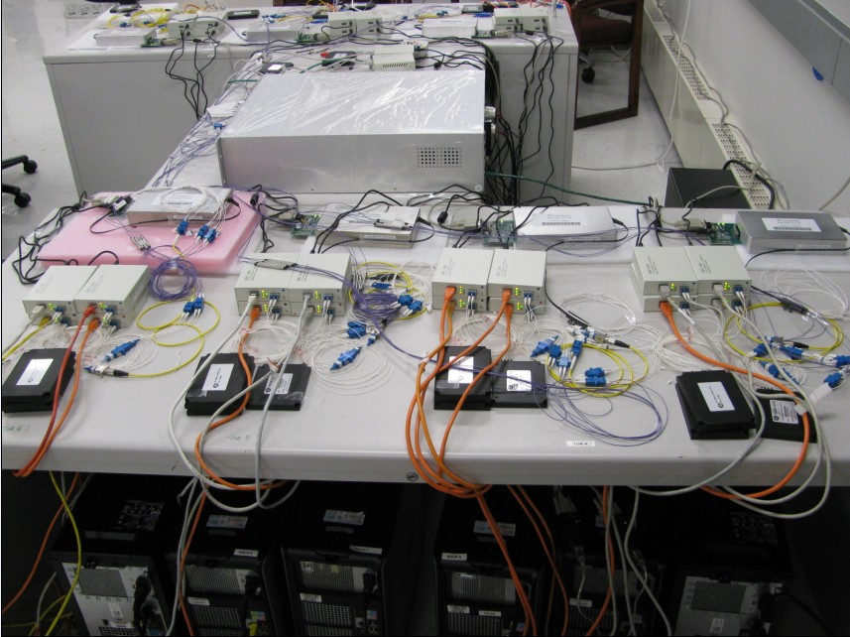
Prototype Implementation
MEMS
WSS
1 MEMS (32 ports: 16×16)
8 WSS units (1×4 ports)
8 ToRs* and 32 servers
Theoretical curve
Experiment curve
Experiment results strictly follow the expectation:
Demonstrate the feasibility of the OSA design!
*Server-emulated ToR

Slide 28
Simulation Results (2560 servers*)
OSA can be close to non-blocking
85%
90%
~100%
80%
Demonstrate the high-performance of the OSA design!
3.86X
3.1X
3.54X
3X
OSA is significantly better than hybrid
*80 ToRs (each with 32 servers) form a 4-regular graph for OSA.

Slide 29
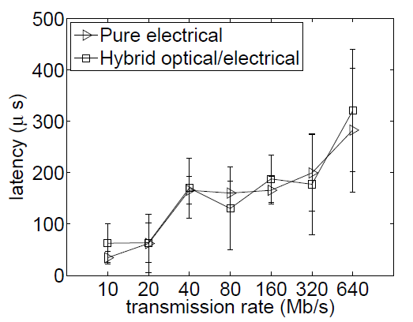
Multi-hop Routing
(MEMS 320 ports)
O-E-O
Sub-nanosecond
29

Slide 30
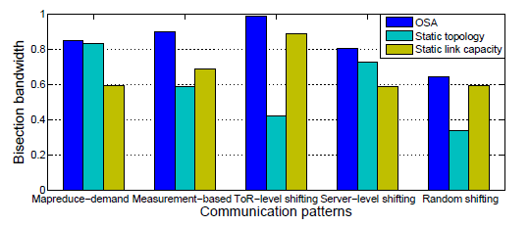
The effect of dynamic topology and link capacity
30

Slide 31
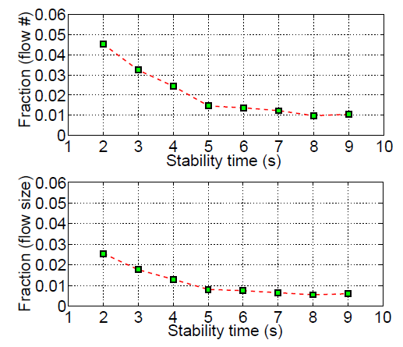
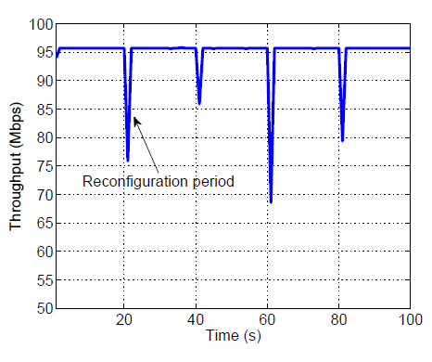
The effect of reconfiguration
31

Slide 32
Cost, Power & Wiring (2560 Servers)
OSA is slightly better than hybrid
OSA is significantly better than Fattree
Demonstrate OSA can potentially deliver high bandwidth in a simple, power-efficient and cost-effective way!

Slide 33
Summary
Static, “fat”
Flexible, “thin”
Fattree
Hybrid
OSA
 | Performance | Complexity | Power | Cost
Fattree | √ | X | X | X
Hybrid | X | √ | √ | √
OSA | √ | √ | √ | √
OSA is inspired by traffic regionality and stability
Sweet spot for performance, cost, power, and wiring complexity
Caveats: not intended for all-to-all, non-stable traffic
Acknowledgement: CoAdna Photonics (WSS) and Polatis (MEMS)

Slide 34
Ananta: Cloud-Scale Load Balancing

Slide 35

Windows Azure - Some Stats
More than 50% of Fortune 500 companies using Azure
Nearly 1000 customers signing up every day
Hundreds of thousands of servers
Doubling compute and storage capacity every 6-9 months
Azure Storage is Massive – over 4 trillion objects stored
Global datacenters
Global CDN
Notes:
It works, and it’s huge
Stats released in April
Sites, numbers fast growth … quite stale

Slide 36
Ananta in a nutshell
Is NOT hardware load balancer code running on commodity hardware
Is distributed, scalable architecture for Layer-4 load balancing and NAT
Has been in production in Bing and Azure for three years serving multiple Tbps of traffic
Key benefits
Scale on demand, higher reliability, lower cost, flexibility to innovate

Slide 37
How are load balancing and NAT used in Azure?

Slide 38
Background: Inbound VIP communication
Terminology:
VIP – Virtual IP
DIP – Direct IP
Internet
Client → VIP
LB
VIP = 1.2.3.4
Client → DIP
LB load balances and
NATs VIP traffic to DIPs
Front-end
VM
Front-end
VM
Front-end
VM
DIP = 10.0.1.1
DIP = 10.0.1.2
DIP = 10.0.1.3
Notes:
Same things happen between the front-end and back-end

Slide 39
Background: Outbound (SNAT) VIP communication
Datacenter
Network
1.2.3.4 → 5.6.7.8
LB
VIP1 = 1.2.3.4
LB
VIP2 = 5.6.7.8
DIP → 5.6.7.8
VIP1 → DIP
Front-end
VM
Back-end
VM
Front-end
VM
Front-end
VM
Front-end
VM
DIP = 10.0.1.1
DIP = 10.0.1.20
DIP = 10.0.2.1
DIP = 10.0.2.2
DIP = 10.0.2.3
Service 1
Service 2

Slide 40
VIP traffic in a data center
Notes:
- This is just the current usage. In reality, we expect the intra-DC VIP traffic to increase faster and that is what we have provisioned for.

Slide 41
Why does Azure need another load balancer?

Slide 42
Traditional LB/NAT design does not meet cloud requirements
Requirement | Details | State-of-the-art
Scale | Throughput: ~40 Tbps using 400 servers (1% of Data center scale) 100Gbps for a single VIP Configure 1000s of VIPs in seconds in the event of a disaster | 20Gbps for $80,000 Up to 20Gbps per VIP One VIP/sec configuration rate
Reliability | N+1 redundancy Quick failover | 1+1 redundancy (active+standby) or slow failover
Any service anywhere | Servers and LB/NAT are placed across L2 boundaries for scalability and flexibility | NAT and Direct Server Return (DSR) supported only in the same L2

Slide 43
Key idea: decompose and distribute functionality
VIP Configuration:
VIP, ports, # DIPs
Multiplexer
Multiplexer
. . .
Multiplexer
Software router
(Needs to scale to Internet bandwidth)
Controller
Controller
Ananta
Manager
VM Switch
VM Switch
VM Switch
Hosts
(Scales naturally with
# of servers)
Host Agent
Host Agent
. . .
Host Agent
. . .
. . .
. . .
VM₁
VM_{N}
VM₁
VM_{N}
VM₁
VM_{N}
Notes:
- High-level design SLBM, Mux and HP

Slide 44
Ananta: data plane
1st Tier: Provides packet-level (layer-3) load spreading, implemented in routers via ECMP.
2nd Tier: Provides connection-level (layer-4) load spreading, implemented in servers.
Multiplexer
Multiplexer
. . .
Multiplexer
VM Switch
VM Switch
VM Switch
3rd Tier: Provides stateful NAT implemented in the virtual switch in every server.
Host Agent
Host Agent
. . .
Host Agent
. . .
. . .
. . .
VM₁
VM_{N}
VM₁
VM_{N}
VM₁
VM_{N}

Slide 45
Inbound connections
Packet
Headers
Dest:
VIP
Src:
Client
Dest:
DIP
Src:
Mux
Dest:
VIP
Src:
Client
Host
Router
2
4
…
Router
Router
MUX
Host Agent
MUX
3
1
MUX
5
Client
8
VM
DIP
7
6
Packet
Headers
Dest:
Client
Src:
VIP

Slide 46
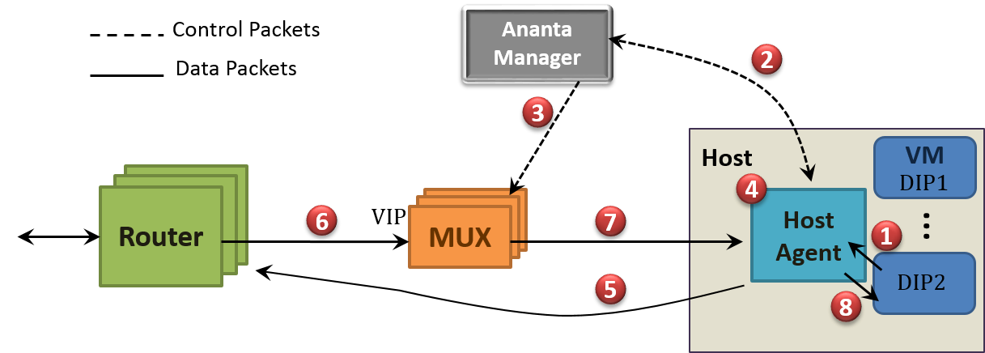
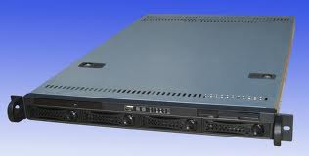
Outbound (SNAT) connections
VIP:1025 → DIP2
Server
Packet
Headers
Dest:
Server:80
Src:
VIP:1025
Dest:
Server:80
Src:
DIP2:5555
Notes:
- Show packet formats

Slide 47
Managing latency for SNAT
Batching
Ports allocated in slots of 8 ports
Pre-allocation
160 ports per VM
Less than 1% of outbound connections ever hit Ananta Manager

Slide 48
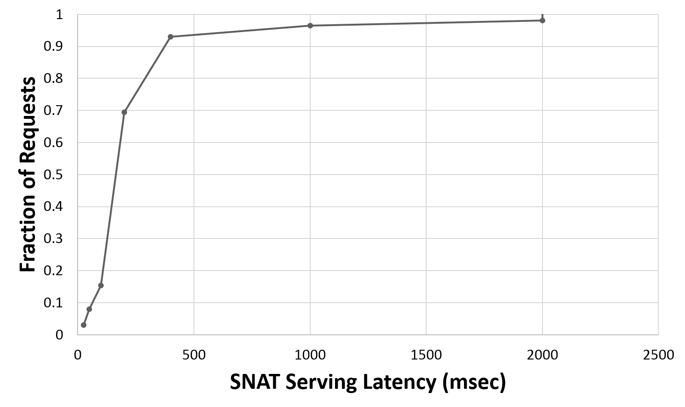
SNAT Latency

Slide 49
Fastpath: forward traffic
Host
VIP1
MUX
Host Agent
MUX
VM
MUX1
DIP1
Data Packets
…
1
SYN
Host
VIP2
MUX
Host Agent
VM
MUX
2
MUX2
DIP2
…
Destination
Notes:
- Show packet formats

Slide 50
Fastpath: return traffic
Host
VIP1
MUX
Host Agent
MUX
4
VM
MUX1
DIP1
Data Packets
…
1
SYN
3
SYN-ACK
Host
VIP2
MUX
Host Agent
VM
MUX
2
MUX2
DIP2
…
Destination
Notes:
- Show packet formats

Slide 51
Fastpath: redirect packets
Host
VIP1
MUX
Host Agent
MUX
VM
Redirect Packets
MUX1
DIP1
Data Packets
…
7
5
7
ACK
6
Host
VIP2
MUX
Host Agent
VM
MUX
MUX2
DIP2
…
Destination
Notes:
- Show packet formats

Slide 52
Fastpath: low latency and high bandwidth for intra-DC traffic
Host
VIP1
MUX
Host Agent
MUX
VM
Redirect Packets
MUX1
DIP1
Data Packets
…
8
Host
VIP2
MUX
Host Agent
VM
MUX
MUX2
DIP2
…
Destination
Notes:
- Show packet formats

Slide 53
Impact of Fastpath on Mux and Host CPU

Slide 54
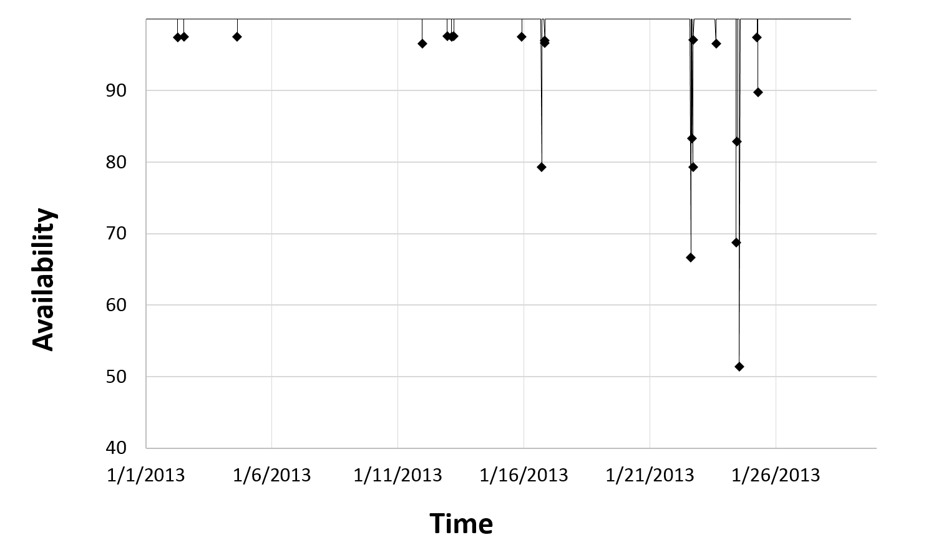
Overall availability

Slide 55
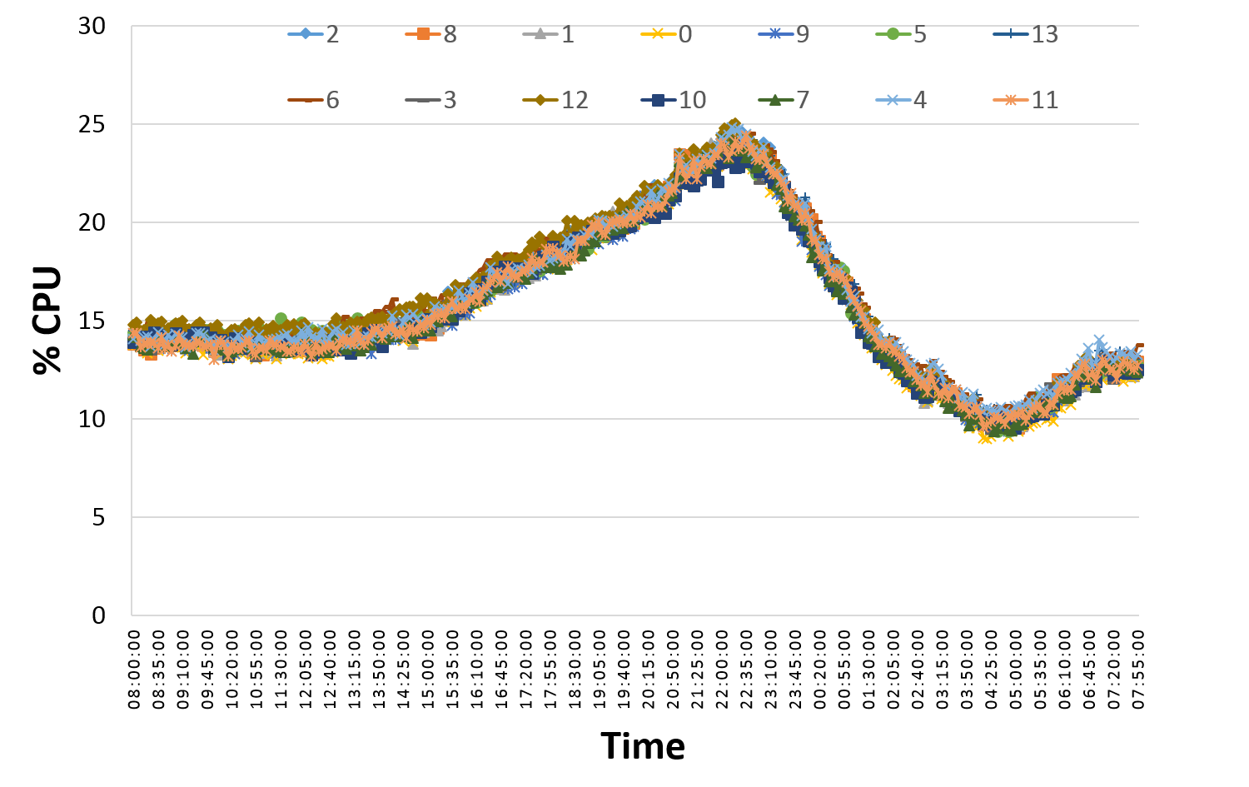
CPU distribution

Slide 56
Lessons learnt
Centralized controllers work
There are significant challenges in doing per-flow processing, e.g., SNAT
Provide overall higher reliability and easier to manage system
Colocation of control plane and data plane provides faster local recovery
Fate sharing eliminates the need for a separate, highly-available management channel
Protocol semantics are violated on the Internet
Bugs in external code forced us to change network MTU
Owning our own software has been a key enabler for:
Faster turn-around on bugs, DoS detection, flexibility to design new features
Better monitoring and management

Slide 57
Summary
Upgrading data network network is a continuous process
Latest technologies are being adopted
Optical networking technology offers one alternative
Pros: Low cost, high flexibility
Cons: Circuit switching (instead of packet switching), medium-sized data centers
Scaling is needed everywhere
Software techniques for load balancing
Distribute the load among servers (host agents in Ananta)
Another form of server-centric design
Still scale out (but not scale up)
Scale with the number of servers

