Slide 1
TCP over Data Center Networks
CS219
Winter 2021

Slide 2


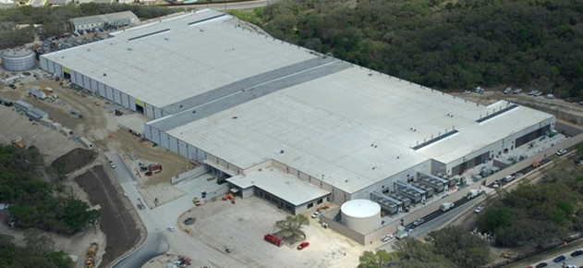


Transport inside the DC
100Kbps–100Mbps links
~100ms latency
INTERNET
Fabric
10–40Gbps links
~10–100μs latency
Servers

Slide 3
Transport inside the DC
INTERNET
Fabric
Interconnect for distributed compute workloads
Servers
web
app
cache
data-base
map-reduce
HPC
monitoring
Notes:
Specifically, while some of the traffic in data center networks is sent across the Internet, the majority of data center traffic is between the servers within the data center and never leaves the data center.
This is because

Slide 4
Characteristics for DC Transport
Network characteristics
Very high link speed (1s~10s Gb/s); very low latency (microseconds or less)
Application characteristics
Large-scale distributed computation
Challenging traffic patterns
Diverse mix of mice & elephant flows
Incast
Cheap switches
Single-chip shared-memory devices; shallow buffers

Slide 5


Data Center Workloads
Mice & Elephants
Short messages
(e.g., query, coordination)
Large flows
(e.g., data update, backup)
Low Latency
High Throughput
Notes:
So the ultimate goal of data center transport is to complete these internal transactions or “flows” as quickly as possible.
What makes this challenging is that the flows are actually quite diverse. In particular, there are…
And these different flows require different things to complete quickly. For the short flows, we need to provide low latency…

Slide 6


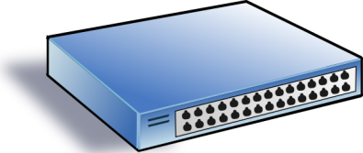
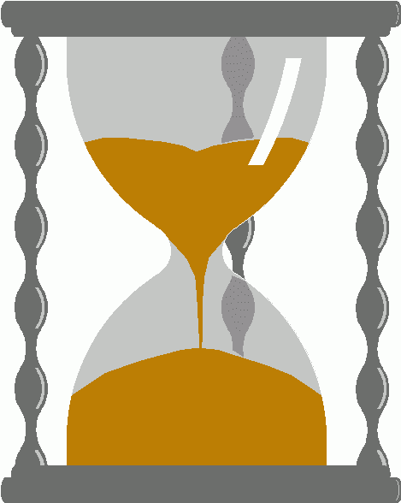
Incast Issue
Synchronized fan-in congestion
Worker 1
Aggregator
Worker 2
Worker 3
RTO_{min} = 300 ms
Worker 4
TCP timeout
Vasudevan et al. (SIGCOMM’09)
Notes:
Not only does DCTCP’s low queue occupancy keep latency down, it also increases tolerance to traffic bursts because most of the buffer is sitting there empty to absorb bursts.
This is important in data centers to handle certain traffic patterns that are particularly bursty…

Slide 7
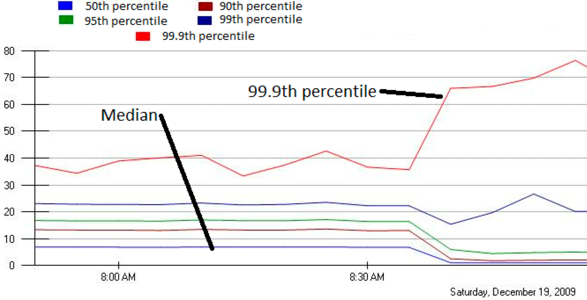
Incast in Microsoft Bing
MLA Query Completion Time (ms)
Jittering trades off median for high percentiles
Requests are jittered over 10ms window.
Jittering switched off around 8:30 am.
Notes:
1. Incast really happens – see this actual screenshot from production tool
2. People care, they’ve solved it at application by jittering.
3. They care about the 99.9th percentile, 1-1000 customers

Slide 8
DC Transport Requirements
Low Latency
Short messages, queries
High Throughput
Continuous data updates, backups
High Burst Tolerance
Incast
The challenge is to achieve these together

Slide 9
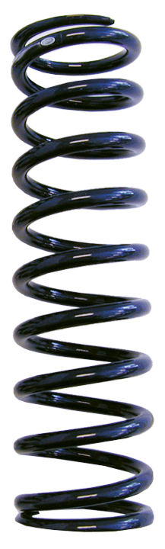
High Throughput
Low Latency
Baseline fabric latency (propagation + switching): 10 microseconds
Notes:
And the reason I say this is a challenge is that there’s an inherent tension between high throughput and low latency in packet-switched networks.
Recall that I said the baseline fabric latency… but this is when there is no traffic. When we have a lot of traffic at high throughput, we also get traffic-dependent queue buildup in the switches that adds latency in the form of queuing delay. This essentially occurs because packet transmissions are not tightly coordinated in packet-switched networks: every flow is independently making decisions which leads to rate mismatches.

Slide 10
High Throughput
Low Latency
Baseline fabric latency (propagation + switching): 10 microseconds
High throughput requires buffering for rate mismatches
… but this adds significant queuing latency
Notes:
Dealing with these rate mismatches requires buffering which adds latency.
Now this is a general problem in networks. But it’s particularly detrimental in data center networks because the baseline latency is so small that queuing delays dominate the overall latency.

Slide 11
TCP in the Data Center
TCP [Jacobsen et al.’88] is widely used in the data center
More than 99% of the traffic
Operators work around TCP problems
Ad-hoc, inefficient, often expensive solutions
TCP is deeply ingrained in applications
Practical deployment is hard
→ keep it simple!
Notes:
TCP has been the dominant transport protocol in the Internet for 25 years and is widely used in the data center as well.
However, it was not really designed for this environment and does not meet the demands of data center applications.

Slide 12
Review on TCP Design
Sender 1
Additive Increase:
W → W+1 per round-trip time
Multiplicative Decrease:
W → W/2 per drop or ECN mark
ECN Mark (1 bit)
Receiver
Window Size (Rate)
Time
Sender 2
ECN = Explicit Congestion Notification
Notes:
DCTCP is based on the existing Explicit Congestion Notification framework in TCP.
----- Meeting Notes (3/7/12 12:24) -----
Remember to mention "SAWTOOTH"

Slide 13
TCP Buffer Requirement
Bandwidth-delay product as the rule of thumb:
A single flow needs C×RTT buffers for 100% Throughput.
B < C×RTT
B ≥ C×RTT
B
Buffer Size
B
100%
100%
Throughput
Notes:
Now in the case of TCP, the question of how much buffering is needed for high throughput has been studied and is known in the literature as the buffer sizing problem.
So if we can find a way to lower the variance of the sending rates, then we can reduce the buffering requirements and that’s exactly what DCTCP is designed to do”

Slide 14

Reducing Buffer Requirements
Appenzeller et al. (SIGCOMM ‘04):
Large # of flows: is enough.
Window Size
(Rate)
Buffer Size
Throughput
100%
Notes:
Now, there are previous results that show in some circumstances, we don't need big buffers.

Slide 15
Reducing Buffer Requirements
Appenzeller et al. (SIGCOMM ‘04):
Large # of flows: is enough
Can’t rely on stat-mux benefit in the DC.
Measurements show typically only 1-2 large flows at each server
Key Observation:
Low variance in sending rate → Small buffers suffice

Slide 16
Three Concrete TCP Proposals
We will next introduce three concrete designs:
TCP Incast
Datacenter TCP (DCTCP)
Deadline-aware Datacenter TCP (D²CTCP)

Slide 17
TCP Incast: Solution with
Aggressive TCP Timeouts

Slide 18


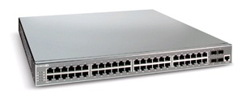
Cluster-based Cloud Storage
Ethernet: 1-10Gbps
Commodity
Ethernet
Switch
Client
Round Trip Time (RTT):
10-100us
Servers
Notes:
A typical datacenter setting might look something like this.
A Client (left) is connected to Servers (right) using 1-10Gbps Ethernet networks, and the client is separated from servers by one of more commodity Ethernet switches. The Round Trip Time in such networks is 100 to 10 micro seconds.
For application developers, the availability of Ethernet as the interconnect allows the use of existing protocols designed for the wide area. For example, developers can use TCP and they readily get
Reliability - dealing with message loss, duplication, damage, and delay
in-order delivery of data
Flow control (receiver controls how much sender sends)
Congestion control (network is probed for available bw, and under congestion senders back-off)
Support for multiple end-points on the same host (mux, demux using port numbers)
{
But the use of TCP in datacenters comes at a cost:
Throughput collapse
Affects latency-sensitive applications
( - other advantages of Ethernet:
shared infrastructure for different clusters,
ease of managing one network type,
low cost
)
}

Slide 19

Cluster-based Cloud Storage
Synchronized Read
1
R
R
R
R
2
Client
Switch
3
1
2
3
4
Server
Request Unit
(SRU)
Client now sends
next batch of requests
4
Storage
Servers
Data Block
Notes:
Data is striped across multiple servers for reliability (coding/replication) and performance. Also aids in incremental scalability.
To read this data a client performs a “Synchronized Read” operation.
The client reads data one data-block at a time. The portion of a data block stored by each server is called a SRU (in our terminology)
- mention that this setting is simplistic
- could have multiple clients, multiple outstanding blocks,
- describe sending of requests, responses
- the client sends out the next batch of requests only after it has received the entire data block (barrier synchronized)
To test how this read operation performs in the real world as we increase the number of servers on which we stripe data … (next slide)

Slide 20
Synchronized Read Setup
Test on an Ethernet-based storage cluster
Client performs synchronized reads
Increase # of servers involved in transfer
Data block size is fixed (FS read)
TCP used as the transport protocol
Notes:
… we conducted an experiment on an Ethernet-based cluster. We kept the block size fixed and increased the number of servers that the data was striped on. TCP was used as the data transfer protocol, and the client performed synchronized reads that we showed in the previous slide.

Slide 21
Main Results
Problem: Coarse-grained TCP timeouts (200ms) too expensive for datacenter applications
Solution: microsecond granularity timeouts
Improves datacenter app throughput & latency
Also safe for use in the wide-area (Internet)
Notes:
So the main takeaway from this talk is that coarse-grained TCP timeouts, in datacenters, result in TCP throughput collapse and in poor response times for latency-sensitive applications. Our solution of microsecond granularity timeouts not only solves these problems, but is also safe for use in the wide-area.

Slide 22
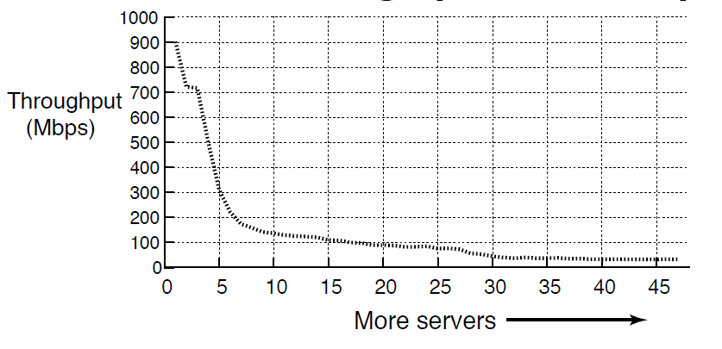
Problem: TCP Throughput Collapse
Cluster Setup
1Gbps Ethernet
Unmodified TCP
S50 Switch
1MB Block Size
Collapse!
TCP Incast
Cause of throughput collapse:
coarse-grained TCP timeouts
Notes:
And, here are the results of the experiment. On the Y axis we have Throughput (Goodput), and on the X axis we have the number of servers involved in the transfer. Initially the throughput is 900Mbps, close to the maximum achievable in the network. As we scale the number of servers, by around 7 servers we notice a drastic collapse in throughput down to 100Mbps (an order of magnitude lower than the max). This TCP throughput collapse is called TCP Incast, and the cause for this is coarse-grained TCP timeouts.

Slide 23
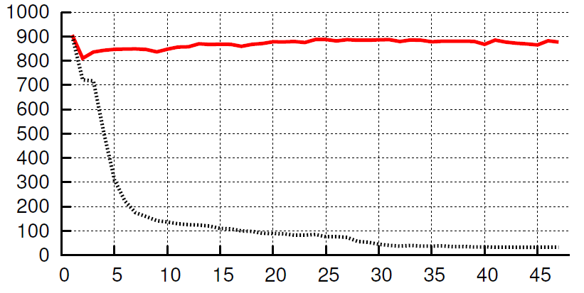
Solution: µsecond TCP + no minRTO
Our solution
Throughput
(Mbps)
Unmodified TCP
more servers →
High throughput for up to 47 servers
Simulation scales to thousands of servers
Notes:
Our solution, of using microsecond granularity timers, solves the problem of TCP throughput collapse. The red line is the result of running servers with our modified TCP stack. It solves the problem here for 47 servers, and we have found in simulation this solution scales to thousands of servers.
Higher is better and Red is us.

Slide 24
Outline
Overview
Why are TCP timeouts expensive?
How do coarse-grained timeouts affect apps?
Solution: Microsecond TCP Retransmissions
Is the solution safe?
Notes:
In the rest of the talk I’ll tell you why coarse-grained TCP timeouts are expensive, followed by how these timeouts affect datacenter applications. I’ll then show you our solution to the problems posed by expensive timeouts, and show that it is safe for use both within the datacenter and in the wide-area.

Slide 25
TCP: data-driven loss recovery
Seq #
1
2
Ack 1
3
4
Ack 1
5
Ack 1
Ack 1
3 duplicate ACKs for 1
(packet 2 is probably lost)
In datacenters
data-driven recovery in µsecs after loss.
Retransmit packet 2
immediately
2
Ack 5
Sender
Receiver
Notes:
TCP recovers from packet losses in two ways
The first way is data-driven loss recovery
Let us consider this example, with the sender on the left and the receiver on the right communicating with each other over a TCP stream. Let us assume that the sender has 5 packets to send, denoted by these sequence numbers 1—5). Let is assume that packet 2 gets dropped due to congestion. Now the receiver acknowledges packet 1 when it gets the packet, but on receiving packets 3, 4, 5, it responds with a ACK for the last packet it received in–order, packet 1. On seeing 3 duplicate ACKs for packet 1, the sender infers that packet 2 must have been dropped and retransmits packet 2 immediately.
{
The sender waits for 3 duplicate ACKs because
- it thinks that packets might have been reordered in the network and that the receiver might have received pkt 2 after 3 and 4
- but it can’t wait forever (hence a limit – 3 duplicate ACKs)
Within a datacenter, where there is no packet reordering, this threshold can be dropped to 1.
}

Slide 26
TCP: timeout-driven loss recovery
Seq #
1
Timeouts are expensive (msecs to recover after loss)
2
3
4
5
Retransmission
Timeout
(RTO)
Retransmit packet
1
Ack 1
Sender
Receiver
Notes:
The second way TCP recovers from packet losses is timeout-driven loss recovery. Consider the same example as about, but this time assume that all the packets that the sender sent get dropped in the network. The sender can wait only so long for feedback from the receiver before it decides the packets it sent are lost. The time a sender waits for before deciding that the packets are lost is called a Retransmission Timeout period, or RTO. Once the timeout is triggered, the sender retransmits packet 1, which is acknowledged by the receiver, and the sender exponentially increases the amount of data it injects into the network.
{
Timeouts are expensive because
- you have to wait for 1 RTO before realizing that a retransmission is required
- RTO is estimated based on the round trip time
- estimating RTO – tricky (timely response vs premature timeouts)
- minRTO value in ms (orders of magnitude greater than the RTTs in datacenters)
- also a timeout results in a sender dropping its packet injection rate to 1, and rediscovering the link capacity
}

Slide 27
TCP: Loss recovery comparison
Timeout driven recovery is
slow (ms)
Data-driven recovery is
super fast (µs) in datacenters
Seq #
Seq #
1
1
Ack 1
2
2
3
Ack 1
4
3
5
Ack 1
Ack 1
4
5
Retransmit
2
Ack 5
Retransmission
Timeout
(RTO)
Sender
Receiver
Ack 1
1
Sender
Receiver
Notes:
So we have seen the 2 loss recovery mechanisms in TCP. The point to note is that timeouts are expensive, in ms, where as data-driven recovery is quick (us in datacenters)
But why are timeouts in milliseconds?

Slide 28
RTO Estimation and Minimum Bound
Jacobson’s TCP RTO Estimator
RTOEstimated = SRTT + (4 * RTTVAR)
Actual RTO = max(minRTO, RTOEstimated)
Minimum RTO bound (minRTO) = 200ms
TCP timer granularity
minRTO (200ms) >> Datacenter RTT (100µs)
1 TCP Timeout lasts 1000 datacenter RTTs!
Notes:
It all goes back to the way a RTO is calculated. Every packet sent out is associated with a timeout value. This RTO should roughly be equal to the RTT of the network. Think of it this way: If I send a packet out and don’t get a response for it within the time it takes to reach the other end and come back, the packet probably is lost. But the RTT is not something that we can determine in advance for each flow because RTTs vary due to buffering at routers/switches (and depending on network conditions). Individual RTTs are determined by attaching a timestamp to a packet when it leaves the network, and checking the time when the ACK for the packet comes back. To simplify state maintenance, ACKs echo back the timestamp of the data packet they are acknowledging.
So, the RTT of the network is estimated, averaged over time. The RTO value is a conservative estimate based on the estimated and smoothed RTT and RTT variance.
The actual RTO of a packet is determined by the equation shown above → max(…)
minRTO = 200ms, exists because
TCP timer granularity: you can timeout in 200ms only if you can tell 200ms have passed, and you can tell 200ms have passed if the TCP timer is interrupted < 100ms
safety concerns (Allman99).
The thing to note is 200ms is three orders of magnitude greater than datacenter RTTs.

Slide 29
Outline
Overview
Why are TCP timeouts expensive?
How do coarse-grained timeouts affect apps?
Solution: Microsecond TCP Retransmissions
Is the solution safe?
Notes:
With that in mind let us look at how coarse-grained timeouts affect datacenter applications.

Slide 30
Single Flow TCP Request-Response
R
Data
Data
Data
Client
Switch
Server
Response
sent
Response
resent
Request
sent
Response
dropped
time
200ms
Notes:
Let us consider a simple example: a single flow client-server interaction using TCP.
We have the client and server separated by a switch shown above. On the lower part of the slide we show the timeline of requests and responses.
To begin with, the client machine sends out a request for data stored on the server. The server responds with data, but let us say that due to instantaneous congestion at the switch the data packet that the server sent gets dropped. The server has to wait at least 200ms before it realizes this loss, times-out, and resends the response. So effectively the response gets delayed by 200ms – a delay that can cripple latency-sensitive applications.

Slide 31
Application Perspective
Applications are sensitive to 200ms timeouts:
Single flow request-response
Latency-sensitive applications
Barrier-Synchronized workloads
Parallel Cluster File Systems
Throughput-intensive
Search: multi-server queries
Latency-sensitive
Notes:
200ms timeouts also affect other workloads, such as barrier synchronized workloads such as those exhibited by cluster filesystems (seen earlier in talk) and in search queries where the application has to wait for results from multiple servers before sorting them and returning them to the user.

Slide 32
Link Idle Time Due To Timeouts
Synchronized Read
1
R
R
R
R
2
4
Client
Switch
3
1
2
3
4
Server
Request Unit
(SRU)
4
Req.
sent
Rsp.
sent
4 dropped
Response
resent
1 – 3 done
time
Link Idle!
Notes:
Let us revisit the synchronized reads scenario (in parallel filesystems) to understand why timeouts cause link idle time (and hence throughput collapse).
Setting: SRU contains only one packet worth of information for simplicity.
If 4 is dropped, when server 4 is timing out, the link is idle – no one is utilizing the available bandwidth.

Slide 33
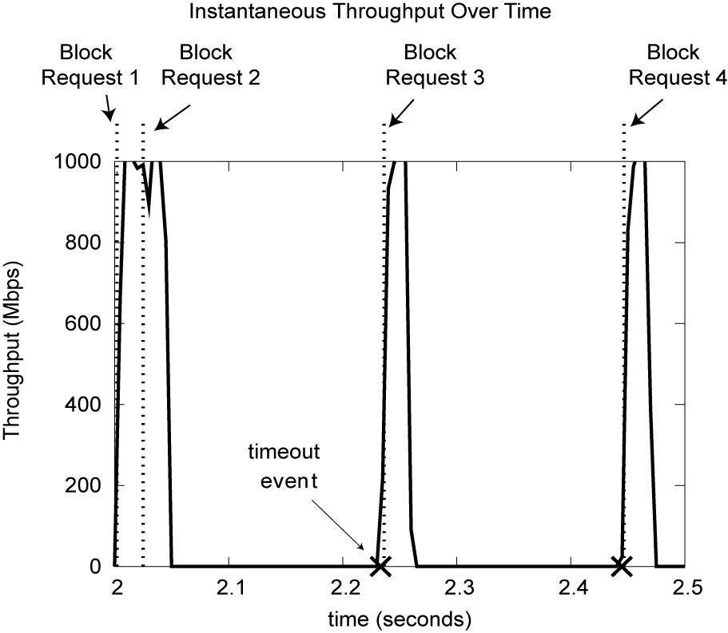
Client Link Utilization
Link Idle!
200ms
Notes:
Another way to visualize this is to look at the client link utilization when the transfer was taking place.
Y axis = Throughput
X axis = time
Let us consider only 1 block transfer (Block 2). When servers send their responses, the client link utilization reaches a peak (all links are 1Gbps). But one of the servers experiences losses and has to fallback on timeout driven loss recovery. When the remaining servers involved in the read finish their transfers, the link is idle (for 200ms in this example), just before the timeout event occurs and the final server completes the transfer. Once the entire data block is received, the request for the next data block can be sent out.
{ This is a visualization of a simulation run }

Slide 34
200ms timeouts → Throughput Collapse
Cluster Setup
1Gbps Ethernet
200ms minRTO
S50 Switch
1MB Block Size
Collapse!
[Nagle04] called this Incast
Provided application level solutions
Cause of throughput collapse: TCP timeouts
Notes:
The link idle times are the cause of the TCP throughput collapse we saw earlier. Once again, Y axis is Throughput, and on the X axis we have the number of servers on which the data is striped.
David Nagle and others at Panasas documented this problem in 2004 and called it Incast (though it was observed earlier at CMU as part of the active disk/object storage project). They attributed the collapse to TCP timeouts, and provided app-level workarounds to the problem.
Our earlier work, in FAST 2008, investigated this problem in the search of a network-level solution.

Slide 35
Outline
Overview
Why are TCP timeouts expensive?
How do coarse-grained timeouts affect apps?
Solution: Microsecond TCP Retransmissions
and eliminate minRTO
Is the solution safe?
Notes:
That brings us to our solution: microsecond granularity TCP retransmissions

Slide 36
µsecond Retransmission Timeouts (RTO)
RTO = max( minRTO, f(RTT) )
200ms
RTT tracked in milliseconds
200µs?
Track RTT in µsecond
0?
Notes:
RTO is a max of 2 values. We have to make sure that both these values are in µseconds.
This means lowering both the minRTO bound to µseconds (or getting rid of it), and
tracking RTT is µseconds (currently tracked in milliseconds)

Slide 37
Lowering minRTO to 1ms
Lower minRTO to as low a value as possible without changing timers/TCP impl.
Simple one-line change to Linux
Uses low-resolution 1ms kernel timers
Notes:
But before that let us see what is the effect of reducing minRTO; this was the most promising solution in simulation from our previous work. Turns out that the lowest possible value we can set minRTO to, without changing the TCP timer implementation, is 1ms. And this requires a simple 1 line change in Linux. Let us see if this alleviates the problem of throughput collapse.

Slide 38
Default minRTO: Throughput Collapse
Unmodified TCP
(200ms minRTO)
Notes:
Same graph as before – synchronized reads, unmodified TCP on servers.

Slide 39
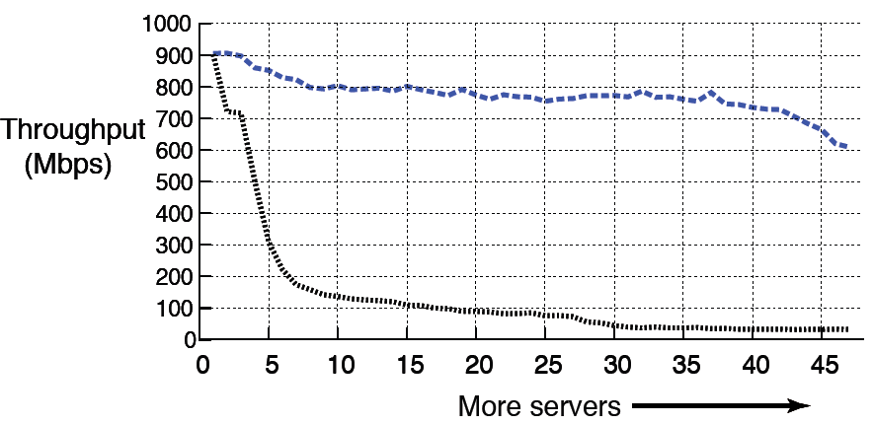
Lower minRTO (1ms) helps
1ms minRTO
Unmodified TCP
(200ms minRTO)
Millisecond retransmissions are not enough
Notes:
The blue line represents the 1ms minRTO TCP implementation.
A single line change helps! Gets rid of collapse.
But not good enough at scale. There is a drop-off close to 40-47 servers.
Based on this one might be tempted to suggest, can we just eliminate minRTO. Only eliminating minRTO will not help. And the reason for this is that RTT is still measured in milliseconds, and hence the RTO values are still in miliseconds.
This is the case for microsecond retransmissions.

Slide 40
Requirements for µsecond RTO
TCP must track RTT in microseconds
Modify internal data structures
Reuse timestamp option
Efficient high-resolution kernel timers
Use high-precision event timer (HPET) for efficient interrupt signaling in Linux
Notes:
And the requirements for µsecond retransmissions are
Being able to keep track of RTT in microseconds
Requires modifications to internal data structures
Requires the use of high-resolution kernel timers

Slide 41
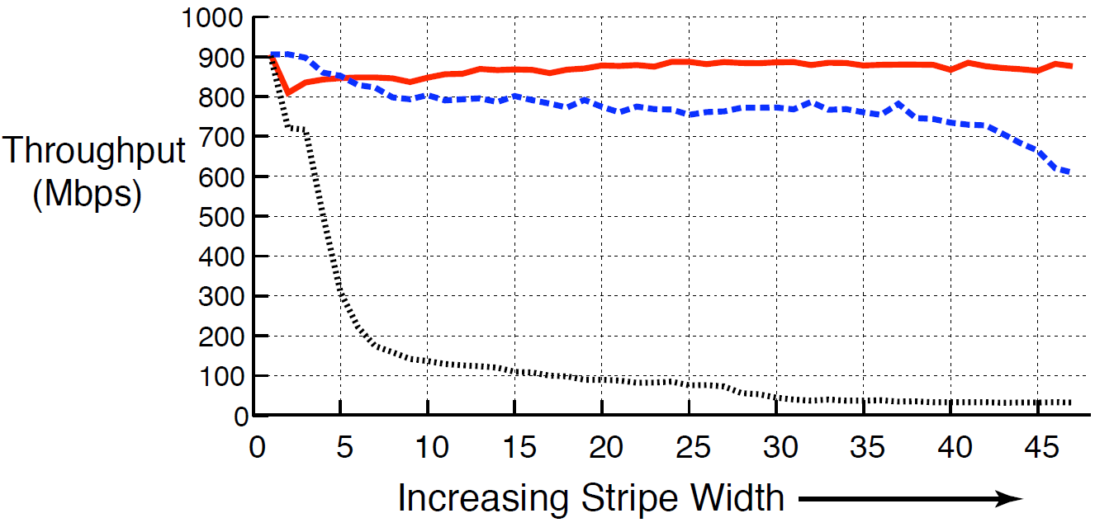
Solution: µsecond TCP + no minRTO
microsecond TCP
+ no minRTO
1ms minRTO
Unmodified TCP
(200ms minRTO)
more servers
High throughput for up to 47 servers

Slide 42
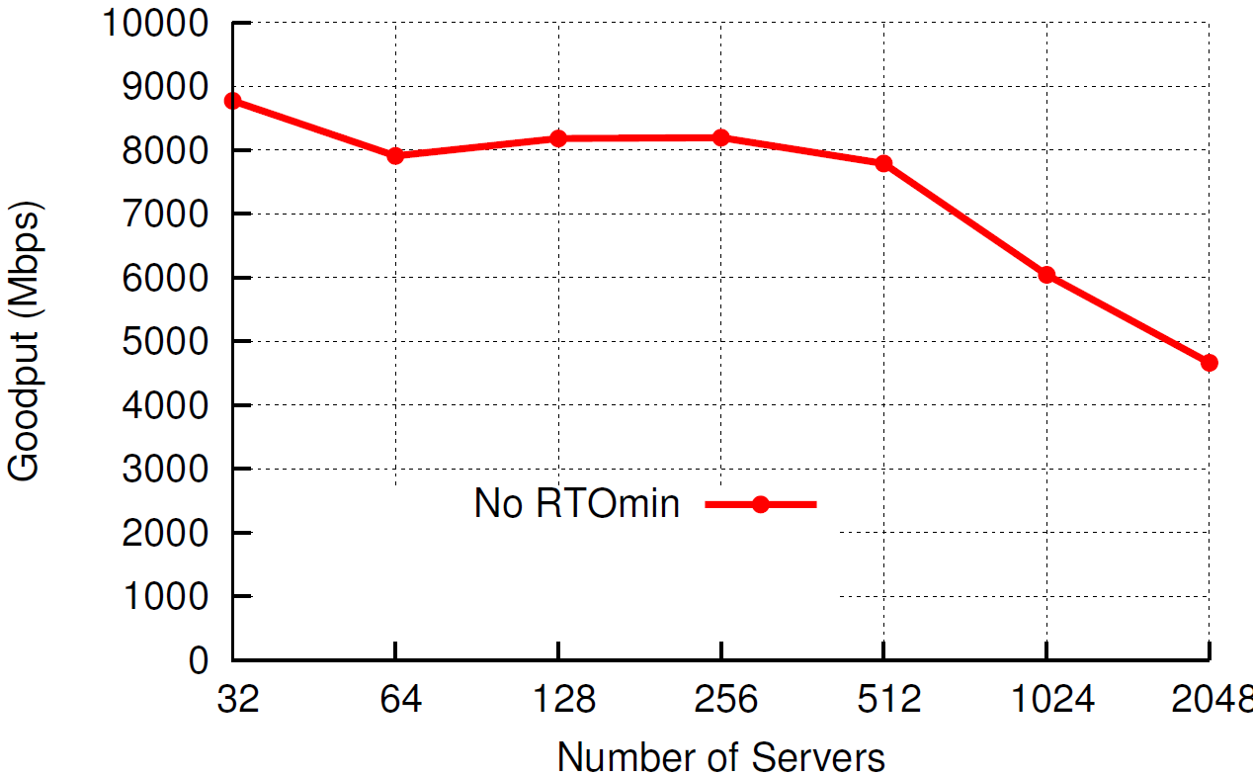
Simulation: Scaling to thousands
Block Size = 80MB, Buffer = 32KB, RTT = 20us
Notes:
Block size = 80MB, buffer = 32KB, RTT = 20us (next generation datacenters)

Slide 43
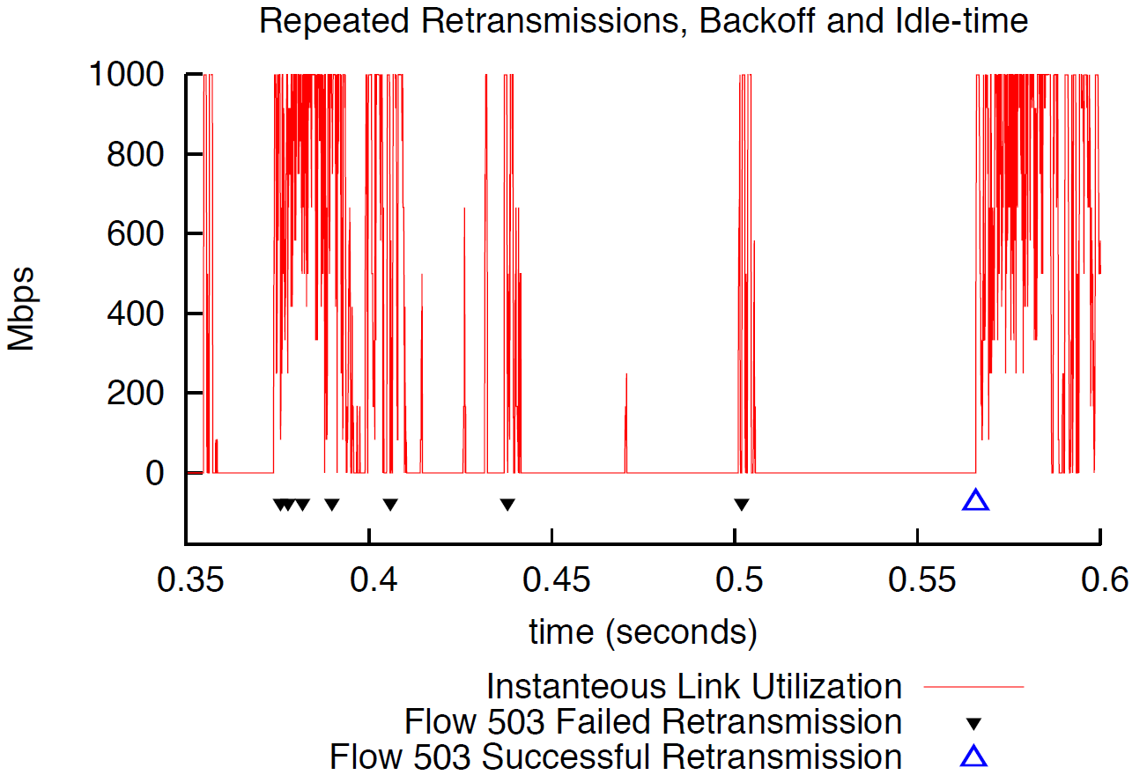
Synchronized Retransmissions At Scale
Simultaneous retransmissions → successive timeouts
Successive RTO = RTO * 2^{backoff}
Notes:
Simultaneous timeouts/retransmissions from different servers results in successive timeouts. Successive timeouts result in an exponential deterministic backoff. In the equation above “backoff” starts at 1.

Slide 44
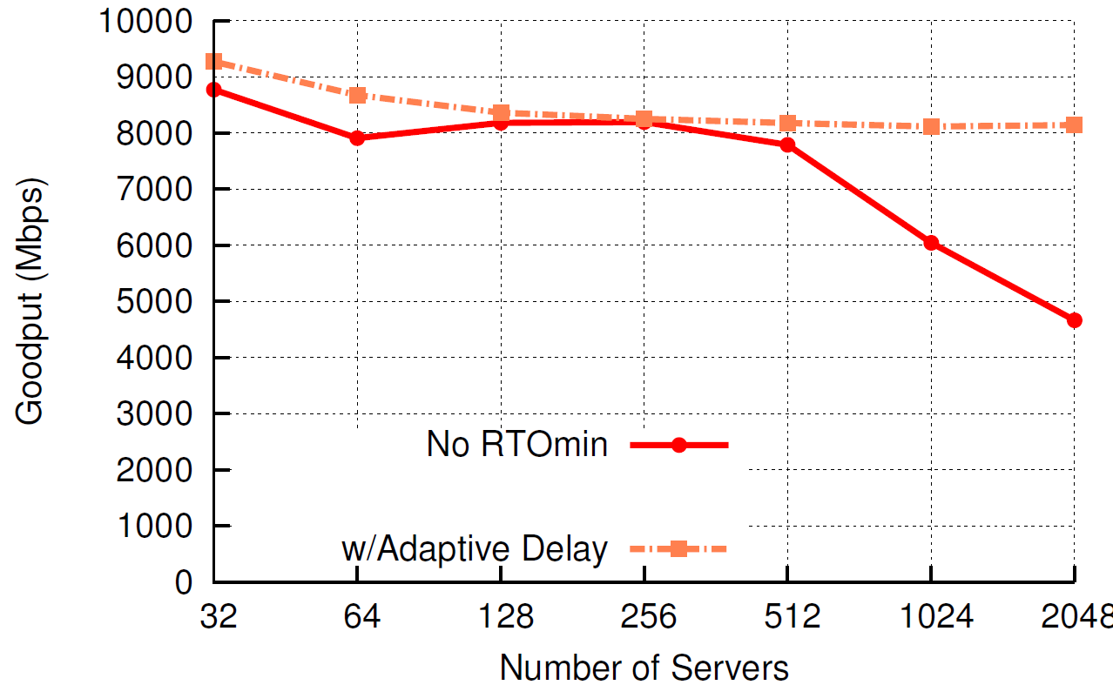
Simulation: Scaling to thousands
Desynchronize retransmissions to scale further
Successive RTO = (RTO + (rand(0.5)*RTO) ) * 2^{backoff}
For use within datacenters only
Notes:
Block size = 80MB, buffer = 32KB, RTT = 20us
Desynchronizing retransmissions help get rid of the drop in throughput and enables us to scale to thousands of servers.

Slide 45
Outline
Overview
Why are TCP timeouts expensive?
The Incast Workload
Solution: Microsecond TCP Retransmissions
Is the solution safe?
Interaction with Delayed-ACK within datacenters
Performance in the wide-area
Notes:
This solution is effective, but is it safe? To answer this question we have to address 2 concerns
Interaction of this fix with delayed-ack within datacenters
Safety in the wide-area

Slide 46
Delayed-ACK (for RTO > 40ms)
Seq #
Seq #
Seq #
1
1
1
2
2
Ack 2
Ack 0
40ms
Ack 1
Sender
Receiver
Sender
Receiver
Sender
Receiver
Delayed-Ack: Optimization to reduce #ACKs sent
Notes:
Explanation of Delayed ACK specification.

Slide 47
µsecond RTO and Delayed-ACK
RTO > 40ms
RTO < 40ms
Seq #
Seq #
1
1
Timeout
Retransmit packet
1
40ms
Ack 1
Ack 1
Sender
Receiver
Sender
Receiver
Premature Timeout
RTO on sender triggers before Delayed-ACK on receiver
Notes:
Premature timeouts slow the rate of transfer (timeouts still result in {slow start + congestion avoidance}).

Slide 48
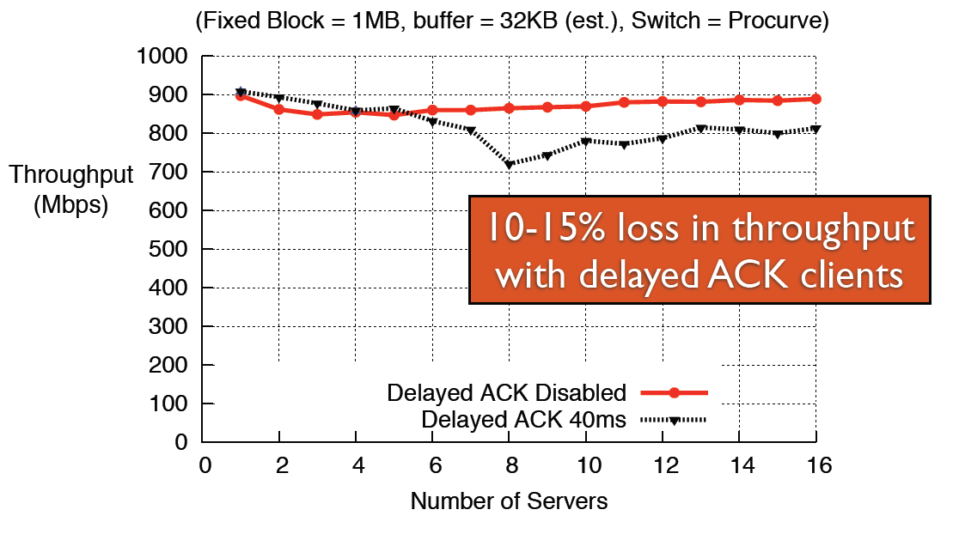
Impact of Delayed-ACK

Slide 49
Safe for the wide-area?
Stability: Could we cause congestion collapse?
No: Wide-area RTOs are in 10s, 100s of ms
No: Timeouts result in rediscovering link capacity (slow down the rate of transfer)
Performance: Do we timeout unnecessarily?
[Allman99] Reducing minRTO increases the chance of premature timeouts
Premature timeouts slow transfer rate
Today: detect and recover from premature timeouts
Wide-area experiments to determine performance impact
Notes:
Allman et. al said that reducing minRTO results in an increase in premature timeouts.
The reason why a premature timeout would occur in such a setting would be because of a sudden jump/increase in RTT, from it steady state value. Such a jump would most probably be caused by a significant path change in the wide area. We have reason to believe that such changes are not a common occurrence in the wide area today.
Also, premature timeouts just slow the rate of transfer (timeouts still result in {slow start + congestion avoidance}).
Premature timeouts are less harmful today
Can detect them using the tcp timestamp option - if we get an ack for a seq number that we retransmitted due to a timeout, but it has a timestamp of the first packet with this seq number that we transmitted, then we know we experienced a premature timeout.
Can recover from them (F-RTO) – If we detect a premature timeout, exit slow start and enter congestion avoidance (with cwnd = cwnd_before_timeout / 2)
Both implemented widely!

Slide 50

Wide-area Experiment
BitTorrent
Seeds
BitTorrent
Clients
Microsecond TCP
+
No minRTO
Standard TCP
Do microsecond timeouts harm wide-area throughput?

Slide 51
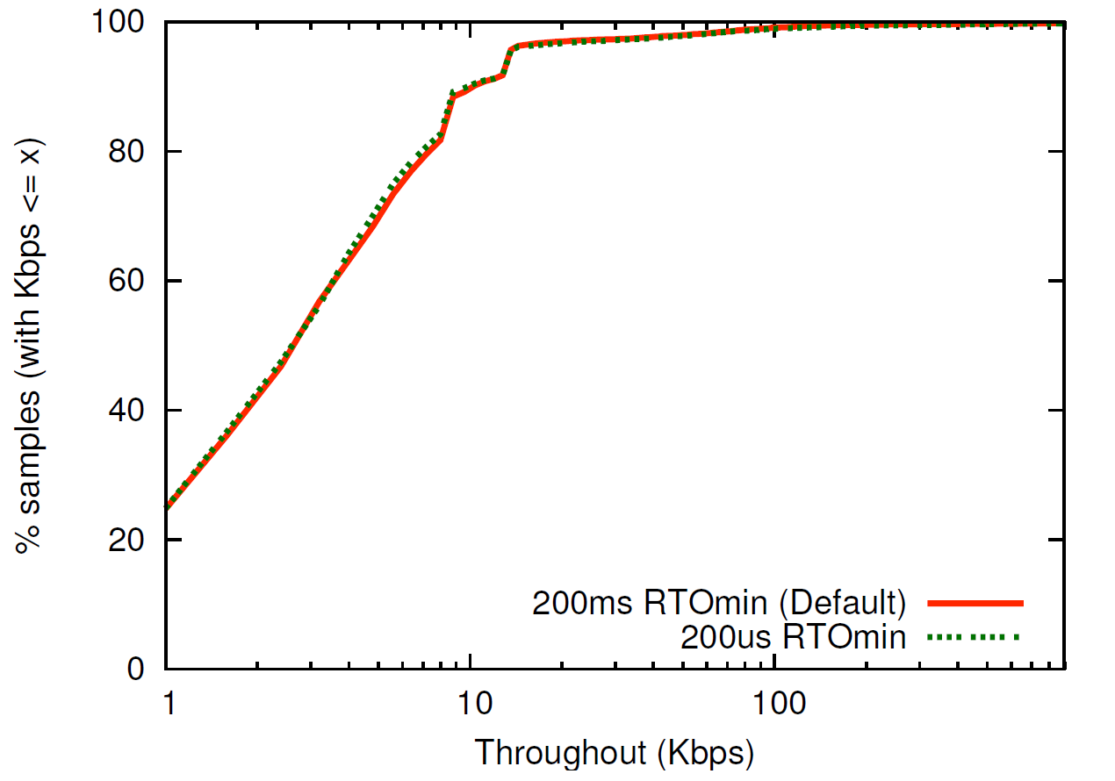
Wide-area Experiment: Results
No noticeable difference in throughput

Slide 52
Recap
Microsecond granularity TCP timeouts (with no minRTO) improve datacenter application response time and throughput
Safe for wide-area communication
Linux patch: http://www.cs.cmu.edu/~vrv/incast/
Notes:
In summary …
Microsecond granularity timeouts solves the problem of TCP Throughput Collapse
Fine-grained timeouts are necessary to improve the response time of latency-sensitive applications
Fine-grained timeouts are safe for use in the wide-area
A Linux patch with changes to the TCP implementation incorporating fine-grained timers is available at the URL shown.
Grab the patch: It is time to fix those ailing TCP stacks in your datacenters.

Slide 53
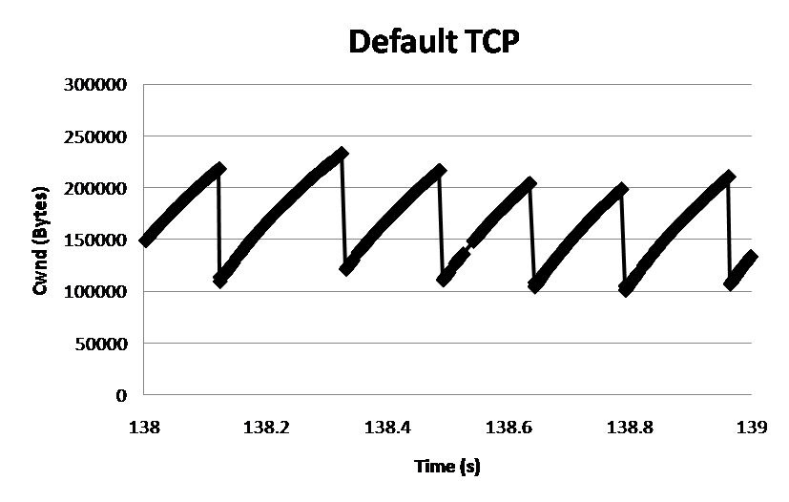
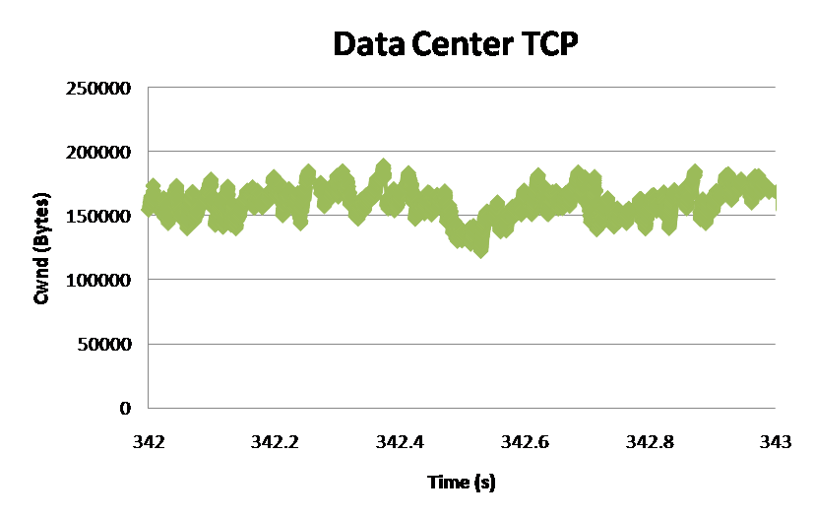
DCTCP: Main Idea
Extract multi-bit feedback from single-bit stream of ECN marks
Reduce window size based on fraction of marked packets.
ECN Marks | TCP | DCTCP
1 0 1 1 1 1 0 1 1 1 | Cut window by 50% | Cut window by 40%
0 0 0 0 0 0 0 0 0 1 | Cut window by 50% | Cut window by 5%
TCP
DCTCP
Window Size (Bytes)
Window Size (Bytes)
Time (sec)
Time (sec)
Notes:
Start with: “How can we extract multi-bit information from single-bit stream of ECN marks?”
- Standard deviation: TCP (33.6KB), DCTCP (11.5KB)

Slide 54
DCTCP: Algorithm
B
K
Don’t
Mark
Switch side:
Mark packets when Queue Length > K.
Mark
Sender side:
Maintain running average of fraction of packets marked (α).
Adaptive window decreases:
Note: decrease factor between 1 and 2.
Notes:
very simple marking mechanism
not all the tunings other aqms have
on the source side, the source is tryign to estimate the fraction of packets getting marked
using the obs that there is a stream of ecn marks coming back – more info in the stream than in any single bit
trying to maintain smooth rate variations to operate well even when using shallow buffers, and only a few flows (no stat mux)
F over the last RTT. In TCP there is always a way to get the next RTT from the window size. Comes from the self-clocking of TCP.
Only changing the decrease. Simplest version – makes a lot of sense. So generic could apply it to any algorithm – CTCP, CUBIC – how to cut its window leaving increase part to what it already does. Have to be careful here.

Slide 55
DCTCP vs TCP
Experiment: 2 flows (Win 7 stack), Broadcom 1Gbps Switch
Buffer is mostly empty
(KBytes)
DCTCP mitigates Incast by creating a
large buffer headroom
ECN Marking Thresh = 30KB

Slide 56
Why it Works
Low Latency
Small buffer occupancies → low queuing delay
2. High Throughput
ECN averaging → smooth rate adjustments, low variance
3. High Burst Tolerance
Large buffer headroom → bursts fit
Aggressive marking → sources react before packets are dropped

Slide 57
Evaluation
Implemented in Windows stack.
Real hardware, 1Gbps and 10Gbps experiments
90 server testbed
Broadcom Triumph 48 1G ports – 4MB shared memory
Cisco Cat4948 48 1G ports – 16MB shared memory
Broadcom Scorpion 24 10G ports – 4MB shared memory
Numerous micro-benchmarks
– Throughput and Queue Length
– Multi-hop
– Queue Buildup
– Buffer Pressure
Bing cluster benchmark
– Fairness and Convergence
– Incast
– Static vs Dynamic Buffer Mgmt

Slide 58
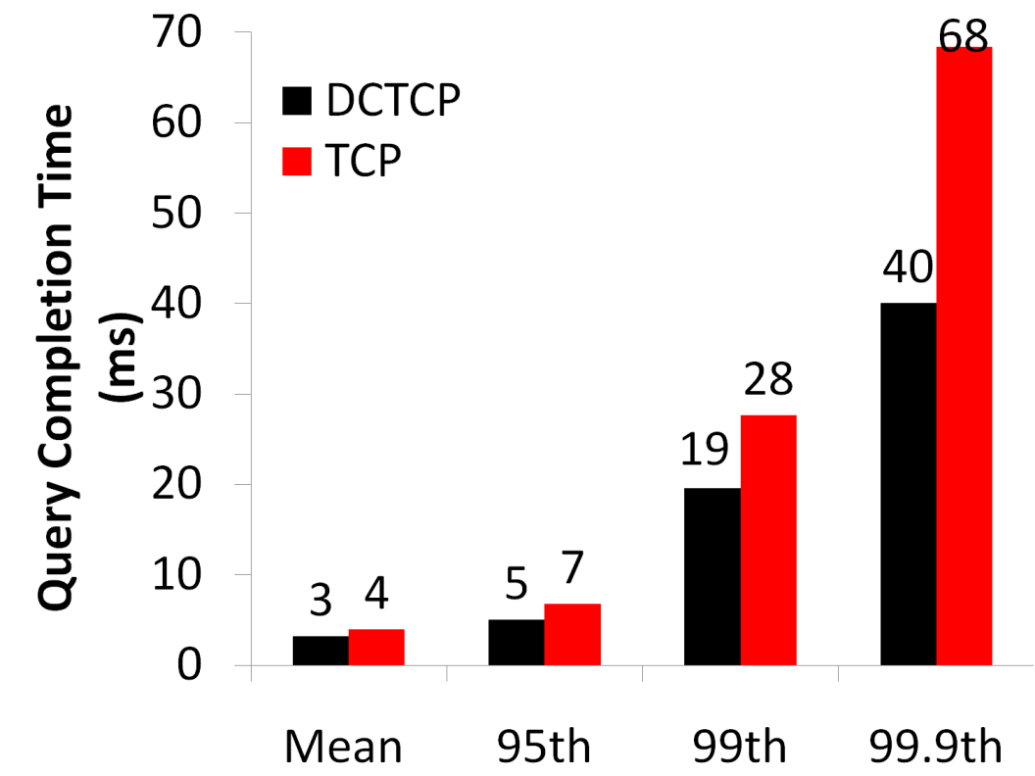
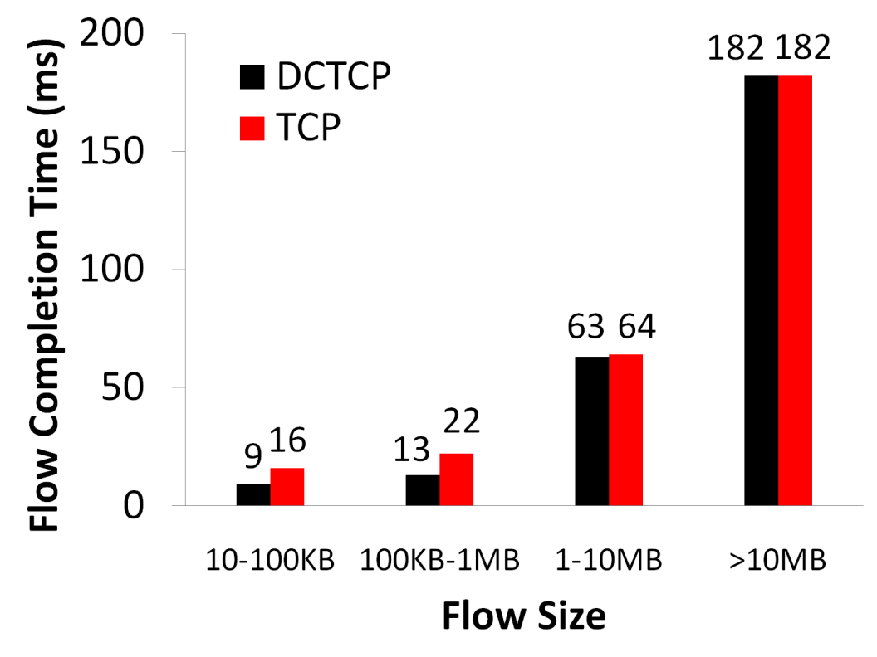
Bing Benchmark (baseline)
Background Flows
Query Flows
Notes:
To transition to scaled traffic: people always want to get more out of their network.

Slide 59
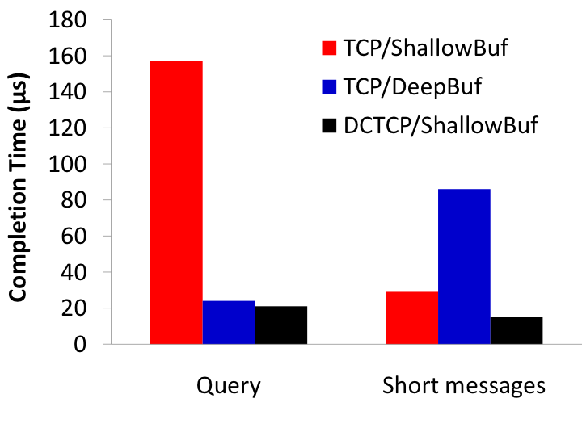
Bing Benchmark (scaled 10x)
Incast
Deep buffers fix incast, but increase latency
DCTCP good for both incast & latency
Completion Time (ms)
Query Traffic
(Incast bursts)
Short messages
(Delay-sensitive)
Notes:
Emphasize that these are two traffic classes within same experiment

Slide 60
A bit of Analysis
B
K
How much buffering does DCTCP need for 100% throughput?
Need to quantify queue size oscillations (Stability).
Packets sent in this
RTT are marked.
Window Size
W*+1
W*
(W*+1)(1-α/2)
Time

Slide 61
A bit of Analysis
B
K
How small can queues be without loss of throughput?
Need to quantify queue size oscillations (Stability).
for TCP:
K > C x RTT
K > (1/7) C x RTT

Slide 62
Convergence Time
DCTCP takes at most ~40% more RTTs than TCP
“Analysis of DCTCP: Stability, Convergence, and Fairness,” SIGMETRICS 2011
Intuition: DCTCP makes smaller adjustments than TCP, but makes
them much more frequently
TCP
DCTCP
Notes:
In the first part of the talk, we established that what we need from DCTCP is to maintain small queues, without loss of throughput
Now in the case of TCP, the question of how much buffering is needed for high throughput has been studied and is known in the literature as the buffer sizing problem.
… and I’ll show you how to get low var…

Slide 63



Datacenters and OLDIs
OLDI = OnLine Data Intensive applications
e.g., Web search, retail, advertisements
An important class of datacenter applications
Vital to many Internet companies
OLDIs are critical datacenter applications

Slide 64
Challenges from OLDIs
Two important properties:
Deadline bound (e.g., 300 ms)
Missed deadlines affect revenue
Fan-in bursts
Large data, 1000s of servers
Tree-like structure (high fan-in)
Fan-in bursts → long “tail latency”
Network shared with many apps (OLDI and non-OLDI)
Network must meet deadlines & handle fan-in bursts

Slide 65
Prior Approaches
TCP: deadline agnostic, long tail latency
Congestion → timeouts (slow), ECN (coarse)
Datacenter TCP (DCTCP) [SIGCOMM '10]
first to comprehensively address tail latency
Finely vary sending rate based on extent of congestion
shortens tail latency, but is not deadline aware
~25% missed deadlines at high fan-in & tight deadlines
DCTCP handles fan-in bursts, but is not deadline-aware

Slide 66
D²TCP’s Contributions
Deadline-aware and handles fan-in bursts
Elegant gamma-correction for congestion avoidance
far-deadline → back off more
near-deadline → back off less
Reactive, decentralized, state (end hosts)
Does not hinder long-lived (non-deadline) flows
Coexists with TCP → incrementally deployable
No change to switch hardware → deployable today
D²TCP achieves 75% fewer missed
deadlines than DCTCP

Slide 67
Background on OLDIs
OLDI = OnLine Data Intensive applications
Deadline bound, handle large data
Partition-aggregate
Tree-like structure
Root node sends query
Leaf nodes respond with data
Deadline budget split among nodes and network
E.g., total = 300 ms, parents-leaf RPC = 50 ms
Missed deadlines → incomplete responses
→ affect user experience & revenue

Slide 68
Long Tail Latency in OLDIs
Large data → High Fan-in degree
Fan-in bursts
Children respond around same time
Packet drops: Increase tail latency
Hard to absorb in buffers
Cause many missed deadlines
Current solutions either
Over-provision the network → high cost
Increase network budget → less compute time
Current solutions are insufficient

Slide 69
Main Idea of D²TCP
Deadline-aware and handles fan-in bursts
Key Idea: Vary sending rate based on both deadline and extent of congestion
Built on top of DCTCP
Distributed: uses per-flow state at end hosts
Reactive: senders react to congestion
no knowledge of other flows

Slide 70
D²TCP: Congestion Avoidance
A D²TCP sender varies sending window (W) based on both extent of congestion and deadline
Note: Larger p ⇒ smaller window when p>0; p = 1 ⇒ W/2.
when p = 0 ⇒ W=W+1 (no loss)
W := W * ( 1 – p / 2 )
P is our gamma correction function

Slide 71
D²TCP: Gamma Correction Function
Gamma Correction (p) is a function of congestion & deadlines
α: extent of congestion, same as DCTCP’s α (0 ≤ α ≤ 1)
d: deadline imminence factor
“completion time with window (W)” ÷ “deadline remaining”
d < 1 for far-deadline flows, d > 1 for near-deadline flows
p = α^{d}

Slide 72
Gamma Correction Function (cont.)
d = 1
d < 1 (far deadline)
d > 1 (near deadline)
Key insight: Near-deadline flows back off less
while far-deadline flows back off more
d < 1 for far-deadline flows
→ p large → shrink window
d > 1 for near-deadline flows
→ p small → retain window
Long lived flows → d = 1
→ DCTCP behavior
W := W * ( 1 – p / 2 )
p = α^{d}
1.0
far
p
d = 1
near
α
1.0
Gamma correction elegantly combines congestion and deadlines

Slide 73
Gamma Correction Function (cont.)
α is calculated by aggregating ECN (like DCTCP)
Switches mark packets if queue_length > threshold
ECN enabled switches common
Sender computes the fraction of marked packets averaged over time
Threshold

Slide 74
Gamma Correction Function (cont.)
The deadline imminence factor (d):
“completion time with window (W)” ÷ “deadline remaining” (d = T_{c} / D)
B → Data remaining, W → Current Window Size
Avg. window size ~= 3⁄4 * W ⇒ T_{c} ~= B ⁄ (3⁄4 * W)

Slide 75
D²TCP: Stability and Convergence
W := W * ( 1 – p / 2 )
p = α^{d}
D²TCP’s control loop is stable
Poor estimate of d corrected in subsequent RTTs
When flows have tight deadlines (d >> 1)
d is capped at 2.0 → flows not over aggressive
As α (and hence p) approach 1, D²TCP defaults to TCP
→ D²TCP avoids congestive collapse

Slide 76
D²TCP: Practicality
Does not hinder background, long-lived flows
Coexists with TCP
Incrementally deployable
Needs no hardware changes
ECN support is commonly available
D²TCP is deadline-aware, handles fan-in bursts, and is deployable today

Slide 77

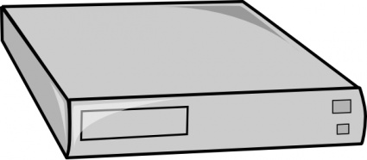
Real Implementation
Rack
16 machines connected to ToR
24x 10Gbps ports
4 MB shared packet buffer
Publicly available DCTCP code
D²TCP → ~100 lines of code over DCTCP
ToR Switch
Servers

Slide 78
D²TCP: Deadline-aware Scheduling
DCTCP → All flows get same b/w irrespective of deadline
D²TCP → Near-deadline flows get more bandwidth

Slide 79
At-Scale Simulation
Fabric Switch
Racks
1000 machines
→ 25 Racks x 40 machines-per-rack
Fabric switch is non-blocking
→ simulates fat-tree

Slide 80
Workloads
5 synthetic OLDI applications
Message size distribution from DCTCP paper
Message sizes: {2,6,10,14,18} KB
Deadlines calibrated to match DCTCP paper results
Deadlines: {20,30,35,40,45} ms
Use random assignment of threads to nodes
Long-lived flows sent to root(s)
Network utilization at 10-20% → typical of datacenters

Slide 81
Missed Deadlines
D²TCP
At fan-in of 40, DCTCP misses ~25% deadlines
At fan-in of 40, D²TCP misses ~7% deadlines

Slide 82
Recap on D²TCP
D²TCP is deadline-aware and handles fan-in bursts
Does not hinder background, long-lived flows
Coexists with TCP
Incrementally deployable
Needs no hardware changes
D²TCP is an elegant and practical solution to the challenges posed by OLDIs

Slide 83
Summary
TCP transport layer design is important for data center networks and cloud computing
People have devised minor changed to improve the performance

