Slide 1
RDMA in Data Centers
SIGCOMM
With slides from Chuanxiong Guo et al.

Slide 2
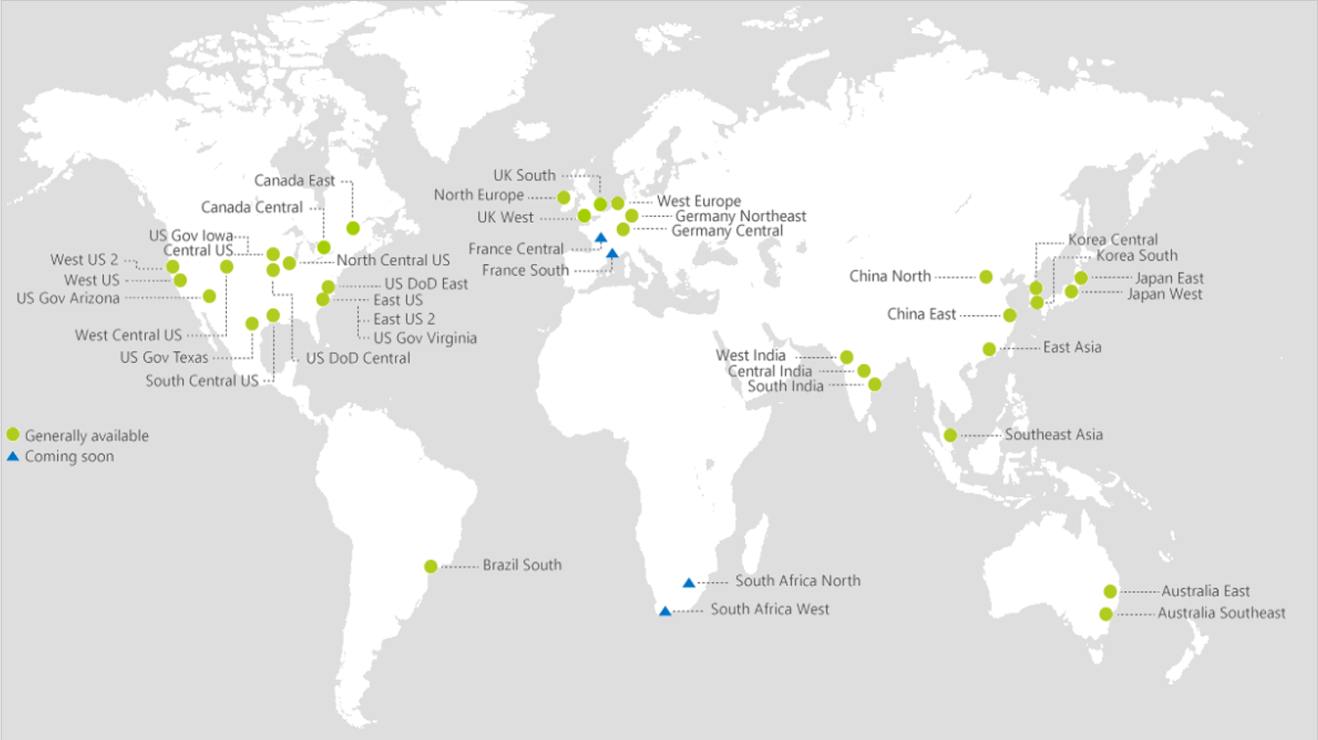
The Rising of Cloud Computing
40
AZURE REGIONS

Slide 3
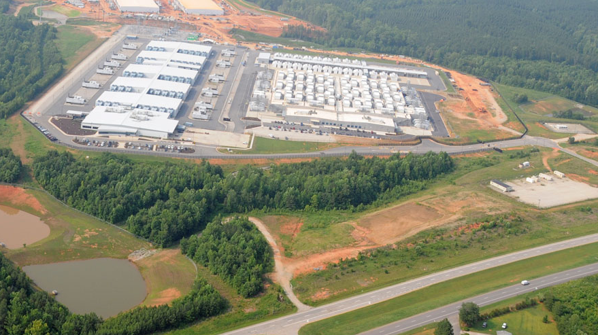
Data Centers

Slide 4
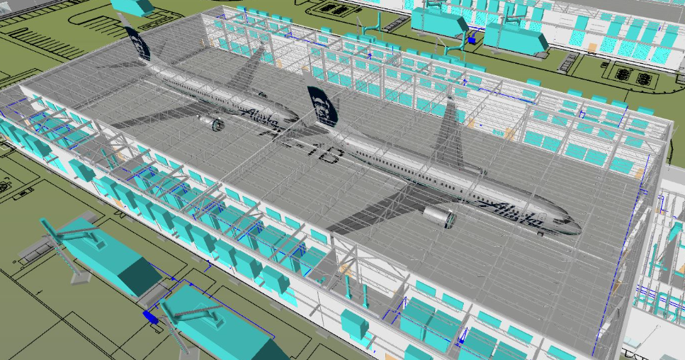
Data Centers

Slide 5
Data center networks (DCN)
Cloud scale services: IaaS, PaaS, Search, BigData, Storage, Machine Learning, Deep Learning
Services are latency sensitive or bandwidth hungry or both
Cloud scale services need cloud scale computing and communication infrastructure

Slide 6
Data center networks (DCN)
Spine
Single ownership
Large scale
High bisection bandwidth
Commodity Ethernet switches
TCP/IP protocol suite
Podset
Leaf
Pod
ToR
Servers

Slide 7
But TCP/IP is not doing well

Slide 8
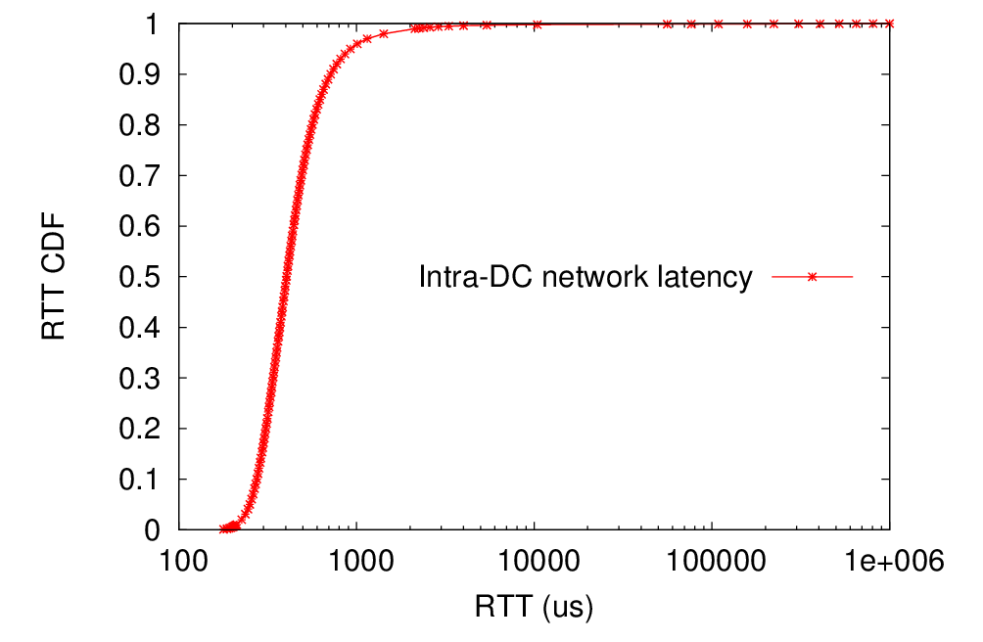
TCP latency
Long latency tail
2132us (P99)
716us (P90)
Pingmesh measurement results
405us (P50)

Slide 9
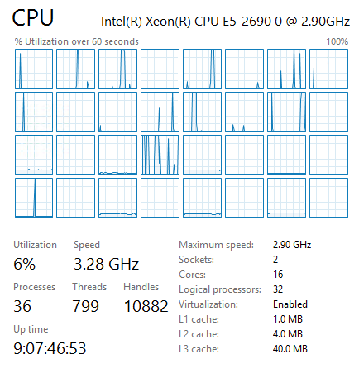
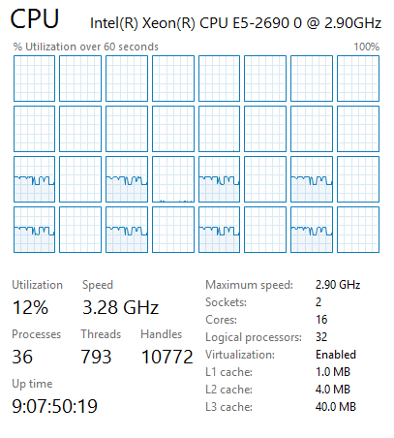
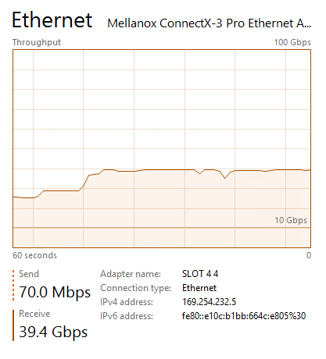
TCP processing overhead (40G)
Sender
Receiver
8 tcp connections
40G NIC

Slide 10
An RDMA renaissance story

Slide 11
RDMA
Remote Direct Memory Access (RDMA): Method of accessing memory on a remote system without interrupting the processing of the CPU(s) of that system
RDMA offloads packet processing protocols to the NIC
RDMA features:
Remote
data transfers between nodes in a network
Direct
no Operating System Kernel involvement in transfers
everything about a transfer offloaded onto Interface Card
Memory
transfers between user space application virtual memory
no extra copying or buffering
Access
send, receive, read, write, atomic operations

Slide 12
RDMA Evolutions
InfiniBand – (41.8% of top 500 supercomputers) (1997)
SDR 4x – 8 Gbps
DDR 4x – 16 Gbps
QDR 4x – 32 Gbps
FDR 4x – 54 Gbps
iWarp – Internet Wide Area RDMA Protocol (2010)
10 Gbps
RoCE – RDMA over Converged Ethernet (2014)
10 Gbps
40 Gbps

Slide 13
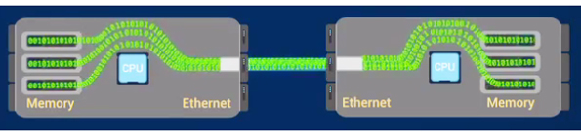
RDMA Illustration

Slide 14
RDMA Layering
User Application
OFA Verbs API
OSI
Layers
RDMAP
DDP
Transport
MPA
IB Transport API
TCP
IB Transport
Network
IP
IB Network
Data Link
Ethernet MAC & LLC
IB Link
Physical
Ethernet PHY
IB PHY
IWARP “RNIC”
RoCE “NIC”
InfiniBand “HCA”

Slide 15
Software RDMA Drivers
Softiwarp
www.zurich.ibm.com/sys/rdma
open source kernel module that implements iWARP protocols on top of ordinary kernel TCP sockets
interoperates with hardware iWARP at other end of wire
Soft RoCE
www.systemfabricworks.com/downloads/roce
open source IB transport and network layers in software over ordinary Ethernet
interoperates with hardware RoCE at other end of wire

Slide 16
Comparisons between TCP and RDMA
Common features:
Both utilize the client-server model
Both require a connection for reliable transport
Both provide a reliable transport mode
TCP provides a reliable in-order sequence of bytes
RDMA provides a reliable in-order sequence of messages
Differences:
“zero copy” – data transferred directly from virtual memory on one node to virtual memory on another node
“kernel bypass” – no operating system involvement during data transfers
asynchronous operation – threads not blocked during I/O transfers

Slide 17
TCP/IP Setup
client
server
setup
setup
bind
User
App
listen
User
App
connect
accept
Kernel
Stack
Kernel
Stack
CA
CA
Wire
Wire
blue lines: control information
red lines: user data
green lines: control and data

Slide 18
RDMA Setup
client
server
setup
setup
rdma_
connect
rdma_bind
User
App
rdma_listen
User
App
rdma_accept
Kernel
Stack
Kernel
Stack
CA
CA
Wire
Wire
blue lines: control information
red lines: user data
green lines: control and data

Slide 19
TCP/IP Data Transfer
client
server
setup
transfer
transfer
setup
data
data
bind
User
App
listen
User
App
connect
send
copy
recv
accept
copy
Kernel
Stack
data
data
Kernel
Stack
CA
CA
Wire
Wire
blue lines: control information
red lines: user data
green lines: control and data

Slide 20
RDMA Data Transfer
client
server
setup
transfer
transfer
setup
rdma_
connect
rdma_
post_
send
data
data
rdma_
post_
recv
rdma_bind
User
App
rdma_listen
User
App
rdma_accept
Kernel
Stack
Kernel
Stack
CA
CA
Wire
Wire
blue lines: control information
red lines: user data
green lines: control and data

Slide 21
RoCEv2: RDMA over Commodity Ethernet
RDMA app
RDMA app
User
RoCEv2 for Ethernet based data centers
RoCEv2 encapsulates packets in UDP
OS kernel is not in data path
NIC for network protocol processing and message DMA
RDMA verbs
RDMA verbs
TCP/IP
TCP/IP
Kernel
NIC driver
NIC driver
RDMA transport
RDMA transport
DMA
DMA
Hardware
IP
IP
Ethernet
Ethernet
Lossless network

Slide 22
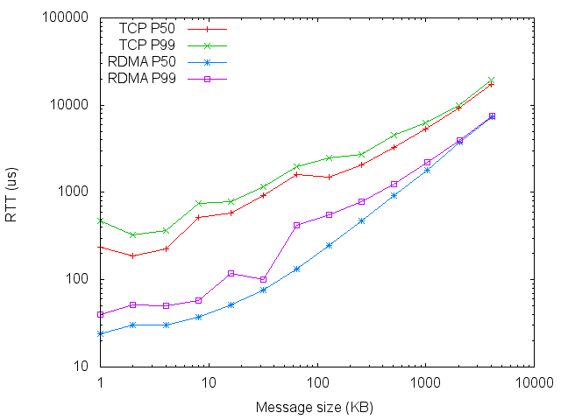
RDMA benefit: latency reduction
Msg size | TCP P50 (us) | TCP P99 (us) | RDMA P50 (us) | RDMA P99 (us)
1KB | 236 | 467 | 24 | 40
16KB | 580 | 788 | 51 | 117
128KB | 1483 | 2491 | 247 | 551
1MB | 5290 | 6195 | 1783 | 2214
For small msgs (<32KB), OS processing latency matters
For large msgs (100KB+), speed matters

Slide 23
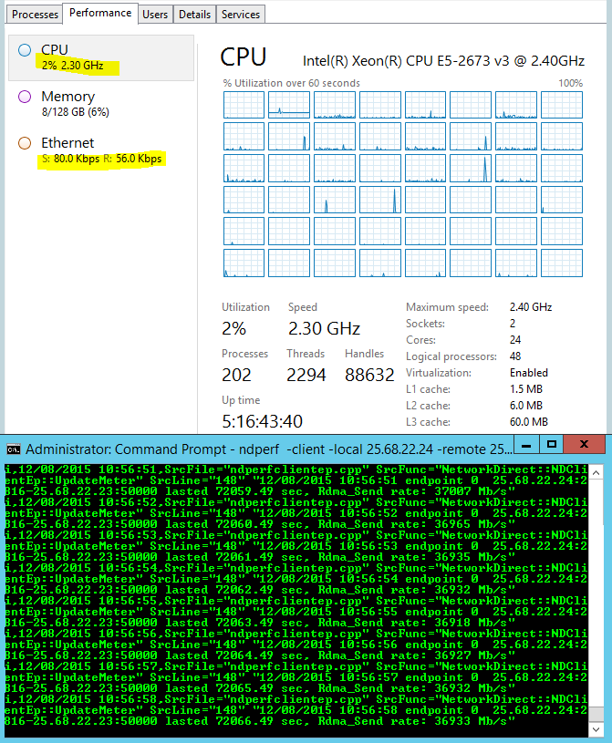
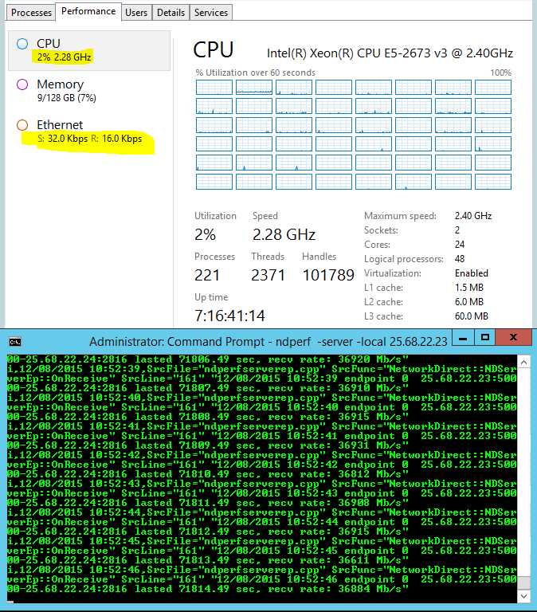
RDMA benefit: CPU overhead reduction
Sender
Receiver
One ND connection
40G NIC
37Gb/s goodput

Slide 24
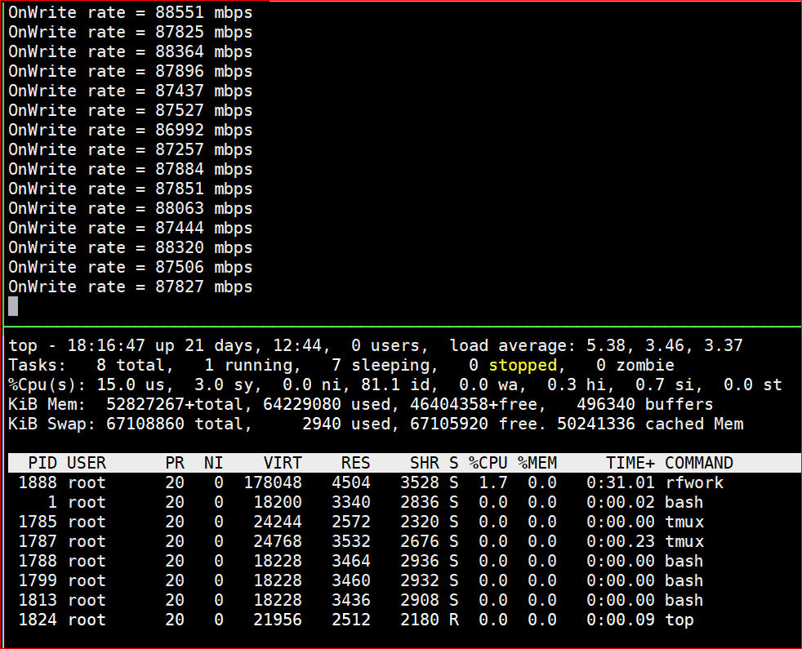
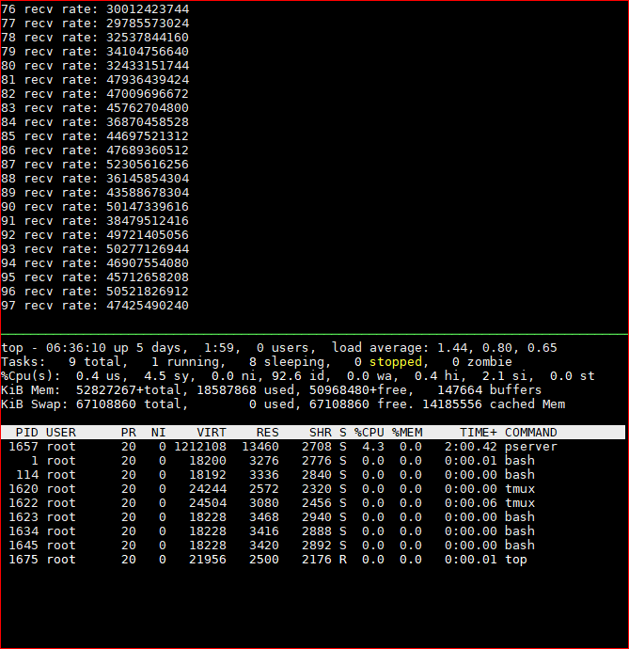
RDMA benefit: CPU overhead reduction
Intel(R) Xeon(R) CPU E5-2690 v4 @ 2.60GHz, two sockets 28 cores
RDMA: Single QP, 88 Gb/s, 1.7% CPU
TCP: Eight connections, 30-50Gb/s,
Client: 2.6%, Server: 4.3% CPU

Slide 25
RoCEv2 needs a lossless Ethernet network
PFC for hop-by-hop flow control
DCQCN for connection-level congestion control

Slide 26
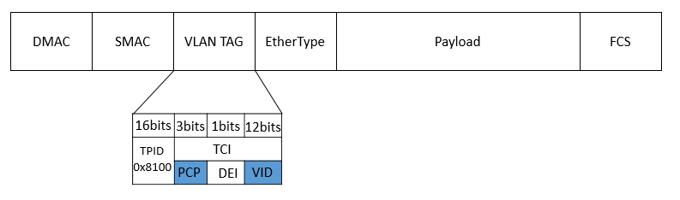

Priority-based flow control (PFC)
Egress port
Ingress port
Data packet
Hop-by-hop flow control, with eight priorities for HOL blocking mitigation
The priority in data packets is carried in the VLAN tag or DSCP
PFC pause frame: inform the upstream to stop
p0
p0
p0
p1
p1
p1
p7
PFC pause frame
p7
XOFF threshold
Data packet
PFC pause frame

Slide 27
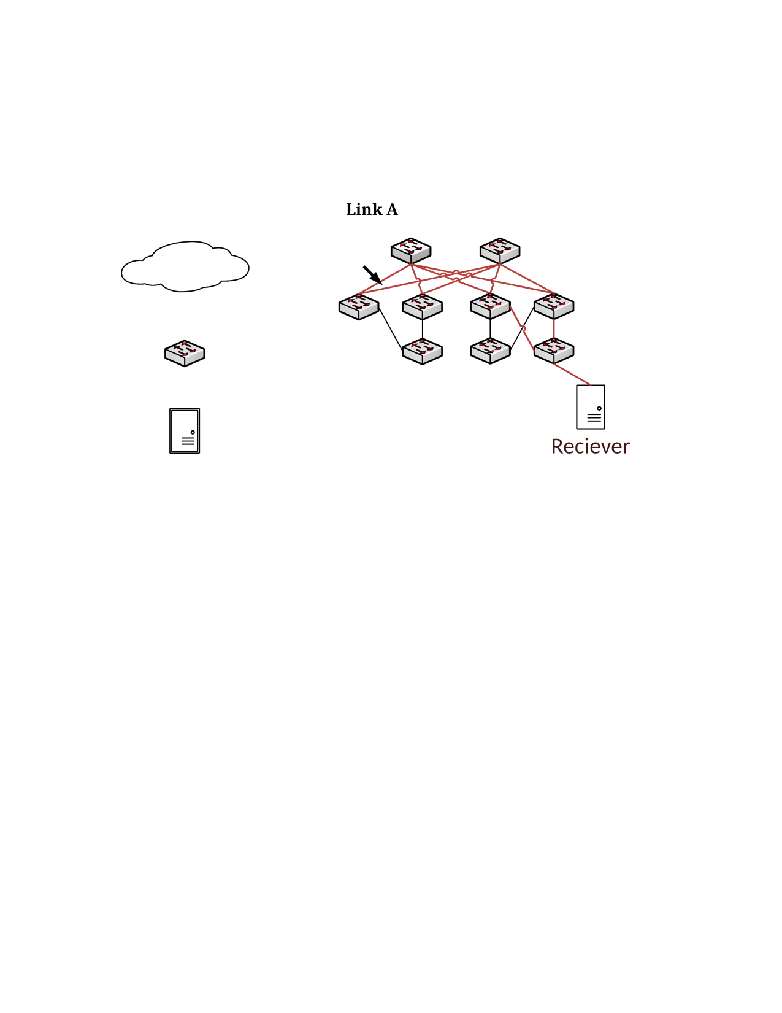
DCQCN
Sender NIC
Reaction Point
(RP)
Switch
Congestion Point (CP)
Receiver NIC
Notification Point (NP)
DCQCN = Keep PFC + Use ECN + hardware rate-based congestion control
CP: Switches use ECN for packet marking
NP: periodically check if ECN-marked packets arrived, if so, notify the sender
RP: adjust sending rate based on NP feedbacks

Slide 28
The lossless requirement poses safety and performance challenges
RDMA transport livelock
PFC deadlock
PFC pause frame storm
Slow-receiver symptom

Slide 29
RDMA transport livelock
Receiver
Sender
Receiver
Sender
RDMA Send 0
RDMA Send 0
Switch
RDMA Send 1
RDMA Send 1
Pkt drop rate 1/256
RDMA Send N+1
RDMA Send N+1
Sender
Receiver
RDMA Send N+2
RDMA Send N+2
NAK N
NAK N
RDMA Send 0
RDMA Send N
RDMA Send 1
RDMA Send N+1
RDMA Send 2
RDMA Send N+2
Go-back-0
Go-back-N

Slide 30
PFC deadlock
Our data centers use Clos network
Packets first travel up then go down
No cyclic buffer dependency for up-down routing -> no deadlock
But we did experience deadlock!
Spine
Podset
Leaf
Pod
ToR
Servers

Slide 31
PFC deadlock
Two tables
ARP table: IP address to MAC address mapping
MAC table: MAC address to port mapping
Timeout values for table entries in the two tables are different
ARP Table: 4 hours
MAC table: 5 minutes
Consequence
Incomplete (i.e., missing) MAC table entries for some ports
If an MAC table entry is missing, packets are flooded to all ports
Input
ARP table
IP | MAC | TTL
IP0 | MAC0 | 2h
IP1 | MAC1 | 1h
MAC table
MAC | Port | TTL
MAC0 | Port0 | 5min
MAC1 | - | -
Dst: IP1
Output

Slide 32
PFC deadlock
Path: {S1, T0, La, T1, S3}
La
Lb
Path: {S1, T0, La, T1, S5}
p0
p1
p0
p1
Path: {S4, T1, Lb, T0, S2}
PFC pause frames
2
3
1
4
Congested port
p2
p3
p3
p4
Ingress
port
T0
T1
p0
p1
p0
p1
p2
Egress
port
Dead server
Packet drop
PFC pause frames
Server
S1
S2
S3
S4
S5

Slide 33
PFC deadlock
Root cause: the interaction between the PFC flow control and the Ethernet packet flooding (due to missing MAC forwarding table entry)
Lead to cyclic buffer dependency
Solution: drop those lossless packets if the ARP table entry is incomplete
Recommendation: do not flood or multicast for lossless traffic

Slide 34
NIC PFC pause frame storm
Spine layer
A malfunctioning NIC may block the whole network
PFC pause frame storms caused several incidents
Solution: watchdogs at both NIC and switch sides to stop the storm
Drop lossless packets
Stop pause frames
Podset 0
Podset 1
Leaf layer
ToRs
0
1
2
3
4
5
6
7
servers
Malfunctioning NIC

Slide 35
The slow-receiver symptom
ToR to NIC is 40Gb/s, NIC to server is 64Gb/s
But NICs may generate large number of PFC pause frames
Root cause: NIC is resource constrained
Mitigation
Large page size for the MTT (memory translation table) entry
Dynamic buffer sharing at the ToR switch
Server
CPU
DRAM
PCIe
Gen3 8x8 64Gb/s
QSFP
40Gb/s
WQEs
MTT
ToR
QPC
NIC
Pause frames

Slide 36
Deployment experiences and lessons learned

Slide 37
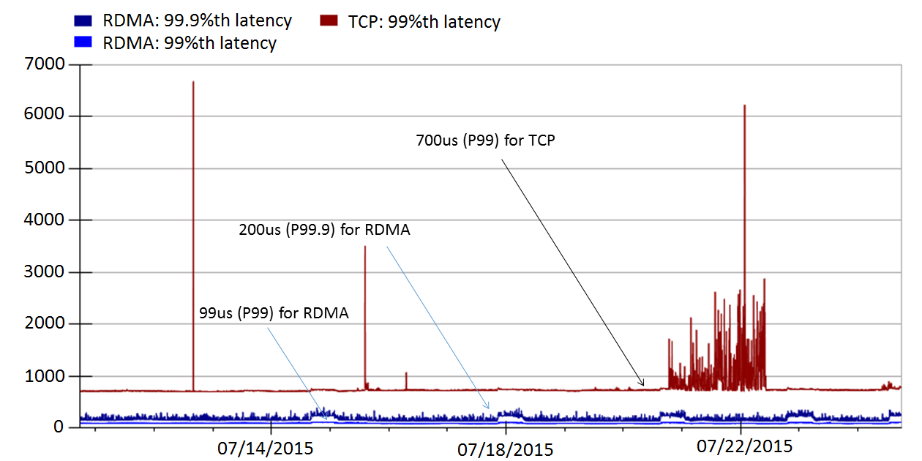
Latency reduction
RoCEv2 deployed in Bing world-wide for two and half years
Significant latency reduction
Incast problem solved as no packet drops

Slide 38
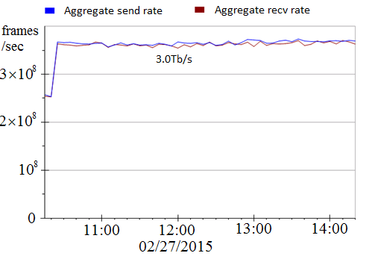
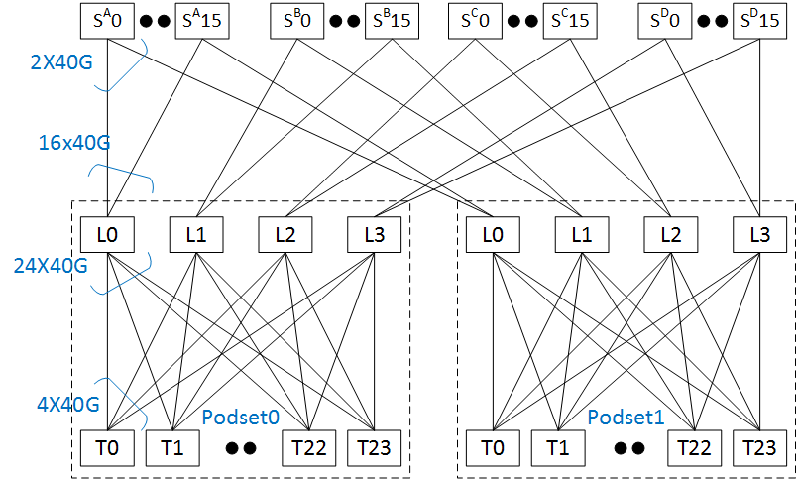
RDMA throughput
Using two podsets each with 500+ servers
5Tb/s capacity between the two podsets
Achieved 3Tb/s inter-podset throughput
Bottlenecked by ECMP routing
Close to 0 CPU overhead

Slide 39
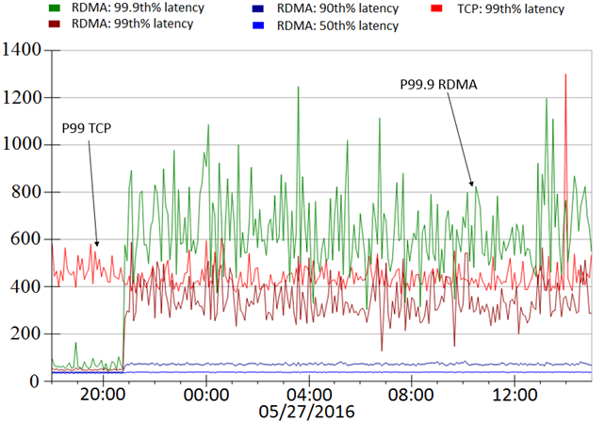
Latency and throughput tradeoff
us
L0
L1
L1
L1
T0
T1
S0,0
S0,23
S1,0
S1,23
RDMA latencies increase as data shuffling started
Low latency vs high throughput
Before data shuffling
During data shuffling

Slide 40
Lessons learned
Providing lossless is hard!
Deadlock, livelock, PFC pause frames propagation and storm did happen
Be prepared for the unexpected
Configuration management, latency/availability, PFC pause frame, RDMA traffic monitoring
NICs are the key to making RoCEv2 work

Slide 41
Future for RDMA?

Slide 42
Applications
Architectures
Software vs hardware
RDMA for X (Search, Storage, DNN, etc.)
Lossy vs lossless network
RDMA for heterogenous computing systems
Technologies
Protocols
RDMA programming
Practical, large-scale deadlock free network
RDMA virtualization
RDMA security
Reducing colleterial damage
Inter-DC RDMA

Slide 43
Will software win?
Historically, software-based packet processing won (multiple times)
TCP processing overhead analysis by David Clark, et al.
Non of the stateful TCP offloading took off (e.g., TCP Chimney)
The story is different this time
Moore’s law is ending
Accelerators are coming
Network speed keeps increasing
Demands for ultra low latency are real

Slide 44
Is lossless mandatory for RDMA?
There is no binding between RDMA and lossless network
But implementing more sophisticated transport protocol in hardware is a challenge

Slide 45
RDMA virtualization for the container networking
A router acts as a proxy for the containers
Shared memory for improved performance
Zero copy possible

Slide 46
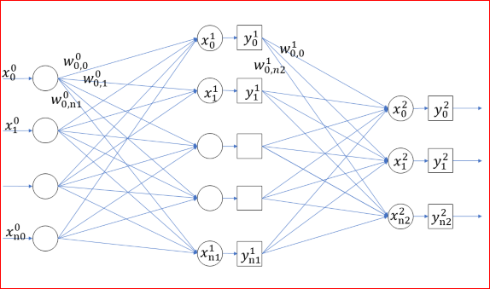
RDMA for DNN
TCP does not work for distributed DNN training
For 16-GPU, 2-host speech training with CNTK, TCP communications dominant the training time (72%), RDMA is much faster (44%)

Slide 47
RDMA Programming
How many LOC for a “hello world” communication using RDMA?
For TCP, it is 60 LOC for client or server code
For RDMA, it is complicated …
IBVerbs: 600 LOC
RCMA CM: 300 LOC
Rsocket: 60 LOC

Slide 48
RDMA Programming
Make RDMA programming more accessible
Easy-to-setup RDMA server and switch configurations
Can I run and debug my RDMA code on my desktop/laptop?
High quality code samples
Loosely coupled vs tightly coupled (Send/Recv vs Write/Read)

Slide 49
Summary: RDMA for data centers
RDMA is experiencing a renaissance in data centers
RoCEv2 has been running safely in Microsoft data centers for two and half years
Many opportunities and interesting problems for high-speed, low-latency RDMA networking
Many opportunities in making RDMA accessible to more developers

