Slide 1
Spanner: Google’s Globally-Distributed Database
OSDI’12

Slide 2
Motivation
SQL → NoSQL → NewSQL
Large-scale transactional databases
Eventual consistency is not good enough
Managing global money/warehouse/resources
Auctions, e.g., Google’s advertisement platform
Social networks, Twitter
We need external consistency model:
T(e₁(commit))< T(e₂(commit)) → s₁ < s₂

Slide 3
What is Spanner?
Get Externally Consistent View of Globally Distributed Multi-version database
General purpose Transactions (ACID)
SQL-like query language
Schematized tables
Semi-relational data model
Synchronized replication
Main Idea of Spanner
BigTable with timestamps + Paxos _TrueTime
In production
Storage for Google’s Ads data
Limitations of BigTable and Megastore

Slide 4
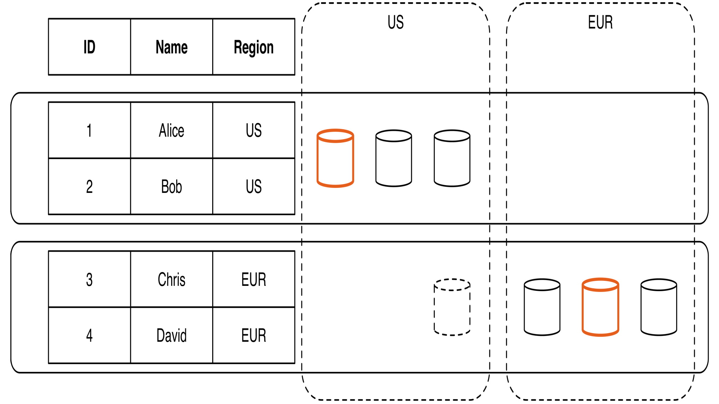
Globally Distributed Data
Cross-Datacenter
Distribution
User Configurable

Slide 5
Usage Example: Social Network
Sao Paulo
Santiago
Buenos Aires
x1000
San Francisco
Seattle
Arizona
Brazil
User posts
Friend lists
User posts
Friend lists
User posts
Friend lists
User posts
Friend lists
User posts
Friend lists
x1000
US
London
Paris
Berlin
Madrid
Lisbon
Moscow
Berlin
Krakow
x1000
x1000
Russia
Spain

Slide 6
Overview
Feature: Lock-free distributed read transactions
Property: Global external consistency of distributed transactions
First system at global scale
Implementation: integration of concurrency control, replication, and 2-phase commit (2PC)
Transparent movement of data
Enabling technology: TrueTime
Interval-based global time

Slide 7
Transaction Model
Two-Phase locking with start/commit
Transactional write and lock-free read
Globally sortable time stamp with each commit
Bounded error between timestamp and wall-clock time
start
commit
t
T₁: s₁
s₁: Timestamp

Slide 8
External Consistency
If a transaction T₁ commits before another transaction T₂ starts, then T₁'s commit timestamp s₁ is smaller than the commit timestamp s₂ for transaction T₂
A real-world approximation of global wall-clock time consistency
start
commit
start
commit
t
t
T₁: s₁
T₁: s₁
T₂: s₂
T₂: s₂
x
s₁ < s₂
s₁ < s₂

Slide 9
Read Transaction Example
Generate a page of friends’ recent posts
Consistent view of friend list and their posts
Why consistency matters:
Remove untrustworthy person X as friend
Post P: “My government is repressive…”

Slide 10
Single Machine
Block writes
Generate my page
Friend1 post
User posts
Friend lists
User posts
Friend lists
Friend2 post
…
Friend999 post
Friend1000 post

Slide 11
Multiple Machines
Block writes
User posts
Friend lists
User posts
Friend lists
Friend1 post
Friend2 post
…
Generate my page
User posts
Friend lists
Friend999 post
User posts
Friend lists
Friend1000 post

Slide 12
Serving Data from Multiple Datacenters
User posts
Friend lists
Friend1 post
x1000
US
User posts
Friend lists
Friend2 post
x1000
Spain
…
Generate my page
User posts
Friend lists
Friend999 post
x1000
Brazil
User posts
Friend lists
Friend1000 post
x1000
Russia

Slide 13
Version Management
Write transactions use strict 2PL
Each transaction T is assigned a timestamp s
Data written by T is timestamped with s
Time
<8
8
15
My friends
[X]
[]
My posts
[P]
X’s friends
[me]
[]

Slide 14
Synchronizing Snapshots
Global wall-clock time
==
External Consistency:
Commit order respects global wall-time order
==
Timestamp order respects global wall-time order
given
timestamp order == commit order

Slide 15
Timestamps, Global Clock
Strict two-phase locking (2PL) for write transactions
Background on 2PL: Concurrency control method to ensure serializability
Using locks applied by a transaction to data, thus blocking other transactions accessing the same data during the transaction’s life
Two phases: acquiring locks, releasing locks
Never acquire a lock before a lock has been released.
Release the write (exclusive) locks after the transaction has ended (i.e., being either committed or aborted)
Assign timestamp while locks are held
Acquired locks
Release locks
T
Pick s = now()

Slide 16
Timestamp Invariants
Timestamp order == commit order
T₁
T₂
Timestamp order respects global wall-time order
T₃
T₄

Slide 17
TrueTime
“Global wall-clock time” with bounded uncertainty
Do not trust synchronization via NTP
TrueTime API:
TT.now(): Interval [earliest, latest]
TT.after(t): true if t has definitely passed
TT.before(t): true if t has definitely not arrived
TT.now()
time
earliest
latest
2*ε

Slide 18
Commit Wait
Acquired locks
Release locks
T
Pick s = TT.now().latest
s
Wait until TT.now().earliest > s
Commit wait
average ε
average ε
What this gives you:
absolute start time < s < absolute commit time

Slide 19
From TrueTime to Consistency
Recall: what TrueTime gives you:
If there are two transactions:
start
commit
t
T₁: s₁
s₁ needs to be in this range
start
commit
t
s₁ < s₂
T₁: s₁
T₂: s₂
s₁ range
s₂ range

Slide 20
Supporting Read/Write Operations
Read-Write transaction
Paxos write
Commit wait
Read transaction with timestamp s
Lock-free
Every replica tracks t_{safe}
Safe time: max timestamp at which a replica is up to date
t_{safe} is the timestamp of the highest-applied Paxos write
Read from any replica with t_{safe} >= s
Other variants of read
Standalone read: read with t.now().latest
Read with bounded timestamp

Slide 21
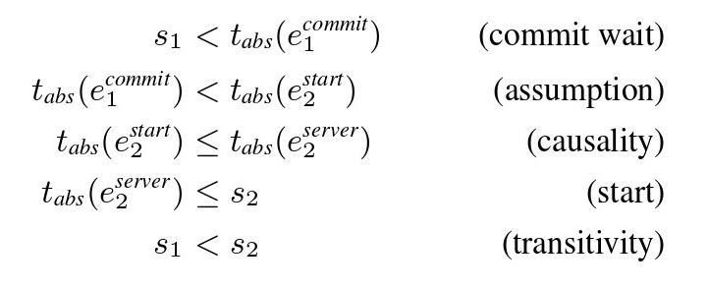
Interplay of Paxos and TrueTime
Guarantee externally consistent transactions

Slide 22
More Details
After() is used for Paxos Leader Leases
Uses after(S_{max}) to check if S_{max} is passed so that Paxos Leader can abdicate its slaves.
Paxos Leaders cannot assign timestamps(S_{i}) greater than S_{max} for transactions(T_{i}) and clients cannot see the data committed by transaction T_{i} till after(S_{i}) is true.
After(t) – returns TRUE if t is definitely passed
Before(t) – returns TRUE if t is definitely not arrived
Replicas maintain a timestamp t_{safe} which is the maximum timestamp at which that replica is up to date.

Slide 23
Commit Wait and Replication
Start consensus
Achieve consensus
Notify slaves
Acquired locks
Release locks
T
Pick s
Commit wait done

Slide 24
Two-Phase Commit (2PC) Protocol
A special type of consensus protocol
Warning: Different from two-phase locking (2PL), which is concurrency control protocol to guarantee serializability
Never acquire a lock before the lock has been released
Distributed algorithm that coordinates all processes in a distributed atomic transaction on whether to commit or abort (roll back) the transaction
Two phases:
Commit-request phase (voting phase)
Prepared by a coordinator
Vote: Yes (commit) or NO (abort)
Commit phase
Based on the voting results
Coordinator decides whether to commit (only if all have voted YES) or abort
Notify the result to all processes

Slide 25
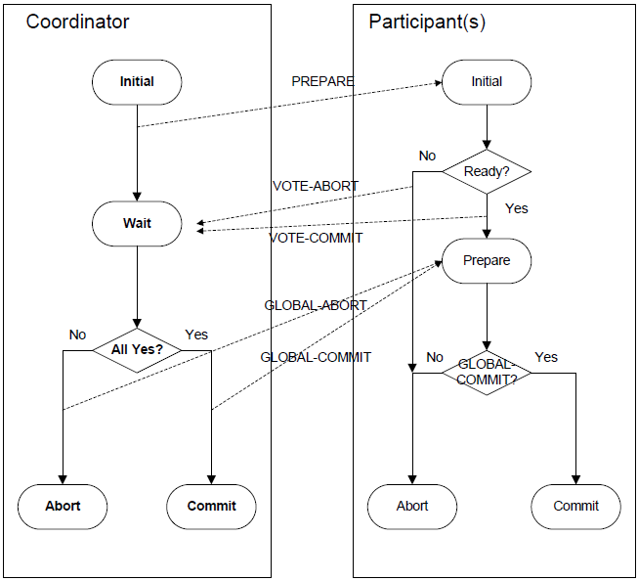
2-Phase Commit (2PC) Protocol

Slide 26
Commit Wait and 2-Phase Commit
Start logging
Done logging
Acquired locks
Release locks
T_{C}
Committed
Notify participants of s
Acquired locks
Release locks
T_{P1}
Acquired locks
Release locks
T_{P2}
Prepared
Send s
Compute s for each
Commit wait done
Compute overall s

Slide 27
Example
Remove X from my friend list
Risky post P
T_{C}
T₂
s_{C}=6
s=8
s=15
Remove myself from X’s friend list
T_{P}
s_{P}=8
s=8
Time
<8
8
15
My friends
[X]
[]
My posts
[P]
X’s friends
[me]
[]

Slide 28
Used Technologies
Lock-free read transactions across datacenters
External consistency
Timestamp assignment
TrueTime
Uncertainty in time can be waited out

Slide 29
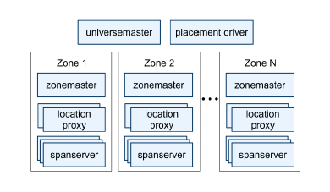
Spanner System Architecture

Slide 30
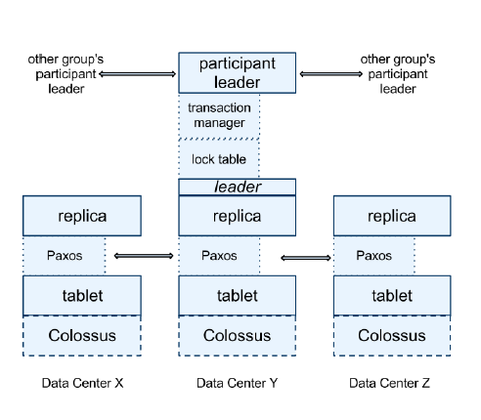
Spanner Software Stack

Slide 31
Software Stack
(key:string, timestamp:int64) → string
Back-End: Colossus (successor to GFS)
Paxos State Machine on top of each tablet stores meta data and logs of the tablet.
Leader among replicas in a Paxos group is chosen and all write requests for replicas in that group initiate at leader.
Transaction Leader
Is Paxos Leader if transaction involves one Paxos group

Slide 32
Directory
Bucketing abstraction with a set of contiguous keys with a shared common prefix
Example:
Key: 0PQRSTUVABC1
Key: 0PQRSTUV1235
Key: 0PQRSTUVLMN
Application-level controllable data locality
Unit of data movement between Paxos groups

Slide 33
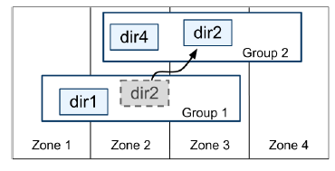
Directory

Slide 34
Data Model
Spanner’s data model based on schematized semi-relational tables, a query language and general-purpose transactions
Spanner’s data model is not purely relational
Every table is required to have an ordered set of one or more primary key columns
Each table defines a mapping of primary key columns to non-primary key columns

Slide 35
Data Model
Example:
CREATE TABLE Users{
uid INT64 NOT NULL, email String
} primary key (uid), DIRECTORY;
CREATE TABLE Albums{
uid INT64 NOT NULL, aid NOT NULL,
name String
} primary key(uid, aid),
INTERLEAVE IN PARENT Users ON DELETE CASCADE;

Slide 36
Data Model
Users(1)
Albums(1,1)
Albums(1,2)
Users(2)
Albums(2,1)
Albums(2,2)
Albums(2,3)
Directory 1 1
Directory 21

Slide 37
Spanner Implementation
Read-Write Transactions:
They require locks
Read only Transactions (Pre-declared snapshot isolation)
Reads information that is up to date
Lock free so that incoming writes are not blocked
Require declaration before start of transaction
Snapshot read: read info from the past by specifying a timestamp or bound
Without locking
Data till that point will be read

Slide 38
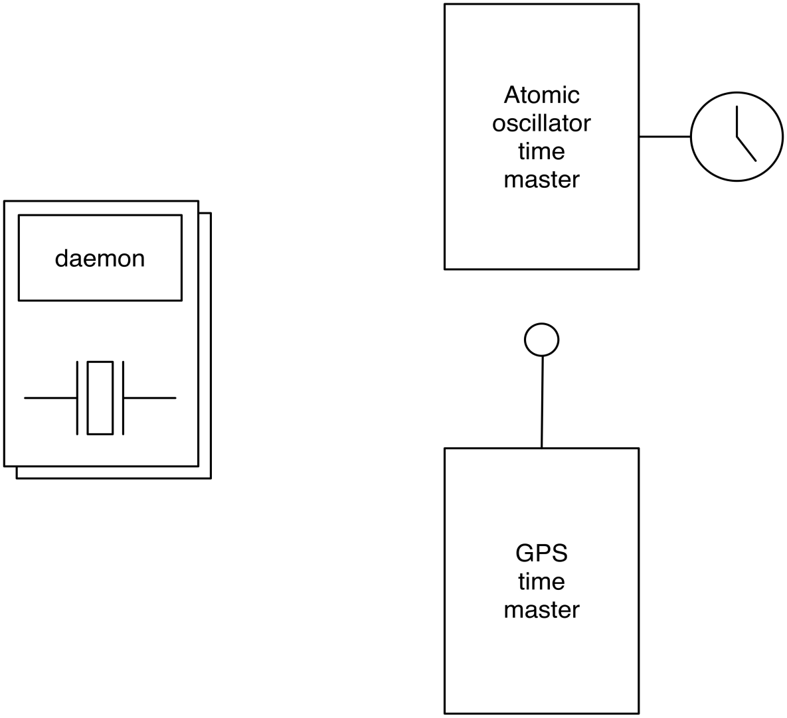
TrueTime
“Global wall-clock time” with bounded uncertainty
TT.now()
time
earliest
latest
2*ε

Slide 39
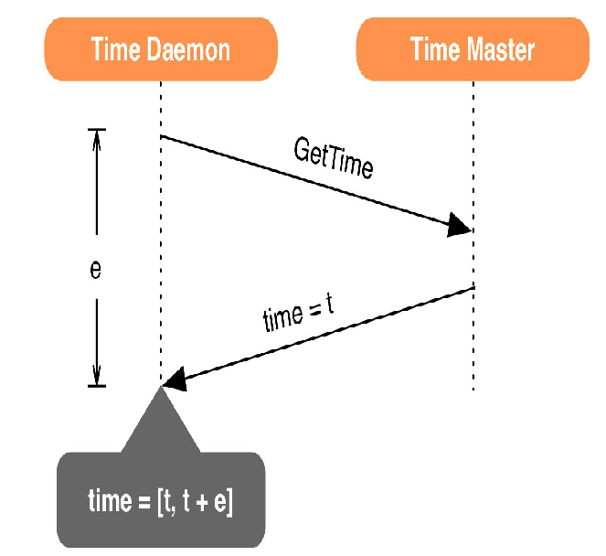
TrueTime

Slide 40
TrueTime Architecture
Implemented by:
Set of Time Master machines per data center
A Time Slave Daemon per machine
Some of the Time Masters are implemented using GPS while others are using atomic clocks
Two forms of Time Masters used as they have different failure modes
True Time makes use of Marzullo’s algorithm to compute intersection of the time intervals returned by Time Masters

Slide 41
TrueTime Architecture
GPS timemaster
GPS timemaster
GPS timemaster
GPS timemaster
Atomic-clock timemaster
GPS timemaster
Client
Datacenter 1
Datacenter 2
…
Datacenter n
Compute reference [earliest, latest] = now ± ε

Slide 42
TrueTime implementation
now = reference now + local-clock offset
ε = reference ε + worst-case local-clock drift
ε
+6ms
200 μs/sec
reference
uncertainty
time
0sec
30sec
60sec
90sec

Slide 43
What If a Clock Goes Rogue?
Timestamp assignment would violate external consistency
Empirically unlikely based on 1 year of data
Bad CPUs 6 times more likely than bad clocks

Slide 44
TrueTime API
Method | Returns
TT.now() | TTInterval: [earliest, latest]
TT.after() | True if t has definitely passed
TT.before() | True if t has definitely not arrived
It provides “Global wall clock time”
It has bounded uncertainty which varies between 1 to 7 ms over each poll interval
Daemon’s poll interval is currently 30 seconds and current applied drift rate is set to 200µs.
This accounts to saw tooth bounds of 0-6 ms.
The remaining 1 ms comes from communication delay to Masters

Slide 45
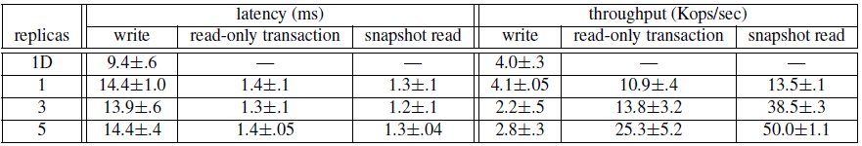
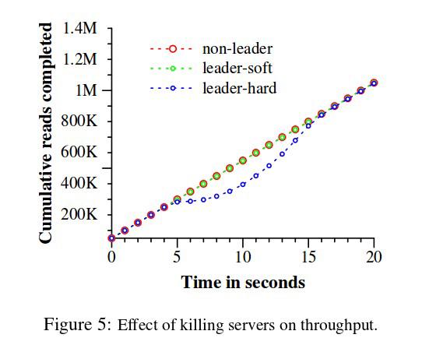
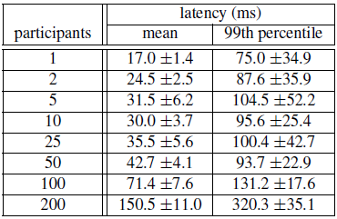
Evaluation
Operations Benchmark
Two-phase commit scalability

Slide 46
Summary
First service to provide global externally consistent multi-version database
TrueTime API
Easy-to-use, semi-relational interface, distributed transactions, SQL-based query language, automatic sharding, fault tolerance, consistent replication
Open Source implementation of similar ideas:
https://github.com/cockroachdb/cockroach

Slide 47
Lessons Learned
Reify clock uncertainty in time APIs
Known unknowns are better than unknown unknowns
Rethink algorithms to make use of uncertainty
Stronger semantics are achievable
Greater scale != weaker semantics

