Slide 1
A Generic Communication Scheduler for Distributed DNN Training Acceleration
Presented By Daniel Achee, Zixuan Zhong, Daniel Meirovitch

Slide 2
Scope

Slide 3
Scope
Distributed deep neural network training acceleration
Systems view
Communication scheduling
Algorithm to improve scheduling
Engineering required to implement generic communication scheduler
Integration with existing frameworks

Slide 4
Background

Slide 5
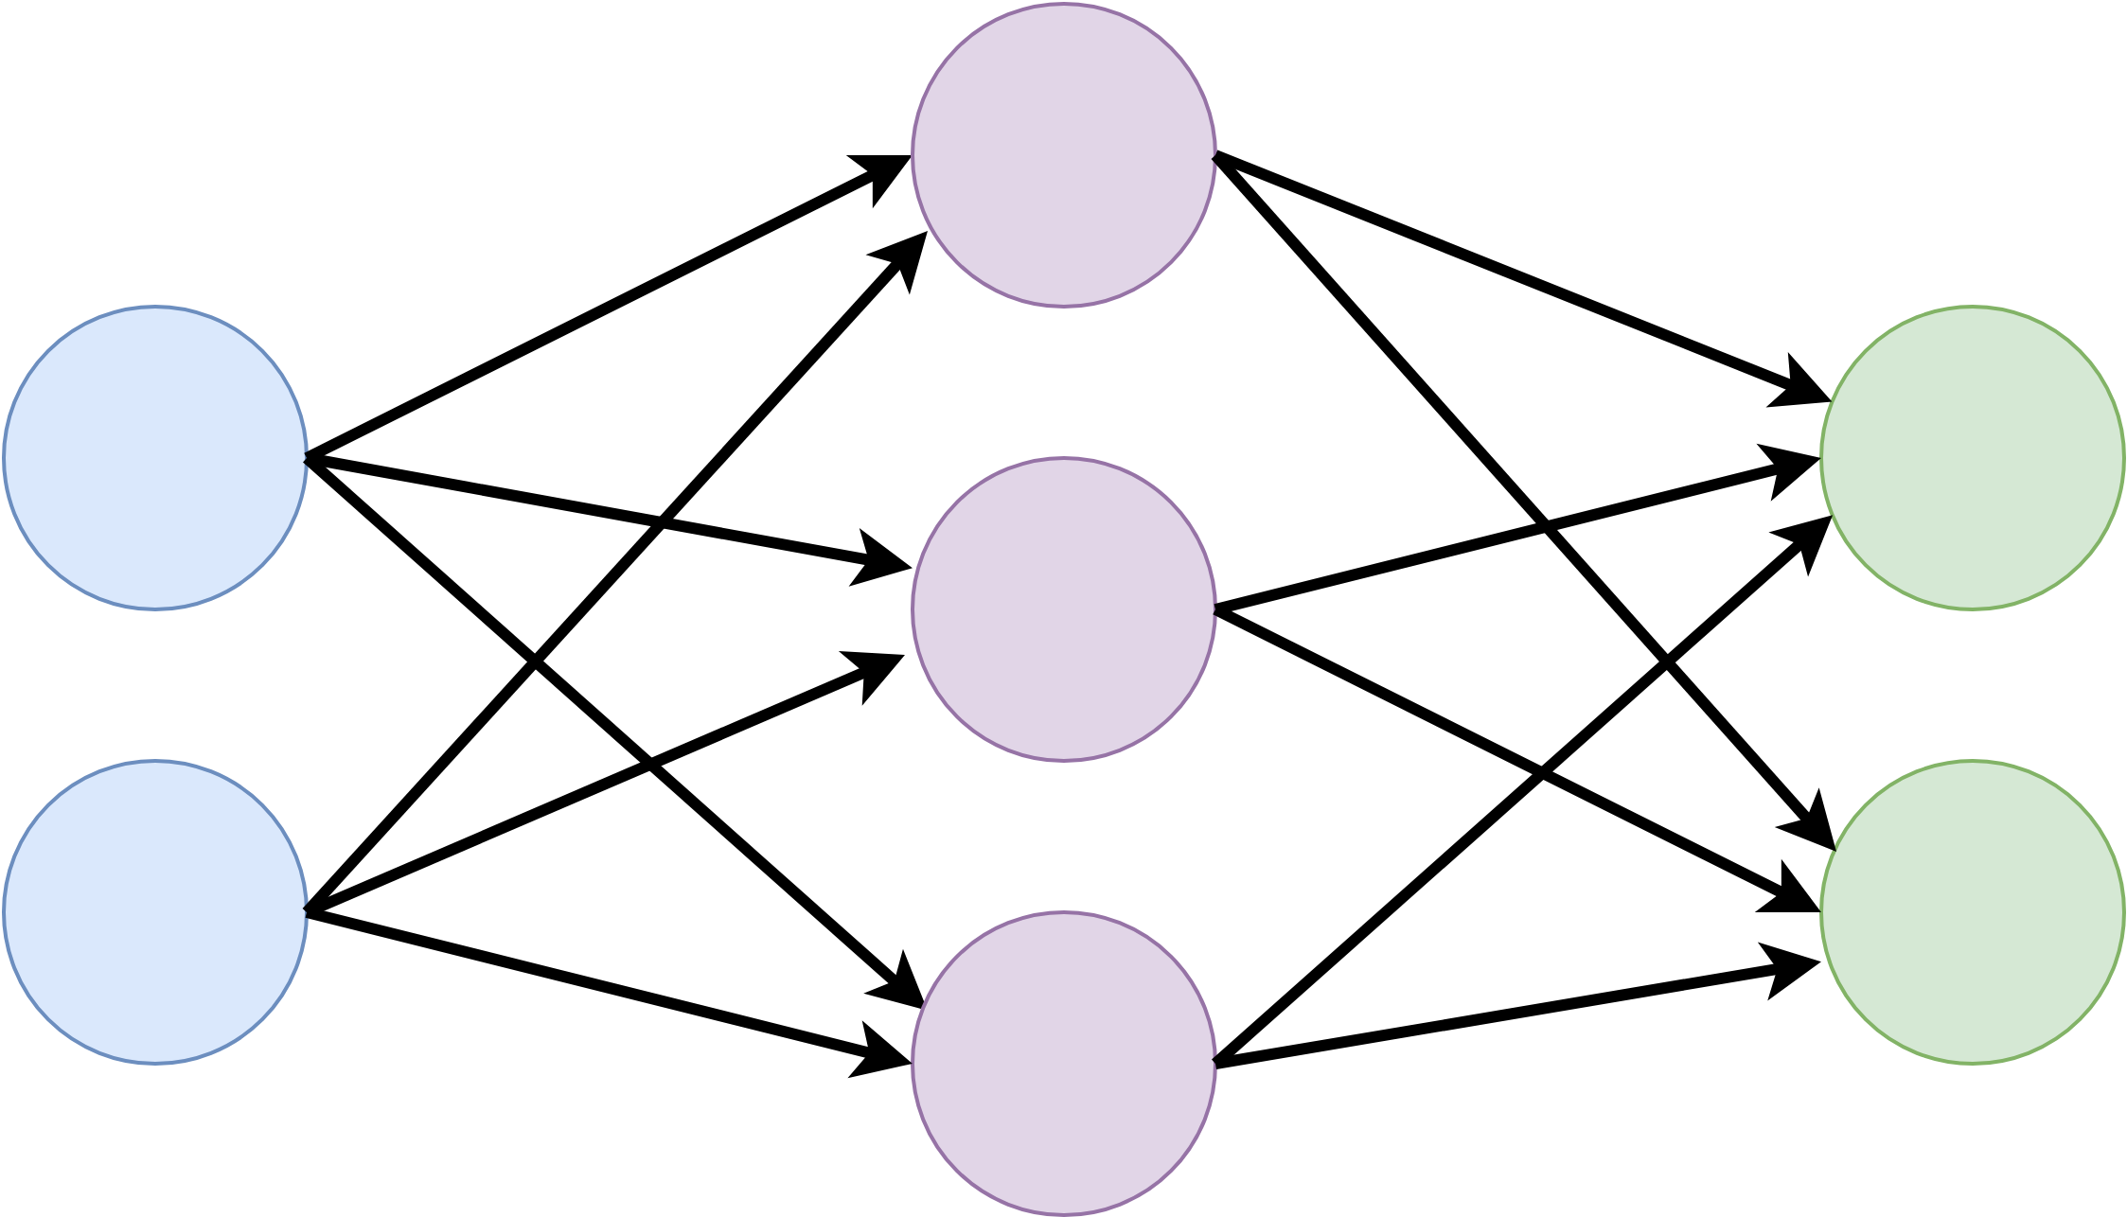
Neural Networks Training
Use data to tune model parameters
Essentially function approximation
For each epoch:
For each minibatch of training data:
Forward propagation
Backward propagation
Update model parameters
Check model’s performance
Notes:
Talk about structure
Talk about applications

Slide 6
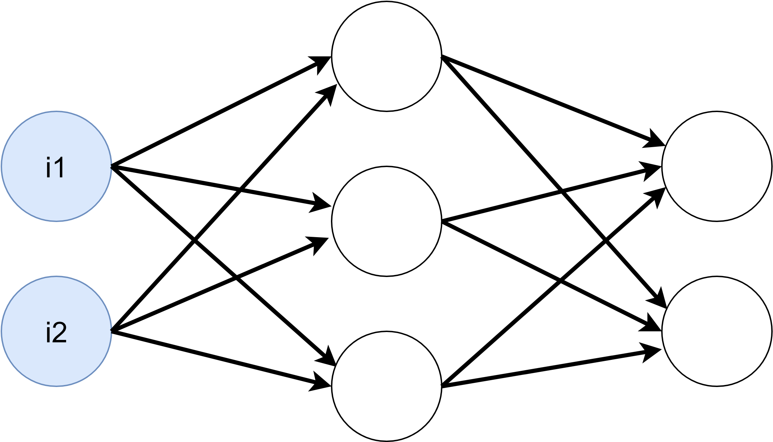
Forward Propagation

Slide 7
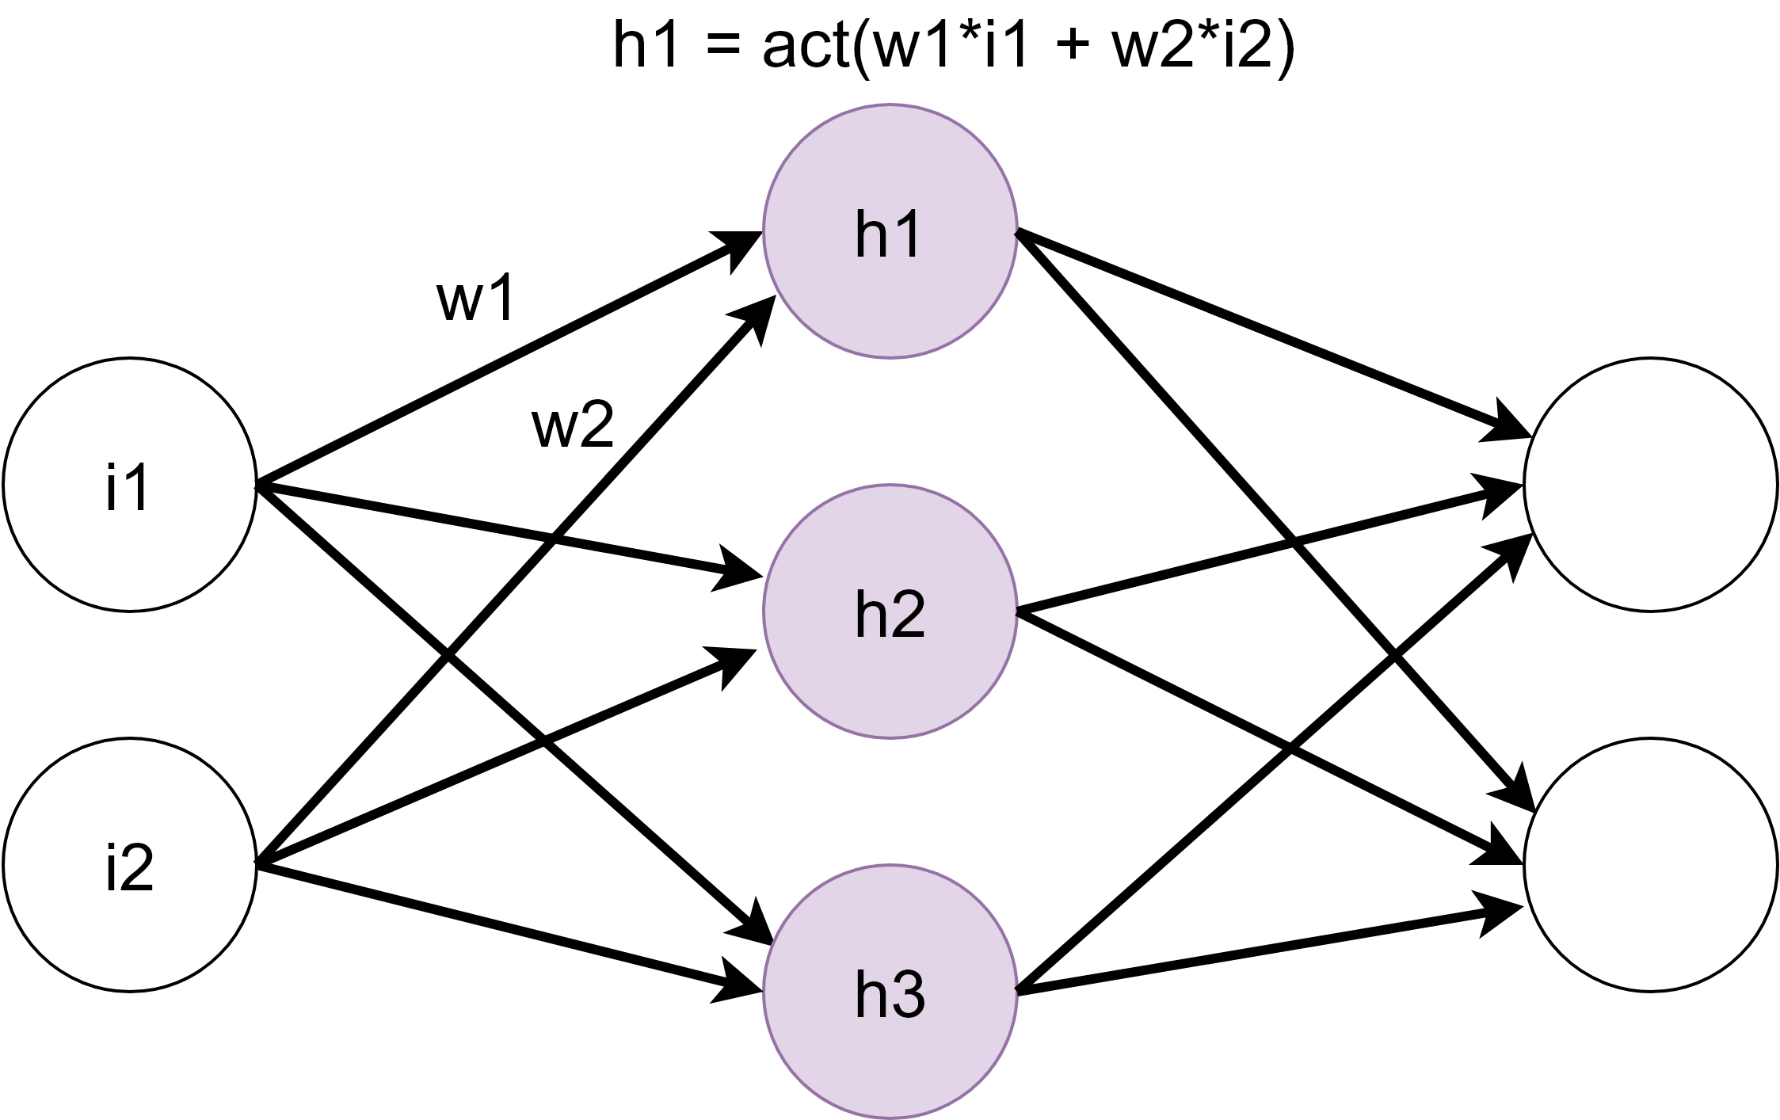
Forward Propagation

Slide 8
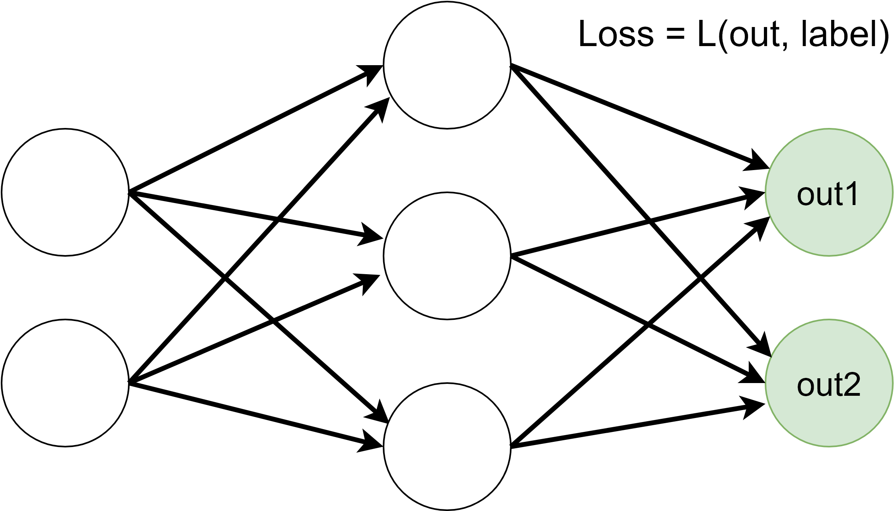
Forward Propagation

Slide 9
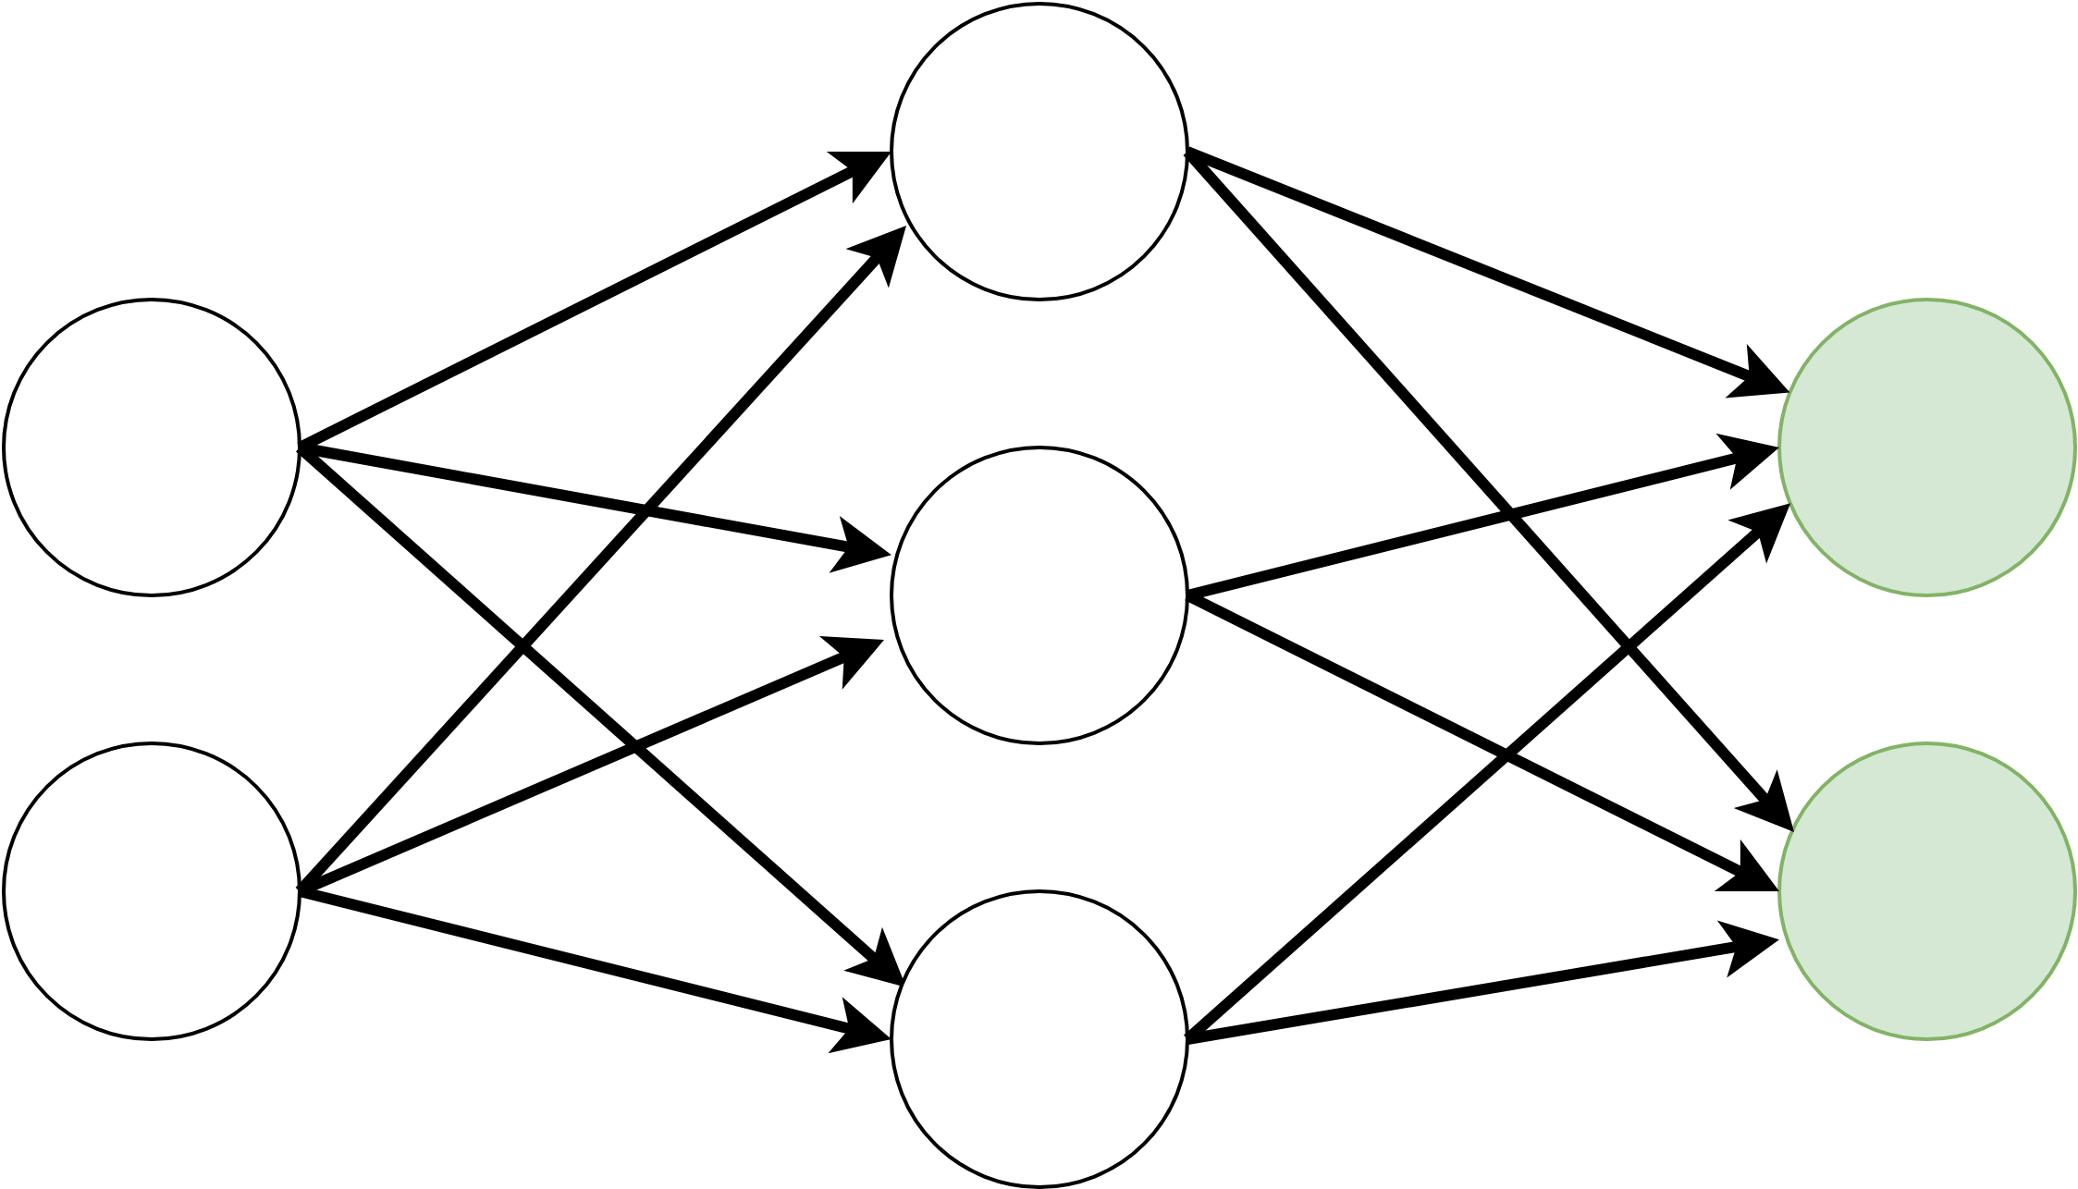
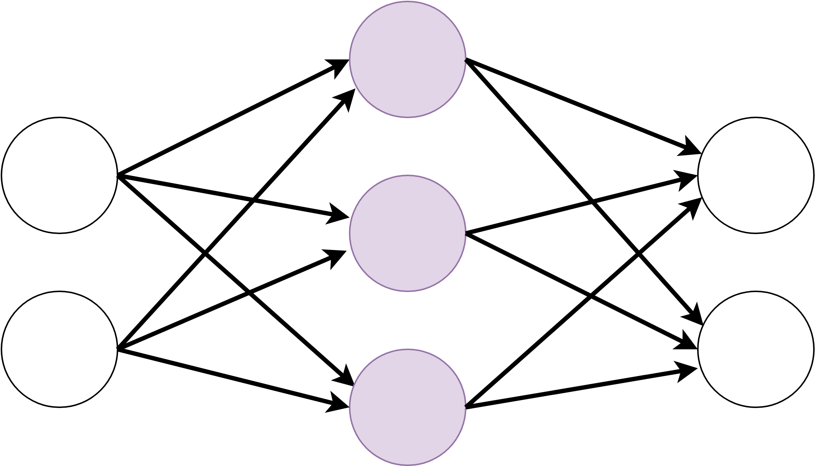
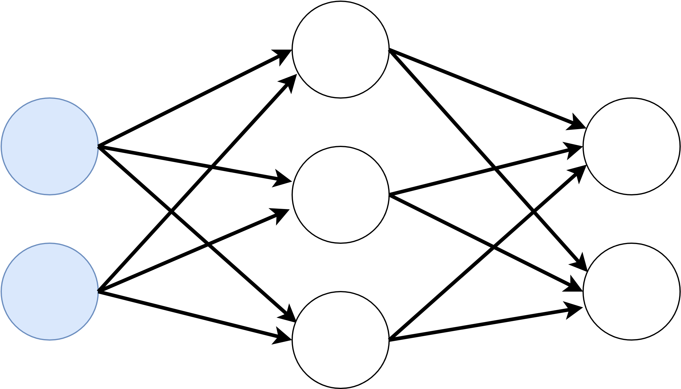
Backward Propagation
calculate gradients layer by layer going in reverse direction
Use these gradients to update the model weights
typically using Stochastic Gradient Descent
b2
b1
b0

Slide 10
Neural Networks Training
For each epoch:
For each minibatch of training data:
Forward propagation
Backward propagation
Update model parameters
Check model’s performance
Too slow to do sequentially
Models too large
Too much training data
Notes:
Talk about structure
Talk about applications

Slide 11
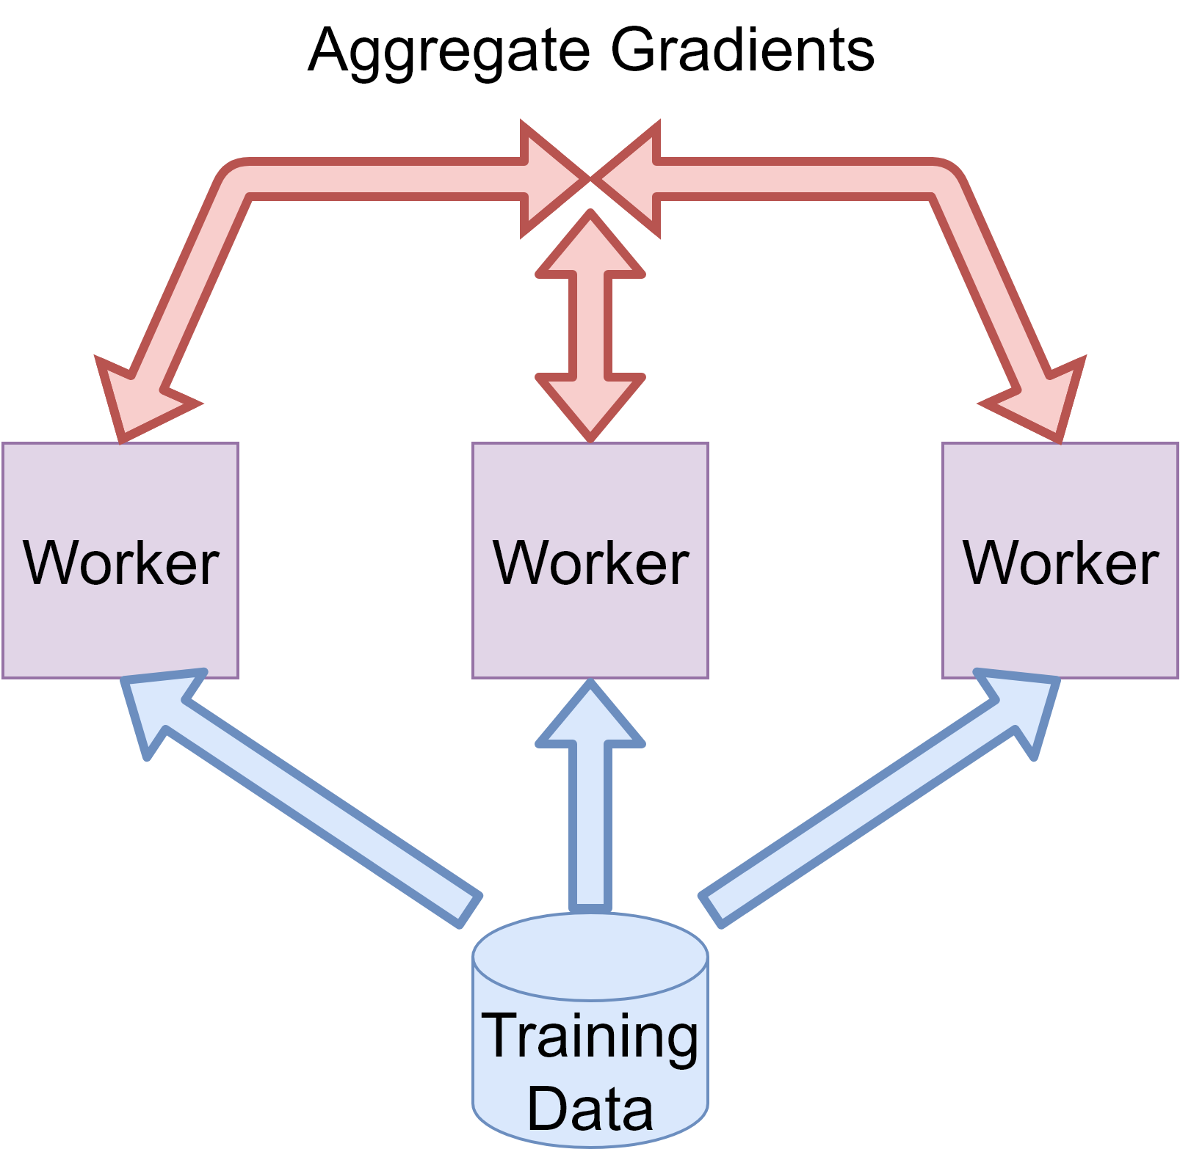
Distributed Training: Data Parallelism
Split data amongst worker nodes who share same model parameters
Workers perform
Forward propagation
Backward propagation (calculate local gradients)
Gradients must be aggregated between worker nodes to update model parameters

Slide 12
All Reduce
Gradients are collected and summed and then distributed to all workers
Ex. MPI_AllReduce
Many different All Reduce algorithms
Tree
Butterfly
Ring

Slide 13
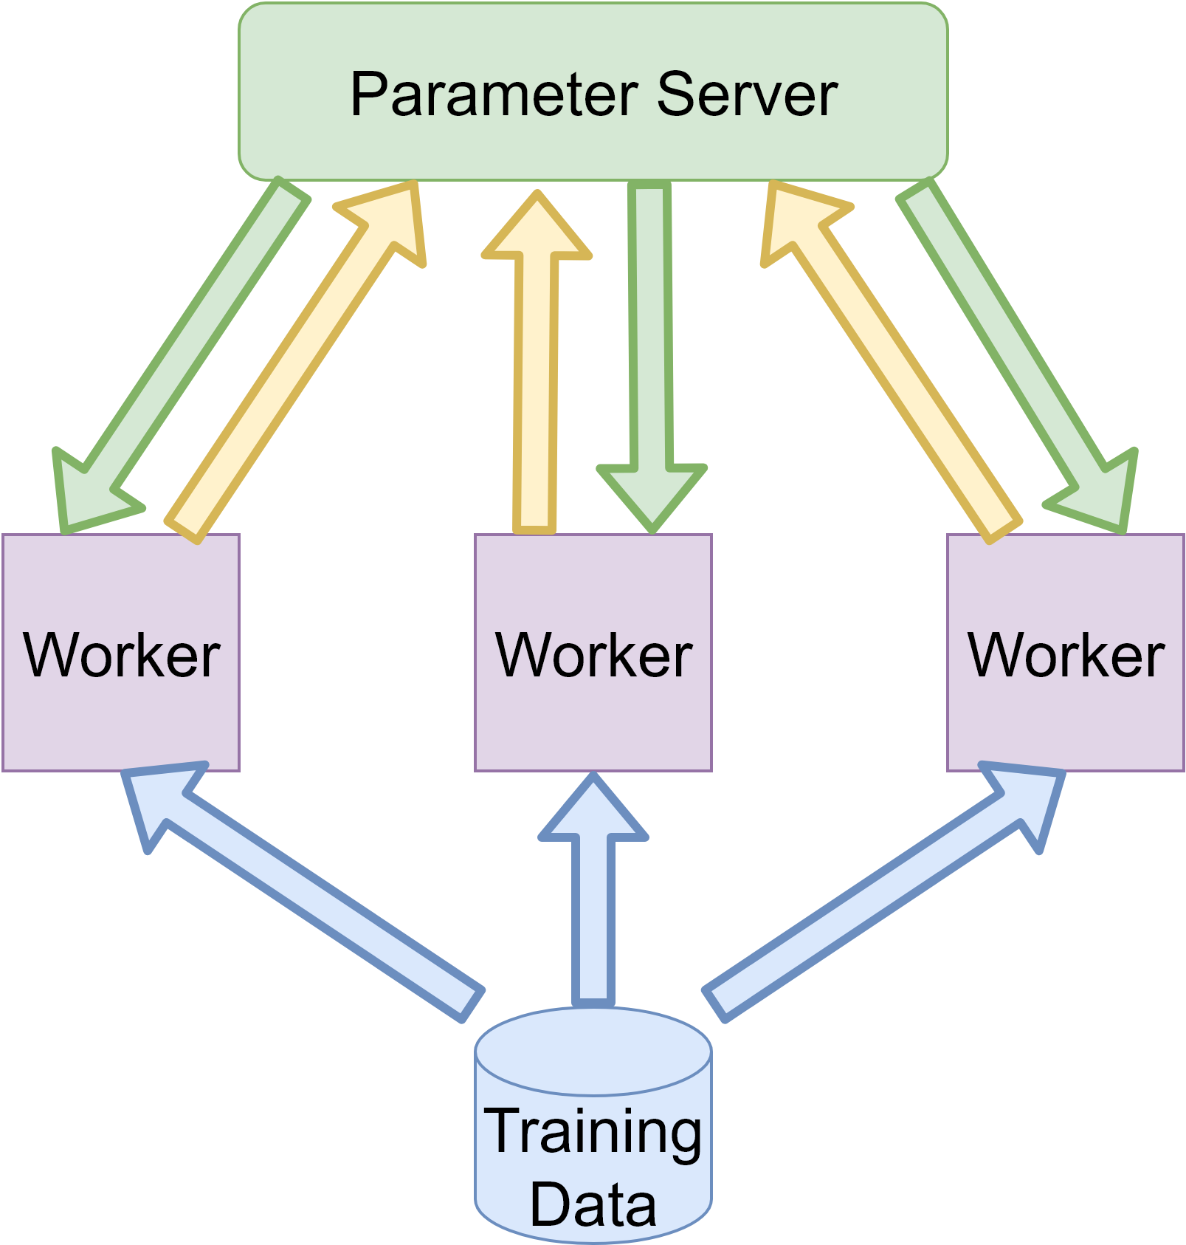
Parameter Server
Logically separate device storing global parameters
Workers push gradients to parameter server
Parameter sums gradients and updates parameters
Workers pull new parameters

Slide 14
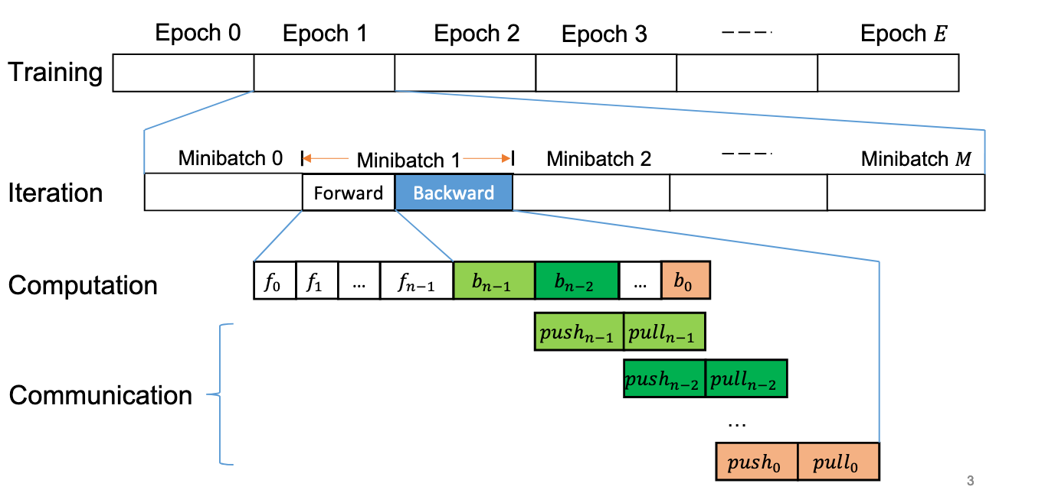
Training Process Summary

Slide 15
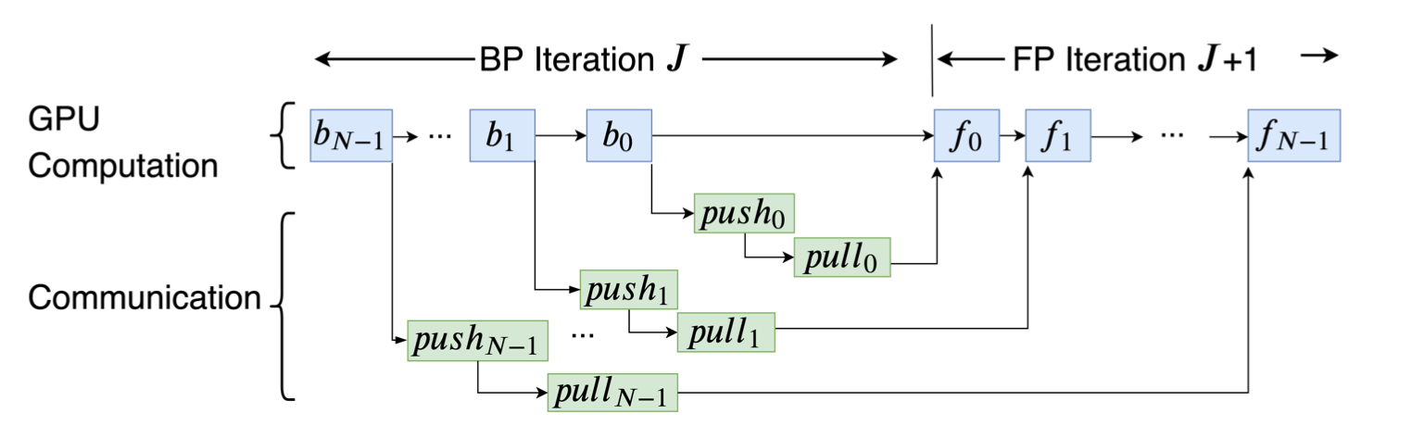
Computation-Communication Dependency Graph

Slide 16
Problems and Motivations

Slide 17
Problem Overview
Training DNNs are time-consuming
Solution: Data parallelism (distributed DNN training)
The performance of distributed DNN training is far below linear speed-up
Main Reason: communication overhead
Solution: communication acceleration
How to accelerate communication?
Different frameworks have drastically different implementations
Communication Scheduling is a promising approach
Idea: changing the transmission order of DNN layers without affecting computation results
Problems:
Existing solutions are framework-specific and communication method-specific
Existing solutions do not adapt well to different system setups

Slide 18
FIFO v.s. Communication Scheduling

Slide 19
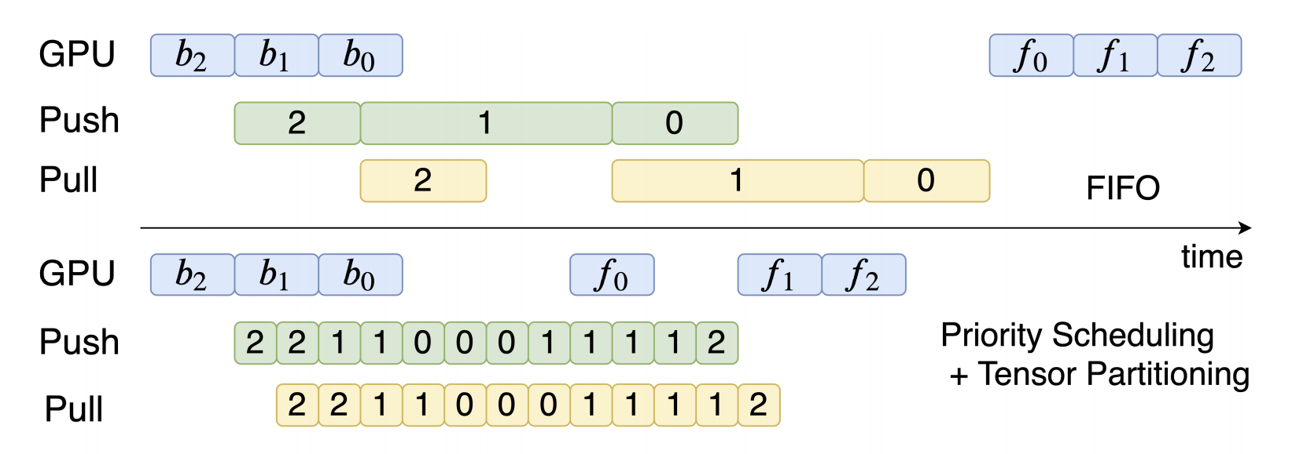
FIFO v.s. Communication Scheduling

Slide 20
Existing Communication Scheduling Solutions
Priority-based Parameter Propagation (P3)
Only for MXNet and PS
Algorithm: Priority-based Scheduling of parameters (tensors) in the Layer granularity
Implementation: Modified several layers in MXNet frameworks and its PS implementation
TicTac
Only for TensorFlow and PS
Algorithms:
Timing-Independent Communication Scheduling for prioritizing those transfers which reduces blocking on network transfers
Timing-Aware Communication Scheduling for prioritizing those transfers which reduces the blocking of computation
Implementation: Modified TensorFlow and its PS implementation

Slide 21
Limitations of Existing Communication Scheduling Solutions
Not generic: P3 only for MXNet PS, TicTac only for TensorFlow PS
Cannot adapt well to various system setups
Not optimal: Heuristic scheduling with empirical results
Goal:
A generic, theoretically optimal solution without heavy modifications on machine learning engines

Slide 22



Limitation 1: Not generic
Diverse combinations:
parameter servers
TCP
all-reduce
RDMA
Machine Learning
Frameworks
Synchronization
Architectures
Network Transport
Protocols

Slide 23
Challenge of being generic: diverse communication orders
ML engines have their own execution engines that run the computation and communication operations
Declarative engines (TensorFlow and MXNet) build dependency DAGs
Imperative engines (PyTorch) run operations in a FIFO manner
How to control the message scheduling without break the original dependencies?
ByteSchuler uses Dependency Proxy to address this challenge

Slide 24
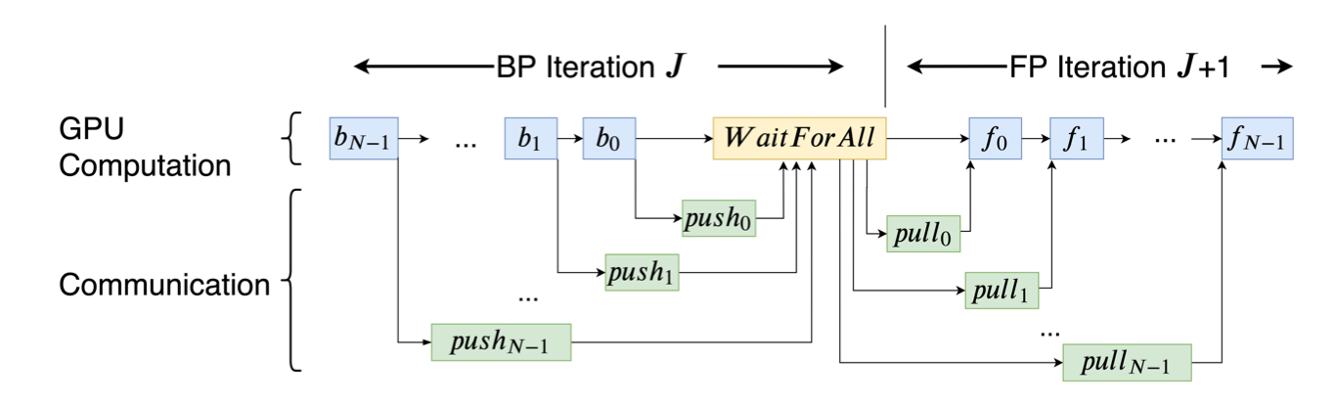
Challenge of being generic: global barriers
Some frameworks (TensorFlow, PyTorch) introduce global barriers that prevent communication scheduling
ByteSchuler uses Layer-wise out-of-engine dependencies to address this challenge

Slide 25
Limitation 2: Cannot adapt well to various system setups
For PS: it is better to slice tensors into smaller pieces, so that push and pull can better utilize bi-directional network bandwidth.
For all-reduce, each partition incurs a synchronization cost among all workers, so small partition sizes may lead to performance penalty.
Different DNNs, bandwidths, and even the number of workers also affect the optimal system parameters
How to choose the optimal system parameters?
ByteScheduler has an auto-tuning algorithm based on Bayesian Optimization.

Slide 26
Limitation 3: Not Optimal
The scheduling algorithms of P3 and TicTac are both heuristic based on empirical results
How to find a theoretically optimal scheduling algorithm?
The scheduling algorithm used in ByteScheduler guided by a theorem (Priority Queuing) with assumptions and works in real world.

Slide 27
Solution

Slide 28
Scheduling Algorithm - Priority Queue
What is the optimal scheduling strategy? - Priority Queue
Intuitively makes sense to communicate tasks which leads to quicker computation
What do we prioritize
If i < k
In a PS (Parameter Server) architecture, prioritize pull_{i} over pull_{k}, and push_{i} over push_{k}
In a All-Reduce architecture, prioritize allreduce_{i} over allreduce_{k}
Also, if we make smaller partitions we can have better usage of bandwidth + more fine-grained scheduling

Slide 29
Priority Queue - Visualization
FIFO
Priority Queue +
Smaller Partition
Notice from reordering, that can process f₀ earlier while still communicating other tensors

Slide 30
Optimization Assumptions
What conditions optimize our priority queue?
Assume that GPU can effectively schedule a sequential set of forward and back propagation tasks (the subgraph of this on the DAG is a chain)
Tensors are partitioned so that parts of a flow can be preempted (some parts are done and can be pulled before the rest is pushed)
As the partition size approaches 0, we assume we can push and pull concurrently
If we push/pull a higher priority task, that can preempt a lower priority task without extra overhead
Problems with assumptions
We cannot make the partition size infinitely small, since that adds overhead to each communication and slows down the system
We cannot always preempt a new higher priority task without penalty

Slide 31
Partition Solutions
What is the overhead of smaller partitions exactly
Delay 1 - The transmission time to send the tensor
Directly related to the size of the tensor
Delay 2 - system slowdown from having to process more tensors
So it is a factor of the number of layers * a constant overhead. O(n)
How do we determine optimal partition size
Sum the two delays together and try to optimize, we get a complicated function that is not smooth or always differentiable
So instead of searching for one perfect answer, tune partition size as a knob in the scheduler

Slide 32
Preemption Solutions
What is goal?
Always send the highest priority tasks so that the ML engine is efficiently scheduled
Move higher priority tasks up in the queue
Potential Solution 1 - send only one tensor at a time, so by default we can always preempt with highest priority task
Send tensor
Wait for acknowledgement that tensor processing is complete
Send next tensor (now highest priority)
Issues - Not an efficient use of Bandwidth
Potential Solution 2 - Send multiple tensors at a time, control amount with a TCP-like ‘sliding window’. Call this “Credit Preemption”
Issues - If we send multiple tensors, it’s possible we will receive a higher priority task but don’t have a chance to preempt before be filled our window
Overall Solution
Need to find balance between two
Use “Credit Preemption” and autotune the window size

Slide 33
Preemption Visualization - No Sliding Window
2
4
3
[]
1
[]
Tasks to be scheduled
Task Queue
Tasks being transmitted
Order of Task Processing
Lower # = Higher Priority
Step 1: Tasks 2, 4, and 3 are set to be scheduled while 1 is transmitting

Slide 34
Preemption Visualization - No Sliding Window
[4, 3, 2]
1
[]
Tasks to be scheduled
Task Queue
Tasks being transmitted
Order of Task Processing
Lower # = Higher Priority
Step 2: Tasks are entered into a queue, and have a chance to be ordered

Slide 35
Preemption Visualization - No Sliding Window
[4, 3]
2
[1]
Tasks to be scheduled
Task Queue
Tasks being transmitted
Order of Task Processing
Lower # = Higher Priority
Step 3: Send next highest priority task (2)

Slide 36
Preemption Visualization - No Sliding Window
[]
[1, 2, 3, 4]
Tasks to be scheduled
Task Queue
Tasks being transmitted
Order of Task Processing
Lower # = Higher Priority
Step 4: Keep sending tasks one at a time, picking next highest priority each time

Slide 37
Preemption Visualization - WITH Sliding Window
2
4
3
[]
1
1
[]
Tasks to be scheduled
Task Queue
Tasks being transmitted
Sliding Window Size = 2
Order of Task Processing
Lower # = Higher Priority
Step 1: Tasks 2, 4, and 3 are set to be scheduled while 1 is transmitting

Slide 38
Preemption Visualization - WITH Sliding Window
[4, 2]
3
1
[]
Tasks to be scheduled
Task Queue
Tasks being transmitted
Sliding Window Size = 2
Order of Task Processing
Lower # = Higher Priority
Step 2: Task 3 arrived first, and was immediately sent to fulfill the window. Did not have a chance to be prioritized

Slide 39
Preemption Visualization - WITH Sliding Window
[]
[1, 3, 2, 4]
Tasks to be scheduled
Task Queue
Tasks being transmitted
Sliding Window Size = 2
Order of Task Processing
Lower # = Higher Priority
Step 3: Finish processing all tasks, however now order is not in correct prioritization order

Slide 40
Combined Overall Solution
Implement scheduler with priority queue algorithm
During runtime, autotune the partition size and credit preemption window
Use Bayesian Optimization for autotuning
Goal is to optimize the training speed

Slide 41
Engineering Solution Architecture
This solution was implemented as “ByteScheduler”
To make it a generic scheduler across multiple frameworks, was implemented as a middleware, and has plugins for each framework
No source code modifications to Engines of PyTorch, TensorFlow, etc
Scheduler abstracts all operations into CommTask:
CommTask.partition() - create sub tasks with a given partition size
CommTask.notify_ready() - Scheduler can begin scheduling this task
CommTask.start() - Let the underlying framework send the tensor for processing
CommTask.notify_finish() - Tell the scheduler a task is complete, and more can be scheduled

Slide 42
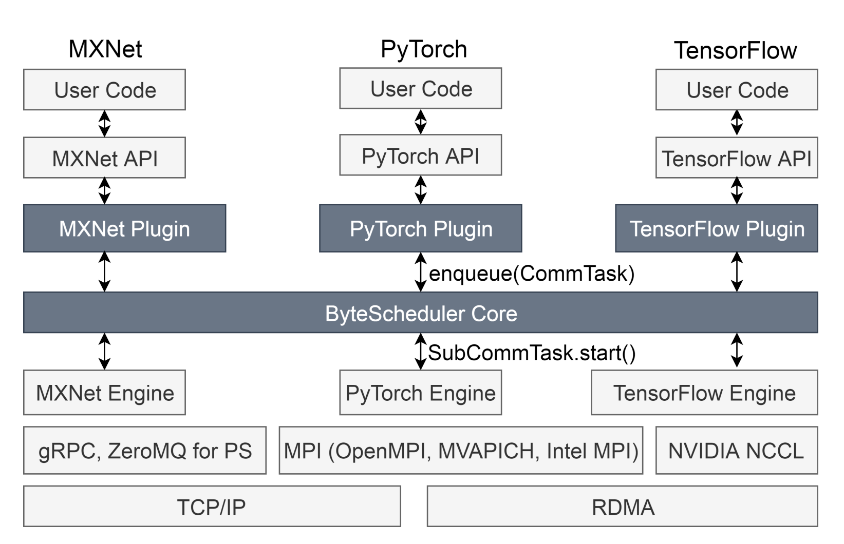
Engineering Solution Architecture Visualization
Generic Scheduler for all frameworks + communication stacks

Slide 43
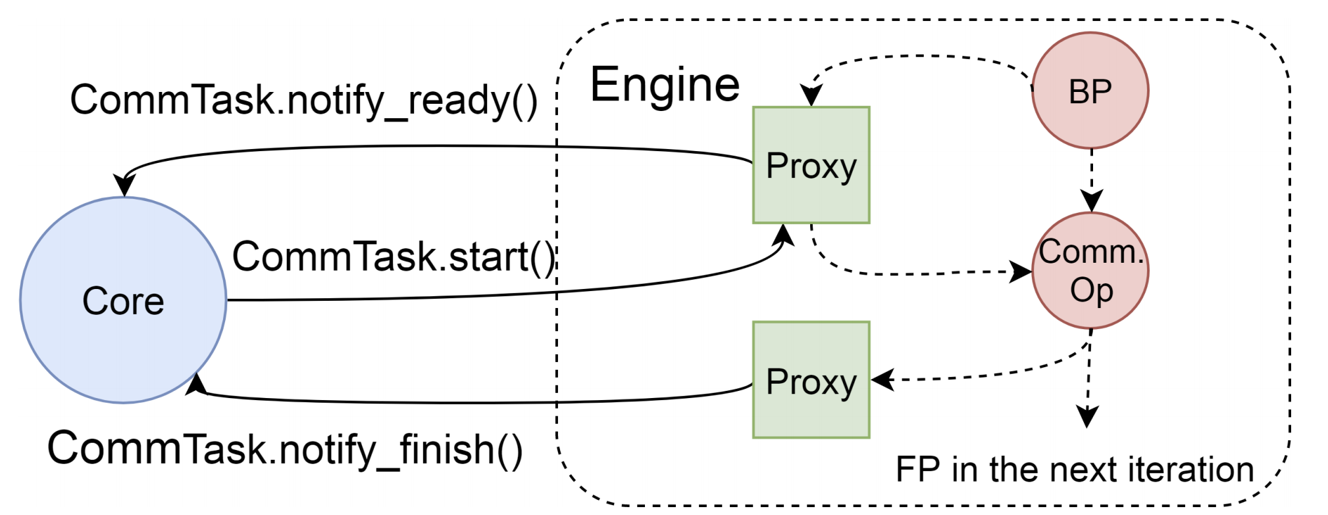
Engineering Solution Details - Dependency Proxy
The Plugin, or Dependency Proxy, implements the framework specific code necessary to integrate with the CommTask API
Depending on the framework, Dependency Proxy may be Declarative or Imperative
Declarative framework: inject the CommTasks as dependencies to tensor processing
Imperative framework: hook into API and execute CommTasks when necessary

Slide 44
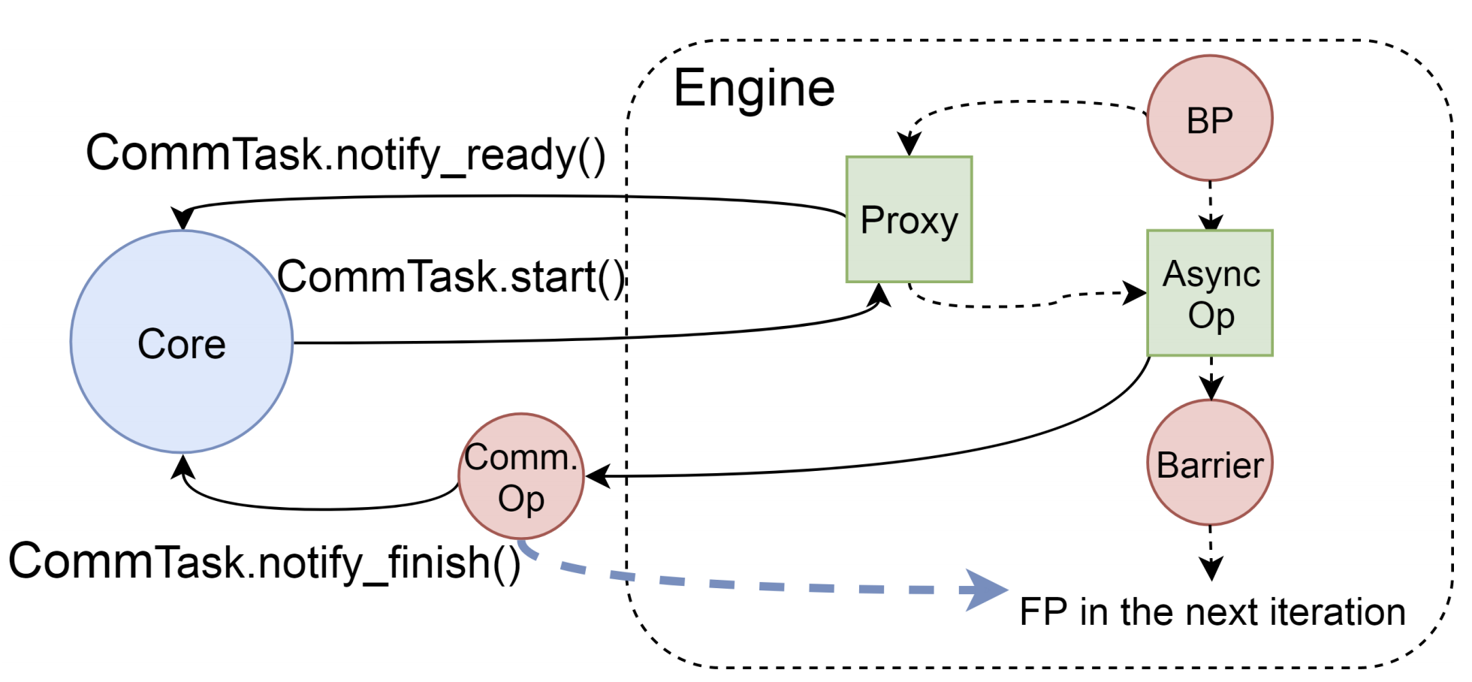
Engineering Solution Details - Global Barrier
Some frameworks have a global barrier between each layer, so ByteScheduler cannot control scheduling.
Instead, make operations asynchronous.
Framework can move to next layer
ByteScheduler processes schedule in background
ByteScheduler tracks dependencies to prevent any out of order processing.

Slide 45
Conclusion

Slide 46
Summary
Training large datasets is time intensive, and tasks must be parallelized to be accomplished in a reasonable time
Better scheduling can improve training time, by prioritizing communications to finish incoming tasks
A generic scheduler is difficult though because:
Different frameworks have different ways to communicate (All Reduce vs PS) and are architected differently (Declarative vs Imperative)
Different frameworks perform better with different parameters (partition size vs preemption)
ByteScheduler proposes a middleware scheduler and framework specific plugins, which:
Allows for a flexible scheduler that can tune itself to the framework
Requires minimal changes to existing framework engines
Results are overall positive and close to linear scaling
Although if autotuning of parameters is disabled, sometimes performs worse than baseline

