Slide 1
Scaling Distributed Machine Learning with the Parameter Server Additional
Presented by: Jiayu Yi, Bowen Wang, Zhaoyi Huang

Slide 2
How to scale
Parameter server supports efficient addition and removal of nodes => easy to scale
Addition of server node:
Server manager assigns a key range to the new node
The new node fetches the range of data it responsible for as master and slave
Server manager broadcasts the node changes. Other nodes may shrink their data if they no longer need to maintain the key range.
Removal of server node:
Server manager tasks a new node with taking the key range of the leaving node

Slide 3
How to scale
Addition of worker node:
Task scheduler assign the node with a range of data
The new node loads the range of training data from file system or existing workers
Task scheduler broadcasts change. Other nodes may free some training data.
Removal of server node:
Algorithm designer has the freedom to continue without replacing the removed worker’s work, or the task scheduler may start a replacement

Slide 4
Handle what kind of failure
From the paper description, the parameter server can handle:
Server node failure
Worker node failure
The paper doesn’t mention how to handle:
Server manager failure
Task scheduler failure

Slide 5
Detect failure & Recovery
Server node failure
The server manager detects node failure by a heartbeat signal
Worker node failure
The worker node failure should be detected by task scheduler, but the paper doesn’t mention in detail how task scheduler detects worker node failure
Recover from failure
By utilizing the replication. Task of server node will be moved to another server node. The designer can choose either to replace the failed worker node or give up the worker altogether.

Slide 6
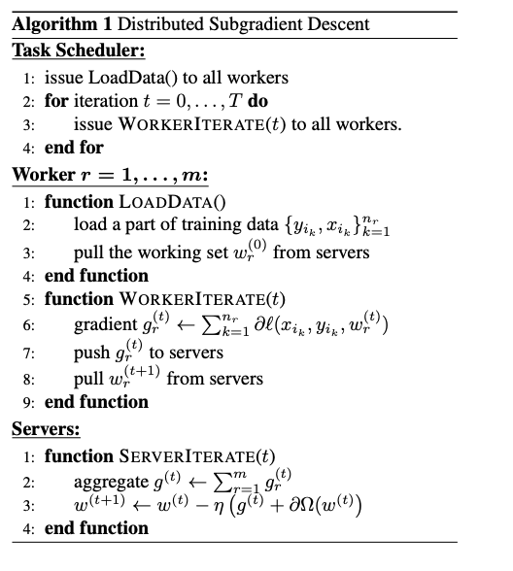
Application
Parameter server can be used for most machine learning tasks.
Two examples given in the paper are risk minimization (using gradient descent) and generative model.
Limited performance in solving sequential ML algorithm.
distributed subgradient descent algorithm

