Slide 1
Scaling Distributed Machine Learning with the Parameter Server
Presented by: Jiayu Yi, Bowen Wang, Zhaoyi Huang

Slide 2
Schedule
Motivation
Architecture
Implementation
Evaluation
Summary

Slide 3
Motivation

Slide 4


Machine learning is about learning things from data
Search
User
charge
Search Engine
Advertiser
Notes:
For the companies making search engines, advertising is a important way to make profit, the user search on the engine and sometimes they will see the promotions by the business. Therefore, to giving out cusomized recommendation and promotions for users is important

Slide 5
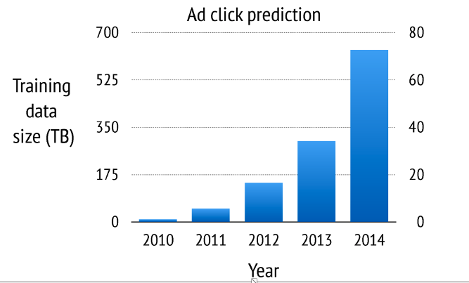
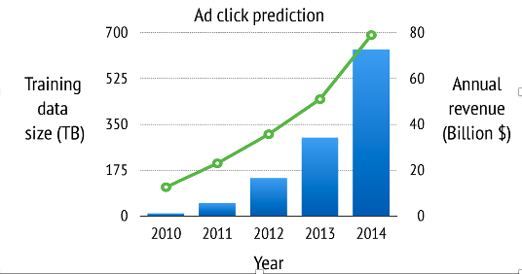
Machine learning is about learning things from data
No single machine can solve machine learning problems rapidly especially with the increasing complexity and amount of data.
Notes:
We know that, for a machine learning problem, the more the data, the better the accuracy
This figure shows how the data size of training data increased for the ads click prediction problem over the past years. In 2010, the training data size was only less than 10 Terabytes, but in 2014, the number went up to more than half petabytes.
The accuracy of this model directly affect the avenue, so you can see that the avenue has increase significantly. So definitely, we want a system that can deal with larger data.

Slide 6
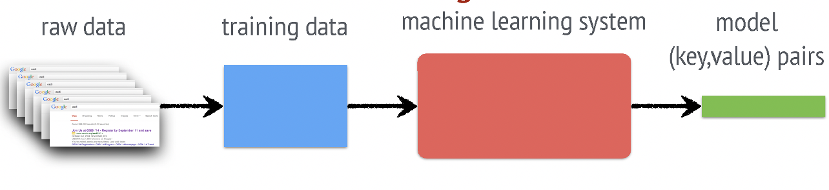
Overview of ad click prediction system
Notes:
. The first step is to collect raw data. In the ads click prediction problem, raw data is the ads impression logs, so it’s basically all the data associated with whether the user could see the ads. After getting the raw data, we perform feature extraction, then we get the training data. Then we input this training data into machine learning system, and get the machine learning model we want. Typically, they are just a list of key value pairs and such pairs can be used for prediction.

Slide 7
Machine learning system challenges
Training Data is Large –-- 1TB to 1PB
Complex Models with Billions and Trillions of Parameters
Parameters are shared globally among worker nodes:
Accessing them incurs large Network costs
Sequential ML jobs has barriers and hurt performance by blocking
At scale, Fault Tolerance is required as these jobs run in a cloud environment where machines are unreliable and jobs can be preempted
Notes:
Then here comes the challenges, as you know, the data is large, the models are complex and might have

Slide 8
Key Goals and Design Features
Efficient Communication: asynchronous communication model (does not block computation)
Flexible Consistency Models: Algorithm designer can balance algorithmic convergence and system efficiency
Elastic Scalability : New nodes can be added without restarting framework
Fault Tolerance and Durability: Recovery from and repair in 1 sec.
Ease of Use: easy for users to write programs
Notes:
The goal for making the parameter servers in machine learning is to make communications as efficient as possible→ especially in the case for asynchronous. ALso, the servers should be flexible and scalable. On the same time, it should be easy for the engineers to implement and deploy what they want.

Slide 9
Architecture & Design Details

Slide 10
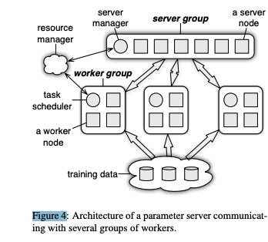
Parameter server system overview
Each parameter server node maintains only a part of the parameters, and each worker node typically requires only a subset of these parameters when operating.
Notes:
so , now, and it becomes the first problem we want to deal with. How do we fit large training data into single machine?
We partition our training data into several workers and call them worker nodes or worker machines
Then for the model itself, which is the list of key value pairs whose size is at least the number of features you have. This number could also be tens of billions. Similarly, we can partition the model into several machines and call them server machine.
After the partition, we can do training now. There are two types of data communication between these machines. One is that, a worker can push the local computed result into the server. Or worker can pull the new results from the server. We often call this architecture as parameter server architecture.

Slide 11
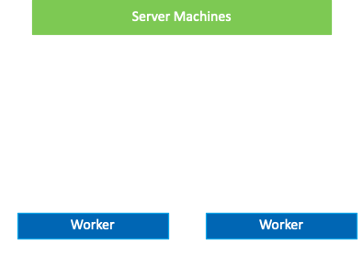


Machine learning models example-- gradient computation
Workers get the Assigned training data
Workers Pull the Working set of Model
DO:
Workers Compute Gradients
Workers Push Gradients
Servers Aggregate into current model
Workers Pull updated model
Notes:
Let me show a concrete example of how to run distributed gradient descent algorithms in this architecture.
For the simplicity, let’s assume we have only one server machine and the training data has been partitioned into two workers.
The first step is that the workers pull the working set of the model from the server.
Now we can start the iteration, each worker compute the gradient using the working set of the model it pull from the server and the local training data. After the computation, the workers push the gradient into the servers. After aggregating the gradient, the server update the model.

Slide 12
Architecture: Parameter Key-Value
Model Parameters are represented as Key – Value pairs for the Parameter Server
models the Key-Value pairs as sparse Linear Algebra Objects.
Batch: compute a vector/matrix using several key-value pairs instead of sending them one by one
Lets us treat the parameters as key-values with matrix semantics→ This is easy to program!
Notes:
To make the access of the model more efficient, the model shared among server nodes can be represented as a set of (key, value) pairs. The parameter server improves upon this basic approach by acknowledging the underlying meaning of these key value items, which is the fact that, machine learning algorithms typically treat the model as a linear algebra object. By treating these objects as sparse linear algebra objects, the parameter server can provide the same functionality as the (key,value) abstraction, but admits important optimized operations such as vector addition, multiplication and other more sophisticated operations. Reducing programmer’s efforts for optimiaations

Slide 13


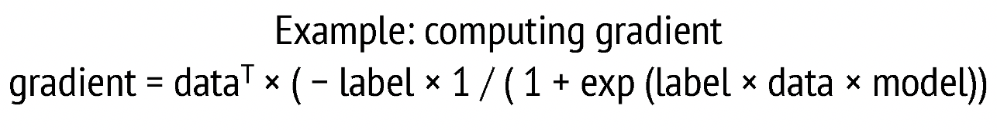
(key, value) example→ Vector to key value
Math sparse vector
Key- value pair
Notes:
Here is an example of using the key value pair as parameters. For the math sparse vector with index and value we create key value pairs for each index and its corresponding value. For example, if we want to implement the computing gradient logic of the ads-click prediction task, what we can do is that we can just use the provided multi-threaded linear algebra operators between the local training data and the global shared model. So that we can write this function in just a few lines of code.

Slide 14
Architecture: Range Push and Pull
Data is sent between Workers and Servers using PUSH and PULL operations.
Parameter Server optimizes updates communication by using RANGE based PUSH and PULL.
→ improve computational and network bandwidth efficiency
Example: let w denote parameters of the model
w.push(Range, dest)
w.pull(Range, dest)
These methods will send/receive all existing entries of w with keys in Range
Notes:
As is mentioned before, data is sent between workers and servers using PUSH and PULL operations. The parameter server optimizes updates communication by using RANGE based PUSH and PULL. This means that only the keys inside the range will be communicated each time, and this will improve computational and network bandwidth efficiency.
For example, let w denote the parameters of the model, the parameters are expressed in a key value pair format in the parameter server, so w.push(Range, dest) will send all existing entries of w in key range to the destination. Similarly, w.pull(Range,dest) will read the corresponding entries from the destination.

Slide 15
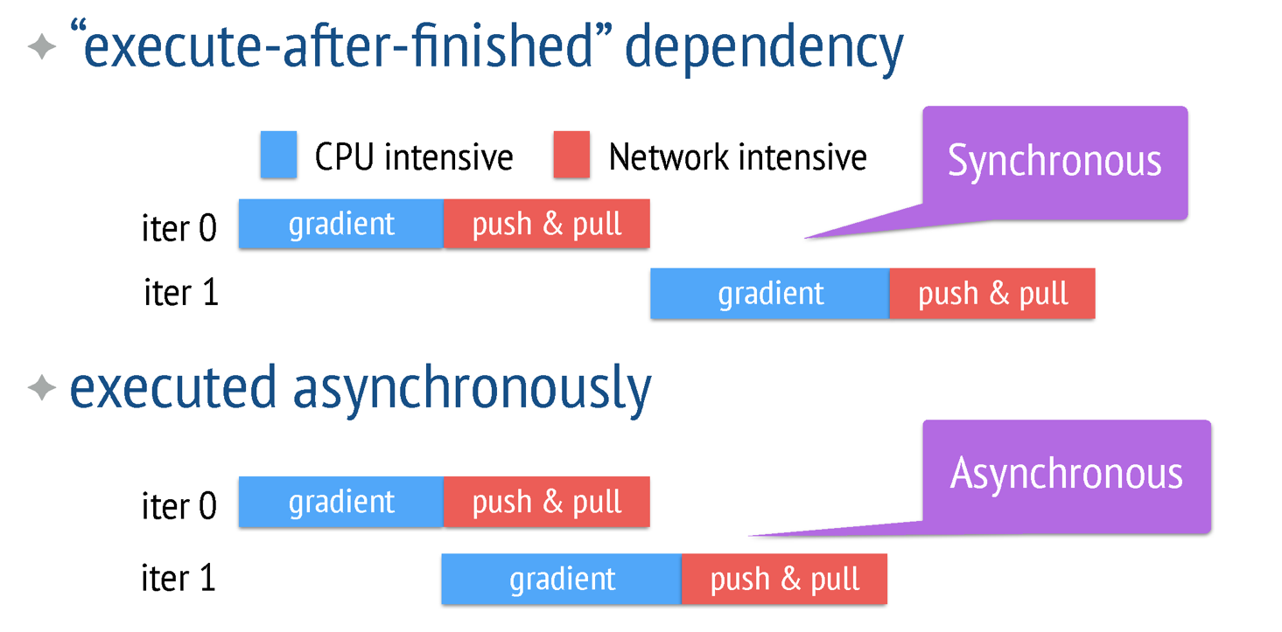
Architecture: Asynchronous tasks and Dependency
Notes:
Consider the previous basic machine learning example, workers need to push gradient to the server and pull parameters back from the server. This will lead to a choice of synchronous or asynchronous execution.
In the example, using the synchronization method between tasks means that the next iteration will begin after the updated parameters are pulled. So you can see the top figure here, the gradient computation of iteration one begins after the pull operation of iteration 0 is completed. This means that there is a global barrier between iterations. This may lead to the situation that some workers are idle and they waiting for other computations to finish, and result in high total finish time because huge amount of time is wasted on waiting.
The asynchronous execution means that the worker will start computing the next iteration gradient with the old parameters, this will lead to data inconsistency and slows down the convergence rate. But the asynchronous execution in general will have better performance in terms of total completion time.
So by default the parameter server execute tasks asynchronously, but users can also have the flexibility to choose the consistency model and I will explain this in detail later.

Slide 16
Architecture: Flexible Consistency
Trade-off between system efficiency and algorithm convergence rate
Depends on: algorithm’s sensitivity to data inconsistency
capacity difference of hardware components
→ Parameter server provides flexible consistency model
Notes:
The data consistency we talk about is a trade-off between system efficiency and algorithm convergence rate. The best trade-off depends on lots of factors, such as algorithms properties, like the algorithm’s sensitivity to data inconsistency, and also the capacity difference of hardware components, like the disk and network bandwidth.
There is no single consistent model that fit every Machine Learning task. And therefore, instead of forcing the user to adopt one particular dependency, the parameter server provides flexibility in defining the consistency models.

Slide 17


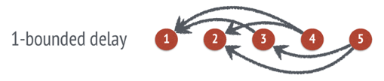
Architecture: Flexible Consistency
Three different consistency model
The dependency may be dynamic. The scheduler may increase or decrease the maximal delay according to the runtime progress
→ balance system efficiency and convergence of algorithm
Notes:
There are typically three kinds of consistency model.
For example, we can place a task dependency between two sequential tasks and get the sequential consistency model. In sequential consistency, all tasks are executed one by one. The next task can start only if the previous one has finished. It produces results identical to the single-thread implementation, and it’s also named as Bulk Synchronous Processing, which is BSP.
We can also just do nothing here, and we get the eventual consistency model. It is just the opposite of the sequential consistency model, which simply means that all tasks may start simultaneously.
Between this two extreme cases, we have a bounded delay model. In this model, you can set a maximal delay time. When a maximal delay time t is set, a new task will be blocked until all previous tasks that are t times ago have finished. Let’s take an example, let’s say task number 4 is the new task, then we need to block task number 1 and 2 which is 1 task ago to be finished so that we can execute task number 4.
Also, in parameter server, the dependency may be dynamic. The scheduler may increase or decrease the maximal delay according to the runtime progress. This will better balance the system efficiency and convergence of algorithm.

Slide 18
Architecture: User-defined Filters
User-defined filters to selectively synchronize individual (key, value) pairs
→ fine-grained control of data consistency within a task
Example:
Significantly modified filter
→ Only pushes entries that have changed for more than a threshold
KKT filter
→ Worker only push gradients that are likely to affect the weights on servers
Notes:
Besides the task dependency that controls the data consistency between tasks, the parameter server also provides fine-grained control of data consistency within a task by supporting user-defined filters that will selectively synchronize individual key value pairs.
The insight is that the optimization algorithm itself usually contains information on which parameters are most useful for synchronization. One example is the significantly modified filter, which only pushes entries that have changed by more than a threshold since their last synchronization.
The other filter the paper discussed about is called KKT filter, which takes advantage of the optimality condition of the optimization problem. Basically, a worker would only push gradients that are likely to affect the weights on the servers.
By using user defined filters, it is possible to save a lot of traffic.

Slide 19
Implementation: Vector Clock
Vector Clocks are attached for each (Key, value) pairs for several purposes
→ Tracking aggregation status
→ Rejecting doubly sent data
→ Fast recovery
Many parameters have same timestamp due to range-based communication
→ Reduce space
Ranged vector clock vc(R) = t means that for any key k in R, vc(k) = t
Notes:
Now I will talk about some detailed implementation of parameter server. The first one is about vector clock. Each key value pair in parameter server is attached a vector clock. This will make tracking aggregation status, rejecting doubly sent data and recover from failure more convenient.
Also, as I mentioned before, the parameter server uses range based PUSH and PULL. since if a node pushes the parameters in a range, then the timestamps of the parameters associated with the node are the same. So, they can be compressed into a single range vector clock, and this will greatly reduce the space used.
In this setting, given a key range R, the ranged vector clock vc(R) = t means that for any key k in R, vc(k) = t.

Slide 20

Implementation: Messages
Message consists of a list of (key, value) pairs in the key range and the associated range vector clock.
Message compression using Snappy compression library
Notes:
Now I will introduce the basic communication format of the parameter server, it is called message. Message consists of a list of (key, value) pairs in the key range and the associated range vector clock.
You can see in the equation, the vc(R) represents for the range vector clock, and the remainings are the key value pairs.
Also, since the machine learning problems typically require high bandwidth, messages are usually compressed using the fast Snappy compression library and this will remove the zeros in the pairs since we only need to send the nonzero key value pairs.

Slide 21
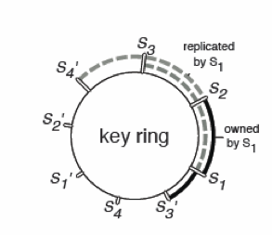
Consistent Hashing & Replication
The parameter server partitions the keys on to the Servers using ranged partitioning.
Servers are themselves hashed to a virtual ring
Server nodes store a replica of (Key, value) pairs in k nodes counter clockwise to it
Notes:
The parameter server partitions keys.
Each server node manages the key range starting with its insertion point to the next point by other nodes in the counter-clockwise direction. This node is called the master of this key range. A physical server is often represented in the ring via multiple “virtual” servers to improve load balancing and recovery. Each server node stores a replica of the k counterclockwise neighbor key ranges relative to the one it owns.

Slide 22
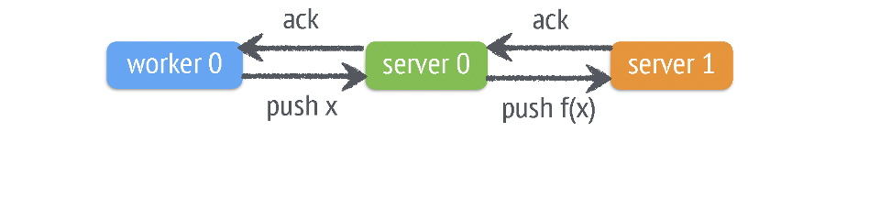
Fault tolerance
Model is partitioned by consistent hashing
Default tolerance: chain replication( safe, consistent, but slow)
Notes:
Modifications to data are pushed synchronously to the slaves. The push task is completed only once the data modification f(x) is copied to the slave. Naive replication potentially increases the network traffic by k times.

Slide 23
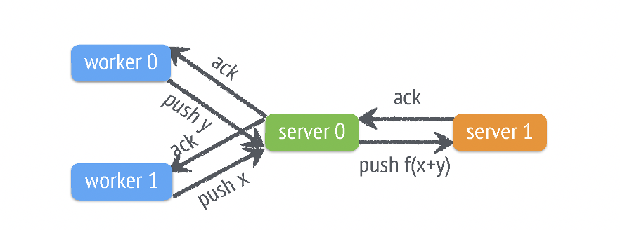
Fault tolerance
Parameter server gives user option to back up the aggregated result
Notes:
Server nodes often aggregate data from the worker nodes, for example in the case of gradient descent, the gradients computed by the workers respectively are not as useful as the sum of those gradients since only the sum would be used to update the parameters. Servers may therefore postpone replication until aggregation is complete. Two workers push x and y to the server, respectively. The server first aggregates the push by x + y, then applies the modification f(x+y), and finally performs the replication.

Slide 24
Evaluation

Slide 25
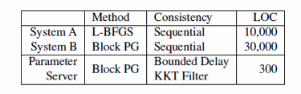
Sparse Logistic Regression
Running a logistic regression on the available data for ads which are ‘close to’ the advertisement want to post
The experiment was run with:
170 billion examples
65 billion unique features
636 TB of data in total
1000 machines: 800 workers & 200 servers
Machines: 16 cores, 192 GB DRAM, and 10 Gb Ethernet links
Notes:
To the best of our knowledge, no open source system can scale sparse logistic regression to the scale described in this paper.7 We compare the parameter server with two special-purpose systems, named System A and B, developed by a large internet company.
we use a bounded-delay model over iterations and use a “KKT” filter to suppress transmission of parts of the generated gradient update that are small enough that their effect is likely to be negligible.

Slide 26
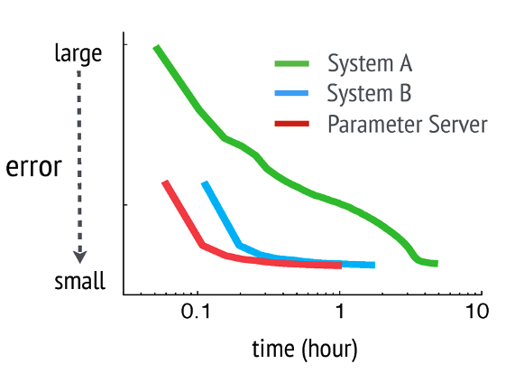
Change in error
Notes:
We first compare these three systems by running them to reach the same objective value.

Slide 27
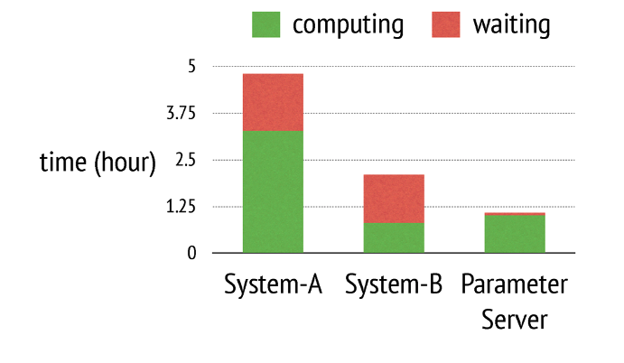
Time taken

Slide 28
Summary
•Efficient Communication:
•Batching (key,value) pairs in Linear Algebra objects
•Filters to reduce unnecessary communication & message compression
•Caching keys at worker and server nodes for local access
•Flexible Consistency Models:
•Can choose between Sequential, Eventual, and Bounded delay consistency models
•Allows for tradeoffs between System Performance and Algorithmic Convergence
•Fault Tolerance and Durability:
•Replication of data in Servers
•Failed workers can restart at the point of failure by using vector clocks
•Ease of Use:
•Linear Algebra objects allow for intuitive implementation of tasks

