Slide 1
Petuum: A New Platform for Distributed Machine Learning on Big Data
- presented by Panqiu Tang, Shuyu Wu, and Yijing Zhou

Slide 2
Introduction
Increasing big data and big model needs
State-of-the-art models and algorithms hard to migrate to larger systems
Current programmable platforms each provide partial solutions
Petuum: distributed machine learning framework
Objective: efficiency, correctness, programmability, and generality tradeoff built on an ML-centric optimization-theoretic principle
ML algorithms as iterative-convergent
Data parallel, model parallel
Error tolerance: robust against limited errors in intermediate results
Dynamic structural dependency: changing correlation strengths between model parameters
Non-uniform convergence: the number of steps required for different parameters to converge
System objectives
Parameter synchronization with bounded staleness guarantees with cheaper communication cost
Dynamic scheduling
Prioritizes computation towards non-converged model parameters
Notes:
In current machine learning algorithms, big data from all the internet and sensory activities, and the increasing needs for big models for ultra high dimensional problems have put pressure on ML algorithms to scale beyond a single machine. Many new ML models and algorithms aimed at scalable applications are still not widely used, perhaps because the migration to larger, less predictable platforms require careful attention to the details. Many programmable platforms have provided partial solutions to this research-to-production gap, including Hadoop, Spark, Graph centric platforms such as GraphLab and Pregel, and all have their own tradeoffs.
The authors observed that ML algorithms goals is fast, efficient convergence to an optimal solution, and existing solutions may work but not be the most efficient method.
They begin by formalizing ML algorithms as iterative convergent programs, which encompass a large space of modern ML, such as stochastic gradient descent. The key to shared properties across all these ML algorithms are data and model parallelism.
The core goal of Petuum is to execute these iterative updates in a manner that quickly converges to an optimum of the ML program’s objective function, by exploiting these three statistical properties of ML, which are fundamental to efficient large-scale ML in cluster environments.
To exploit these properties, Petuum introduces three novel system objectives

Slide 3


Data Parallelism and Model Parallelism
Iterative-Convergent ML Algorithm
explicit loss function to monitor the quality of convergence to a solution
Data parallelism: data is divided across machines
Data parallel equation: update can be applied to each data partition independently and additively combine the results
Additive updates: allow updates to be computed locally before sent over network
Crucial to speed up data parallel execution

Slide 4

Data Parallelism and Model Parallelism
Model parallelism: model is partitioned and updated in parallel update functions
Output first concatenated into full vector before aggregated with model
Scheduling: updating only selective parameters that are affected
Needs independent model parameters for parallel updates
Scheduling function design
Safety and correctness by selecting independent parameters
Speed-up by prioritizing computations to non-converged parameters
Implementation
The systems are stateful: continually update shared parameters
High performance, non-blocking asynchronous strategy
Fine-grained scheduling

Slide 5
Petuum Design
Provide APIs to key systems for easy implementation
The Petuum System:
Parameter server
data-parallelism with global read/write to model parameters
Distributed shared memory API
Eager Stale Synchronous Parallel (ESSP) consistency model
Reduce network synchronization and communication costs
Staleness bound: if a worker reads from parameter server at iteration c, it will definitely receive all updates from all workers computed at and before iteration c − s − 1, where s is a staleness threshold
Scheduler
Model parallelism by allowing users to control which model parameters are updated
User defined scheduling function
Common scheduling design patterns: fixed scheduling, dependency aware, prioritized
Worker
Receive parameters to be updated from scheduler
Runs parallel update functions
Synchronize model states with parameter server

Slide 6


Parallel Algorithms in Petuum
Data-Parallel Distance Metric Learning
Original problem: Learn a Mahalanobis distance matrix
Minimize distance between pairs labeled as similar
Separating dissimilar pairs with a margin 1
Relaxed form: Convert to unconstrained optimization problem by using slack variables and hinge loss
Uses lack variables and hinge loss
Can be solved via data-parallel SGD

Slide 7
Parallel Algorithms in Petuum
Model-Parallel Lasso
Scheduler chooses nearly independent parameters to guarantee convergence
If there exists conditional dependency between parameters and if they update concurrently, it might lead to parallelization error.
Prioritize these parameters based on their distance to convergence to speeding up optimization
Use schedule() to choose parameters with low dependency and prioritize non-converged parameters
Other Algorithms
Topic Model (LDA)
Use a fixed schedule function to cycle disjoint subsets of the word-topic table and data across machines for updating.
Matrix Factorization
Each worker machine performs the model update on a disjoint, unchanging subset of factor matrix rows.
Deep learning: a fully-connected Deep Neural Network (DNN) and a Convolutional NN (CNN)
Each worker uses its data subset to perform updates to the full model.

Slide 8
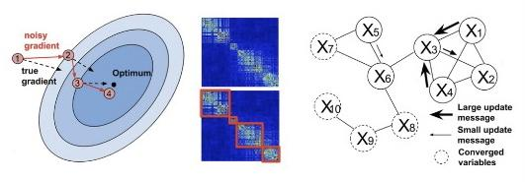
ML Program Properties
Error Tolerant Convergence
Robust against minor errors in intermediate calculations
With SSP consistency model, if some straggling worker is more than s iteration behind, the reader will stop and wait.
Dependency Structures
Allow users to use dynamic scheduling functions to analyze dependencies at run time
Select subsets of independent parameters for parallel updates
Non-uniform Convergence
Propose parameters with probability proportional to their current magnitude
Speed up convergence

Slide 9
Experiment set-up
- 3 types of clusters with varying individual machine specifications
- 2 AMD cores, 8GB RAM, 1Gbps Ethernet
- 64 AMD cores, 128 GB RAM, 40Gbps Infiniband
- 16 Intel cores, 128 GB RAM, 10 Gbps Ethernet
- data is sharded over local hard drives

Slide 10
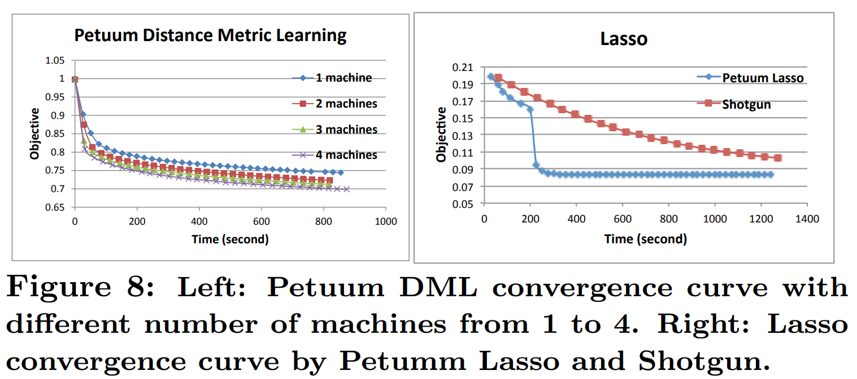
Performance

Slide 11
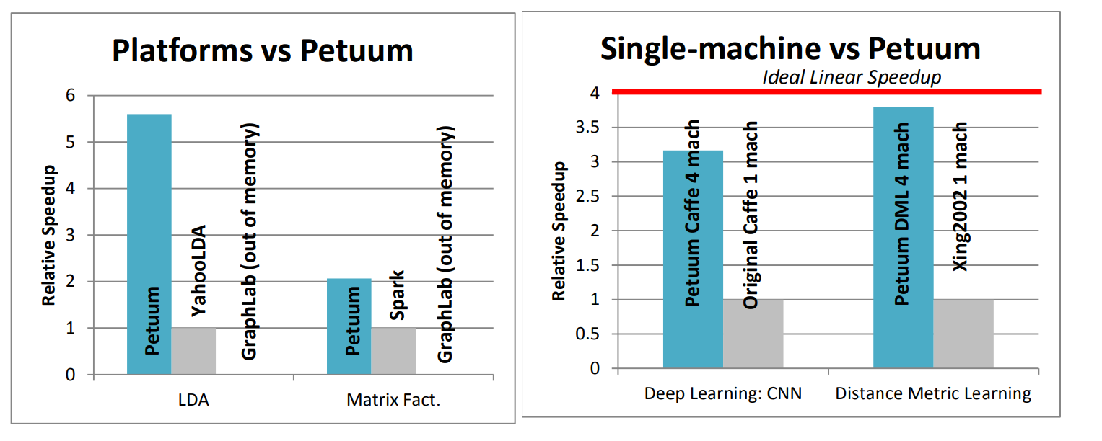
Performance

Slide 12
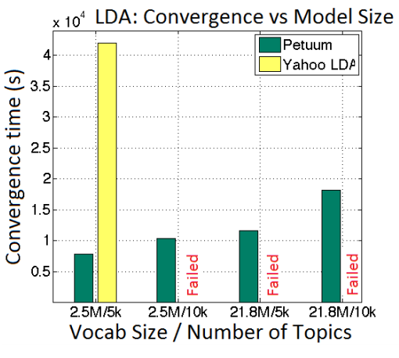
Performance

Slide 13
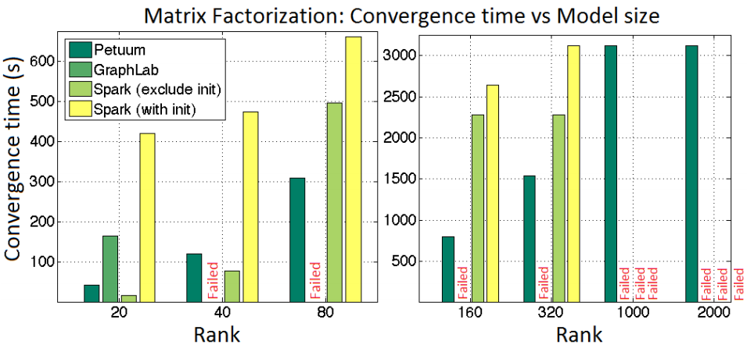
Performance

Slide 14
Conclusion
takes advantages of the common properties of ML programs
limited error tolerance
dependency structures between parameters
non-uniform parameter convergence
uses (E)SSP consistency model to exploit error tolerance convergence
recognizes the dependency structures and solves the correlation between parameters at runtime to avoid divergence
provides a dynamic priority scheduler to enable non-uniform parameter convergence within the framework
data-parallelism is achieved by using Parameter Server as the foundation
model-parallelism is achieved by providing a versatile scheduler
data-model-parallelism is achieved under the Petuum framework

Slide 15
Future work
All of the experiments are run with under 128 machines (small ~ medium cluster)
the design goal of Petuum is facing most ML practitioners
the fault tolerance and scalability for thousands of machines is still under work
Out-of-core model storage for memory-limited situations
we can see that Petuum still needs machines with 128GB of memory to run large models such as the Caffe CNN
Distribution of input data is still under-development
the experiments are run with input data already sharded in the local hard drives
distribution of data might be challenging when the number of machines scales
Integration with cluster management framework such as Yarn, Mesos, and Hadoop

Slide 16
Links:
The paper: https://petuum.com/wp-content/uploads/2019/01/Petuum_Platform_Distributed_Machine_Learning_Big_Data.pdf
Petuum platform: https://petuum.com/
Google slides with speaker notes: https://docs.google.com/presentation/d/18crIBEoJRWrGu0NcBaoSK637NzAE25hJdDXWu8wgPO8/edit?usp=sharing
Any questions?

