Slide 1
Pregel: A System for Large-Scale Graph Processing
Group 3: Hao Zhuang, Sichen Song, Hannah Nguyen

Slide 2
Outline
Introduction
Motivation
Model of Computation
API
Implementation
Experiments

Slide 3
Introduction
Pregel is a scalable and fault-tolerant general-purpose graph processing platform with a flexible and expressive API

Slide 4
Motivation
Need to scale to large graphs (billions of vertices, trillions of edges)
Web graph
social networks
Need a general-purpose system
large-scale distributed environment
arbitrary graph algorithms
arbitrary graph representations
Need a fault-tolerant system

Slide 5
MODEL OF COMPUTATION: Overview
Initializes the graph with input
A sequence of supersteps
Computation associated with each vertex
Pass messages to other vertices to be processed at next superstep
Terminates with output

Slide 6
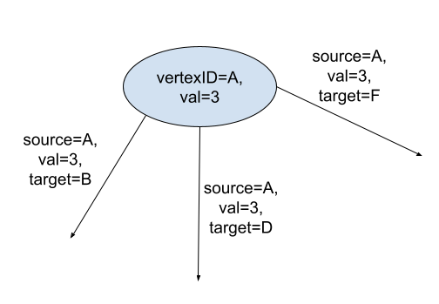
MODEL OF COMPUTATION: Input
Vertex:
has unique identifier
has modifiable, user-defined state
Edge: directed
associated with source vertex
has modifiable, user-defined value
has target vertex identifier
can be added or removed

Slide 7
MODEL OF COMPUTATION: Superstep
Within each superstep, each active vertex executes the same user-defined function in parallel
A vertex can
modify its state or that of its outgoing edges
receive messages sent to it in the previous superstep
send messages to other vertices
mutate the topology of the graph
Each superstep can be determined by the state and messages from previous superstep

Slide 8
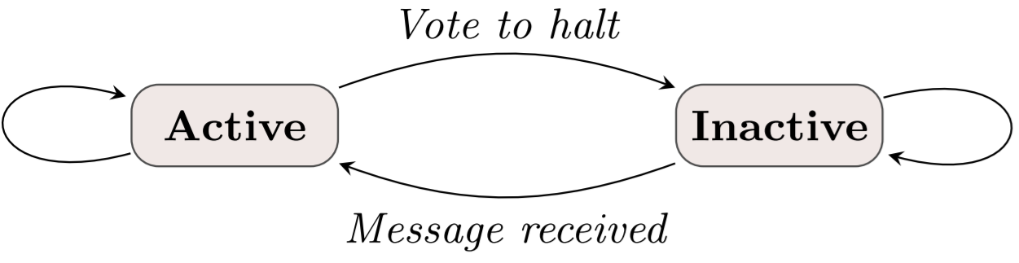
MODEL OF COMPUTATION: Termination
all vertices are simultaneously inactive
In superstep 0, every vertex is in the active state
all active vertices participate in the computation of any given superstep
A vertex deactivates itself by voting to halt
A vertex reactivates if it receives a message
If reactivated by a message, a vertex must explicitly deactivate itself again
no messages in transit

Slide 9
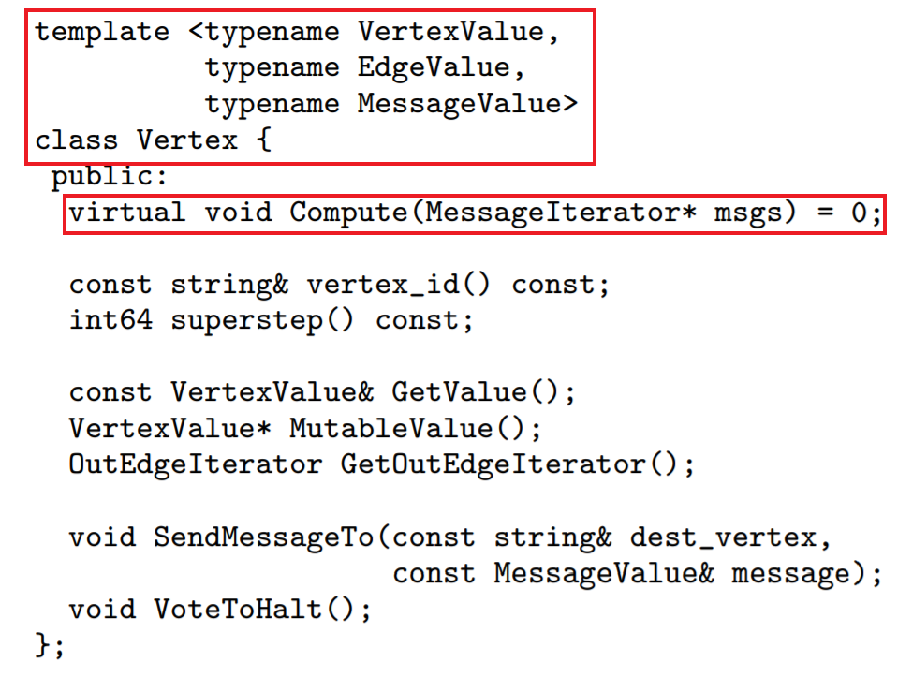
C++ API: Overview
Subclass the predefined Vertex class and define three value types:
vertices
edges
messages
Override the virtual Compute() method
a user-defined function that expresses the logic of a given algorithm

Slide 10
C++ API: Message Passing
Vertices communicate directly with one another by sending messages
A message consists of a message value and the name of the destination vertex
All messages sent to vertex V in superstep S are available via an iterator, when V ’s Compute() method is called in superstep S + 1
Destination vertex does not need to be a neighbor of V
When the destination vertex does not exist, we execute user-defined handlers

Slide 11
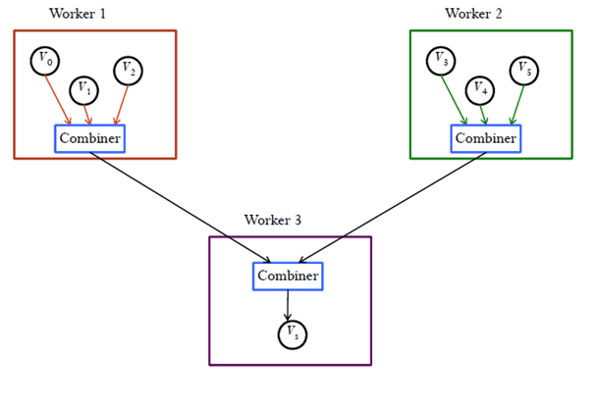
C++ API: Combiners
Sending a message, especially to a vertex on another machine, incurs some overhead
The system can combine several messages intended for a vertex V into a single message
To enable this optimization the user subclasses the Combiner class, overriding a virtual Combine() method
Example: summation

Slide 12
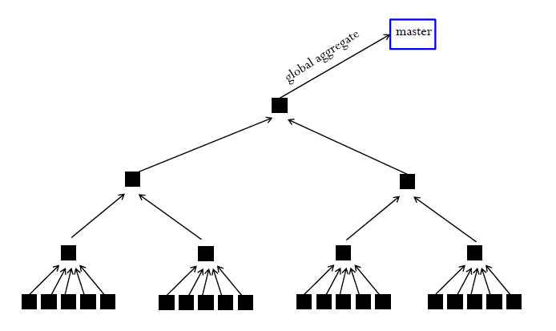
C++ API: Aggregators
Aggregators: for global communication and monitoring
Each vertex can provide a value to an aggregator in superstep S, the master combines those values using a reduction operator, and the resulting value is made available to all vertices in superstep S + 1
To define a new aggregator, a user
subclasses the predefined Aggregator class
specifies how the aggregated value is initialized from the first input value
specifies how multiple partially aggregated values are reduced to one
Example: maximum

Slide 13
C++ API: Topology Mutations
Issue: Vertices may issue conflicting requests to modify topology in the same superstep
Solution part 1: partial ordering
edge removal → vertex removal → vertex addition → edge addition → Compute()
Solution part 2: handlers
The remaining conflicts are resolved by user-defined handlers

Slide 14
C++ API: Input and output
Pregel library provides readers and writers for common file formats
Users can write their own by subclassing the Reader and Writer classes

Slide 15
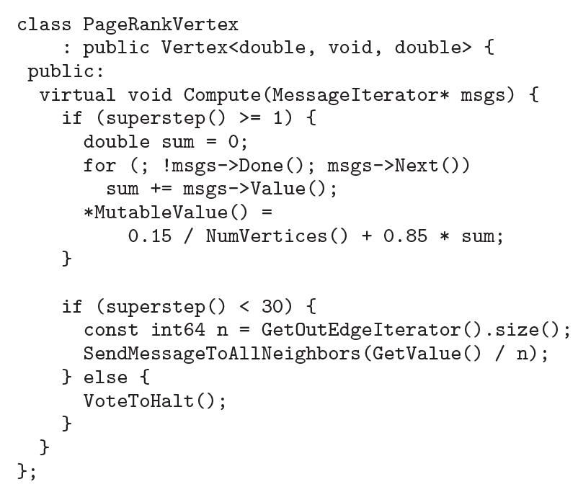
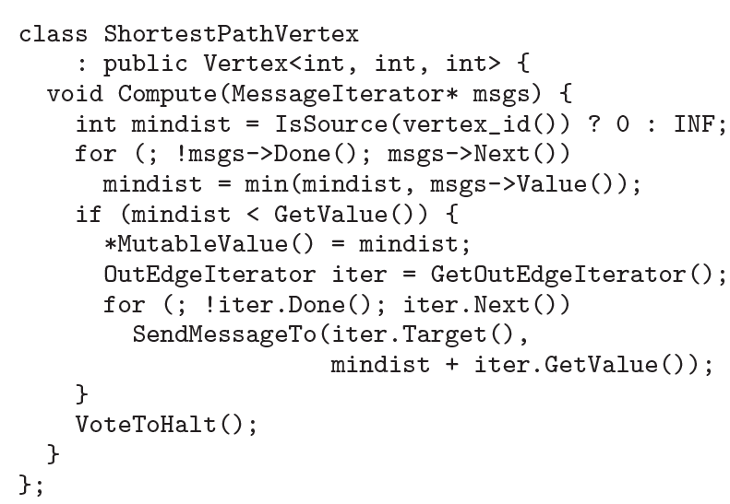
Examples

Slide 16
IMPLEMENTATION: Partition
The Pregel library divides a graph into partitions
Each partition consists of a set of vertices and all of those vertices’ outgoing edges

Slide 17
IMPLEMENTATION: Execution
Distribute user program and determine master
Master assigns partition(s) to each worker
Master assigns a portion of the user’s input to each worker
User input portion is not the same as the graph partition. Worker will sort the data and distribute data it has to the correct worker.
Master instructs each worker to perform a superstep
Worker calls Compute() for each active vertex
Computation halts. Master may instruct each worker to save its portion of the graph

Slide 18
IMPLEMENTATION: Fault Tolerance
Fault tolerance is achieved through checkpointing:
At the beginning of a superstep, the master instructs the workers to save the state of their partitions to persistent storage.
Master detects worker failures by issuing regular “ping” messages to workers
When one or more workers fail, the master reassigns graph partitions to the currently available set of workers to recompute the results
Workers log outgoing message history and recompute lost parts during recovery

Slide 19
IMPLEMENTATION: Master
Maintains a list of all workers currently known to be alive
the worker’s unique identifier
its addressing information
which portion of the graph it has been assigned
Increments the global superstep index and proceeds to the next superstep
Maintains statistics about computation progress and the state of the graph

Slide 20
IMPLEMENTATION: Worker
Maintains a map (vertexID, vertexState) in memory of its partition of the graph
the current value of the vertex
a list of the vertex's outgoing edges
a queue containing incoming messages for the vertex
a flag specifying whether the vertex is active
Each superstep: loops through all vertices and calls Compute()
Sends message to another vertex if requested by Compute()
if remote destination (another worker): message buffered for delivery
if local destination (same worker): message placed directly in the destination vertex’s incoming message queue

Slide 21
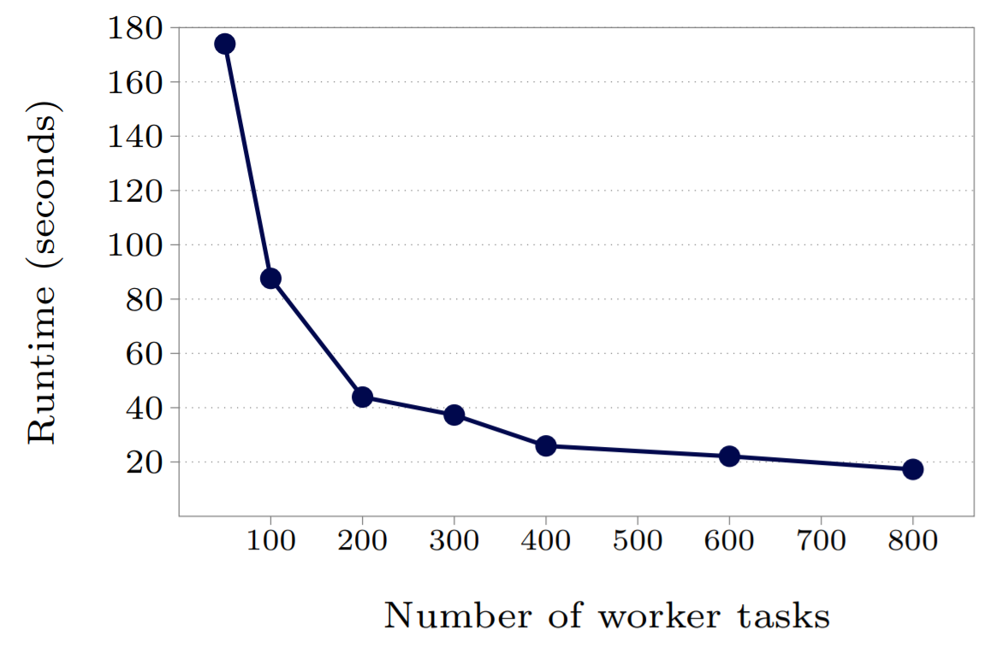
Experiment: Shortest paths runtimes for a binary tree with a billion vertices

Slide 22
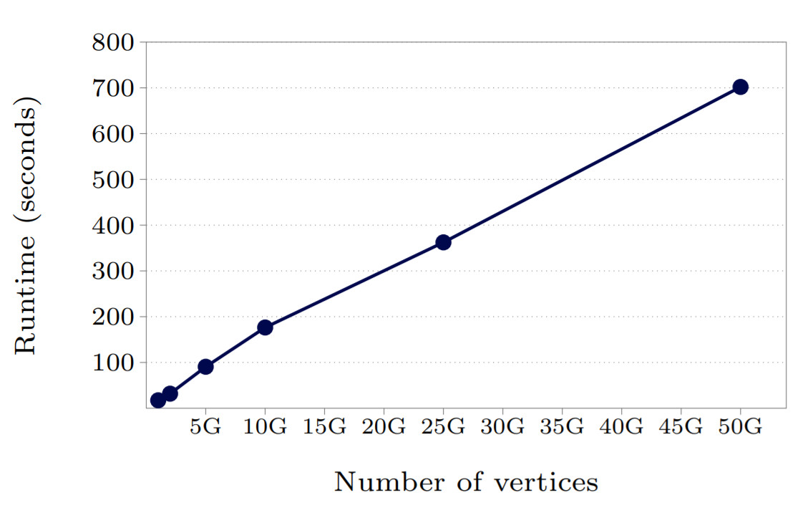
Experiment: Shortest paths runtimes for binary trees varying in size from a billion to 50 billion vertices

Slide 23
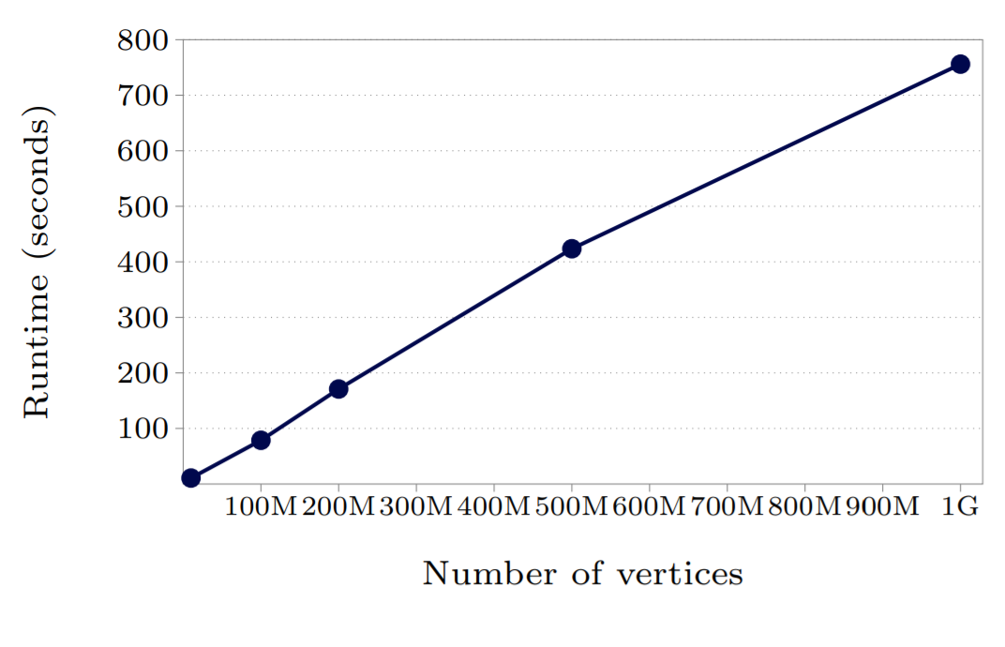
Experiment: Shortest paths runtimes for such graphs varying in size from 10 million to a billion vertices

Slide 24
Related work
Other BSP models: (Oxford BSP, Green BSP, BSPlib, Paderborn University BSP)
Both: Bulk Synchronous Parallel = superstep-based processing
Pregel: scalability/fault-tolerance beyond several dozen machines + graph-specific API
GraphLab: completely async, graph-parallel processing
Both: frameworks optimized for graph-based processing
Pregel: Use supersteps as barriers to synchronize, instead of entirely asynchronous. It also allows dynamic modifications to graph
Parallel BGL: property maps to hold graphs, ghost cells to hold remote values
Both: define distributed graphs, implement variety of algorithms
Pregel: explicit messages instead of holding remote state. Better scalability/fault-tolerance
CGMgraph: object-oriented, Coarse Grained Multicomputer graph model
Both: implement variety of algorithms
Pregel: focused on providing infrastructure for algorithms, better performance

Slide 25
Summary
Pregel: general, scalable, fault-tolerant graph processing
Computation:
input ⇒ supersteps ⇒ termination
per superstep: Compute() at each vertex
message passing, combiners, aggregators
Distribution:
master assigns graph partitions to workers
fault tolerance via checkpointing

