Slide 1
TensorFlow
A system for large-scale machine learning
Google Brain
Presentation by
Varun, Chang, Hunter

Slide 2
Introduction
Sophisticated models
Large datasets
Leverage GPU and ASIC
Production from datacenter to mobile devices
Flexible for experimentation/research
Open source

Slide 3
Representational Overview
Unified dataflow graph - represent both computation and state
Vertices represent computations that own mutable state
Unlike traditional dataflow systems, where vertices are computations on immutable data
Edges carry data between nodes as higher dimensional arrays (“tensors”)

Slide 4
Challenges in the earlier system (DistBelief)
Used the parameter server architecture
Stateless workers perform computation
Parameter server maintains state (model parameters)
Hard to perform optimizations
Parameter server provides only limited APIs (get-set)
Cannot offload certain operations to parameter server to reduce network traffic
Fixed execution pattern
Forward loss - backward gradient
Fails for more advanced models (e.g. RNNs with loops)
Hard to scale down - too heavyweight
Built only for very large datasets

Slide 5
TensorFlow Design Principles
Production flexibility - run anywhere
Simpler graph nodes
DistBelief represented computations with complex “layers”
TensorFlow computations are individual mathematical computations (matrix multiplication)
Model flexibility
Deferred execution and automated optimization
Optimize with global view
Common abstractions for accelerators
Common primitives for GPU and ASIC (TPU)
Dense tensors and other optimizations, e.g. RDMA.
No parameter server
Set of tasks communication over the network

Slide 6
TensorFlow Execution Model
Single dataflow graph
Represents computations, individual mathematical operations, update rules etc.
Communication between subcomputations is explicit
Easy to parallelize
Different from batch dataflow (e.g. MapReduce)
Support multiple concurrent executions on overlapping subgraphs
Shared mutable state for individual vertices - crucial for large models

Slide 7
Dataflow graph elements
Vertex - represents a computation (“operations”)
Take m tensors and produce n tensors
E.g. addition, matrix multiplication etc.
Edge - output from, or input to a vertex (“tensors”)
n-dimensional arrays of primitives (int, float, string)
Always densely represented for optimization
Variable - “operation” containing mutable state
No input, output as handler, used to read/write
Queue - mutable queue of elements
Similar to variable

Slide 8
Partial and concurrent execution
Can execute subgraph asynchronously
Provide input to certain vertices, request output of others
Separate I/O subgraph
Checkpointing subgraph for fault tolerance and recovery
Easy to run algorithms with weak consistency requirements
Many neural network training algorithms
Execution can be distributed across devices
Certain devices may not be able to run all subgraphs (feasibility)
Automatic inference and optimization

Slide 9
Dynamic control flow
Output is a function of accumulated state
Sequential models, e.g. RNN, LSTM
Sequences have variable length
Cannot define the graph statically
Supported through conditionals and loops in dataflow
Can parallelize conditional branches and loop bodies

Slide 10
Tensorflow—Extensibility with Case Studies
By choosing a unified representation for all computation in TensorFlow, we enable users to experiment with features that were hard-coded into the DistBelief runtime.
Four cases:
Differentiation and Optimization
Large Models
Fault Tolerance
Synchronous Replica Coordination

Slide 11
Differentiation and Optimization
TensorFlow includes a user-level library that differentiates a symbolic expression for a loss function and produces a new symbolic expression representing the gradients. For example, given a neural network as a composition of layers and a loss function, the library will automatically derive the backpropagation code.

Slide 12
Differentiation and Optimization
Differentiation
The differentiation algorithm performs breadth-firs search to identify all of the backwards paths from the target operation (e.g., a loss function) to a set of parameters, and sums the partial gradients that each path contributes.
We have extended the algorithm to differentiate conditional and iterative subcomputations (as in section 3) by adding nodes to the graph that record the control flow decisions in the forward pass, and replaying those decisions in reverse during the backward pass.
Differentiating iterative computations over long sequences can lead to a large amount of intermediate state being accumulated in memory, and we have developed techniques for managing limited GPU memory on these computations.

Slide 13
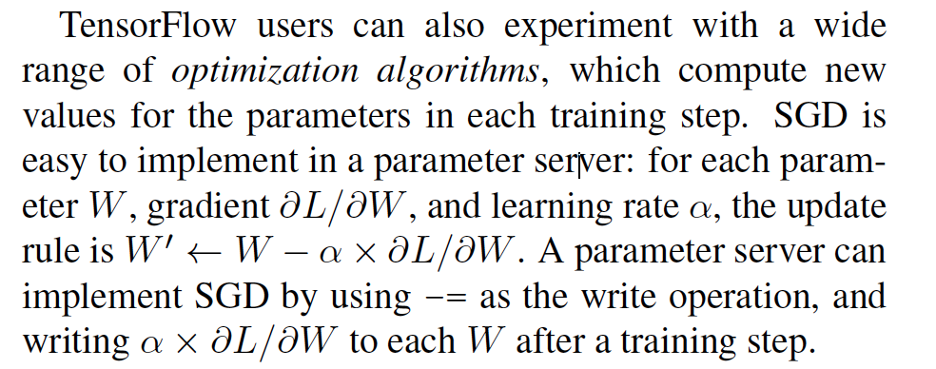
Differentiation and Optimization
Optimization

Slide 14
Differentiation and Optimization
Optimization
For advanced optimization schemes that are difficult to express as a single write operation, researchers have implemented several on top of TensorFlow
Momentum, Ada- Grad, AdaDelta, RMSProp, Adam, and LBFGS.
Advantage: can be built in TensorFlow using Variable operations and primitive mathematical operations without modifying the underlying system, so it is easy to experiment with new algorithms as they emerge.

Slide 15
Large Models
Background: To train a model on high-dimensional data, such as words in a corpus of text [7], it is common to use a distributed representation , which embeds a training example as a pattern of activity across several neurons, and which can be learned by backpropagation
Problem: Inference begins by multiplying a batch of smaller sparse vectors against the big embedding matrix , to produce a much smaller dense matrix representation. Embedding matrix models sometimes are too large to copy to a worker on every use, or even to store in RAM on a single host

Slide 16
Large Models
Solution:
Implement sparse embedding layers in the TensorFlow graph as a composition of primitive operations

Slide 17
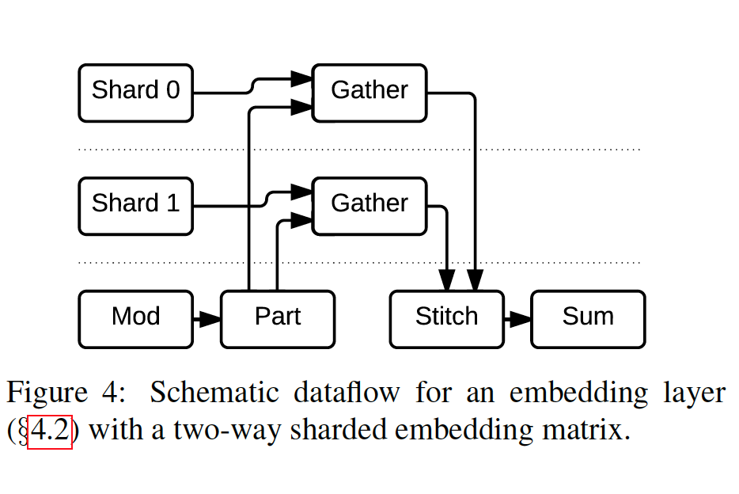
Large Models
shows a simplified graph for an embedding layer
that is split across two parameter server tasks. The core operation of this subgraph is Gather , which extracts a sparse set of rows from a tensor, and TensorFlow colocates this operation with the variable on which it operates. The dynamic partition (Part ) operation divides the incoming
indices into variable-sized tensors that contain the
indices destined for each shard, and the dynamic stitching (Stitch ) operation reassembles the partial results from each shard into a single result tensor
** TensorFlow includes libraries that expose the abstraction of a sharded parameter, and build appropriate graphs of primitive operations
based on the desired degree of distribution.

Slide 18
Large Models
While sparse reads and updates are possible in a parameter server, TensorFlow adds the flexibility to offload arbitrary computation onto the devices that host the shared parameters.
E.g., classification models typically use a softmax classifier that multiplies the final output by a weight matrix with c columns, where c is the number of possible classes; for a language model, c is the size of the vocabulary, which can be large.
2 approaches:
the weights are sharded across several tasks, and the multiplication and gradient calculation are colocated with the shards
More efficient: sampled soft-max, which performs a sparse multiplication based on the true class for an example and a set of randomly sampled false classes

Slide 19
Fault Tolerance
Background:
Training a model can take several hours or days, even using
need to train a model using non-dedicated resources, which does not guarantee availability of the same resources for the duration of the training process.
Therefore, a long-running TensorFlow job is likely to experience failure or pre-emption
However, mechanism like Spark’s RDDs would impose significant overhead for little benefit: It is unlikely that tasks will fail so often that individual operations need fault tolerance, and we can recompute any update from the input data, and many learning algorithms do not require strong consistency. so a There is no need to make every write to the parameter state durable

Slide 20
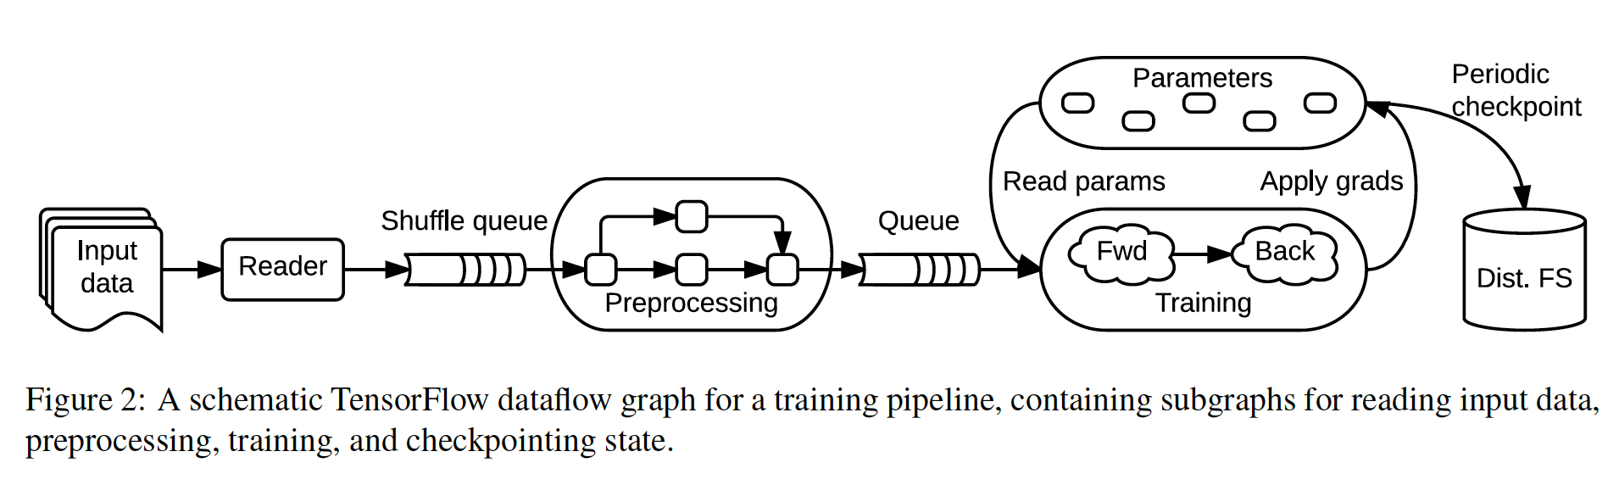
Fault Tolerance
Solution: user-lever checkpointing

Slide 21
Basic operation
Save writes one or more tensors to a checkpoint file
Restore reads one or more tensors from a checkpoint file.
User-customizable and reuseable:
Customizable: the user can apply different policies to subsets of the variables in a model, or customize the checkpoint retention scheme
Reuseable: it may be used for model fine-tuning and unsupervised pre-training, which are forms of transfer learning, in which the parameters of a model trained on one task (e.g., recognizing general images) are used as the starting point for another task (e.g., recognizing breeds of dog).

Slide 22
Fault Tolerance
Checkpoint consistency among distributed servers:
The checkpointing library does not attempt to produce consistent checkpoints. if training and checkpointing execute concurrently, the checkpoint may include none, all, or some of the updates from the training step. (if training and checkpointing execute concurrently, the checkpoint may include none, all, or some of the updates from the training step.)
Consistent checkpoints require additional synchronization to ensure that update operations do not interfere with checkpointing; if desired, one can use the scheme of syncronization to take a checkpoint after the synchronous update step.

Slide 23
Synchronous replica coordination
Problem:
Asynchronous: maintain high throughput in the presence of stragglers but using stale parameter values in training steps
Synchronous training may be faster (in terms of time to quality) than asynchronous training on the same platform.
Solutions:
The TensorFlow graph enables users to change how parameters are read and written when training a model with three alternatives.

Slide 24
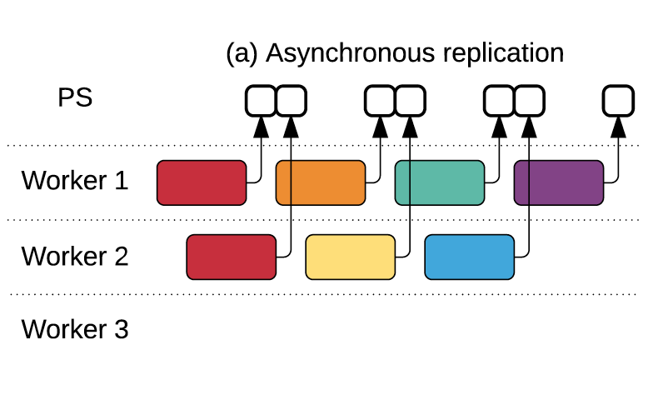
Case 1: Asynchoronous
each worker reads the current values of parameters when each step begins,
and applies its gradient to the (possibly different) current values at the end: this approach ensures high utilization, but the individual steps use stale parameter values, making each step less effective

Slide 25
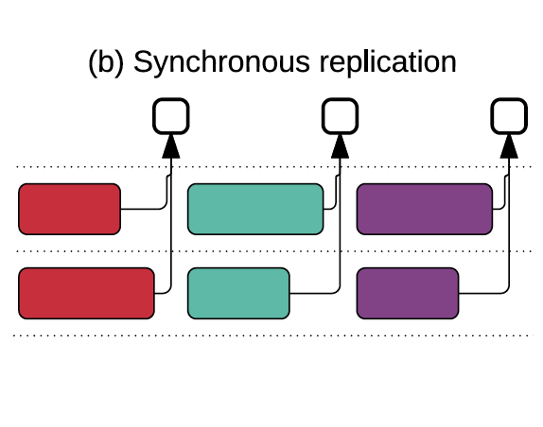
Case 2: Simple Synchronous
Using queues to coordinate execution: a blocking queue acts as a barrier to ensure that all workers read the same parameter values, and a per-variable queue accumulates gradient updates from all workers in order to apply them atomically.
** The simple synchronous version accumulates updates from all workers before applying them, but slow workers limit overall throughput.

Slide 26
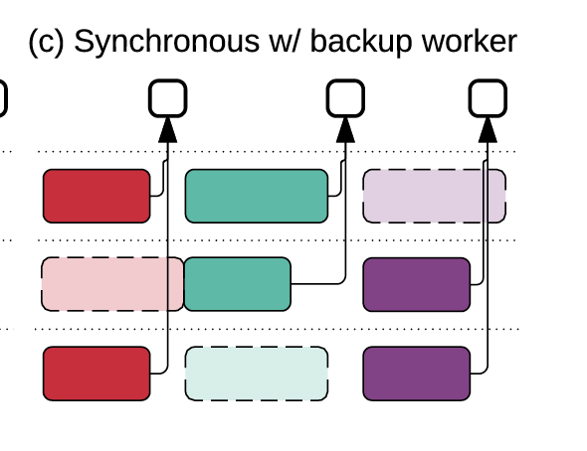
Case 3: Backup Workers
backup workers is to mitigate stragglers, which are similar to MapReduce backup tasks.
However, whereas MapReduce TensorFlow backup
Tensor-Flow | workers run proactively, and the aggregation takes the first m of n updates produced
Map-Reduce | starts backup tasks reactively (after detecting a straggler)
** exploit the fact that SGD samples training data randomly at each step, so each worker processes a different random batch, and it is not a problem if a particular batch is ignored

Slide 27
NOTE: ADD SECTION 2.3 (Related Work) to conclusion
Has a nice comparison with spark

Slide 28
Evaluation
Goal of TensorFlow is to create a system with little overhead, as well as one able to employ large amounts of computation to accelerate real-world applications s.t. researchers can play with new techniques
Does it meet this goal?
All experiments on a shared production cluster, and all figures plot median values with error bars showing the 10th and 90th percentiles.

Slide 29
Single-Machine Benchmarks
Though TensorFlow is designed for large-scale machine learning, it’s important that it also work reasonably well on small scales.
Test uses Chintala’s benchmark of convolutional models to test TensorFlow against other ML frameworks.
All tests used a six-core Intel Core i7- 5930K CPU at 3.5 GHz and an NVIDIA Titan X GPU.
Notes:
As was noted in Human-level control through deep reinforcement learning

Slide 30
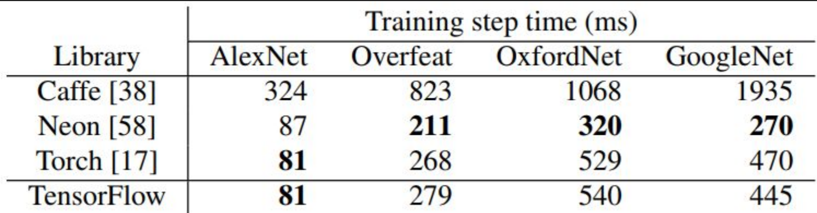
TensorFlow outperforms Caffe, does similarly to Torch
both use the same version of the cuDNN library
Neon library uses hand-optimized convolutional kernels implemented in Assembly
Theoretically could also be done in TensorFlow

Slide 31
Synchronous replica microbenchmark
Coordination implementation is main limiting factor to scaling with additional machines
Test number of null training steps that TensorFlow performs per second for varying model sizes & increasing numbers of synchronous workers
In a null training step, a worker fetches the shared model parameters from 16 PS tasks, performs a trivial computation, and sends updates to the parameters.

Slide 32
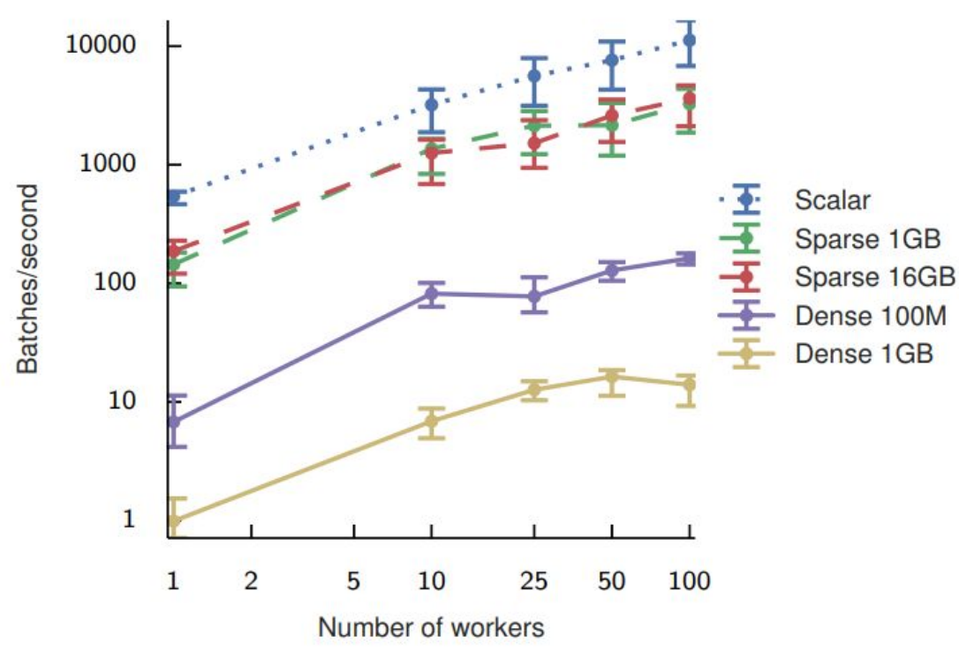
Scalar curve involves a single 4-byte value is fetched from each PS task
Dense curves show the performance of a null step when the worker fetches the entire model.
Sparse curves show the throughput of an embedding lookup operation.
Notes:
The Scalar curve in Figure 7 shows the best performance that we could expect for a synchronous training step, because only a single 4-byte value is fetched from each PS task. The median step time is 1.8 ms using a single worker, growing to 8.8 ms with 100 workers. These times measure the overhead of the synchronization mechanism, and capture some of the noise that we expect when running on a shared cluster.
Dense: We repeat the experiment with models of size 100 MB and 1 GB, with the parameters sharded equally over 16 PS tasks. The median step time for 100 MB increases from 147 ms with one worker to 613 ms with 100 workers. For 1 GB, it increases from 1.01 s with one worker to 7.16 s with 100 workers
Sparse: Each worker reads 32 randomly selected entries from a large embedding matrix containing 1 GB or 16 GB of data. As expected, the step times do not vary with the size of the embedding, and TensorFlow achieves step times ranging from 5 to 20 ms

Slide 33
Image Classification
Common task for real-world neural nets
Uses Google’s Inception-v3 model, using multiple replicas. TensorFlow was configured with 7 PS tasks, with the number of worker tasks varied between two different clusters
First, test TensorFlow vs MXNet, using Intel Xeon E5 servers with NVIDIA K80 GPUs, configured with 8 vCPUs, 16Gbps of network bandwidth, and one GPU per VM.

Slide 34
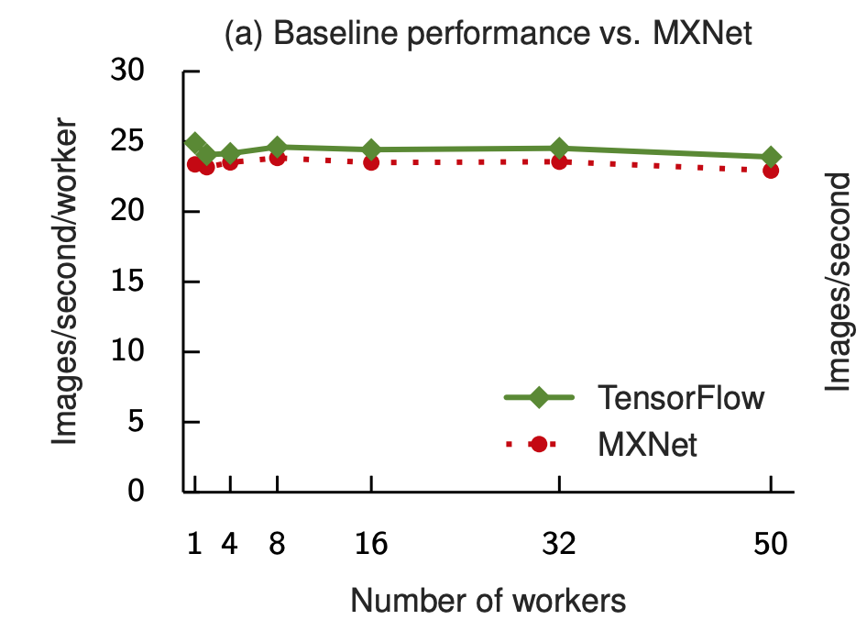
Image Classification

Slide 35
Image Classification
Next, we try a larger cluster with NVIDIA K40 GPUs, and a shared datacenter network, in order to test the effects of coordination on performance.
We get increased performance, though at diminishing returns.
This is due to tail latency – for all synchronous operations, all workers must wait for the slowest worker to catch up before moving to the next step.

Slide 36
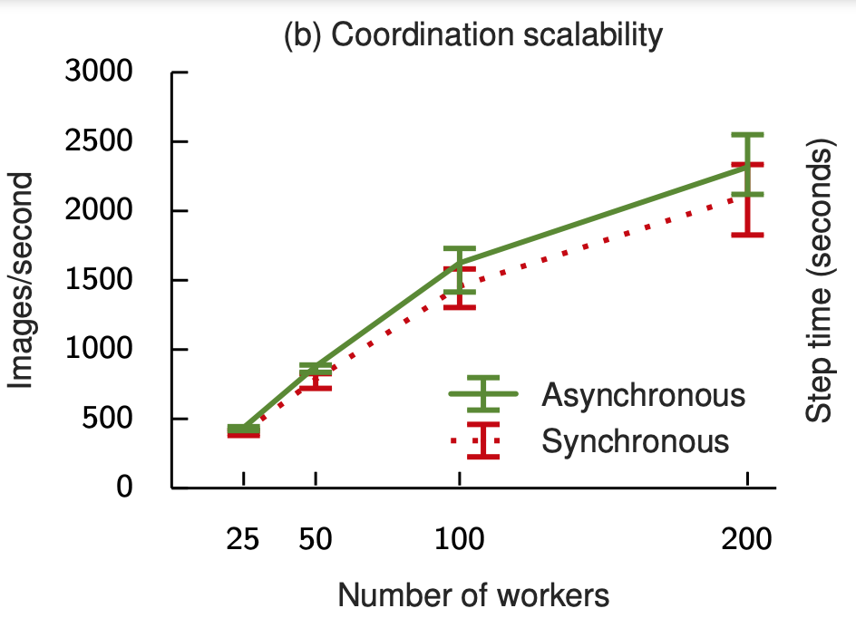
Image Classification
Notes:
Training throughput improves to 2,300 images per second as we increase the number of workers to 200, but with diminishing returns
As expected, for all configurations, synchronous steps are longer than asynchronous steps, because all workers must wait for the slowest worker to catch up before starting the next step. While the median synchronous step is approximately 10% longer than an asynchronous step with the same workers, above the 90th percentile the synchronous performance degrades sharply, because stragglers disproportionately impact tail latency.

Slide 37
Image Classification – mitigating tail latency
Add backup workers so that a step completes when the first m of n tasks produce gradients.
Additional workers (up to the fifth) reduces median step time. Adding a fifth worker does not, as the first worker whose result is discarded in favor of a backup is more likely to be a non-straggler.
Adding 3 backup workers maximized the highest normalized speedup (aggregate GPU time)

Slide 38
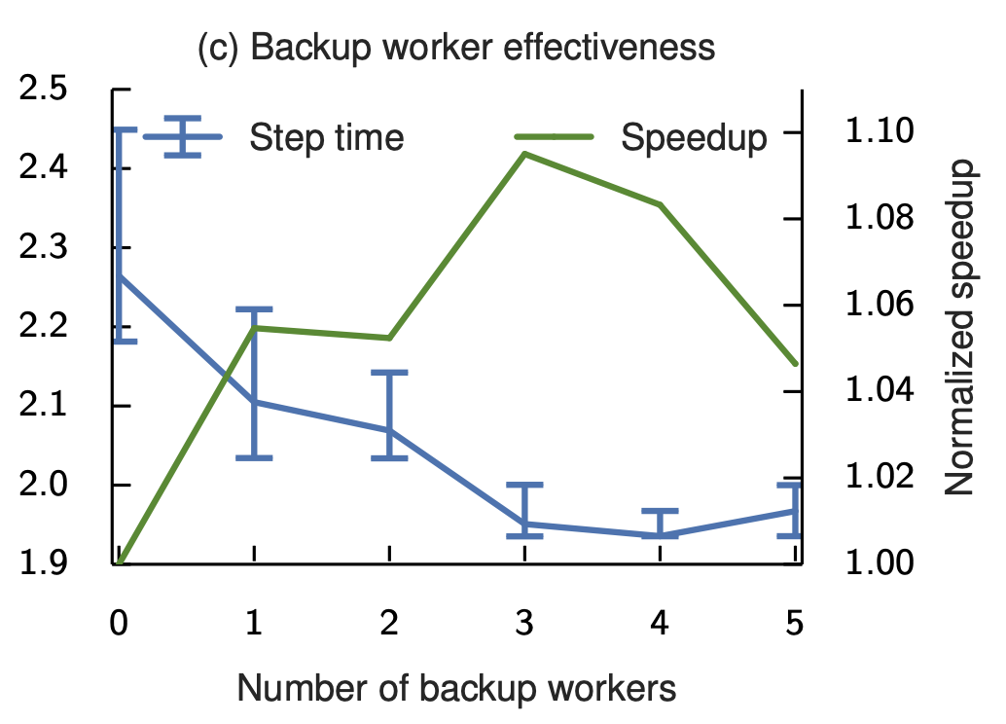
Image Classification – mitigating tail latency

Slide 39
Language Modeling
Task: Predict next word given a sequence of words
Test how TensorFlow can train a RNN to model the text in the One Billion Word Benchmark.
Notes:
PS parameter server tasks

Slide 40
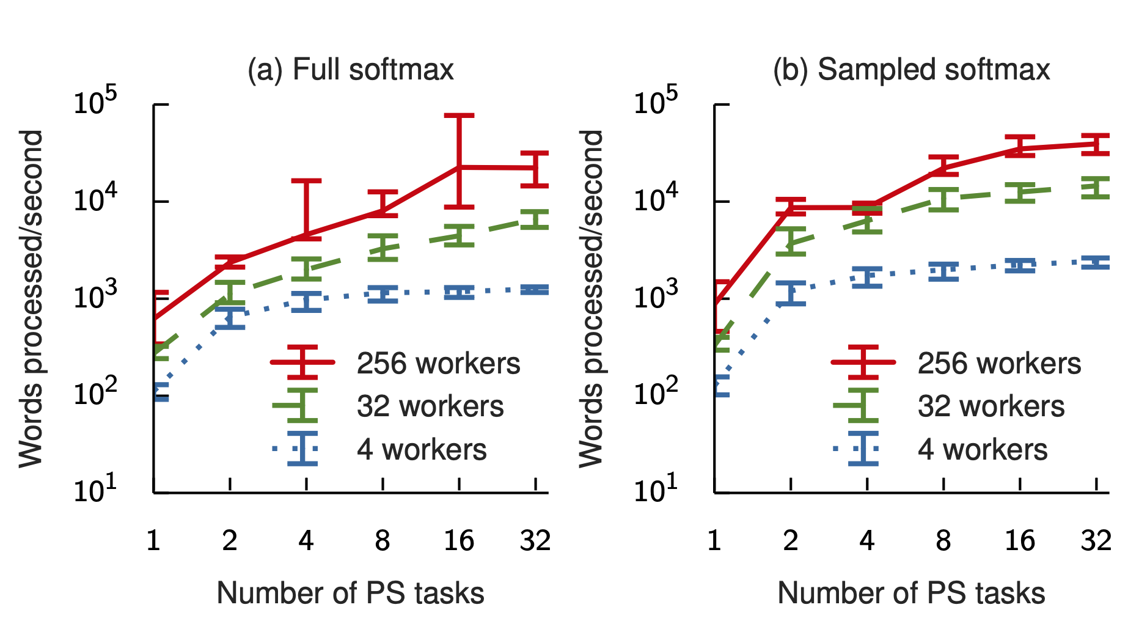

Slide 41
Future Work
Default Policies and automatic optimization
New and better algorithms for automatic placement, kernel fusion, memory management, and scheduling.
Building stronger consistency at user-level
Moving past a static dataflow graph (deep reinforcement learning)

Slide 42
Conclusion
TensorFlow system and programming model gives a flexible and efficient framework for scaling ML.
Any Questions?

