Slide 1
Project Adam: Building an Efficient and Scalable
Deep Learning Training System
Chiao Lu, Koji Kusumi, Po-Chun Chiu

Slide 2
Overview
Motivation
Architecture
Fast Data serving
Model Training
Global Parameter Server
Evaluation
Summary
Notes:
First i will discuss Adam’s motivation, and its high level design
Also, I will discuss the first feature of Adam’s architecture: it's fast data serving.
Next, Ciao wil cover how Adam quickly trains models, and Po-Chun will cover the global parameter server.
I will conclude with the author’s evaluation of the system and a summary of the system as a whole.

Slide 3
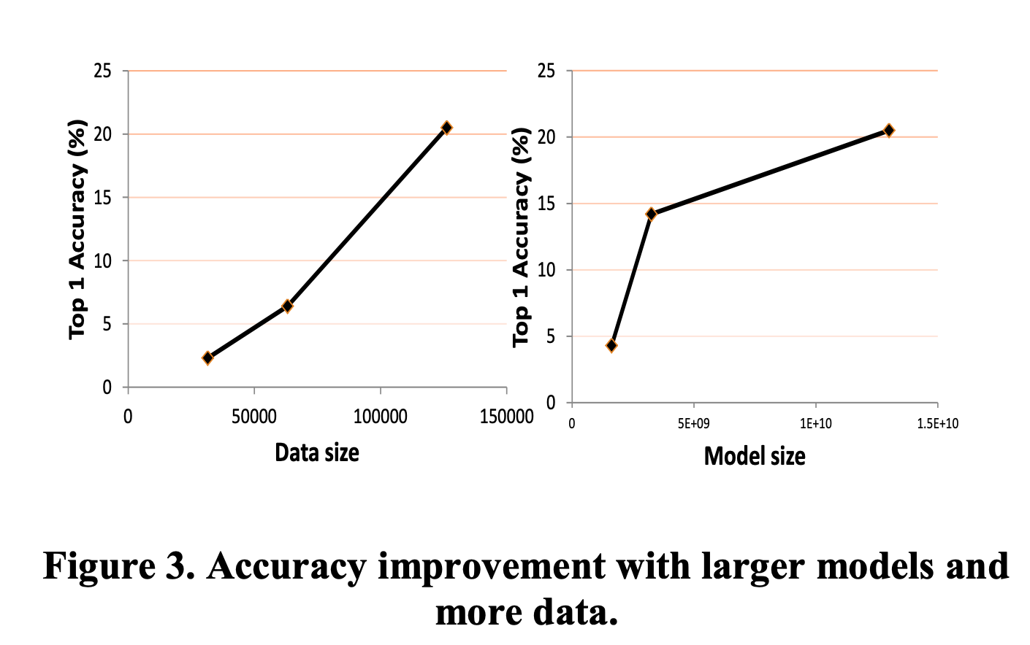
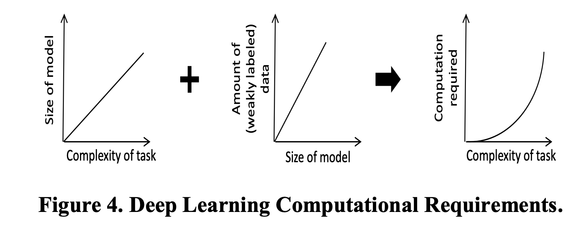
Motivation
Powerful DNNs are very large
Model accuracy increases with size
But this is more expensive
Adam: Distributed system designed to train state-of-the art DNNs
Done efficiently on commodity machines
Focus on visual tasks
Notes:
DNNs are the cutting edge of Machine Learning. They are extremely powerful, but also very large. The reason for their size is that models get more accurate as we increase the number of amount of training data and the number of parameters. As a result, the most accurate models are huge.
For additional intuition, if we increase the complexity of the task, the size of the model scales linearly, coupled with the fact that we need to increase the amount of training dat, we get quadratically increasing computiona
Adam is a distributed system designed to train state-of-the art DNNs. The designers goals where to do this efficiently and on commodity machines. The authors focus on visual tasks since they are the most complex DNN problems.

Slide 4
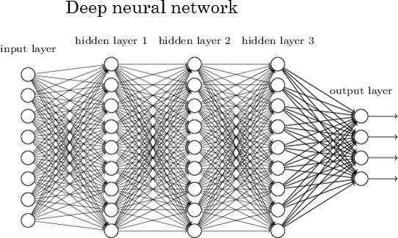
Background
Feed Forward
Compute activation for all nodes
Matrix multiplication
BackPropagation
Computer error based on desired output
Error in a layer l influences error in l-1
Parameter Updates
Based on our error
Update our weights in our network

Slide 5
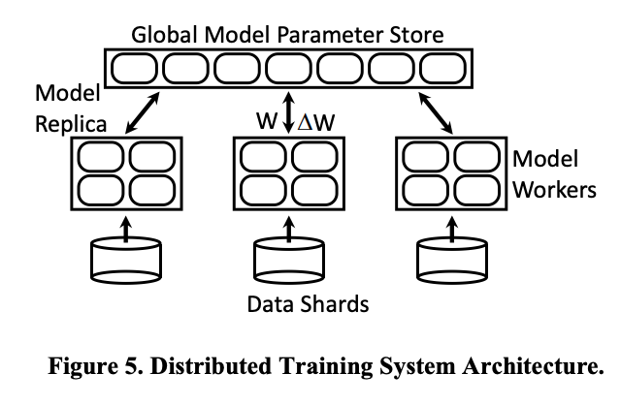
Adam System Architecture
Based on Multi-Spert
Composed on 3 distributed components
Data serving machines (Data shards)
Partition data to work in parallel
Vertically partitioned model replica
Large models cannot fit on one machine
Global parameter server
Done asynchronously
Efficiency
Accuracy
Notes:
Adam is based on multi-spert. Which is a well known design for distributed model training. Adam has three distributed components. The first are the data shards. The data shards partition the dataset so that inputs can be processed in parallel. Each data shard feeds a model replica. These models are partitioned across multiple machines because models are often to large to fit in a single machine. Finally, there is a global parameter that stores the model weights. Updates are done asynchronous. This was done first for performance benefits, but it actually resulted in increased inference accuracy.

Slide 6
Fast Data Serving
Need to serve vast quantities of training images
With expensive transforms applied
Data servers use almost all memory as image cache
Serve image asynchronous
Worker machines request image in background thread
Main thread always has images available
Notes:
Model replicas consume vast quantities of training images. Before they are fed to models, the training images have transforms applied. The data servers do this eagerly, and store them. They use almost their entier memory as an image cache. Worker machines request images in a background thread so that images are always available for the main worker thread.

Slide 7
2. Model Training
Vision Task
Convolutional layers followed by a few fully connected layers
Vertical model partitioning
Reduce cross-machine communications
Optimizations
Synchronization Optimization
Communication Data Optimizations

Slide 8
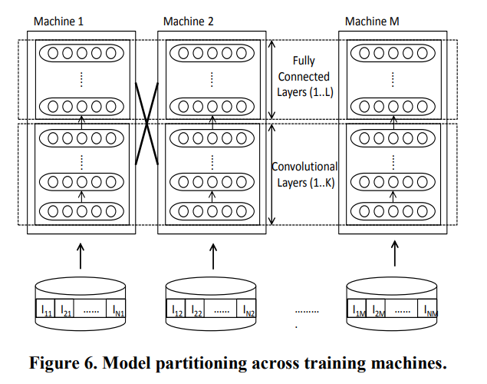
2. Model Training - Vertical Model Partitioning

Slide 9
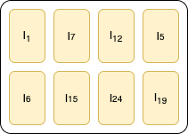
2. Model Training - Multithreading
Different images assigned to threads that share same model weights.
Thread contexts are pre-allocated to avoid heap locks
NUMA aware threads
Non-Uniform Memory Access
Lock free local weights update/access for different threads
Makes sense because weight updates are commutative and associative
Also because deep neural networks are resilient to small noise
Figure: Multiple threads can work on different inputs in parallel

Slide 10
2. Model Training - Reducing Memory Copies
For threads in a single machine, communicate through pointers instead of copying data
For cross machine communication, use Windows Socket API with IO completion ports
Reference counting to ensure safety

Slide 11
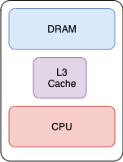
2. Model Training - Memory System Optimizations
Use L3 cache instead of RAM for storing working sets
Forward and backward propagation require different matrix layout (row-major vs column-major)
Use custom hand-tuned assembly kernels
Figure: L3 Cache is a good balance between size and speed

Slide 12
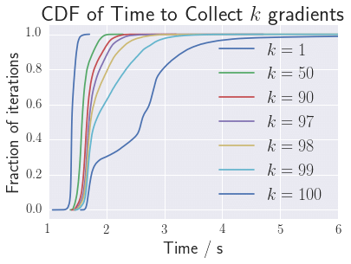
2. Model Training -Mitigating the Impact of Slow Machines
Allow multiple threads to process images in parallel
Early end of epoch - when 75% of the model replicas complete processing their images
Alternative approach that wasn’t implemented
Fast machines steal work from slow machines

Slide 13
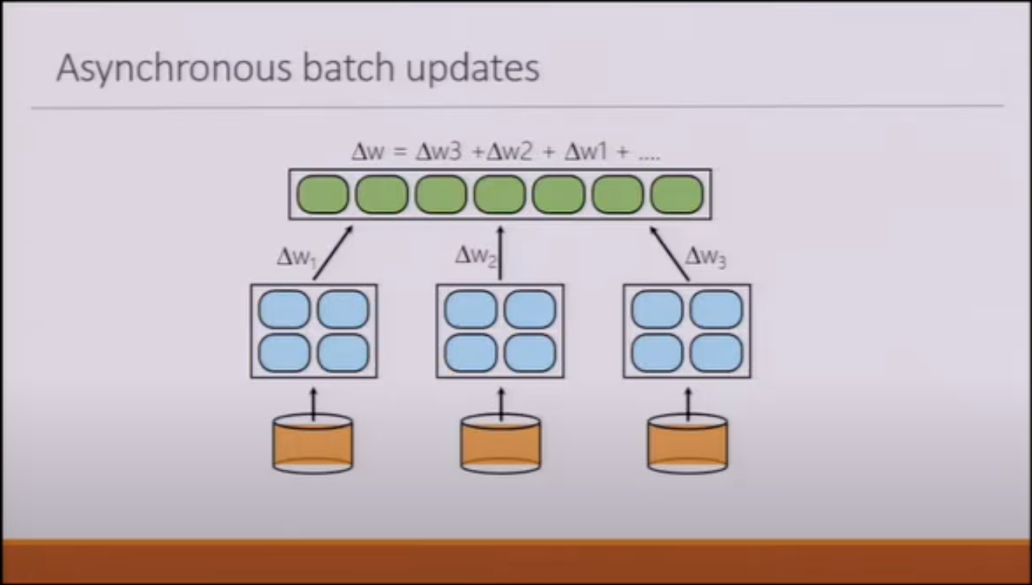
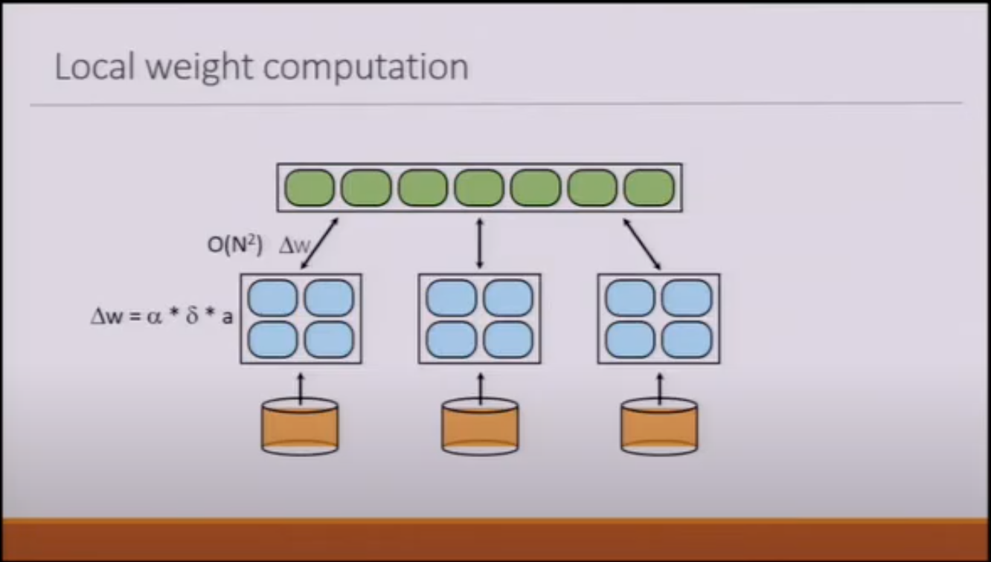
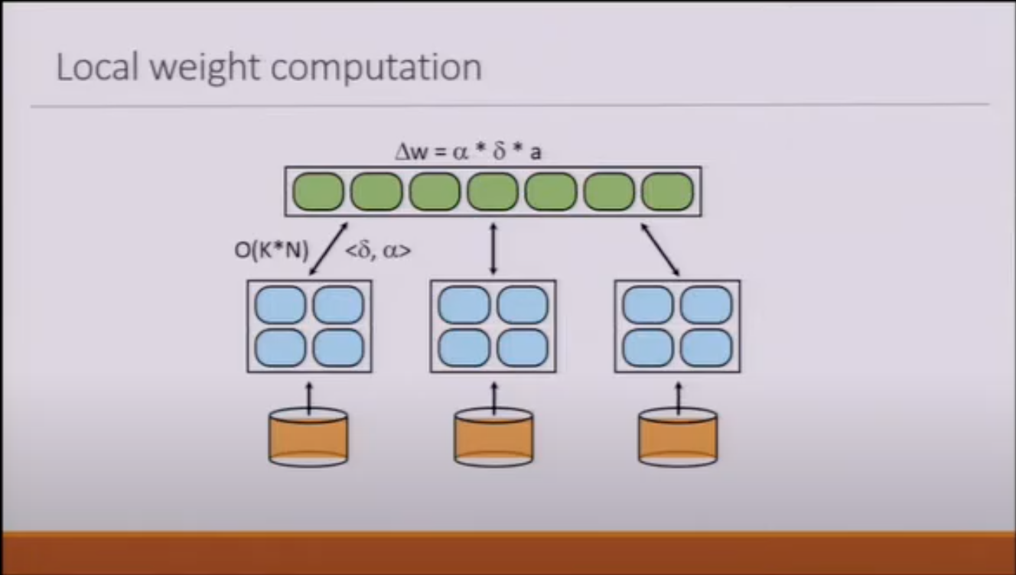
2. Model Training - Parameter Server Communication
Locally compute and accumulate weights in a buffer and send k-batch into parameter server periodically
For fully-connected layers which have many more weights, do not send weight updates to parameter server
Send activation and error gradient vectors instead
Significantly reduces communication from M*N to k*(M+N)
Leverages the CPU power in parameter servers which are typically underutilized

Slide 14
3. Global Parameter Server
The Parameter Server communicates with model training machines(Clients)
Multiple Design features are introduced in Parameter Server for better scalability and fault tolerance:
Throughput Optimizations
Delayed Persistence
Fault Tolerant Operation
Communication Isolation
Notes:
This communications sends current weight values and receives updates to model parameters.

Slide 15
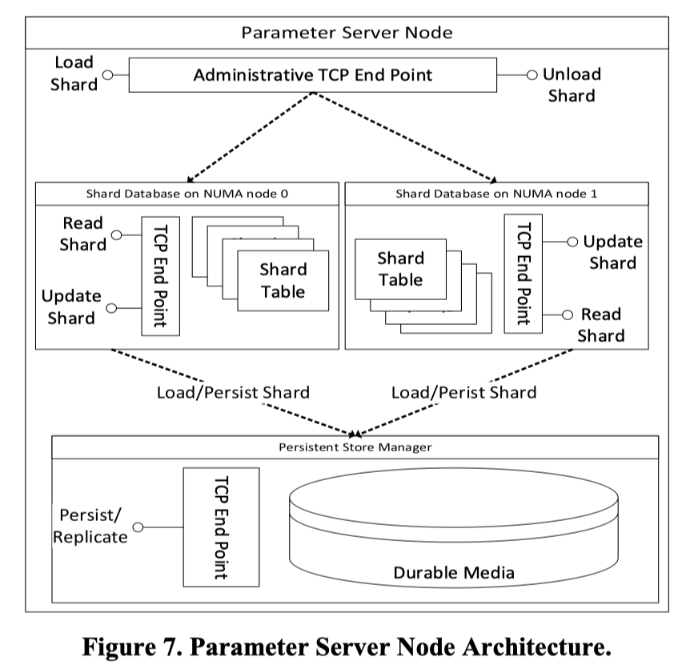
3. Parameter
Server
Node
Architecture
Notes:
2 Paths are isolated in that they don’t interfere each other
Parameters are partitioned into shards to be read and update
Store persistent shards in persistent manager

Slide 16
3. Global Parameter Server
Throughput Optimizations
Model parameters divided into 1MB sized shards
Partitions improve spatial locality of update processing
Distributions help load balance workload
Batch updates for locality and relieve L3 Cache pressure
Notes:
The parameters are hashed into buckets distributed across parameter server machines
Partitioning the shards improve the locality
Distributing the shards actually help to load balance workload across
Apply updates to a block of parameters, allows improvement for locality and L3 cache pressure relieve

Slide 17
3. Global Parameter Server
Throughput Optimizations (Continue)
Lock Free Data Structures (Queues & Hash Tables) in high traffic execution, which improves the following speed up: Network, Update, Disk IO Processing
Lock Free Memory Allocation: Buffers are allocated from pools of specified size from 4KB to 32MB (in powers of 2)
Notes:
What’s Learned: The design features and refinements in this section primarily achieves scalability and eliminates scalability bottlenecks

Slide 18
3. Global Parameter Server
Delayed Persistence
Potential Data Loss is tolerable
Updates can be recovered
Achieve Compressed writes to durable storage
Notes:
1. The DNN models still learn even in the presence of small amount of update loss
2. Simply retrain the model with appropriate input data when needed
3. Folds many updates to a single parameter update

Slide 19
3. Global Parameter Server
Delayed Persistence (Continue)
What’s Learned: Persistence can be delayed in order to achieve high throughput serving to training nodes

Slide 20
3. Global Parameter Server
Fault Tolerant Operation
Central Parameter Server Controller
3 copies per shard (1 primary and 2 secondaries)
Controller hand out bucket assignments
Constant heartbeats communications
Clients contact Controller for parameter shards location
Notes:
Parameter Server Controller controls and manages these servers
3 Copies of replica, storing across different servers
Hand primary with lease generated, Hand Secondary with associated primary lease info
Heartbeats to check server status and handle machine failure

Slide 21
3. Global Parameter Server
Fault Tolerant Operation (Continue)
Primary’s role: Accepts update & Makes replication via heartbeats
Secondary’s role: Checks the lease info & Potential role change proposal
Controller’s role: Elect new primary, manage lease info, and propagate role updates
Notes:
Primary accepts updates for all chunks within a bucket, makes replication changes to shards for all secondaries
Secondary checks lease info for commit, and secondary makes role change proposal with lease info it holds to controller if encounter prolonged absence of primary heartbeats
Controller propagates changes to all servers related to the bucket

Slide 22
3. Global Parameter Server
Fault Tolerant Operation (Continue)
What’s Learned: Many mechanisms, including the central controller design, primary and secondary replica, heartbeats communication are used to achieve fault tolerance

Slide 23
3. Global Parameter Server
Communication Isolation
Two 10Gb NICs (Network Interface Controller)
2 paths are isolated into their own NICs
Maximize network bandwidth and minimize interference
Administrative traffic isolated from the controller to the 1Gb NIC

Slide 24
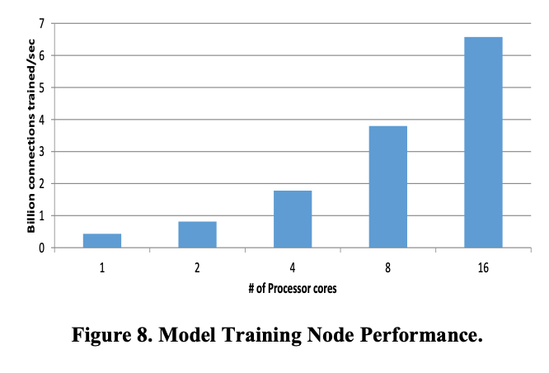
Evaluation: Model Training System
Baseline
Single model training and no parameter server
Only vary number of cores
On MNIST digits dataset
Superlinear speedup until 4 cores
Cache performance
Linear after that
Notes:
The first experiment the authors ran studied that scalability across multiple cores. They tested their system on a single model without a parameter sever. They tested on the MNIST dataset. The authors found a superlinear speed until 4 cores. This was enabled by exploiting cache performance and avoiding extra accesses to memory. After 4 cores, the authors experienced good linear speedup.

Slide 25
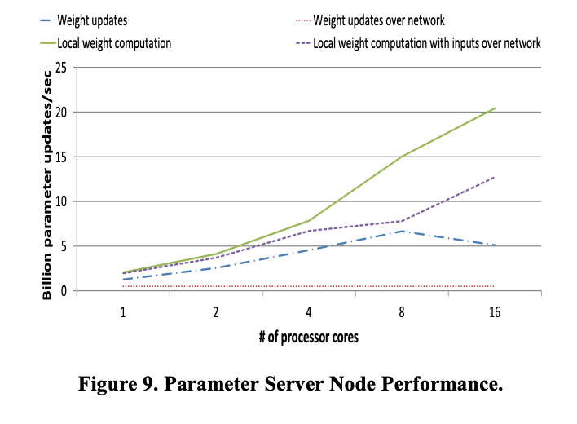
Evaluation: Parameter Server
Run on Image 22k dataset
Computation local to parameter server
Only send gradient
<𝛿, ɑ> vs. Δw
Purple shows a huge improvement over red
Notes:
The next experiment the authors ran studied the effect of local computation. The first experiment was sending all of the weights over the network. This scaled poorly as the system was bottlencked by the network bandwidth. By arbitrary removing the network limitations they got better scalability until 8 cores. However, they were then bottlenecked by the machines NIC. Next, they tested the scalability using local computation. Instead of sending the weight delta, they only sent the gradients. This exhibited much better scaling. Finally, they removed the network constraint and got the best scalability. The two lines we care about are the red and blue/ since they exhibit performance in real-world scenarios (with a network).

Slide 26
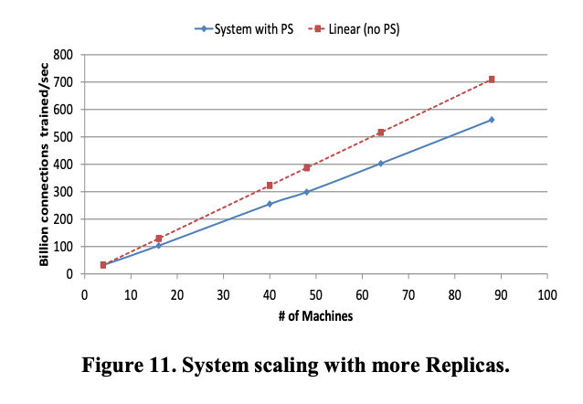
Evaluation: Scaling Model Replicas
Parameter adds little overhead
Still exhibits strong linear scaling
Redline does not actually train
Notes:
Finally, the authors tested the scalability of the parameter server. They ran an experiment where machines didn’t coordinate and another where they did. They saw that both scaled well, and there wasn’t much overhead associated with the parameter server.

Slide 27
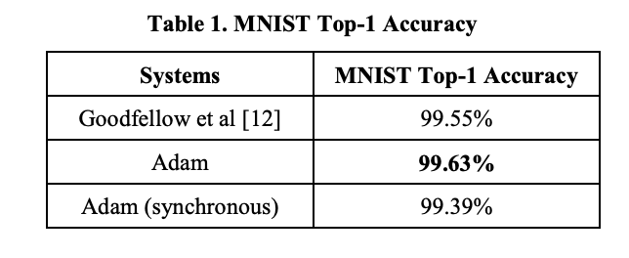
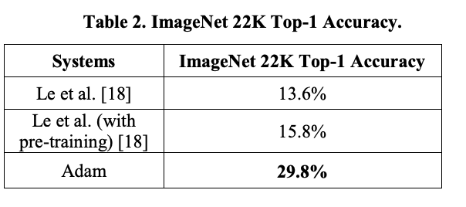
Evaluation: Accuracy
Improved on MNIST state-of-the-art by 0.08%
Previous jump took four years
Improved on Image 22k state-of-the-art 14%
Random guessing is 0.0045%
Could reach previous best
With 62 machines, 1 day of training
Vs. 2000 machines, 1 week of training
Asynchronicity introduces noise
Allows Adam to “jump” out of unstable local minima
Notes:
The authors found that Adam had great accuracy. They experienced a 0.08% improvement over the state-of-the art MNIST model. To put that in perspective in took 4 years for a jump of that size. They also compared there accuracy against the state of the art on the Image22k dataset, which has images from 22k different categories. A random guess would only get an accuracy of 0.0045%. Adam improved on the best by 14%. In addition, it took Adam onl 62 machines and 1 dat of rtraiing to achieve what the previous best required 2000 machines and a week of training. The authors believed that the asynchronicity of the global parameter server was was introduced improved accuracy.

Slide 28
Summary
Scaling
Partitioned dataset for parallel computation
Partitioned models for greater cache utilization
Global parameter server
minimize communication & delayed calculation
Asynchronous updates
Fault Tolerance
Parameter server shards are replicated 3 times
Controller machines create PAXOS cluster that route request to parameter server
Usage
Lots of low-level optimizations
Usage of an asynchronous global parameter store is probably applicable to other systems

