Slide 1
Dynamo: Amazon’s Highly Available Key-Value Store
SOSP’07

Slide 2
Goals
Building a distributed storage system with following attributes:
Simple: key/value pair
Scalable
High Availability
Guarantee Service Level Agreement (SLA)

Slide 3
Comparison with BigTable
Big Table
Distributed storage system for structured data
Sparse, multi-dimensional sorted map
Applications access the data via multiple attributes
Dynamo
Applications require only key-value access
Mainly for managing state of services (e.g., shopping cart, customer preferences, sales rank, product catalog)
High availability where updates are not rejected even in the presence of server failures and network partitions
“Always writable” data store due to failures or concurrent writes
Eventual consistency
For higher availability in read get() and write put()
Latency-sensitive applications: 99.9% read/writes within 100s of milliseconds

Slide 4
System Assumptions
Query Model: Simple read and write operations to a data item that is uniquely identified by a key.
Binary objects (i.e., blob) with a primary key
ACID Properties not guaranteed
No Isolation guarantees, only single key updates
Efficiency: Latency requirements which are in general measured at the 99.9th percentile of the distribution.
Operation environment is assumed to be trusted, and there are no security related requirements such as authentication and authorization.

Slide 5
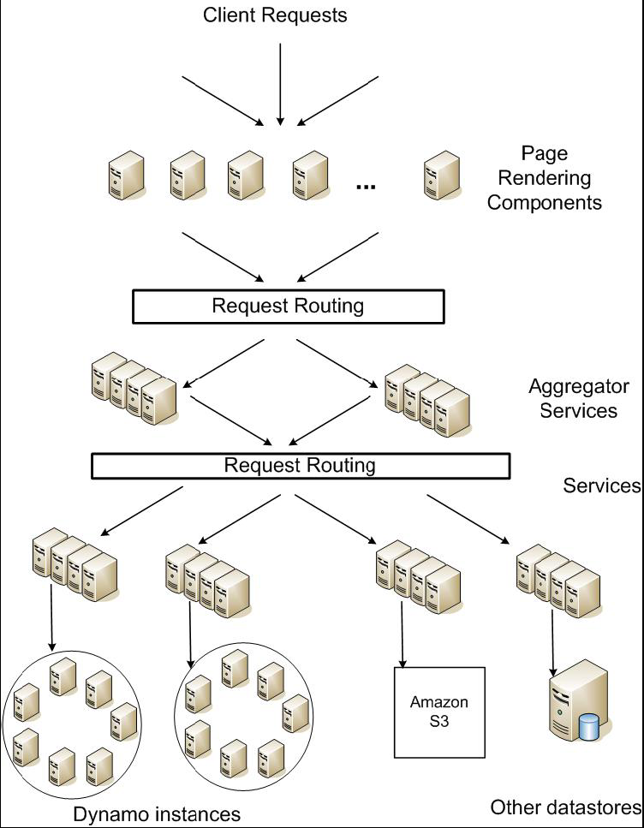
Service Level Agreements (SLA)
Service-oriented architecture of Amazon’s platform
Application can deliver its functionality in abounded time: Every dependency in the platform needs to deliver its functionality with even tighter bounds.
Example: service guaranteeing that it will provide a response within 300ms for 99.9% of its requests for a peak client load of 500 requests per sec.

Slide 6
Design Considerations
Strong consistency and high availability cannot be achieved simultaneously. Thus, sacrificing consistency for availability.
CAP theorem
Conflict resolution is executed during read instead of write. (“always writeable”)
Other principles:
Symmetry
Increased scalability
Decentralization
Heterogeneity

Slide 7
Summary of techniques used in Dynamo
Problem | Technique | Advantage
Partitioning | Consistent Hashing | Incremental Scalability
High Availability for writes | Vector clocks with reconciliation during reads | Version size is decoupled from update rates.
Handling temporary failures | Sloppy Quorum and hinted handoff | Provides high availability and durability guarantee when some of the replicas are not available.
Recovering from permanent failures | Anti-entropy using Merkle trees | Synchronizes divergent replicas in the background.
Membership and failure detection | Gossip-based membership protocol and failure detection. | Preserves symmetry and avoids having a centralized registry for storing membership and node liveness information.

Slide 8
Partitioning Algorithm
Dynamo’s partitioning algorithm relies on consistent hashing and concept of “virtual nodes”.
Consistent Hashing: The
output range of a hash
function is treated as a fixed
circular space or “ring”.
“Virtual Nodes”: Each node can
be responsible for more than one
virtual node.

Slide 9
Advantages of virtual nodes
If a node becomes unavailable (due to failure or routine maintenance), the load handled by this node is evenly dispersed across all remaining nodes.
When a node becomes available, or a new node is added to system, the newly available node accepts a roughly equivalent amount of load from every other available node.
The number of virtual nodes that a node is responsible for can be decided on its capacity, accounting for heterogeneity in the physical infrastructure.

Slide 10
Replication
Every item is replicated at N hosts.
The list of nodes that is responsible for storing a particular key is called preference list.

Slide 11
Data Versioning
A put() call may return to its caller before the update has been applied at all the replicas
A get() call may return many versions of the same object.
Challenge: an object having distinct version sub-histories, which the system will need to reconcile in the future.
Solution: uses vector clocks in order to capture causality between different versions of the same object.

Slide 12
Vector clock example

Slide 13
Issue with vector clock
Size of vector clocks may grow if many servers coordinate the writes to an object.
Solution: Limit the size of vector clock but might lead inefficiencies in reconciliation
Not observed practically.

Slide 14
Execution of get () and put () operations
Route its request through a generic load balancer that will select a node based on load information.
Use a partition-aware client library that routes requests directly to the appropriate coordinator nodes.

Slide 15
Sloppy Quorum
R/W is the minimum number of nodes that must participate in a successful read/write operation.
Setting R + W > N yields a quorum-like system.
In this model, the latency of a get (or put) operation is dictated by the slowest of the R (or W) replicas. For this reason, R and W are usually configured to be less than N, to provide better latency.

Slide 16
Flow of put and get
Upon receiving put() request coordinator generates the vector clock for new version and sends the new version to N highest ranked reachable node.
If at least W-1 responds then write is successful.
Similarly for read, if R responses are received from top N then successful

Slide 17
Hinted handoff
Assume N = 3. When A is temporarily down or unreachable during a write, send replica to D.
D is hinted that the replica is belonging to A and it will deliver to A when A is recovered.
Thus Writeable even if some nodes are down.

Slide 18
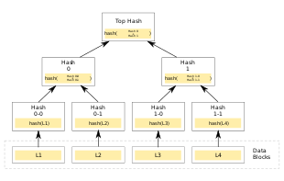
Other techniques
Replica synchronization:
Merkle/Hash tree.
Detecting inconsistencies among replicas
Hash tree where leaves are hashes of the values of individual keys
Parent nodes higher in the tree are hashes of their respective children
Membership and Failure Detection:
Gossip
External Discovery to avoid logical partition
Seed nodes
Commonly shared

Slide 19
Implementation
Dynamo has three main software components: request coordination, membership and failure detection, and a local persistence engine.
All these components are implemented in Java
Local persistence component allows for different storage engines to be plugged in:
Berkeley Database (BDB) Transactional Data Store: object of tens of kilobytes
MySQL: object of > tens of kilobytes
BDB Java Edition, etc.

Slide 20
Evaluation
99.9th percentile latencies are affected by several factors such as
variability in request load, object sizes, and locality patterns.

Slide 21
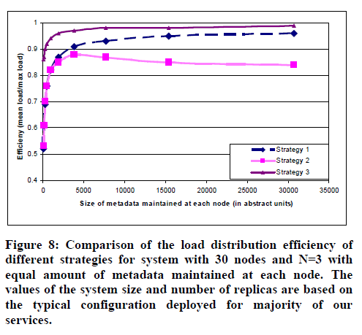
Load distribution analysis

Slide 22
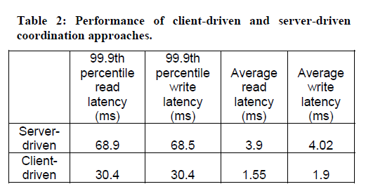
Client-driven or Server-driven Coordination
Advantage of client driven coordination is that a load balancer is no longer required to uniformly distribute client load.

Slide 23
More on Dynamo
Dynamo offers user flexibility to change the values of N,R and W.
Unlike popular commercial data stores, Dynamo exposes data consistency and reconciliation logic issues to the developers.
Dynamo adopts a full membership model where each node is aware of the data hosted by its peers (via gossip).
But full membership is difficult to attain for thousands of node as overhead of maintaining routing table increases with system size.
The problem can be solved by hierarchy model implementation.

