Slide 1
f4: Facebook’s Warm BLOB Storage System
CS219, Winter 2021

Slide 2
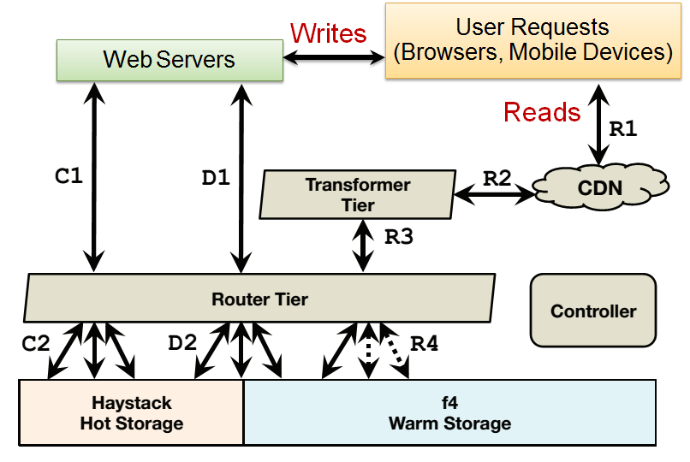
Facebook’s BLOB Storage Architecture

Slide 3
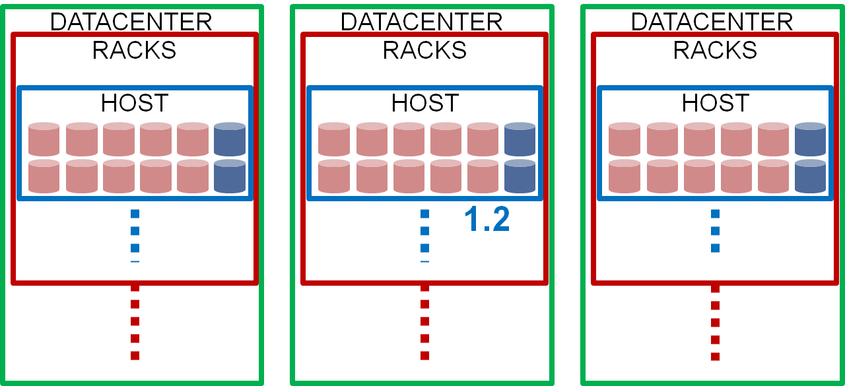
Haystack: Facebook’s Hot Storage System Optimized for IOPS
Handling failures: DC failures, Rack failures, Host failures, Disk failures
Handling load: load splits to 3 ways
Replication factor: 3 * 1.2 = 3.6 (triple replication for data files and hardware RAID-6)
Notes:
IOPS（Input/Output Operations Per Second）

Slide 4
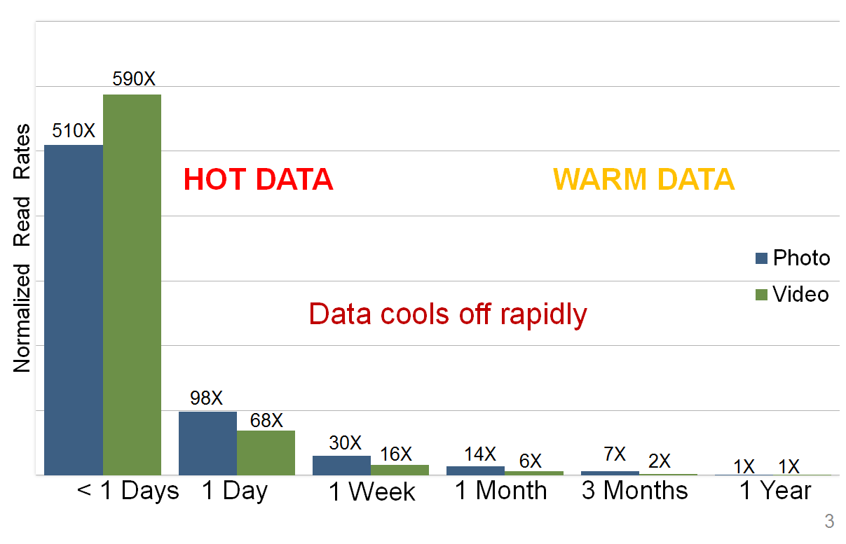
The Case of Warm Storage

Slide 5
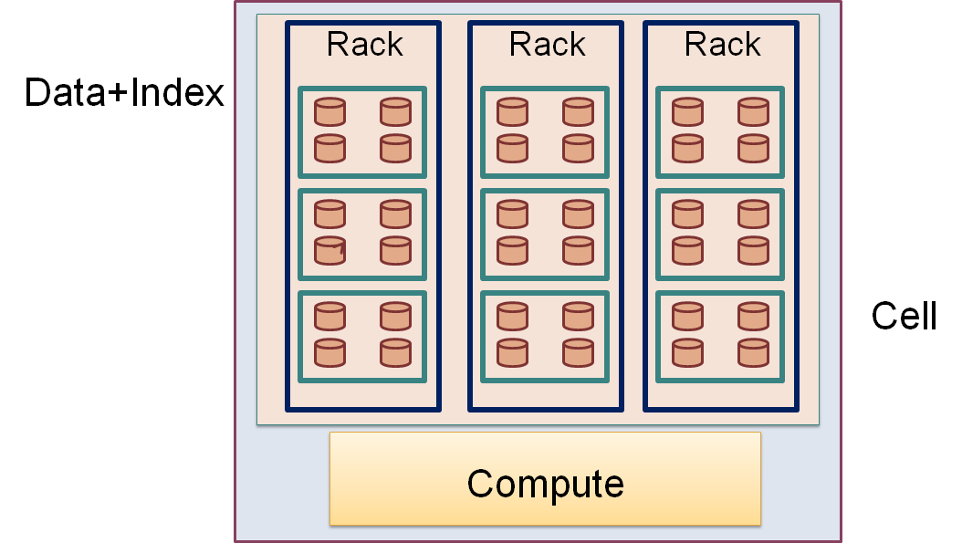
Introducing f4: Haystack on cells

Slide 6
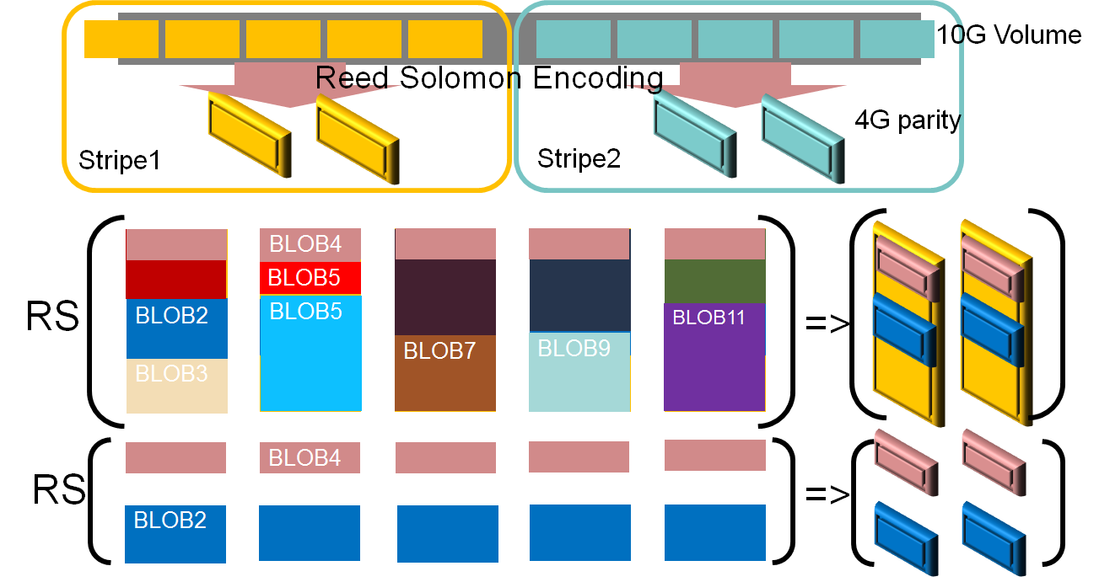
Data Splitting

Slide 7
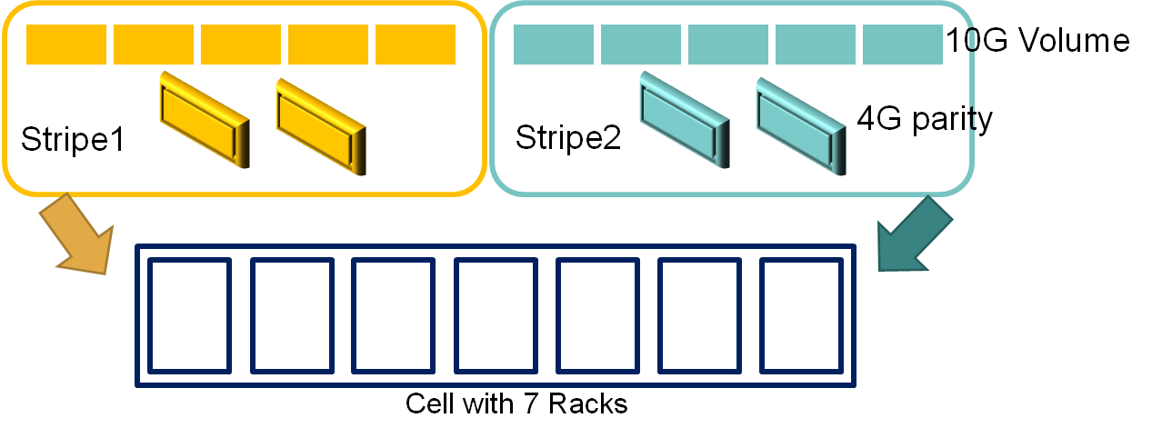
Data Placement
Reed Solomon (10, 4) is used in practice (1.4X)
Tolerates 4 racks (4 disk/host ) failures

Slide 8
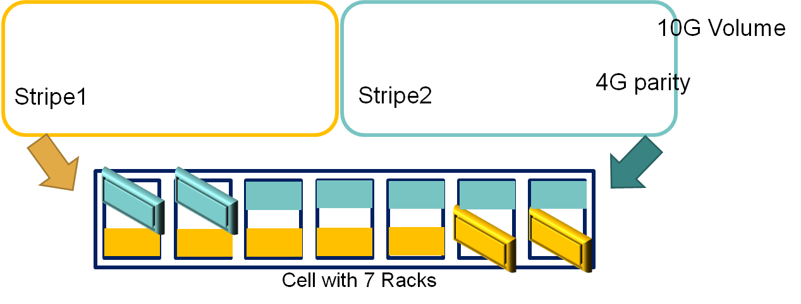
Data Placement
Reed Solomon (10, 4) is used in practice (1.4X)
Tolerates 4 racks (4 disk/host ) failures

Slide 9
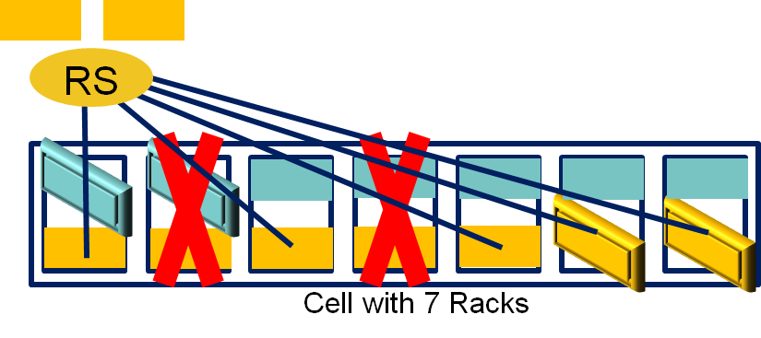
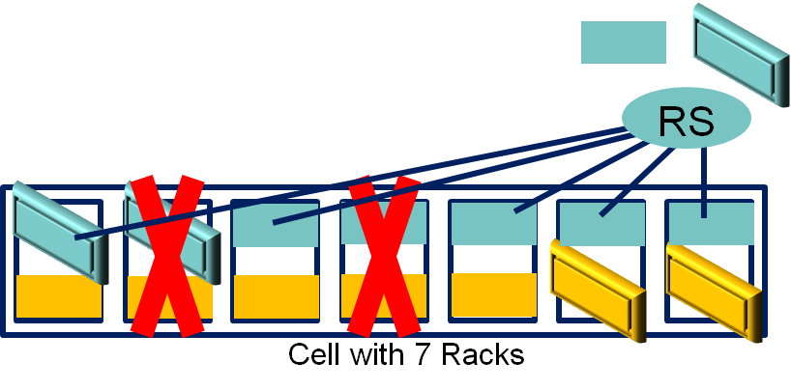
Reed Solomon in Practice: 2 Racks Failure

Slide 10
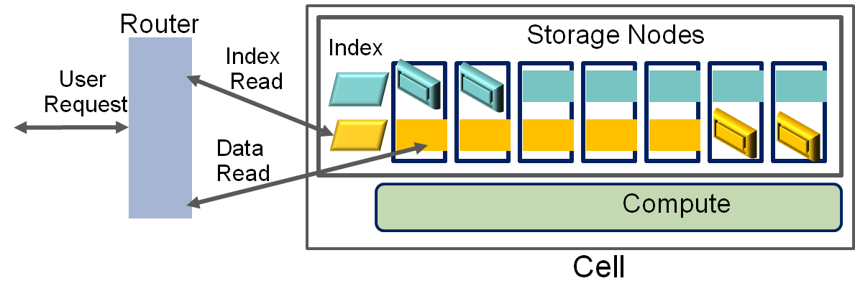
Reads
2-phase: Index read returns the exact physical location of the BLOB

Slide 11
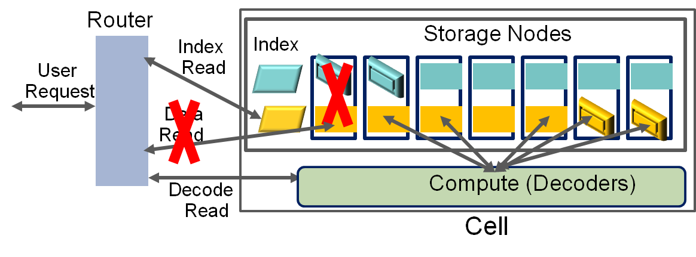
Reads Under Cell-Local Failures
Cell-Local failures (disks/hosts/racks) handled locally

Slide 12
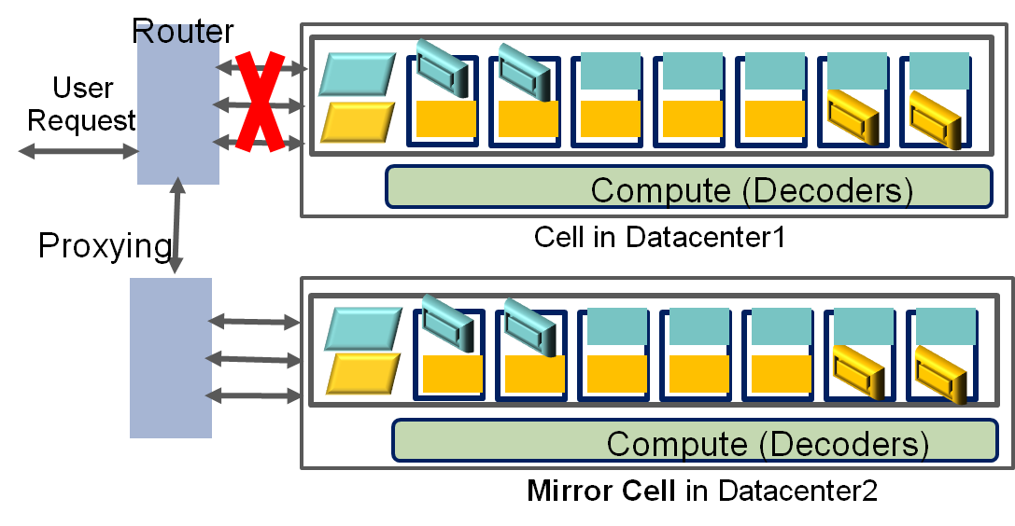
Reads Under Datacenter Failures (2.8X)
Replication factor: 2 * 1.4X = 2.8X (Mirror Cell and Reed Solomon Coding)

Slide 13
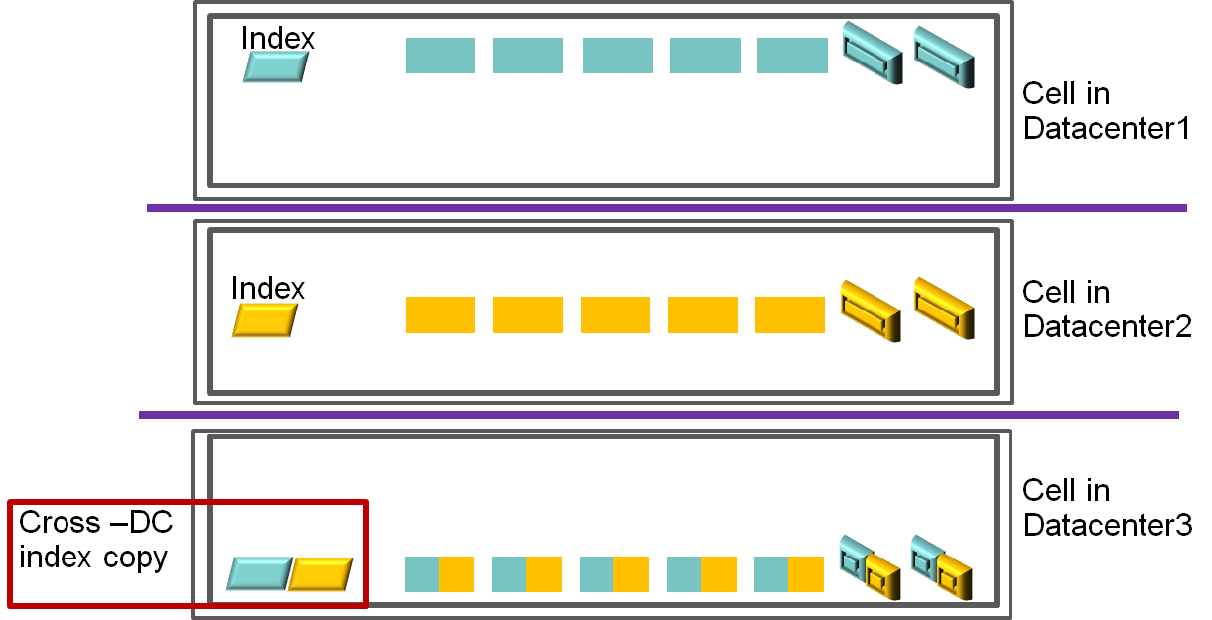
Cross Datacenter XOR

Slide 14
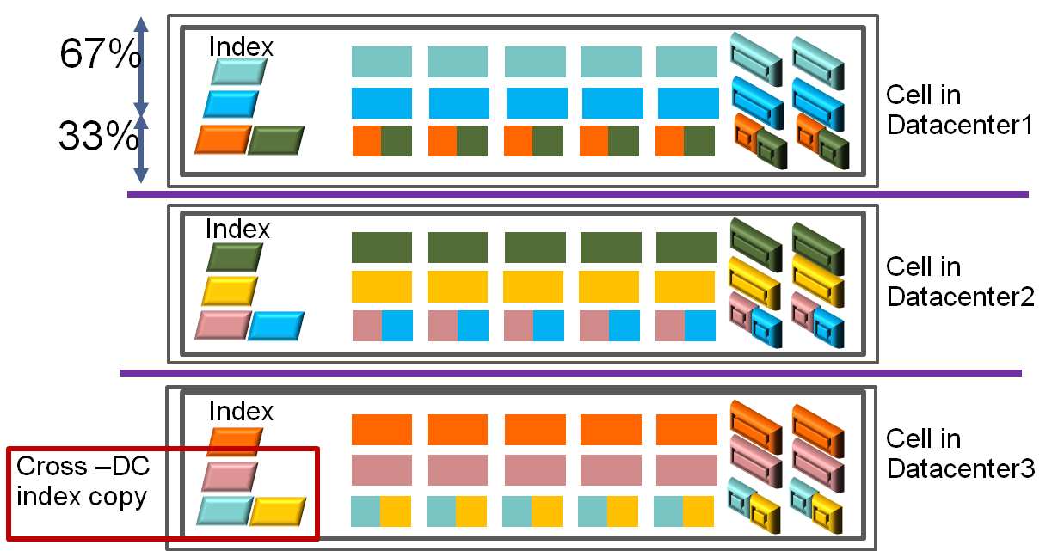
Cross Datacenter XOR
Replication factor: 1.5 * 1.4X = 2.1X (1 Cross copy for every 2 DC and Reed Solomon Coding)

Slide 15
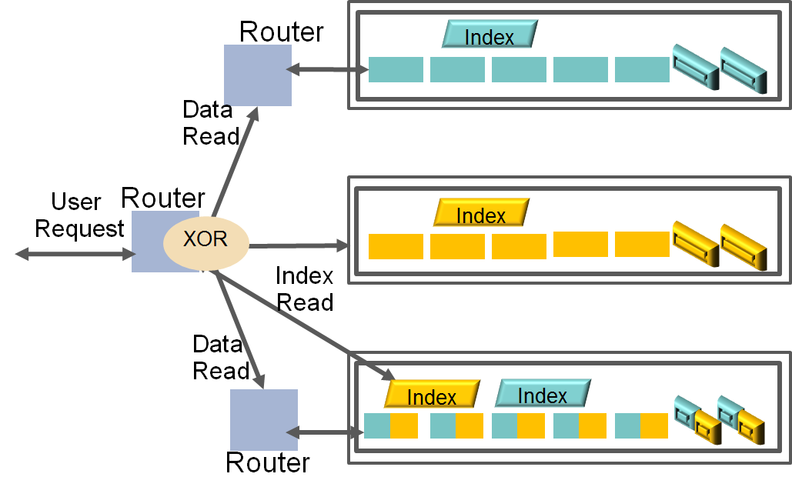
Reads With Datacenter Failures (2.1X)

Slide 16
Haystack v/s f4 2.8 v/s f4 2.1
 | Haystack with 3 copies | f4 2.8 | f4 2.1
Replication | 3.6X | 2.8X | 2.1X
Irrecoverable Disk Failures | 9 | 10 | 10
Irrecoverable Host Failures | 3 | 10 | 10
Irrecoverable Rack failures | 3 | 10 | 10
Irrecoverable Datacenter failures | 3 | 2 | 2
Load split | 3X | 2X | 1X

Slide 17
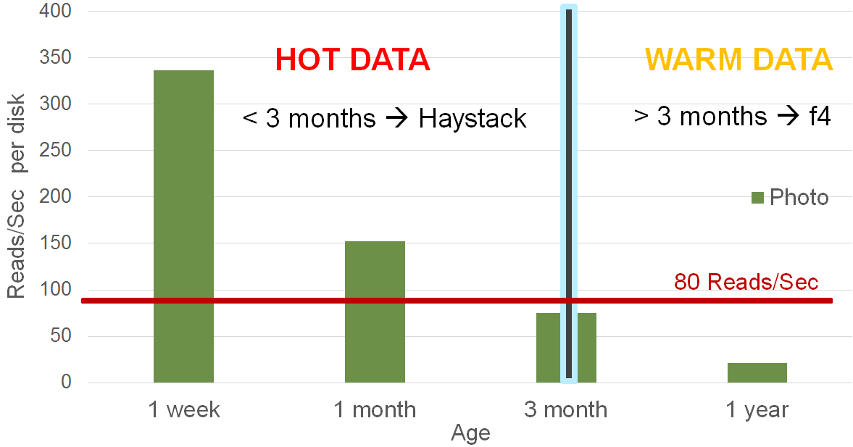
Hot and Warm Divide

Slide 18
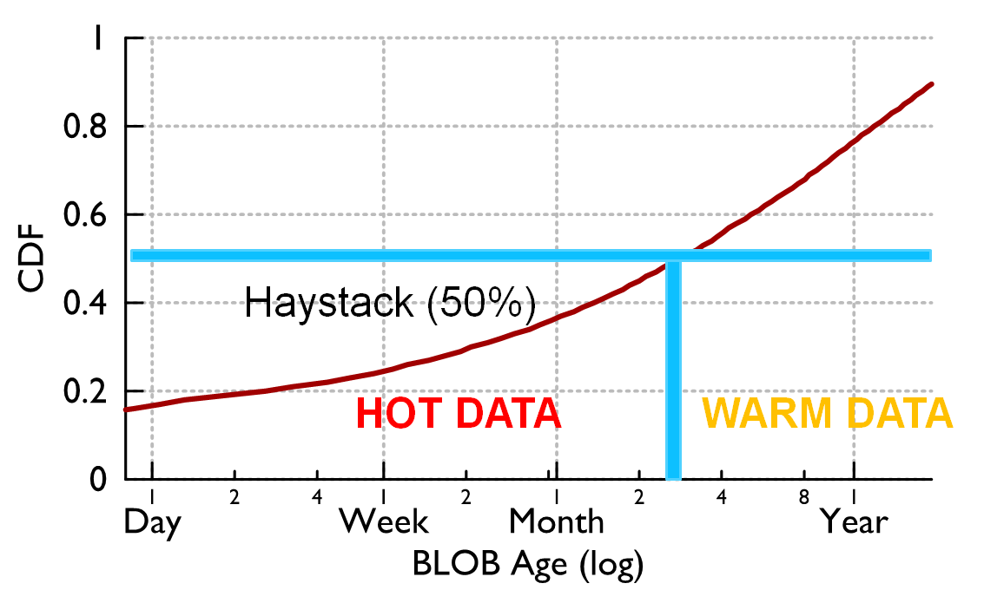
Haystack Handles more than 50% of Data Requests

Slide 19
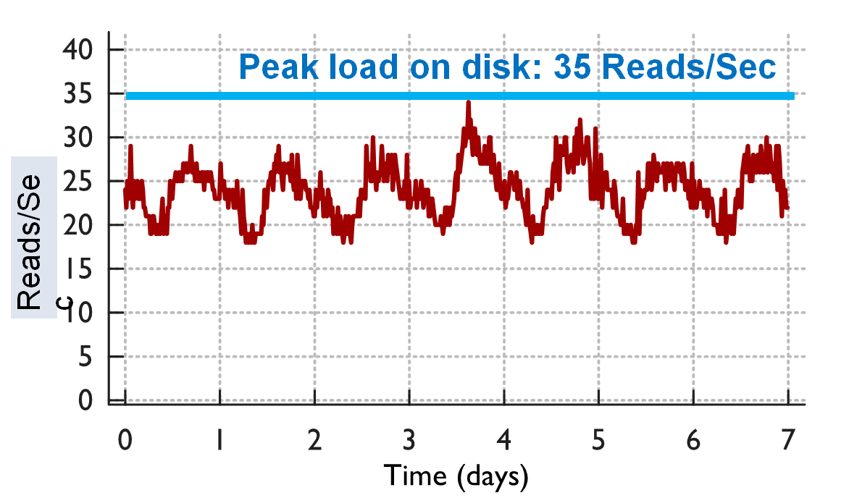
f4 Performance: Most Loaded Disk in Cluster

Slide 20
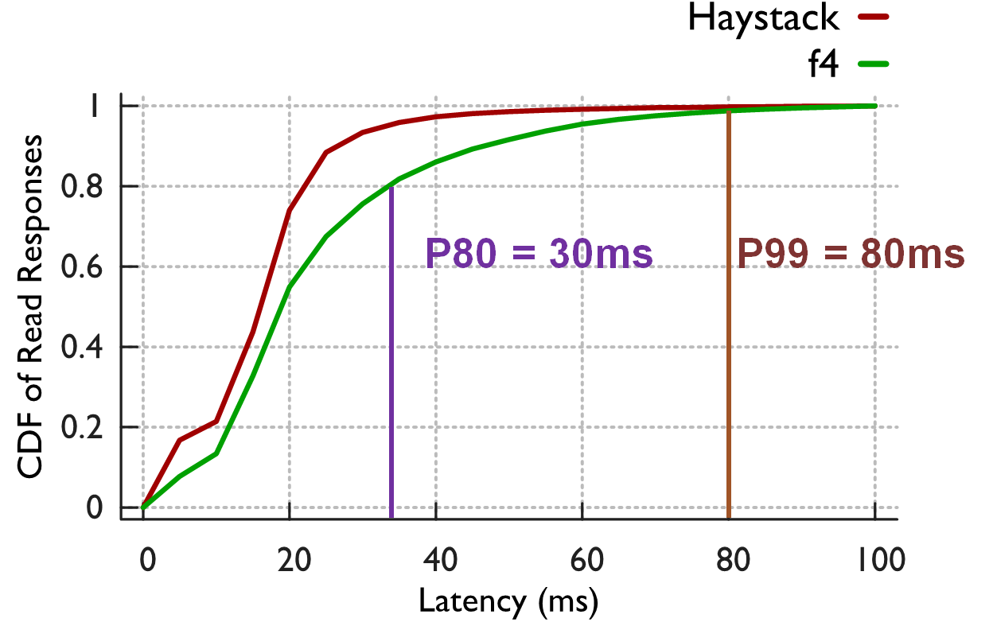
f4 Performance: Latency

Slide 21
Conclusion
Facebook’s BLOB storage is big and growing
Recency, frequency, age factors impact cache
BLOBs cool down with age
~100X drop in read requests in 60 days
Haystack’s 3.6X replication over provisioning for old, warm data.
f4 encodes data to lower replication to 2.1X

