Slide 1
Megastore: Providing Scalable, Highly Available Storage for Interactive Services
CIDR’11

Slide 2
Outline
Desired Features
Background
Toward Availability and Scale
Replication
Partitioning and Locality
A Tour of Megastore
API Design
Data Model
Transactions and Concurrency Control
Related Work
Conclusion

Slide 3
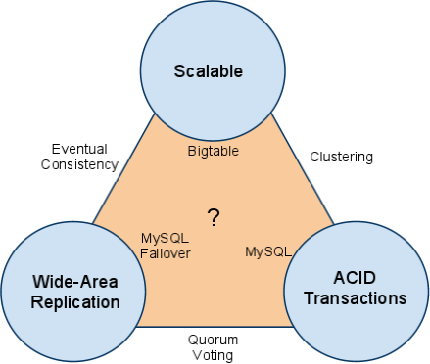
Desired Features

Slide 4
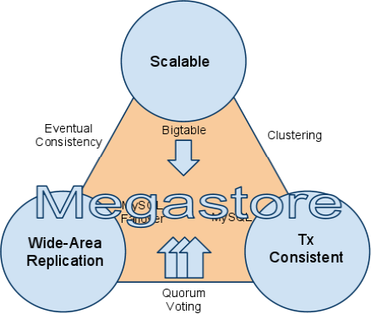
Technology Solution

Slide 5
Storage System Contexts
Today’s storage requirements
Highly scalable (MySQL is not enough)
Rapid development (fast time-to-market)
Low latency (service must be responsive)
Consistent view of data (update result)
Highly available (24/7 internet service)
Conflicts
RDBMS
difficult to scale to hundreds of millions of users
NoSQL datastores
Google’s Bigtable, Apache Hadoop’s HBase, Facebook’s Cassandra
Limited APIs, loose consistency models
Megastore: take the middle ground
Scalability of a NoSQL with the convenience of a traditional RDBMS
Synchronous replication to achieve high availability and a consistent view of the data
NoSQL != Not SQL
NoSQL == Not Only SQL
Not using fixed table schemas
Avoid join operations
Typically scale horizontally

Slide 6
Background: Why not lots of RDBMS’s?
Functional
Need a place to store global and full-text indexes
Space and time
Create new local entity group (EG) in ~10ms
Overhead of <1KB per EG
Administration
Load rebalancing
Fault recovery
Monitoring
Operational team

Slide 7
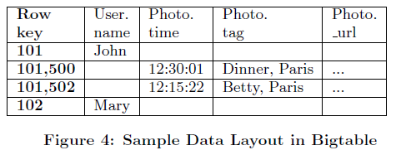
Background: Locality in Bigtable
Bigtable:
Column-oriented storage
Faster access to nearby rows

Slide 8
Megastore
Started in 2006 for app development at Google
Service layered on
Bigtable (NoSQL scalable data store per datacenter)
Chubby (Config data, config locks)
TurnKey scaling (apps, users)
Developer-friendly features
Wide-area synchronous replication
Partition by “Entity Group”

Slide 9
Megastore
The largest system deployed using Paxos to replicate primary user’s data across datacenters on every write
Contributions
Design of data model & storage system allows rapid development of interactive applications
Optimized for low-latency operations across geo-distributed datacenters
Experience with large-scale deployment of Megastore at Google

Slide 10
Achieving Goals
Scale
Bigtable within a datacenter
Easy to add entity groups (storage, throughput)
ACID Transactions
Write-ahead log per entity group
Two-phase commit (2PC) for atomic commitment or queues between entity groups
Wide-area replications
Paxos
Tweaks for optimal latency

Slide 11
Toward Availability and Scale
For availability
Synchronous, fault-tolerant log replicator optimized for long-distance links
For scale
Partitioned data with a vast space of small databases
Each replicated log stored in a per-replica NoSQL datastore

Slide 12
Replication
Replicating data across hosts
Improves availability by overcoming host-specific failures
ACID transactions are important
Solution approach by Megastore: Paxos algorithm
Proven, optimal, fault-tolerant consensus algorithm
No requirement for a distinguished master
Any node can initiate reads and writes of a write-ahead log
Latency driven
Multiple replicated logs (due to communication latencies)

Slide 13
Paxos Recap
Solving consensus in a network of unreliable processors and communications
Consensus: the process of agreeing on one result among a group of participants
Roles
Client, acceptor, proposer, learner, leader
Protocols: 2-phases
Phase 1a: Prepare
A Proposer (the leader) selects a proposal number N and sends a Prepare message to a Quorum of Acceptors.
Phase 1b: Promise
If the proposal number N is larger than any previous proposal, then each Acceptor promises not to accept proposals less than N, and sends the value it last accepted for this instance to the Proposer (the leader).
Otherwise a denial is sent (Nack).
Phase 2a: Accept!
If the Proposer receives responses from a Quorum of Acceptors, it may now Choose a value to be agreed upon. If any of the Acceptors have already accepted a value, the leader must Choose a value from this set. Otherwise, the Proposer is free to choose any value.
The Proposer sends an Accept! message to a Quorum of Acceptors with the Chosen value.
Phase 2b: Accepted
If the Acceptor receives an Accept! message for a proposal it has not promised not to accept in 1b, then it Accepts the value.
Each Acceptor sends an Accepted message to the Proposer and every Learner.

Slide 14
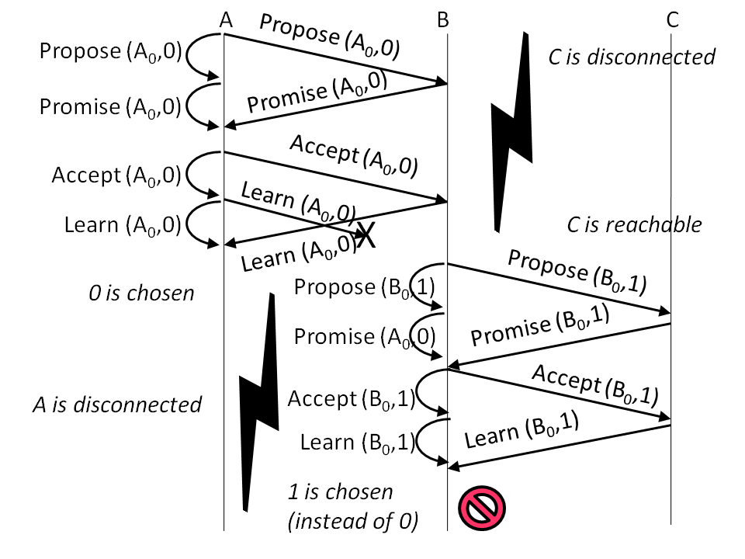
Another Simplistic Example for Paxos

Slide 15
Paxos: Megastore Tweaks
Replicates transaction log entities on each write
Writes: one WAN round trip (average)
Strong Reads: zero WAN round trips (average)
Per-replica bitmap invalidated on faults
Reads/Writes from any replica (no master)
No pipelining: limited per-EG throughput
Batching will improve throughput
Background scanners finish all operations

Slide 16
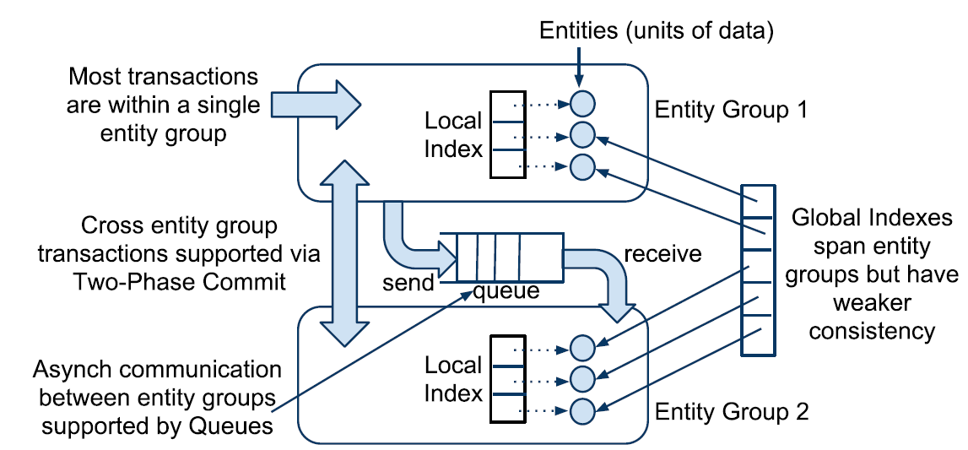
Partitioning and Locality
For scale-up of the replication scheme
Entity groups
Data is stored in a scalable NoSQL datastore
Entities with an entity group are mutated with single-phase ACID transactions
Operations
Cross entity group transactions supported via two-phase commits
Inter-Entity Groups have
looser consistency

Slide 17
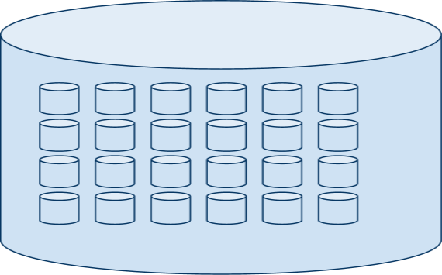
Entity Groups
Entity groups are sub-databases

Slide 18
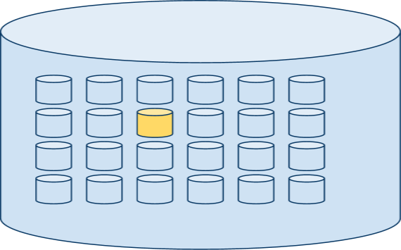
Entity Groups
Cheap transactions within each entity group (common)

Slide 19
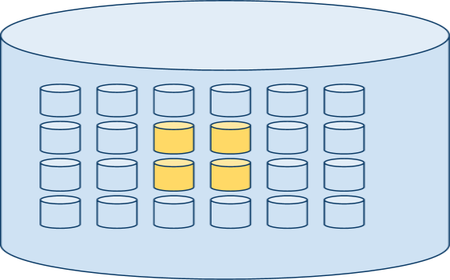
Entity Groups
Expensive or loosely-consistent operations across entity groups (rare)

Slide 20
Entity Group Example
An Example of entity groups in applications
Email
Each email account forms a natural entity group
Operation within an account are transactional: user’s send message is
guaranteed to observe the change despite of fail-over to another replica
Blogs
User’s profile is entity group
Operations such as creating a new blog rely on asynchronous messaging with two-phase commit
Maps
Diving the globe into non-overlapping patches
Each patch can be an entity group

Slide 21
Entity Group Mapping Example
Applications must choose their partitioning
Common operations within an EG
Application | Entity Groups | Cross-EG Operations
Email | User accounts | None (out-of-system)
Blogs | Users, blogs | Access control, notifications, global indexes
Map | Local patches | Patch-spanning ops (2PC)
Social | Users, groups | Messages, bi-directional relations, notifications
Resources | sites | shipments

Slide 22
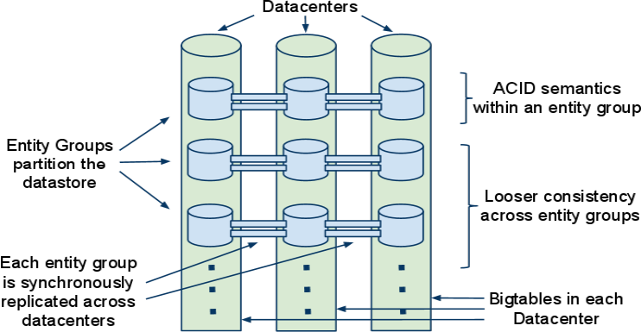
Scale Axis versus Replication Axis

Slide 23
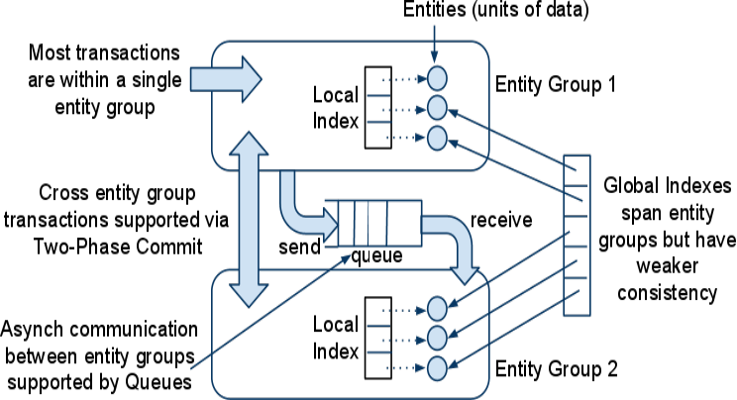
Operations Across Entity Groups

Slide 24
Megastore Design
API design philosophy
Trade-off between scalability and performance
ACID transaction need both correctness and performance
Relational schema is not right model
Bigtable (e.g., key-value store) is straightforward to store and query hierarchical data
Data model
(Hierarchical) data is de-normalized to eliminate the join costs
Joins are implemented in application level
Outer joins with parallel queries using secondary indexed
Provides an efficient stand-in for SQL-style joins

Slide 25
Data Model
Basic strategy
Abstract tuples of an RDBMS + row-column storage of NoSQL
RDBMS features
Data model is declared in a schema
Tables per schema / entities per table / properties per entity
Sequence of properties is used for primary key of entity
Hierarchy (foreign key)
Tables are either entity group root or child tables
Child table points to root table
Root table and child table are stored in the same entity group

Slide 26
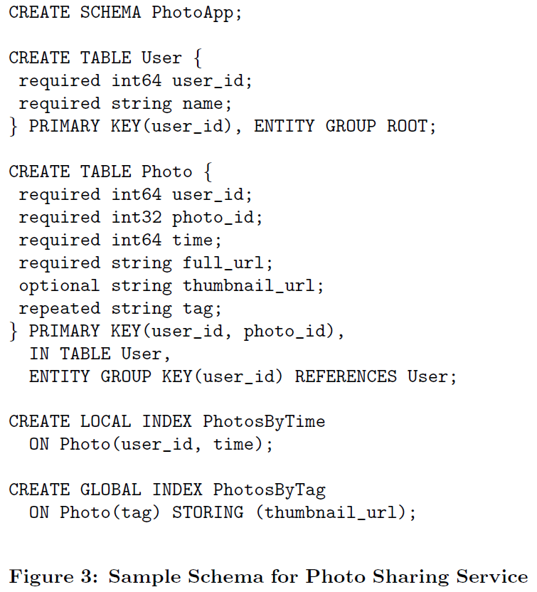
Data Model Example

Slide 27
Data Model
Indexes
Secondary indexes are supported
Local index
separate indexed for each entity group (e.g. PhotosByTime)
Global index
spans entity groups, indexed index across entity groups (e.g. PhotosByTag)
Repeated Index
Supports indexing repeated values (e.g. PhotosByTag)
Inline Index
Provide a way to de-normalized data from source entities
A virtual repeated column in the target entry (e.g. PhotosByTime)

Slide 28
Transactions and Concurrency Control
Concurrency Control
Each entity group is a mini-database, which does provide serializable ACID Semantics
A transaction writes its mutation into the entity group’s write-ahead log, then the mutations are applied to the data
MVCC: multi-version concurrency control
Read consistency
Current: last committed value
Snapshot: value as a start of the read transaction
Inconsistent reads: ignore the state of log and read the last values directly
Write consistency
Always begins with a current read to determine the next available log
Commit operation assigns mutations of write-ahead log a timestamp higher than any previous one
Paxos uses optimistic concurrency with mutations (write operations)

Slide 29
Transactions and Concurrency Control
Complete transaction lifecycle in Megastore
1. Read
Obtain the timestamp and log position of the last committed transaction
2. Application logic
Read from Bigtable and gather writes into a log entry
3. Commit
Use Paxos to achieve consensus for appending that entry to the log
4. Apply
Write mutations to the entities and indexes in Bigtable
5. Clean up
Delete data that is no longer required

Slide 30
Replication
Megastore’s replication system
Single, consistent view of the data stored in its underlying replicas
Characteristics
Reads and writes can be initiated from any replicas
ACID semantics are preserved regardless of what replica a client starts from
Replication is done per entity group
By synchronously replicating the group’s transaction log
Writes require one round of inter-datacenter communication

Slide 31
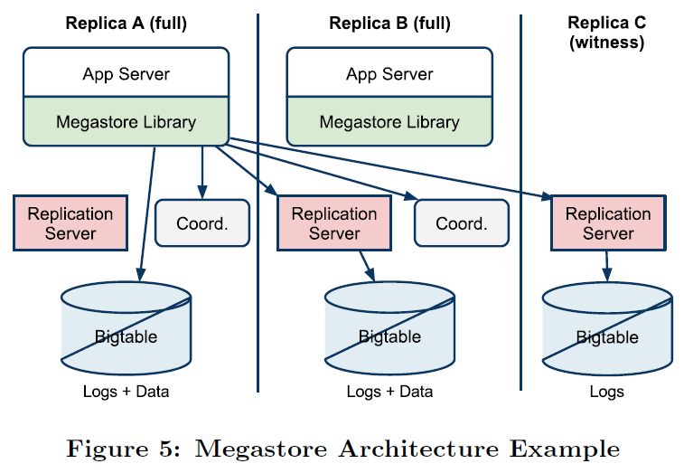
Megastore Replication Architecture
Replica type
Full: contain all the entity and index data, able to service current reads
Witness: storing the write-ahead log (for write transaction)
Read-only: inverse of witness (storing full snapshot of the data)

Slide 32
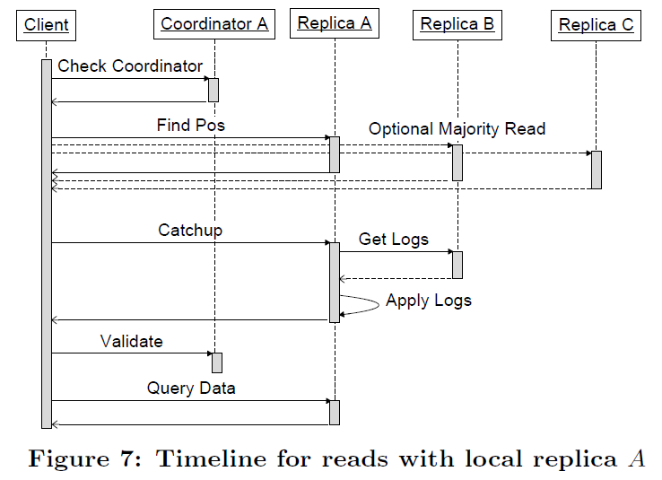
Replication
Coordinator: a server tracking a set of entity groups, for which its replica has observed all
Paxos writes. For entity groups in the set, the replica has sufficient state to serve local reads.
Data structure and algorithms
Each replica stores mutations and metadata for the log entries
Read process
1. Query Local replica’s coordinator
Check if entity group is up-to-date locally
2. Find position
If local replica is to date, read highest committed log position & timestamp from local replica
Select another replica if local replica is not up to date
3. Catch-up the local replica to max known log position
Check the consensus value from other replicas (after running Paxos)
4. Validate to the coordinator
Synchronizing with up-to-data for local replica
5. Query data from the selected replica
Read data with timestamp of the selected log
position

Slide 33
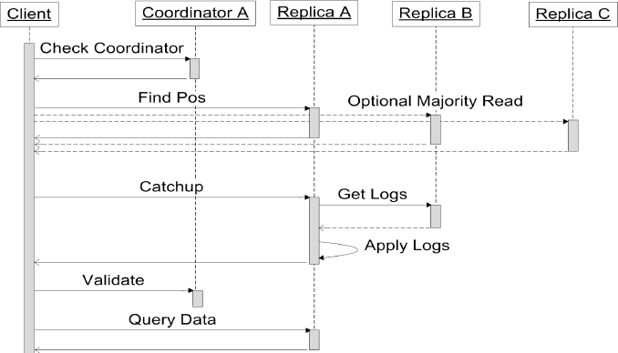
Timeline of Read Algorithm

Slide 34
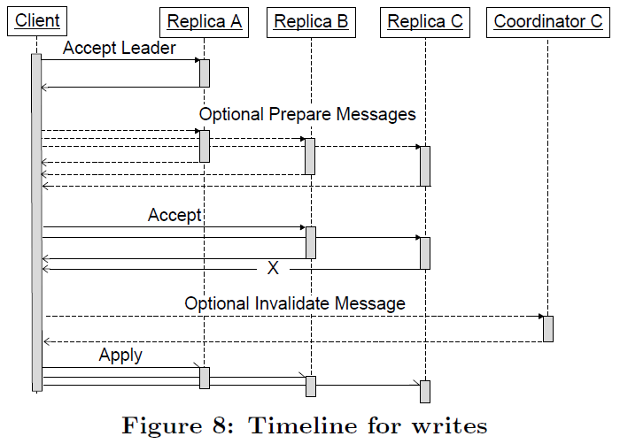
Replication
Data structure and algorithms
Each replica stores mutations and metadata for the log entries
Write process
1. Accept leader
Ask the leader to accept the value as proposal number 0;
Skip to Step 3 if successful
2. Prepare
Run the Paxos Prepare phase at all replica
Replace the value being written with the
highest-numbered proposal discovered, if any.
3. Accept
Ask remaining replicas to accept the value
4. Invalidate
Fault handling for replicas which did not accept the value
Invalidate the coordinator at all full replicas that do not accept the value
5. Apply
Apply the value’s mutation at as many replicas as possible

Slide 35
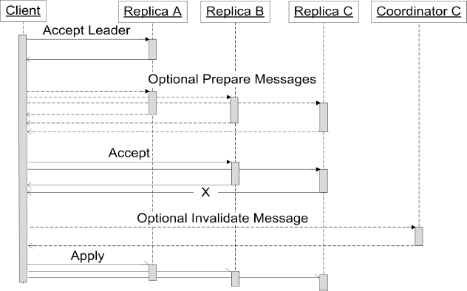
Timeline of Write Algorithm

Slide 36
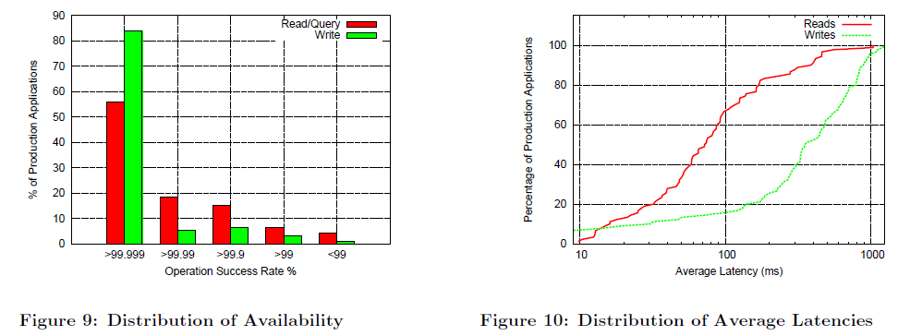
Experience
Real-world deployment
More than 100 production application use Megastore (e.g. Google App Engine)
Most of applications see extremely high availability
Most of users see average write latencies of 100~400 ms.

Slide 37
Comparisons with Other Approaches
Applications must choose their partitioning
Common operations within an EG
NoSQL | Megastore | RDBMS
Minimal features | Scalable features | Full-featured
Highly scalable | Highly scalable | Medium scale with efforts
PK lookup and scan | Indexes, scans, physical clustering | Storage abstractions, complex query planning and execution
Limited/eventual consistency | Partitioned consistency | Global consistency

Slide 38
Summary
Megastore:
Scalable, highly available data-store for Interactive Internet services
Paxos is used for synchronous replication
Bigtable as the scalable datastore while adding richer primitives (ACID, Indexes)
Limitations: relatively poor write throughput

