Slide 1
Sentiment Analysis of Covid-19 tweets
Rittika
Sweta

Slide 2
Twitter Scraping:
tweepy | snscrape
1) You need to have twitter developer account and apply for access tokens. | 1) No such account or keys needed. Very simple to use.
2) Upper limit on how many tweets can be extracted. | 2) No such upper limit.
3) Historical data can not be extracted, used onky for streaming data, atmost can go for the past 7 days data. | 3) Historical data can be extracted.

Slide 3
Data Scraping:
keyword_list = ["corona", "covid19", 'covid-19’, 'wuhan’, 'covid’, 'pandemic', 'coronavirus’]. Tweets containing any of these words is extracted.
Geolocation was set to near:”India”, lang:en.
The data scraped 1) First wave- 14th to 20th sept 2020, 2) 6th to 12th may 2020.
Duplicated tweets were removed i.e., tweets with the same id were removed.
It took ~1min to scrape 1000 tweets.
6th to 12th may 2020: 16499 tweets ; First wave(14th to 20th sept 2020): 6046 tweets

Slide 4
Text Pre-processing:
URLs are removed.
Letters are made lower case.
Stopwords and popular hashtags removed.
Punctuations removed.

Slide 5
Major road-bloacks:
What kind of pre- processing works best for twitter sentiment analysis(how to best utilize twitter lingo or acronyms, punctuations, emoticons, hashtags )
Need for labelled dataset for classification.
Twitter scraping: There might be problems extracting location of the tweet.

Slide 6
Works done till now:
Data Handling:
Prepared the script to scrape data from twitter => Created a pipeline to pre-process the text => Ran VADER to classify texts as positive, negative or neutral
Basic Implementation:
Implemented: VADER- to classify tweets as positive, negative and neutral

Slide 7
There could be two ways of dealing with sentiment analysis:
Lexicon based/Rule based
Machine Learning based
Lexicon Based | Machine Learning based
Rule based, maps sentiment realed words to scores and sums them up. | Uses previously labelled data to train the models.
Does not need labelled data. Unsupervised rule based method. Performance can be boosted by incorporating domain specific sentimental words. E.g., twitter lingo | Needs labelled datasets. More labelled data usually boosts performance. Works better is training data is domain specific.

Slide 8
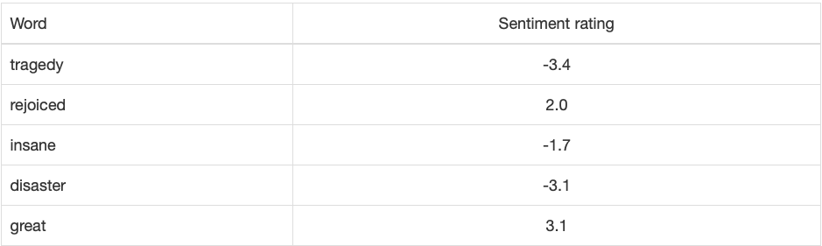
VADER:
Excerpt from VADER lexicon: It assigns many of the sentiment related words a rating, indicating how much positive or negative the word is:
It combines a dictionary, which maps lexical features to emotion intensity, and five simple heuristics, which encode how contextual elements increment, decrement, or negate the sentiment of text.
It also takes into account many of the twitter slang and emoticons like “smh” and “☹” respectively!
VADER recognises is capitalisation, some information is lost when we do lower case text.
The food is really GOOD! But the service is dreadful. {'neg': 0.192, 'neu': 0.529, 'pos': 0.279, 'compound': 0.3222} so neutral might mean it is an objective sentence or it congains both negative an dpostive emotions.

Slide 9
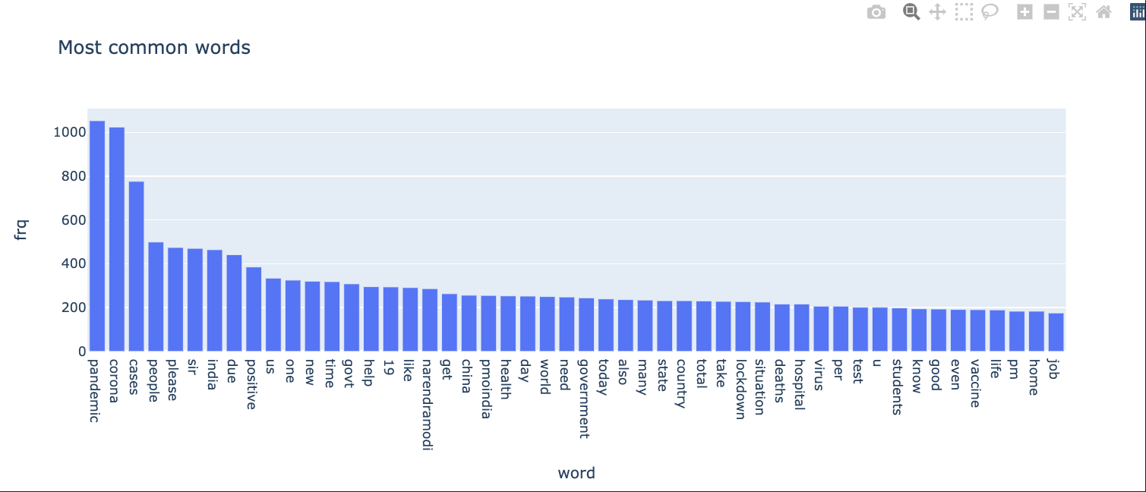
First wave(15th to 20th sept 2020):

Slide 10
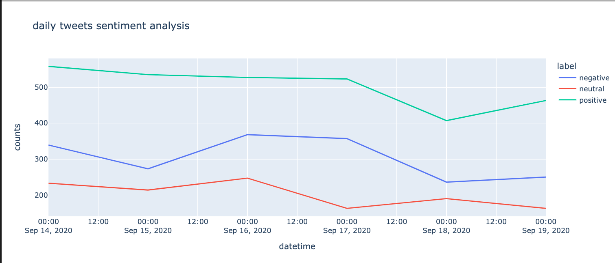
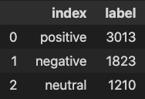
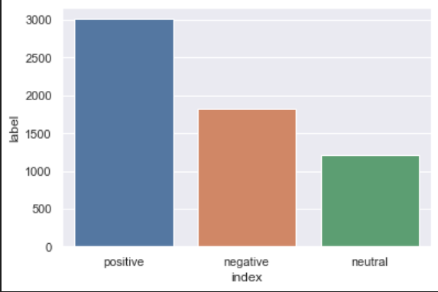
First wave:

Slide 11
First wave:

Slide 12
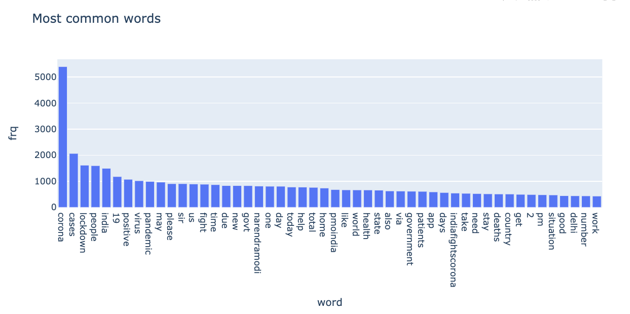
6th may 2020 to 12th may 2020:

Slide 13
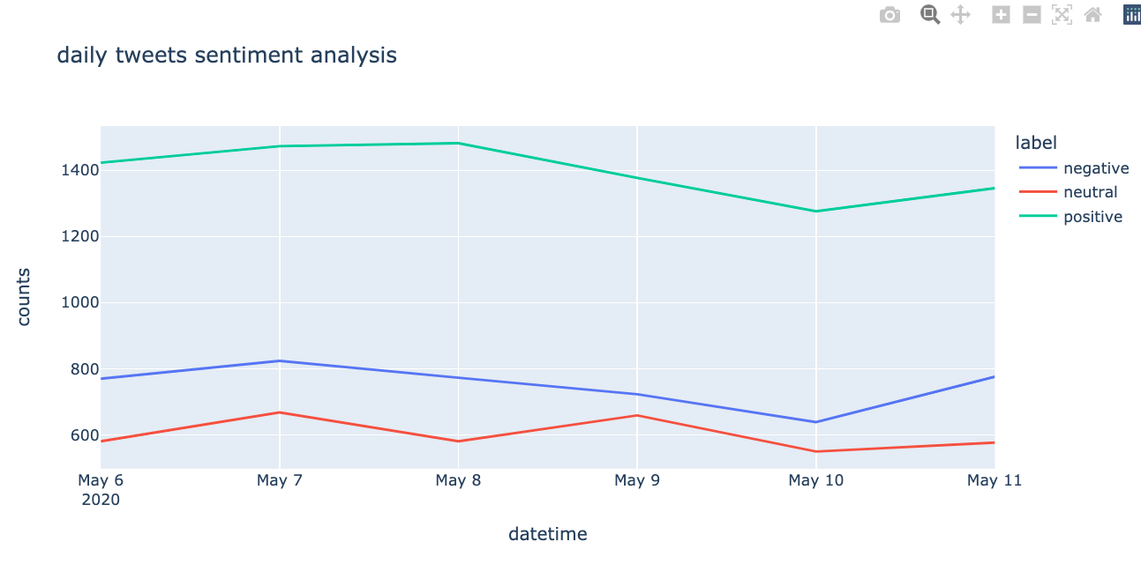
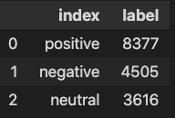
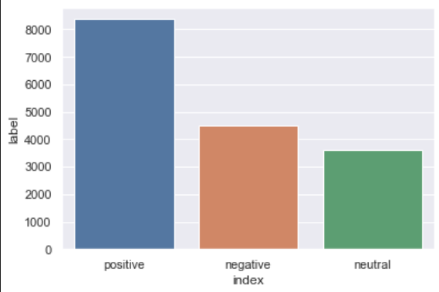
6th may 2020 to 12th may 2020:

Slide 14
Work to be done:
We want to investigate how the retweets of a tweet vary as the “emotional divergence” varies.
We want to see how subjectivity scores of tweets correlates with their emotional divergence.
Combining the above two, twitter can implement algorithms which catalyses the propagation of informative tweets so that useful information is reached to the public. It can also inhibit the propagation of highly subjective tweets as they are most likely to contain personal opinions and reduce panick.

Slide 15
Work to be done:
We can do the same analysis around first wave, second wave, third wave and compare the trends.

Slide 16
References:
https://t-redactyl.io/blog/2017/04/using-vader-to-handle-sentiment-analysis-with-social-media-text.html
https://medium.com/@piocalderon/vader-sentiment-analysis-explained-f1c4f9101cd9
https://t-redactyl.io/blog/2017/01/how-do-we-feel-about-new-years-resolutions-according-to-sentiment-analysis.html

