Slide 1

Data Science Job Analysis
Sweta Gaurav

Slide 2
Overview
As Data Science field is exponentially growing; Number of job seeker has spiked up and so, there is a need to closely analyze the job market to know about different job sectors of Data Science, industry, job location, job title and its salary range.
Problem Statement:
Data Science Job analysis project is to evaluate various aspect of Data Science skill market such as
Find best jobs by Salary, Company Rating and Location.
Chances of getting hired in different job sectors (data scientist, data engineer and data analyst)
Skills needed to get hired in a specific job sectors and salary range.
Which company hires the most Data Science professionals?
Best hot spot (cities) of all.
After analysis will get to know answer to all the above questions.

Slide 3
Dataset
The datasets link is mentioned below:
https://www.kaggle.com/andrewmvd/data-scientist-jobs
For this project I obtain the data from Kaggle. This dataset was containing data science positions (all assumed to be open positions at the time the dataset was published in July 2020), with features such as: Salary Estimate, Location, Company Rating, Headquarter and more.
Dataset has lots of missing value in a form of “ -1”, “unknown”. I have taken care of those missing values and replace it with most appropriate values.

Slide 4
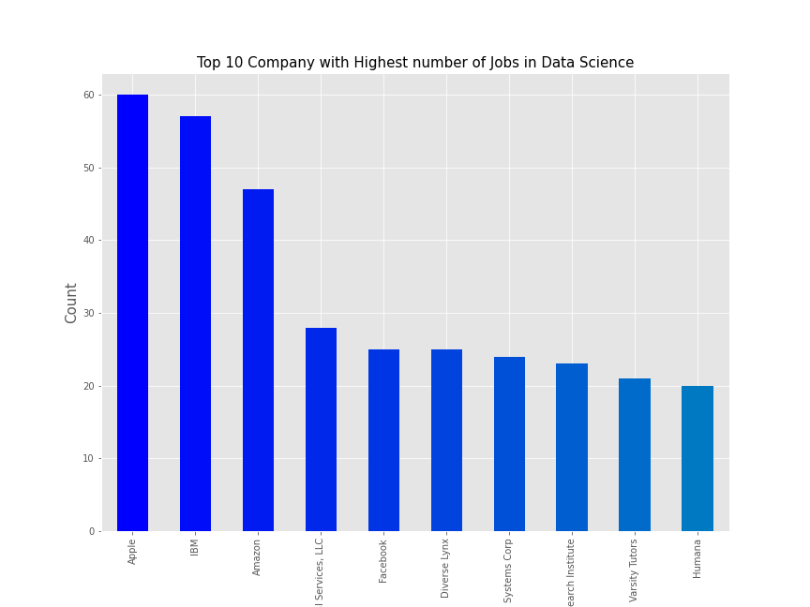
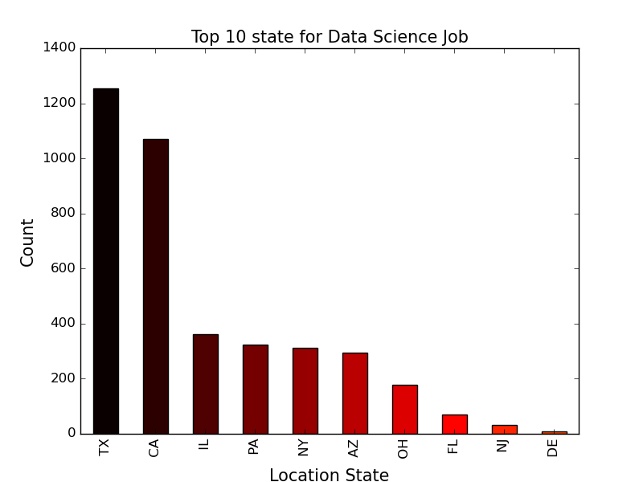
Top 10 company & state for Data Science job

Slide 5
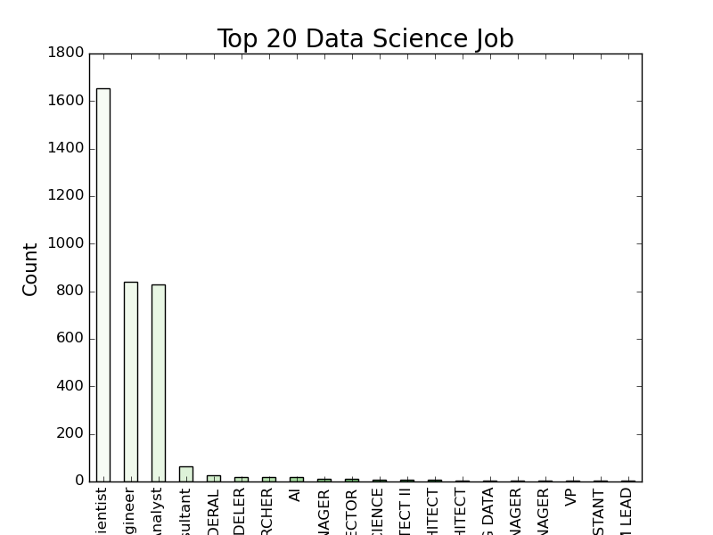
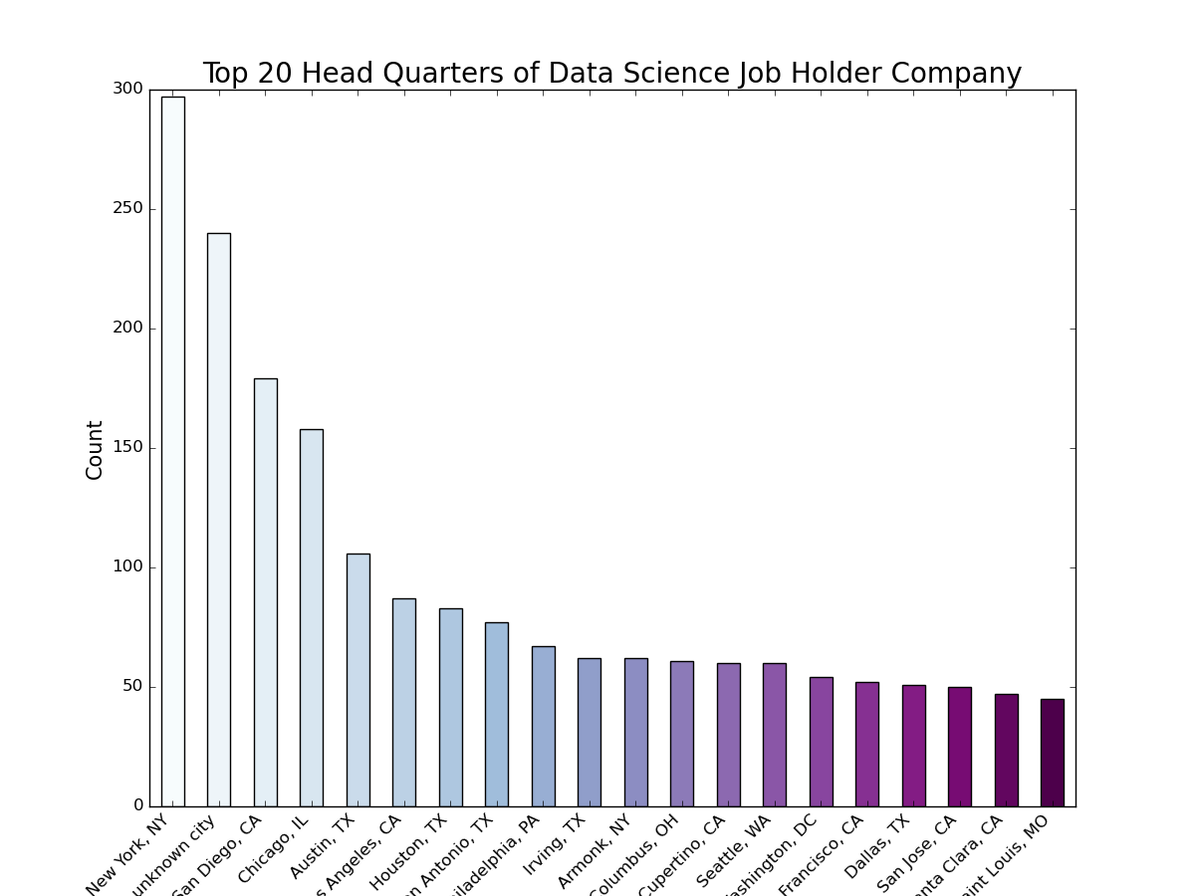
Top Data Science job title & Headquarters

Slide 6
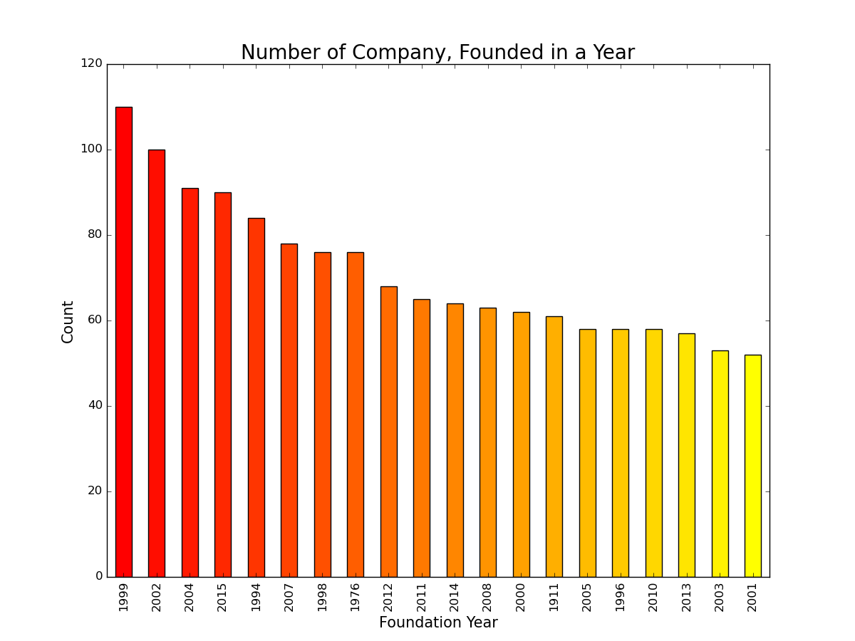
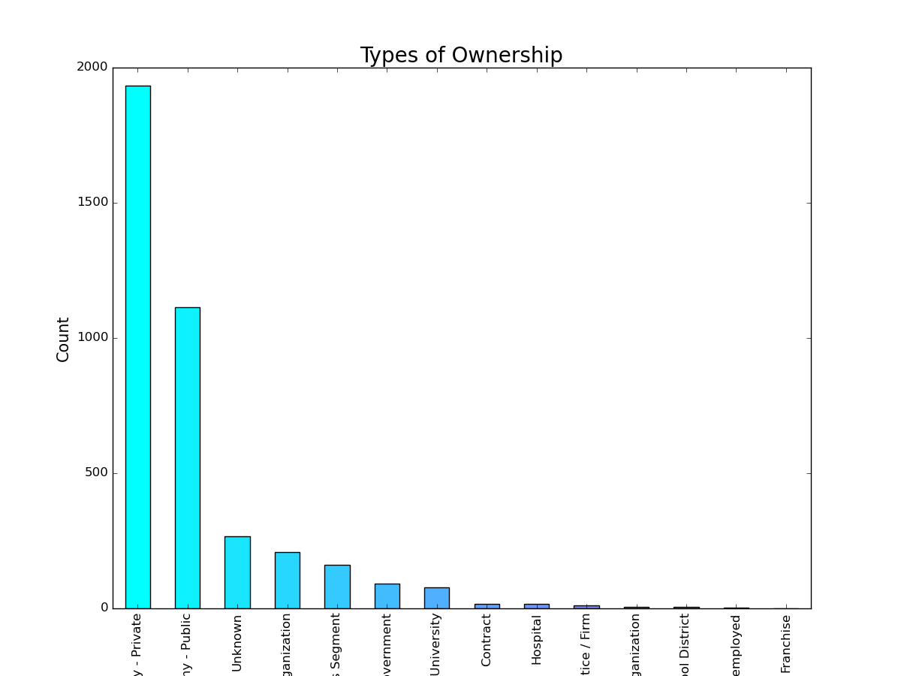
Foundation year & type of ownership

Slide 7
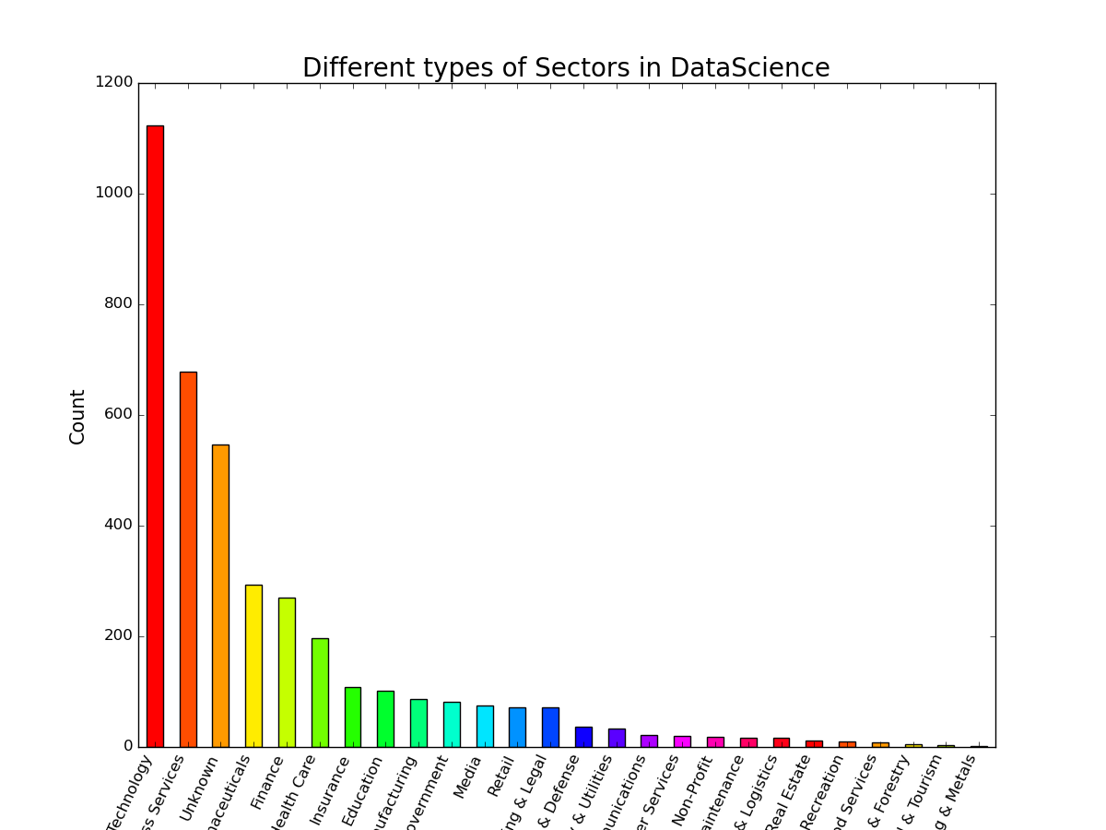
Sectors in data science job

Slide 8
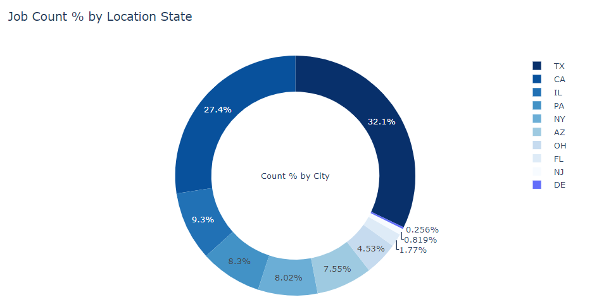
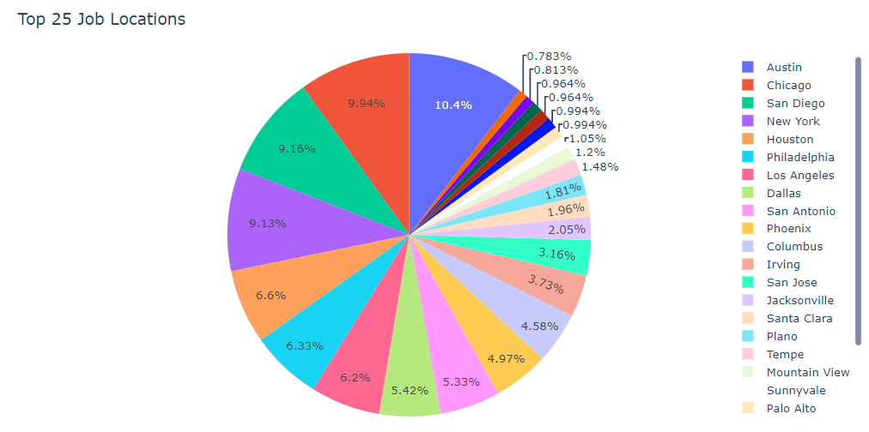
Job percentage by state and city
Above graph shows that in data science role Texas and California has highest no of job among all the state. Delaware has least number of job. When I visualize the city graph Austin, TX comes in first place and San Diego, CA comes after that.

Slide 9
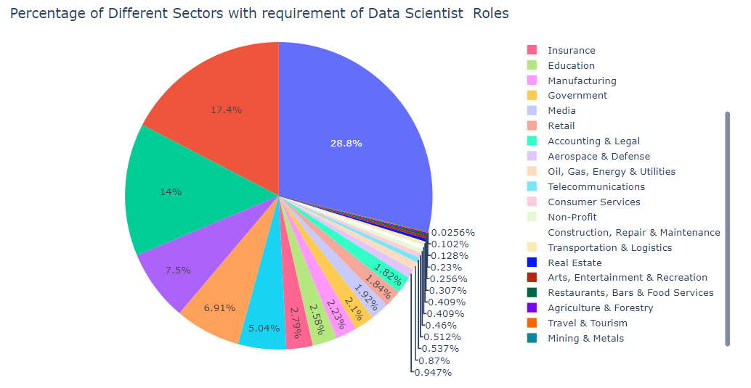

Slide 10
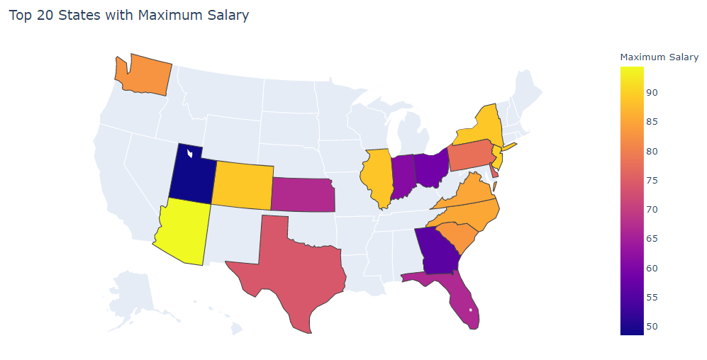

Slide 11
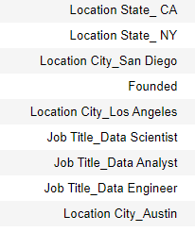
Conclusion
Salary is mostly dependent on location after that role come in picture. If anyone looking data science role in CALIFORNIA salary must be higher than NY. Salary also depends on how establish company is means how old is the company. Data Scientist salary must be higher than Analyst and engineer position

